Slide 1
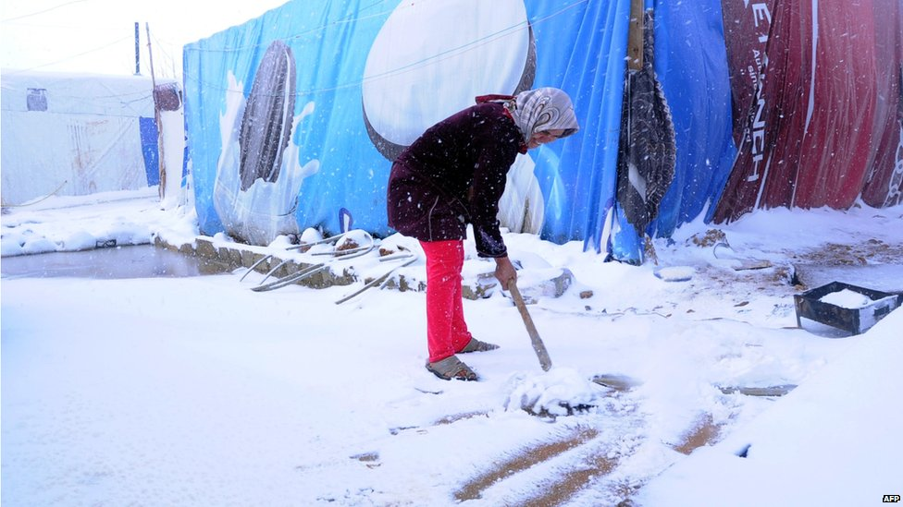

VASyR 2014
I. Presentation
Susana Moreno Romero
Food Security Expert - WFP Lebanon CO
susana.moreno@wfp.org

Slide 2
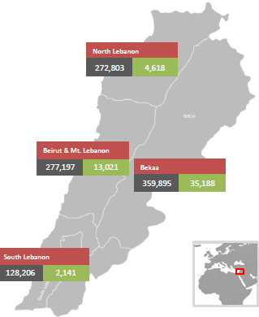
Rational
Last multi-sectorial survey representative at national level: VASyR 2013
Significant changes in context 2013-2014
What is the impact of these factors on the vulnerability and living conditions of Syrian refugees in Lebanon?
UNHCR, UNICEF and WFP joint exercise
 | 2013 | 2014
Number of refugees | 423,495 | 1,087,814
Targeting | No | Yes
Time after the conflict started | 2 years | 3 years
Source: UNHCR 5th June 14
Notes:
Number of refugees by end of June 13 and 2nd of June 14,

Slide 3
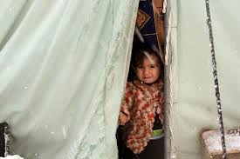
Objectives
GENERAL
  To monitor and evaluate the vulnerability situation of Syrian refugees in Lebanon one year after the original 2013 VASyR.
SPECIFICS
  Provide a multi-sectorial overview of Syrian refugees’ living conditions.
  Analyze the main changes found compared to their situation last year
  Discuss major drivers of these possible changes (if any)
  Recommend steps forward.

Slide 4
Methodology I
Population
  UNHCR registered and awaiting registration Syrian refugees - Included and excluded for assistance
Sampling frame
  Representativeness at regional level:
    Beirut - Mount Lebanon
    Bekaa
    Akkar
    T5
    South (including Nabatieh)
Notes:
Agreement on regions

Slide 5
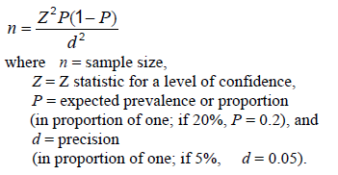
Methodology II
Sample size
  1750 HH
  350 HH / region
  35 clusters (=locations=villages, towns, neighborhoods) / region
  10 HH / cluster
  Representative sample size per region based on parameters:
    Prevalence: 50% Precision: 10% Design effect: 3
Questionnaire
  HH questionnaire
    Based on VASyR 2013 to ensure comparability
    Information needs identified by MSNA to be included
  FGD (8/region)
Training
  ToT – minimum standard training to be repeated in each region.
Notes:
Problme of different type of assistance received, winterization…of time of reinclusion….etc…

Slide 6
Methodology III. Data collection
  When?
  26th May – 13th June (3 weeks)
  How?
  Mobile devices-ODK
  Team:
  2 enumerators (1 team) per HH visit or FGD
  5 HH visits /team / day
  8 teams (2 people) / region
  1 supervisor/ 4 teams
  1 coordinator per region
  1 global assessment coordinator
  Quality monitors 2/region approx.
Notes:
Problme of different type of assistance received, winterization…of time of reinclusion….etc…

Slide 7
Methodology III. Data collection
  Who?
  Field data collection by CPs and region
  Akkar: REACH/ ACTED
  Beirut/Mount Lebanon: REACH & PU
  Bekaa: InterSOS, Mercy Corps & WorldVision.
  South: ACF, NRC, Sheild
  Tripoli 5: Care, NRC and Solidarite International
Notes:
Problme of different type of assistance received, winterization…of time of reinclusion….etc…

Slide 8
Timeline
 | MARCH |  |  |  | APRIL |  |  |  | MAY |  |  |  | JUNE |  |  |  | JULY
Activities | 1 | 2 | 3 | 4 | 1 | 2 | 3 | 4 | 5 | 6 | 7 | 8 | 9 | 10 | 11 | 12 | 9 | 10 | 11 | 12
Draft concpet note |  |  | x
Presentation of the exercise to stakeholders |  |  | x | x
Methodology agreement among partners |  |  |  |  | x
Questionnaire discussions |  |  |  | x | x | x | x
Questionnaire finalized |  |  |  |  |  |  |  | x
Questionnaire field test (paper an electronic) |  |  |  |  |  |  |  |  | x | x
Households selection |  |  |  |  |  |  |  |  | x
FLAs with partners |  |  |  |  | x | x | x | x | x | x
Logistics preparation |  |  |  |  |  |  |  |  |  | x | x
Staff recruitment |  |  |  |  |  |  |  | x | x | x
Training |  |  |  |  |  |  |  |  |  |  | x
Data collection |  |  |  |  |  |  |  |  |  |  |  | x | x
FGD |  |  |  |  |  |  |  |  |  |  |  |  |  | x
Data cleaning and preparation |  |  |  |  |  |  |  |  |  |  |  |  |  | x
Analysis |  |  |  |  |  |  |  |  |  |  |  |  |  |  | x | x | x
Reporting |  |  |  |  |  |  |  |  |  |  |  |  |  |  |  |  | x | x | x | x
Presentation of results |  |  |  |  |  |  |  |  |  |  |  |  |  |  |  |  |  |  |  | x

Slide 9
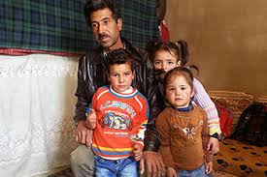
Where we are and steps forward
Field data collection finished
Analysis plan shared and comments received
Data cleaning in process
Preliminary results to be shared by the end of June

Slide 10
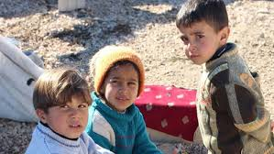
Thank you

Slide 11

Questions & comments

