Slide 1


Hidden Victims of the Syrian Crisis: disabled, injured and older refugees
Presentation on the findings and recommendations
19th August 2014
Becky Achan, Inclusion Technical Advisor

Slide 2
Purpose of the Survey
To provide robust evidence of the numbers and needs of older persons, and people with impairments, injuries and chronic diseases in Jordan and Lebanon.
Findings of the study are intended to contribute to evidence based programming for humanitarian partners; to use for design and service delivery and advocacy.
Notes:
The study described “Specific Needs” as; Syrian refugees affected by impairment, injury and chronic diseases.

Slide 3
Research Methodologies
Qualitative and quantitative research methodologies were applied.
Random cluster sampling technique.
30 clusters were drawn out of 100, from each governorate.
3,202 individuals were selected and interviewed in Jordan and Lebanon.
1,192 individuals were interviewed from Jordan.
Samples were extracted from UNHCR register and other databases of humanitarian agencies.

Slide 4
Data collection
The questionnaire formats were designed using a range of recognized tools and approaches.
The HESPER scale was used to understand the expressed needs and problems of the Syrian refugees.
Two questionnaires were used.
One general and the other specific to describe the different categories of impairment and analyze challenges in Activities of Daily Living (ADL)
Notes:
WHO and King’s College London (2011). The Humanitarian Emergency Setting Perceived Needs Scale (HESPER) provides a quick and scientific method of assessing the perceived needs of people affected by large-scale humanitarian emergencies such as war, conflict or major natural disaster.

Slide 5
Research Location
Survey was carried out in seven areas of Jordan and Lebanon.
Lebanon; North Lebanon, Bekaa, Beirut City and Mount Lebanon governorate.
Whereas in Jordan the locations were: Amman, Irbid and Za’atari Camp.

Slide 6
Data documentation and analysis
The research process was undertaken by a research consultant, Thomas Calvot, review and editing was done by HI and HAI.
Survey teams were recruited and provided with trainings.
The findings represent findings from the survey as well as, information from key informants, secondary data view and reports from other sources.
The margin of error for governorate level in Jordan is ±4.6% whereas for country level it is ±2.7%.

Slide 7
Ethical Considerations
Primary data collectors explained the aim, objective and outcome of the study prior to obtaining consent from interviewees.
For young or intellectually impaired individuals consent was obtained from family.
Survey aim, objective and outcome was discussed with UNHCR and national authorities as well.
Questionnaires were translated into Arabic.

Slide 8
Key findings with special focus no Jordan

Slide 9
1. UNHCR Registration of PwS
UNHCR registration database does not capture detailed information on disabilities/impairments disaggregated by Sex, Age and Gender. Specifically sensory impairments.
Thus; Speech, Visual and Hearing impairments as mild and severe.

Slide 10
Notes:
Jordan and Lebanon

Slide 11
2. Impairments
22% of the 3,202 surveyed Syrian refugees have an impairment; 6% have a severe impairment.
26% for Jordan.
Where as, just 1.4% of UNHCR registered refugees are recorded as having a disability.
7% of the surveyed refugees were suffering from NCD and Impairments.

Slide 12
Statics on impairment in Jordan and Lebanon
Notes:
Hidden Victims of the Syrian Crisis (HelpAge International and Handicap International 2014)

Slide 13
Causes of Injuries in the Syrian Crisis
Notes:
Life accidents for example; burns or falls.
“Injuries–resulting from traffic collisions, drowning, poisoning, falls or burns - and violence - from assault , self-inflicted violence or acts of war–kill more than five million people worldwide annually and cause harm to millions more. They account for 9% of global mortality, and are a threat to health in every country of the world. For every death, it is estimated that there are dozens of hospitalizations, hundreds of emergency department visits and thousands of doctors’ appointments. A large proportion of people surviving their injuries incurs temporary or permanent disabilities” (WHO 2014).

Slide 14
Implications of the findings impairment
There is lack of a shared understanding on the definition of impairments or disabilities as well as the categories, which affects detailed data collection by UNHCR.
The lack of data and information affects programming as well as initiation of projects specific to addressing the needs of PWS.
The absence of assistive device can increase the severity of disability.

Slide 15
3. NCD findings
15.6% of the 3,202 refugees surveyed were affected by chronic diseases.
2 out of 3 older people surveyed in Jordan were affected by chronic diseases.
WHO pre-conflict data shows that NCD accounted for 74% of all deaths (52,000 out of 71,000 deaths) in Syria in 2002.
In Jordan comprehensive health coverage is good for refugees in camps, whereas the situation is difficult for out of camp refugees. (registered and unregistered refugees)

Slide 16
3. Gaps in the quality of NCD management specifically Chronic Illnesses
Lack of health education to patients affected by NCD.
Limited capacity of staff to properly assess patients with NCD.
Limited services to support early screening for NCDs such diabetes and hypertensions.
No proper monitoring (laboratory tests) or follow up.
Some gaps in the quantity of NCD drugs or in absolute availability (especially insulin).
Cost of managing NCD of individuals on HH income (diet, NFIs)

Slide 17
4. Relationship between NCD and Disability
Untreated Chronic diseases often lead to severe complications. Such as:
Stroke, diabetic complication such as gangrene, Kidney problems and blindness.
Survey findings established that 7% of others interviewed were affected by both chronic disease and disability.

Slide 18
Injuries 183
% of total survey
Pop 5.7%
NCD/ Chronic Disease 501 % of total survey pop 15.6%

Slide 19
5. Injuries
Survey findings established that 5.7% of 3,202 surveyed Syrian Refugees were injured.
90% of these injuries in Jordan were caused by direct consequences of the war in Syria.
Henceforth, 1 in 15 Syrian Refugees in Jordan has been injured, because of the war.
Men accounted for 72% of the injured persons where women accounted for 28%.
Highest proportion of injuries were found amongst those age 30 to 50 years.

Slide 20
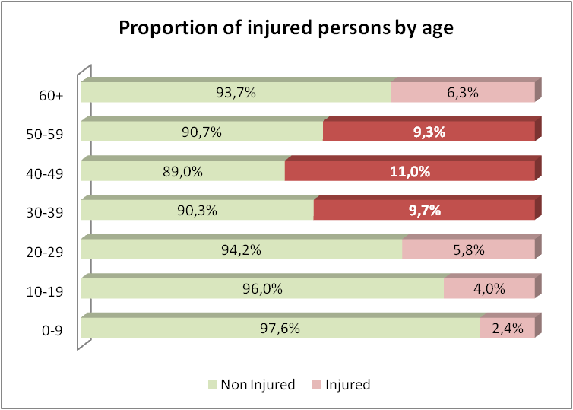

Slide 21
Implications of the findings on Injuries
Continued need for immediate health care as well as rehabilitation services to prevent impairment.
Rehabilitation services should not be limited to provision of assistive devices.
The impact of injuries on the men of productive age (30 to 50 years) increases HH vulnerability.
The numbers of Syrian refugees with injuries in Jordan are higher because of the free and full health care coverage and minimal backlog in registration when compared to Lebanon.

Slide 22
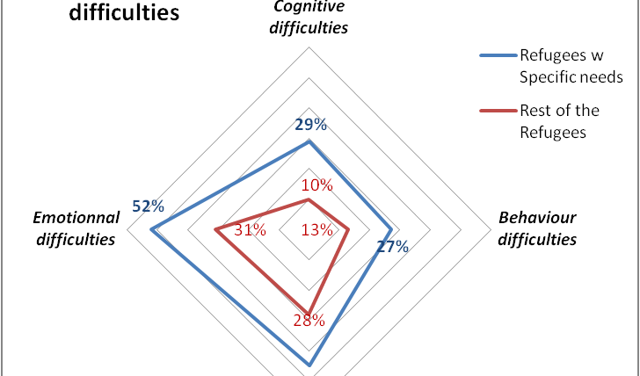
6. Psychological Distress
Relational difficulties

Slide 23
Gaps related to Psychological Distress
Gaps in psychosocial services for older, women and children with disabilities.
Specifically social spaces for older persons, and children with disabilities.
Gaps in community-based psychosocial support initiatives.

Slide 24
Needs and Challenges
Concerns | Identified priority
Income, livelihood | 25.6%
Shelter | 11.4%
Essential, non-food items | 10.1%
Water | 9.3%
Healthcare | 8.6%
Food | 7.9%

Slide 25
Recommendations
Collect analyse and use sex, age and disability disaggregated data (SADDD).
Build capacities of partners to identify and include persons with specific needs in humanitarian response.
Ensure medical assistance addresses the need for post-operatory care of patients (to avoid creation of disabilities.

Slide 26
Recommendations
Address gaps in the quality of primary health care services for those with chronic disease.
Ensure adequate provision on NCD drugs at primary health care level.
Improve access to laboratory tests at primary health care level.
Improve access to primary care services.

Slide 27
Acknowledgements
Syrian Refugees in Jordan and Lebanon.
UNHCR, ACTED, CARE, NRC, ICRC

