Slide 1
Unaccompanied and separated children trend analysis
January to June 2014

Slide 2
OVERVIEW
Identification and registration of Syrian Unaccompanied and Separated children (UASC) in Jordan being supported jointly by UNHCR and UNICEF through International Medical Corps (IMC) and International Rescue Committee (IRC).
IRC and IMC are providing case management to UASC, guided by the Best Interests of the Child, which includes documentation of the children, family tracing, verification and family reunification, Best Interests Determination (BID) processes and alternative care arrangements in addition to providing access to services needed by the child.
Data used for this trend analysis come from Activity Info, UNHCR’s Inter-Agency Information Sharing Portal, monthly reports and causes of separation monitoring sheet

Slide 3
General trends relating to UASC
 | 2013 (year) | 2014 (six months)
#of Unaccompanied children | 472 | 538
# of Separated children | 1,185 | 829
Girls (%) | 37.6% | 44%
Boys (%) | 62.5% | 56%
Reunification rate (%) | 65 % | 89%

Slide 4
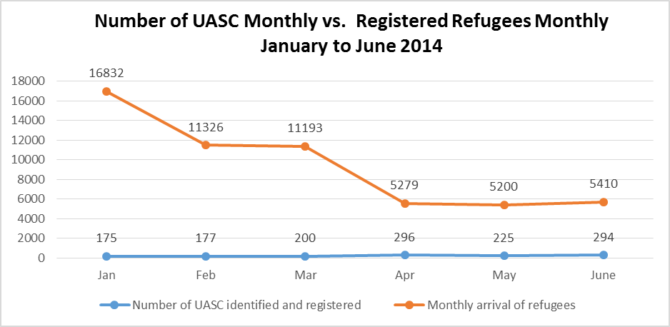
Trends in refugee Flows

Slide 5
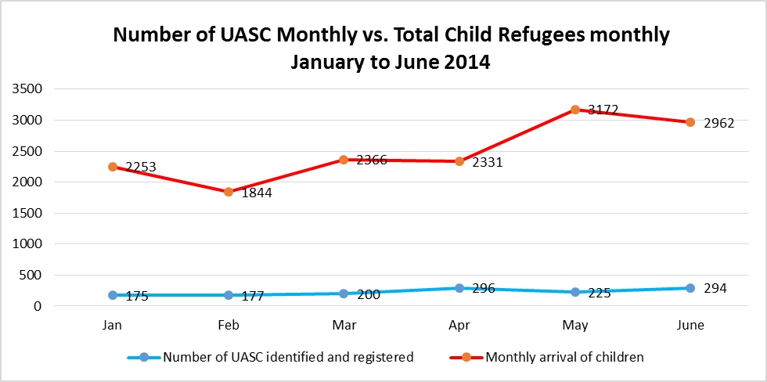
Trends in Refugee flows (2)

Slide 6
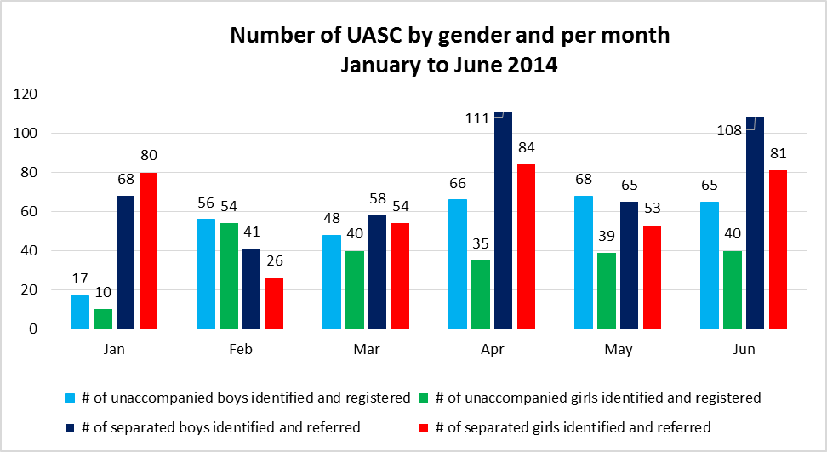
Trend in refugee flows (3)

Slide 7
Reunification of unaccompanied children in Jordan
out of the total 538 unaccompanied children, 479 (89%) have been reunified with a family member. The gender breakdown for reunification is 37.8% for girls and 62.2% for boys.
According to IRC, this high rate of reunification of unaccompanied children could be explained by the fact that children are unaccompanied during their trip to Jordan but most of them know the whereabouts of their family members living in Jordan
Social media and mobile phones have been seen as an asset to facilitate the reunification of children as children communicate with their parents through SMSs, email, WhatsApp or Facebook, etc.
Also contributing to the high reunification rates is the outreach work conducted by IMC and IRC in urban settings and camps. These outreach activities have helped IMC and IRC to identify the family members of UASC

Slide 8
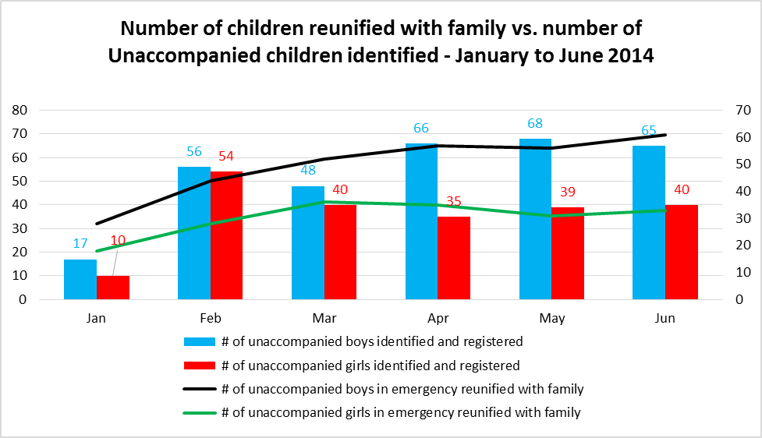
Reunification of unaccompanied children in Jordan

Slide 9
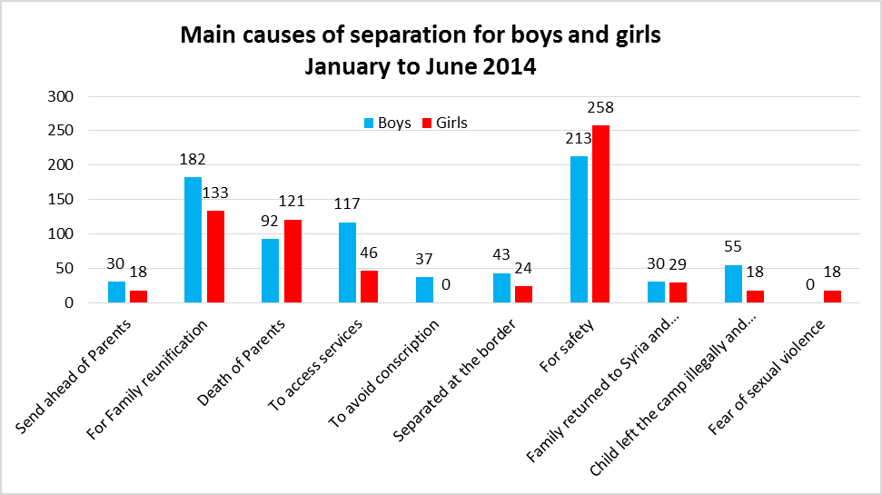
Main causes of separation for boys and girls

Slide 10
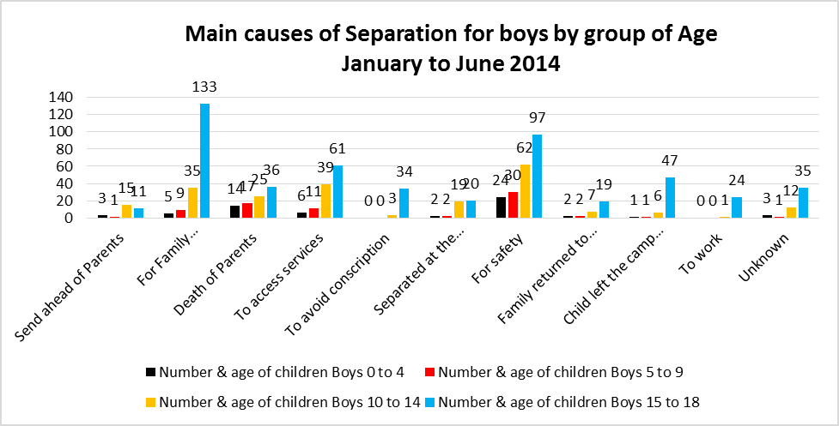
Causes of separation for boys

Slide 11
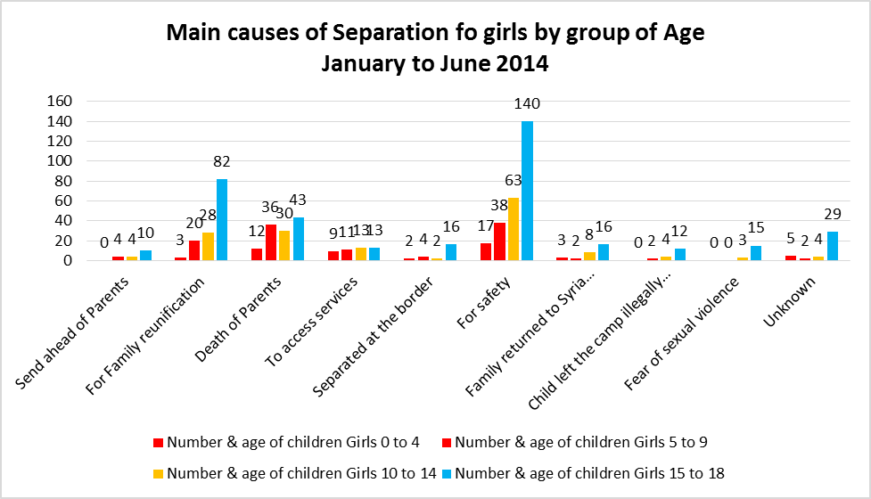
Causes of separation for girls

Slide 12
Conclusion
There has been an increase in UASC entering Jordan in the first six months of 2014 compared to 2013.
The reunification rate of children changes from 63 % in 2013 to 89% in 2014 which shows improvements in the response to UASC.
More girls are entering Jordan as unaccompanied in 2014 compared to last year’s caseload.
The number of UASC has remained consistent despite the inconsistency of total refugees entering Jordan the past six months.
The decrease in the number of refugees arriving to Jordan might impact the reunification process with a lesser chance of having a family member here in Jordan.
The main causes of separation for UASC the past six months are for safety, family reunification and death of the parents.

