Slide 1
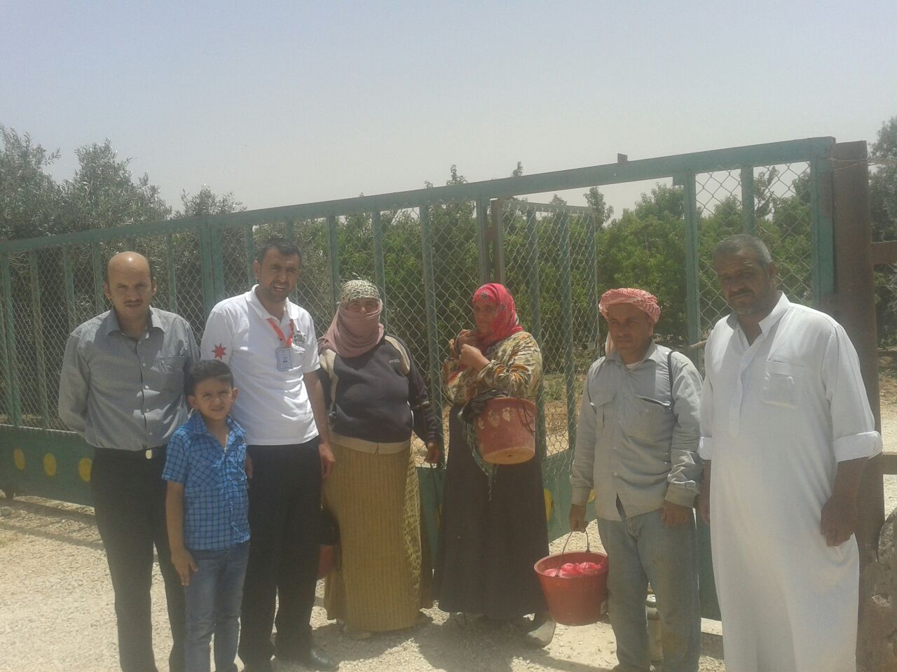
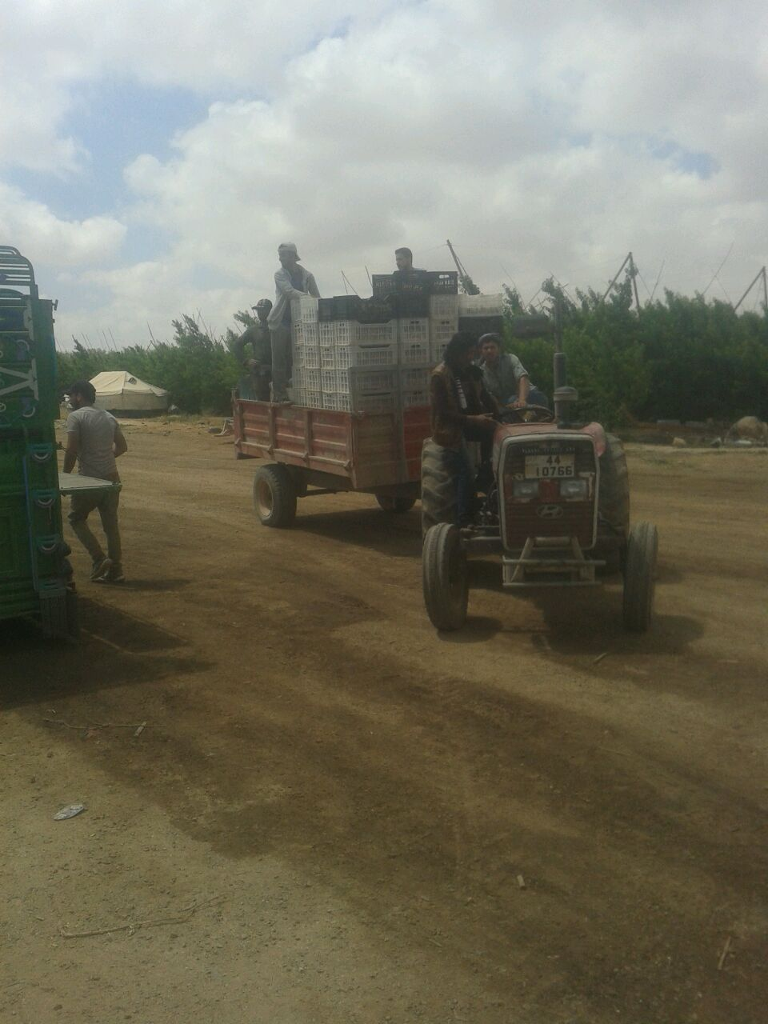
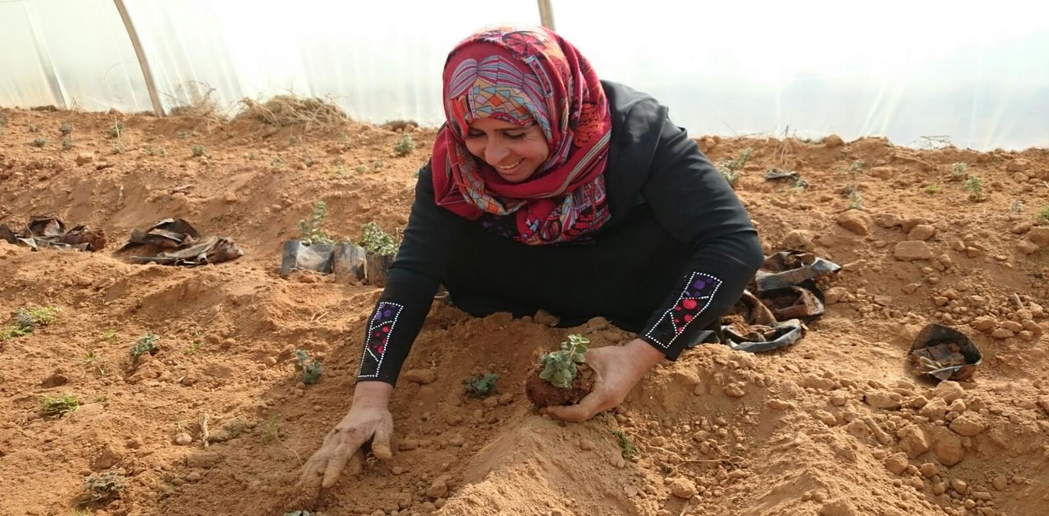


Support the Ministry of Labour in regulating Syrian workers in the Agricultural and Construction Sectors
Dr. Maha Kattaa
ILO Crisis response coordinator in Jordan

Slide 2
Share of Syrians among migrant workers having received a work permit

Slide 7
Working permits – towards 200,000
Ministry of Labour actively seeking ways to increase number of Syrians with working permits
Grace period of 3 months for fees and no deportation of illegal workers to camps – probably prolonged.
Working permits in agriculture de-linked from employers & active campaign with Cooperatives supported by ILO
Next – working permits to be replaced by social security numbers, ministry of interior cards?

Slide 8
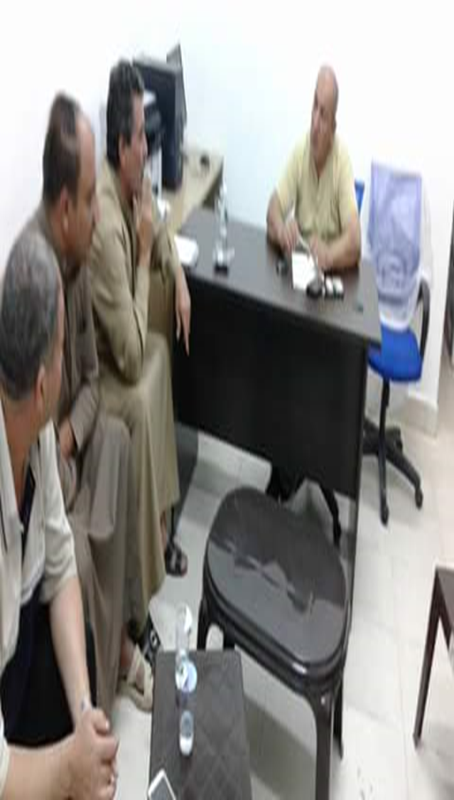
Work permits through agriculture cooperatives
Conducting awareness raising campaigns for improved implementation of the regulatory environment, and to support the Ministry of Labour in delivering work permits in a timely manner to a greater number of Syrian workers; and
Supporting 10,000 Syrian workers in obtaining work permits in the agricultural and construction sectors in the targeted areas;

Slide 9
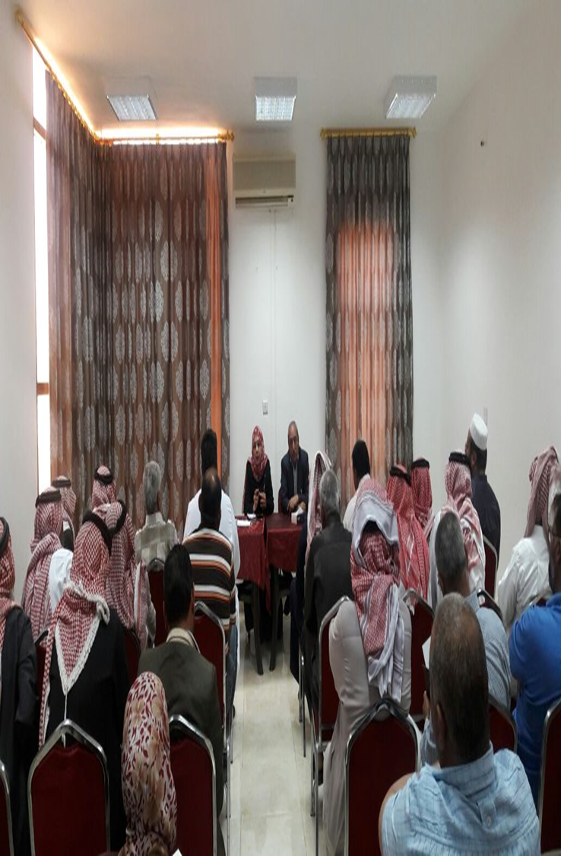
Advocacy and awareness raising
Support the Ministry of labour on the implementation of the new work permits procedures and advocate for policy changes.
Hold awareness raising workshops for Syrian workers on the procedures to obtain work permits .
Hold awareness raising workshops for Syrian workers on the Jordanian labour law.
Conduct focus group discussions with Syrian refugee workers and employers to understand why the latest government steps have not led to a greater number of registered Syrian workers.
Support the MOL to produce brochures on the procedures for
obtaining a work permit and distribute them among Syrian workers.
Hold consultative meetings with labour directors and representatives
of the cooperatives on the procedures for obtaining work permits,
Hold meetings with the farmers’ union to discuss the cooperation mechanisms.

Slide 10
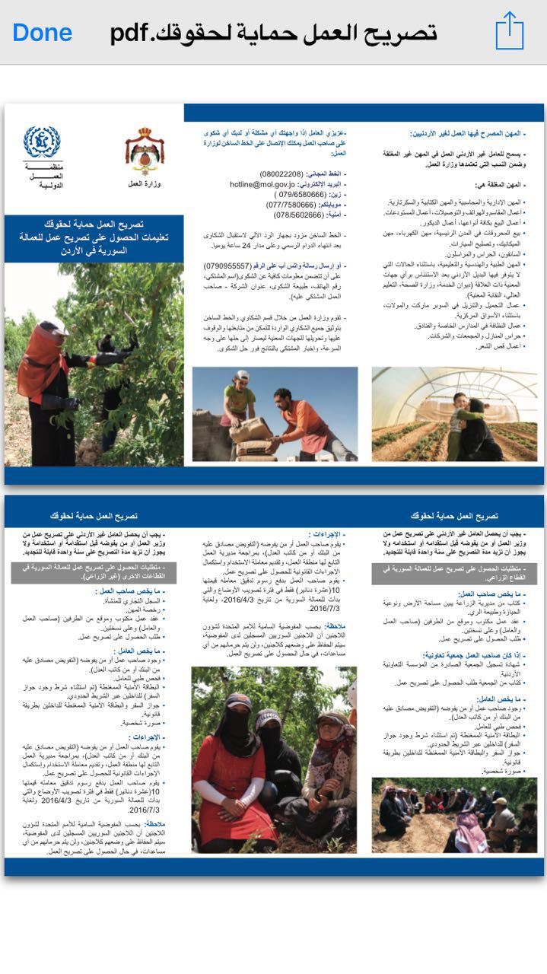

Slide 11
Requirements for obtaining a work permit among Syrian workers in the agricultural sector
With respect to the employer, the requirements include:
A letter from the Governorate of Agriculture showing the area of land, type of ownership and the quality and nature of irrigation.
Two copies of the written work contract, which must be signed by both parties (the employer and the worker).
Application form for a work permit.
- With respect to the worker, the requirements include:
The presence of an employer or a representative (authorization should be certified by a bank or by a notary public).
Proof of worker’s medical examination.
Ministry of interior card
Personal photo

Slide 12
Work permits through cooperatives
Registration certificate of the cooperative issued by the Jordanian Cooperative Establishment.
A letter from the cooperative requesting the work permit.
Proof of worker’s medical examination.
Ministry of interior card
Personal photo

Slide 13
Advantages
Applying for work permits through cooperatives has the following advantages:
No need for an employer to apply for the work permits;
The freedom to work in agriculture sector for more than one employer and the possibility to move from employer to another.
Labour mobility from one governorate to another.

Slide 15
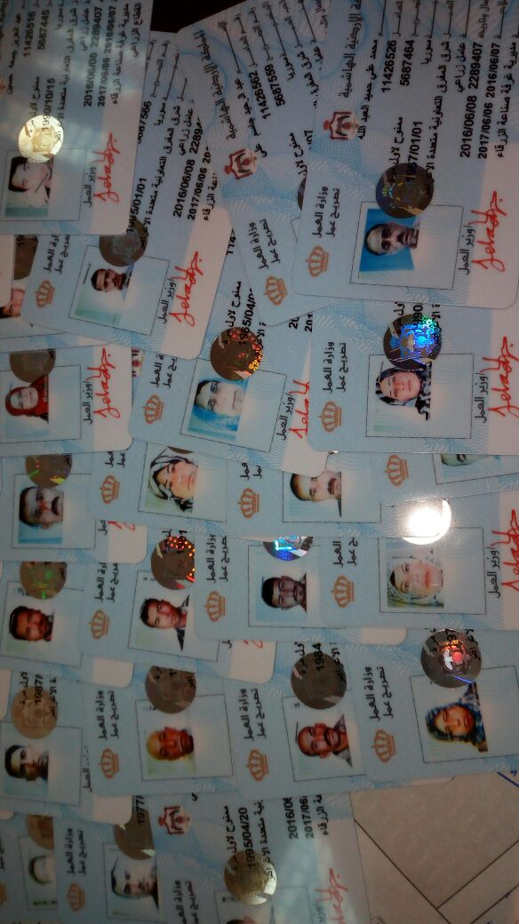
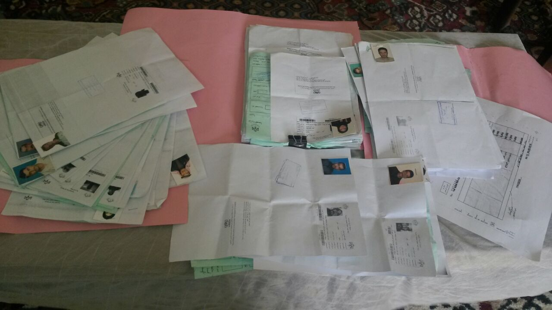
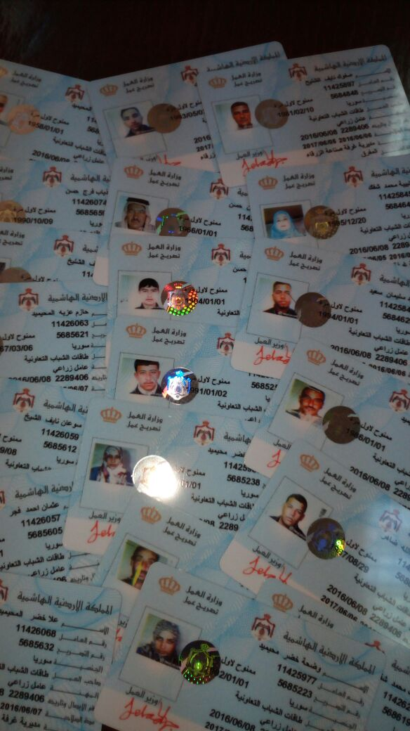

Slide 16
Next steps
Ten cooperatives in each governorate will be trained and empowered to provide an innovative package of services for jobseekers and aspiring entrepreneurs from refugees and host communities, including:
REGISTERING
COUNSELLING
OUTREACH
REFERRALS
PLACEMENT

Slide 17
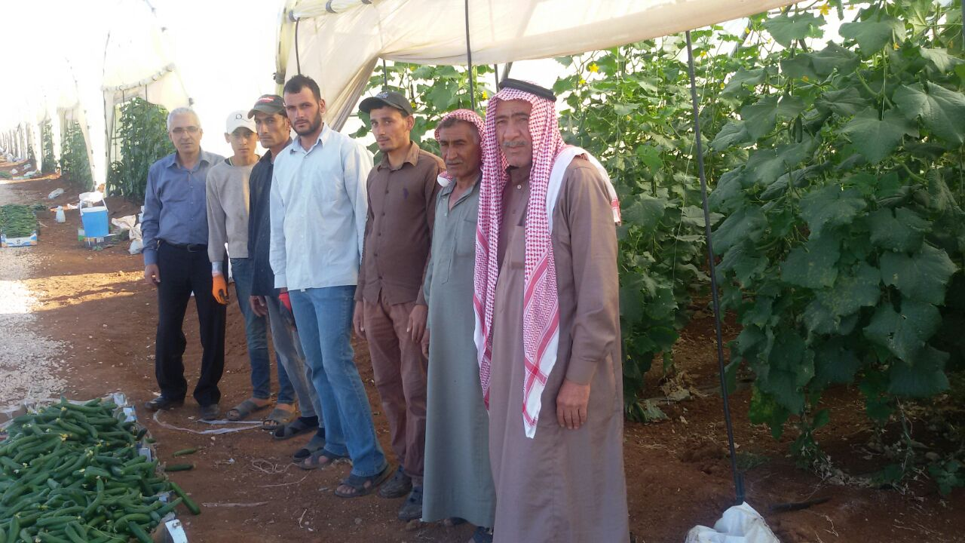
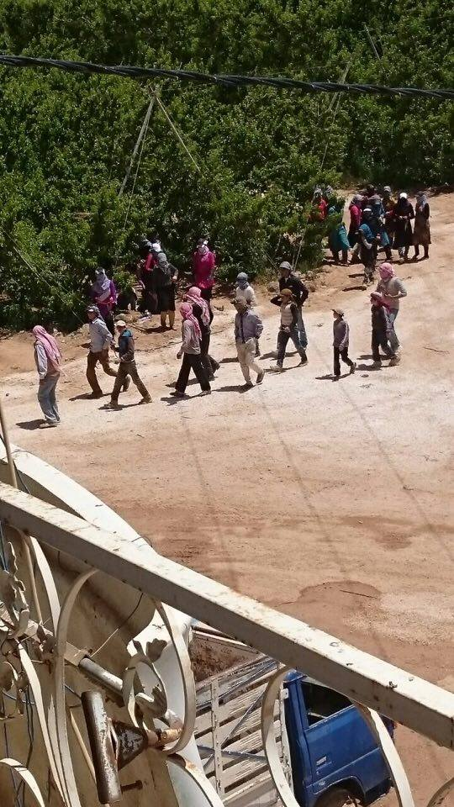
Thank you

