Slide 1
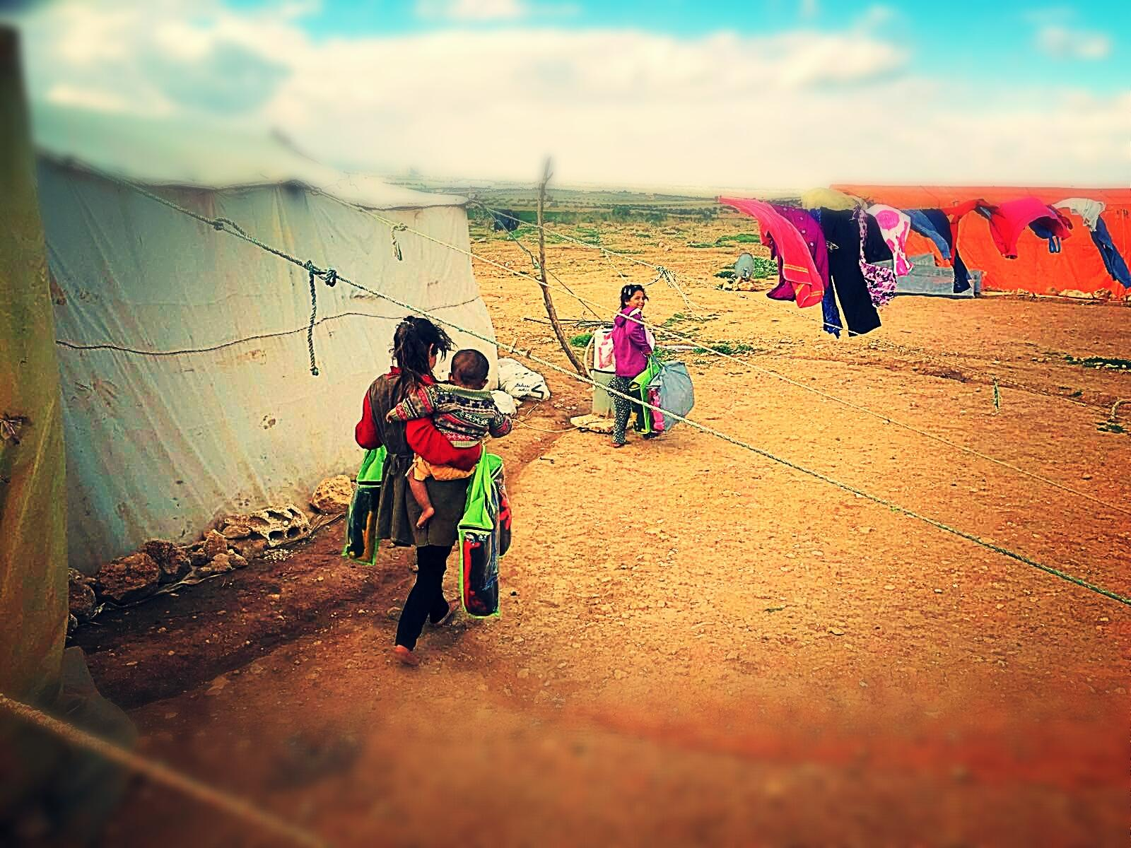





WINTERIZATION INTERVENTION
IN SUPPORT OF MOST VULNERABLE
SYRIAN AND JORDANIAN FAMILIES
LIVING IN CAMP AND NON-CAMP SETTINGS
2015-2016 ECHO FUNDED PROGRAM
4th April 2016 - Basic Needs Working Group

Slide 2
INTRODUCTION
The Consortium
INTERSOS - leading agency
Save the Children (StC) Jordan
International Catholic Migration Commission (ICMC)
Norwegian Refugee Council (NRC)
Added Value
Extended geographical coverage
Deep knowledge of needs and gaps in the targeted areas
Coordination with relevant actors and bodies
Capacity to operate in hosting communities and in refugee camps
Objective of the Program
To respond to winterization needs among Syrian and Jordanian most vulnerable families in camp and non-camp settings, including ITSs, with the objective of providing social protection and reducing economic vulnerability.

Slide 3
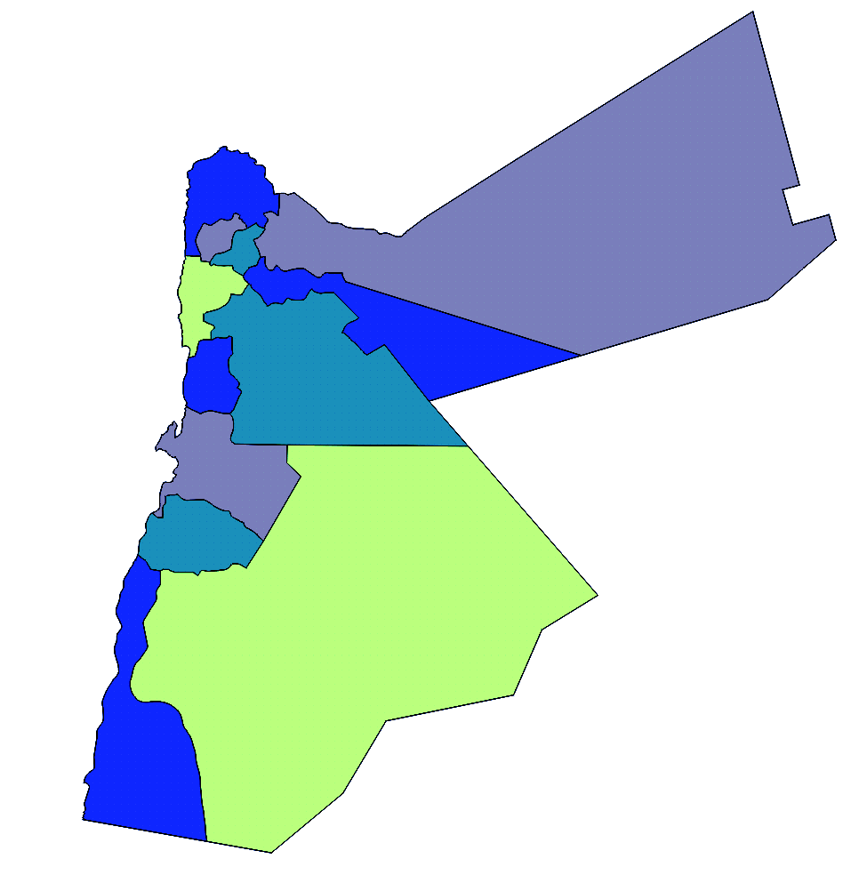
JORDAN: AREAS OF INTERVENTION
Aljun & Jarash
Al Mafraq
Irbid
Al Balqa
Az Zarqa
Amman
Al Karak
Ma’an

Slide 4
COMPONENTS OF THE PROGRAM
Host communities and rural areas
Winterization unconditional cash assistance | TOTAL: 6,944 households
INTERSOS | 1,823 Syrian households and 775 Jordanian households
Save the Children Jordan | 1,075 Syrian households and 460 Jordanian households
ICMC | 1,968 Syrian households and 843 Jordanian households
Provision of winter clothing kits | TOTAL: 8,741 children (0-17)
Save the Children Jordan
Provision of emergency kits | TOTAL: 1,000 households
INTERSOS | 663 Syrian households and 53 Jordanian households
Save the Children Jordan | 1,185 Syrian households and 197 Jordanian households

Slide 5
COMPONENTS OF THE PROGRAM
Za’atari refugee camp
Direct cash assistance for purchasing multi-use items (silicon sealant, insulation tapes and door/window locks) for small shelter repairs | TOTAL: 72,989 individuals
NRC
Winterization unconditional cash assistance | TOTAL: 1,820 families with at least one member affected by a disability
Save the Children Jordan
Azraq refugee camp
Provision of winter clothing kits | TOTAL: 9,749 children (0-17)
Save the Children Jordan

Slide 6
ASSESSMENT METHODOLOGY
Beneficiaries’ identification
Outreach visits.
List provided by the MoSD through UNHCR (Jordanians).
List provided by Community Based Organizations (CBOs).
List provided by Municipalities.
Coordination through RAIS to avoid duplication in the assistance.
Criteria for selection
Initial vulnerability assessment tool (Household Initial Registration Form) jointly developed and designed by INTERSOS, ICMC and Save the Children Jordan (based on VAF).
Eligibility criteria for cash assistance based on vulnerability and protection score assigned to each case/household through the assessment conducted by trained social workers.
Some data
Approximately 11,000 assessments conducted to households in host communities from October 2015 to January 2016.
42% Syrians (score 60+) and 82% Jordanians (score 37+) extremely vulnerable cases identified.

Slide 7
MODALITIES OF ASSISTANCE
In refugee camps
Blank distribution.
Harmonization of cash assistance to cover in an equitable manner as many families as possible with the funds available.
Minimize the risk of tensions between families receiving assistance.
In host communities
Assistance delivered through “money transfer” Companies.
On-site (87%) and off-site distribution (13%), the latter to support extremely vulnerable beneficiaries having difficulties in accessing money dealer’s branches.
Set-up of a complaint mechanism to improve accountability of the entire process.
Follow-up visits to monitor the relevance and effectiveness of the assistance.
Ad hoc visit from protection teams in case of specific protection concerns.

Slide 8
STATISTICS
Referral
Referral to other Organizations (Caritas, DRC, HI, ICMC, IMC, Save the Children, IRC, Legal Aid, MSF, UNHCR): 105 cases.

Slide 9
STATISTICS

Slide 10
STATISTICS

Slide 11
STATISTICS

Slide 12
MAIN CHALLENGES
Approval Process
MOPIC approval process (different line ministries for each partner).
Bank system (new policies and regulations) cause of delay.
Implementation
Re-contact beneficiaries and relocation/movement of people from areas/governorates,
specially on a large scale program.
Hard to reach areas not easily accessible during storms/bad weather conditions.
Coordination in camp setting (I.E. gulf actors/PDM/Distribution priorities).
Consortium
Coordination may represent an additional burden to consortium members already
overloaded with respective programs and tasks.
Common standards of reporting and sharing information (both program and financial
wise).

Slide 13
LESSONS LEARNED
Approval Process
Joint advocacy with local authorities and support from UNHCR to solve approval issues.
Implementation
Joint assessment forms (harmonization approach and guarantees consistency in
identification of vulnerability – hosting communities).
Good coordination with other actors during emergency response to guarantee a more
efficient and prompt assistance.
Money dealer provides easy access and low visibility to vulnerable individuals –
mitigation of risks.
Stronger coordination with other actors through an ad hoc MoU
Consortium
Steering committees/admin-finance/protection meetings to coordinate/discuss solve
common issues and challenges.
Stronger negotiation capacity in front of “Money Transfer” Companies.
Joint assessment of bank challenges and common identification of a solution.

