Slide 1
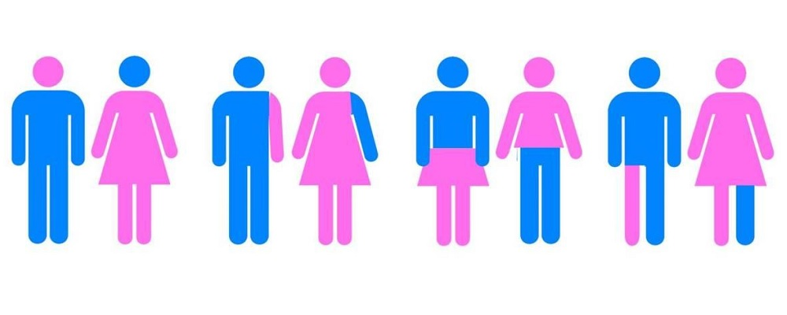
Gender and Nutrition

Slide 2
Gender and Sex
Gender: Socially constructed characteristics of women and men – such as norms, roles and relationships of and between groups of women and men. (WHO)
It varies from society to society and can be changed. (WHO)
They are the roles or responsibilities assigned to a person based on whether they are a man or woman, boy or girl.

Slide 3
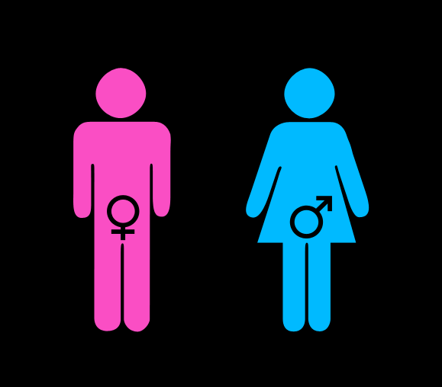
Sex: Biological differences between men and women.
Sexual differences cannot be changed.

Slide 4
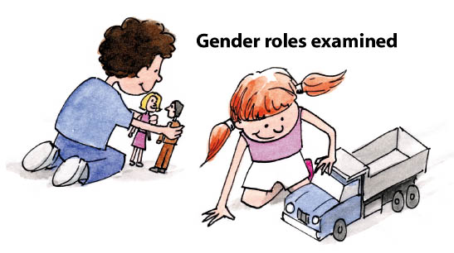
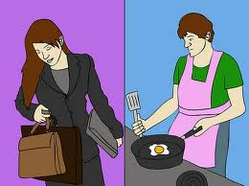

Slide 5

Gender requires us to ensure that health policy, programmes and services are responsive to the needs of women, men, girls and boys. (WHO)

Slide 6
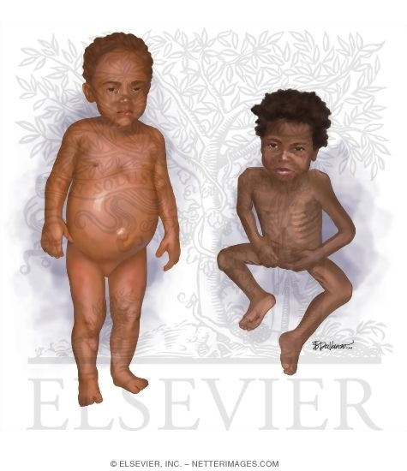
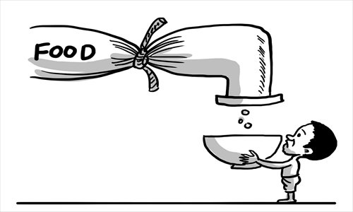
Gender Equality in Nutrition Interventions.
During emergencies:
Acute Malnutrition.
Micronutrient deficiency diseases.
Death

Slide 7
Women, girls, boys and men.
Different nutrition requirements.
Different socio-cultural factors.
Different deterioration in their nutritional status.
Therefore,
Project life cycle.
Gender and age sensitive.
Efficient response.

Slide 8

Nutrition programs that improve lives must:
Analyse
and
Take into consideration needs, priorities and capacities
of
Both the female and male population of all ages.

Slide 9
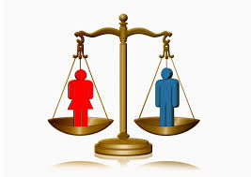
IASC Gender Marker
A tool that codes, on a 2-0 scale.
It ensures that women, girls, men and boys will benefit equally from a project.

Slide 10
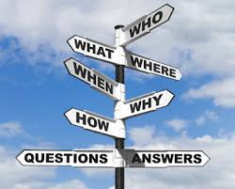

Project Life Cycle.
1) Needs Assessment :
First step in designing a program.
Gender analysis in the needs assessment is essential for finding gaps.
Example:
Unequal access to nutrition services for women, girls, men and boys.

Slide 11

2) Activities: The gaps identified in the needs assessment should be integrated into activities.
3) Outcomes: Should capture the change that is expected for female and male beneficiaries.

Slide 12

Examples
Needs Assessment:
Who makes the decisions around breastfeeding– whether or not to breastfeed, when to start, how long? Mothers, mothers in law, fathers, other?
What is the nutritional status of adolescent girls and women of reproductive age? What are their levels of anaemia?

Slide 13
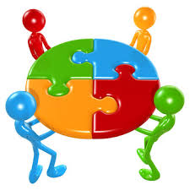

Activities:
Refocus breastfeeding campaigns to include local women’s groups, where older women (mothers in law) congregate and to include campaigns for men .
Recruit and train gender balanced nutrition teams.

Slide 14
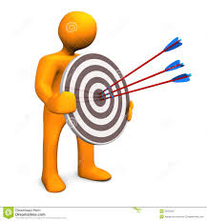

Outcomes:
An equal number of women and men are trained and employed in nutrition programmes.
All U5s (girls and boys) and PLW are covered by supplementary feeding and treatment for moderate acute malnutrition.

Slide 15
The ADAPT and ACT-C Gender Equality Framework.
Outlines basic actions that can be used when designing or piloting a gender integrated project.
Useful reference in designing minimum gender commitments.

Slide 16
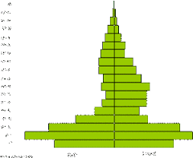
Examples of commitments and activities (ADAPT and ACT-C Gender Equality Framework ).
1) Collect, analyse and report Sex and Age Disaggregated Data (SADD).
Sample Activity:
Collection, analysis and reporting of SADD on the nutritional status of women (including plw), men, girls and boys.

Slide 17

2) Ensure women, men, boys and girls participate equally in all stages of the project.
Sample Activity:
Consult through conducting focus groups with women, men, girls and boys on needs, capacities and concerns related to the nutrition activities.

Slide 18
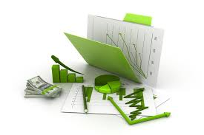
3) Analyse the impact of the crisis on women, men, girls and boys, ensuring all strategies and projects include a gender analysis.
Sample Activity:
Conduct a gender and age analysis which includes an understanding on women’s, men’s, girl’s and boys nutritional requirements, feeding practices and access to nutrition services.

Slide 19
Take specific actions to prevent GBV experienced by women, girls, boys or men receiving assistance through nutrition programmes.
Sample Activity:
Develop and display the code of conduct on SEA and where and how people may people make anonymous reports.

Slide 20
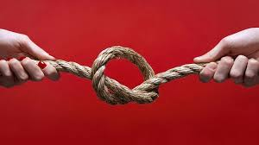
5) Ensure that women and men benefit equally from training or other development activities. Also ensure fathers and mothers are targeted equally by nutrition education activities.
Sample Activity :
Provide nutrition education sessions to both mothers and fathers.

Slide 21


