Slide 1

What is the Graduation Approach?
The Graduation Approach is an ambitious effort to address the multiple constraints of the extreme poor, originally developed by BRAC in Bangladesh. The CGAP-Ford Foundation has tested the Graduation Approach with 10 pilots in eight countries since 2006.

Slide 2
Sequencing Interventions:
To help very poor people move out of poverty
Creating Pathways for the Poorest
promotion
transformation
creating ladders
safety nets + livelihoods + microfinance
protection
prevention
stabilization
sequencing

Slide 3
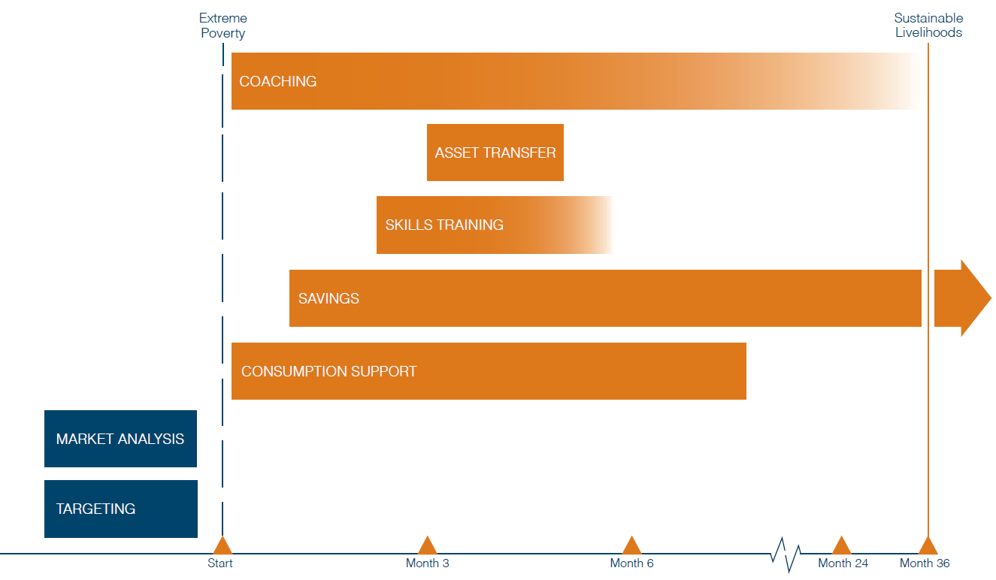
The Graduation Approach
Notes:
Purpose of slide: time-bound intervention, careful sequencing, moving into sustainable livelihoods

Slide 4
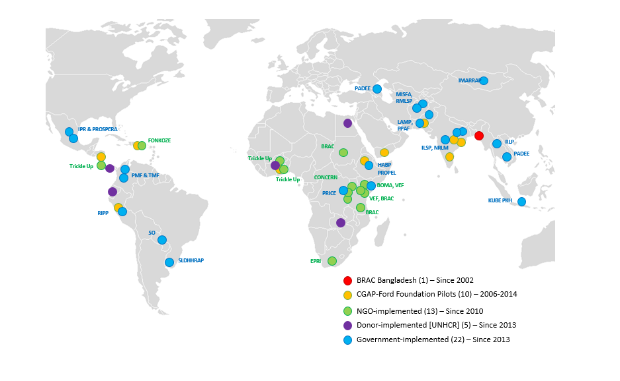
Research Sites
Pilot Sites
CGAP-Ford Foundation Graduation
Notes:
Purpose of slide: a methodology that’s been tested, in multiple countries and multiple contexts

Slide 5










Graduation Approach Evaluation Results
Impacts of 8/10 indicators still evident 12 months after the intervention
Income significantly higher in all countries – in the majority of these countries exceeding the cost of the program
Household consumption significantly higher in all countries but Honduras
Lessons for future implementations – the context and the quality of implementation are important
Abhijit Banerjee et al. Science 2015;348:1260799
“The Graduation approach has led to broad improvements in key dimensions of economic and non-economic well-being…Policymakers seeking a program to sustainably improve the lives of the very poor should consider investing in this approach.” Esther Duflo, J-PAL

Slide 6
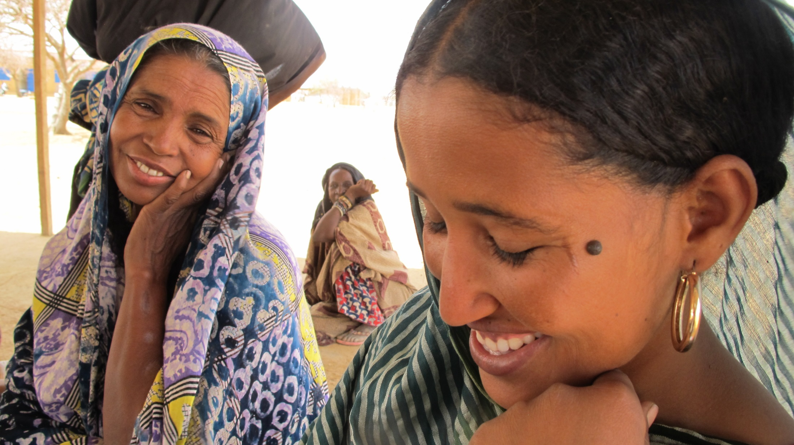
Questions?

Slide 7

GRADUATION APPROACH COMPONENTS
GRADUATION CRITERIA

Slide 8
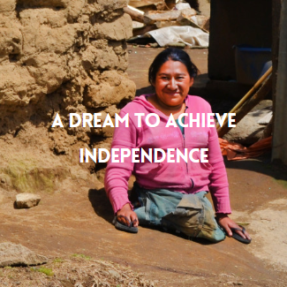

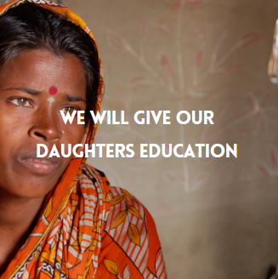
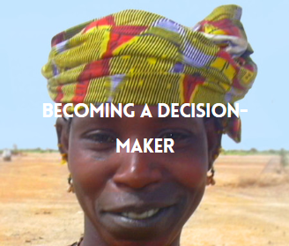
GRADUATION CRITERIA
GRADUATION CRITERIA
A rigorous criteria to define program success and to establish interim and end goals for program participants.
Graduation Criteria Provide a Means to:
Define what is ‘Graduation’ in the context of the target population
Determine the length of the program (time to achieve Graduation)
Rationalize the design of the program
Provide concrete goals and objectives for staff and participants
Select key indicators to track performance

Slide 9
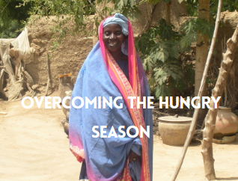
GRADUATION CRITERIA
Sample Graduation
Category | Criteria
Food security | Participant’s family is food secure (“household eats a cooked meal at least once a day” or “household is eating at least two meals a day per day all year round” or “ household does note experience starvation due to unavailability of food”
Income, Assets and savings | Household has at least two sources of income and owns income-generating assets/and or savings worth at least US$ XXX
Self-confidence /agency | Participants have a plan for the future and/or “feel they have made progress through the course of the program.” Other examples: Participant is able to write her name. Participants are aware of accessible government programs. Households know and demand their rights and are aware of where to report instances of abuse.
Health | Participant maintains basic hygiene and has access to healthcare Participants’ hemoglobin level must reach a “normal” level
Other | Participants maintains basic hygiene Household has access to healthcare All children aged five to ten are attending school if a school is accessible in a radius of 1.5km

Slide 10

Reaching graduation
Coaching visits help measure a participant’s progress in achieving their individual Graduation goals and address problems if they appear unable to meet them.
It is best to wait until the end of the program cycle and then celebrate graduation collectively for all participants in a cohort.
Typically a Graduation ceremony is held for participants, their families, and their coaches to celebrate their success, talk about lessons learned, and discuss next steps.
If there are participants who are not able to meet program goals, managers must determine ahead of time what actions to take.
At Graduation it is important to remind participants about what, if any, support they can continue to expect and reiterate where they can access other programs and services.

Slide 11
GRADUATION CRITERIA examples
Trickle Up (India): Selects Graduation criteria jointly with participants a the beginning of the program. In one case, participants who had not reached all of the criteria felt they had nonetheless successfully emerged from extreme poverty and would remain that way. They were allowed to graduate and the criteria used were re-assessed for subsequent cycles.
UNHCR (Costa Rica): Give piggy banks to their participants at the start of the program to encourage them to save. One of their Graduation criteria is the use of these piggy banks to help reinforce the message.
UNHCR (Egypt): Had still not decided on Graduation criteria after 2 years of operating the program. This led to considerable confusion and lack of direction on the part of staff and participants.

Slide 12

GRADUATION APPROACH TARGETING
Targeting, or participant selection, consists of these elements in a rural context:
  Area selection
  Community selection
  Community mapping
  Wealth ranking
  Verification
GRADUATION CRITERIA
A rigorous procedure to ensure the most vulnerable in a community benefit from the program.
For transparency, accuracy, and to build buy-in/trust, community participation is essential!

Slide 13
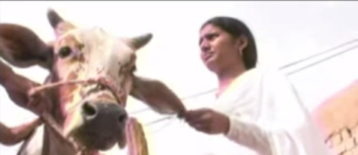
GRADUATION APPROACH LIVELIHOODS
Things to consider:
Livelihoods must fit into the value chain
Know your market
Know your participants’ challenges and opportunities
Mix short and long-term activities - diversify to mitigate risks
Support services are key – ensure you have the right technical skills available
Appropriate training & coaching are keys to ensuring success
GRADUATION CRITERIA
Livelihoods encompass the market assessment, skills training, and asset transfer (cash or in-kind)
Innovations/adaptations include using faster-learning participants as mentors and facilitating safe wage employment
Barefoot Vet

Slide 14
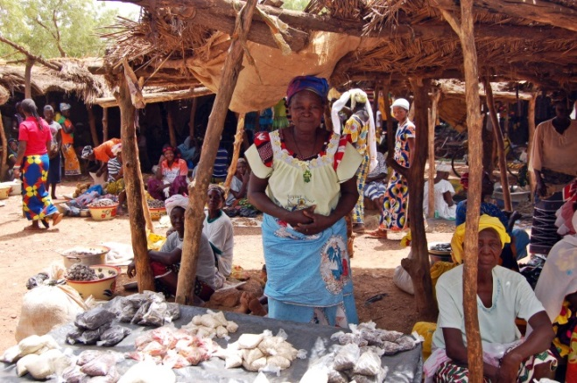
MARKET ASSESSMENT
Conducted to choose appropriate livelihood options and give information on issues such as food security and access to financial services.
What to consider: market overview, priority sectors, value chain analysis, cashflow, opportunities for sustainability & scale
Markets are dynamic: Be aware of ongoing market conditions to monitor changes that will economically affect participants
Markets vary from region to region: Do not assume opportunities in one area will be suitable in another. Depending on the context (e.g. rural/urban), opportunities may exist for self-employment enterprises and/or wage employment.
Selection of activities is important: Provide a wide enough selection to accommodate participant skills and avoid flooding the market without burdening the program with too much complexity.
Notes:
What to Consider in a Market Assessment
When assessing potential markets it is important to do so with the experience, capacity and interests of participants in mind. There are many toolkits available to help structure a market assessment, however generally speaking, the following items should be investigated:
Market Overview: Identify value chains, market cycles, environmental factors, key players, opportunities, and constraints. Project how this might change over time.
Priority Sectors: Include a variety of short-, medium- and long-term options. Typically the extreme poor are risk adverse. Ongoing coaching will eventually help develop an entrepreneurial spirit, but it is often best to start in sectors where participants feel most comfortable. Factor in the risk of market saturation – do not recommend the same livelihood options to all participants if there is not enough room in the market to accommodate them. At the same time, do not stretch staff training needs by choosing too many options.
Value Chains Analysis: Research, interviews, and focus group discussions with local entrepreneurs, government officials, sector specialists, local NGOs, and key market actors. Note possible barriers to entry for the extreme poor (e.g. transportation) and anticipated future changes in supply/demand/pricing/etc.
Cashflow: Do the math. Do not just assume a livelihood option is sustainable – work out a cashflow based on the level at which your participants will enter to determine the level and timing of returns. Use conservative estimates to allow for a buffer.
Opportunities for Sustainability and Scale: Identify partners in the Government and private sector who can help build markets and foster sustainability.

Slide 15
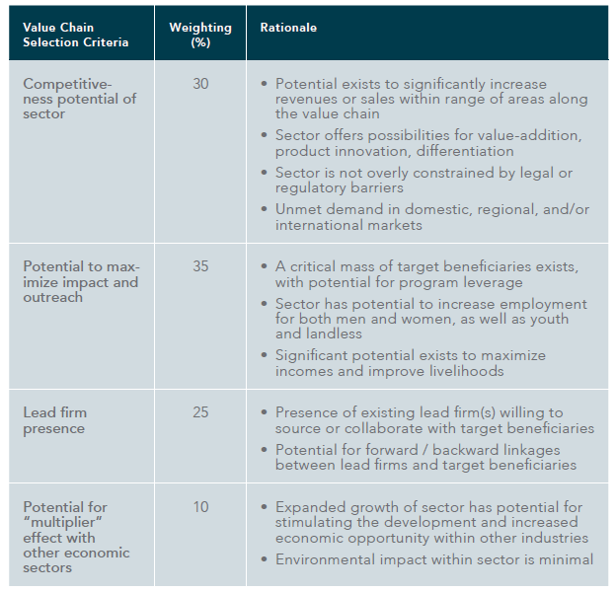
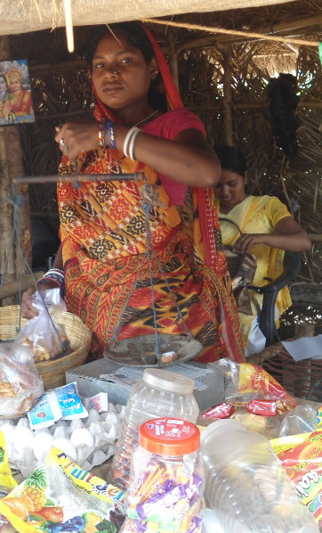
MARKET ASSESSMENT
Ranking Matrix
This is an example of a viable market ranking matrix used by REST in Ethiopia:

Slide 16
Wage employment
Particularly in an urban environment, wage employment opportunities may be the best solution for participants given that:
  They are provided with the proper skills and training
  They are not put at risk or taken advantage of by employers or employment conditions
  Relations with employers are maintained and monitored by program staff
Important questions for potential employers:
Identification/documentation requirements
Training/skills requirements
Conditions of employment: compensation, benefits, transportation, hours, options for promotion/growth, training offered, etc.
Potential issues for vulnerable employees (gender, disability, status) and strategy for addressing these
Problem identification and resolution process

Slide 17
Livelihood examples
Trickle Up (India): Promoted an improved method of cultivating rice (system of rice intensification). Participants were initially adverse to change, but a few decided to try it on a limited basis. The results were so successful, the early adopters became leaders for the whole community in disseminating the new approach.
UNHCR (Egypt): Found that wage employment opportunities were not suitable for female participants as travel outside the home put their security at risk and left children unattended. UNHCR negotiated with international companies such as Unilever to create in-home sales opportunities.
UNHCR (Ecuador): Has negotiated agreements with a number of private sector companies and helped create linkages with CERES (an international certification institution for socially responsible companies) and the Ministry of Labor. They hold regular events to recognize existing employers and recruit new ones. In designing their training courses, employers are first asked to list their skills requirements.

Slide 18

GRADUATION APPROACH COACHING
Coaching Provides:
A regular touch-point to track participant progress and identify issues
A means to reinforce skills training
Encouragement for positive attitudinal changes (e.g., health, education)
Linkages with social programs
Support in developing self-confidence
Information for M&E
GRADUATION CRITERIA
Ongoing engagement with participants is crucial to helping participants gain the skills and self-confidence to develop and follow a personalized pathway from extreme poverty to self-sufficiency.
Where weekly coaching is not possible, alternatives exist such as: community coaches, peer-to-peer support groups, and technologies (cell phones, tablets, etc.)

Slide 19
Coaching
What to Decide in Designing the Coaching Component
Assessment of budget and resource needs
Coaching duration and frequency
Method of coaching
Linkages available to support coaching
Coaching content
Profile and skills required for coaches
Training requirements for coaches
Coaching resources and materials
Tailored versus uniform coaching
Systems/processes/tools for monitoring coaching
Coaches do not need to have the answers to all questions, but should know where to find them. Coaches should meet weekly amongst themselves to resolve any questions and share information.

Slide 20
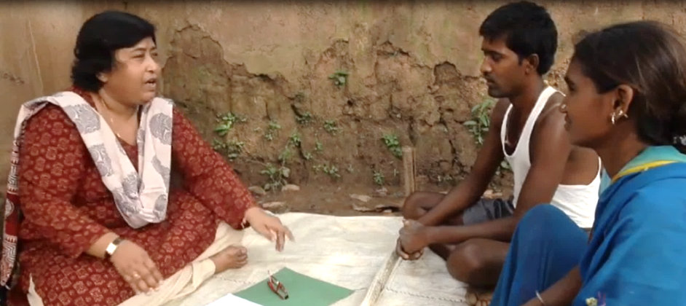
Qualities of a good coach
Respect for participants and desire to engage with them as equals.
Ability to listen to before proposing solutions, and to work with participants to creatively resolve issues together.
Open and encouraging attitude.
Ability to seek answers and identify resource persons when necessary.
Willingness to adapt the support that is given to the needs of the household
Appropriate staff selection, orientation, and ongoing training is essential to ensuring success. The same coach should accompany a participant throughout the program to establish trust and ensure good monitoring.

Slide 21
Coaching examples
Fundación Capital (Mexico, Colombia, Paraguay): Works with governments in implementing the Graduation approach. They have integrated technologies such as cellphones and tablets with training modules for participants to attempt to address the challenges of providing coaching at scale.
Trickle Up (India): Uses savings and credit groups to provide peer-to-peer coaching and training to support the work of their field officers.
UNHCR (Egypt, Costa Rica, Ecuador, Burkina Faso): Trains extension workers who are already skilled in either psychosocial support or in livelihood development to provide all aspects of coaching so that participants have a consistent point of contact.

Slide 22


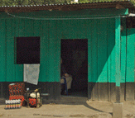
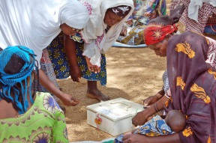
GRADUATION APPROACH FINANCIAL SERVICES
Purpose of savings and financial education:
  Safe place for vulnerable to save
  Instill good financial habits
  Promote mindset of planning for the future
  Help build assets and safety net
  Savings groups: Promote solidarity
GRADUATION CRITERIA
Savings and financial education are a critical factor for success in Graduation and should be introduced early in the program.
Participants do not need to save much to begin – it is the habit that is important. Therefore, consumption support and savings can occur at the same time.
BANK/
POST OFFICE
VILLAGE
BANK
VSLA/
SHG
MFIs
Notes:
Bank Account: While often not an option in rural areas, reputable and insured banks may be sought to provide individual bank accounts or group savings accounts.
Post Office Account: Often with a geographic reach into rural communities, this may be a good savings option.
Microfinance Institution: Several microfinance institutions have undertaken Graduation programs and are able to offer their services to participants, however if they are not formally registered with the central bank they may not be able to take savings. Due diligence should be conducted to ensure that appropriate client protection policies are in place.
Savings and Credit Cooperative/Village Bank: These financial institutions often have good reach into rural communities and have the benefit of mixing better-off and poorer clients. Program designers should, however, inquire carefully as to power dynamics in the group as sometimes the more vulnerable members struggle to gain access to loans.
Savings-and-Credit Group/Village Savings and Loan Association: This is Trickle Up’s favored savings strategy. The groups are self-managed and set their own rules. But there are many bad savings-and-credit groups in the world—the methodology should be widely accepted by development practitioners and training and support to the groups must be thorough. Group management can be a challenge with groups with no literacy.

Slide 23

FINANCIAL SERVICES
Planning a Savings Strategy
Calculate the optimal amount of savings to buffer participants without encouraging hardship.
  What is the amount of savings needed to sustain a family for 3 months if there is a shock?
  How much can a participant save during the program to achieve this?
  When will income from livelihoods be available to help (short, medium & long-term)?
  What is the most sustainable option for guarding these savings?
  What financial training is required for participants?

Slide 24
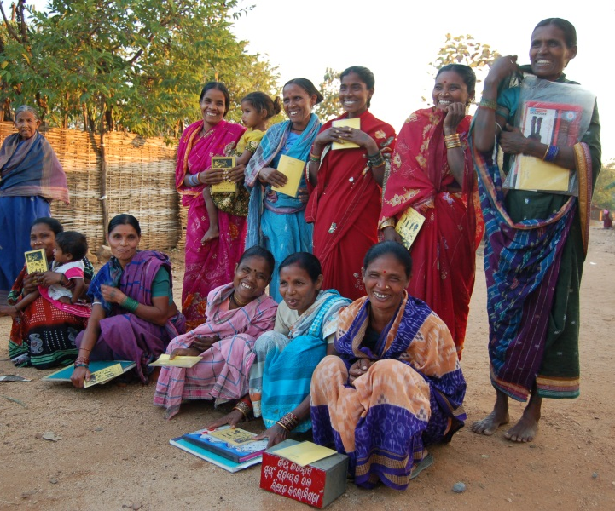
SAVINGS GROUPS
Called savings groups, village savings and loan associations (VSLAs), or self-help groups (SHGs)
Associations of 10-25 members that provide financial services as well as a support network that will last beyond the length of the program.
Vehicle for financial services.
Organized group coaching and training.
Offer platform for accessing banks/public services, defending rights, and spearheading change.
Possibility for connection to other networks.
Promote self-respect, self determination, economic independence, protection for women, and social transformation.

Slide 25
SAVINGS GROUPS
Best Practices
Build affinity:
  Develop good conflict resolution strategies
  Ensure that members feel equal to one another - determine if mixing different ethnic, social, or religious groups is desirable or not
Diversify livelihood activities within the group to manage risks
Build financial and social discipline:
  Establish and follow rules of procedure, including participation
  Where possible, rotate leadership and other roles and work to gain independence from coaches
  Balance focus on economics as well social elements
  Provide financial training (there are many possible solutions to literacy & numeracy issues)
Work with existing structures rather than attempt to replace them

Slide 26
FINANCIAL SERVICES examples
SKS (India): Supports in-kind savings that are contributed towards a communal food bank.
Trickle Up (India): Helped their participants negotiate with local banks and was successful in bringing bank officers to the villages where they worked for registration days. Problems of insufficient identification were solved by issuing TU identification cards to be used in conjunction with national ID. Self-help groups formed through the Graduation program are now being linked into a regional, Government-supported network.
Trickle Up (Guatemala): Learned that integrating people with disabilities into existing savings groups can help establish important links with members of the community, however coaches play an important role in facilitating this integration and breaking down barriers of stigma and discrimination.

Slide 27





GRADUATION APPROACH CONSUMPTION
Things to consider when deciding on consumption support:
  Participant needs
  Duration
  Timing
  Form
  Individualized vs uniform
  Linkages to existing social protection programs
Consumption stipends are an optional component, used to support participants who are at risk of selling assets or not being able to participate.
NON-FOOD
ITEMS
MARKET
GARDEN
CASH
VOUCHER

Slide 28
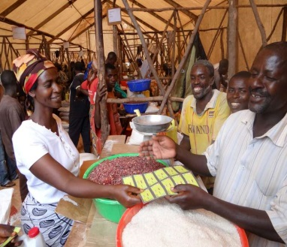
Consumption stipend
Buffer for families while participating and before economic activities start generating profits.
          Are there weeks or months in the year when one or more family members cannot eat more than two meals a day? When? For how long?
          Did your family migrate away from home in the past 3 years? How many times? For how long?
          Did you or any family members engage in any unsafe work activities in the past 3 years to earn money for consumption?
Encouragement to stay and participate in the program for families that practice distress migration or other unsafe economic activities.
Bridge during the lean season when participants risk being forced to sell off assets.
Support to women who cannot work in the last months of pregnancy or just after childbirth.
Should be closely monitored in the pilot phase to determine if it is necessary and if the amount and the duration are sufficient.

Slide 29
Consumption stipend examples
Bandhan (West Bengal, India): Duration of consumption support is linked to livelihoods – for example participants engaged in agriculture receive support for longer periods to account for delays in generating income as compared to those starting small enterprises such as shops.
Trickle Up (India): Participants only receive support in the lean season when caloric intake is insufficient and daily wage labor is not readily available to bring money into the household. Linkages are made to Government social support programs and kitchen gardens are promoted to improve nutritional quality.
Fonkoze (Haiti): Uses regular payment of consumption support at the beginning of the program to build trust with participants and encourage planning ahead.
REST (Ethiopia): Tied their consumption support to public works payment-for-labor programs.

Slide 30
Questions?

Slide 31
Hyperlinks

Slide 32
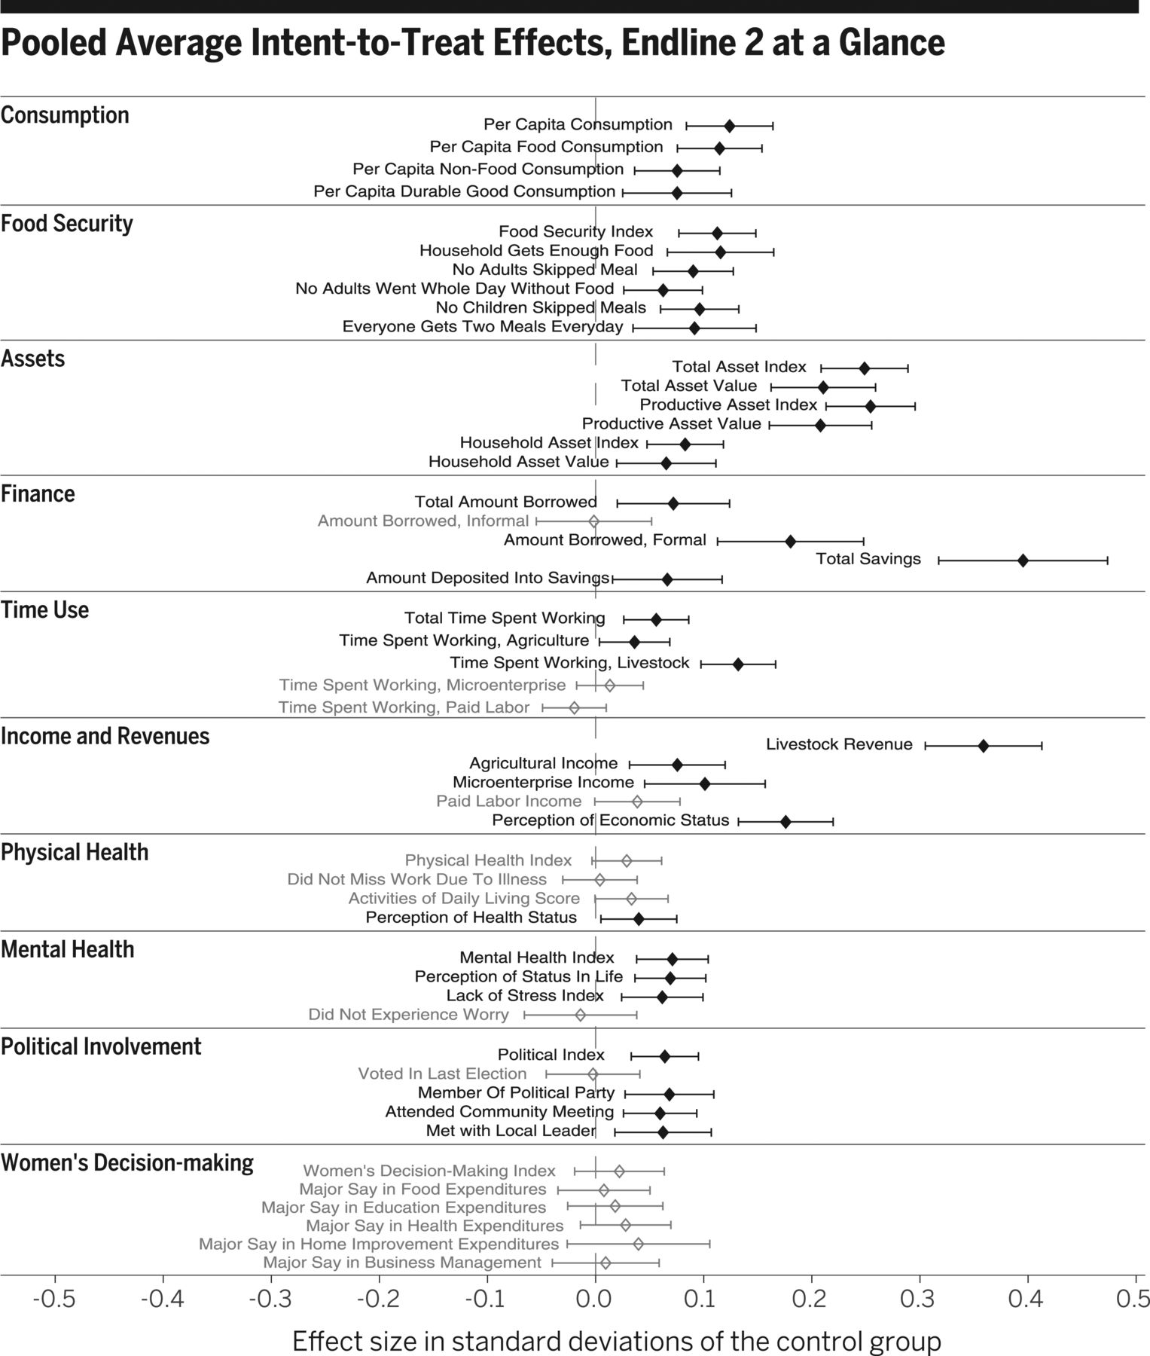

Program Evaluation Results
Abhijit Banerjee et al. Science 2015;348:1260799
Back

Slide 33
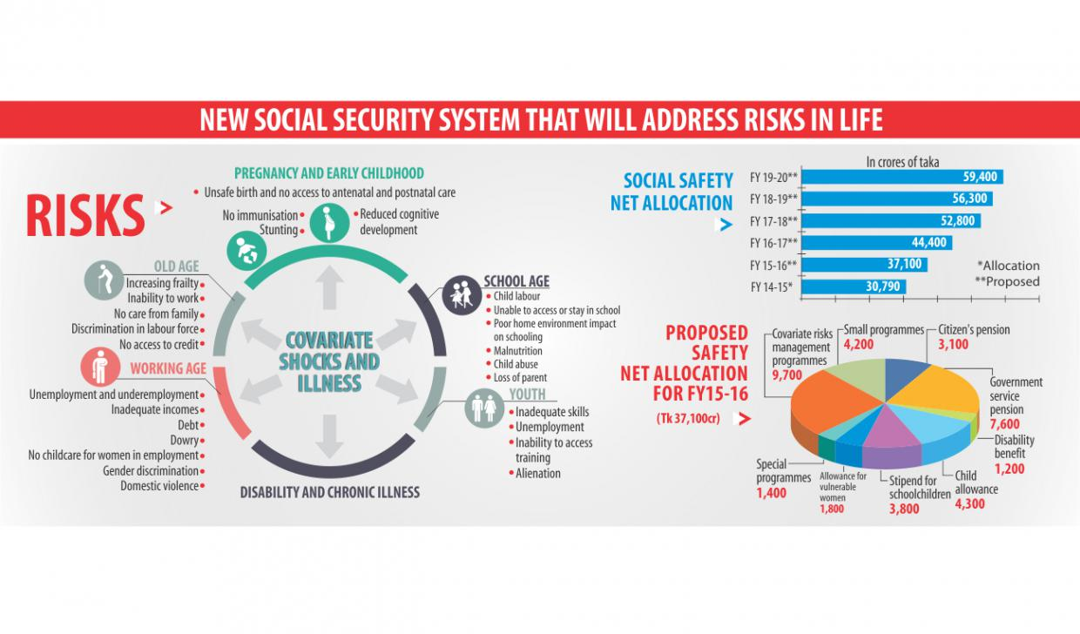
Bangladesh:
Social Protection Framework
Back

Slide 34
Graduation Approach and Scale
Organization | Pilot Country | Pilot Participant # | Scale Up # | Years elapsed | Strategy
Bandhan | India | 300 | 17,249 | 6 | Large grant (Axis Bank), funding with profits from MFI
Trickle Up | India | 300 | 8,470 | 6 | Increasing # of participants/partner and increasing # of partners
PPAF | Pakistan | 1,000 | 43,100 | 6 | Graduation components integrated into national livelihood promotion unit
Back
Notes:
Purpose of slide: Scaling this model is possible and has been successful. There’s no one way to do it. There are two major constraints to scale: capital and capacity.

Slide 35
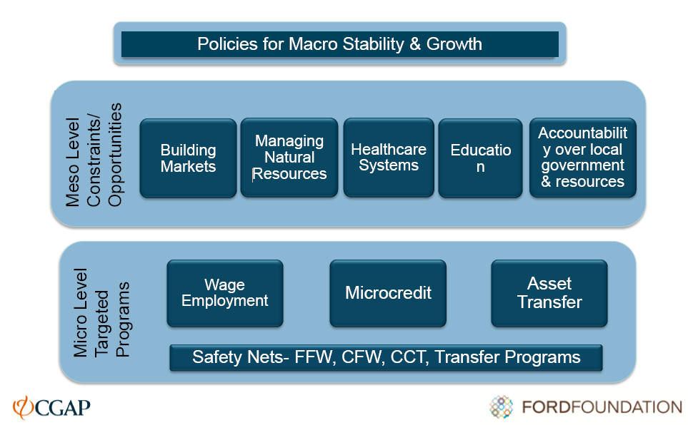
Developing an Analytical Framework for Action:
Challenging Extreme Poverty
BACK

