Slide 1
Tuberculosis statistics

Slide 2
All TB cases 2015 (until September)
Pulmonary |  |  |  |  |  |  |  |  |  |  |  |  |  |  |  |  |  |  |  |  |  |  |  |  |  |  |  |  |  |  |  |  |  |  |  | Al Pulmonary Cases
positive |  |  |  |  |  |  |  |  |  |  |  |  |  |  |  |  |  |  |  |  |  |  |  |  |  | negative
New |  |  |  |  | Previously Treated |  |  |  |  | Relapse |  |  |  |  |  | Retreatment after loss of follow up |  |  |  |  | Transferred from another country |  |  |  |  | New |  |  |  |  | Retreatment after loss of follow up
M | F |  | T |  | M | F |  | T |  | M |  | F |  | T |  | M |  | F |  | T | M |  | F |  | T | M |  | F |  | T | M |  | F |  | T | M | F | T
97 | 86 |  | 183 |  | 0 | 1 |  | 1 |  | 4 |  | 3 |  | 7 |  | 1 |  | 0 |  | 1 | 0 |  | 1 |  | 1 | 51 |  | 69 |  | 120 | 0 |  | 1 |  | 1 | 153 | 161 | 314
Extra Pulmonary
New |  |  |  |  |  |  | Previously Treated |  |  |  |  |  | Relapse |  |  |  |  |  | Retreatment after loss of follow up |  |  |  |  | Transferred |  |  |  |  | Retreatment after treatment failure |  |  |  |  |  |  |  | All Extra Pulmonary Cases
M |  | F |  | T |  |  | M |  | F |  | T |  | M |  | F |  | T |  | M |  | F | T |  | M |  | F | T |  | M |  |  | F |  | T |  |  | M | F | T
78 |  | 119 |  | 197 |  |  | 0 |  | 2 |  | 2 |  | 0 |  | 1 |  | 1 |  | 0 |  | 2 | 2 |  | 0 |  | 2 | 2 |  | 1 |  |  | 1 |  | 2 |  |  | 79 | 127 | 206
 |  |  |  |  |  |  |  |  |  |  |  |  |  |  |  |  |  |  |  |  |  |  |  |  |  |  |  |  |  |  |  |  |  |  |  |  | All TB Cases
 |  |  |  |  |  |  |  |  |  |  |  |  |  |  |  |  |  |  |  |  |  |  |  |  |  |  |  |  |  |  |  |  |  |  |  |  | M | F | T
 |  |  |  |  |  |  |  |  |  |  |  |  |  |  |  |  |  |  |  |  |  |  |  |  |  |  |  |  |  |  |  |  |  |  |  |  | 232 | 288 | 520

Slide 8
TB screening Process
≤ 18yrs > 18yrs
Training of CHVs and NTP staff on screening and referral
Mapping of different IS/CS locations and coordinating with relevant authorities
Identified for referral cases
Referral to NTP physician
Referral to X-ray and physician consultation
Notes:
Referral to NTP physician

Slide 9
Screening Campaign (June-September 2015)
Region | Total Number screened | Number of identified refugees for referral | Referred for radiology | Referred for NTP physician assessment | Lost to Follow-up | Presence of active TB
Mount Lebanon | 5101 | 51 | 45 | 45 | 5 | 0
South | 4981 | 51 | 32 | 41 | 10 | 0
Bekaa | 32750 | 536 | 311 | 475 | 26 | 2
North | 19348 | 585 | 585 | 585 | 0 | 14
Total | 62180 | 1223 | 973 | 1146 | 41 | 16

Slide 10
Screening form in Arabic

Slide 11
Screening campaign in Bekaa
(June-September 2015)

Slide 12
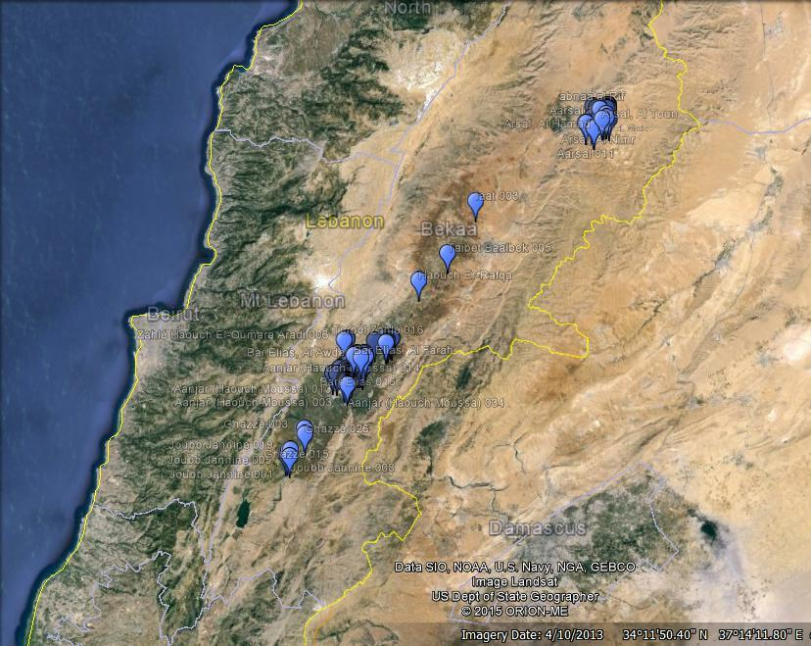
Map 2. Locations of informal settlements screened (June-September 2015)

Slide 13
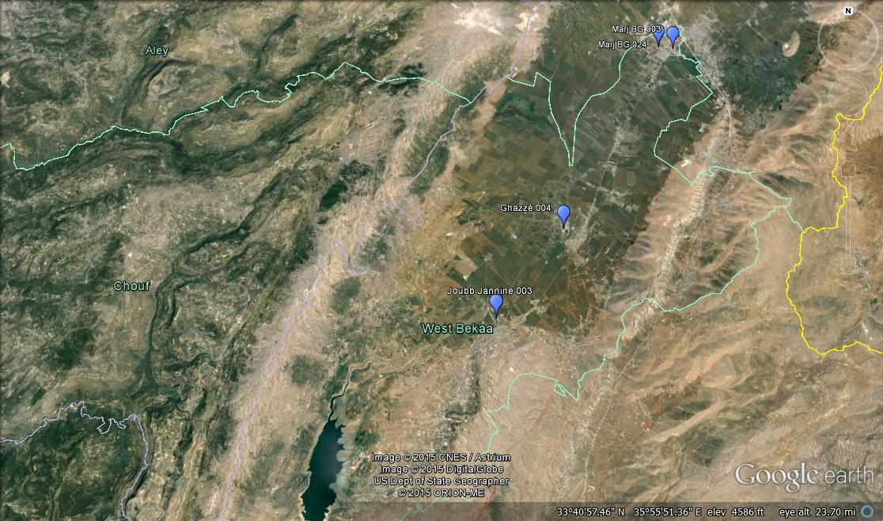
West Bekaa
Number of informal settlements screened/Total number of informal settlements | Number of screened individuals/Total number of individuals | Number of individuals identified for referral
4/194 | 2323/21489 | 38

Slide 14
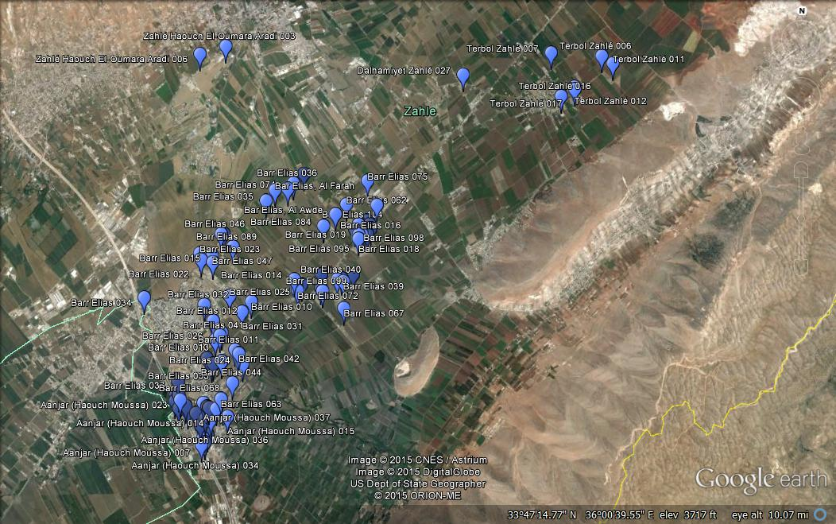
Zahle
Number of informal settlements screened/Total number of informal settlements | Number of screened individuals/Total Number of individuals | Number of individuals identified for referral
70/495 | 11926/55147 | 374

Slide 15
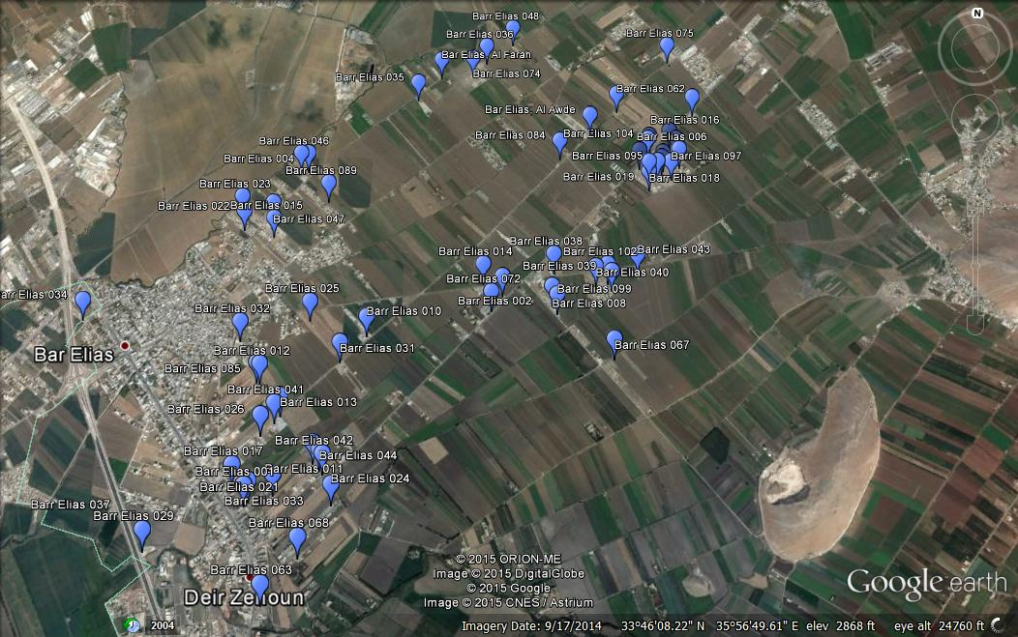
Zahle(Cont.)
Bar Elias
60 informal settlements screened
8136 screened individuals
189 identified for referral
1 active TB case

Slide 16
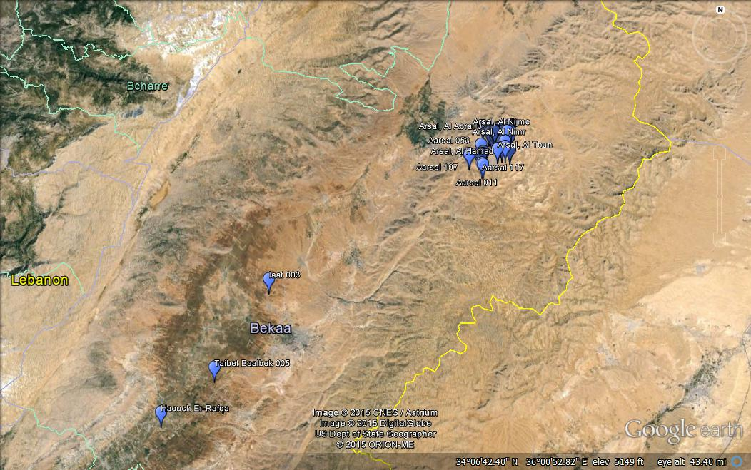
Baalbeck

Slide 17
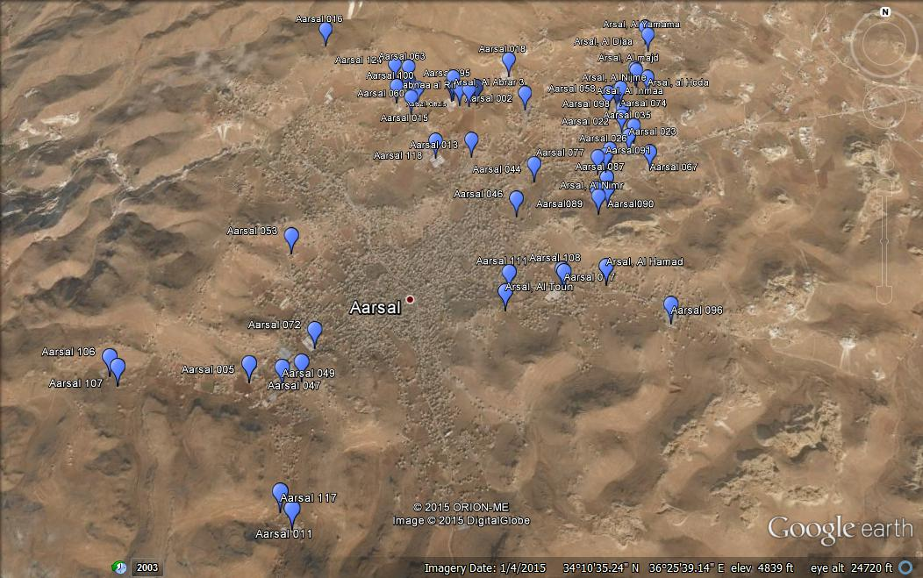
Baalbeck Cont. (Aarsal)
54/86 informal settlements screened
18169/25594 screened individuals
106 identified for referral
1 active TB case

Slide 18
Summary
Screened Vs Total

