Slide 1


The Department of Breast Disease
Ghiras Alkhair Specialist Polyclinic
Implemented by
Sponsored and Supervised by

Slide 2

Epidemiology
The most common site-specific cancer in women
Accounts for 26% of all newly diagnosed cancers in female and responsible for 15% of the cancer-related deaths in women
one in every 8 women will be diagnosed with breast cancer
There is overall increase in incidence rate of approximately 0.5% annually
F.Charles Brunicardi ,Dana K.Andersen,Timothy R.Billiar ,David L.Dunn :Schwartz's principles of surgery –Ninth Edition-Chapter 17 .the breast ,,P1024-p1026

Slide 3
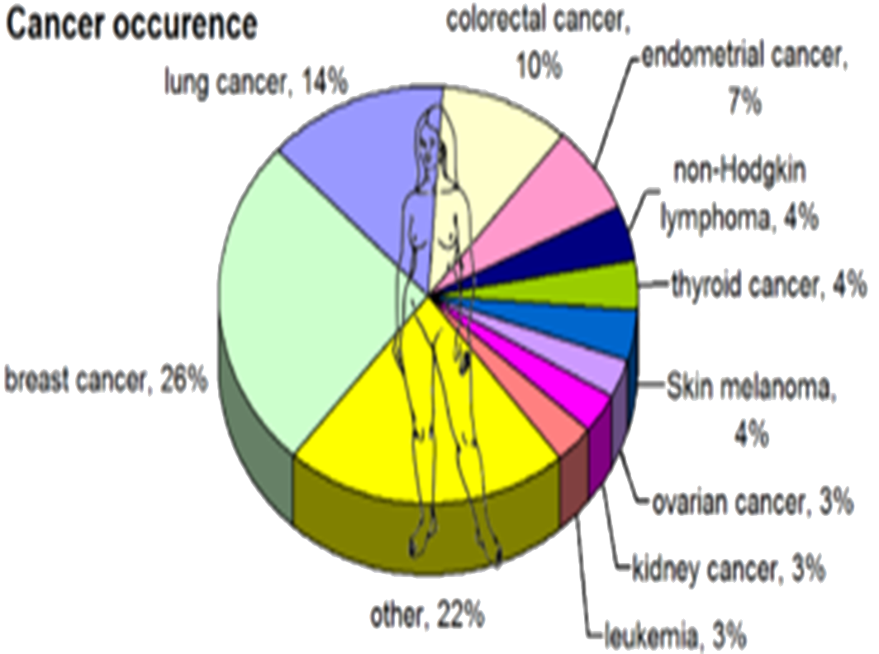
https://en.m.wikipedia.org/wiki/Epidemiology-of-breast-cancer

Slide 4
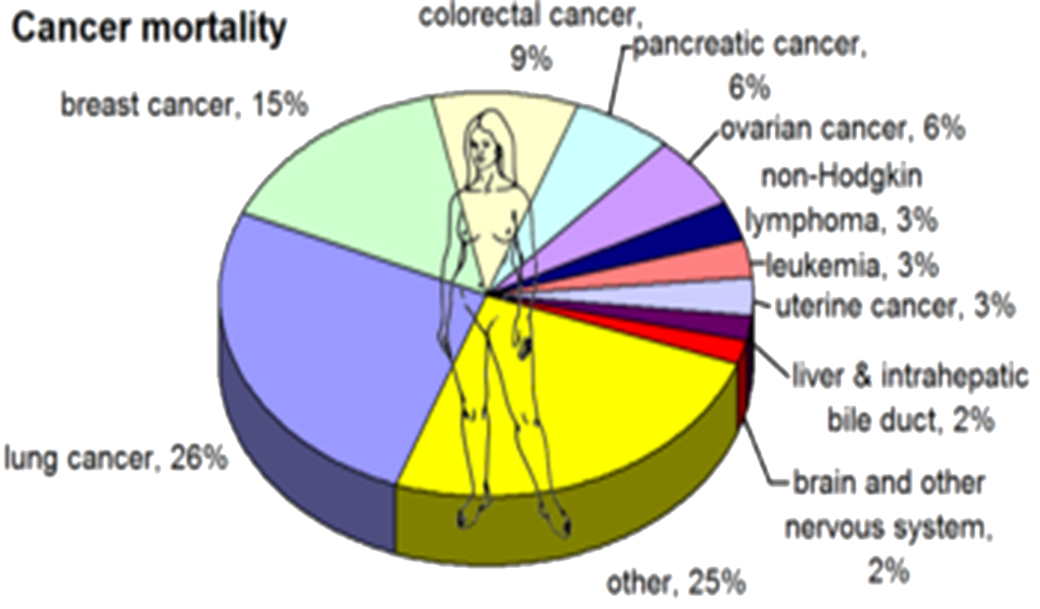
https://en.m.wikipedia.org/wiki/Epidemiology-of-breast-cancer

Slide 5
Breast Cancer Survival Rates, by Stage
American Cancer Society

Slide 6
Early Detection
GREAT RANG OF TREATMENT OPTIONS
LESS EXTENSIVE SURGERY
BETTER OUTCOMES

Slide 7
Mammography
Mammography screening leads to 40% reduction in stage 2-3 and 4 cancer in screened population with a 30% increase in overall survival.
F.Charles Brunicardi ,Dana K.Andersen,Timothy R.Billiar ,David L.Dunn :Schwartz's principles of surgery –Ninth Edition-Chapter 17 .the breast ,,P1051

Slide 8
The Need for Breast Cancer Screening Amongst Syrian Refugees in Lebanon
According to the UNHCR, the number of registered Syrian refugees in Lebanon has reached 1.173 million in September 2015. This is an underestimate as there are many unregistered Syrians in Lebanon.
25.5 % of those are adult females which mean the number of adult Syrian females in Lebanon is about 300000, 12% of them may develop breast cancers during their lifetime .
http://data.unchr.org/syriarefugees/regional.php

Slide 9
The Need for Breast Cancer Screening Amongst Syrian Refugees in Lebanon
Needless to state how complicated this health issue is, knowing, the understandable poverty among the Syrian refugees and the high cost of mammography and other diagnostic tests (30$ for mammography, 30$ for breast ultrasound and more than 100$ for breast biopsy provided by breast cancer awareness campaigns; National Lebanese Campaign).
It is expected that third of Syrian adult females in Lebanon (100000) are more than 40 years old. Therefore, the cost of screening mammography alone will be at least 3000000$ per year.

Slide 10
Our Center
It is a unique center as it is the only breast diseases specialized center in Lebanon for Syrian refugees.
Our services are provided free of charge.
It is located in Majdal Anger town in middle Bekaa, where the number of Syrian refugees is high (more than 35% of Syrian refugees in Lebanon live in Al Bekaa).

Slide 11
Our Services
Educational brochure for every visitor
Periodically simplified lectures
Screening
mammography
Physical examination
Diagnosis
educational movies show continuously
Planning
Core-biopsies and ultrasound-guided biopsies
Laboratory tests
Breast ultrasound
FNA
Raise of awareness

Slide 12
Our project Team Members
Surgeon as a manager
Radiologist
Radiographer
Nurse
Receptionist and Data Entry

Slide 13
Our Brochure
Awareness is the main key of early detection of breast cancer
Designed in a simplified and understandable manner.
Depends on scientific principles.
Promoted with meaningful pictures.

Slide 14

Our Brochure

Slide 15
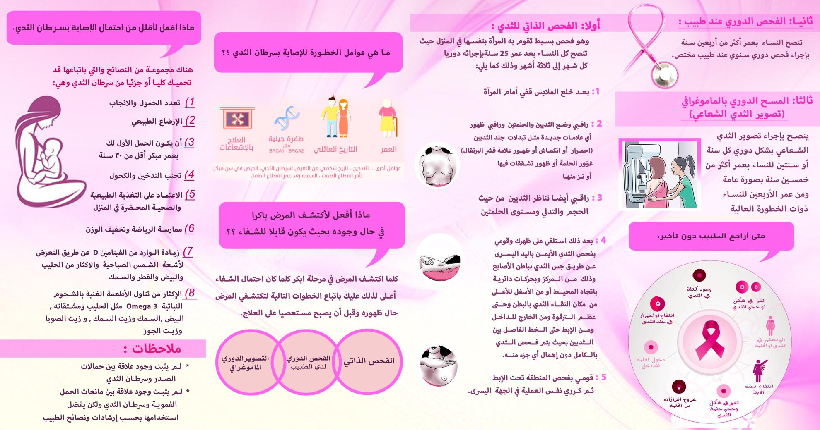
Our Brochure

Slide 16
The Questionnaire
we designed our questionnaire according to the proven scientific principles and to the specificity of our community and its needs.
Supply adequate information for both statistical studies and scientific researches.
Determine the spread of breast cancer and related risk factors in our society.
Estimate educational and economic status and its reflection on the detection of the disease.
Contain Gail model for breast cancer risk assessment.

Slide 17
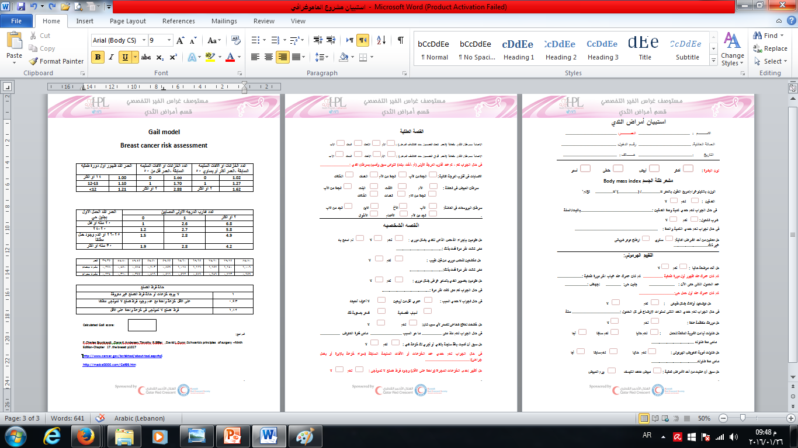
The Questionnaire

Slide 18
Breast Cancer Risk Assessment
Gail model
The most frequently used model
Incorporates:
Age at menarche.
The number of breast biopsies.
Age at first live birth.
The number of first –degree relatives with breast cancer.
Predicts the cumulative risk of breast cancer according to decade of life
F.Charles Brunicardi ,Dana K.Andersen,Timothy R.Billiar ,David L.Dunn :Schwartz's principles of surgery –Ninth Edition-Chapter 17 .the breast ,P1016

Slide 19
There is no recommendation for screening when life expectancy less than 10y
F.Charles Brunicardi ,Dana K.Andersen,Timothy R.Billiar ,David L.Dunn :Schwartz's principles of surgery –Ninth Edition-Chapter 17 .the breast ,P1019
Gail score
Low or moderate risk
High risk
Aged 40_49 screen
every 2y
Aged 50y and older: annual screening
Baseline mammography at age 35 and then annual mammographic screening at age 40

Slide 20
Outline of work
No Yes
Have you had a previous problem?
Do you want to be examined?
Do you have a recent symptoms ?
Filling the questionnaire and doing mammographic imagine
Physical examination and full assessment
Negative
BI-RADS1
BI-RADS2-3-4
Positive
Continuation of routine age-appropriate screening
Filling the medical file and Request investigations as needed
Planning
diagnosis

Slide 21
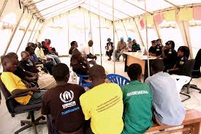
Our Long Term Vision
We are planning to increase the Syrian refugees’ awareness of the services provided through mobile campaigns among camps and regions that are highly populated by Syrian refugees.
We hope to cover other investigations which are not available in our center like mammographic guided biopsies and breast MRI for some special cases

Slide 22
Our Long Term Vision
But most importantly, we are conscious of the fact that early diagnoses in cancer make a significant difference to outcome only through the provision of timely therapy.
In order for this project to become an all-round success and beneficial to a community with an ongoing anguish, we believe we must secure the cost of treatment and provide it freely.

Slide 23
Our Long Term Vision
Treatment Aspects
Surgery
Hormonal Therapy
Chemotherapy
Radiotherapy

Slide 24
Thanks
Dr.Wissam Dalati, MD
General Suregeon
Project Manager
E-mail: Wissam.d@multiaidprograms.org
Phone: 76815746

