Slide 1

proGres in Partnership

Slide 2
Advantages
Web-based system
Partner Access
Workflows (vs. events and results):
  process and reporting streamlined with UNHCR standards and guidelines
Interoperability:
  Available with standard Microsoft tools e.g. Outlook, SharePoint, MS Office
  Developable if compliant with technical & data protection considerations (development time & resources required)
Enhanced Data Security and Data Protection

Slide 3
Microsoft CRM Application
proGres in Partnership is built on Microsoft Dynamics Customer Relationship Management (CRM).
CRM was designed for the sales, marketing and service sectors, but has been customized to UNHCR and partner activities.

Slide 4
Grouping Concept
Individuals are registered into “Registration Groups.”
Registration Group is flexible to accommodate different household compositions, e.g. nuclear or extended family concepts.
Specific Needs, Addresses, Nationalities, etc. are recorded at the individual level.
Separate (RSD, RST, CP etc.) cases are created for members of a Registration Group without needing to change the Registration Group.
Notes:
In the previous version of proGres, individuals were registered in either cases (mostly in urban settings) or households (mostly in camps).
Frequently, this method of grouping individuals required that cases be split or merged for RSD and resettlement purposes.

Slide 5
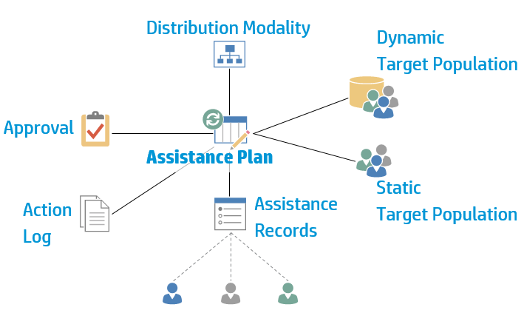
Assistance: Data Model

Slide 6
Assistance Plan: Workflow

Slide 7
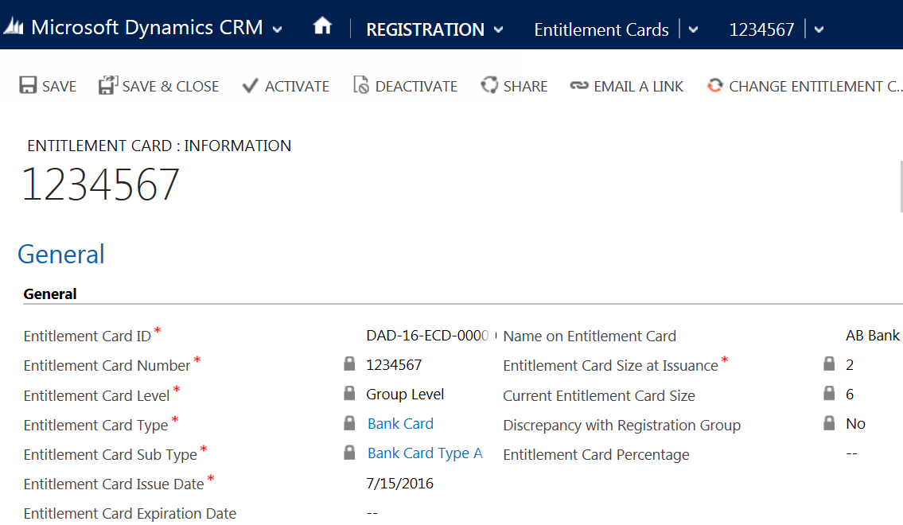

Slide 8
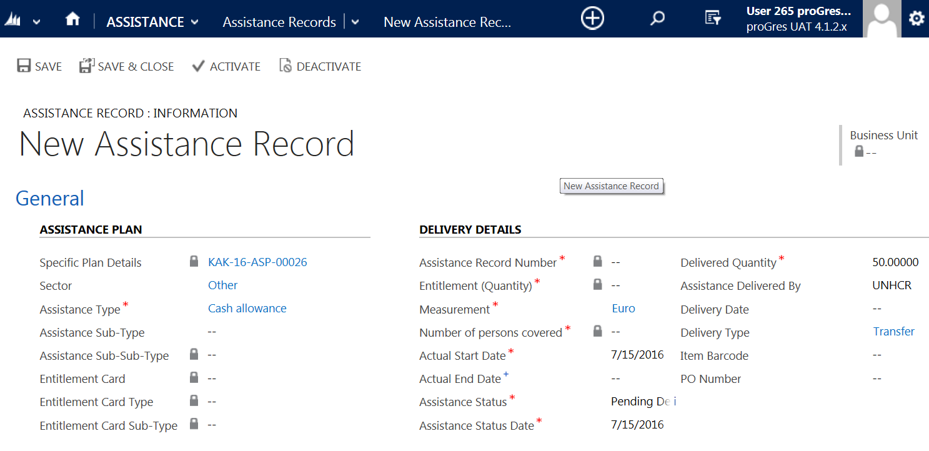

Slide 9
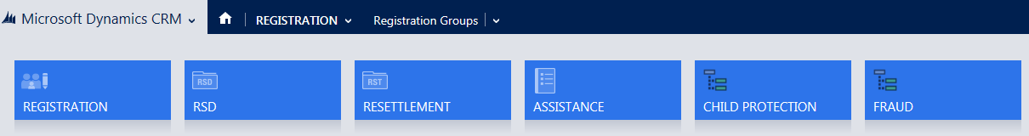
Modules
Each functional area e.g. Registration, Refugee Status Determination (RSD), Resettlement, Assistance, Protection, SGBV and Child Protection are considered to be distinct business processes.
Each business process - a module.
Notes:
Additional modules are currently under development.

Slide 10
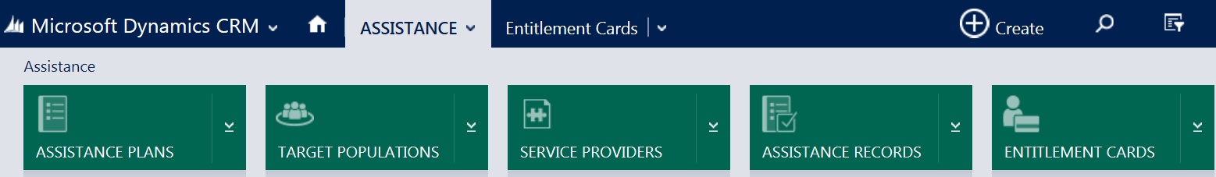
Entities - 1
used to hold related data;
e.g. five entities in Assistance module: Assistance Plans, Target Populations, Service Providers, Assistance Records and Entitlement Cards

Slide 11
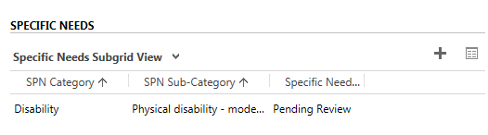
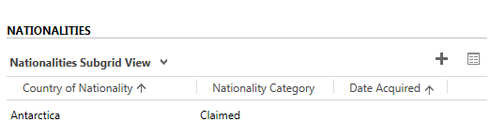
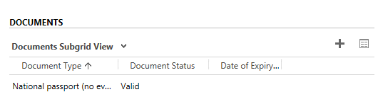
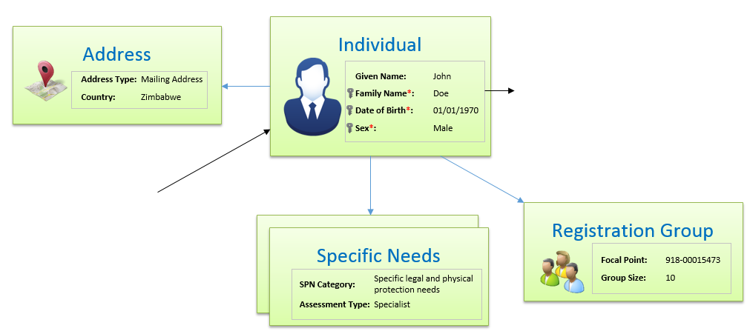
Entities - 2
other examples: Specific Needs, Nationalities, Documents, Addresses, Relatives (and many more!);
all are associated with an individual.

Slide 12
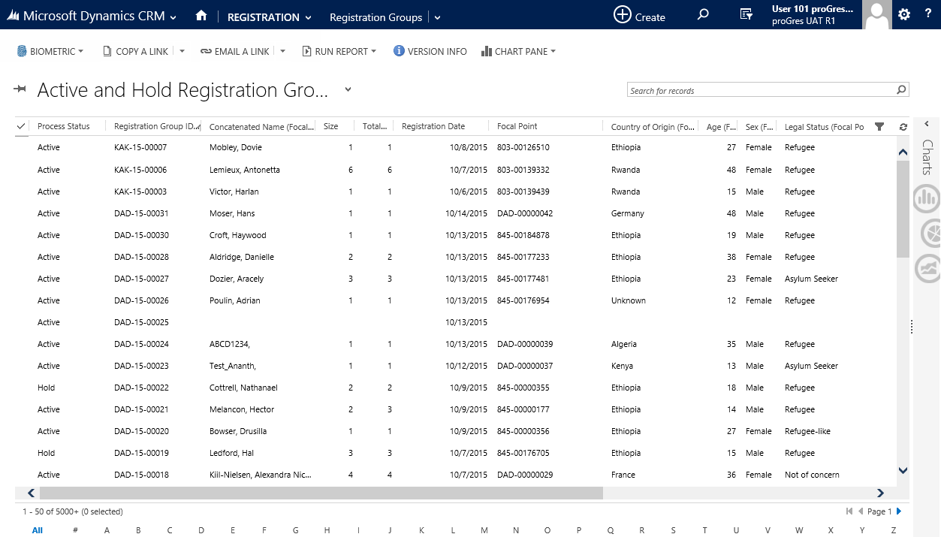
Navigation Bar
Ribbon
Workspace
Notes:
This is what the main window of a module looks like. It consists of three components:
Navigation Bar at the top
Contextual Ribbon below the Navigation Bar
Workspace

Slide 13
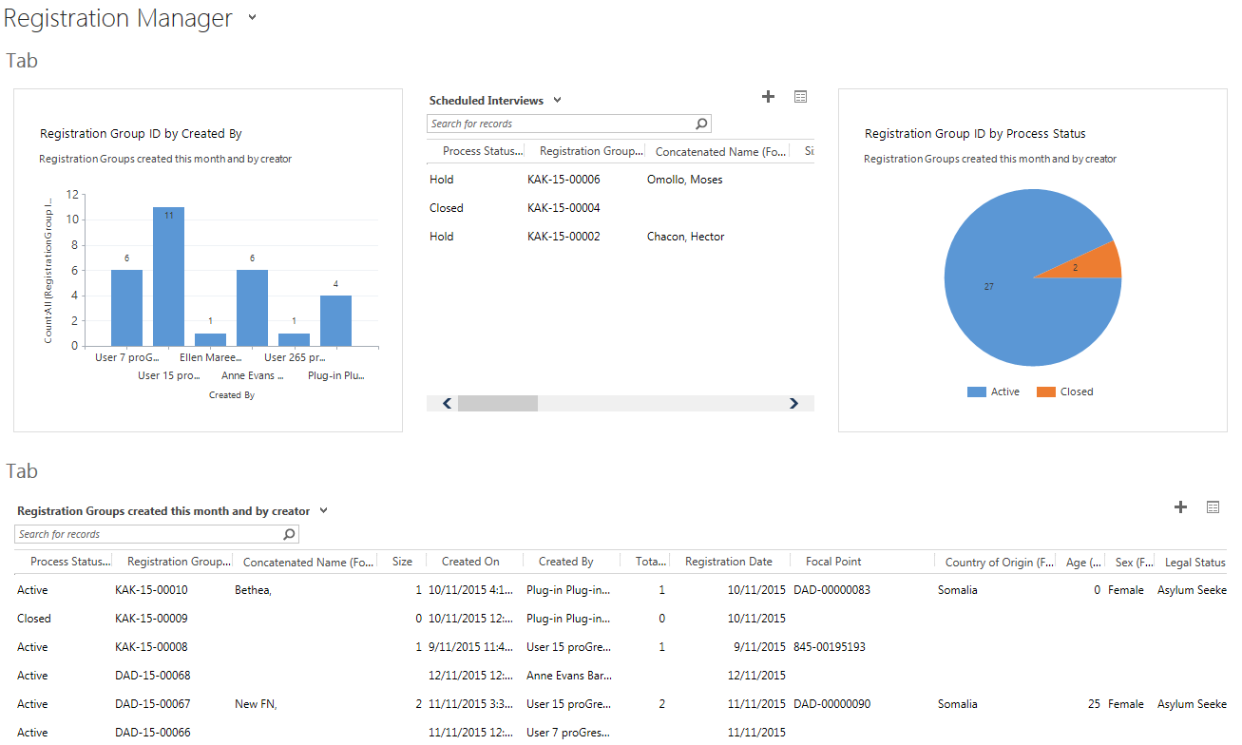
Notes:
This is a sample dashboard containing data potentially relevant to a registration supervisor.
Dashboards are dynamic and update as the data in proGres is updated.
Dashboards can be saved and appear as a user’s “home page” in proGres in Partnership.

