Slide 1
Regular Perception Surveys on Social Tensions throughout Lebanon
Wave III: Summary Results
Social Stability Sector Working Group Meeting
Lebanese Ministry of Social Affairs (MoSA) | Beirut, Lebanon
27 February 2018

Slide 2
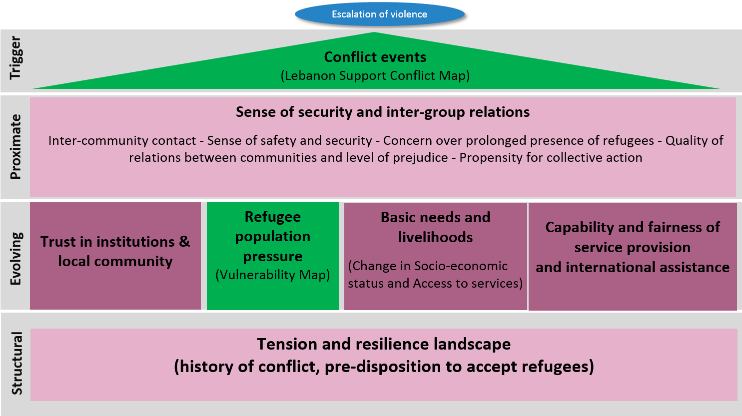
BACKGROUND
Survey Questionnaire Themes

Slide 3
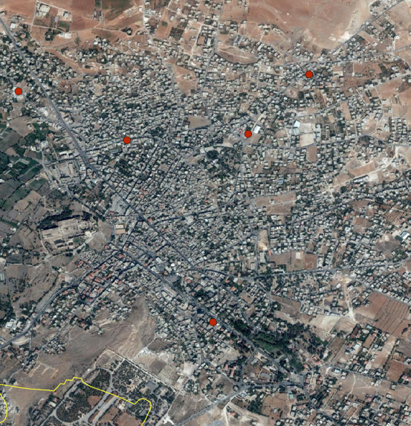
SURVEY METHOD
N = 15,000 (3 waves x 5,000 interviews).
Multi-stage stratified cluster design:
  First stage: Stratification over districts and cadaster selection probability proportionate to population size (PPS) and vulnerability.
  Second stage: Starting locations within cadasters sampled from satellite imagery.
  Third stage: First and subsequent households selected randomly.
  Fourth stage: Adult primary respondent selected randomly.
Analysis: Imputation for non-response and application of probability weight.
Baalbek Locations

Slide 4
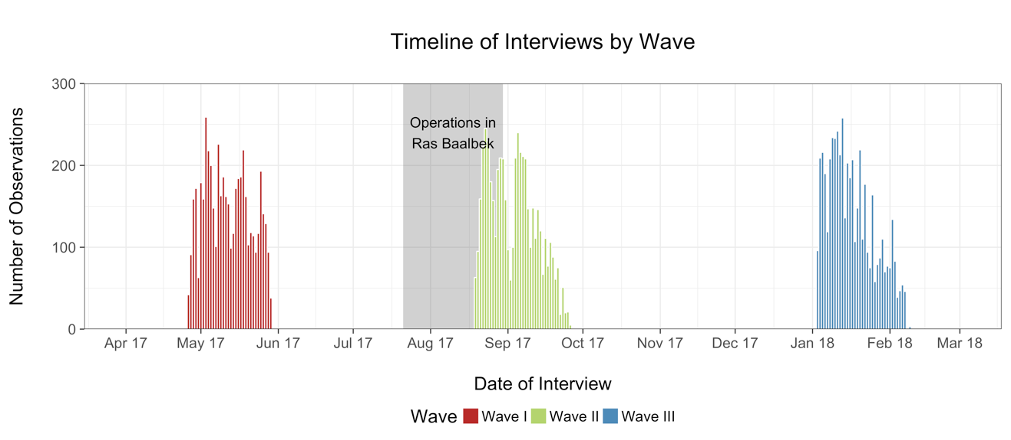
DATA COLLECTION

Slide 5
TOP-LINE FINDINGS
For many changes observed in Wave II, especially those attributable to military operations, public opinion has returned to Wave I baseline.
Over the three waves, the greatest observed changes have been in the South, where social stability has improved on multiple dimensions.
Assumptions in the Stablisation and Monitoring Evaluation Framework (SMF) remain valid, with greater social instability in Lebanon a complex result of multiple compounding factors.
Lebanese public opinion regarding Syrian refugees in Lebanon has been slow to change with, on average, only minor deviations over time.

Slide 6
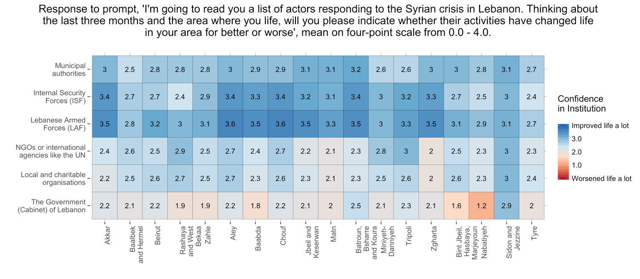
PUBLIC INSTITUTIONS

Slide 7
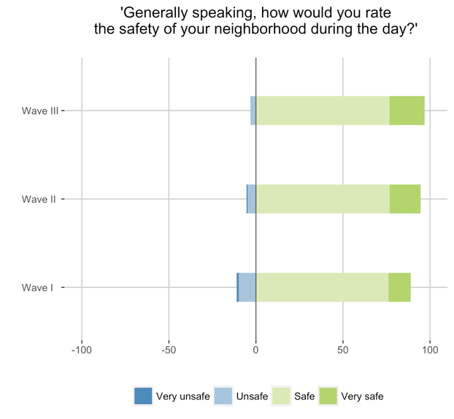
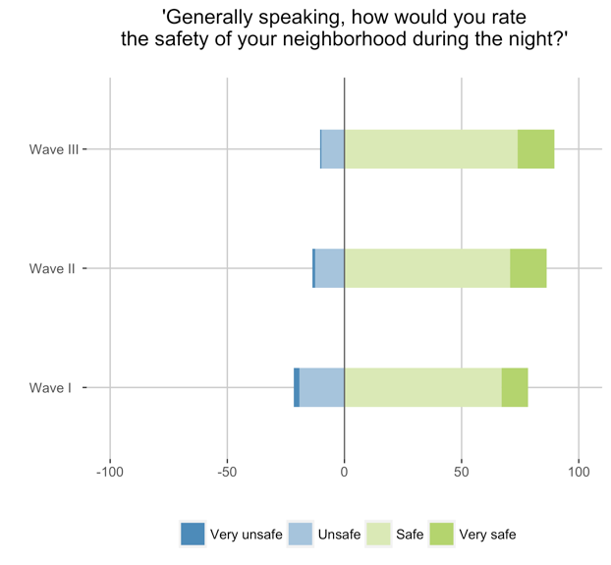
SAFETY & SECURITY

Slide 8
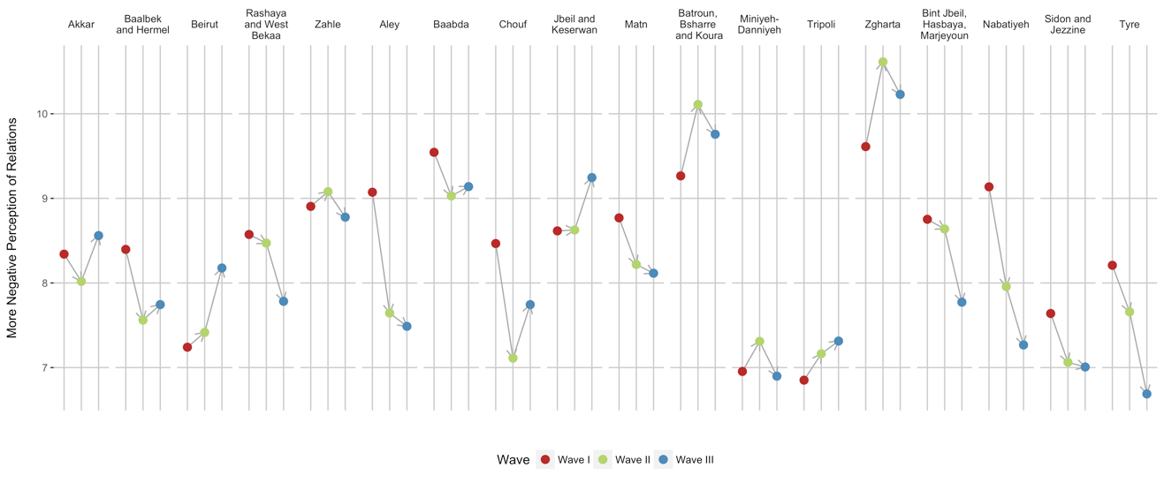
QUALITY OF RELATIONS
* On scale from 0 – 15.

Slide 9
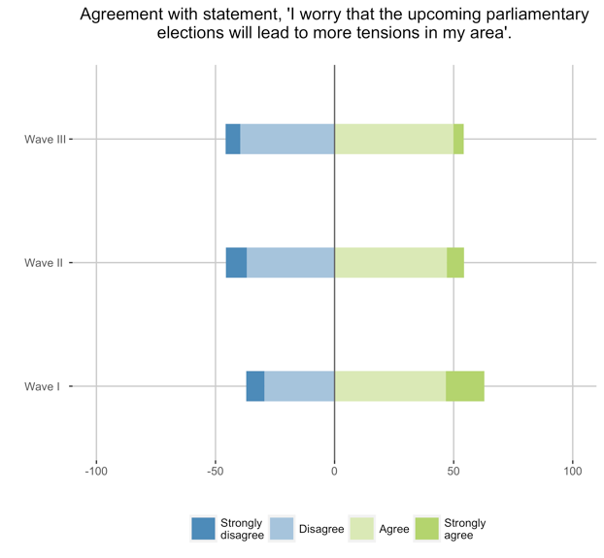
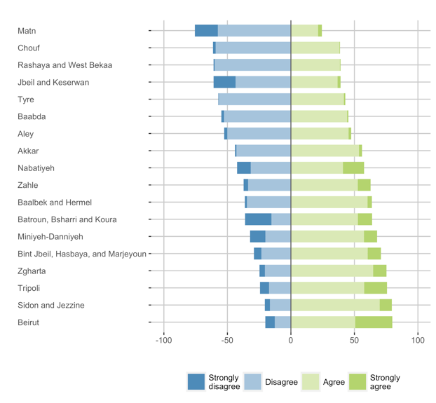
VIOLENCE & ELECTIONS

Slide 10
PRESSURES & COLLECTIVE ACTIONS
Quality of Relations
The Lebanese people in this area have since 2011 been good hosts to refugees displaced by the Syrian conflict who are in need’.
Lebanese and Syrians in this community are able to work together to solve problems they have together’.
‘The presence of so many Syrian refugees in Lebanon today is placing too much strain on resources, like water and electricity’.
‘Lebanese and Syrians share many values and have compatible lifestyles’.
‘The presence of a large number of Syrian refugees in this community has contributed to more incidents of crime and violence’.
Propensity to Collective Action
‘S‎/he thinks people should follow rules at all times, even when no-one is watching’.
‘It is important to her‎/him to listen to people who are different from her‎/him. Even when she‎/he disagrees with them, s‎/he still wants to understand them’.
‘S/he believes it is acceptable to hit someone who hits her‎/him first’.
‘S/he would physically attack someone who verbally insulted her‎/him’.
‘If s‎/he saw someone getting harassed on the street s‎/he would get involved’.
‘If s‎/he got in an argument s‎/he would be able to call on her‎/his friends to intervene’.

Slide 11
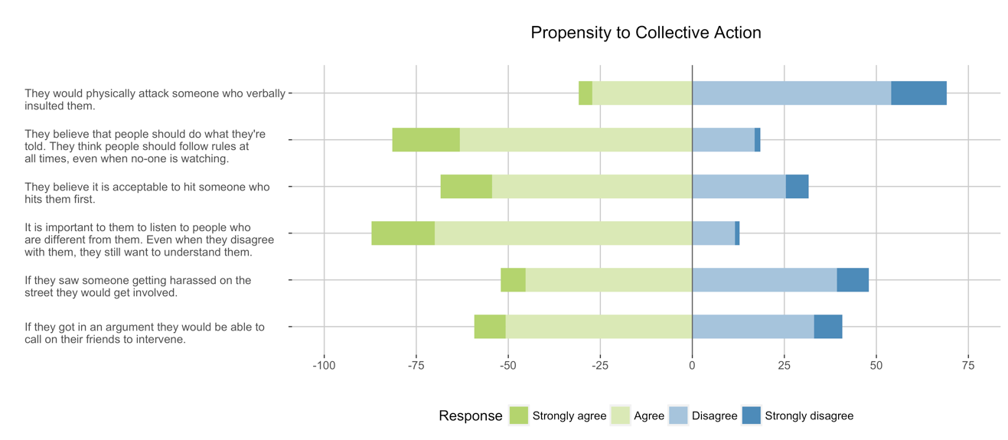
PROPENSITY TO COLLECTIVE ACTIONS

Slide 12
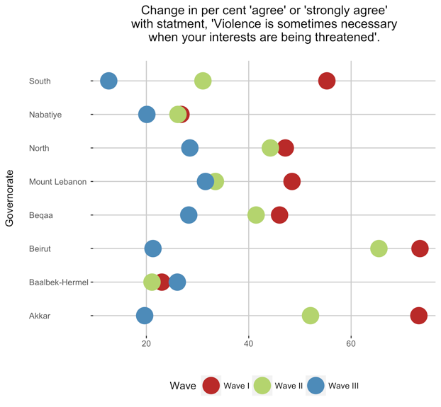
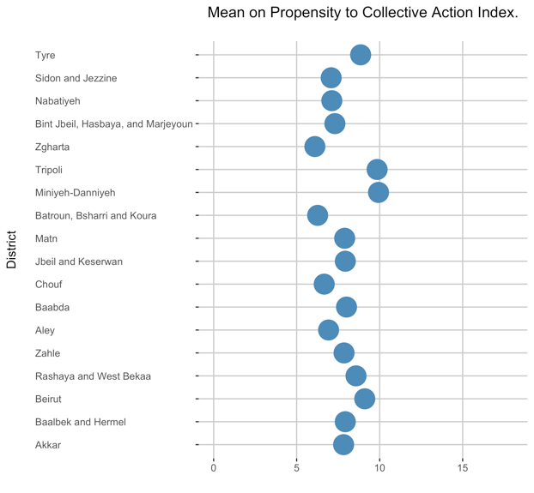
PROPENSITY TO VIOLENCE

Slide 13
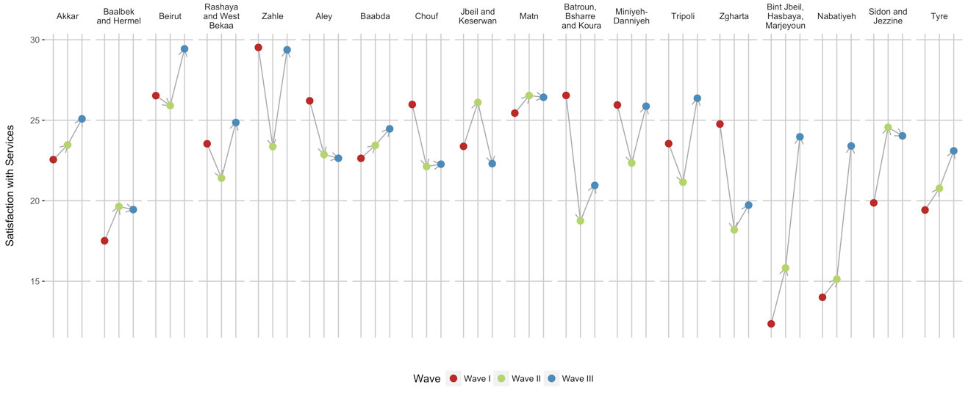
SERVICE PRESSURE
* On scale from 0 – 40.

Slide 14
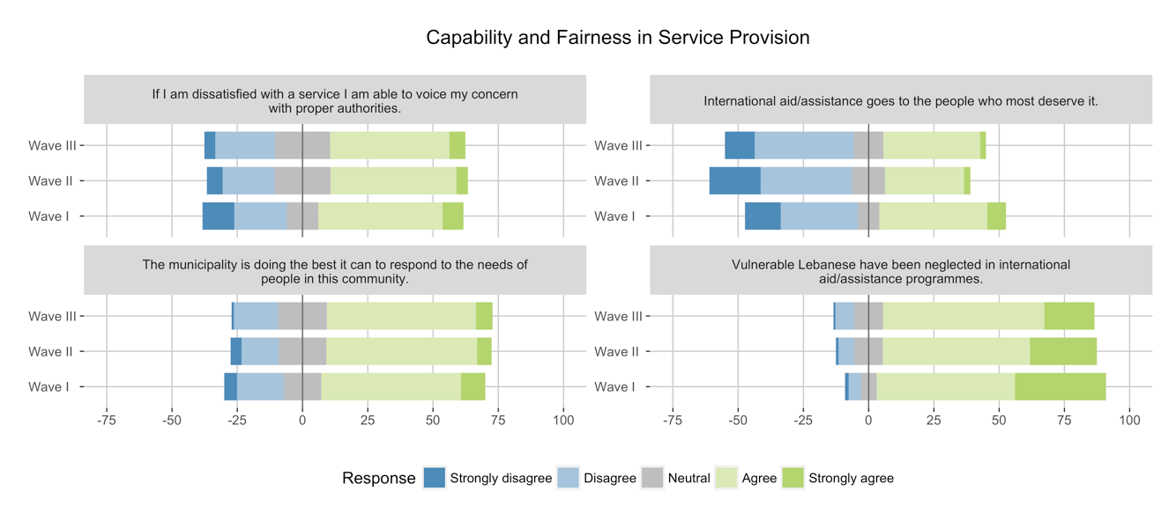
CAPABILITY AND FAIRNESS

Slide 15
For more information, contact Taylor Long (TLong@arkgroupdmcc.com).

