Slide 1
Introductory Presentation
Inter-agency guidelines for working with and for young people in humanitarian settings

Slide 2
Why work with young people?
A period for investment. Youth has distinctive capacities and skills and it presents a unique opportunity for breaking inter-generational cycles and manifestations of inequality.
Demographic dividend. Most countries with the largest portions of youth are among the poorest in the world. Investment in youth contributes to a demographic dividend.
It’s their right. The Convention on the Rights of the Child and General Comment 20 recognise the need to realise the rights of children during adolescence.
Source: Guidelines for Working with and for Young People in Humanitarian Settings

Slide 3
The Challenge
408 million youth aged 15-29 or 23% of the global youth population are affected by violence or armed conflict (The Missing Peace, 2018). 68.5 million people around the world have been forced from home, among them nearly 25.4 million refugees, over half of whom are under 18 years (UNHCR)
Youth have distinct needs, experiences and
capacities for responding and recovering from crisis
Humanitarian organisations have little guidance on effectively incorporating youth into response programming

Slide 4
The Compact
Overview
The Compact is a global call to prioritise the needs and rights of young women and men, girls and boys in humanitarian action
Why? To guarantee that youth are included within humanitarian response
When? Launched at the World Humanitarian Summit in 2016
By whom? Led by UNFPA and IFRC
How? Involvement of international and local NGOs, youth networks and the private sector, as well as UN bodies and governments.
Source: Compact for Young People in Humanitarian Action, UNFPA and IFRC
Notes:
The Igniting Hope report (picture) was launched at the 2018 ECOSOC Humanitarian Affairs Segment. This initial report, covering the work of the Compact in its first 18 months, presents just a sample of the ways in which young people are adapting to and learning from these early efforts, in engaging with each other and serving populations in need. It also documents some of the innovative programming that puts the rights and needs of young people front and centre stage.
For the presenter: More detail on the ECOSOC HAS 2018 side event can be found here: https://www.unocha.org/sites/unocha/files/Transforming%20humanitarian%20action%20with%20and%20for%20young%20people.pdf
Depending on audience:
Event co-sponsored by the Permanent Mission of Denmark to the UN and the Permanent mission of Qatar to the UN and co-organized by UNFPA, IFRC, Office of the Secretary-General’s Envoy on Youth and the Major Group for Children and Youth [on behalf of the Compact for Young People in Humanitarian Action].
Event moderated by Lama Ranjous, a young Syrian woman - Global Focal Point on Migration with UN Major Group for Children and Youth and was the national co-coordinator of the “Arab Youth for Climate Movement” in Syria.
69 participants at the event, which was the only youth engagement focused event of the ECOSOC HAS and besides the Compact members, the Missions of Switzerland, Qatar, EU, Denmark, Estonia, and Austria joined alongside the IASC Secretariat, IOM, UNESCO, and ICRC
Renewed commitment to the Compact by many of its members in the room - UNFPA, IFRC, UNHCR, UNICEF, Norwegian Refugee Council, Reach out to Asia, The World Organization of the Scout Movement and others.
Introduction of the newest Compact member International Rescue Committee

Slide 5
Timeline
United Nations
Security Council Resolution 2250
World Humanitarian
Summit
Launch of Global Compact for young people in humanitarian settings
Youth Peace and Security
Output: 5 actions
Sept. 2015
Dec. 2015
2015 - 2016
May 2016
Sept. 2017
World Humanitarian
Summit
Global Refugee
Youth Consultations
United Nations General Assembly
Doha Declaration
on reshaping Humanitarian Agenda
Consultations with 1,482 youth from 65 nationalities in 23 countries
Launch of Global Compact for young people in humanitarian settings
Output: Priorities and responsibilities
Output: 7 core actions for refugee youth

Slide 6
The Compact
Five key actions
Services
Support age- and gender-responsive programmes to protect the health and well-being of all young people in humanitarian settings
1
Participation
Unleash the power of young people to help and to lead
2
Capacity
Build skills for humanitarian action and beyond
3
Resources
Increase attention to and resources for young people in humanitarian settings
4
Data
Use accurate information to understand the needs of young people in humanitarian settings
5
Notes:
Guidelines respond to action 1 “services”.
Under the umbrella of the Compact, UNICEF and NRC have led the development of the Inter-agency Guidelines for Working with and for Young People in Humanitarian Settings “Promote and increase age- and gender-responsive and inclusive programmes that contribute to the protection, health and development of young women, young men, girls and boys within humanitarian settings”. Adolescents and youth are a vital positive force in emergency preparedness and response. They have wide-ranging capacities and unique needs, but they often get lost between programming for children and programming for older adults. These Guidelines are not just about ‘mainstreaming’ their needs, but about reinforcing the contributions they make to humanitarian programming, improving responses. These guidelines address a gap in humanitarian tools that tend to overlook young people, a specific but broad demographic with interlinked needs across multiple sectors.

Slide 7
The Guidelines
Overview
The guidelines are an easy-to-use programming tool for all humanitarian aid workers at country level for working with and for adolescents (10-19 years) and youth (15-24 years).
When? In emergency response humanitarian situations, across natural disasters and conflict, rapid onset and slow onset, refugee and internally displaced persons (IDP) and other situations. It can be used before or during a crisis response.
Where? Useful for adaptation everywhere around the world.
For whom? Civil society organisations, local and national NGOs, government, international NGOs and UN Agencies.
The final version of the guidelines will be available in May 2019
Notes:
Age brackets: Data group is working on harmonising recommendations. Until then the guidelines use the UN definition as a guideline, but understand that practitioners contextualise accordingly.
The guidelines are intended for all humanitarian practitioners promoting: - a common set of principles, including rights-based approach and participation
- adolescent and youth inclusive programming across all sectors in the humanitarian programming cycle, taking advantage of young people's' potential, their high-level energy and creativity to prevent the persistence of intergenerational problems
- adolescent and youth targeted programming, which shall go beyond solely preventing negative consequences and recognise the positive contribution young people can offer in the short term and laying the foundation for adolescents and youth to continue contributing positively in the longer term

Slide 8
The Guidelines
Consultations 2018-19
The recommendations of young people are a cornerstone of these guidelines.
Gender-balanced consultations were held with 291 youth and at least 77 practitioners. Many targeted individual feedback requests were solicited by email across sectors and with youth specialists
In total the responses of more than 500 individuals were recorded, consolidated and incorporated into this guidance to the extent possible
Consultations with young people took place across the globe, from Afghanistan, Jordan, Iraq to Nigeria, Kenya to Venezuela and Ecuador
A total of 25 countries were covered
The final version of the guidelines will be available in May 2019
Notes:
See p.8 and 9 of the guidelines to see references to other major recent global youth consultations where crisis-affected adolescents and youth have expressed their priorities for improving humanitarian action. These should be mentioned.

Slide 9
The Guidelines
Impressions from youth & practioners
During revision phase 1 and through consultations held with youth and practitioners reviewers shared highlights and lowlights of draft 1
Highlights
Areas for improvement
Young people shown in positive nature/light
Comprehensive, straightforward
Strong gender & age lens
Filling a major gap!
Add participation as a core principle
Technology empowers as actors of change
Advocate at onset beyond sexual & reproductive health needs
The final version of the guidelines will be available in May 2019
Notes:
This was feedback from youth and practitioners in round 1 review. From the next slide (slide 9) we start are talking about version 2 which incorporates feedback. There are “tick” animations on each bullet point under “areas for improvement” to show that we responded to these areas for improvement in the draft version 2.
Note to Jordan YTF: You could also include photos from your consultations.

Slide 10
The Guidelines
Principles for working with and for young people
Positive development approach
Meaningful participation
Giving away power
Solidarity
Do no harm
Zero tolerance of sexual exploitation and abuse
Inclusion
Sustainability
Commitment
Gender and age sensitivity
Flexibility
Notes:
Please see Section B p.10 for explanations of each suggested principle

Slide 11
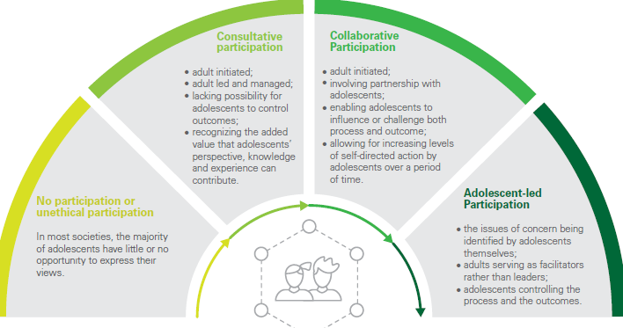
The Guidelines
Meaningful participation (1/2)
Enables young people to:
acquire knowledge and skills
build competencies
extend aspirations and gain confidence
Promotes:
youth’s capacity for civic engagement
collective organisation
tolerance and respect for others
Modes of participation
Notes:
Can be found on p.12 of the guidelines

Slide 12
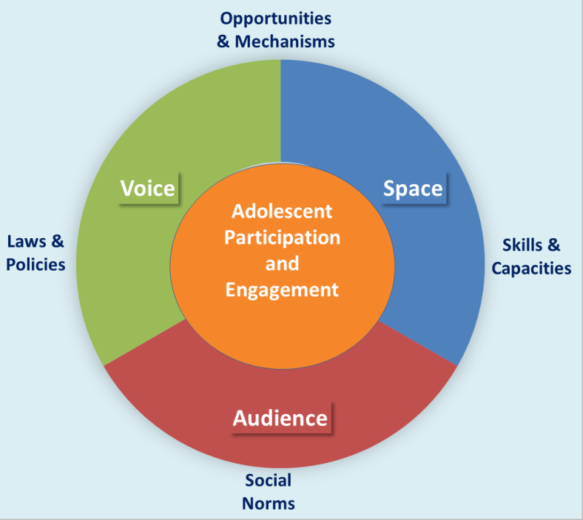
The Guidelines
Meaningful participation (2/2) – key features required
Notes:
Can be found on p.13 of the guidelines. Here explain the 4 key features that enable meaningful participation

Slide 13
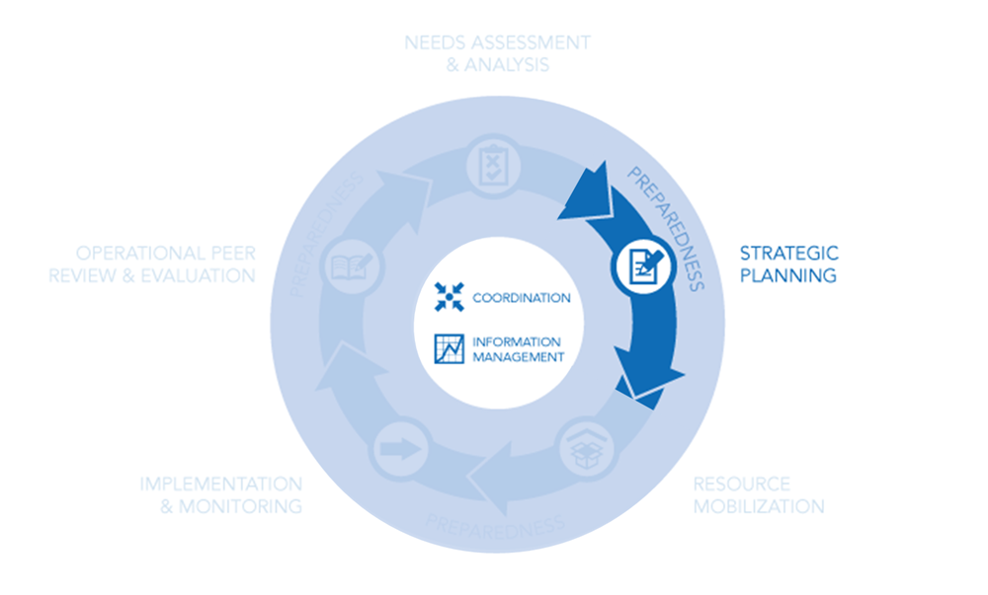
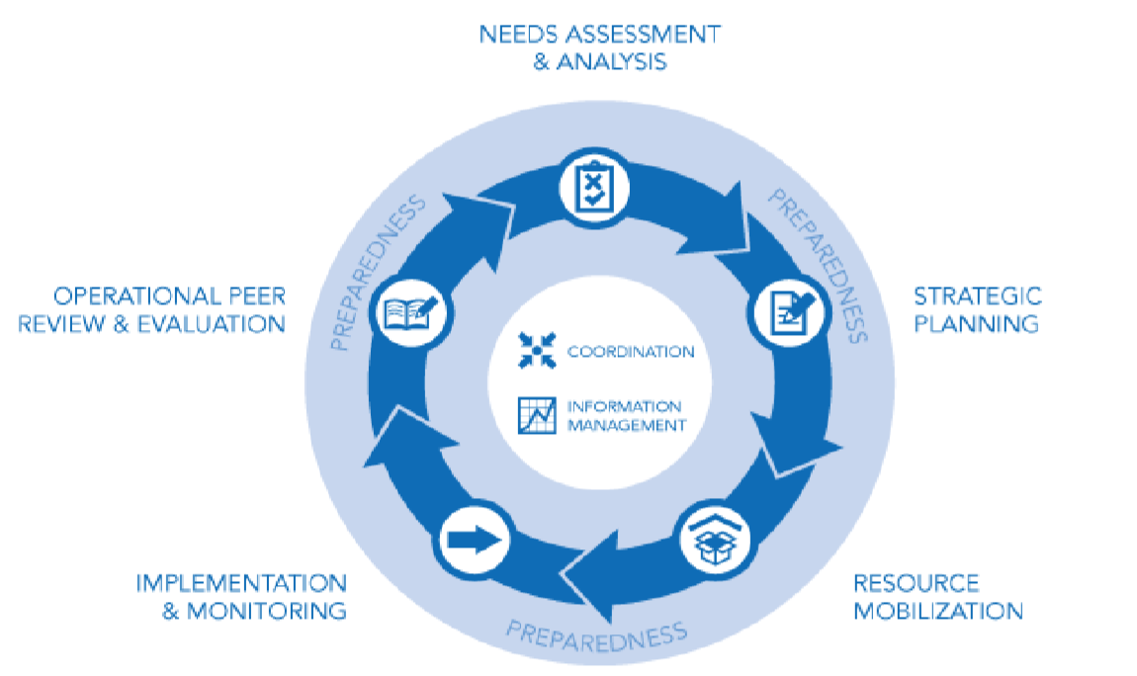
The Guidelines
Adolescents & Youth across the Humanitarian Programme Cycle
Guidance, checklists and examples for participatory programming across all phases of the cycle:
“Nothing about us, without us”
Notes:
a) First image depicts the logical cycle of the Humanitarian Programme Cycle (from needs assessment and analysis to operational peer review and evaluation. NOTE: “Implementation” as seen in “implementation and monitoring” is dealth with in Section E.) then b) the second image zooms in to cross-cutting elements such coordination; information management and preparedness overall.

Slide 14
The Guidelines
Participatory programming with and for Young People
Example: i. Needs Assessment and Analysis
Brief description:
include young people’s needs and interests
meaningfully engage young people
collect sex and age disaggregated data
ensure appropriate training in skills for safely engaging young people including child safeguarding and confidentiality
Assessment tip sheet / questions
What sources of disaggregated data exist on the demographic profile of the community?
What are the existing local structures for young people (e.g. youth organisations, clubs)?
Tools: participatory appraisal tool
Case study

Slide 15
The Guidelines
Sector-specific entry points
Notes:
This section is organised by including key priorities, indicators and resources with and for young people across the various clusters/sectors and areas of responsibility (AoR). However, the need to ensure linkages within and across clusters/sectors and AoRs cannot be emphasized enough. For instance, Livelihoods and education have many crucial linkages that must be fostered. Similarly, education and child protection sectors acting together, creates a virtuous cycle for crisis-affected adolescents. GBV principles and considerations are essential to youth outcomes in nutrition, shelter and all other sectors.

Slide 16
The Guidelines
Implementation: Young People Responsive Programming
Programming tips by sector
Camp Coordination & Camp Management Education Livelihoods & Economy Strengthening Health Nutrition | WASH Protection Shelter, Settlement & Recovery Peacebuilding & Social Cohesion Emergency Telecommunications Housing, Land & Property (HLP) Sustaining Peace
Notes:
Section E responds to “Implementation” within the HPC as explained in the notes of Slide 9.
This section focuses on sector-specific guidance, but has included consultations with colleagues working on HLP and sustaining peace (as seen in green)

Slide 17
The Guidelines
Young People Responsive Programming
Example: Livelihoods
Assessment questions
How are young people currently / previously engaged in livelihoods?
Has a youth labour market assessment been conducted?
What livelihood/economic strengthening programmes and resources are available to young people? To what extent are they aware of these?
Are they eligible for any available cash-based interventions?
How do existing livelihood programmes connect with technical (ICT, language), vocational (trade) training and youth organisations?
Priority Actions
Provide business management and entrepreneurship training, business capital and mentorship.
Identify livelihood opportunities linked to training and skills development in other sectors
Manage young people’s expectations around technical and vocational education and training (TVET), which usually leads to sustained employment only for a small minority but can have important psychosocial benefits.
Notes:
Please feel free to choose another sector example

Slide 18
The Guidelines
Young People Responsive Programming
Example: Livelihoods
Key indicators
% of youth observed using cash for business purpose at the end of the programme
# of youth receiving cash for business start-up
Evidence of holistic programmes designs linking education, trainings, skills and employment, social empowerment, attitude and behaviour change programming.
Tips and resources
Youth-led Labor Market Assessment Tool, Mercy Corps
Youth Labor Market Assessment Manual, Save the Children
Good Practices in Adolescent and Youth Programming, UN Inter-Agency Technical Task Team on Young People
CLARA: Cohort Livelihoods and Risk Analysis, USAID/WRC (English, Arabic, French)
Demand-Driven Training for Youth Employment Toolkit, Making Cents International
Case Study
Notes:
Case Study:
Livelihoods and Protection in Northeastern Nigeria: Mercy Corps
An escalation of violence in 2014 resulted in mass displacement throughout northeastern Nigeria due to military operations, Boko Haram activities, return of Nigerians from neighbouring countries, and communal clashes. To improve the safety, livelihoods, and personal agency of displaced adolescent girls and boys, Mercy Corps introduced a mix of life skills, reproductive health and psychosocial support, financial literacy, access to savings and loans, livelihood skills, and vocational training. The programme built some of its safe spaces upon existing meetings that girls were already holding in the community. Because girls’ movement outside of the home was extremely limited, girls played a critical role in helping identify their hard-to-reach peers to participate. Committees of parents, local leaders, school officials, teachers and youth became advocates for the programme and educated parents about the programme’s goals. Mercy Corps adapted to meet the specific needs of younger adolescents with the use of pictures, role-playing and storytelling. Older adolescents facilitated lessons with younger children, creating a cascading leadership model.

Slide 19
Next steps
Operationalising the Guidelines
Consolidation feedback round 2 (April 2019)
Soft launch: Women Deliver (June 2019)
Official launch: ECOSOC HAS (JUNE 2019)
Operationalisation of the Guidelines & joint monitoring
Notes:
Consultant now working on joint monitoring tool

Slide 20
Roll-out
Minimum suggestion for all agencies (Compact membership)
A
Each organisation responsible for roll-out within own country programmes
B
Inter-agency roll-out through select Clusters/Working Groups and/or priority countries at inter-agency level
All
Joint monitoring of use of the guidelines
Consolidation of learning/monitoring
Notes:
OPTIONS:
Each organiSation is responsible for roll out within its own country programmes
This will be the minimum ASK from all COMPACT members
Monitor all agencies/partners plan to create awareness internally within their organisations.
inter agency ROLL OUT THROUGH SELECT CLUSTERS AND/OR PRIORITY COUNTRIES at the inter agency level
More coordinated, could take time given multiple partners/clusters/sectors involved.
All to work simultaneously (via clusters to see how best to roll out through specific clusters/sub-clusters), MENA region is eager to roll out (inter-agency roll out can be planned through regional and select country trainings, for which we would need also envisage developing a standard training package)
Core management team of Task Force 1 has a roll in monitoring the roll out
Joint fundraising efforts may be needed trainings in countries, facilitating youth participation, funds to youth organisations to roll out guidelines, funds for design, translations, uploading on COMPACT website + IASC websites).
It would benefit to have a global coordination team including an implementation support team

Slide 21
Need Support?
Contact us if you need more information, wish for us to conduct a presentation for your team, agency or sector or for any additional form of support:
Emma Bonar: emma.bonar@nrc.no
Leana Islam: lislam@unfpa.org

Slide 22
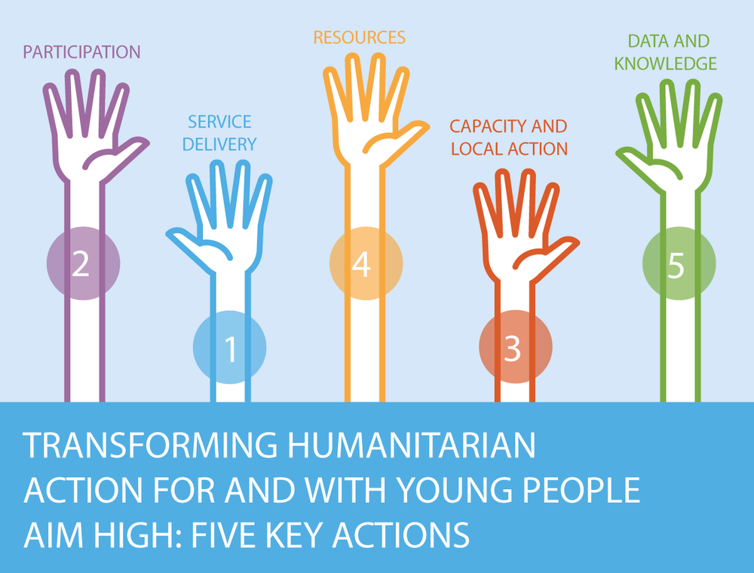
Stay in touch!
pmarwah@unicef.org
sophia.kousiakis@nrc.no

