Slide 1
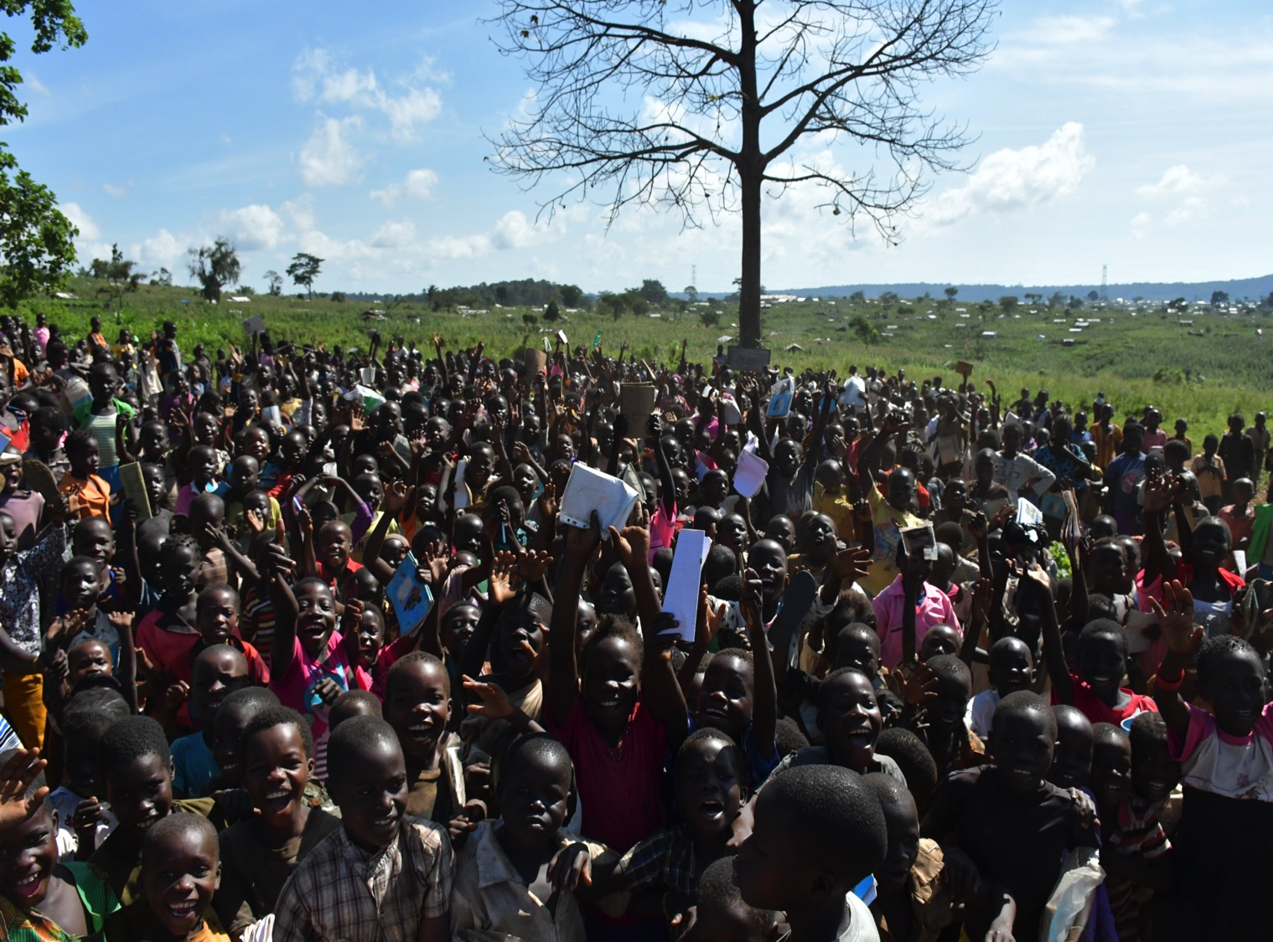
Inter-Agency Coordination Meeting
3 May 2019, Kampala
Situation update
Vulnerability and Essential Needs Assessment (VENA)
Health & Nutrition Sector Update
CRRF update
ActivityInfo RRP response monitoring – status and next steps
AOB

Slide 2
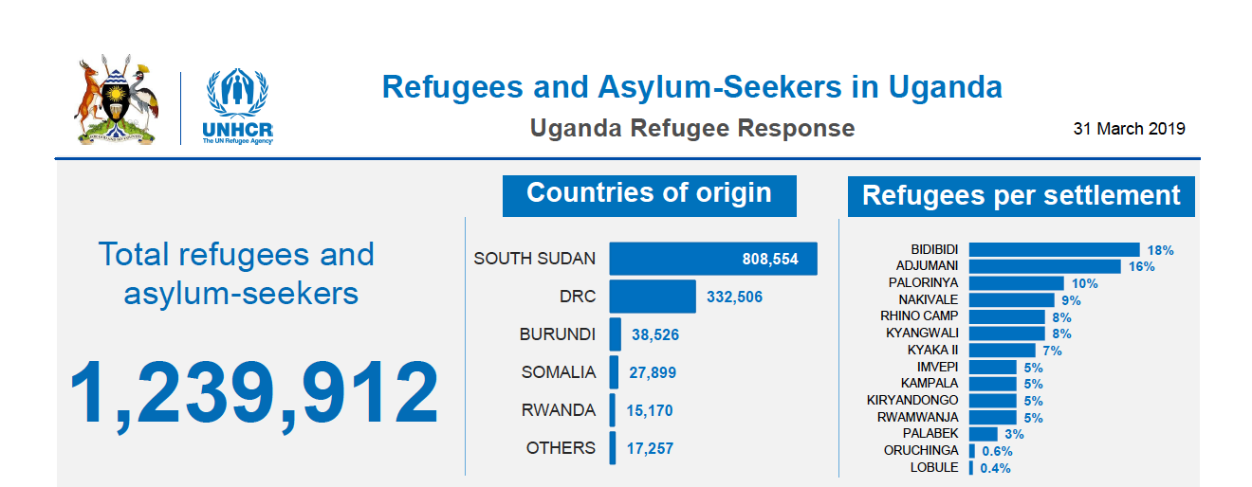
Refugee population, March 2019 | Source: OPM proGres
Notes:
Riek Machar has requested an extension of the pre-transitional period by six months until security arrangements are in place: cantonment of armed groups, unification of the army and the number of regional states

Slide 3
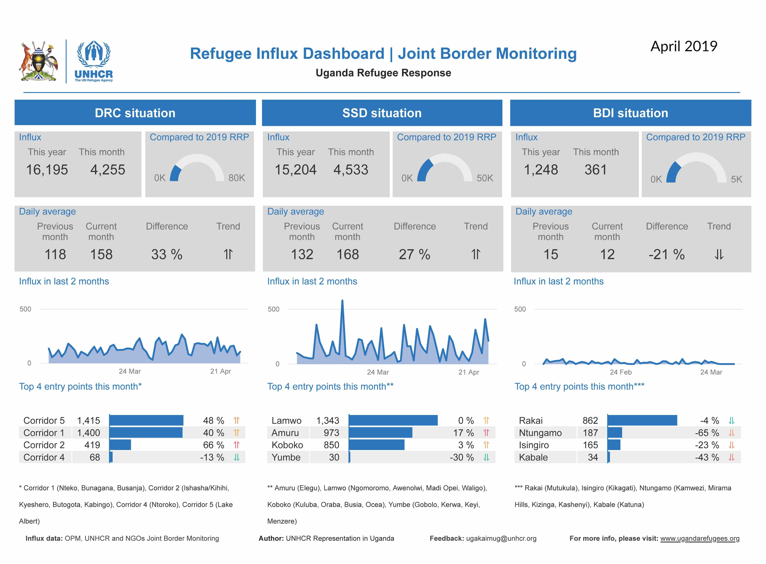
Notes:
Riek Machar has requested an extension of the pre-transitional period by six months until security arrangements are in place: cantonment of armed groups, unification of the army and the number of regional states

Slide 4
South Sudan – Key developments
Under the terms of R-ARCSS, a transitional government of national unity is to be formed by 12 May, but delays are very likely:
  Riek Machar has requested an extension of the pre-transitional period by six months until security arrangements are in place
  President Kiir rejected the request
  Ceasefire monitoring and verification mechanisms remain weak:
IGAD sought to organize a meeting in Addis Ababa on 2-3 May to mediate disagreement over government formation, but President Kiir has declined to meet with Machar and opposition representatives.
According to political analysts, cantonment of forced may lead to displacement of rural communities and violence
According to the Famine Early Warning Systems Network, an estimated 7.7 million people will be in need of food assistance during the May-July/August peak of the lean season, and the population in Catastrophe (IPC Phase 5) is also expected to increase.
UNHCR Position on returns to South Sudan - Update II, published on 17 April 2019, stating that “sustainable conditions are not in place for the safe and dignified return of refugees and IDPs in South Sudan.”

Slide 5
Democratic Republic of the Congo – Key developments
1,367 Ebola cases (1,301 confirmed and 66 probable) as of 23 April according to WHO, including 885 deaths (fatality rate: 65%). Since 24 March, there are additional 351 cases and 251 deaths. Fatality rate increased by 3% compared to the previous month.
On 9 April alone, 18 new EVD cases were confirmed: the highest single day figure since the outbreak. According to IFRC, “Ebola is now spreading faster, and many people are no longer seeking care.”
On 19 April, armed groups stormed the Butembo University Hospital where a Ebola response coordination meeting was being held, killing a WHO doctor. Later the same day, armed actors tried to burn down an Ebola treatment centre in Katwa.
On 18 and 19 April, thousands of people were displaced from Bovata, Kanyimbe and Kamango to Nobili in Beni territory, following an attack on a military camp in Bovata on 16 April. Islamic State claimed responsibility for the attack. Some 7,000 people were reportedly stranded at a school in Nobili. OCHA/UNHCR DRC mission to Nobili via Uganda planned in the week of 6 May.
On 29 April, opposition leader Martin Fayulu called on Congolese people to drive President Tshisekedi from power, branding the December’s presidential election results as a “stich-up between Tshisekedi and the outgoing president Kabila.”
Since Tshisekedi was sworn is as the new President of the DRC on 24 January, a new government has not been formed yet . Tshisekedi is largely working with Kabila’s former ministers or intermediaries. Kabila’s Common Front for Congo (FCC) coalition has comfortable majorities in both houses of parliament as well as provincial assemblies. Kabila supporters recently swept gubernatorial elections.

Slide 6
Key Developments – Refugee Response in Uganda
Joint Review of Food Assistance Collection Procedures
→ Secondary data review, perception survey, and primary data collection in all settlements complete
→ Draft report ready, consultations on priority follow-up actions ongoing between WFP and UNHCR
→ Next steps: Validation meetings with partners (May); draft report shared; implementation of follow-up actions
World Bank provided $150 million grant to support host communities and refugees in Uganda (IDA 18 Refugee Sub Window)
Return Intention survey is ongoing among South Sudanese refugees, with 820 households interviewed so far in Adjumani and Lamwo. Another 215 households will be interviewed in the week of 8 May. Preliminary findings indicate that the refugees are unwilling to return to South Sudan.
RRP revision complete; launch of revised 2019-2020 Refugee Response Plan scheduled for 28 May 2019
The update of the Contingency Plan for influxes from South Sudan remains an open action point and will be prioritised over the coming month
Financial inclusion (bank accounts for refugees): Oruchinga and Imvepi are complete; WFP pilot with Equity Bank in Nakivale; Joint WFP-UNHCR Action Plan finalised shortly

Slide 8
Forced displacement in DRC North Kivu province
Possible mass influx
UNHCR and partners remains in contact with authorities and partners in DRC concerning reports of DRC IDPs stranded at Nobili, 1 km west of Bundibugyo on the Ugandan border with DRC.
OCHA/UNHCR DRC mission to Nobili scheduled next week, via Uganda
Current planning parametres:
Possible influx of up to 20,000 refugees via Bundibugyo
Transit centre in Bundibugyo operational, current capacity about 1,000 individuals
Initial receiving settlement: Kyaka II (up to 9,000 max. capacity)
Once Kyaka is full, Rubondu and Juru zones in Nakivale settlement (up to 15,000 max. capacity) .
As the preparedness for reception in Nakivale is low, and UNHCR currently does not have sufficient funding to construct a new reception centre in Nakivale, possibly reception in Rwamwanja (in proximity, and existing reception facilities, 30,000 max capacity)

Slide 9
Preparedness – DRC refugee influx at Bundibugyo
Operational preparedness
Operational planning takes place at Mbarara level (contact UNHCR head of Sub-Office Mahamadou Guindo; guindo@unhcr.org)
First preparedness coordination meeting took place in Mbarara on 29 April 2019;
Response matrix under development (for 20,000 arrivals)
  UNHCR internal operational planning for reception of 5,000 individuals at Bundibugyo under way
Call for emergency response offers (by operational partners with own funding) at Bundibugyo, Nakivale and possibly Rwamanja if required.
Please indicate your response offer to Mahamadou Guindo, Rocco Nuri and Jens Hesemann latest by Wednesday, 8 May 2019 specifying:
For which sector
How many people you can assist and /or amount of funding available
How long your engagement can be sustained with existing funding

Slide 10
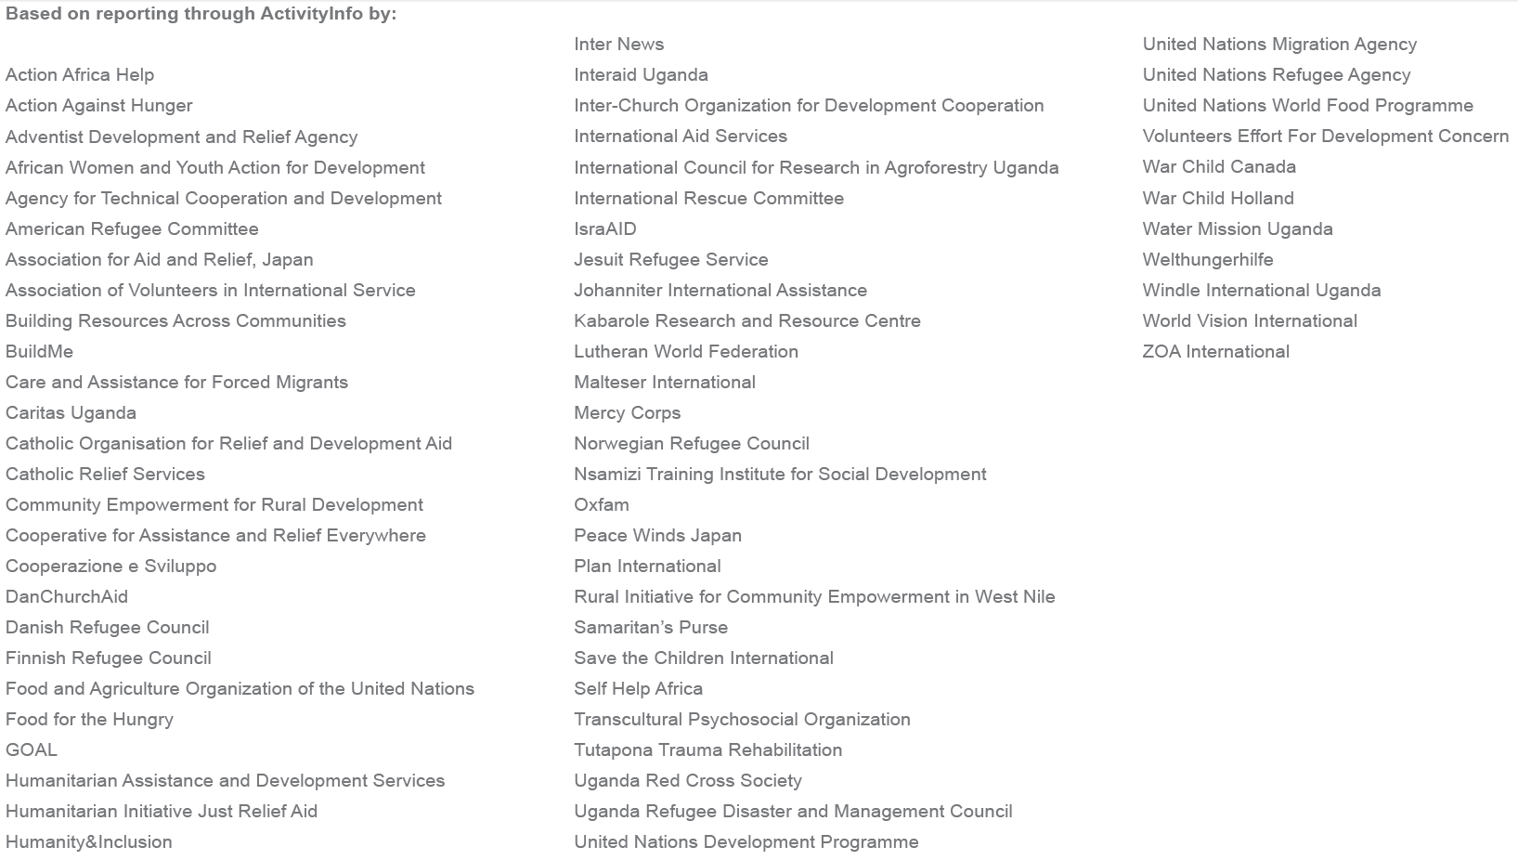
ActivityInfo RRP response monitoring – status and next steps

Slide 11
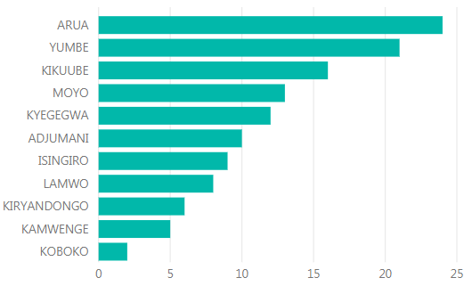
ActivityInfo RRP response monitoring – status and next steps
Q1 timeline:
Partner reporting: 3 – 18 April (12 working days, normally 1 week)
Sector-lead clearance: 24 April – 2 May (6 working days)
Product development: 24 April – 10 May (12 working days, normally 1 week)
Product clearance: 13-17 May (5 working days)
Dissemination: 20 May
Number of partners reporting (67 in total) broken down by sector and district

Slide 12
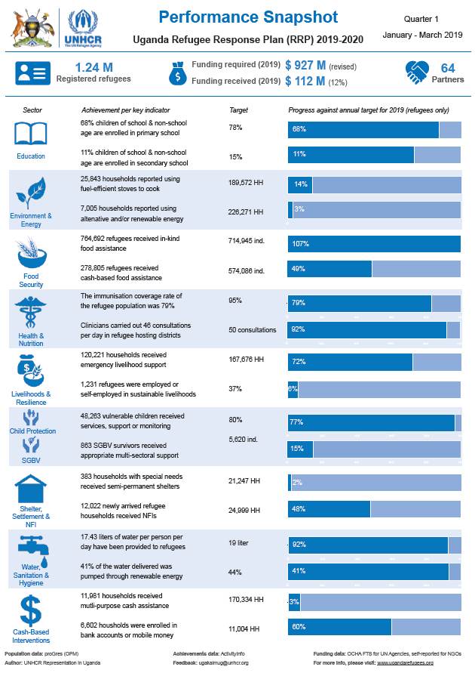
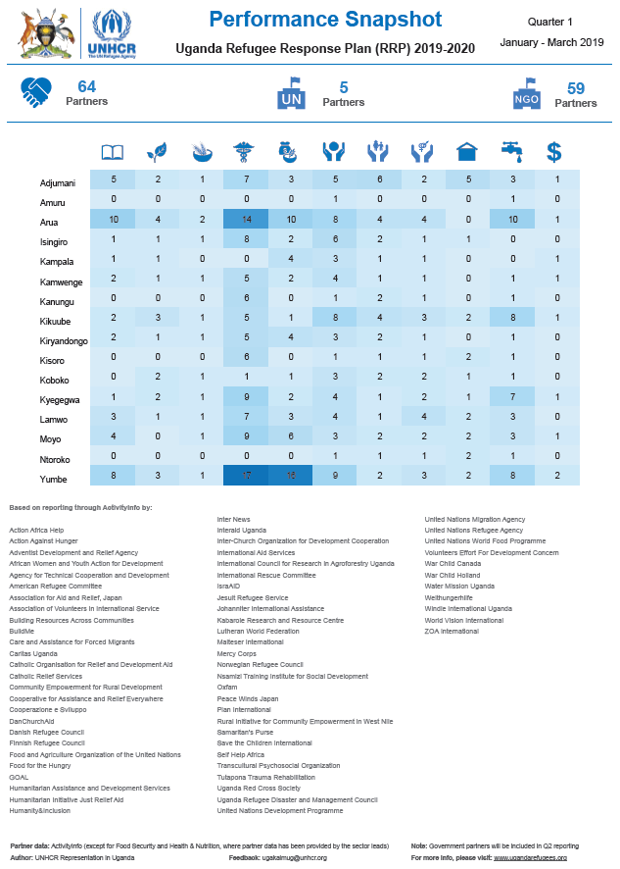
ActivityInfo RRP response monitoring – status and next steps
Products:
  3-page “Performance Snapshot” with key figures for the response, achievements against key indicators and operational presence for all sectors.
  3-page “Sector Overview” per sector with short narrative, all indicators as well as sector-specific operational presence.

Slide 13

ActivityInfo RRP response monitoring – status and next steps
Upcoming deadlines
  April reporting: 3 May (for Protection/CP/SGBV/SSNFI/E&E/WASH)
  Term 1: 10 May (for Education)
  May reporting: 7 June (for Protection/CP/SGBV/SSNFI/E&E/WASH)
  June / Q2 reporting: 5 July (All sectors – feeds into RRP Mid-Year Report)
Next steps:
  Feedback session for partners and sector leads in May/June
  Train government partners (DLGs)
  Simplified reporting for cash-for-work activities

