Slide 1
Update on Contingency Plans
The draft of the Contingency plan for DRC is shared with OPM for their inputs;
Draft 1 of the South Sudan Contingency plan is ready and will be shared soon with OPM;
Draft 0 of the contingency plan for the Burundi situation is almost complete and may be shared next week.

Slide 2
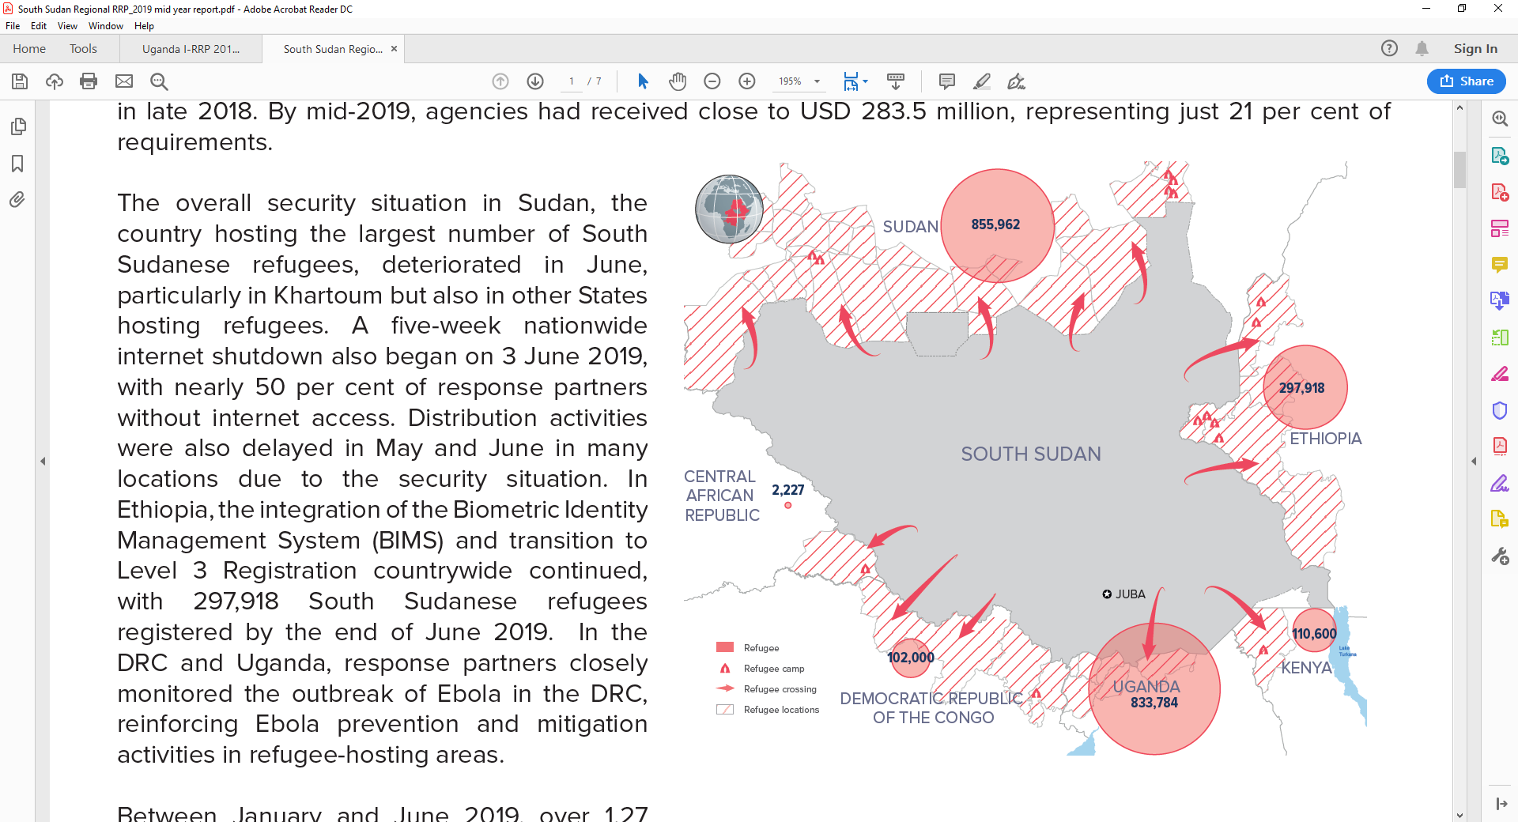
SOUTH SUDAN - Regional RRP 2019 Mid Year Report
January - June 2019

Slide 3
In the 6th year of response
Key figures
Uganda, DRC, Ethiopia, Kenya, Sudan continue to host 2.2 million South Sudanese refugees
95 partners requesting USD 1.4 billion to meet live-saving and resilience needs
56,297 new refugees from South Sudan fled in the first half of 2019, average of approximately 9,380 new arrivals per month compared to 8,900 monthly arrivals across 2018
USD 283.5 million received representing just 21% of the requirements

Slide 4
Achievements
over 1.27million received food assistance
11.500 refugee children were delivered with the assistance of qualified personnel
322,000 children attended early childhood development, primary & secondary schools
All 5 CoA advanced in the application of the CRRF (integration into national & local development plans, health & education)
Challenges
50% of UAM/SC reported to be in appropriate intern or long-term care
Access to safe drinking dropped in DRC, Ethiopia & Uganda
Refugees did not regularly receive the standard amount of soap in the 5 countries
Inadequate funding for livelihoods & security activities (the majority of refugee depend heavily on humanitarian assistance)

Slide 5
Regional intention survey (May 2019)
Surveyed: 6,964 in CAR, the DRC, Ethiopia, Kenya, Sudan and Uganda
42% do not plan to return to South Sudan.
38% plan to return
3% to return immediately
1% in the next 3 months
3% in the next 6-18 months
31% to return but undecided/unsure when to do so
20% undecided

Slide 6
Thank you
Merci

