Slide 1
MHPSS KAPS SURVEY
KYAKA II

Slide 2
Background
Survey Objectives
To establish the knowledge, attitudes, and practices of persons of concern in Kyaaka II and neighbouring communities in relation to MHPSS services.
Specific Objectives
To establish the numerous causes of psychosocial problems with in the settlement.
Establish capacity gaps in the service delivery of mental health services in Kyaka.
Assess available opportunities for capacity building.
To find out the prevalence of symptoms of mental illness and the coping mechanisms
Approach: Both qualitative and Quantitative.
Tools: Adapted from WHO/UNHCR, (2012) MHPSS Assessment Guide
Notes:
“Assessing Mental Health and Psychosocial Needs and Resources: Toolkit for Major Humanitarian Crises.”

Slide 3
Background Continued
Sampled 05 villages (Mukondo, Sweswe, Bukere, Koborogota and Itambabiniga)
515 Total complete responses
Survey Monkey: Created on Monday, May 06, 2019
Data Collection
Pilot done in Bujubuli
All five data collectors were residents of the settlement.

Slide 4
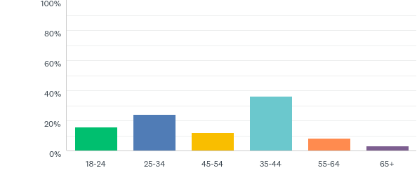
Age range

Slide 5
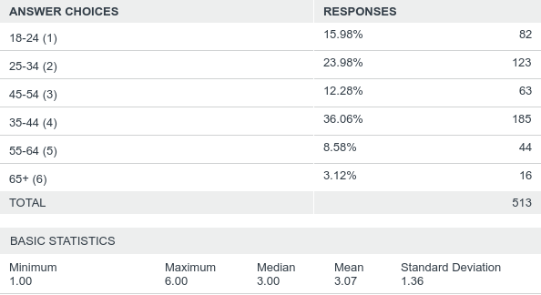
Age range broken down

Slide 6
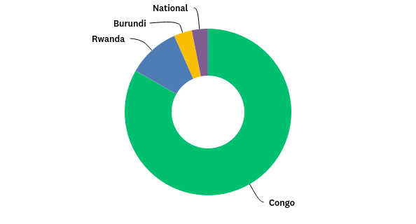
Country of Origin

Slide 7
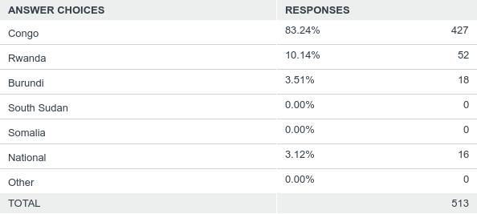
Country of Origin-Disaggregated

Slide 8
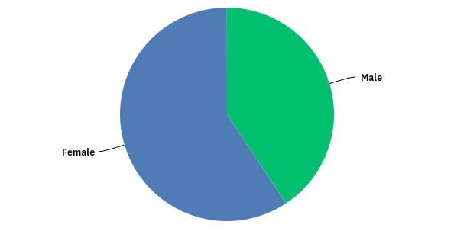
Gender

Slide 9
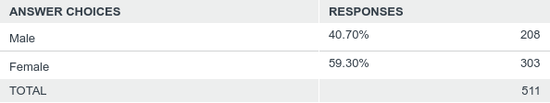
Gender disaggregated

Slide 10
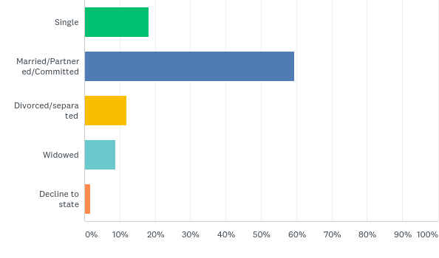
Current Relationship Status

Slide 11
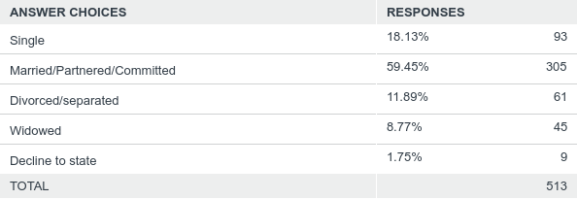
Current Relationship Status Disaggregated

Slide 12
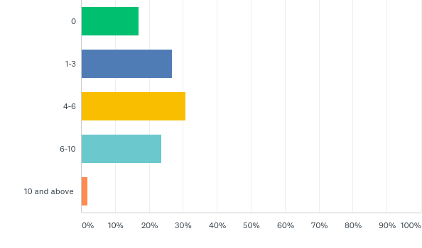
Number of children in house hold

Slide 13
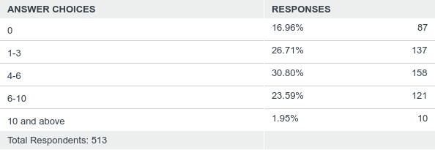
No of children disaggregated

Slide 14
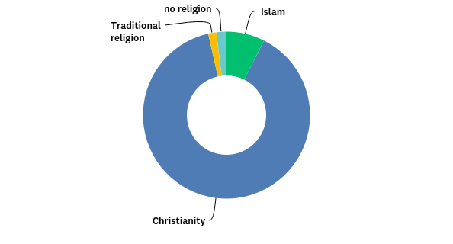
Religion

Slide 15
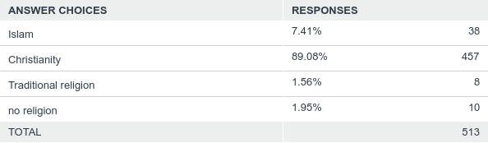
Religion disaggregated

Slide 16
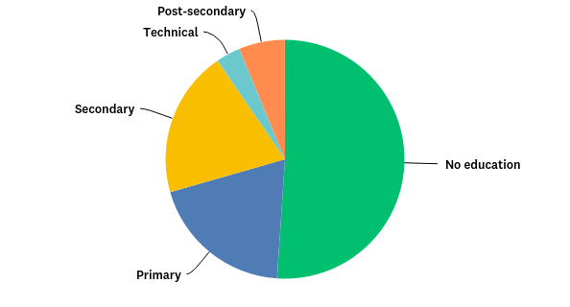
Level of education

Slide 17
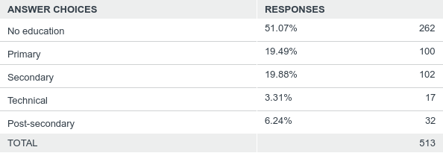
Level of Education disaggregated

Slide 18
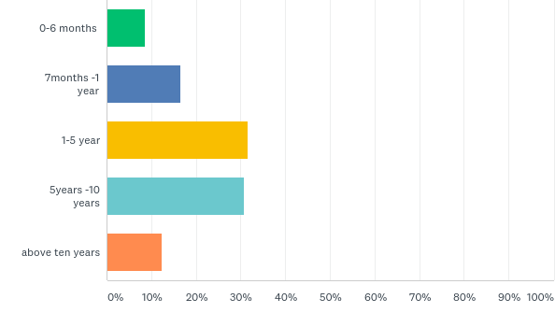
How long have you stayed in Kyaaka II?

Slide 19
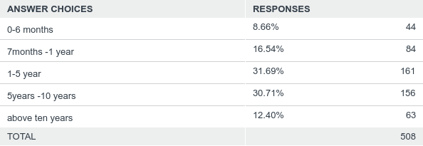
How long have you been in Kyaaka II?

Slide 20
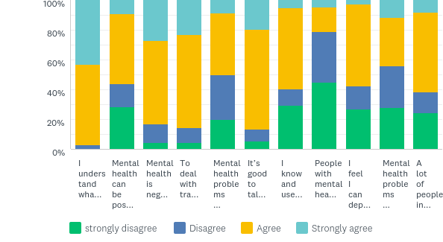
I will read some statements about mental health that you may agree or disagree with .Please tell me if you Agree , strongly agree ,disagree or strongly disagree

Slide 21
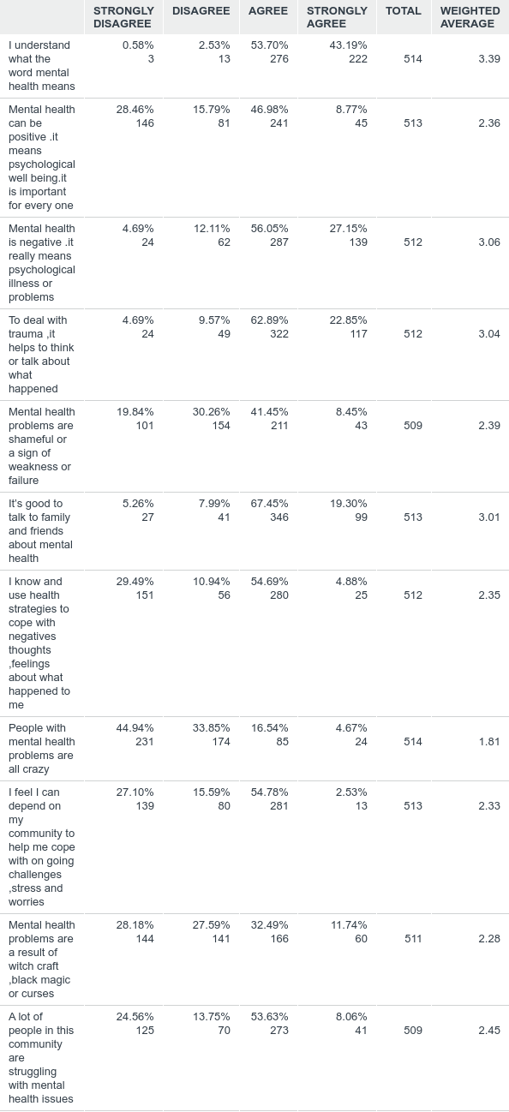
I will read some statements about mental health that you may agree or disagree with. Please tell me if you Agree , strongly agree ,disagree or strongly disagree

Slide 22
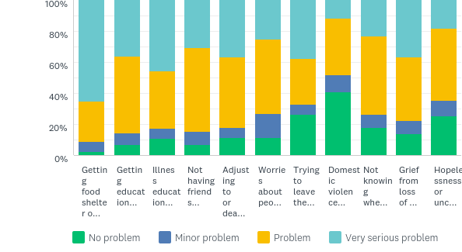
How difficult is this in your life right now?

Slide 23
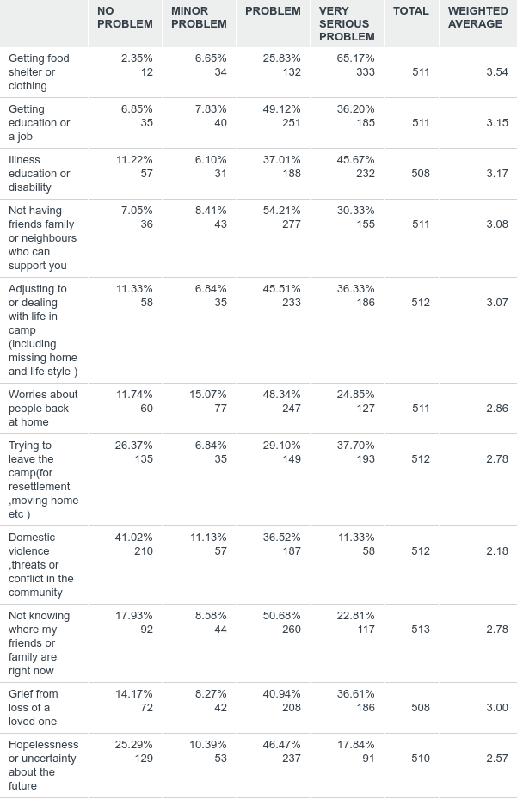
How difficult is this in your life right now?

Slide 24
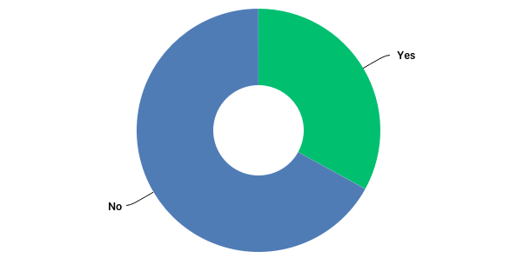
Is there something else that I have not mentioned that causes you most stress right now?

Slide 25
Other causes of stress
“I lost my husband from Congo that is why I am having Sleeplessness nights. I don't have an appetite; I lack work that causes me to think more about my life. I am almost like a mad person. I am seeing images that nobody else is not seeing.”
“The most problems are about living with hopelessness and children are not studying.”
“The most problem is my health; I don't get good treatment. If you go to the hospital they tell you that you're looking for resettlement, we are not on the good condition of life.”
“What makes me think more is I cannot go back to Congo and I can't get out of this place. It is very stressing.”
“My problem is about when going to the office of resettlement I never got service.”

Slide 26
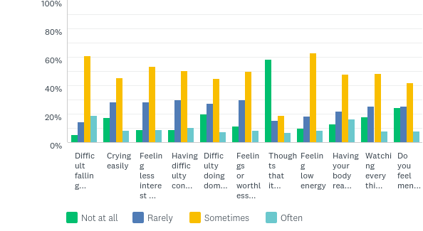
How much have these symptoms disturbed you in the last two weeks?

Slide 27
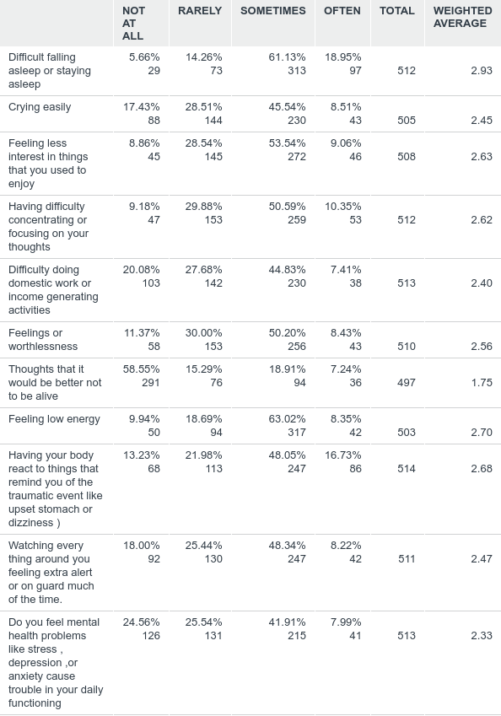
How much have these symptoms disturbed you in the last two weeks?

Slide 28
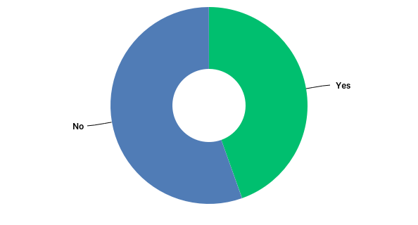
Do you experience chronic pain in your body?

Slide 29
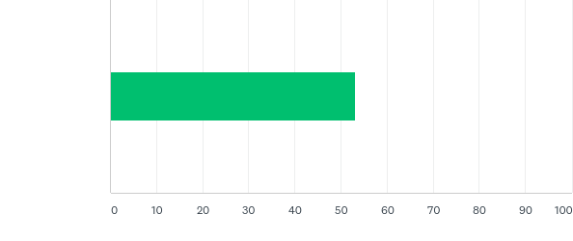
If yes on a scale of 0 to 10 where zero is no pain at all and 10 is the most pain possible, how much pain have you felt in the last week?

Slide 30
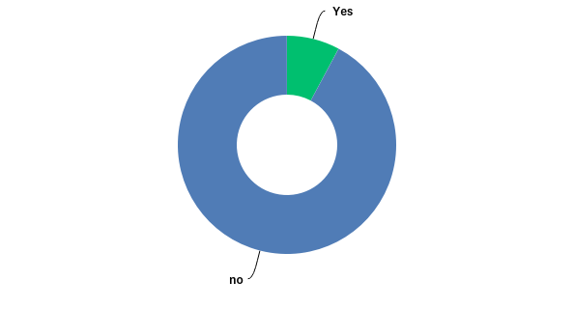
Have you ever had uncontrolled convulsions in your body that you can’t remember?

Slide 31
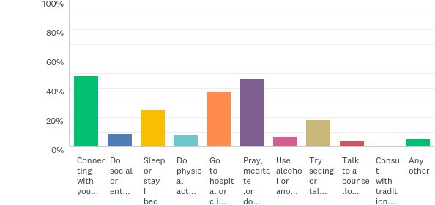
On a day where you felt very sad, anxious, or overwhelmed, what did you do to help yourself deal with these emotions? Am going to read a list of things you might do and you can tell me if you do them or don’t do them

Slide 32
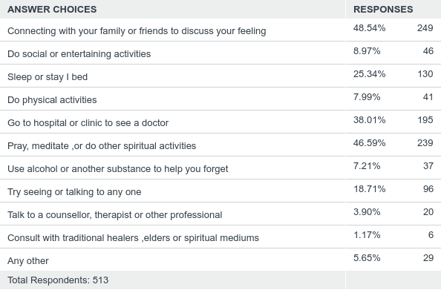
Coping strategies continued….

Slide 33
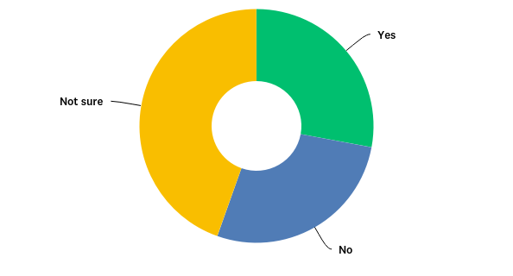
Do you feel symptoms of mental health problems like stress , depression ,or anxiety cause trouble in your daily functioning?

Slide 34
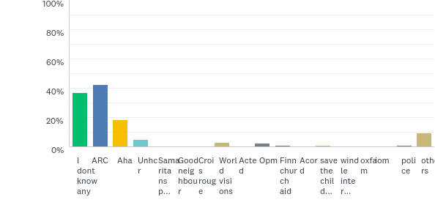
Which organisation or agency can you go to receive mental health or psycho social support services in Kyaka II? (dont mention the organisations)

Slide 35
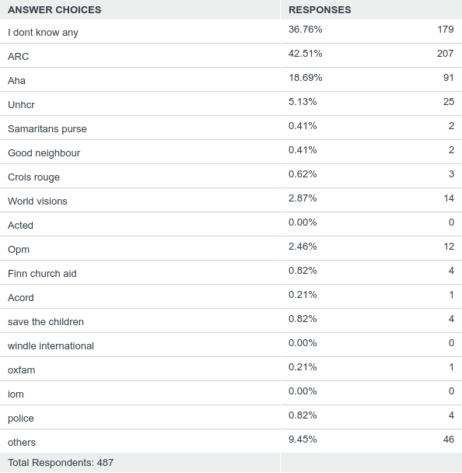

Slide 36
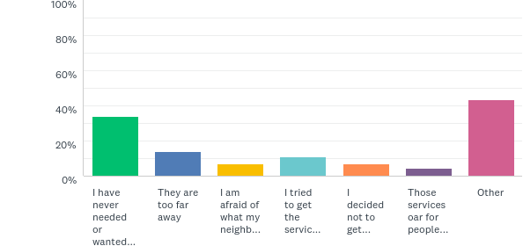
What are some of the reason why you don't access mental health services?

Slide 37
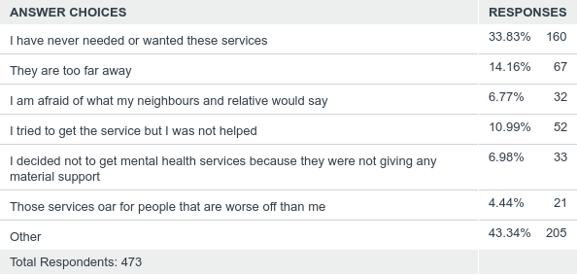
Reasons for not seeking services cont’d

Slide 38
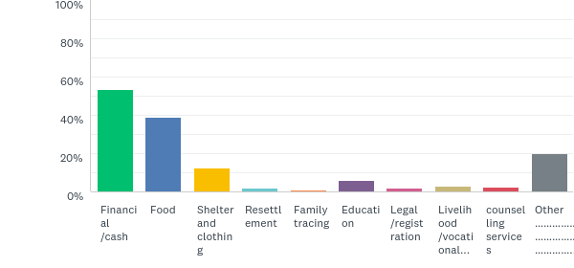
What kind of help have you received from NGOs or other service providers in the past month ? (don’t read)

Slide 39
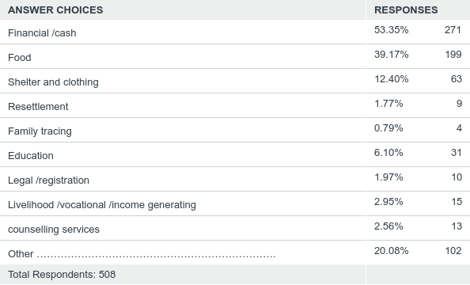
Services sought in past one month continued

Slide 40
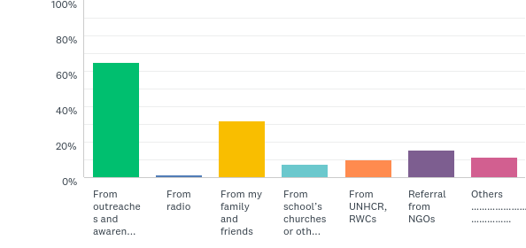
How do you get information about available services? (don’t read options select all that apply)

Slide 41
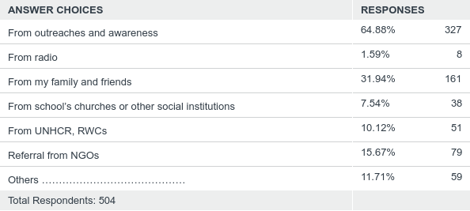
Information Sources cont’d

Slide 42
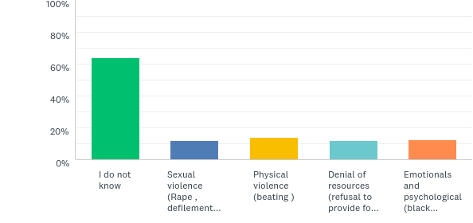
What are the different types of gender based violence that you aware of in your community ?

Slide 43
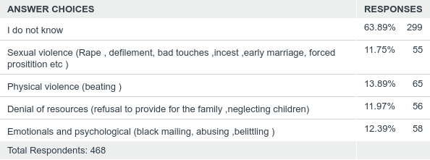
Known types of Gender Based Violence

Slide 44
Observations
Strengthen awareness on GBV related topics
Distant service points hindering service utilization
More awareness creation on how disabling mental health issues are.
Any that you have noted?

Slide 45
General Recommendations
Availing Psychological First Aid for communities especially new arrivals.
Partnerships with local and available structures like traditional healers, religious leaders
Linking GBV and MHPSS
Strengthening family ties and cohesion
Linking child protection and MHPSS
Strengthening referral pathway (new arrivals)
Mainstreaming MHPSS in other sectors

Slide 46
Recommendations cont’d
Medium for disseminating information-awareness sessions
Materials for IEC
Addressing the topic of “Resettlement”.
Trained personnel for MHPSS
Coordination amongst MHPSS partners
MHPSS in primary health care.
Demystify myths surrounding Epilepsy and convulsions
Strongly consider inclusion and participation of minority groups

Slide 47
ASANTE….!

