Slide 1
Empowered Aid
3rd technical advisory group (TAG) meeting
Kampala, Uganda
20 Nov 2019

Slide 2
Empowered Aid: Review
Phase 1
To better understand the ways in which distribution of material resources in emergencies may create or reinforce opportunities for sexual exploitation and abuse of women and girls.
Phase 2
To identify, prioritize, and test a range of options for improving current distribution mechanisms and modalities.
Phase 3
To disseminate, validate and replicate research findings in a third country, including networking and training led by women and girl refugee researchers, building on the participatory action approach.
Implementation science, pilot tests
Ethnographic fieldwork with refugee women and girls
Research uptake, dissemination, network-building
Notes:
Human-centered design
Important to work with young women practitioners – build capacity for research – now embedded in NGOs
Also TAG at national and global levels to build ownership of process and findings, and ensure we also learn from related initiatives

Slide 3
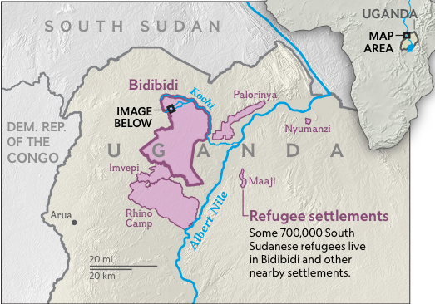
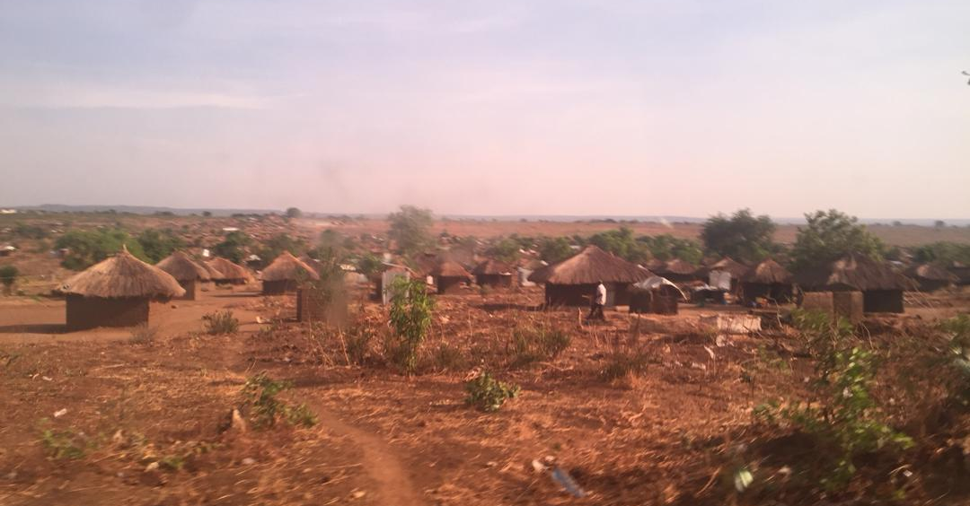
uganda Context
More than 1 million people from DRC & South Sudan since July 2016
Bidi Bidi & Imvepi: 287,399 pop, ~53% women & girls
“The negative use of power in relationships continues to be the main contributing factor to SGBV in the settlements and host communities. Other drivers of the violence include scarcity of fuel and natural resources increasing risks of attacks, limited livelihood opportunities, poverty and conflict among others.”
– UNHCR Monthly SGBV Update, May 2019
Map Source:
National Geographic
Partners:
Notes:
In Uganda hosts South Sudanese refugees in some of the largest camps in the world. These are in very rural contexts, in which refuges are living among host communities.

Slide 4
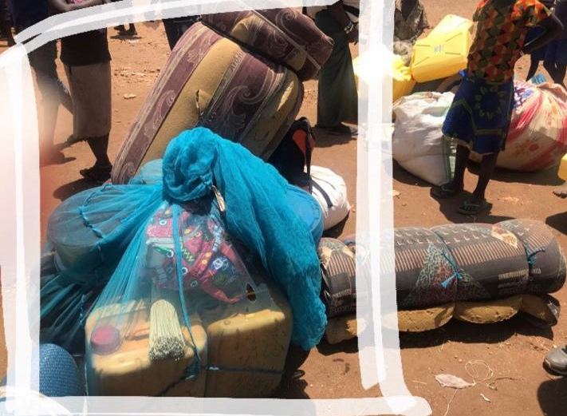
Clockwise from top left:
New arrivals to the camp; items they receive before being transferred to other areas of the settlement; food & NFI distribution point
Notes:
These show some of the distribution sites in the camp: above and to the right are new arrivals being given a set of items to start their lives in Uganda, and moved in trucks to other areas of the camp.
Bottom left is a food distribution point.

Slide 5
Data collection
Semi-Structured Qualitative Interviews (QI) with Women and Girls
Participatory Group Discussion (PGD) – Women and Girls
PGDs and Key Informant Interviews (KIIs) – Community members & humanitarian stakeholders
Food
Water & Sanitation
Fuel & Firewood
Shelter
Cash
Notes:
These are the main methods used in the first phase of the project: semi-structured qualitative interviews, participatory group discussions, and key informant interviews.
In the workshops, women and girls in Uganda and Lebanon selected 4 types of aid to focus on. The ones in lighter pink – food, shelter, WASH -- are the same in both countries. In Lebanon, they are focusing on cash. In Uganda, it’s fuel & firewood.
For reasons of safety and literacy, women and girls do not write down their observations. Instead, we met with them about every two weeks to record their observations orally.
--
Overall, we met with the core group of women and girls 10 times over a 6 month period, sometimes in age-segregated groups (i.e. women separately from girls) and sometimes one-on-one.
First to talk about the project, and for the design workshop.
Once they started their ethnographic fieldwork, we met for small group discussions using exercises like free-listing and open-ended stories.
About every two weeks, we then met individually for semi-structured conversations to record their participant-observations around each type of aid.

Slide 6
Discussions with.. | Total | Method
Refugee Women & Girls (29) 16 Women, 13 Girls | 12 PGDs | Participatory Focus Group Discussions (PGDs)
 | 108 | Semi-Structured Narrative Interviews
Refugee men & boys; Host community women, men, girls and boys; Vulnerable groups | 18 PGDs (79 people) | Participatory Focus Group Discussions
Community Leaders & Humanitarian Personnel | 10 | Key Informant Interviews
 | 118 | People engaged
Notes:
Out of our core team of 26 women and girls in Lebanon, 5 either returned to Syria or left for school during the project period. In Uganda, out of the 29 women and girls, 3 returned to South Sudan during this period.
In total, we spoke with 195 people -- 69 in Lebanon and 126 in Uganda.
Overall, we held 278 individual or group discussions, which have all been analysed qualitatively.

Slide 7
Participatory data collection & analysis
Reflection
At mid-point of data collection, pause to reflect on process & power
Analysis
Qualitative analysis using Dedoose
Action Analysis Workshop
Participative analysis (visual methods), prioritize recommendations
Data Collection
Conducted over 3 months in two countries

Slide 8
Overview of Findings - SEA
SEA most frequently noted at distribution points and in relation to registration. Also occurs in relation to finding out about aid (info/communication), transit to/from sites (especially when carrying heavy or bulky aid, such as food, home), and safely storing aid.
SEA noted across all types of aid but most mentions in relation to food and shelter distributions.
Perpetration by aid actors as well as guards/security actors; drivers; other refugees & host community members.
Groups vulnerable to SEA included: elderly women; disabled women and girls; adolescent girls; women and girls who are alone/unaccompanied and lack familial support; those living in isolated locations.
Notes:
Preliminary findings include reports of sexual exploitation and abuse in registration and at distribution points when women and girls line up for food, shelter, fuel and firewood, or WASH aid;
at water and firewood collection points;
and when communicating who is or is not eligible for aid.
Vulnerable groups identified by the women and girls include elderly women, disabled women and girls, adolescent girls, women and girls who are alone/unaccompanied and lack familial support, and those living in isolated locations far from other refugees’ homes.
Transporting aid from distribution sites also opens space for sexual exploitation and abuse, as women and girls must carry heavy and bulky aid home, with boda boda drivers reported as perpetrating abuses.

Slide 9
Families & communities offer varying degrees of support to survivors. Refugee women and girls describe families assessing the extent to which they view survivors as responsible for their own exploitation, and this assessment guiding whether and how they pursue the issue further:
“If they are at home they first assess was it the will of this woman who accepted to have the relationship with that man or not and if it’s their agreement they just leave them and if it’s not the woman agreeing to that person and just wanted to use the woman then they will report the issue ahead.” - Qualitative interview with adolescent girl
Seeking help from informal supports or formal mechanisms is limited by lack of awareness, normalization of SEA, victim-blaming, and fear of losing aid, as well as confusion around actual role of perpetrator.

Slide 10
At times you find that we girls or women we find difficulties with the distributors. They come and tell that, ‘if you fall in love with me, I will add you more food, or for the cooking oil you will get a big share.’ So you end up… after they have realized the food is about to come, they move around corning girls or women, that, ‘if you really fall in love with me, I will add you food.’ So those are big challenges.
“She cannot tell anyone because she is using that as an opportunity for adding her food ration, so she will not tell anyone about her situation. Because if she tells anyone about her situation, this person will follow the person who is doing that to her, and the person may lose job which will make her also lose her addition of food ration.”
- Qualitative interview with adolescent girl
– PGD with host community boys
Notes:
Here are some of the things women and girls told us.
We also asked about how survivors are treated, from who and where they may seek help, and what happens to perpetrators. As one South Sudanese participant-researcher said, “Something should be done to the men who do bad things at distribution points, so that others learn.”
As one of the Syrian women told us: ““Sometimes, women accept because they’re in need. And sometimes they don’t. In both cases, it’s abusive.”
In each conversation, we asked for their observations and recommendations of how to make aid safer. These we prioritized during the Action Analysis Workshops, in which women and girls actively feed into meaning making processes.
Slide 5: Achievements
Main question/s:
What is part of this project/work will have the biggest impact on the sector and why?

Slide 11
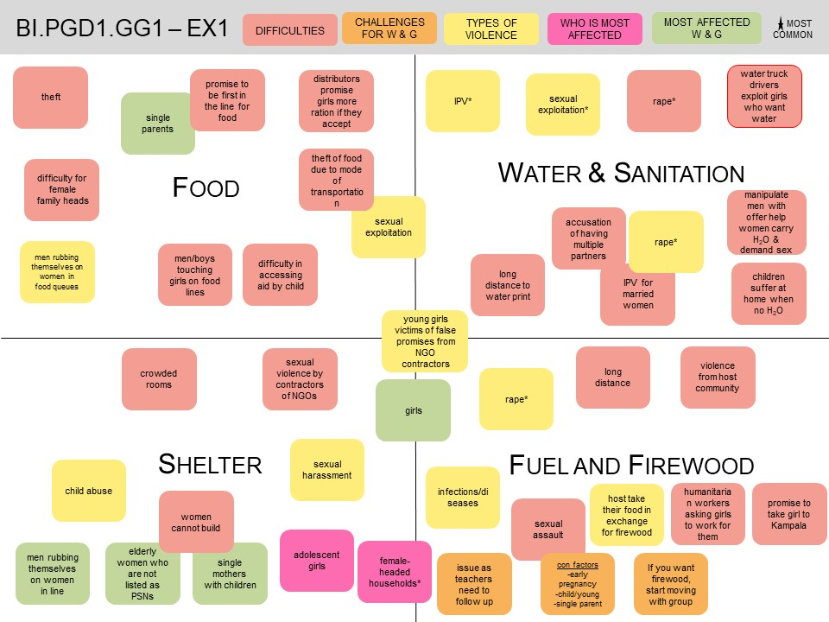
Example from one of the participatory group discussions with adolescent girls
(later diagrammed)

Slide 12
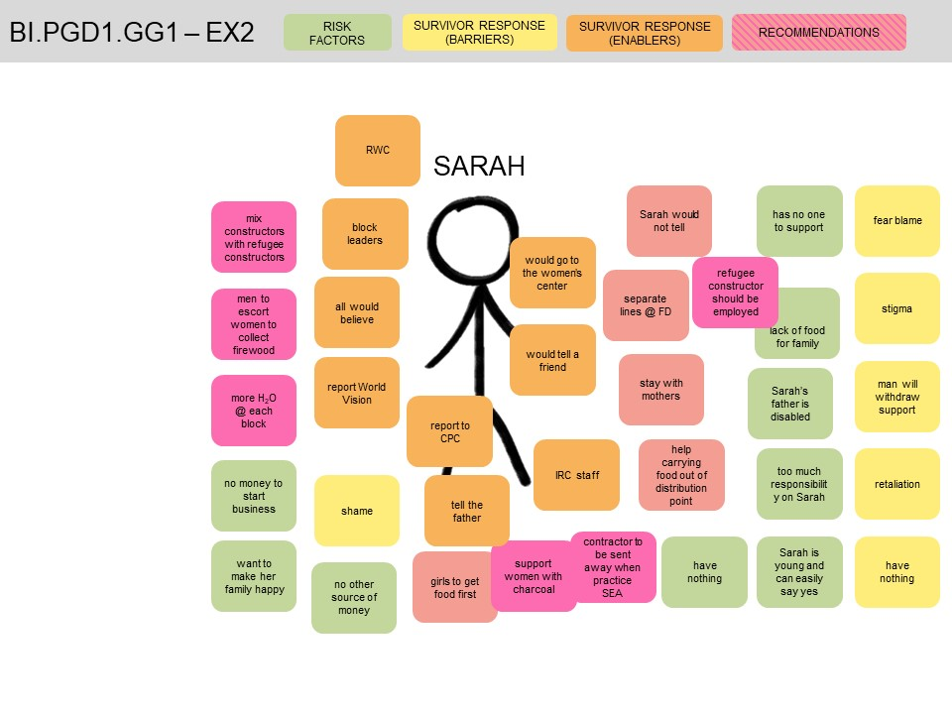
Example from same participatory group discussions with adolescent girls
(later diagrammed)

Slide 13
FINDINGS related to other forms of gbv
During distribution processes:
Sexual assault and harassment in lines while waiting for food distribution or at DP gates
Sexual violence perpetrated by host community when going to collect firewood or grass from the bush where perpetrators hide in bushy, isolated areas and attack women and girls when they go to collect firewood
Unsafe access to WASH aid
Assaulted or harassed in latrines / toilets / bathing shelters, particularly if not sex-segregated or lack doors/locks
Sexual violence when collecting water from boreholes at night; perpetrators can be host community or refugees
Sexual harassment when collecting sanitary materials and pads
In relation to shelter aid
Risk of sexual violence, especially at night, if structures are not well built and lack doors
Rape by men who help women and girls construct houses; unaccompanied/separated girls can be particularly vulnerable
Overcrowding in small homes leads to sexual violence between family members

Slide 14
Links to intimate partner violence
When wives sell food to pay for transport or other living costs; when husbands sell part food ration for their own benefit
Women blamed for taking too long to collect/transport water or sanitary materials
Perpetration
Perpetrators may be from refugee or host community; sometimes don’t know. IPV perpetrated by male spouses.
Family or community response
May blame and shame GBV survivors (her ‘fault’/‘choice’); stop her from reporting/accessing services, force her to leave home or marry the perpetrator. Others will support her to access services and/or justice.

Slide 15
“I also want to talk about the firewood. This is what I have seen and what I have heard. In our camp there is a group of girls who went to collect firewood in the bush. Then from there, there is a man who started chasing these girls. The man caught one girl and started strangle the girl, and raped the girl there.”
“At the food distribution, these men at times don’t line after the old women or the elderly women but if they see were the young girls have lined they go and line behind these young girls and they begin to rub themselves on these girls and sometimes others will be in front and they will squeeze their breasts.”
- Qualitative interview with adolescent girl
– PGD with host community boys
“They tell women to come in the morning …and they can come at 2 or in the evening and for the women they will be there waiting for this materials and after getting these things late, you still go back home, the husband will bark at you that you have not been for the distribution of these materials because if you were there you would have come back early but you delayed the whole day there so the husband will beat you that you have not been where those things are distributed.”
- Qualitative interview with woman participant
Notes:
Here are some of the things women and girls told us.
We also asked about how survivors are treated, from who and where they may seek help, and what happens to perpetrators. As one South Sudanese participant-researcher said, “Something should be done to the men who do bad things at distribution points, so that others learn.”
As one of the Syrian women told us: ““Sometimes, women accept because they’re in need. And sometimes they don’t. In both cases, it’s abusive.”
In each conversation, we asked for their observations and recommendations of how to make aid safer. These we prioritized during the Action Analysis Workshops, in which women and girls actively feed into meaning making processes.
Slide 5: Achievements
Main question/s:
What is part of this project/work will have the biggest impact on the sector and why?

Slide 16
Need for safeguarding the context
A distribution system that does not meet women and girls needs for fuel/firewood & shelter materials, as well as WASH & food items (for example, safe latrines) in safer ways inadvertently opens up this space for exploitation and abuse.
For example, by requiring them to negotiate access to host community land; travel long or isolated distances; ask men for help for things like digging latrines & constructing shelters; and in other ways.
SEA by aid actors
SEA by other actors
Other distribution-related GBV
Women & girls faced with sexual abuse & exploitation in order to access life-saving aid
Notes:
SEA does not occur in a vacuum. It filters into multiple aspects of how women & girls interact with distribution systems

Slide 17
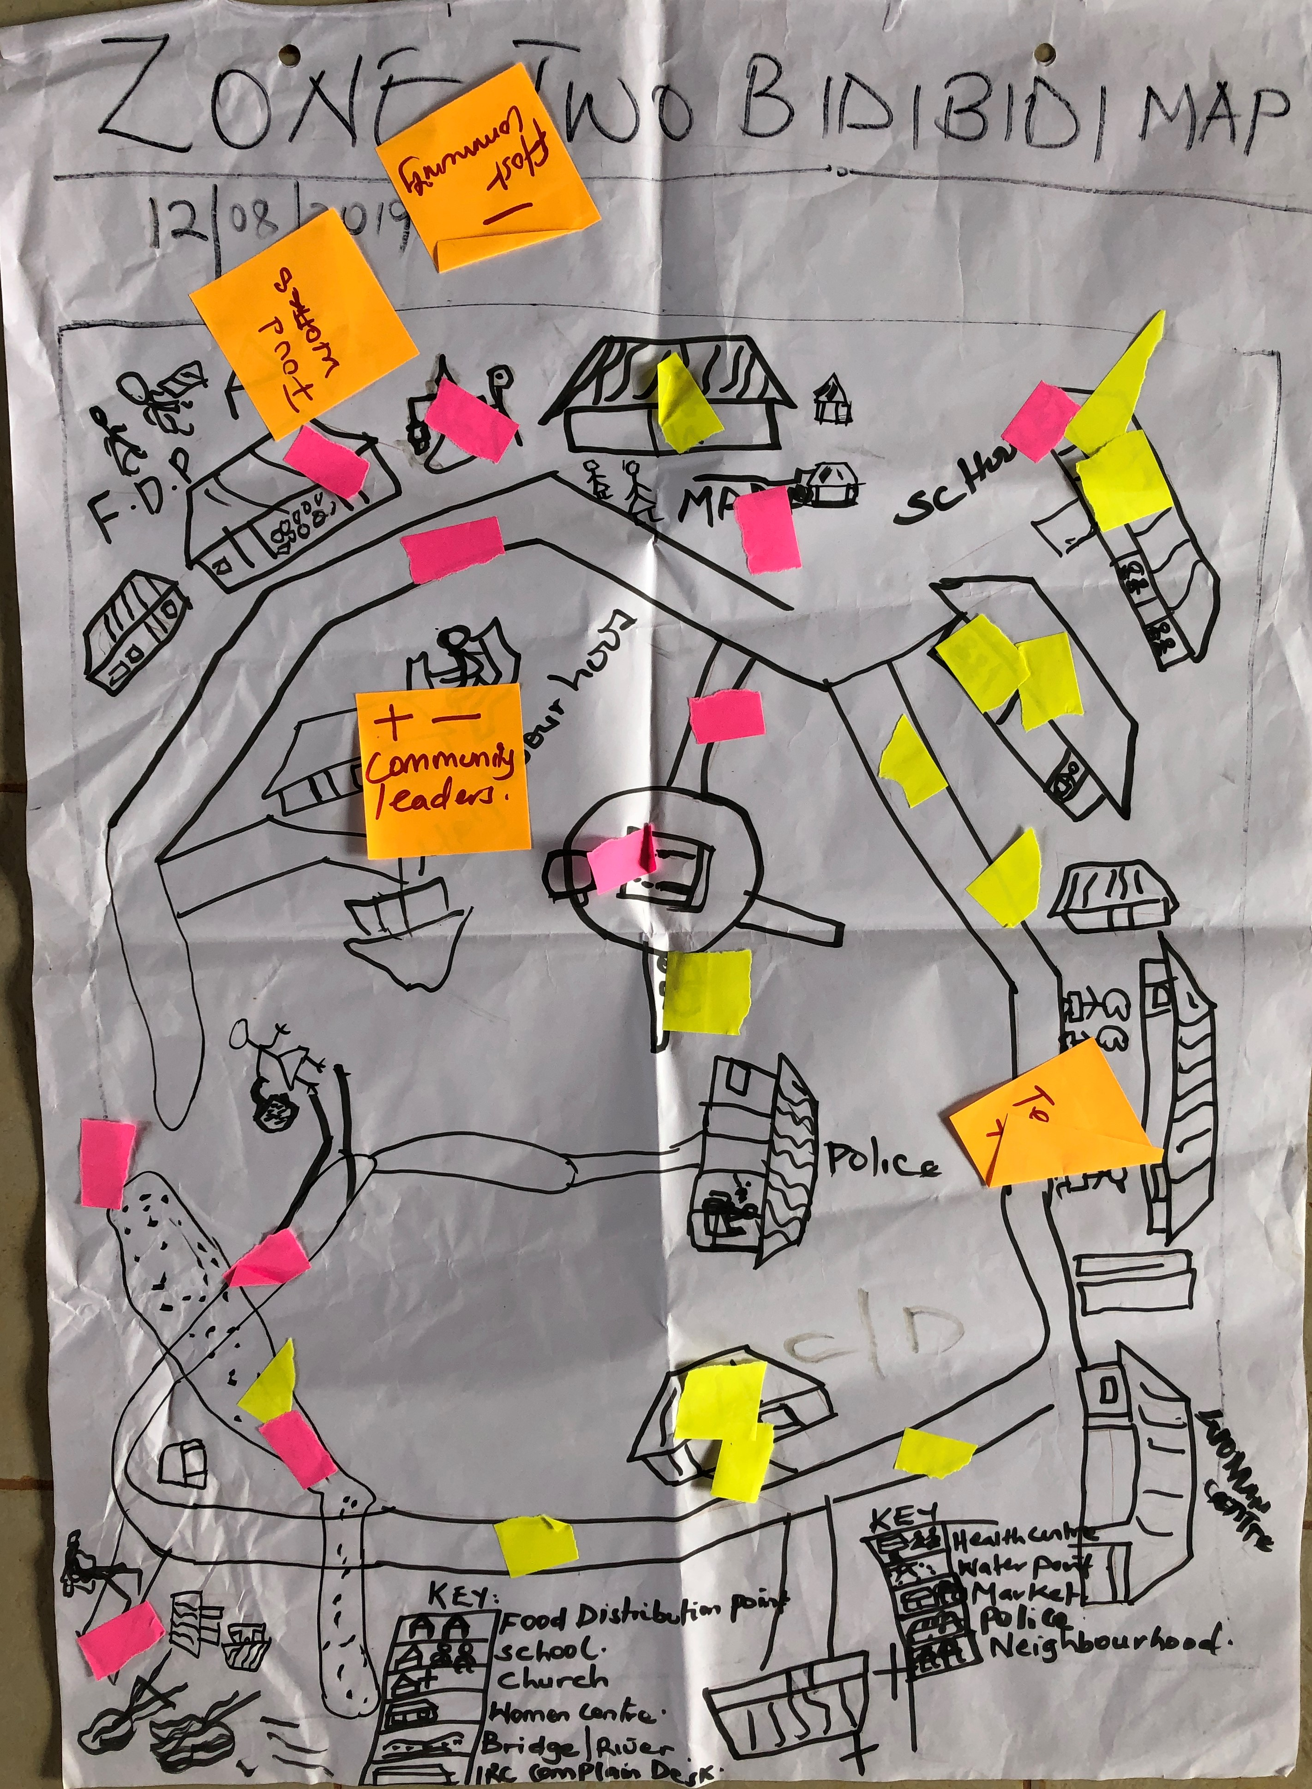
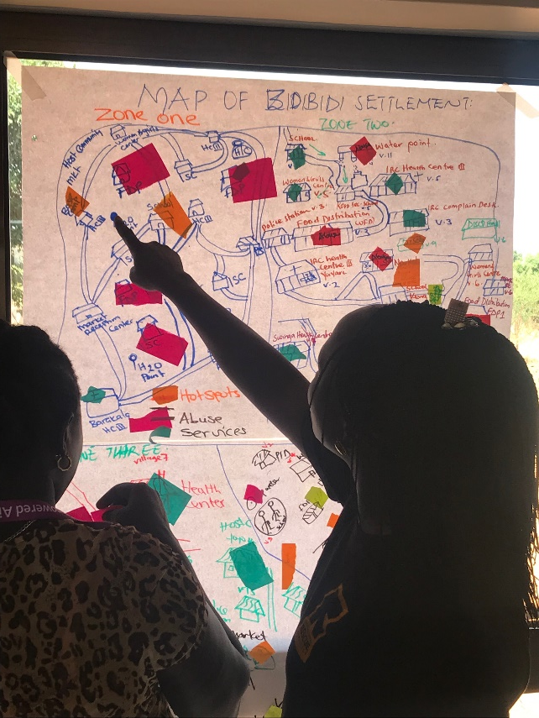
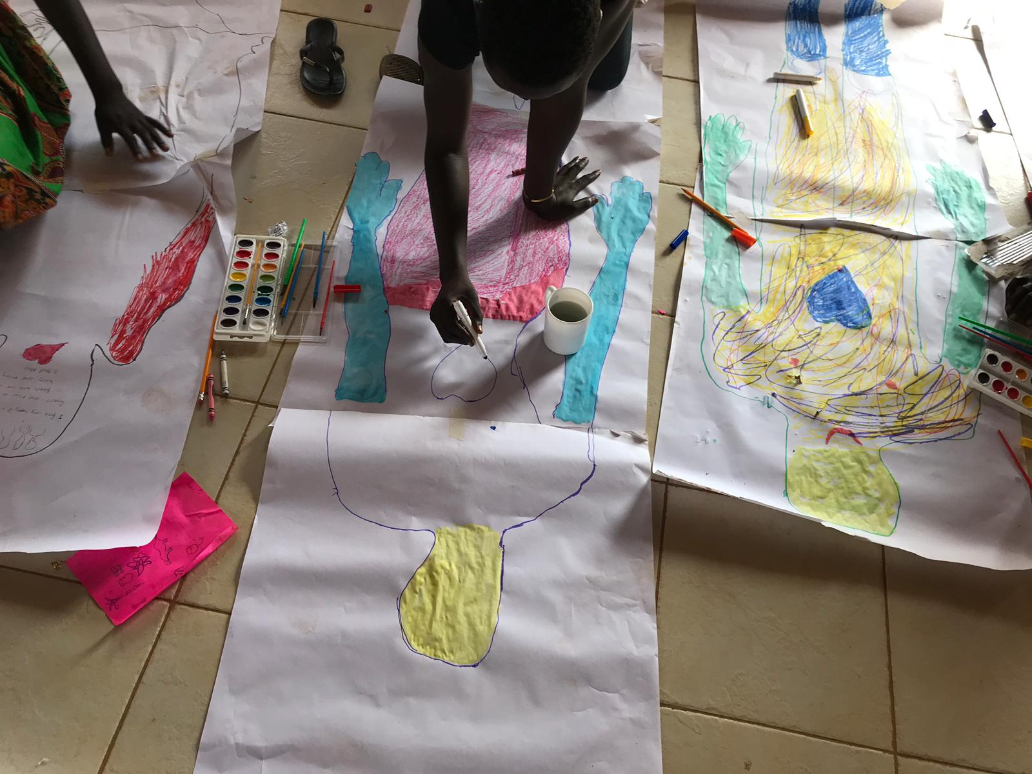
women & girls are expert in contextual safeguarding
(L-R) Community mapping & body mapping as part of Empowered Aid participatory group discussions & workshops.
Notes:
We have much more to share – but the key message is: women & girls are experts in contextual safeguarding.

Slide 18
Next steps
Currently using findings from Phase to design Phase II
Women and girls involved have decided to serve as Advisory Boards in Phase II
Dissemination of results and learning from Phase I to relevant fora i.e. in-country and global working groups (SEA, GBV); practice briefs; reports; articles; etc.
Will discuss further at next TAG meeting on Wednesday

Slide 19
Thank you
To our co-researchers in Lebanon & Uganda, all those who participated in discussions & national & Technical Advisory Group members.
Empowered Aid is funded by the US State Department (BPRM).
For more info: contact Alina Potts (PI) apotts@gwu.edu, Harriet Kolli (Uganda Research Manager) Harriet.Kolli@rescue.org
#EmpoweredAid updates and further resources forthcoming at globalwomensinstitute.gwu.edu
We commit to amplifying & supporting each others’ work to address SEA.

