Slide 1

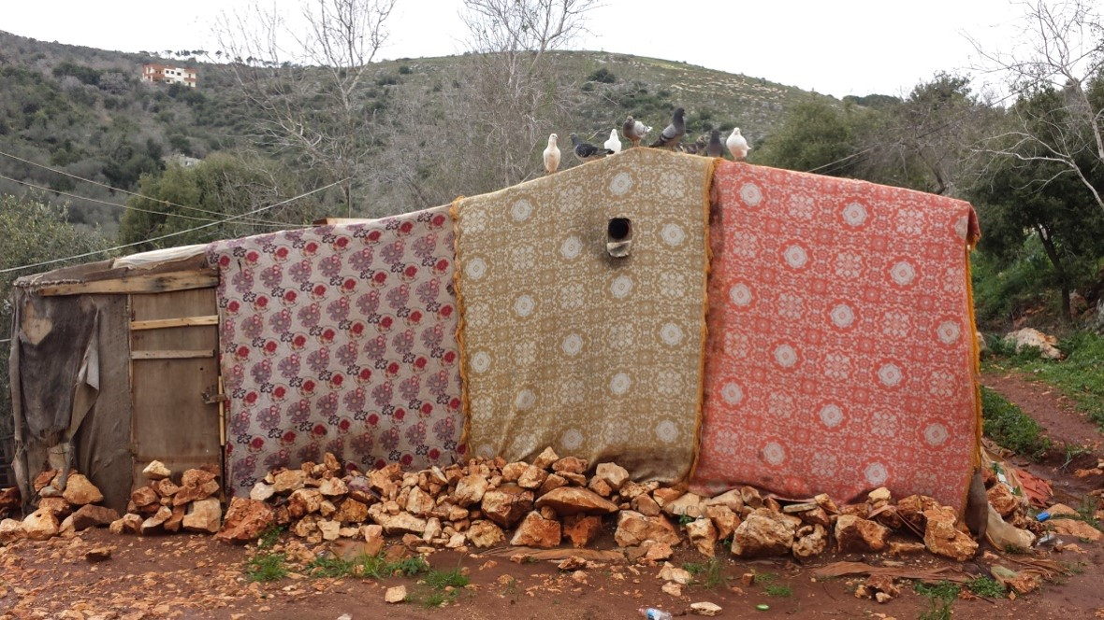
SHELTER SECTOR ACTIVITIES
NORTHERN LEBANON

Slide 2
SHELTER SECTOR OVERVIEW | Northern Lebanon
North: Led by UNHCR – with rotating Co-Lead | National: MoSA, UNHCR, and UN-HABITAT
North Shelter Operational Partners: Akkarouna, CARE, CWW, ICRC, Mercy USA, NRC, PCPM, PU-AMI, SCI, SI, UN-HABITAT
Shelter Sector activities are guided by the LCRP and Temporary Technical Committees (TTCs):
TTC2: Weatherproofing in Informal Settlements
TTC3: Upgrade of substandard Residential Shelters
TTC4: Upgrade of Common Building Areas
TTC5: Fire Prevention, Preparedness and Response
TTC6: Area-based Profiling and Area-based approach
TTC7: Site Improvement in Informal Settlement
TTC8: Cash For Rent

Slide 3
SHELTER SECTOR OVERVIEW | Northern Lebanon
2018 VASyR: Syrians have been progressively downgrading their shelter types, moving from residential buildings to non-residential and non-permanent structures.
In Akkar, decrease in residential shelters from 64% in 2017 to 48% in 2018 and in T5 decrease from 82% to 72%.
Economic vulnerability and increased debt accumulation has forced 55 % of the displaced population to reside in inadequate shelter conditions.
VASYR - 2018
VASYR - 2018
VASYR - 2018

Slide 4
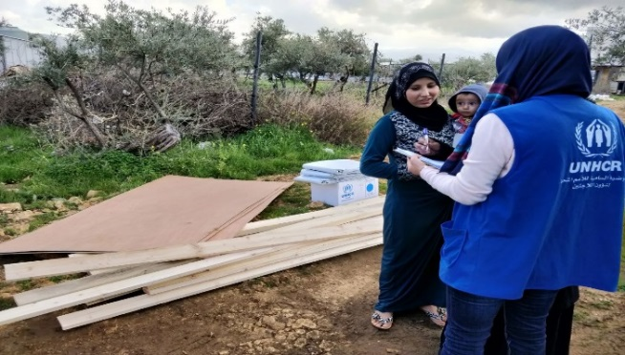
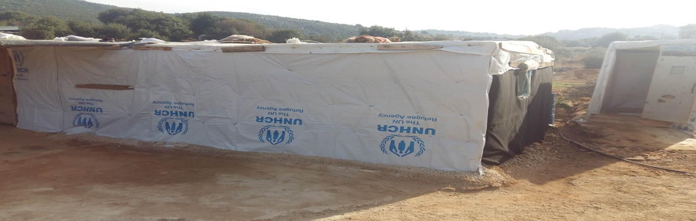
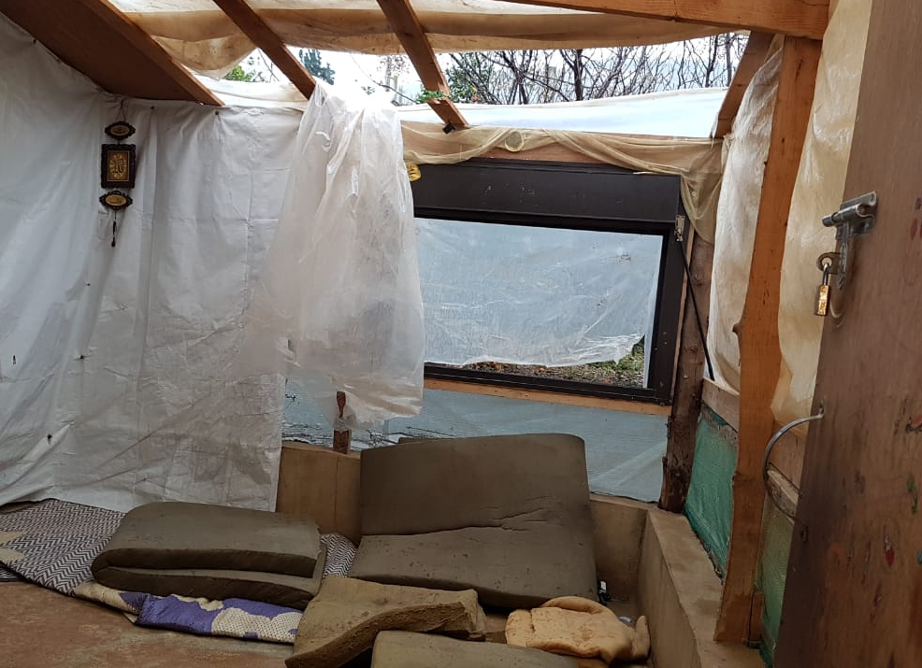
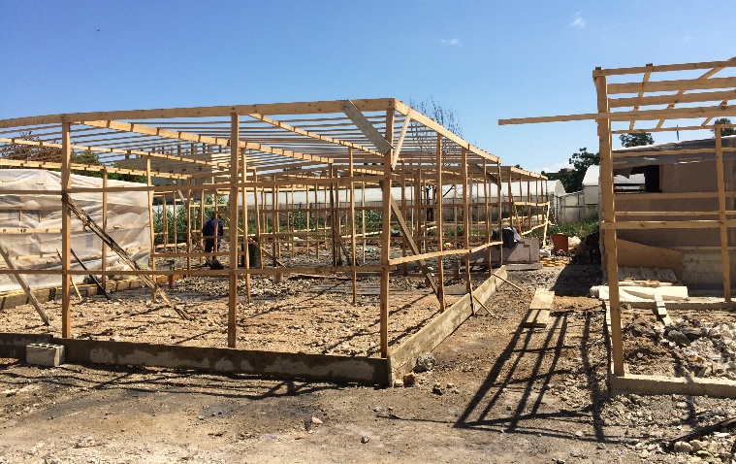
SHELTER ASSISTANCE | Informal Settlements
Distribution of Weatherproofing kits
Distribution of weatherproofing shelter materials, mainly plastic sheets and wooden support.
The Government of Lebanon’s official no-camp policy and associated restrictions on the durability of shelter materials allowed in informal settlements has meant that weatherproofing activities aimed at ensuring basic liveability need to be repeated regularly, generally on an annual basis.
Winterization: Yearly Harmonized Weatherproofing assessment to be conducted in all IS, prior to winter seasons. Distribution based on eligibility criteria.
In 2018: 9,222 assessments conducted: 35% LRK, 42% MRK, 1%
NAK, 22% None.
In 2019: Pilot of Cash for Weatherproofing in the North with CWW and SCI.
Emergency Response: During events of Fire, Eviction and Extreme weather.

Slide 5

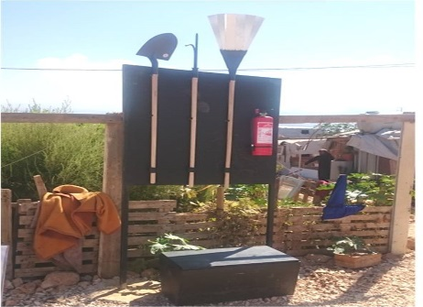
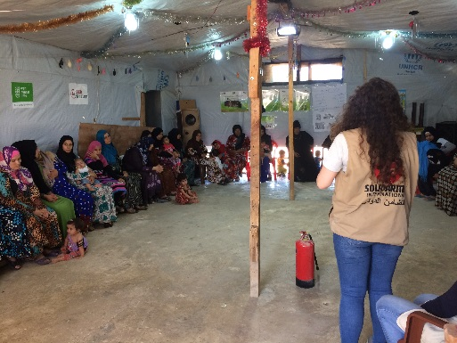
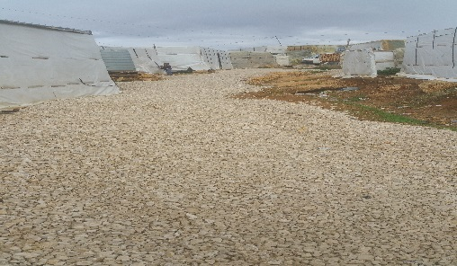
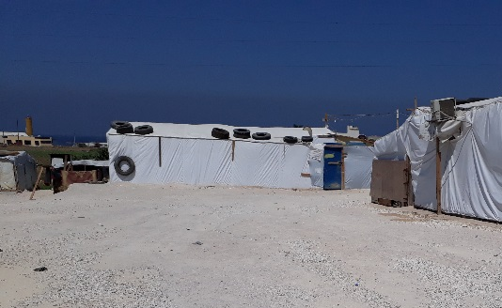
SHELTER ASSISTANCE | Informal Settlements
The ad-hoc nature of informal settlements, materials used and their often-remote location leaves them particularly exposed to Fire and Flood risks.
Fire Prevention, Preparedness and Response
Provision of fire fighting equipment, coupled with training and awareness- raising on fire risks and hazards.
The Sector in the North has succeeded in covering all IS with more than 10 tents with FPPR activities.
In 2019: focus on IS with less than 10 tents and refilling of Fire Extinguishers.
Site Improvement
Supporting communities through semi-permanent site improvements to Informal Settlements: improving access and accessibility to PWSN, mitigating flood/innundation/fire/environmental risks, etc.
The Sector in the North is prioritizing sites for site improvement activities, based on previous instances of flooding and vulnerability to extreme weather conditions.

Slide 6
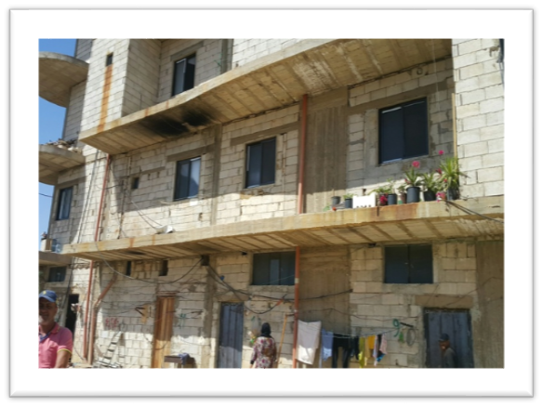
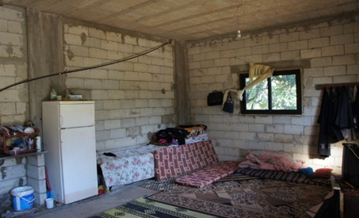
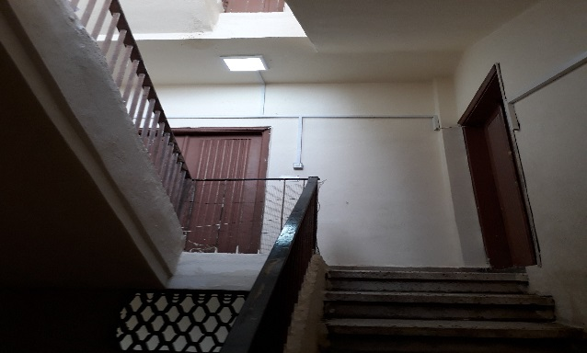
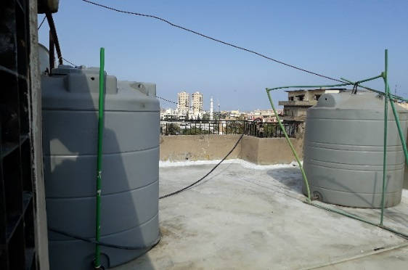
SHELTER ASSISTANCE | Residential and Non-Residential Buildings
Upgrade of Occupied Shelters
Upgrade of shelter conditions up to minimum standards. Ensure adequate access to water, sanitation, electricity and protection from the elements (weather, security, etc.) + security of tenure.
Upgrade of Building Common Areas
Rehabilitation works in the common areas of the buildings: staircase, roof, entrance, water supply, sewage collection, etc.
Area-based Profiling
Multi-sectorial needs assessments or profiling of poor neighborgoods, used for geographical coordination and evidence-based programming of interventions by partners.

Slide 7
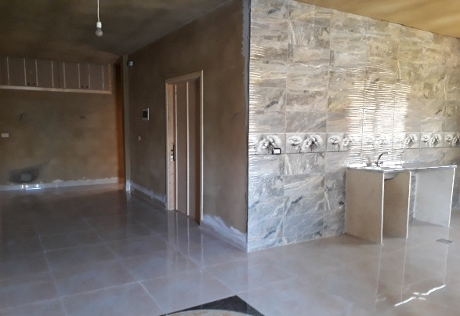
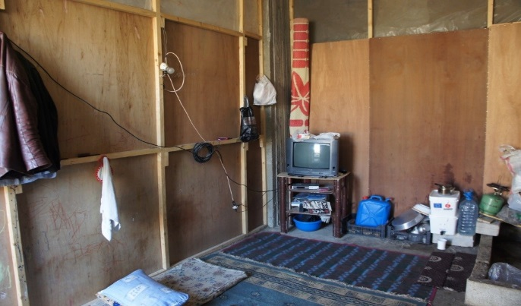
SHELTER ASSISTANCE | Residential and Non-Residential Buildings
CASH for Rent
ONLY IN AKKAR
Provision of monthly conditional cash grants intended to cover the costs of rent and therefore reduce the risk of eviction and secondary displacement. Cash for Rent is restricted to urgent, mainly protection-based cases.
Rehabilitation of Un-Occupied Shelters – Relocation to SSUs
ONLY In Minnie-Dennieh, Zgharta and Akkar districts
SSUs are unfinished apartments, rehabilitated by shelter partners to accommodate the most vulnerable persons. SSU is a shared apartment - two or more families - sharing the toilets and kitchen.
Homeless
Evicted
Families are able to live in the SSU, free of rent for the hosting period, as mentioned in the lease agreement (around one year).
Families are responsible for covering utilities cost (water, electricity).
At risk of eviction
Specific needs

Slide 8
SHELTER SECTOR INITIATIVES | Northern Lebanon
COSIMA – Collective Shelter Sites Mapping
Collective Shelter: Any structure or building containing six or more households of PoCs, with either shared or non-shared facilities. These are typically old abandoned factories, farms, resorts, hotels and schools.
To date, 190 Collective Shelters are mapped in the North.
Area-Based Task Force
An area-based neighbourhood Task Force is set up in Tripoli under the Shelter sector and co-lead with UN-HABITAT.
It is linked into the union of municipalities and is actively using neighbourhood data to organize multi-partner, multi-sector interventions in an evidence-led way
RAIS Shelter Sector Referral System
The Shelter Sector in the North has launched the RAIS Referral tool in July 2018.
On average, 250 referrals are received per month, created by around 17 agencies. All the referrals are centralized and forwarded by UNHCR Shelter to corresponding Operational Shelter partners.
The tool has substantially improved the sector referral pathway: handling, coordination, follow-up and feedback mechanisms.

Slide 9
SHELTER SECTOR REFERRALS | Northern Lebanon
From January – March 2019, in Akkar and T5, a total number of 774 shelter referrals were received on the RAIS Tool.
A similar number of referrals was received in 2018 over a period of seven months. It is assumed that the number in 2019 have increased, due to the emergency incidents (flood, fire, evictions).This can also be due to increased vulnerabilities of refugees and inability to pay rent.

Slide 10
THANK YOU !!

