Slide 1
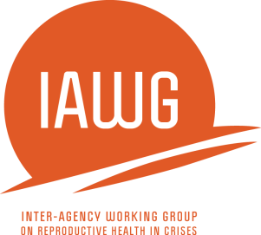
Adolescent Sexual & Reproductive Health in Humanitarian Settings Zaatari Youth Task Force 27/08/2019 by: Ali Al-Gharabli

Slide 2
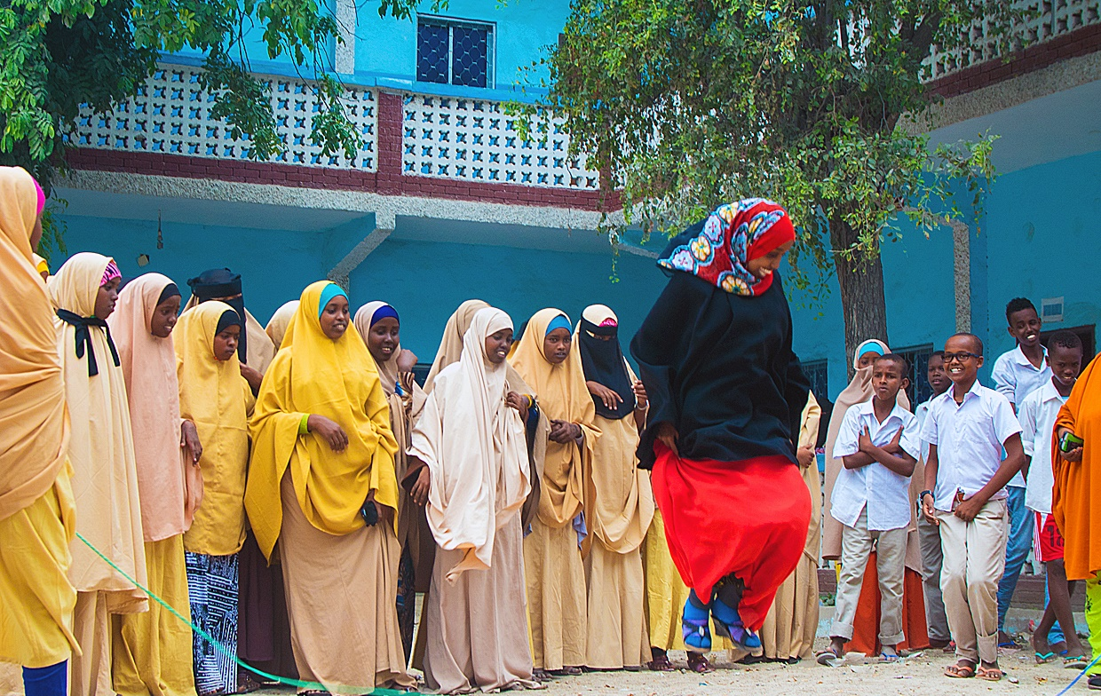
Photo Credit: Mercy Corps

Slide 3
Session ONE
What is adolescent sexual & reproductive health (ASRH)?

Slide 4
What is Adolescence?
Period from 10 – 19 years of age:
Very Young Adolescence: 10-14 years
Middle Adolescence: 15-16 years
Older Adolescence: 17- 19 years
Common references:
- Children under 18
- Young People 10-24
- Youth are generally referred to as 15-24 years
Notes:
Photo: UNFPA

Slide 5
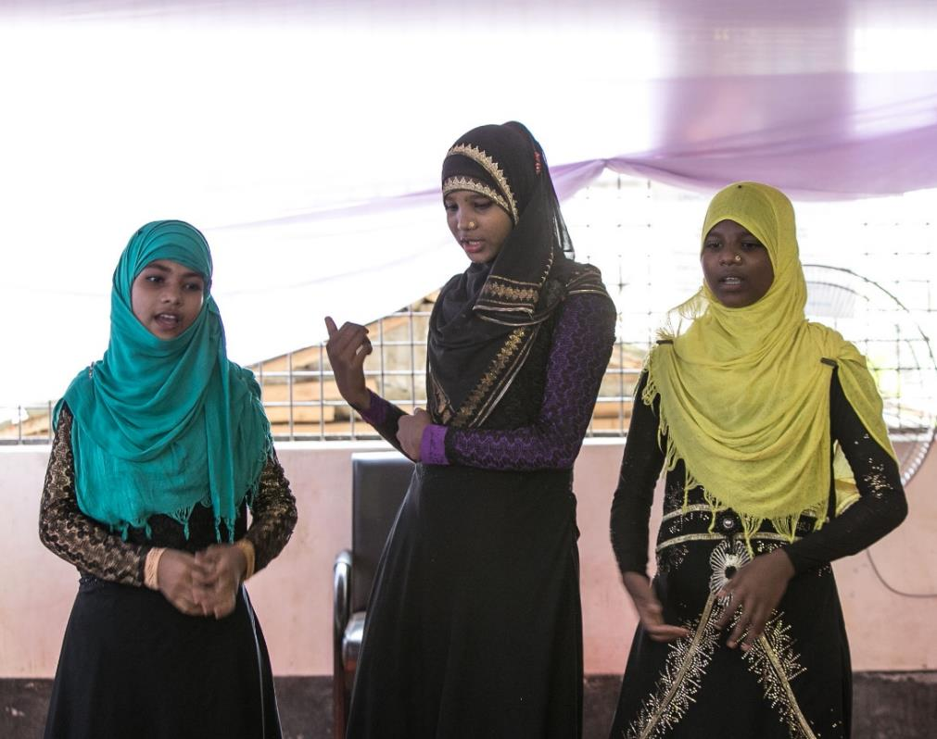
What is Adolescence?
Period between childhood and adulthood
Visible physical, behavioral and psychological change
Increase feeling of independence especially independence from adults
Notes:
Photo: UNFPA

Slide 6
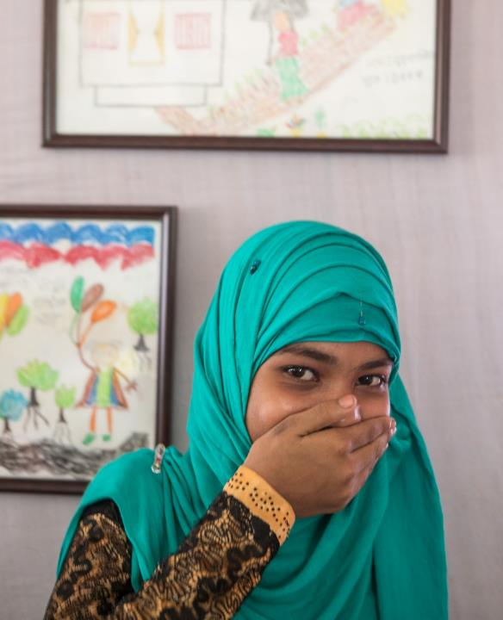
Adolescents are not a homogenous group!
Certain adolescents are always at high risk, regardless of the situation:
Pregnant adolescents
Orphaned adolescents
Adolescent heads of household
Marginalized adolescents:
Adolescents living with HIV
Adolescents with disabilities
Adolescents who identify as LGBTI
Adolescents belonging to indigenous or migrant groups
Notes:
Photo: UNFPA

Slide 7
Why prioritize adolescents and young people during emergencies?
“Demographic imperative”:
Today we have the largest generation of young people the world has ever known
There are now 17.2 million refugees under UNHCR’s mandate – half of them under the age of 18 and a large proportion. Youth (aged 15-24) also constitute a large proportion of populations affected by forced displacement (UNHCR, 2015)
Notes:
Sierra Leone: 63% of the pop was under 25 in 2002
Northern Uganda: 70% of the population is under 25
65% of Sudanese refugees in Northern Uganda were under 25 in 2005
http://www.unhcr.org/child-and-youth-protection.html

Slide 8
What is sexual & reproductive health?
“A state of complete physical, mental and social well-being and not merely the absence of disease or infirmity, in all matters relating to the reproductive system and its functions and processes. This implies that people are able to have a satisfying and safe sex life and that they have the capability to reproduce and the freedom to decide if, when and how often to do so.”
International Conference on Population & Development (ICPD), Cairo 1994
“Sexual health requires a positive and respectful approach to sexuality and sexual relationships, as well as the possibility of having pleasurable and safe sexual experiences, free of coercion, discrimination and violence. For sexual health to be attained and maintained, the sexual right of all persons must be respected, protected and fulfilled”
World Health Organization (WHO), 2006

Slide 9
Why is ASRH important?
Important Facts about ASRH:
We start our reproductive life cycle during adolescence with puberty
Each year about 15 million girls are married before the age of 18 years and 90% of births to girls aged 15-19 years occur within marriage (UNFPA, 2015)
AIDS is now the leading cause of death among young people ages 10-24 years in Africa (AVERT, 2018)
An estimated 23 million adolescents age 15 to 19 years living in low and middle-income countries have an unmet need for modern methods of contraception (Darroch et al., 2016; MacQuarrie, 2014).

Slide 10
Why is ASRH important?
Every year, estimated 21 million girls ages 15-19 years and 2 million girls under 15 years become pregnant in low income countries. (UNFPA, 2015)
It is projected that adolescent pregnancies will increase globally by 2030 with the greatest proportional increases in West & Central Africa. (UNFPA, 2013)
Complications during pregnancy and childbirth is the leading cause of death for 15-19 years old girls globally. (WHO, 2016)
The risk of pregnancy-related death is still twice as high for girls aged 15-19, and five times higher for girls aged 10-14, compared to women in their twenties. (UNFPA)
Unmet need for family planning is highest amongst 15-19 year-olds, and youth aged 15-24 account for just under half of all unsafe abortions worldwide (UNFPA, 2012)
Babies born to adolescent mothers face a much higher risk of dying than those born to women ages 20-24 years, including 50% higher risk of being still born. Newborns of adolescent mothers also have high risk of low-birth weight (WHO, 2014)
Notes:
- There is the term of ASRHR – so don’t get confused

Slide 11
ASRH Rights are Human Rights
Freedom from
Harmful Practices
Education & Information
Health
Equality in
Marriage
Adolescent
Sexual & Reproductive
Health
Freedom from
violence
Privacy
Consent to
Marriage
Decide Number & Spacing of Children
Freedom from
Discrimination

Slide 12
ASRH rights are protected by international law
Adolescents’ Human Rights are Protected by International Law
Universal Declaration of Human Rights
Constitution of the World Health Organization
1994 Cairo International Conference on Population and Development
1995 Beijing Conference
UN Convention on the Rights of the Child
UN Convention on the Rights of Persons with Disabilities
During the 2016 Word Humanitarian summit, UN member states signed on to the 2030 Agenda for Sustainable Development and the Youth Compact, pledging to reach first those who are furthest behind. (Source: World Humanitarian Summit. Compact for Young People in Humanitarian Action. 2016.)

Slide 13
Questions/Comments

Slide 14
Session TWO
Meeting ASRH Needs in Humanitarian Settings

Slide 15
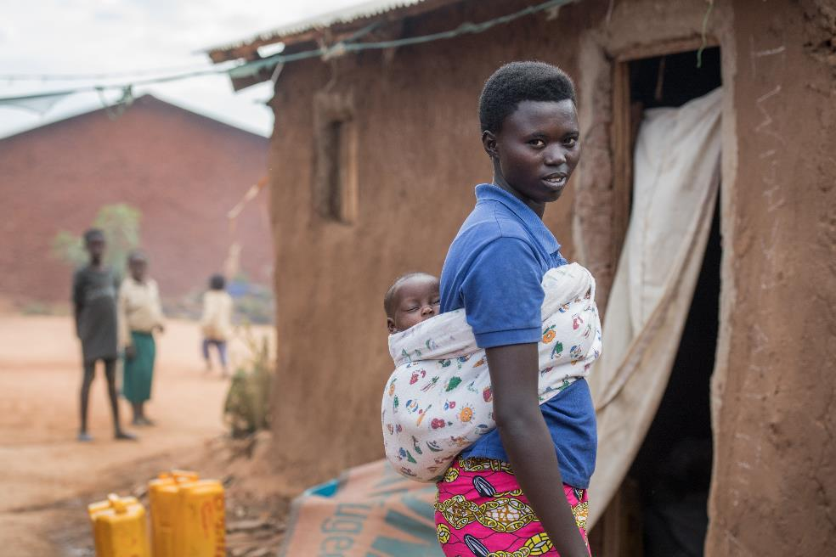
Why focus on ASRH in humanitarian situations?
In humanitarian emergencies adolescents face:
losing family, social, educational and religious structures
high risk of child-marriage
high risk for sexual violence
increased consensual or coerced sexual activity
high risk for forced recruitment to armed groups
limited access to health services
Notes:
Photo: Susan Warner / Save the Children

Slide 16
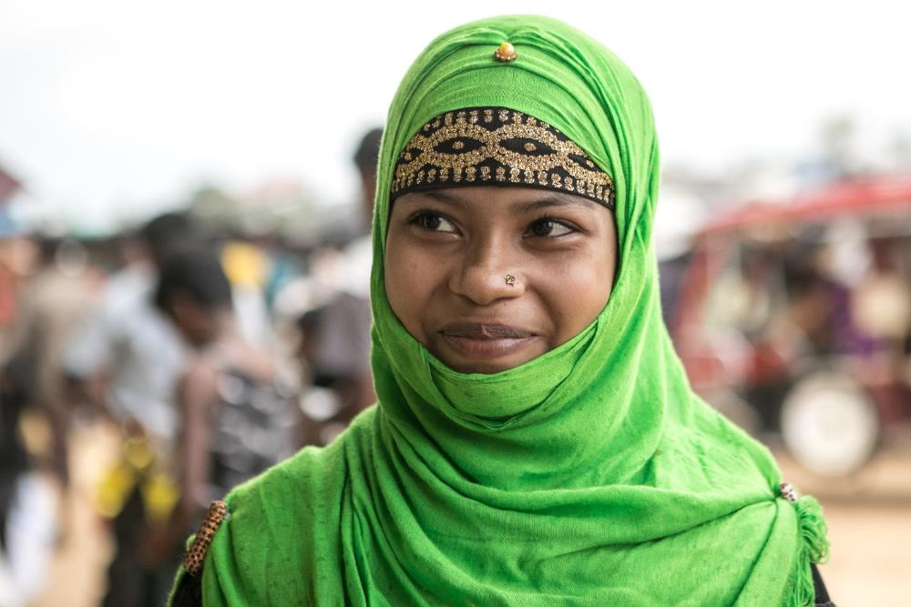
ASRH is seldom addressed in emergencies
Even in “normal” settings, adolescents face barriers that prevent them from accessing health services:
Individual
Socio-cultural
Structural
Notes:
Photo: UNFPA

Slide 17
Vulnerable adolescents in humanitarian situations
Certain adolescents are always at high risk, regardless of the situation:
Very Young Adolescents (VYAs)
Pregnant adolescents
Orphaned adolescents
Adolescent heads of household
Marginalized adolescents:
Adolescents living with HIV
Adolescents with disabilities
Adolescents who identify as LGBTI
Adolescents belonging to indigenous or migrant groups
Notes:
Photo: UNFPA

Slide 18
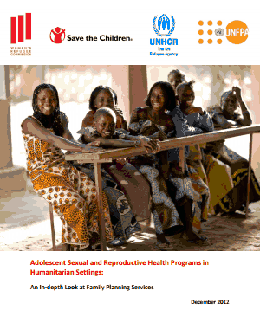
Operational research on gaps in ASRH funding & programming in humanitarian settings
Conducted in 2011-2012, published in December 2012
1) Program Mapping
Based on >200 responses, 37 programs focused on the SRH needs of 10-19 year-olds in humanitarian settings since 2009
Among the 37, only 21 offered at least two methods of contraception. None were from acute emergency settings.
2) Funding Analysis
Between January 2009 – October 2012
Among a total of 2,638 health only 37 included some element of ASRH
Proposals for ASRH through humanitarian funding streams constituted less than 3.5% of all health proposals per year
Among the 37 programs, only 32% received any funding: 7 programs were fully funded and five were partially funded.
Report further shared good practices and recommendations for donors/governments, organizations and the cluster system.

Slide 19
Questions/Comments

Slide 20
Session THREE
Participation Tools

Slide 21
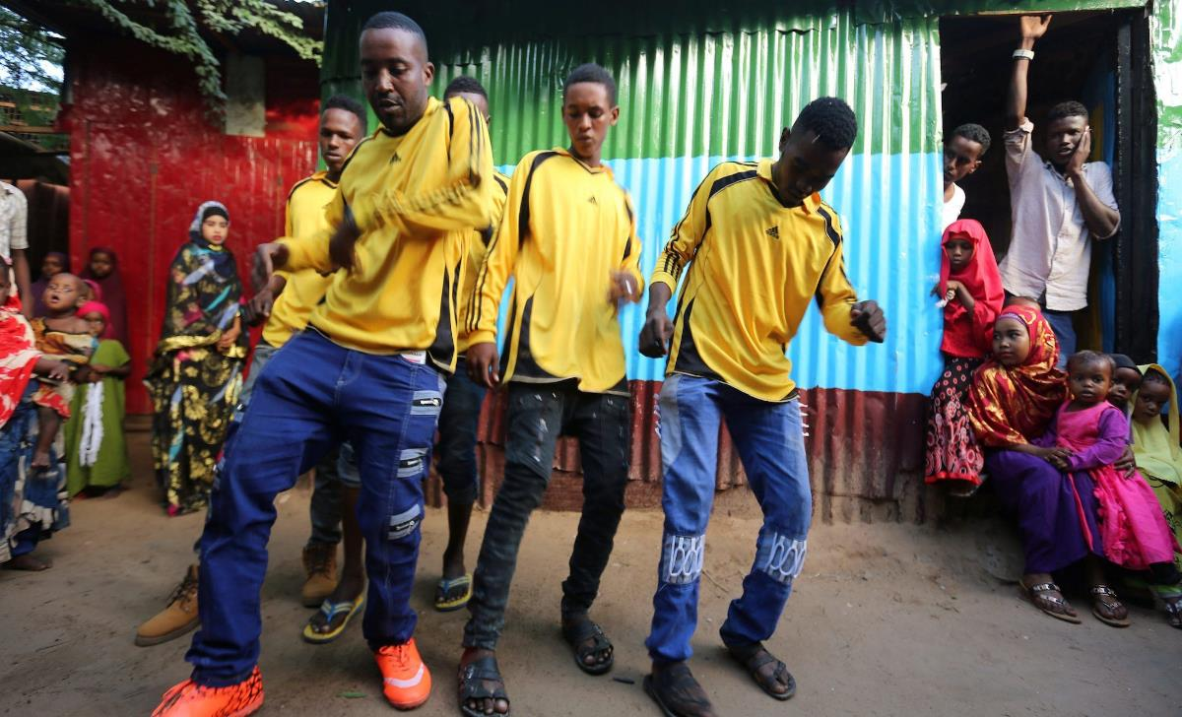
Participation Tools
Meaningful participation of adolescents is key to ensure services are accessible and acceptable to them
Consulting and involving parents and communities from the design phase of ASRH programs can lead to long-lasting impact
Photo Credit: UNFPA

Slide 22
Levels of Participation
Adolescent Participation
(p. 45)

Slide 23
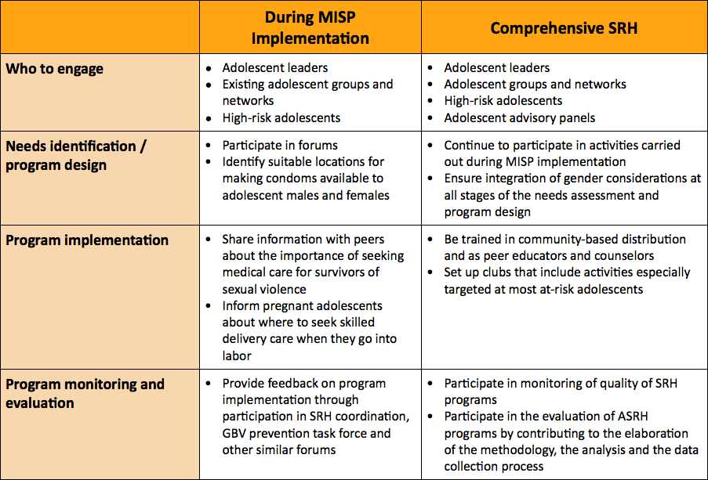
Adolescent Participation (pg. 45)
Adolescent Participation
(p. 45)

Slide 24
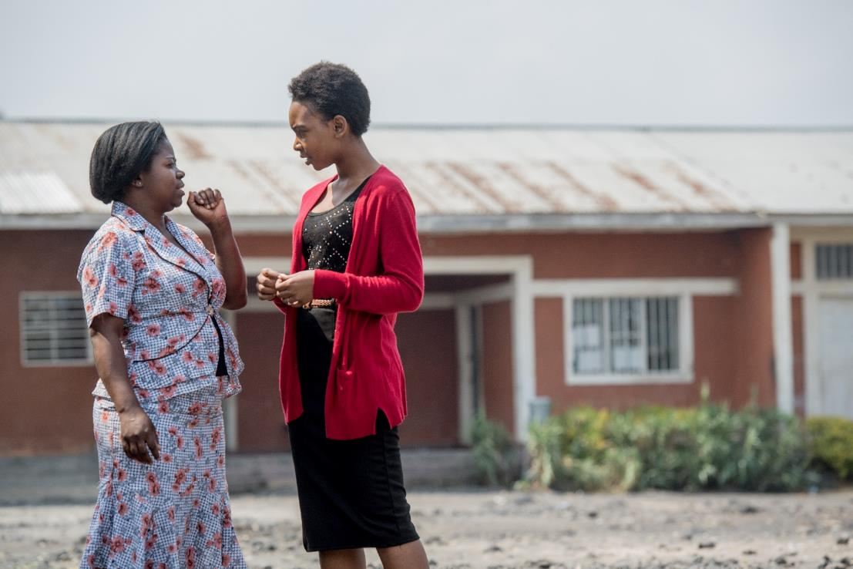
Youth Adult Partnership
Integrates creativity and insights of adolescents with experience and knowledge of professional adults
Equal partnership
Both groups contribute
Mutual respect!
Notes:
Photo: Susan Warner / Save the Children

Slide 25
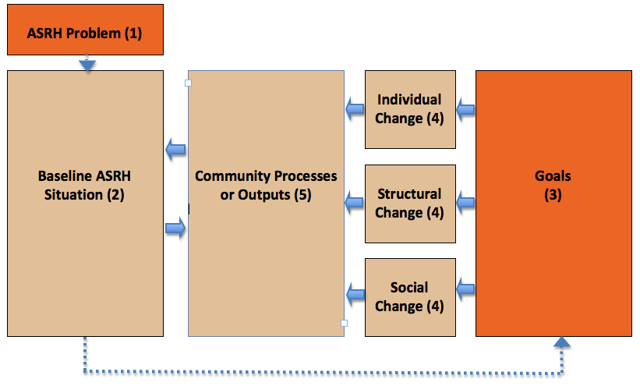
Community and Parental Participation Tool (pg. 48)
Community and Parental Participation Tool
(p. 48)

Slide 26
Community and Parental Participation Tool (pg. 48)
Community and Parental Participation Tool
(p. 48)

Slide 27
Partnership Defined Quality for Youth Tool
Planning and Design
Building Support
Youth Defined
Exploring Quality
Health Worker Defined
Bridging the Gap
Working in Partnership
ACTION

Slide 28
Other Participatory Techniques
Participatory Ranking
Community Scorecard for Young People
Representation of young-people in decision-making groups, such as SRH Working Groups
Creation of youth/adolescent WG

Slide 29
Questions/comments

Slide 30
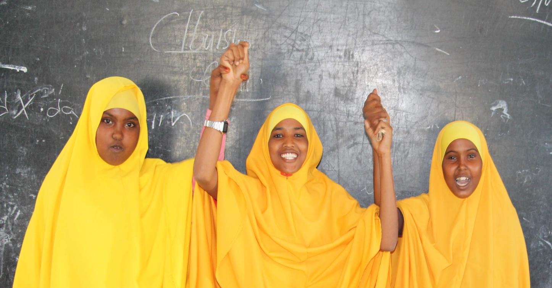
Thank You
Photo Credit: Relief International

