Slide 1
The Compact for Young People in Humanitarian Action

Slide 2
Agenda

Slide 3
Why work with young people?
Source: Guidelines for Working with and for Young People in Humanitarian Settings

Slide 4
Why work with young people?
A period for investment. Youth has distinctive capacities and skills and it presents a unique opportunity for breaking inter-generational cycles and manifestations of inequality.
Demographic dividend. Most countries with the largest portions of youth are among the poorest in the world. Investment in youth contributes to a demographic dividend.
It’s their right. The Convention on the Rights of the Child and General Comment 20 recognise the need to realise the rights of children during adolescence.
Source: Guidelines for Working with and for Young People in Humanitarian Settings

Slide 5
The Challenge
408 million youth aged 15-29 or 23% of the global youth population are affected by violence or armed conflict (The Missing Peace, 2018). 68.5 million people around the world have been forced from home, among them nearly 25.4 million refugees, over half of whom are under 18 years (UNHCR)
Youth have distinct needs, experiences and
capacities for responding and recovering from crisis
Humanitarian organisations have little guidance on effectively incorporating youth into response programming

Slide 6
The Challenge (Or Opportunity?) in Jordan
Children make up over half of all Syrian refugees in Jordan with 322,395 registered Syrian refugees under the age of 18. Youth aged 15 to 24 number 128,181 in urban and camps settings combined.
In the humanitarian coordination context of Jordan, youth are represented at the Zaatari level within the Youth Task Force. However, there is no national level coordination forum for youth specific to the Syria response. Furthermore, there is no mechanism in place to ensure that youth is considered across sectors, in the same way that gender is.

Slide 7
Youth in Zaatari Camp
The Zaatari refugee camp, situated in the northern governorate of Al Mafraq, remains the largest refugee camp in Jordan with a population of more than 75,285 people.
According to the UNHCR, 19.6 percent of the population in Zaatari is aged between 15 and 24.
The vast majority of those aged 16-24 in Zaatari camp is currently unemployed (92.4 percent).
83.2 percent of youth aged 19-24 have not completed either high school or university. This displays the harsh reality experienced by a large segment of the refugee population who are left to deal with the lack of opportunities.

Slide 8
The Compact
Overview
The Compact is a global call to prioritise the needs and rights of young women and men, girls and boys in humanitarian action
Why? To guarantee that youth are included within humanitarian response
When? Launched at the World Humanitarian Summit in 2016
By whom? Led by UNFPA and IFRC
How? Involvement of international and local NGOs, youth networks and the private sector, as well as UN bodies and governments.
Source: Compact for Young People in Humanitarian Action, UNFPA and IFRC
Notes:
Objective:
The Compact facilitates partnership building for young people in humanitarian action. It aims to achieve the critical mass required to embed its principles in the form of the 5 actions into the existing humanitarian architecture to ensure the humanitarian system systematically and structurally addresses the needs and priorities of young people including adolescent in all stages of humanitarian action.
A successful implementation will result in an institutionalization of the key actions of the Compact in all stages of humanitarian action including an increase of humanitarian projects addressing needs of adolescents and youth, participation of young people in decision making, the systematic use of the age/gender marker and increased funding earmarked for youth-serving and youth-led action in emergencies.

Slide 9
Purpose of The Compact
The Compact for Young People in Humanitarian Action represents a formal agreement among the Members to be held accountable by each other, and by young people, in each of the key action areas. The Compact provides the dedicated space and the necessary framework for Members to ensure that the priorities, needs and rights of young women and young men, girls and boys affected by disaster, conflict, forced displacement and other humanitarian crises, are addressed; and that young people are informed, consulted, and meaningfully engaged throughout all stages of humanitarian action.
Compact Members acknowledge that young people have the skills, capacity and resources to prevent, prepare for, respond to and recover from humanitarian situations, and that supporting and working with them will help improve humanitarian effectiveness and efficiency and strengthen resilience of communities.

Slide 10
Objective of The Compact
The Compact will facilitate partnership building for young people in humanitarian action. It aims to achieve the critical mass required to embed its principles in the form of the 5 actions into the existing humanitarian architecture to ensure the humanitarian system systematically and structurally addresses the needs and priorities of young people including adolescent in all stages of humanitarian action.
A successful implementation will result in an institutionalization of the key actions of the Compact in all stages of humanitarian action including an increase of humanitarian projects addressing needs of adolescent and youth, participation of young people in decision making, the systematic use of the age/gender marker and increased funding earmarked for youth-serving and youth-led action in emergencies.

Slide 11
The Compact
Five key actions
Services
Support age- and gender-responsive programmes to protect the health and well-being of all young people in humanitarian settings
1
Participation
Unleash the power of young people to help and to lead
2
Capacity
Build skills for humanitarian action and beyond
3
Resources
Increase attention to and resources for young people in humanitarian settings
4
Data
Use accurate information to understand the needs of young people in humanitarian settings
5
Notes:
Guidelines respond to action 1 “services”.
Under the umbrella of the Compact, UNICEF and NRC have led the development of the Inter-agency Guidelines for Working with and for Young People in Humanitarian Settings “Promote and increase age- and gender-responsive and inclusive programmes that contribute to the protection, health and development of young women, young men, girls and boys within humanitarian settings”. Adolescents and youth are a vital positive force in emergency preparedness and response. They have wide-ranging capacities and unique needs, but they often get lost between programming for children and programming for older adults. These Guidelines are not just about ‘mainstreaming’ their needs, but about reinforcing the contributions they make to humanitarian programming, improving responses. These guidelines address a gap in humanitarian tools that tend to overlook young people, a specific but broad demographic with interlinked needs across multiple sectors.

Slide 12
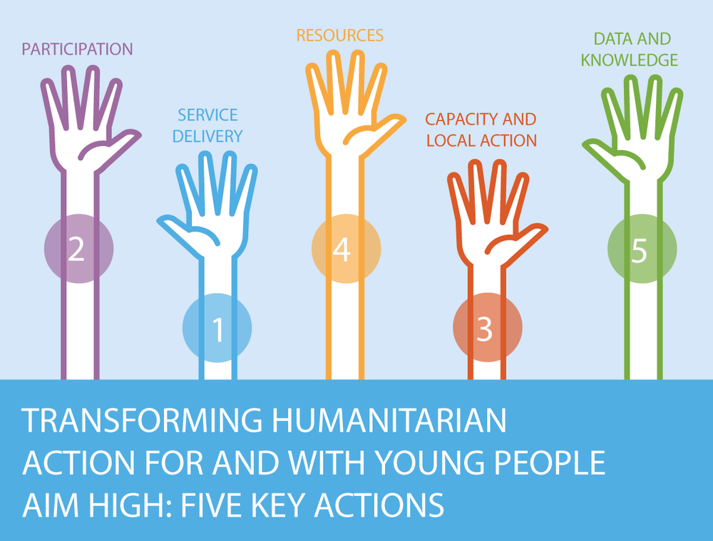
SUPPORT and PROMOTE the Compact WHEREVER and WHENEVER you can.

Slide 13
Timeline
United Nations
Security Council Resolution 2250
World Humanitarian
Summit
Launch of Global Compact for young people in humanitarian settings
Youth Peace and Security
Output: 5 actions
Sept. 2015
Dec. 2015
2015 - 2016
May 2016
Sept. 2017
World Humanitarian
Summit
Global Refugee
Youth Consultations
United Nations General Assembly
Doha Declaration
on reshaping Humanitarian Agenda
Consultations with 1,482 youth from 65 nationalities in 23 countries
Launch of Global Compact for young people in humanitarian settings
Output: Priorities and responsibilities
Output: 7 core actions for refugee youth

Slide 14
The Compact in Jordan
MENA Youth Capacity Building in Humanitarian Action
Sector WG presentations
Introduction to the guidelines for CP, LH, SGBV & Educ.
Training in Jordan
May-June 2018
Sept. 2018
Dec. 2018
May – June 2019
June 2019
Jordan Compact Workshop
Youth and stakeholder consultations on guidelines
ISWG & SGFPN presentations
Introduction to the Compact for WG members
Youth Envoy visit

Slide 15
Check Out The Compact Website
https://www.youthcompact.org
Also check out Igniting Hope Report ☺
Is your organization member of the
Global Compact?

Slide 16
Based on the conversation so far. What do you expect organizations commitments are under the Compact?
Notes:
And based on your experience working in the camp or camp coordination

Slide 17
What Are The Commitments?
Make humanitarian programmes contribute to protection, health, development of young women, young men, girls, boys
Support systematic engagement and partnership with youth in all phases of humanitarian action, especially decision-making and budget allocations
Strengthen young people’s capacities to be effective humanitarian actors, and support local youth-led initiatives and organizations in humanitarian response. This includes young refugees and internally displaced persons living in informal urban settlements and slums
Increase resources to address the needs and priorities of adolescents and youth affected by humanitarian crises and
use the new gender and age marker for better tracking and reporting
Generate and systematically use age- and sex- disaggregated data
Notes:
More than 40 humanitarian partners have endorsed the Compact and its five key actions for accountability to young people
in humanitarian action:

Slide 18
Coffee Break ☺

Slide 19
The Guidelines
Overview
The guidelines are an easy-to-use programming tool for all humanitarian aid workers at country level for working with and for adolescents (10-19 years) and youth (15-24 years).
When? In emergency response humanitarian situations, across natural disasters and conflict, rapid onset and slow onset, refugee and internally displaced persons (IDP) and other situations. It can be used before or during a crisis response.
Where? Useful for adaptation everywhere around the world.
For whom? Civil society organisations, local and national NGOs, government, international NGOs and UN Agencies.
The final version of the guidelines will be available in May 2019
Notes:
Age brackets: Data group is working on harmonising recommendations. Until then the guidelines use the UN definition as a guideline, but understand that practitioners contextualise accordingly.
The guidelines are intended for all humanitarian practitioners promoting: - a common set of principles, including rights-based approach and participation
- adolescent and youth inclusive programming across all sectors in the humanitarian programming cycle, taking advantage of young people's' potential, their high-level energy and creativity to prevent the persistence of intergenerational problems
- adolescent and youth targeted programming, which shall go beyond solely preventing negative consequences and recognise the positive contribution young people can offer in the short term and laying the foundation for adolescents and youth to continue contributing positively in the longer term

Slide 20
The Guidelines
Consultations 2018-19
The recommendations of young people are a cornerstone of these guidelines.
Gender-balanced consultations were held with 291 youth and at least 77 practitioners. Many targeted individual feedback requests were solicited by email across sectors and with youth specialists
In total the responses of more than 500 individuals were recorded, consolidated and incorporated into this guidance to the extent possible
Consultations with young people took place across the globe, from Afghanistan, Jordan, Iraq to Nigeria, Kenya to Venezuela and Ecuador
A total of 25 countries were covered
The final version of the guidelines will be available in May 2019
Notes:
See p.8 and 9 of the guidelines to see references to other major recent global youth consultations where crisis-affected adolescents and youth have expressed their priorities for improving humanitarian action. These should be mentioned.

Slide 21
The Guidelines – Structure
Introduction – Who Are Youth?
Principles for working with and for young people in humanitarian settings
Meaningful Participation
Young People across the Humanitarian Programme Cycle
Implementation of Adolescent & youth-responsive programming

Slide 22
The Guidelines – Who Are Youth?
Notes:
Go back to guideline notes

Slide 23
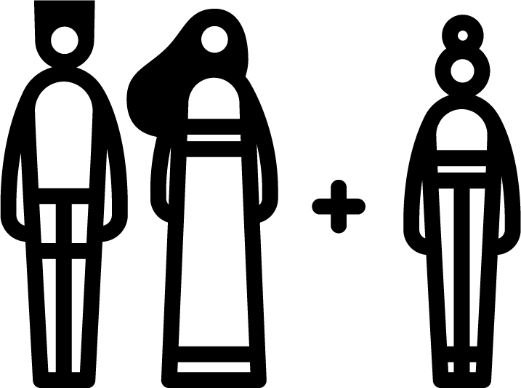
The Guidelines
Principles for working with and for young people
Positive development approach
Meaningful participation
Giving away power
Solidarity
Do no harm
Zero tolerance of sexual exploitation and abuse
Inclusion
Sustainability
Commitment
Gender and age sensitivity
Flexibility
Notes:
Please see Section B p.10 for explanations of each suggested principle

Slide 24
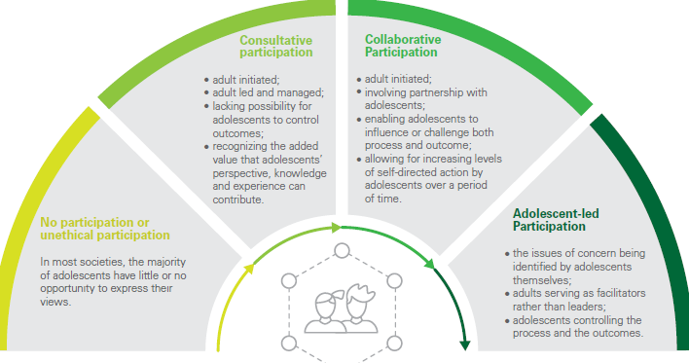
The Guidelines
Meaningful participation (1/2)
Enables young people to:
acquire knowledge and skills
build competencies
extend aspirations and gain confidence
Promotes:
youth’s capacity for civic engagement
collective organisation
tolerance and respect for others
Modes of participation
Notes:
Can be found on p.12 of the guidelines
An exercise – write on sticky notes examples of youth engagement and participation from your organisation or your coordination structure
Then we can categorize them based on the scale.

Slide 25
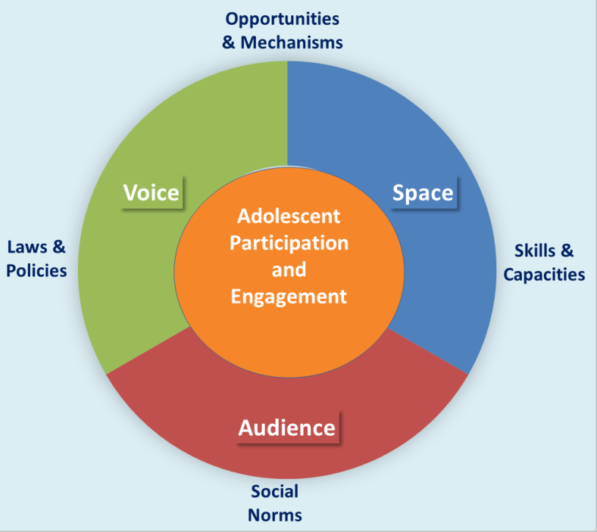
The Guidelines
Meaningful participation (2/2) – key features required
Notes:
Can be found on p.13 of the guidelines. Here explain the 4 key features that enable meaningful participation

Slide 26
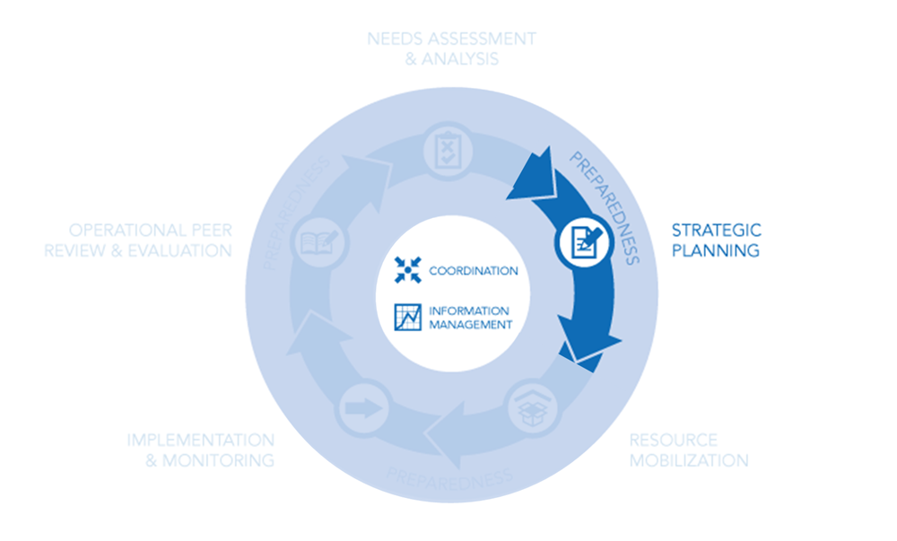
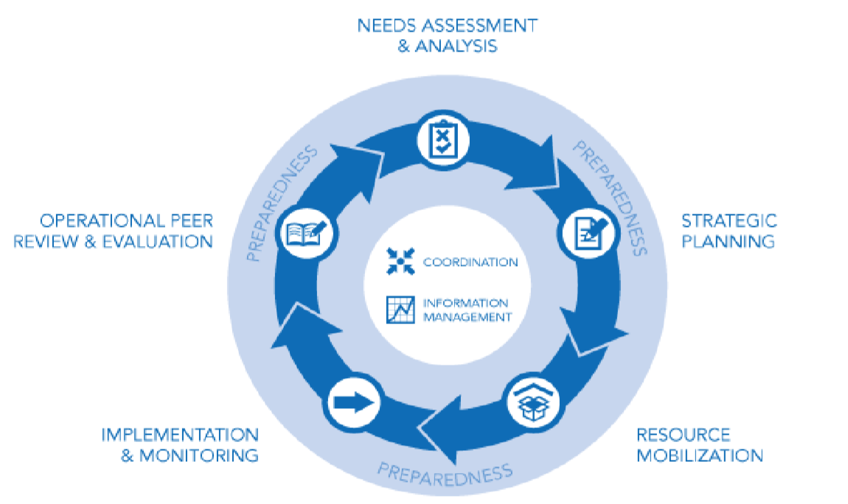
The Guidelines
Adolescents & Youth across the Humanitarian Programme Cycle
Guidance, checklists and examples for participatory programming across all phases of the cycle:
“Nothing about us, without us”
Notes:
First image depicts the logical cycle of the Humanitarian Programme Cycle (from needs assessment and analysis to operational peer review and evaluation. NOTE: “Implementation” as seen in “implementation and monitoring” is dealth with in Section E.) then b) the second image zooms in to cross-cutting elements such coordination; information management and preparedness overall.
Could be group work – based on time of the session

Slide 27
The Guidelines
Sector-specific entry points
Notes:
This section is organised by including key priorities, indicators and resources with and for young people across the various clusters/sectors and areas of responsibility (AoR). However, the need to ensure linkages within and across clusters/sectors and AoRs cannot be emphasized enough. For instance, Livelihoods and education have many crucial linkages that must be fostered. Similarly, education and child protection sectors acting together, creates a virtuous cycle for crisis-affected adolescents. GBV principles and considerations are essential to youth outcomes in nutrition, shelter and all other sectors.

Slide 28
The Guidelines
Participatory programming with and for Young People
Example: i. Needs Assessment and Analysis
Brief description:
include young people’s needs and interests
meaningfully engage young people
collect sex and age disaggregated data
ensure appropriate training in skills for safely engaging young people including child safeguarding and confidentiality
Assessment tip sheet / questions
What sources of disaggregated data exist on the demographic profile of the community?
What are the existing local structures for young people (e.g. youth organisations, clubs)?
Tools: participatory appraisal tool
Case study

Slide 29
The Guidelines
Implementation: Young People Responsive Programming
Programming tips by sector
Camp Coordination & Camp Management Education Livelihoods & Economy Strengthening Health Nutrition | WASH Protection Shelter, Settlement & Recovery Peacebuilding & Social Cohesion Emergency Telecommunications Housing, Land & Property (HLP) Sustaining Peace
Notes:
Section E responds to “Implementation” within the HPC as explained in the notes of Slide 9.
This section focuses on sector-specific guidance, but has included consultations with colleagues working on HLP and sustaining peace (as seen in green)

Slide 30
The Guidelines
Young People Responsive Programming
Example: GBV
Assessment questions
Is a GBV specialist available to inform the assessment?
What GBV services are available in the area?
How does GBV affect adolescents and young people (particularly girls and young women)
How can adolescents and young people safely be involved in GBV assessment and planning activities?
Priority Actions
Allocate a GBV focal point specifically for adolescents & youth.
Develop a sub-strategy under GBV for adolescent girls and boys.
Ensure adolescents and young people – particularly adolescent girls and young women – are included safely in all aspects of design, implementation and monitoring of GBV programming activities.
Notes:
Please feel free to choose another sector example

Slide 31
The Guidelines
Young People Responsive Programming
Example: GBV
Key indicators
Existence of a GBV focal point for adolescents and youth.
Existence of an adolescent GBV sub-strategy.
% of interventions with young people (# female, # male, # with disabilities # U15, #15-24) as active and directive participants.
% adolescent girls and young women who report easily accessing women and girls’ safe spaces, and other GBV-related services, in their own languages.
Tips and resources
Guidelines for Integrating Gender-Based Violence Interventions in Humanitarian Action, IASC
Women and Girls Safe Spaces, UNFPA
GBV Guidelines: Child Protection
Caring for Child Survivors of Sexual Abuse, UNICEF and IRC
Case Study
Notes:
Case Study
Example but not specific case study: Gender-Based Violence
Women’s and girls’ risk of various forms of violence increases in humanitarian settings due to the worsening of existing inequalities between men and women and the overall instability and violence. Women and girls are at risk of sexual assault and rape, especially if food, water or fuel sources are far from settlements or in unsafe areas. Sexual exploitation, including the exchange of sex for essential goods and services, trafficking and sexual slavery, may increase. Soldiers or armed groups can perpetrate systematic sexual violence including as a weapon of war. Violence in the home can escalate during emergencies as men lose their jobs and status—particularly in communities with traditional gender roles and where family violence is normalised. Girls are also more vulnerable to forced and early marriage during emergency situations.85

Slide 32
Group Work
Which working groups/ sub WG’s/ and TF are you attending?
If you are not attending, which areas you are interested with?
Based on the selected sector, revise the guidelines and work on:
Make the case for youth in this sector
Address clear recommendations for the sector to include and engage with youth
Identify next steps to activate the compact within your sector
Notes:
4 Groups to work on the Guidelines
Feel free to grab a cup of coffee or tea and bring it to the session

Slide 33
Need Support?
Contact us if you need more information, wish for us to conduct a presentation for your team, agency or sector or for any additional form of support:
Bothaina Qamar: qamar@unfpa.org
Dina Alaadein: dina.alaeddin@nrc.no

Slide 34
Questions?

