Slide 1


Sudan Map 2020
The diﬀerences in Sudan Map between 2014 and 2020

Slide 2
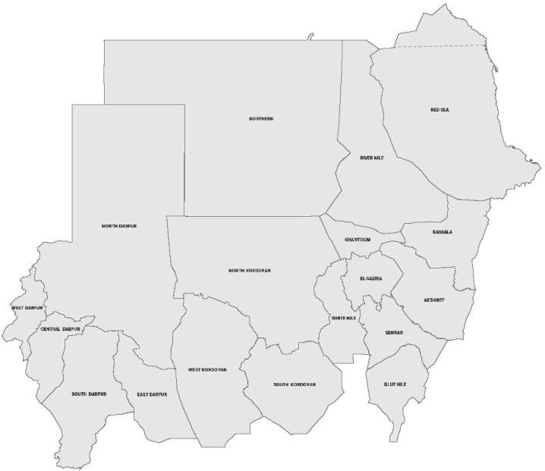
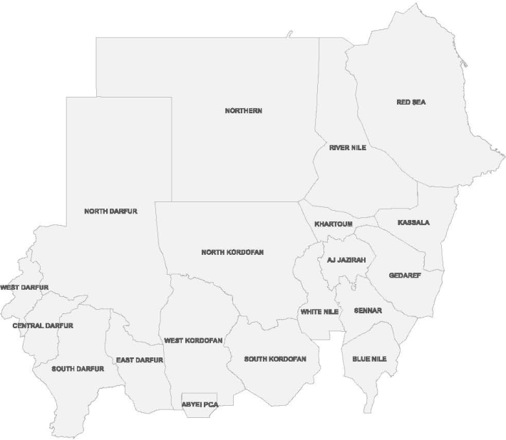
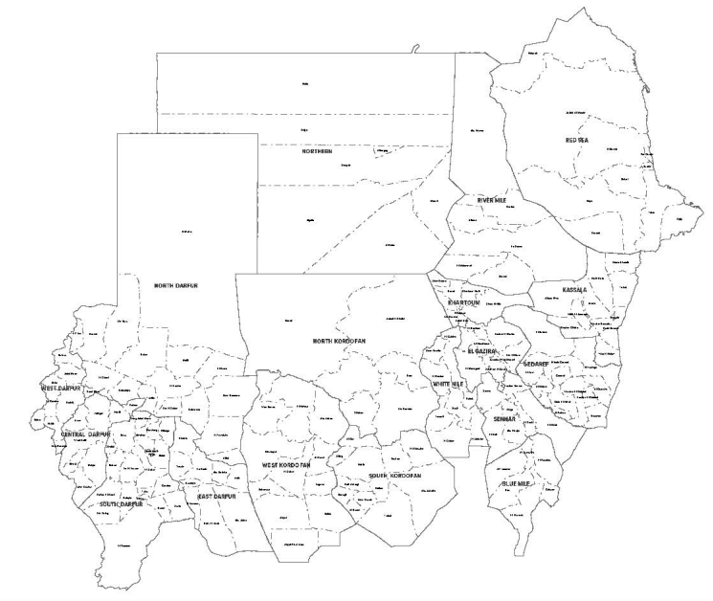
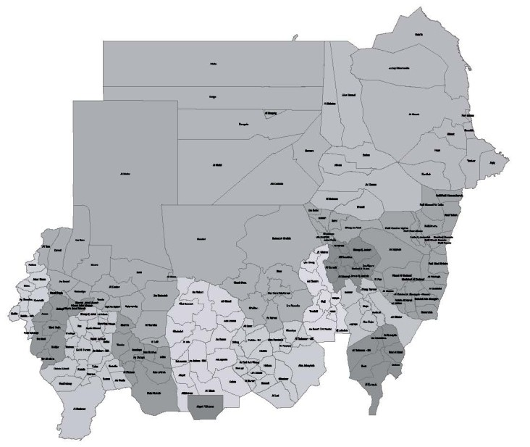
The diﬀerences in Sudan Map between 2014 and 2020
as of 4 March 2020
Changes on States and
Localities - National Level:
2014
2020
Number of states remained as
18 states
Number of Localities increased
from 171 localists to
188 localities
The depiction and use of boundaries, geographic names and related data shown on maps and included in lists, tables, documents, and databases are not warranted to be error free nor do they necessarily imply official endorsement or acceptance by the United Nations. Final status of the Abyei area is not yet determined.
Creation date: 2 April 2020 Sources: OCHA Feedback: Information Management "sudkhim@unhcr.org"

Slide 3
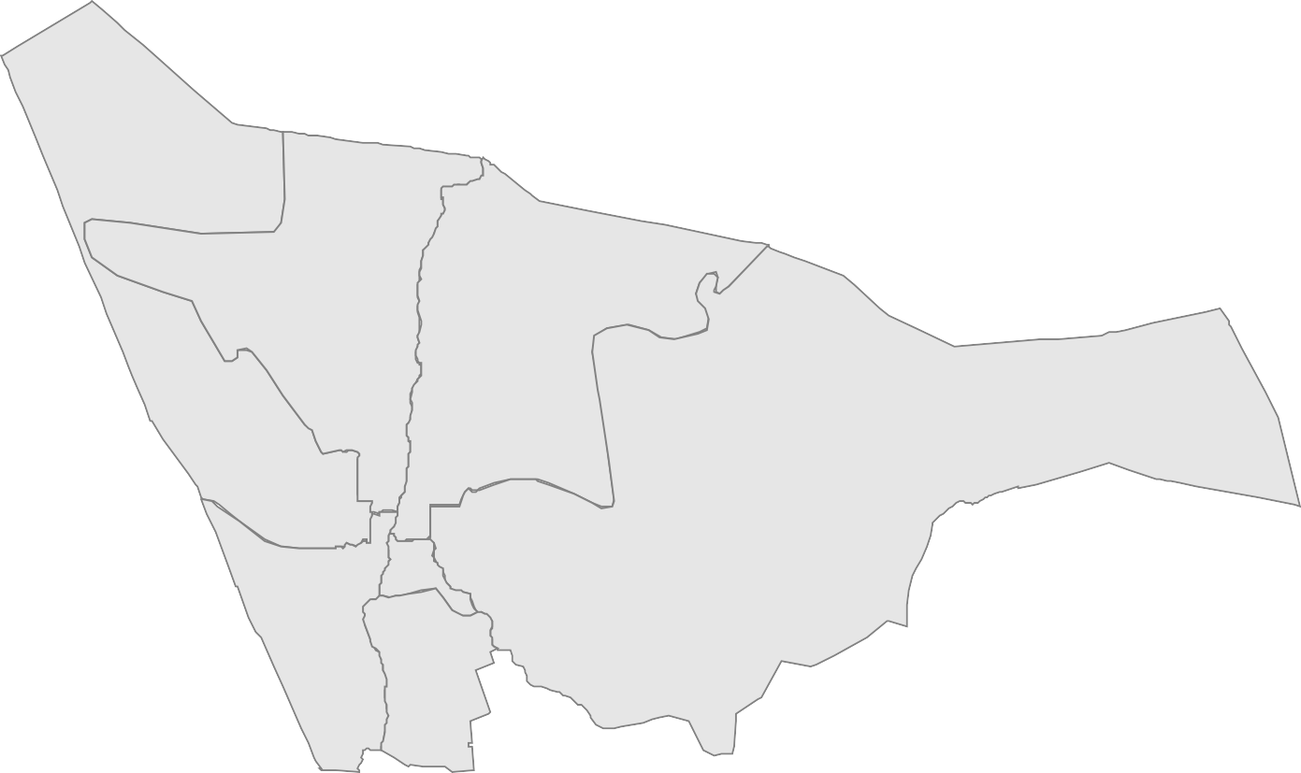
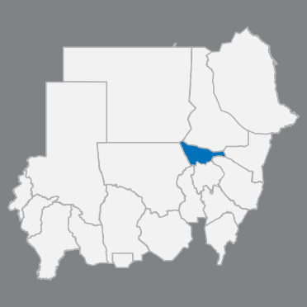
The diﬀerences in Sudan Map between 2014 and 2020
as of 4 March 2020
Khartoum State:
Number of localities remained as
7 localities
Khartoum | مﻮطﺮﺨﻟا
Um Durman | أم درمان
Um Bada | ةﺪﺒﻣأ
Karrari | كرري
Sharg An Neel | شرق النيل
Bahri | يﺮﺤﺑ
Jebel Awlia | جبل أولياء
Um Bada
Karrari
Bahri
Sharg An Neel
Um Durman
Khartoum
Jebel Awlia
The depiction and use of boundaries, geographic names and related data shown on maps and included in lists, tables, documents, and databases are not warranted to be error free nor do they necessarily imply official endorsement or acceptance by the United Nations. Final status of the Abyei area is not yet determined.
Creation date: 2 April 2020 Sources: OCHA Feedback: Information Management "sudkhim@unhcr.org"

Slide 4
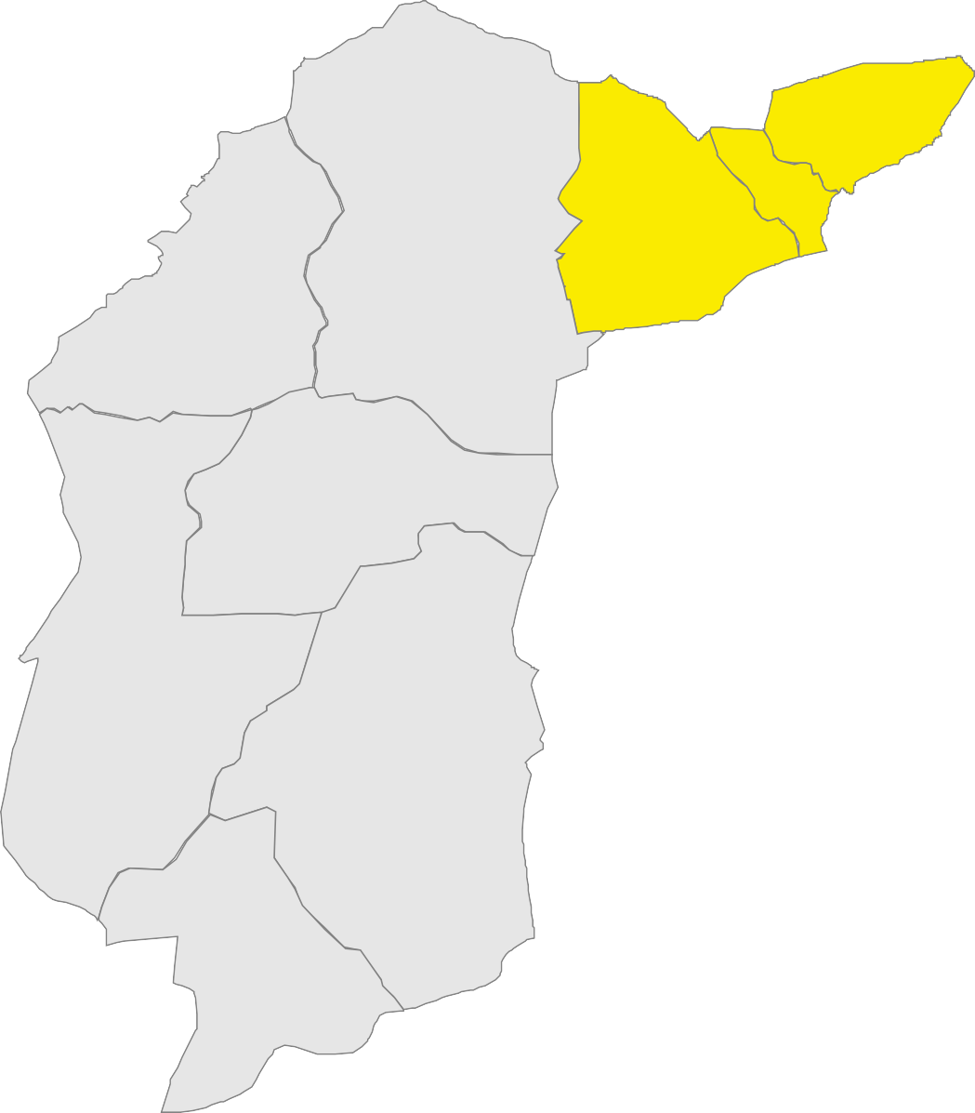
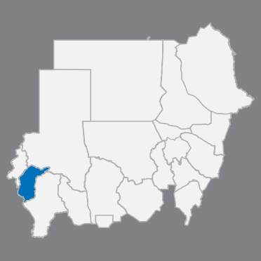
The diﬀerences in Sudan Map between 2014 and 2020
as of 4 March 2020
Central Darfur State:
Number of localities increased from 8 localities to
9 localities*
Shamal Jabal Marrah
¹Shamal Jabal Marrah | ةﺮﻣ ﻞﺒﺟ لﺎﻤﺷ
¹Wasat Jabal Marrah | ةﺮﻣ ﻞﺒﺟ ﻂﺳو
²Gharb Jabal Marrah | ةﺮﻣ ﻞﺒﺟ بﺮﻏ
Zalingi | زالنجي
Azum | أزوم
Wadi Salih | وادي صالح
Bendasi | ﻲﺳﺪﻨﺑ
Mukjar | ﺮﺠﻜﻣ
Um Dukhun | أم دخن
Gharb Jabal Marrah
Wasat Jabal Marrah
Zalingi
Azum
Wadi Salih
* Localities highlighted in yellow are the new localities
Bendasi
Mukjar
Um Dukhun
¹ Rokoro locality divided into two new localities Shamal and Wasat Jabal Marrah localities.
² Nertiti locality is the previous name of Gharb Jabal Marrah locality.
The depiction and use of boundaries, geographic names and related data shown on maps and included in lists, tables, documents, and databases are not warranted to be error free nor do they necessarily imply official endorsement or acceptance by the United Nations. Final status of the Abyei area is not yet determined.
Creation date: 2 April 2020 Sources: OCHA Feedback: Information Management "sudkhim@unhcr.org"

Slide 5
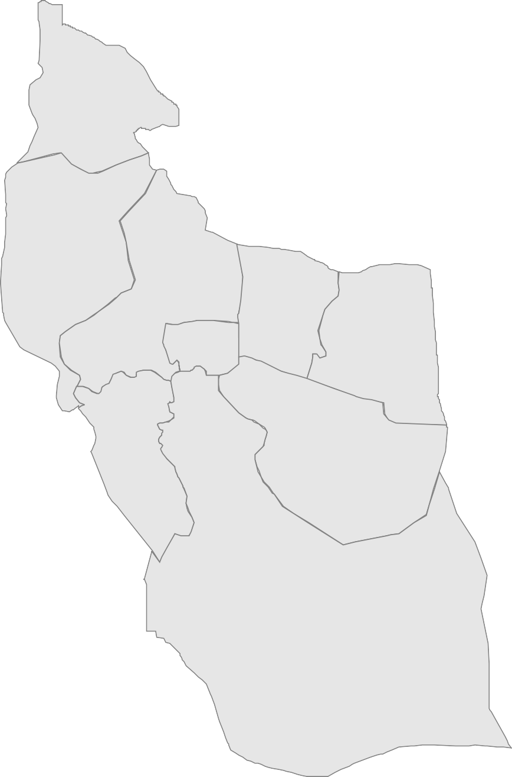
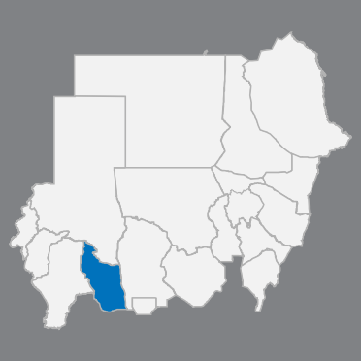
The diﬀerences in Sudan Map between 2014 and 2020
as of 4 March 2020
East Darfur State:
Number of localities remained as
9 localities
Shia'ria
Shia'ria | ﺔﻳﺮﯿﻌﺷ
Yassin | ﺲﻳ
Assalaya | ﺔﻳﻼﺴﻋ
Ad Du'ayn | ﻦﯿﻌﻀﻟا
Abu Karinka | ﺎﻜﻧﺮﻛ ﻮﺑأ
Adila | ﺔﻠﻳﺪﻋ
Abu Jabrah | ةﺮﺑﺎﺟ ﻮﺑأ
Al Firdous | الفردوس
Bahr Al Arab | بحر العرب
Yassin
Assalaya
Abu Karinka
Ad Du'ayn
Adila
Al Firdous
Abu Jabrah
Bahr Al Arab
The depiction and use of boundaries, geographic names and related data shown on maps and included in lists, tables, documents, and databases are not warranted to be error free nor do they necessarily imply official endorsement or acceptance by the United Nations. Final status of the Abyei area is not yet determined.
Creation date: 2 April 2020 Sources: OCHA Feedback: Information Management "sudkhim@unhcr.org"

Slide 6
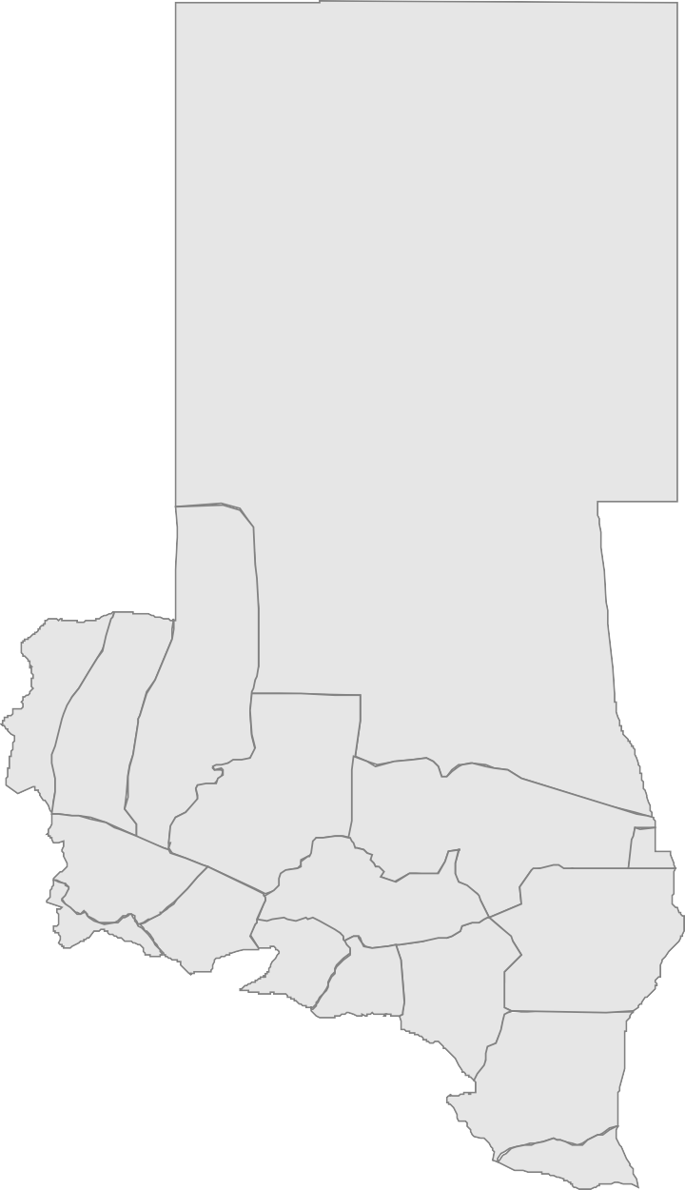
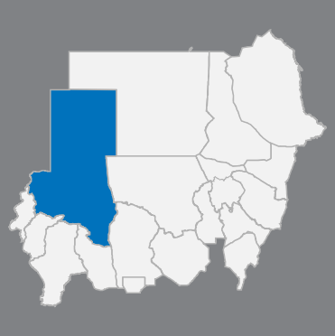
The diﬀerences in Sudan Map between 2014 and 2020
as of 4 March 2020
North Darfur State:
Number of localities remained as
17 localities
Al Malha | ﺔﺤﻟﺎﻤﻟا
At Tina | ﺔﻨﯿﻄﻟا
Kernoi | يﻮﻧﺮﻛ
Um Baru | أم برو
Kutum | ﻢﺘﻛ
Melit | ﻂﯿﻠﻣ
Al Koma | ﺔﻣﻮﻜﻟا
Um Kadadah | أم كدادة
Kelemando | وﺪﻨﻤﻠﻛ
Al Fasher | ﺮﺷﺎﻔﻟا
Dar As Salam | دار السلام
Tawila | ﺔﻠﻳﻮط
Kebkabiya | ﺔﯿﺑﺎﻜﺒﻛ
As Serief | ﻒﻳﺮﺴﻟا
Saraf Omra | ةﺮﻤﻋ فﺮﺳ
At Tawisha | ﺔﺸﻳﻮﻄﻟا
Al Lait | ﺖﯿﻌﻠﻟا
Al Malha
At Tina
Kernoi Um Baru
Kutum
Melit
As Serief
Al Koma
Saraf Omra
Kebkabiya
Al Fasher
Tawila
Um Kadadah
Dar
Kelemando
As Salam
At Tawisha
Al Lait
The depiction and use of boundaries, geographic names and related data shown on maps and included in lists, tables, documents, and databases are not warranted to be error free nor do they necessarily imply official endorsement or acceptance by the United Nations. Final status of the Abyei area is not yet determined.
Creation date: 2 April 2020 Sources: OCHA Feedback: Information Management "sudkhim@unhcr.org"

Slide 7
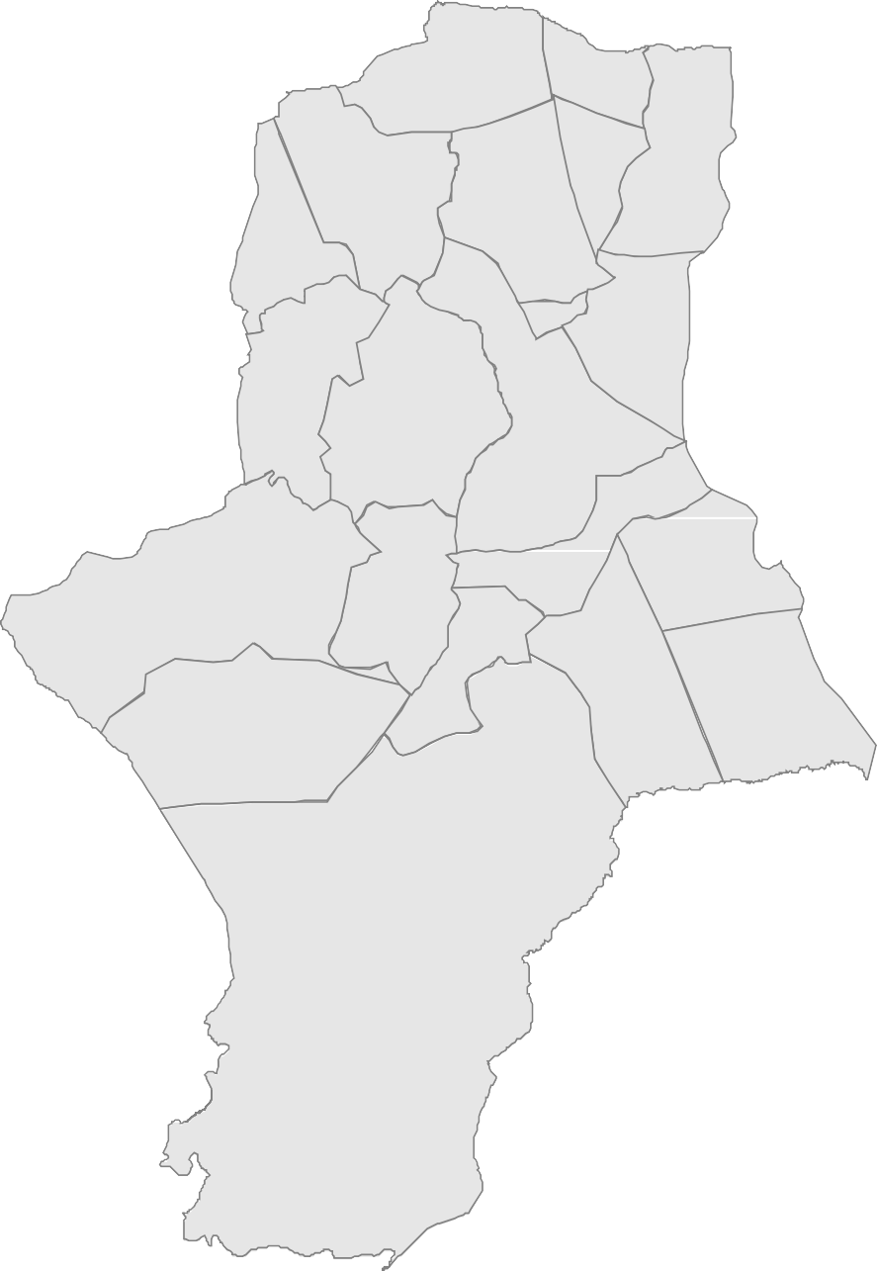
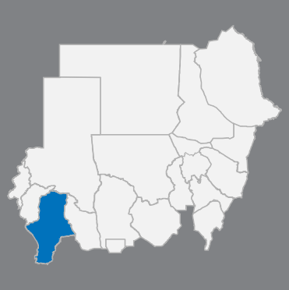
The diﬀerences in Sudan Map between 2014 and 2020
as of 4 March 2020
South Darfur State:
Number of localities remained as
21 localities
Sharg Aj Jabal
Al Wihda
Mershing
Sharg Aj Jabal | شرق الجبل
Al Wihda | ةﺪﺣﻮﻟا
Nitega | ﺔﻘﯿﺘﻧ
Mershing | ﺞﻨﺷﺮﻣ
Nyala Shimal | لﺎﻤﺷ ﻻﺎﯿﻧ
Nyala Janoub | بﻮﻨﺟ ﻻﺎﯿﻧ
Kas | سﺎﻛ
Shattaya | ﺔﻳﺎﻄﺷ
Kubum | ﻢﺒﻛ
Ed Al Fursan | الفرسانﺪﻋ
As Salam - SD | ج د- مﻼﺴﻟا
Beliel | ﻞﯿﻠﺑ
Tulus | ﺲﻠﺗ
Gereida | ﺔﻀﻳﺮﻗ
As Sunta | ﺔﻄﻨﺴﻟا
Buram | برام
Damso | ﻮﺴﻣد
Kateila | ﻼﯿﺘﻛ
Rehaid Albirdi | رهيد البردي
Um Dafoug | أم دافوق
Al Radoum | الردوم
Kas
Nyala Shimal
Nitega
Shattaya
Nyala Janoub
Kubum
Beliel
Ed Al Fursan
As Salam - SD
Tulus
Gereida
Rehaid Albirdi
Kateila
Damso
Buram
Um Dafoug
As Sunta
Al Radoum
The depiction and use of boundaries, geographic names and related data shown on maps and included in lists, tables, documents, and databases are not warranted to be error free nor do they necessarily imply official endorsement or acceptance by the United Nations. Final status of the Abyei area is not yet determined.
Creation date: 2 April 2020 Sources: OCHA Feedback: Information Management "sudkhim@unhcr.org"

Slide 8
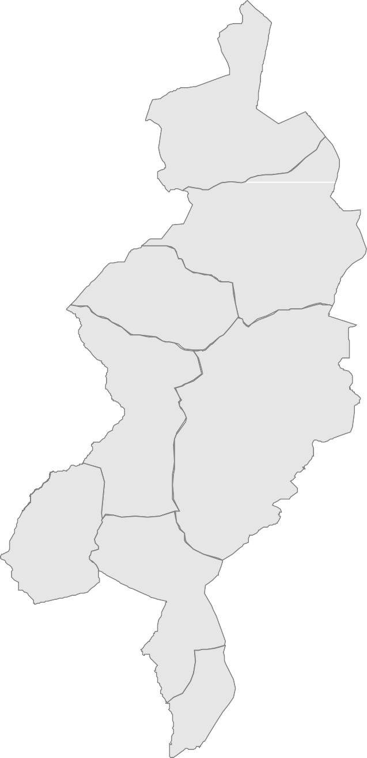
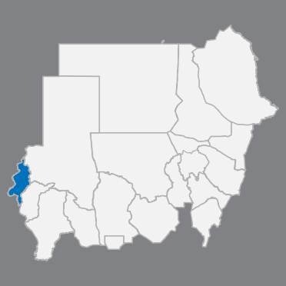
The diﬀerences in Sudan Map between 2014 and 2020
as of 4 March 2020
West Darfur State:
Number of localities remained as
8 localities
Kulbus | ﺲﺒﻠﻛ
Jebel Moon | نﻮﻣ ﻞﺒﺟ
Sirba | ﺎﻳﺮﺳ
Ag Geneina | ﺔﻨﯿﻨﺠﻟا
Kereneik | ﻚﻨﻳﺮﻛ
Beida | ﺎﻀﯿﺑ
Habila - WD | غ د- ﺔﻠﯿﺒھ
Foro Baranga | ﺎﻘﻧﺮﺑ رﻮﻓ
Kulbus
Jebel Moon
Sirba
Kereneik
Ag Geneina
Beida
Habila - WD
Foro Baranga
The depiction and use of boundaries, geographic names and related data shown on maps and included in lists, tables, documents, and databases are not warranted to be error free nor do they necessarily imply official endorsement or acceptance by the United Nations. Final status of the Abyei area is not yet determined.
Creation date: 2 April 2020 Sources: OCHA Feedback: Information Management "sudkhim@unhcr.org"

Slide 9
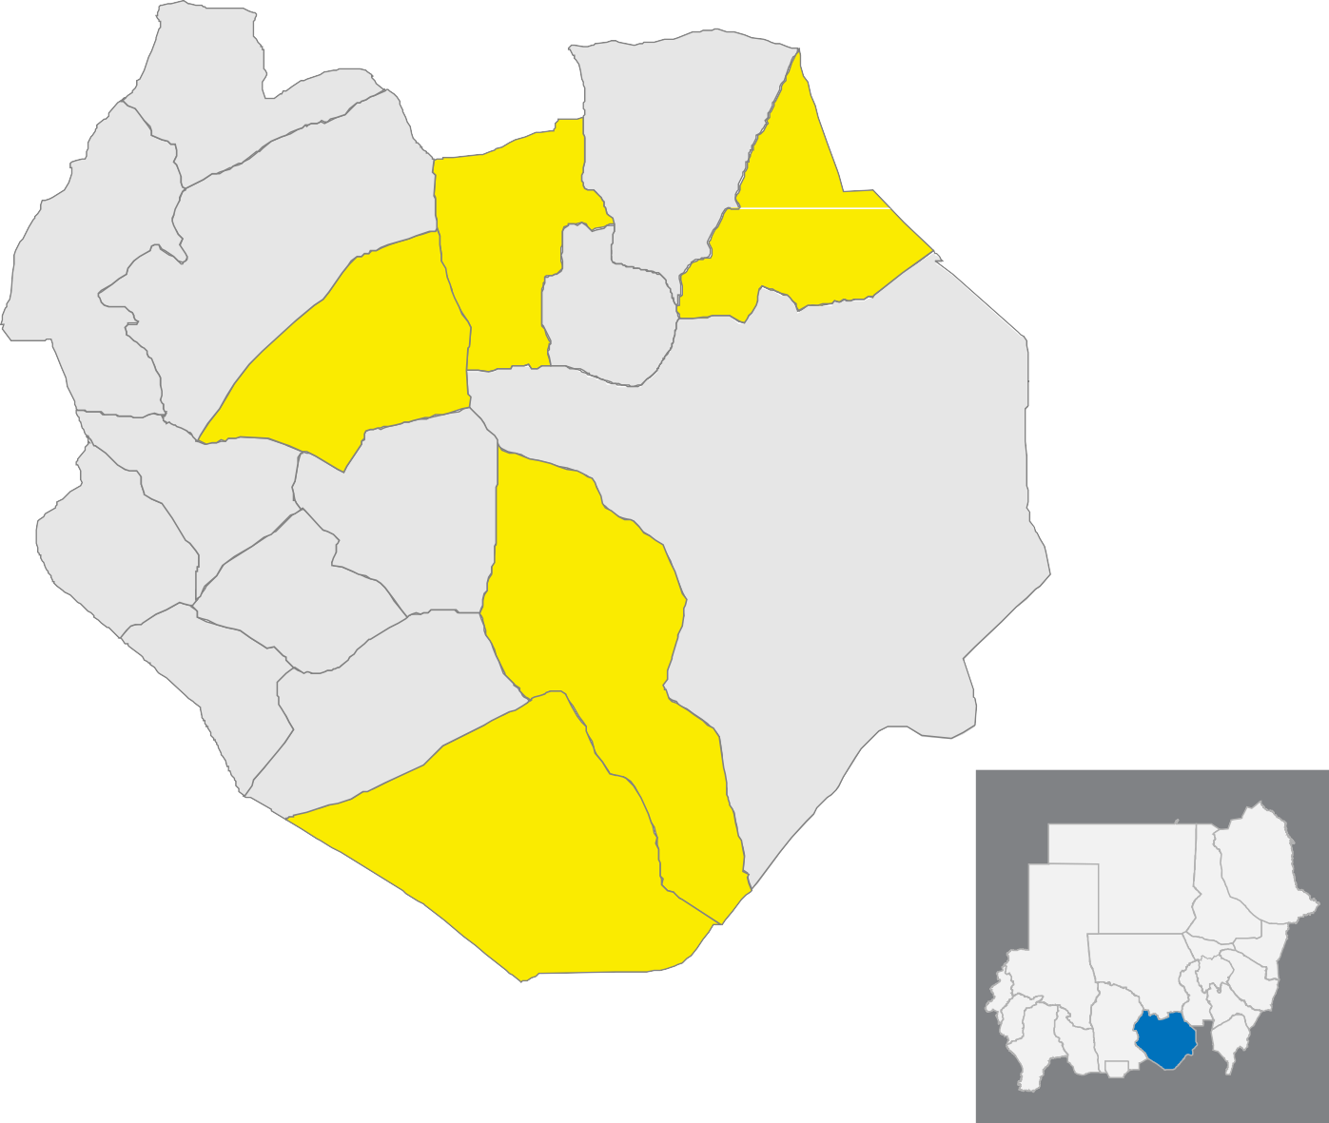
The diﬀerences in Sudan Map between 2014 and 2020
as of 4 March 2020
South Kordofan State:
Number of localities increased from 12 localities to
17 localities*
Abassiya | ﺔﯿﺳﺎﺒﻌﻟا
At Tadamon - SK | ج ك- ﻦﻣﺎﻀﺘﻟا
Abu Kershola | ﻻﻮﺷﺮﻛ ﻮﺑأ
Ar Rashad | دﺎﺷﺮﻟا
Abu Jubayhah | ﺔﮫﯿﺒﺟ ﻮﺑأ
Ghadeer | ﺮﻳﺪﻏ
Al Leri | يﺮﯿﻠﻟا
Talawdi | تلودي
Al Buram | البرام
Um Durein | أم دورين
Heiban | نﺎﺒﯿھ
Kadugli | ﻲﻠﻗدﺎﻛ
Ar Reif Ash Shargi | الريف الشرقي
Delami | ﻲﻣﻻد
Habila - SK | ج ك- ﺔﻠﯿﺒھ
Dilling | ﺞﻨﻟﺪﻟا
Al Quoz | زﻮﻘﻟا
Al Quoz
Abassiya
Abu Kershola
Dilling
Habila - SK
At Tadamon
- SK
Ar Rashad
Delami
Ar Reif Ash Shargi
Abu Jubayhah
Heiban
Kadugli
Um Durein
Ghadeer
Al Buram
Talawdi
Al Leri
* Localities highlighted in yellow are the new localities
The depiction and use of boundaries, geographic names and related data shown on maps and included in lists, tables, documents, and databases are not warranted to be error free nor do they necessarily imply official endorsement or acceptance by the United Nations. Final status of the Abyei area is not yet determined.
Creation date: 2 April 2020 Sources: OCHA Feedback: Information Management "sudkhim@unhcr.org"

Slide 10
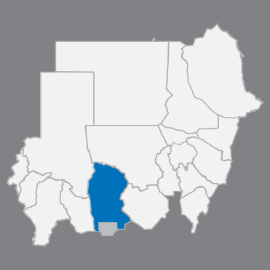
The diﬀerences in Sudan Map between 2014 and 2020
as of 4 March 2020
West Kordofan State:
Number of localities increased from 10 localities to
14 localities*
An Nuhud
Al Khiwai | يﻮﺨﻟا
Abu Zabad | زيدﻮﺑأ
An Nuhud | دﻮﮫﻨﻟا
Wad Bandah | ود بندة
As Sunut | طﻮﻨﺴﻟأ
Al Idia | ﺔﯿﺿﻷا
Ghubaish | ﺶﯿﺒﻏ
Al Lagowa | لقاوة
As Salam - WK | غ ك- مﻼﺴﻟا
Babanusa | ﺔﺳﻮﻨﺑﺎﺑ
Keilak | ﻚﻠﯿﻛ
Al Dibab | ﺐﺑﺪﻟا
Abyei | ﻲﯿﺑأ
Al Meiram | مﺮﯿﻤﻟا
Al Khiwai
Wad Bandah
Abu Zabad
Ghubaish
As Sunut
Al Idia
As Salam
- WK
Al Lagowa
Babanusa
Abyei
Keilak
Al Meiram
Al Dibab
A PCA area
* Localities highlighted in yellow are the new localities
The depiction and use of boundaries, geographic names and related data shown on maps and included in lists, tables, documents, and databases are not warranted to be error free nor do they necessarily imply official endorsement or acceptance by the United Nations. Final status of the Abyei area is not yet determined.
Creation date: 2 April 2020 Sources: OCHA Feedback: Information Management "sudkhim@unhcr.org"

Slide 11
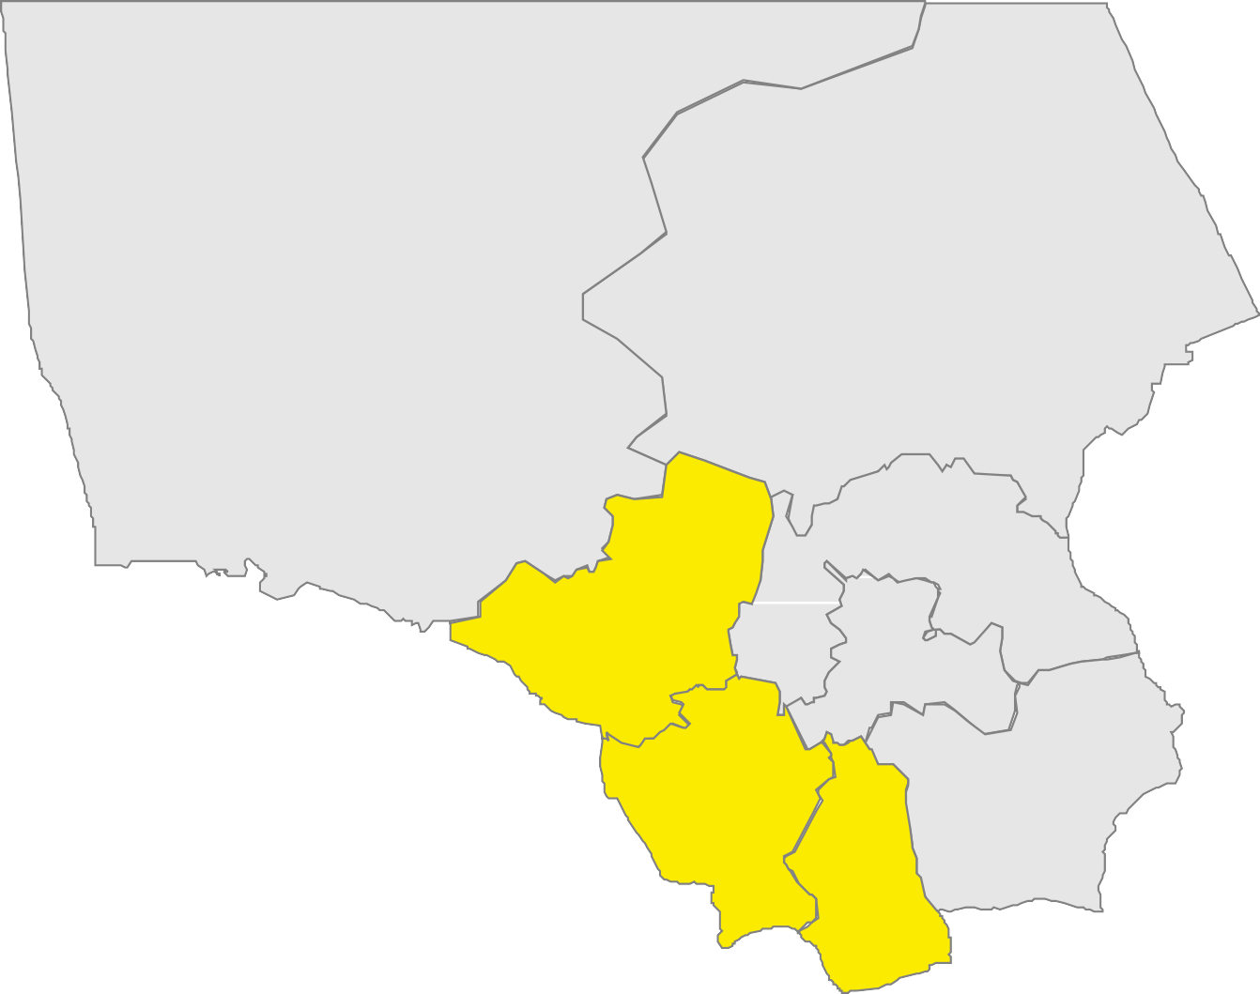
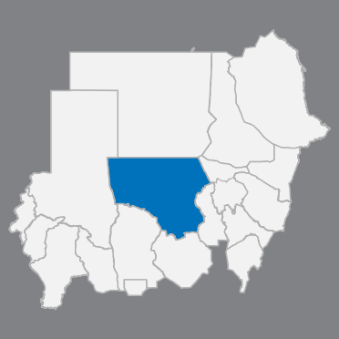
The diﬀerences in Sudan Map between 2014 and 2020
as of 4 March 2020
North Kordofan State:
Number of localities increased from 5 localities to
8 localities*
Gebrat Al Sheikh | ةﺮﺒﺟ ﺦﯿﺸﻟا
Soudari | سودري
Bara | بارا
Gharb Bara | ارﺎﺑ بﺮﻏ
Um Dam Haj Ahmed | أم دم حاج أحمد
Um Rawaba | أم روابة
Ar Rahad | ﺪھﺮﻟا
Sheikan | نﺎﻜﯿﺷ
Soudari
Gebrat Al Sheikh
* Localities highlighted in yellow are the new localities
Bara
Gharb Bara
Um Dam Haj Ahmed
Sheikan
Um Rawaba
Ar Rahad
The depiction and use of boundaries, geographic names and related data shown on maps and included in lists, tables, documents, and databases are not warranted to be error free nor do they necessarily imply official endorsement or acceptance by the United Nations. Final status of the Abyei area is not yet determined.
Creation date: 2 April 2020 Sources: OCHA Feedback: Information Management "sudkhim@unhcr.org"

Slide 12
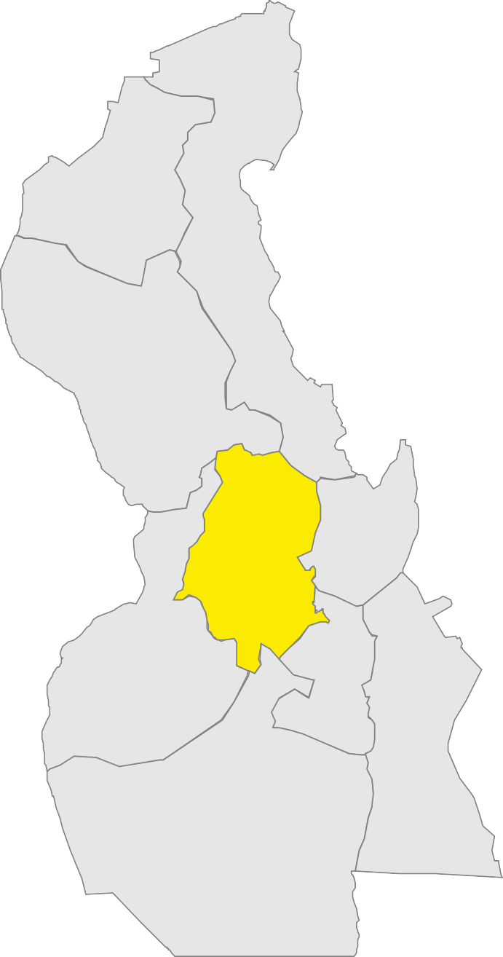
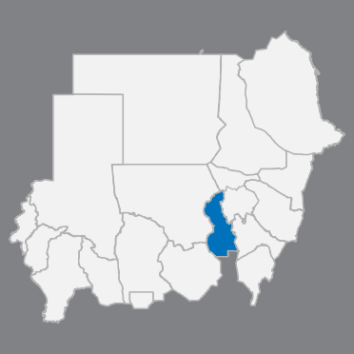
The diﬀerences in Sudan Map between 2014 and 2020
as of 4 March 2020
White Nile State:
Number of localities increased from 8 localities to
9 localities*
Al Gitaina
Al Gitaina | ﺔﻨﯿﻄﻘﻟا
Um Rimta | أم رمتة
Ad Diwaim | ﻢﻳوﺪﻟا
Rabak | ﻚﺑر
Guli | ﻲﻠﻗ
Tendalti | ﻲﺘﻟﺪﻨﺗ
Kosti | ﻲﺘﺳﻮﻛ
As Salam / Ar Rawat | السلام / الراوات
Aj Jabalain | ﻦﯿﻠﺒﺠﻟا
Um Rimta
Ad Diwaim
Rabak
Guli
* Localities highlighted in yellow are the new localities
Kosti
Tendalti
As Salam / Ar Rawat
Aj Jabalain
The depiction and use of boundaries, geographic names and related data shown on maps and included in lists, tables, documents, and databases are not warranted to be error free nor do they necessarily imply official endorsement or acceptance by the United Nations. Final status of the Abyei area is not yet determined.
Creation date: 2 April 2020 Sources: OCHA Feedback: Information Management "sudkhim@unhcr.org"

Slide 13
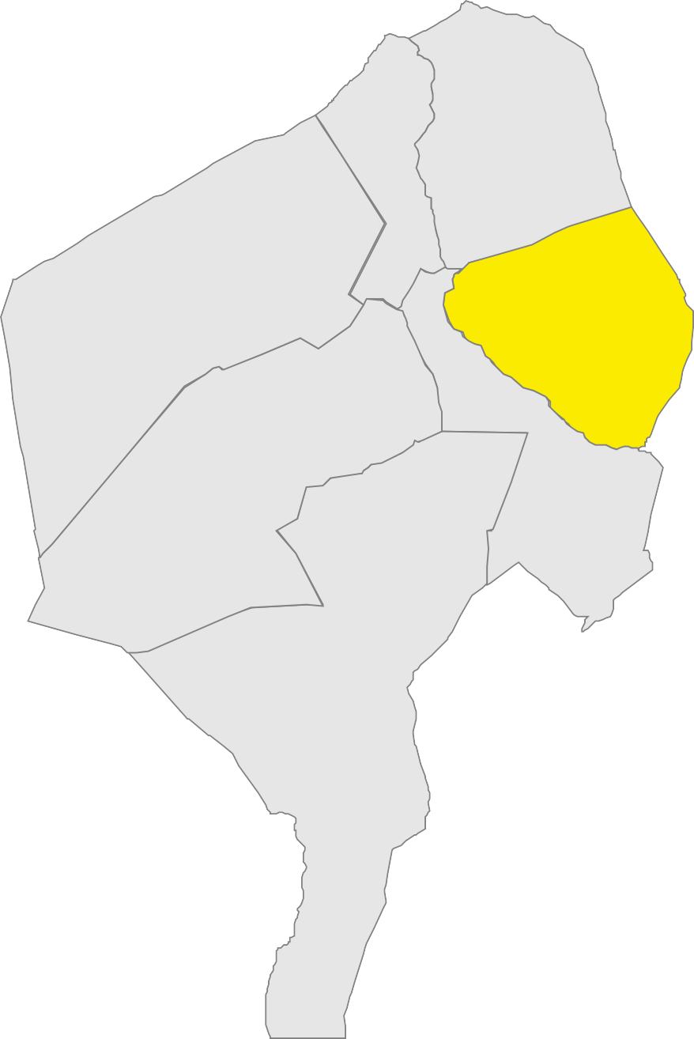
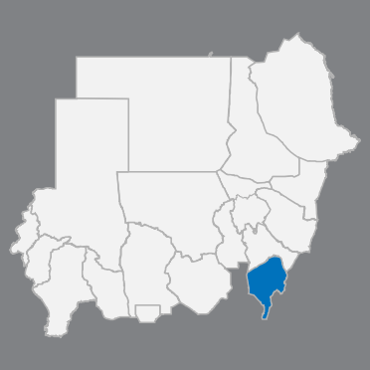
The diﬀerences in Sudan Map between 2014 and 2020
as of 4 March 2020
Blue Nile State:
Number of localities increased from 6 localities to
7 localities*
Ed Damazine
Ar Rusayris
Ed Damazine | ﻦﻳزﺎﻣﺪﻟا
Ar Rusayris | الروصيرص
Wad Al Mahi | ود الماحي
Geisan | نﺎﺴﯿﻗ
Al Kurmuk | ﻚﻣﺮﻜﻟا
Baw | وﺎﺑ
At Tadamon - BN | ن ق- ﻦﻣﺎﻀﺘﻟا
At Tadamon - BN
Wad Al Mahi
Baw
Geisan
* Localities highlighted in yellow are the new localities
Al Kurmuk
The depiction and use of boundaries, geographic names and related data shown on maps and included in lists, tables, documents, and databases are not warranted to be error free nor do they necessarily imply official endorsement or acceptance by the United Nations. Final status of the Abyei area is not yet determined.
Creation date: 2 April 2020 Sources: OCHA Feedback: Information Management "sudkhim@unhcr.org"

Slide 14


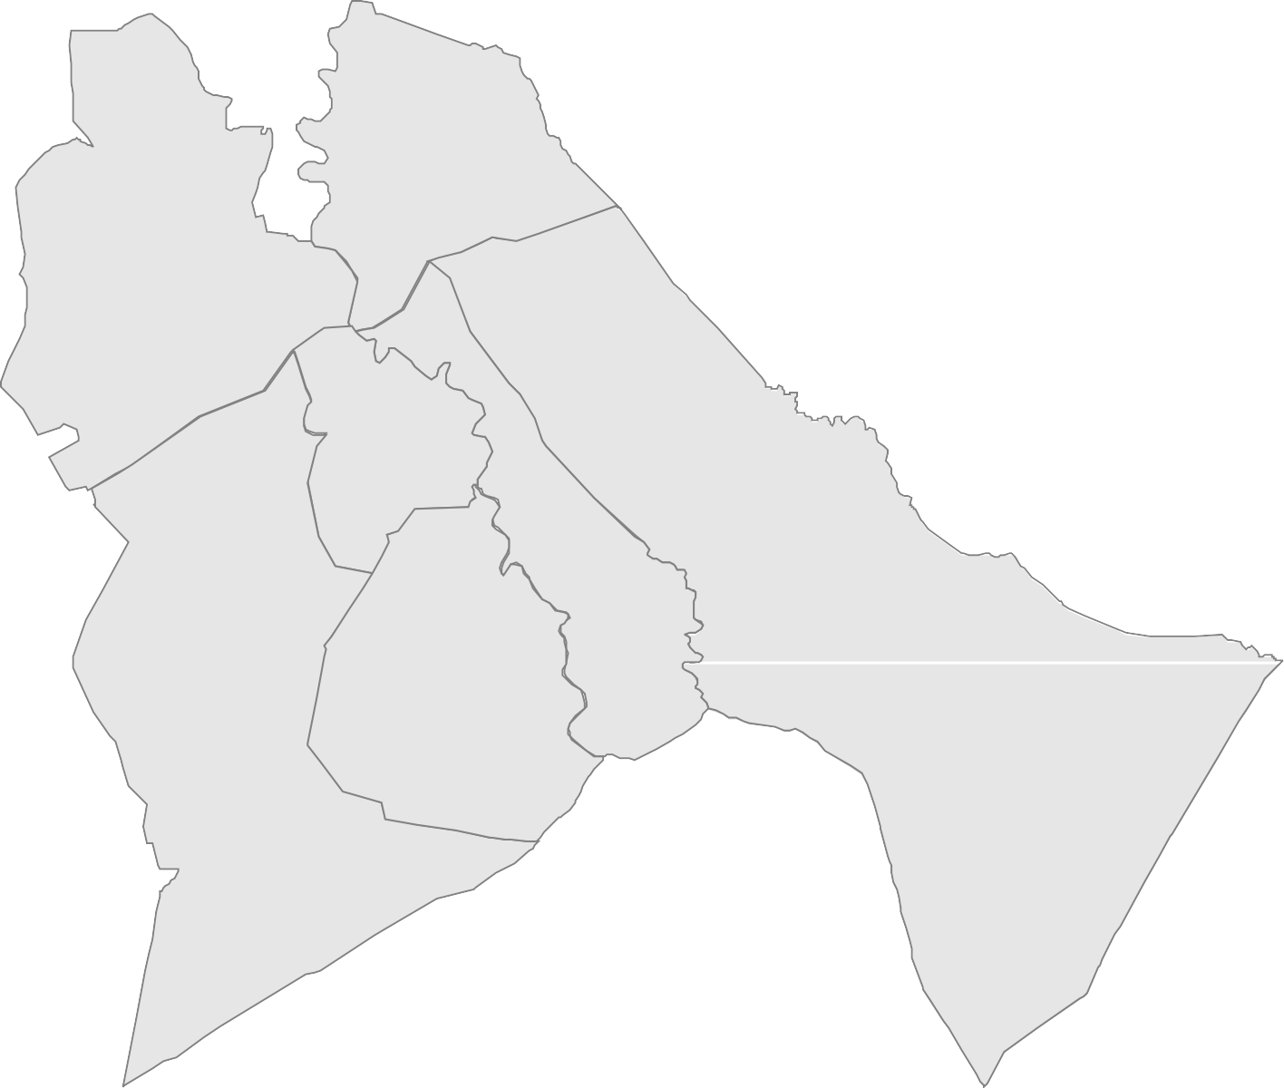
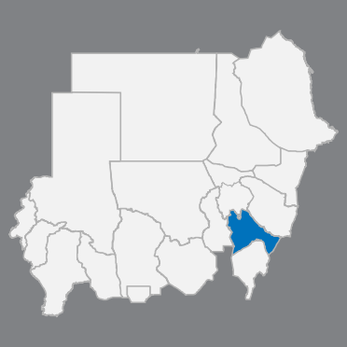
The diﬀerences in Sudan Map between 2014 and 2020
as of 4 March 2020
Sennar State:
Number of localities remained as
7 localities
Sharg Sennar | رﺎﻨﺳ قﺮﺷ
Sennar | رﺎﻨﺳ
Ad Dinder | رﺪﻧﺪﻟا
As Suki | السوكي
Sinja | ﺔﺠﻨﺳ
Ad Dali | ﻲﻟاﺪﻟا
Abu Hujar | رﺎﺠﺣ ﻮﺑأ
Sharg Sennar
Sennar
Sinja
As Suki
Ad Dinder
Ad Dali
Abu Hujar
The depiction and use of boundaries, geographic names and related data shown on maps and included in lists, tables, documents, and databases are not warranted to be error free nor do they necessarily imply official endorsement or acceptance by the United Nations. Final status of the Abyei area is not yet determined.
Creation date: 2 April 2020 Sources: OCHA Feedback: Information Management "sudkhim@unhcr.org"

Slide 15
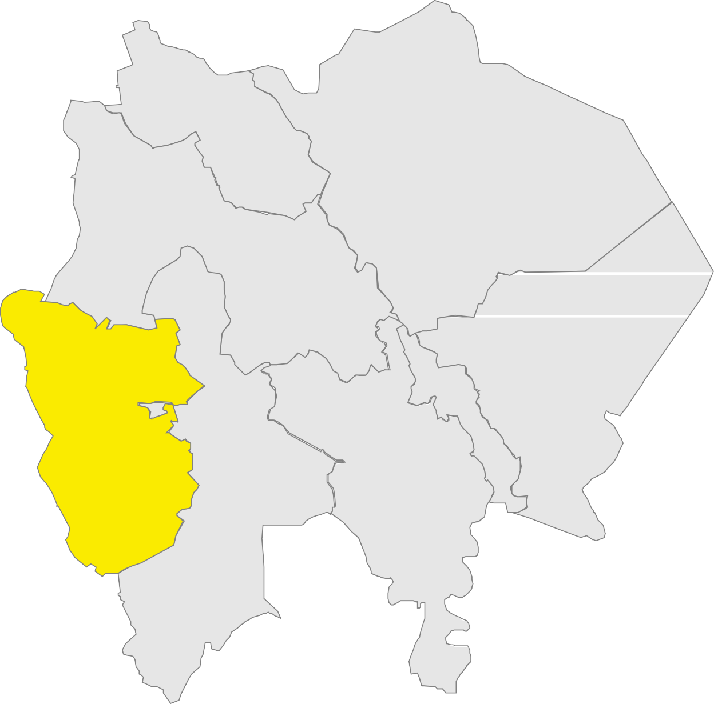
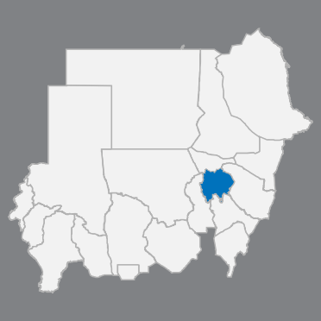
The diﬀerences in Sudan Map between 2014 and 2020
as of 4 March 2020
Aj Jazirah State:
Number of localities increased from 7 localities to
8 localities*
Sharg Aj Jazirah | شرق الجزيره
Al Kamlin | ﻦﯿﻠﻣﺎﻜﻟا
Al Hasahisa | ﺎﺼﯿﺣﺎﺼﺤﻟا
Um Algura | أم القرى
Medani Al Kubra | مدني الكبرى
Janub Aj Jazirah | جنوب الجزيرة
Al Manaqil | ﻞﻗﺎﻨﻤﻟا
Al Qurashi | ﻲﺷﺮﻘﻟا
Al Kamlin
Sharg Aj Jazirah
Al Hasahisa
Medani Al Kubra
Um Algura
* Localities highlighted in yellow are the new localities
Al Qurashi
Al Manaqil
Janub Aj Jazirah
The depiction and use of boundaries, geographic names and related data shown on maps and included in lists, tables, documents, and databases are not warranted to be error free nor do they necessarily imply official endorsement or acceptance by the United Nations. Final status of the Abyei area is not yet determined.
Creation date: 2 April 2020 Sources: OCHA Feedback: Information Management "sudkhim@unhcr.org"

Slide 16
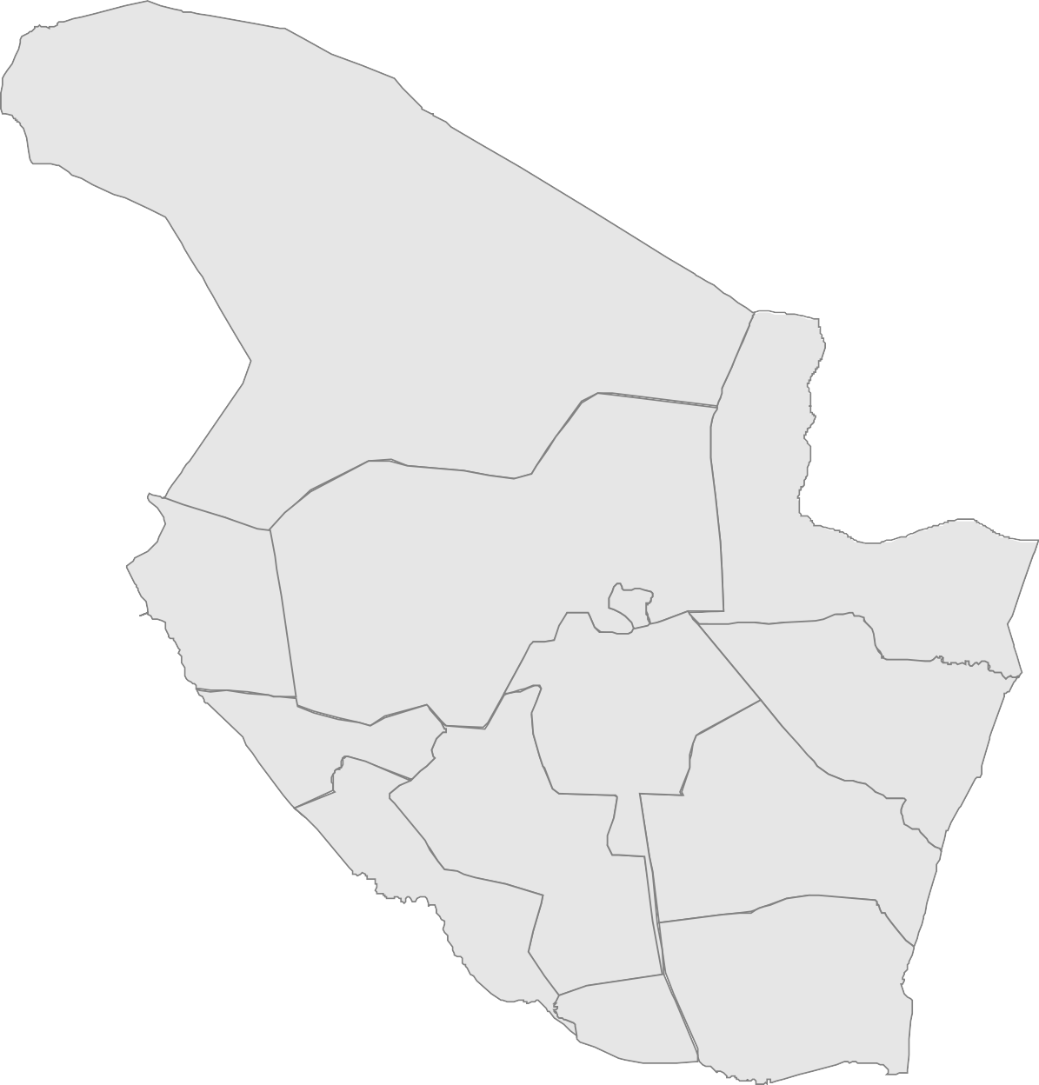
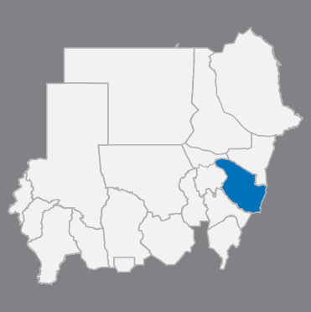
The diﬀerences in Sudan Map between 2014 and 2020
as of 4 March 2020
Gedaref State:
Number of localities remained as
12 localities
Al Butanah | ﺔﻧﺎﻄﺒﻟا
Al Fashaga | ﺔﻘﺸﻔﻟا
Wasat Al Gedaref | وسط القضارف
Madeinat Al Gedaref | مدينة القضارف
Al Fao | وﺎﻔﻟا
Al Qureisha | القرش
Galabat Ash-Shargiah | القلابات الشرقية
Gala'a Al Nahal | قلع النحل
Al Mafaza | المفازة
Ar Rahad | ﺪھﺮﻟا
Basundah | ةﺪﻨﺳﺎﺑ
Al Galabat Al Gharbyah - Kassab | القلابات الغربية – كساب
Al Butanah
Wasat
Al Gedaref
Madeinat Al Gedaref
Al Fashaga
Al Fao
Al Galabat Al Gharbyah
- Kassab
Al Qureisha
Al Mafaza
Gala'a Al Nahal
Galabat Ash-Shargiah
Ar Rahad
Basundah
The depiction and use of boundaries, geographic names and related data shown on maps and included in lists, tables, documents, and databases are not warranted to be error free nor do they necessarily imply official endorsement or acceptance by the United Nations. Final status of the Abyei area is not yet determined.
Creation date: 2 April 2020 Sources: OCHA Feedback: Information Management "sudkhim@unhcr.org"

Slide 17
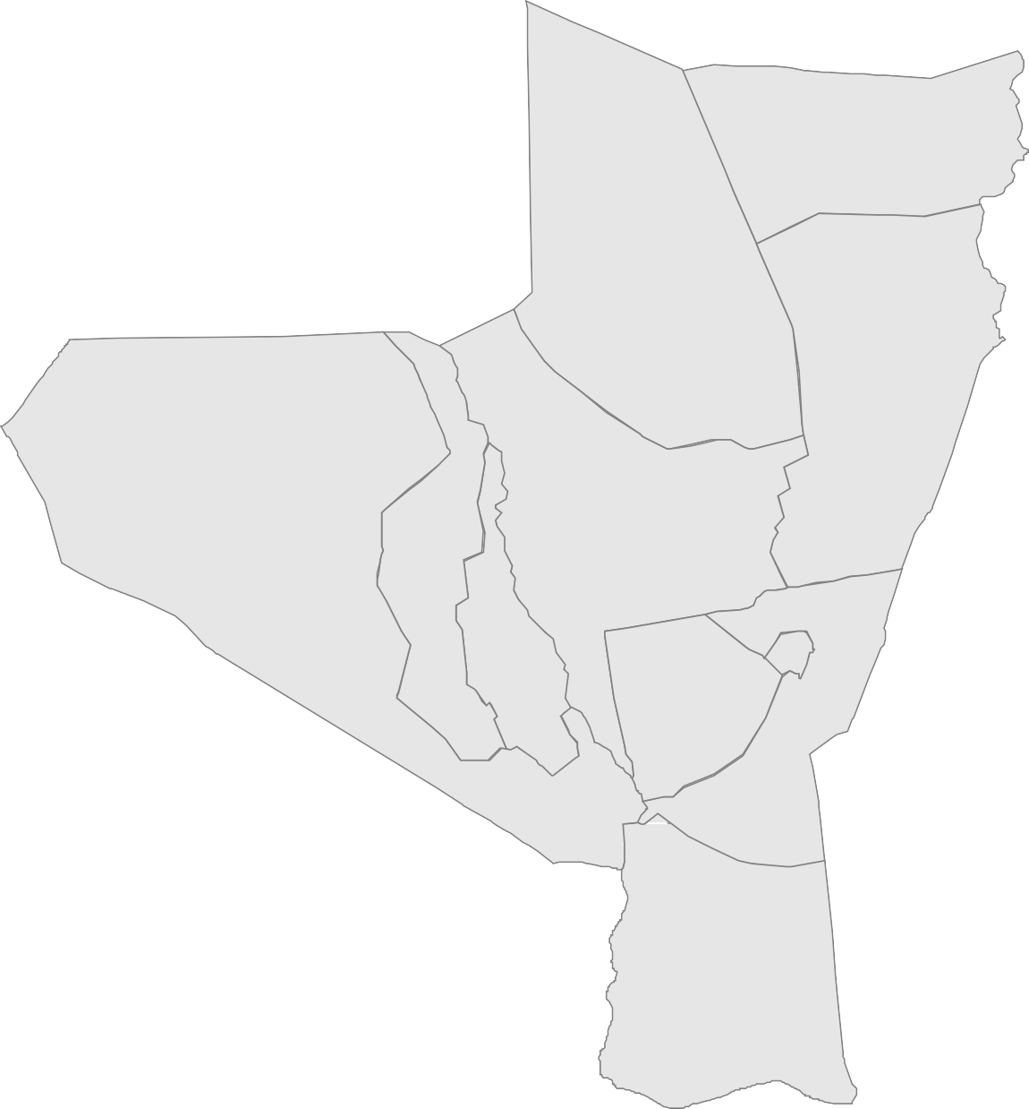
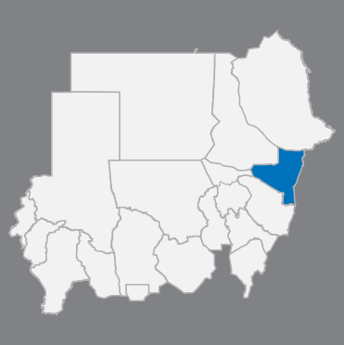
The diﬀerences in Sudan Map between 2014 and 2020
as of 4 March 2020
Kassala State:
Number of localities remained as
11 localities
Reiﬁ Reiﬁ Hamashkureib
Reiﬁ Reiﬁ Hamashkureib | ريفي همش كوريب
Reiﬁ Shamal Ad Delta | لﺎﻤﺷ ﻰﻔﻳر ﺎﺘﻟﺪﻟا
Reiﬁ Telkok | كﻮﻜﻠﺗ ﻰﻔﻳر
Reiﬁ Aroma | ريفي أروما
Halfa Aj Jadeedah | حلفا الجديدة
Reiﬁ Nahr Atbara | ةﺮﺒﻄﻋ ﺮﮫﻧ ﻰﻔﻳر
Reiﬁ Khashm Elgirba | ﻢﺸﺧ ﻰﻔﻳر ﺔﺑﺮﻘﻟا
Reiﬁ Kassla | ﻼﺴﻛ ﻰﻔﻳر
Madeinat Kassala | ﻼﺴﻛ ﺔﻨﻳﺪﻣ
Reiﬁ Gharb Kassala | بﺮﻏ ﻰﻔﻳر ﻼﺴﻛ
Reiﬁ Wad Elhilaiw | ريفي ود الحليو
Reiﬁ Shamal Ad Delta
Reiﬁ Telkok
Reiﬁ Khashm Elgirba
Reiﬁ Nahr Atbara
Reiﬁ Aroma
Halfa
Aj Jadeedah
Madeinat Kassala
Reiﬁ Gharb Kassala
Reiﬁ Kassla
Reiﬁ Wad Elhilaiw
The depiction and use of boundaries, geographic names and related data shown on maps and included in lists, tables, documents, and databases are not warranted to be error free nor do they necessarily imply official endorsement or acceptance by the United Nations. Final status of the Abyei area is not yet determined.
Creation date: 2 April 2020 Sources: OCHA Feedback: Information Management "sudkhim@unhcr.org"

Slide 18
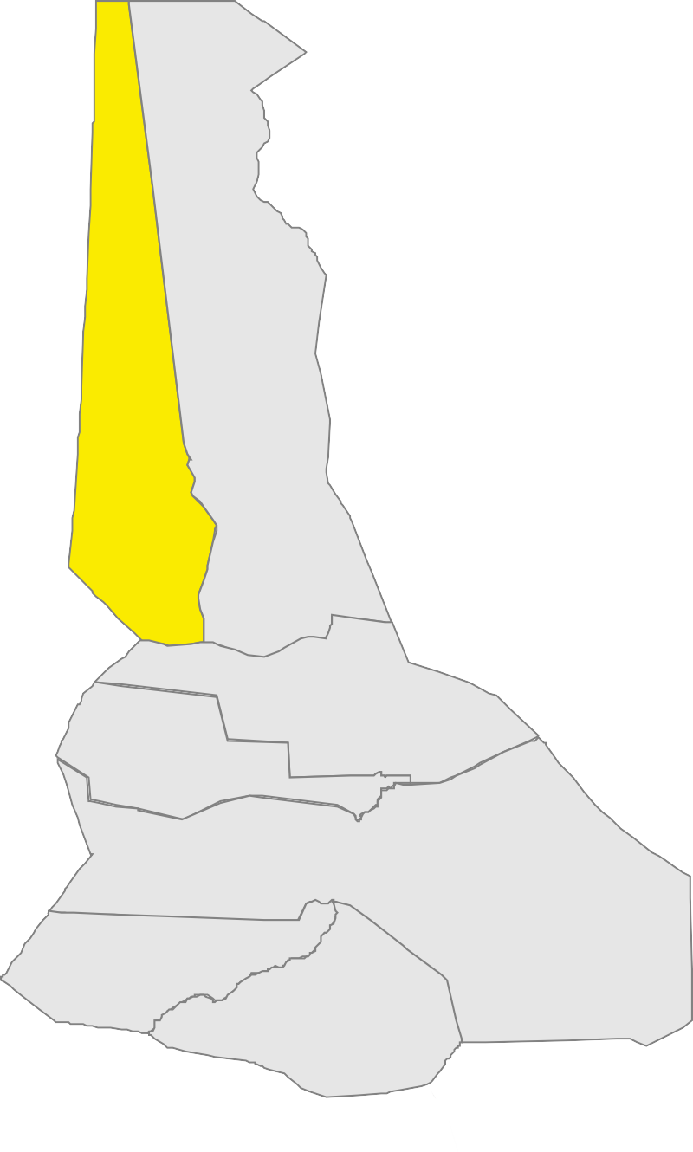
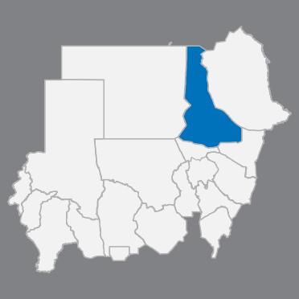
The diﬀerences in Sudan Map between 2014 and 2020
as of 4 March 2020
River Nile State:
Number of localities increased from 6 localities to
7 localities*
Al Buhaira | ةﺮﯿﺤﺒﻟا
Abu Hamad | ﺪﻤﺣ ﻮﺑأ
Barbar | ﺮﺑﺮﺑ
Atbara | ةﺮﺒﻄﻋ
Ad Damar | ﺮﻣاﺪﻟا
Al Matama | ﺔﻤﺘﻤﻟا
Shendi | يﺪﻨﺷ
Abu Hamad
Al Buhaira
* Localities highlighted in yellow are the new localities
Barbar
Atbara
Ad Damar
Al Matama
Shendi
The depiction and use of boundaries, geographic names and related data shown on maps and included in lists, tables, documents, and databases are not warranted to be error free nor do they necessarily imply official endorsement or acceptance by the United Nations. Final status of the Abyei area is not yet determined.
Creation date: 2 April 2020 Sources: OCHA Feedback: Information Management "sudkhim@unhcr.org"

Slide 19
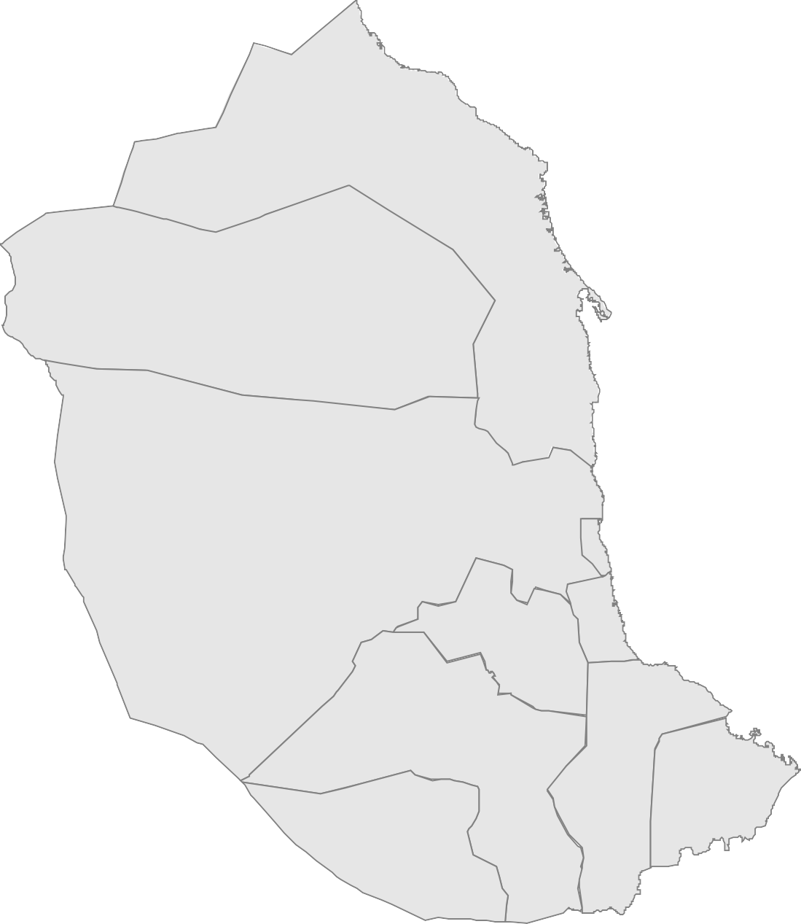
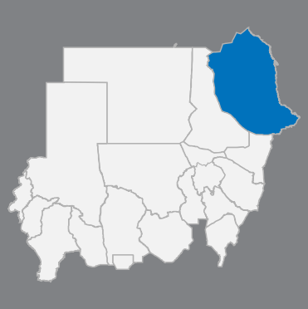
The diﬀerences in Sudan Map between 2014 and 2020
as of 4 March 2020
Red Sea State:
Number of localities remained as
10 localities
Hala'ib | ﺐﻳﻼﺣ
Jubayt Elma'aadin | جبيت المعادن
Al Ganab | ﺐﻨﻘﻟا
Port Sudan | بورتسودان
Sawakin | ﻦﻛاﻮﺳ
Sinkat | تﺎﻜﻨﺳ
Haya | ﺎﯿھ
Dordieb | ﺐﻳدرد
Tawkar | ﺮﻛﻮط
Agig | ﻖﯿﻘﻋ
Hala'ib
Jubayt Elma'aadin
Al Ganab
Port Sudan
Sawakin
Sinkat
Haya
Tawkar
Agig
Dordieb
The depiction and use of boundaries, geographic names and related data shown on maps and included in lists, tables, documents, and databases are not warranted to be error free nor do they necessarily imply official endorsement or acceptance by the United Nations. Final status of the Abyei area is not yet determined.
Creation date: 2 April 2020 Sources: OCHA Feedback: Information Management "sudkhim@unhcr.org"

Slide 20
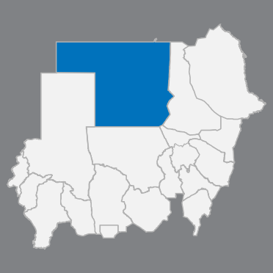
The diﬀerences in Sudan Map between 2014 and 2020
as of 4 March 2020
Northern State:
Number of localities remained as
7 localities
Halfa | ﺎﻔﻠﺣ
Delgo | ﻮﻘﻟد
Al Burgaig | ﻖﯿﻗﺮﺒﻟا
Dongola | ﻼﻘﻧد
Al Golid | ﺪﻟﻮﻘﻟا
Merwoe | مروي
Ad Dabbah | ﺔﺑﺪﻟا
Halfa
Delgo
Al Burgaig
Dongola
Merwoe
Al Golid
Ad Dabbah
The depiction and use of boundaries, geographic names and related data shown on maps and included in lists, tables, documents, and databases are not warranted to be error free nor do they necessarily imply official endorsement or acceptance by the United Nations. Final status of the Abyei area is not yet determined.
Creation date: 2 April 2020 Sources: OCHA Feedback: Information Management "sudkhim@unhcr.org"

Slide 21


Author: UNHCR in Sudan
Feedback: Information Management "sudkhim@unhcr.org"

