Slide 1

Cash Transfer Programming Cash Working Group (CTP)

Slide 2
What is Cash Transfer Programming?
Cash is not a sector in itself
Cash is only useful where there is a supply in the market (e.g. food, fuel, water).
Cash provides:
Free choice for beneficiaries (dignity, priorities)
Provide time-bound emergency assistance to most in need
Mitigate negative coping mechanisms affecting communities
Support local economy (host communities)
It’s Possible
=> markets and banks function effectively
It’s Beneficial to the operation
=> efficiency gains and better cost-benefit ratio
compared to sector-specific in-kind distribution
Its Effectiveness is proven (lessons learned)
=> food (e-voucher), winterization and emergency protection

Slide 3
Cash Transfer Programming in Lebanon
CTP in Lebanon can be categorised as:
  Conditional (e.g. Cash for Work)
  Restricted (e.g. WfP E-Cards)
  Unrestricted (Multi-Sectoral Cash). Often seen as UCT in documents.
Many agencies are already providing cash assistance
  ACTED, Action Aid, Caritas , DRC, IOCC, IOM, Islamic Relief, JRS, Makhsoumi Foundation, NRC, Oxfam, PCMP, PU-AMI, SCI, SDC, THD-L, UNRWA, WFP, WVI and others

Slide 4
Governance (coordination, harmonization)
  Cash Working Group (reports to the Inter-Agency Coordination)
    Informs and guides the overall objectives of cash assistance in Lebanon
    Members: MoSA, Donors, NGOs and UN Agencies active in CTP
  CWG Core Group (reporting to the CWG)
    Ensures cash assistance is implemented according to CWG recommendations
    Members: 10 people voted by the CWG (endorsed by I-A Coord.). Includes WfP, UNHCR, MoSA and INGO reps
  Task Teams (report to the Core Team)
    Tecnical working groups working on specific topics (i.e. Targeting*, MEB, operational setup, accountability & communication, market assessment, M&E)
  *Targeting Task Force (TTF) does not report directly to Cash Core Group, however CCG is responsible for providing the recommendations on their findings

Slide 5
CTP in Lebanon:
32 agencies reported totally 173 CTP projects
Unconditional cash assistance*
  86’000 HH received USD 100 - 200 (winterization, hygiene and baby kits)
  300 HH/month receive USD 200 (one-off emergency protection assistance)
Conditional cash assistance
  Food: 30 USD/month for 630’000 persons (140’000 HH)
  Education: 630 USD/year for 30’000 pupils (+ transportation)
  Health: 580 USD/month for 5’000 persons (only UNHCR caseload)
  Rent : 150 USD/month for 1’700 HH
Cards in use for cash assistance
  170’000 ATM cards distributed (CSC - White card for use with any ATM)
  230’000 POS cards distributed (BLF - Blue card for use only in contracted POS)
  and various different cards (LibanPost, …)
  *Now called ‘Multi-Sector Cash Transfer’
Since 2012, there has been $504 million in CTP in Lebanon.
  However this drops to $107 million when we remove food assistance (WfP)

Slide 6
What do we need in order to do quality cash programming?
Clear Targeting
  This should also include what kind of sectoral impact we are hoping to have (e.g. just economic or wider?)
Clear understanding of the market and expenditures
  Defined value of transfer depending on the impact we want to have
Clear Operational Structure
Clear Monitoring Guidelines
Clear Communications

Slide 7
Targeting
To define ‘economic vulnerability’ only, a Targeting Task Force was convened
  Represented by members of UNHCR/WfP and INGOs with input from World Bank
Aim: Revise Targeting tools (to be used for unconditional cash grants and food vouchers)
Tools Developed: To predict and measure economic vulnerability
(1)Pre-ide Index (ProGres data)
(2) Verification Index based on household data

Slide 8
According to the TTF:
There are 4 categories of vulnerabilities.
Approximately 29% of the population make up the economically ‘severely vulnerable’ category using this Proxy Means Testing (PMT)

Slide 9
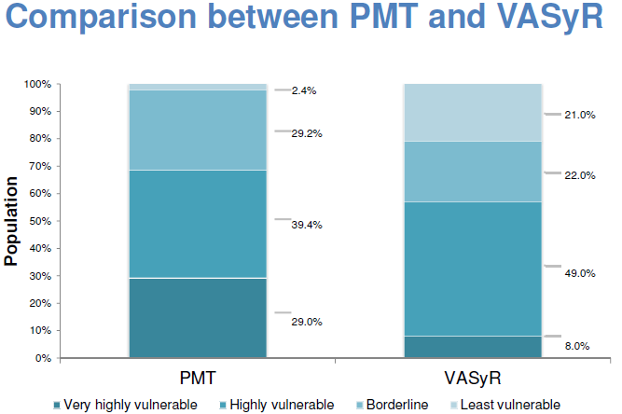

Slide 10
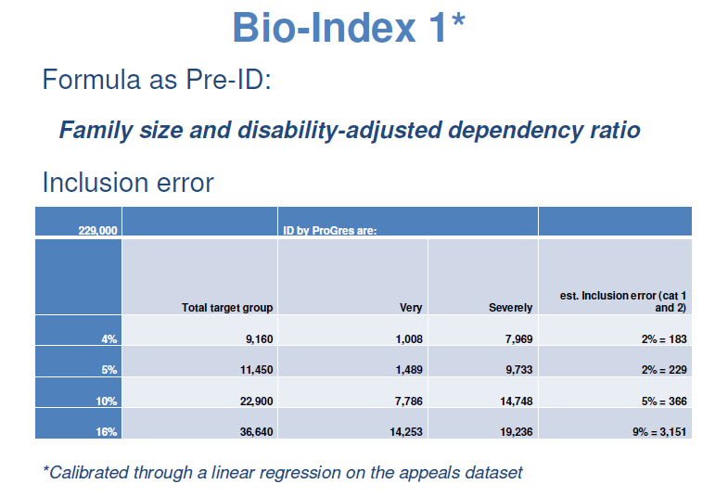

Slide 11
Limitations:
Used VASyR and appeals data-set (not accurately representing the ProGres based refugee profile
Only a small portion of those in need can be accurately targeted (depending on inclusion error
ProGres contains data of ‘cases’ (nuclear family). Bio-index refer to HHs which can be sereral cases
Advantages:
Start project quickly without long and expensive identification process (Bio-Index)
Very low inclusion error
ProGres is the only existing source of information for the whole population
Is always available and updated (e.g. new caseload)

Slide 12
Next Steps: HH Assessment Tool
HH level survey (1,000 sample) to
  Verify the most reliable indicators and decision formula
  Validate the HH collection form
Mid July 2014
Key Indicators:
Expenditure – proxy for income, debt to expenditure ratio
Disability-adjusted dependency ratio and family size
Living Conditions – type of housing, occupancy, crowding, toilet
Asset holdings – absence of basic, presence of luxury assets in HH
Food Security, consumption and dietary diversity
Coping mechanisms / strategies

Slide 13
Market Assessment and (S)MEB
How do we decide what to give?
  Define a ‘Survival Minimum Expenditure Basket’
  Monitor the markets
    What are the impacts to the market?
    What are the fluctuations?

Slide 14
Value…..

Slide 15
Funding Scenarios

Slide 16
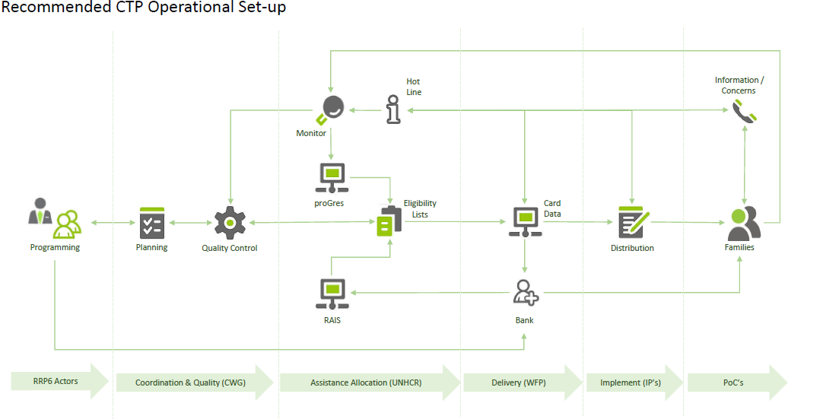
Operational Structure

Slide 17
Monitoring
Minimum standards for indicators
M&E framework: what to measure, how to measure, when to measure
The incorporation of other the cash working subgroup M&E requirements
Tools and processes, and necessary staffing requirements
Data quality and management good practices
Requirements for data analysis
M&E training needs
Potential nationwide sampling methodologies
Potential need for some level of 3rd party support for management of a monitoring system

Slide 18
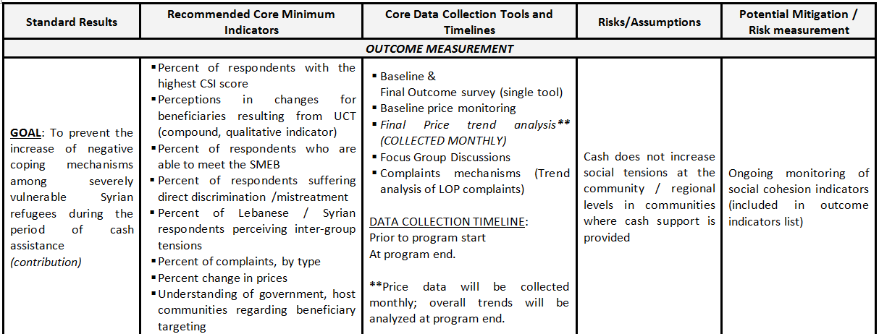

Slide 19
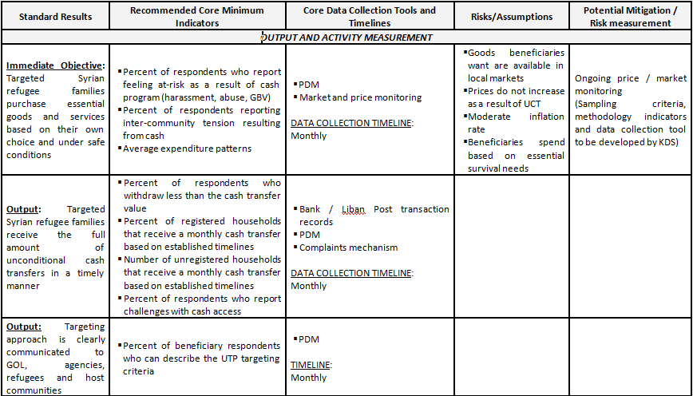

Slide 20
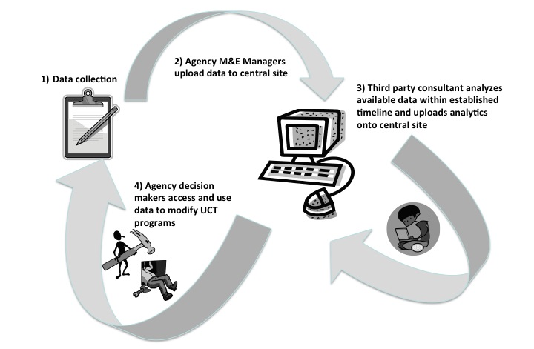

Slide 21
Communications and Accountability
Mass Communications Guidelines have been defined
Accountability Mechanisms
Inter-agency Q&A to reflect broad changes on assistance
Video on assistance cards

Slide 22
Questions
What can we implement now?
Targeting – are we comfortable with the ideas of targeting
  Do we aspire to meet the 29%
  Investment in HH assessments?
Transfer value needs to be decided
Prioritization related to winter
  Budgetary priorities for ongoing cash assistance vs. winterization specific support

