Slide 1
World Vision Lebanon
Humanitarian Accountability
Accountability to Affected Populations
8th April 2016

Slide 2
Program Accountability Framework
Providing Information : World Vision commits to ensuring that relevant program information is made available and intentionally provided to communities in a timely, accessible and accurate manner.
Consulting with Communities : We are committed to the principle of informed consent and ensuring that communities are aware of, understand and agree with key decisions relating to our intervention.
Promoting Participation :We are devoted to purposely empowering communities and building their capacity to participate in all
Collecting and Acting on Feedback and Complaints :We undertake to implement community feedback and complaints procedures that are accessible, safe and effective.

Slide 3
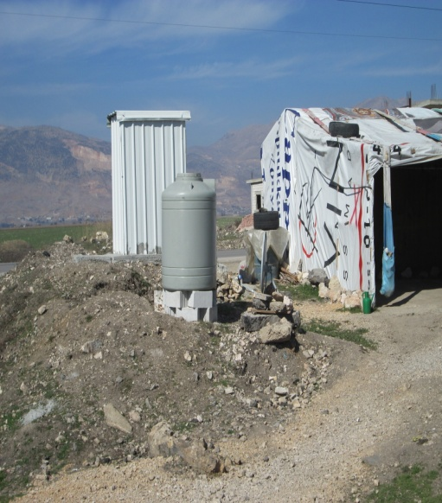

Channels
1-Helplines
2-ITS Committees
3-HH visit
4-Partner Referral
5-Colleauge Referral
6-Suggestion box at Help
7-Children activity
Centralized Data base
Most Frequent complaints
Most Frequent Complaints
a. Delay in water
b. Water Supplier Issues
c. Delay in dislodging
d. Dislodging provider Issues
e. Delayed WASH items / not distributed
f-Delayed vouchers / not distributed
g. Damaged Distributed Item(s) h. Staff abusing community/
i. Diseases j. Shaweesh/Landlord Issues
k. Toilets Issues
l. No WASH Intervention
A-Card not activated
B-Card not received
C-Lost card
D-Switched e-card
E-Actual ammount was not reloaded
F-Damaged card
G-Staff abuse at distribution site / shops
H-Non contracted shops
I-Contracted shops
J-Lost pin
K-Wrong pin
Accountability officer refers on a Weekly basis
Accountability officer refers on a weekly basis
Accountability officers filter from central data base their relative area/sector complaints
Accountability officer refers on a Weekly basis
A- Bus drivers
B-Teachers /animators
C- Edu/CFS center (location, safety, equipment)
D-Activities (courses, sessions)
E-Registration limitations
Most Frequent complaints

Slide 4
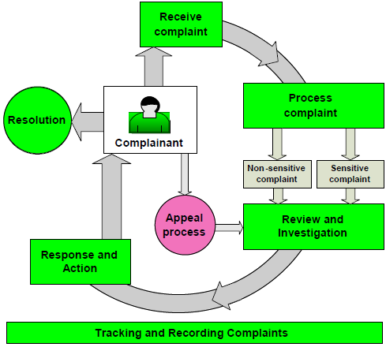
Procedure to handle a complaint

Slide 5


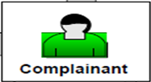


Complaints flow process
Process
complaint
Segragate
Sensitive
Or Non sensitive
Receive
complaint
Respond
To complainant
Referr to sector lead
Response
& action
Follow up
Review
&
investigate

Slide 6
External CRM
Proccess Flow
Partner Referral
Complaints are collected through WVL accountability channels , handled with confidentiality and processed to the relevant INGO depending on the nature and type of each complaint.
Urgent and sensitive cases also referred immediately to the relevant INGO
HA Lebanon established with the below INGO a referral collaboration system.
1-InterAgency Referral
2-DRC referral Mechanism
3-INTERSOS referral Collaboration
5- ICRC / Caritas Migrant / others
4-World Food Program

Slide 7
Mainstreaming Humanitarian Accountability in all programs
Set up sector or grant specific accountability tools and train project staff on them
Established a New automated system “Call Center“ for complaints and feedback handling as well as information provision .
Incorporate humanitarian accountability indicators in all M&E frameworks to be measured on a monthly basis.

Slide 8
Thank you
Questions ?

