Slide 1

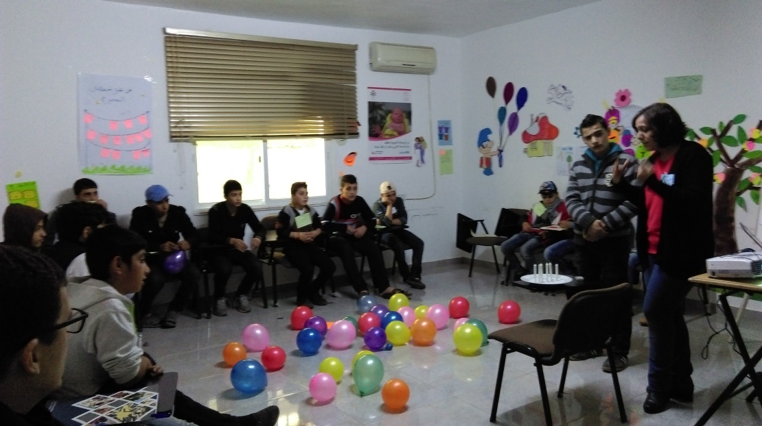
CHILD RECRUITMENT SESSIONS
Reflection through JRF eyes

Slide 2
Child Recruitment Sessions- for Syrians: at Sanabel Al Kheir Charitable Association - MAKANI Center in Al Hashemi Al Shmali
2nd December 2015 15 participant in each session
6th December 2015
15 participant in each session
9.00 – 9.45 am
12-15 yrs.
10.00 – 10.45 am
10.00 – 10.45 am
15-17 yrs.
15-17 yrs.
11.00 – 11.45 am
11.00 – 11.45 am
12-15 yrs.
12.00 – 12.45 am

Slide 3
Facilitation Strategy used :
Get to know your audience activities
Ice Breaking Activities
Delivering the content & showing the video
Energizing Activities
Summarizing and Learning points activities

Slide 4
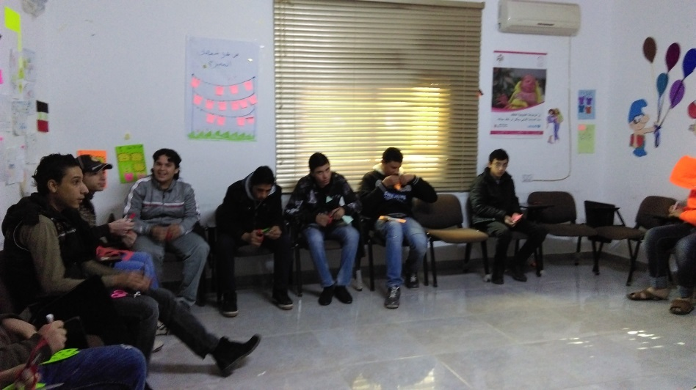
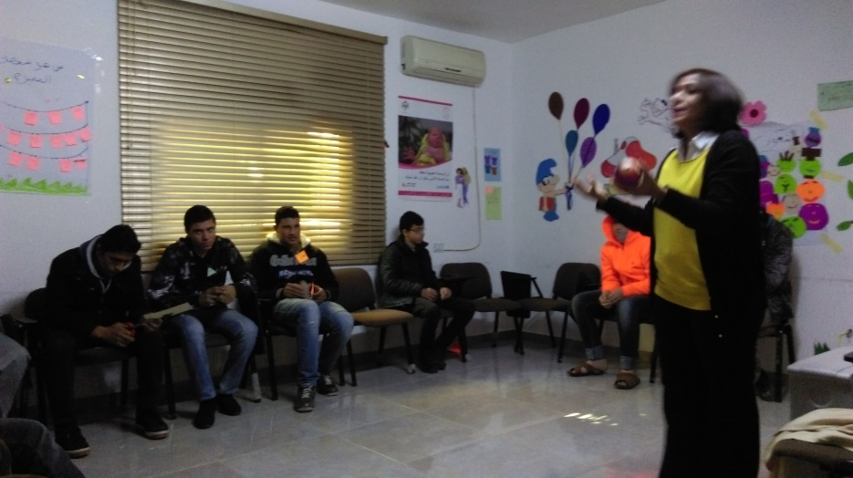
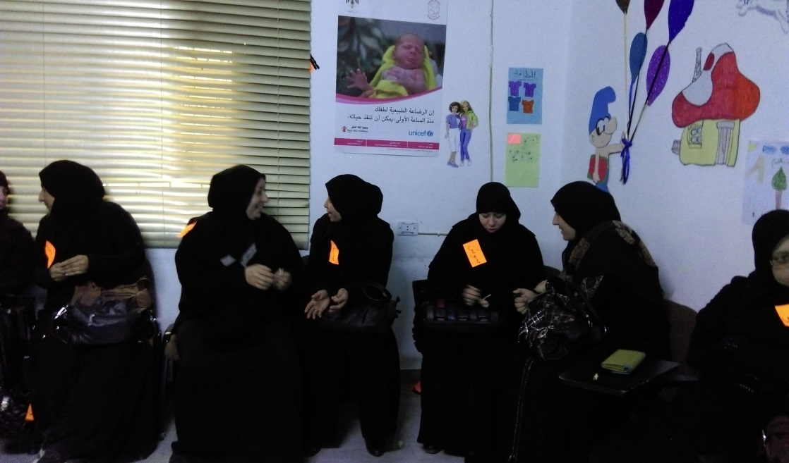
Get to know your audience activities:
Names on cards
Catch the ball and introduce yourself
Talk to your partner and introduce him/her

Slide 5
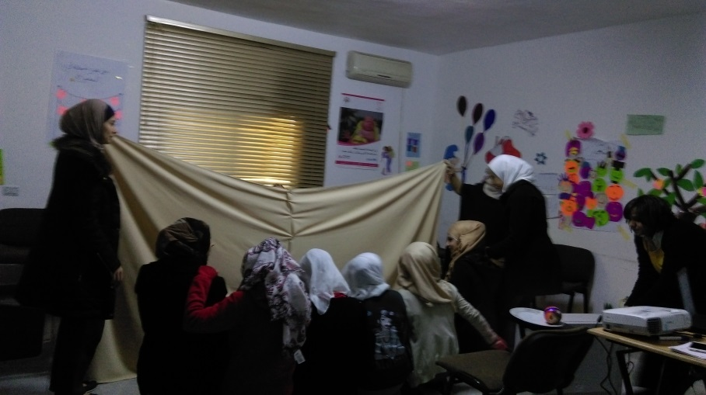
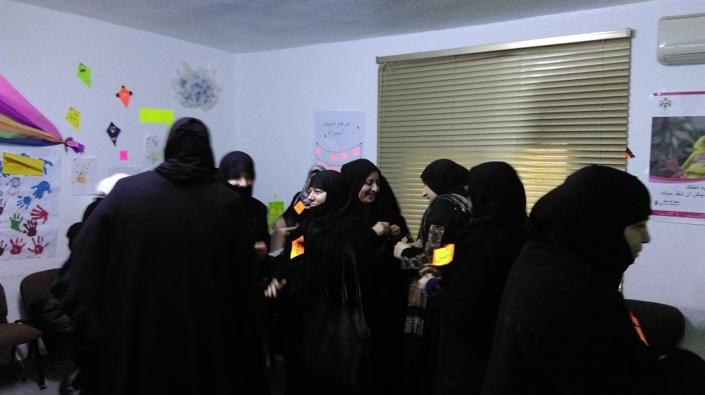
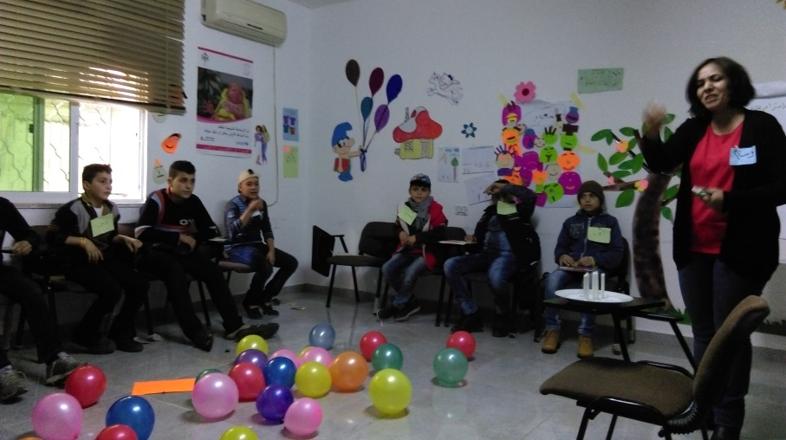
Ice breaking activities:
See through…. behind the scene
Three matches to start with (questions game)
Make a wish… Blow a balloon

Slide 6
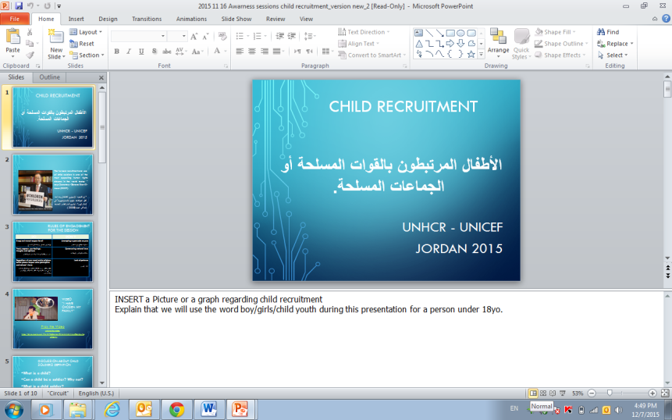
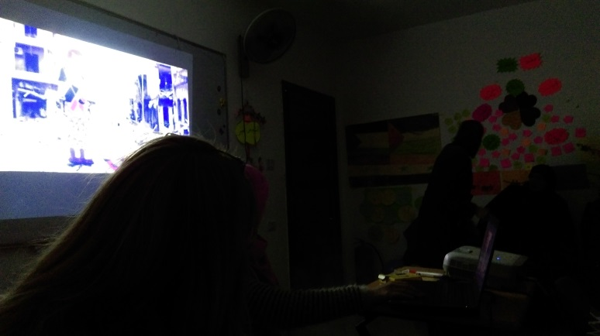
Delivering the content & showing the video:
Display slides from the Power Point presentation
Show the video
Verbal brain storming
Asking questions
Discussions
Using different facilitation techniques.

Slide 7
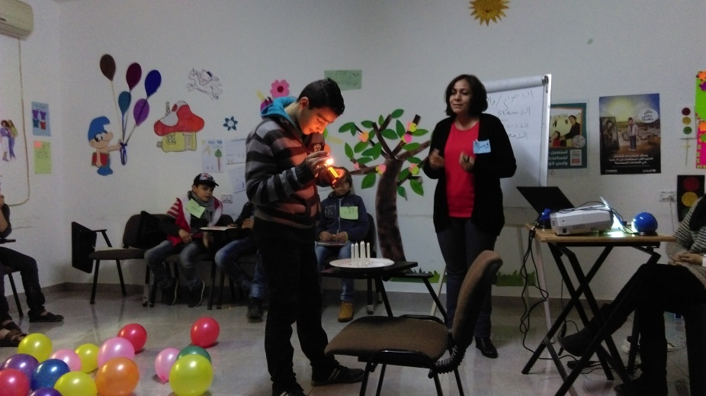
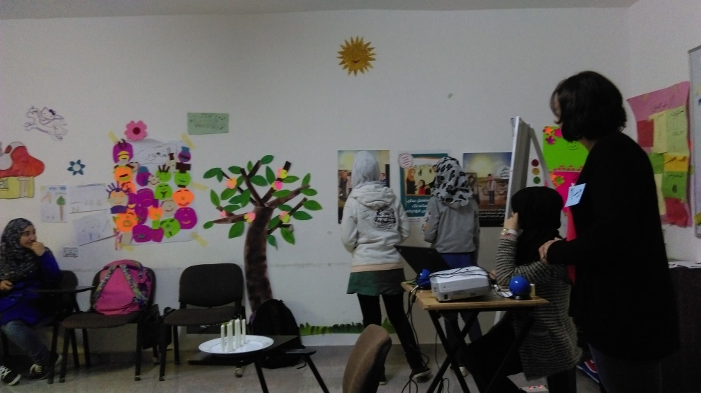
Energizing activities:
Candles in a row…future insight
Child recruitment- The photo gallery

Slide 8
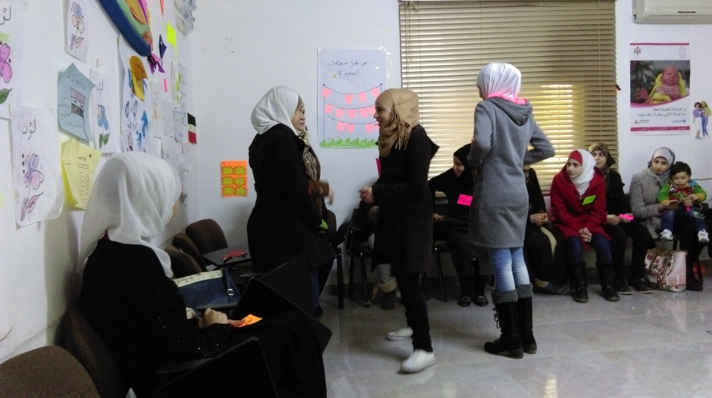
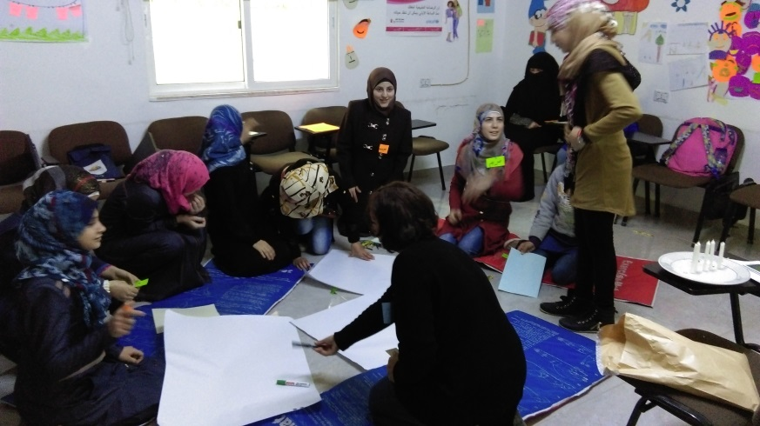
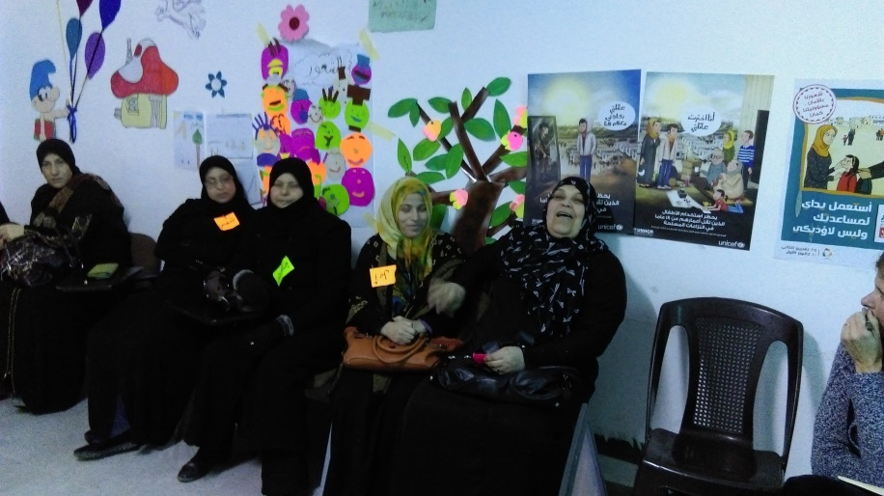
Summarizing and Learning points activities:
Drawing
Role playing
Asking for support through taking the number of UNHCR child protection unit
Verbal messages

Slide 9
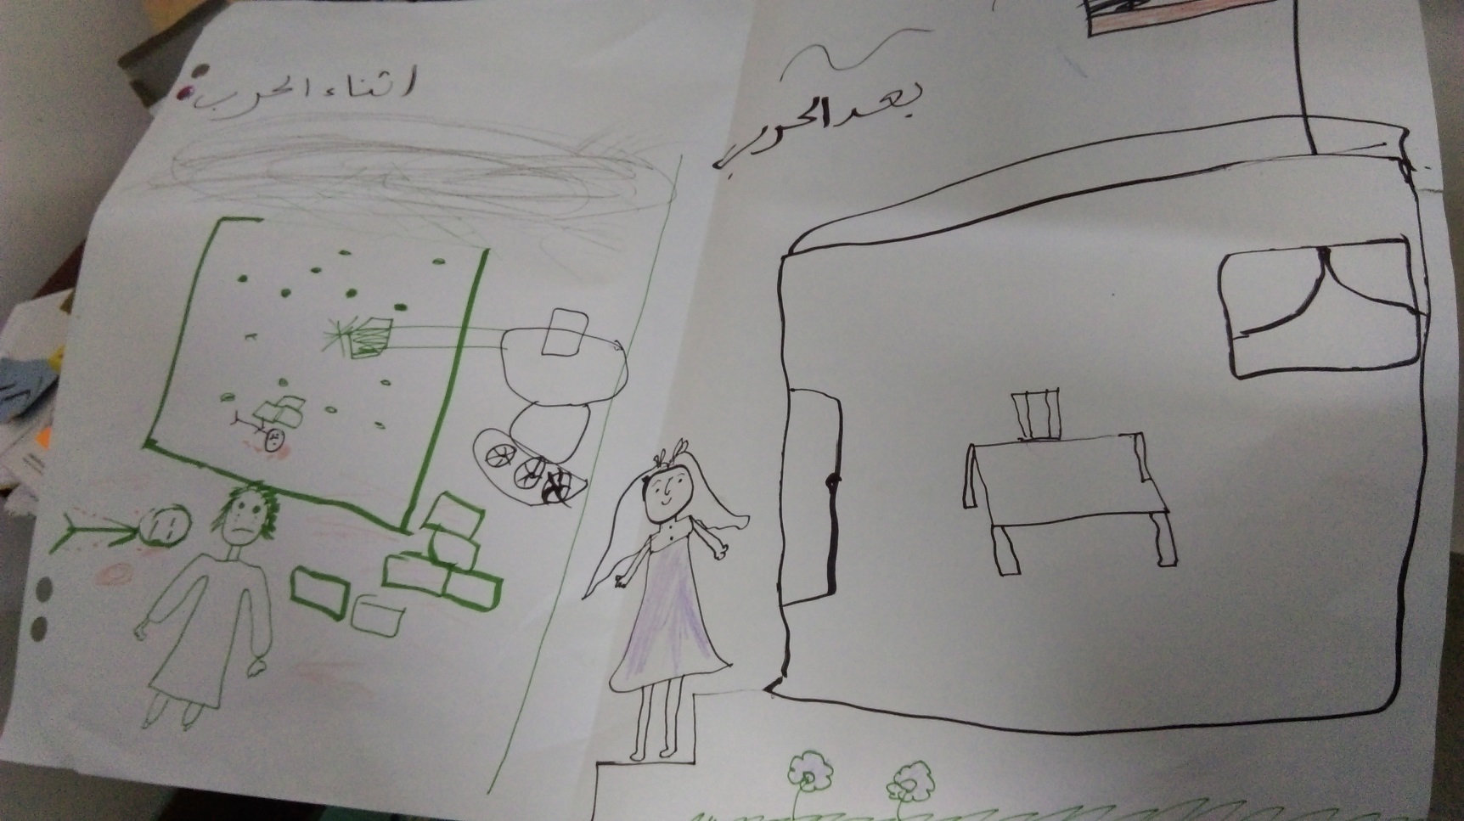
Examples of drawings – Females session:

Slide 10
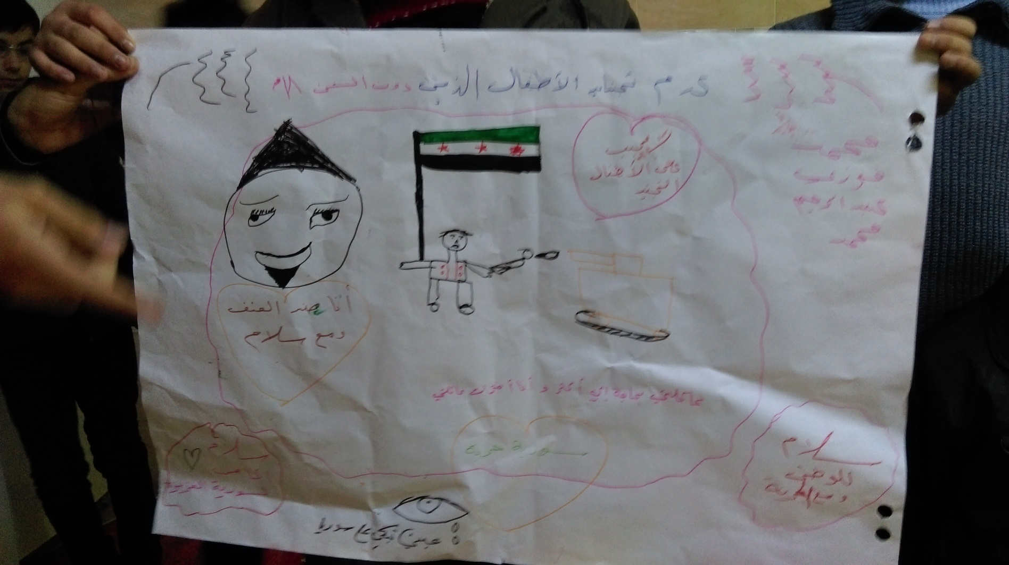
Examples of drawings – Males session:

Slide 11
Feedback and Recommendations:
The content prepared and its sequence is suitable for the target audiences.
The target audiences have shown acceptance. From their perspective, it gave them the opportunity to talk, discuss, and express their fears and ask for the support offered.
The target audiences have been able to see, understand, and pass to others this subject from age perspective despite their thoughts and beliefs.

Slide 12
Feedback and Recommendations:
Providing the content and the video to the facilitator a week in advance is recommended.
    Despite the fact that this subject is touching what is happening in reality, when its first read, the content seems to be rigid.
    It needs to be read thoroughly and in depth to fully understand all the aspects objectively and accept it.
    The session needs to be planned well in order to achieve its objectives.

Slide 13
Feedback and Recommendations:
The facilitator is encouraged to deliver the sessions on an interactive/ sharing experiences basis.
Presenting only the first four slides using the data show and the video is recommended.
Delivering the content of slides 5-8 using verbal brain storming, asking questions, and discussions techniques is recommended.

Slide 14
Feedback and Recommendations:
The session delivery depends highly on the facilitator and on how he/she introduces the subject due to :
    The sensitivity of subject to the target audiences.
    The negative experiences the target audiences have and associated with this subject.
    How this subject had an impact on the different aspects of their lives ( emotional, social, economical, knowledge,…)
    The facilitator should have the skill of dealing with vulnerable people as the subject triggers the target audiences’ emotions and past negative experiences.

Slide 15
Feedback and Recommendations:
The Facilitator should be able to gain the target audiences’ trust through:
    Welcoming the target audiences as they first arrive.
    Building a positive professional relationship with them through the first activity.
    Showing sympathy when they share their negative experiences .
    Taking into account their individual differences.

Slide 16
Feedback and Recommendations:
The facilitator is encouraged to prepare different activities as each group audience is unique.
The facilitator is encouraged to understand his audience group in order to decide on the best activity to introduce the subject to them.

Slide 17
Thank you

