Slide 1
CMW project
MEDAIR-LEBANON COMMUNITY MIDWIFE PROJECT
MAY 2016

Slide 2
OBJECTIVES
Objective:
To provide pregnant and lactating women and especially newly delivered women and their newborns maternal health education and post-natal care visits. Initially this services will focus on informal settlements.
Project design:
The project design is based on WHO’s guidelines for Postnatal Care for Mothers and New born (2013)
Target and area of implementation
The project will initially target Syrian refugees in Informal Settlements (IS) in Central, West and North Bekaa.
Priority will be ISs, but CMW visiting also collective shelters

Slide 3
Team
2 midwives
35 CHVs (Leb and Syr)

Slide 4
Project flow of cases
Identification
Visit
Follow up
Medair CHVS
Medair CMW
ANC records
Chaweesh
MoPH
Other NGOs
CMW
Follow up
Birth certf
ANC records
MoPH
End of Case

Slide 5
Services:
Postnatal Care follow up for mothers and their newly delivered infants
Antenatal Care for women in the last trimester in preparation for the upcoming birth
Referral complications
Family planning advice and provision of FP supplies
Referral to vaccination
Promote exclusive breast feeding

Slide 6
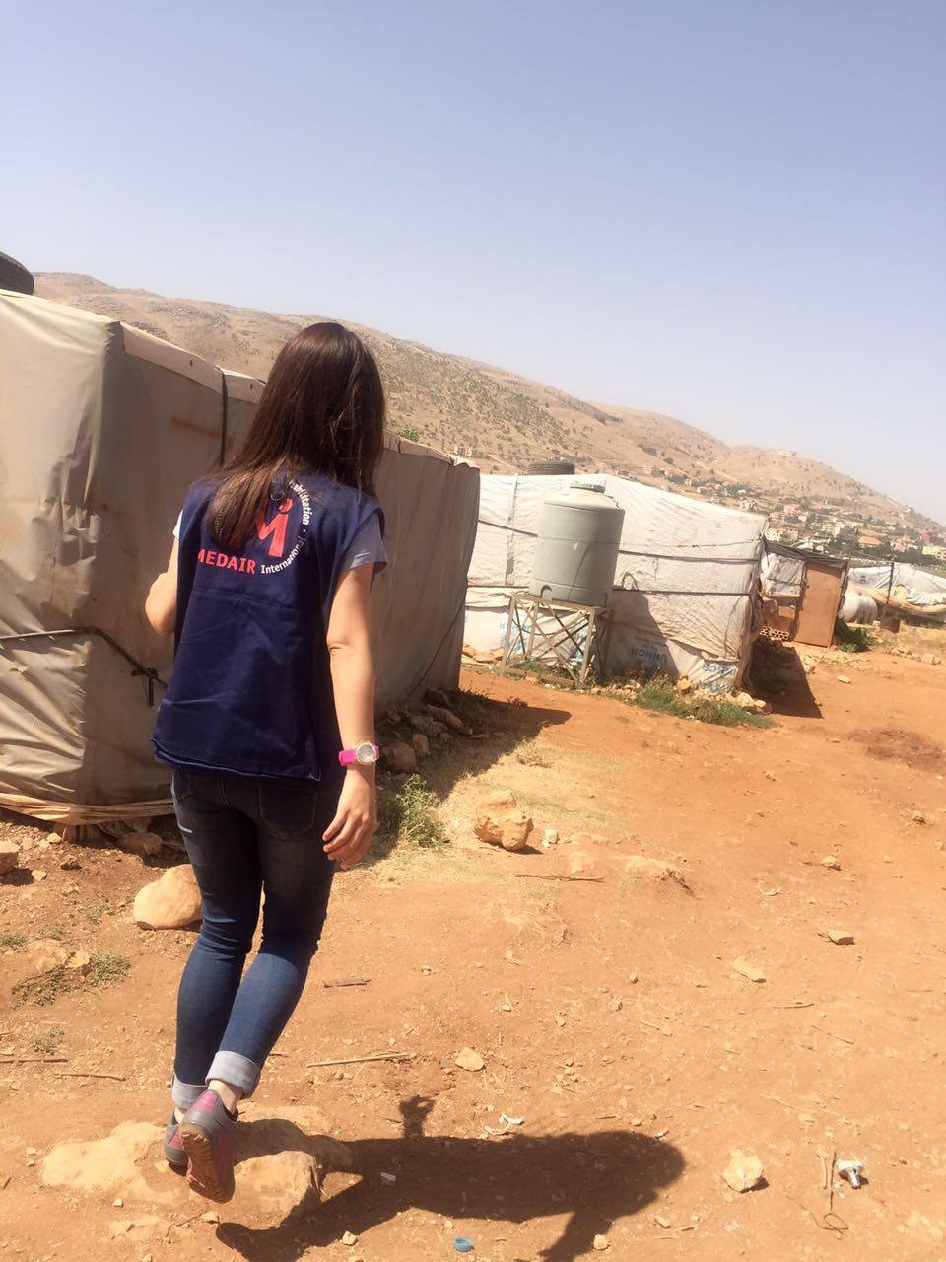
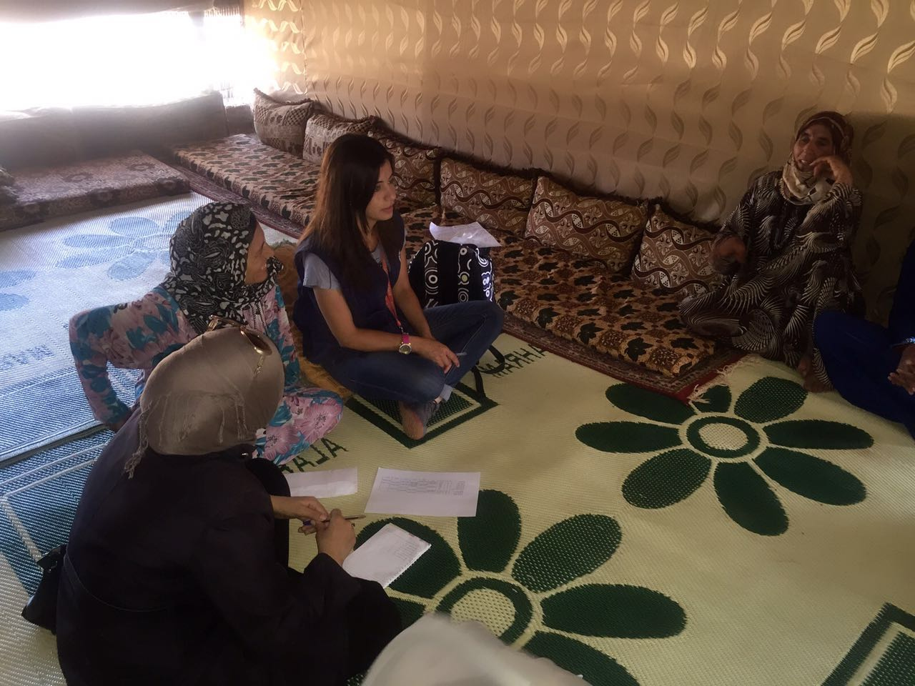
Data

Slide 7
FINDINGS IN THE FIELD
3 deliveries at home
Most of cases didn’t have or didn’t plan PNC after discharge from hospital
Most of not registered ANC cases thought that they are not covered by UNHCR
Lack of awareness about ANC in first trimester
Lack knowledge about family planning methods, exclusive breast feeding, and hygiene
Lack knowledge about immunization
Supported Health services are not well promoted in ISs

Slide 8
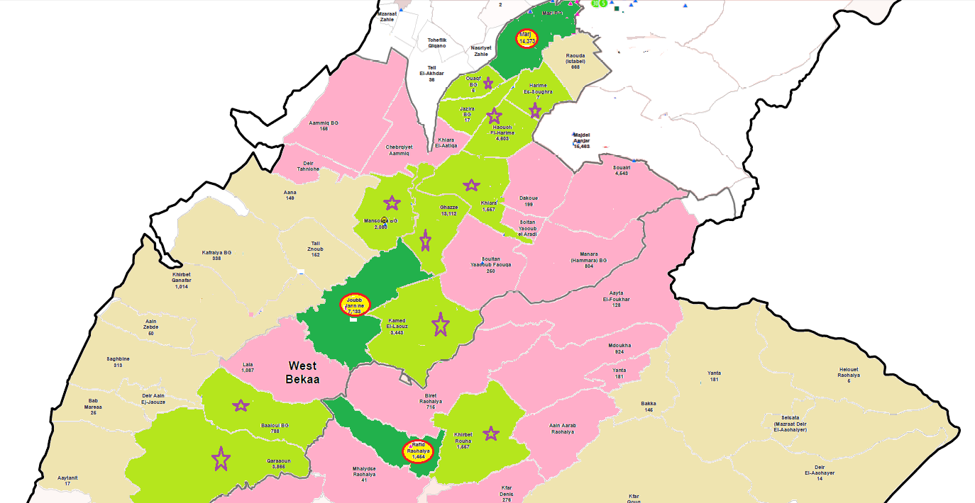
MAPs of coverage West Bekaa

Slide 9
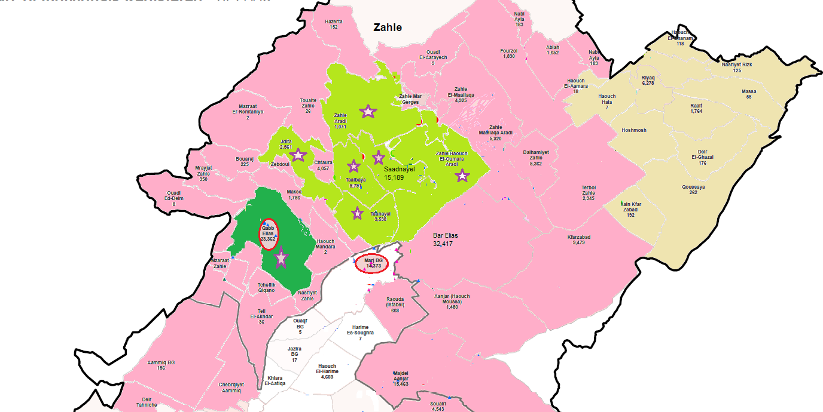
MAP of coverage central Bekaa

Slide 10
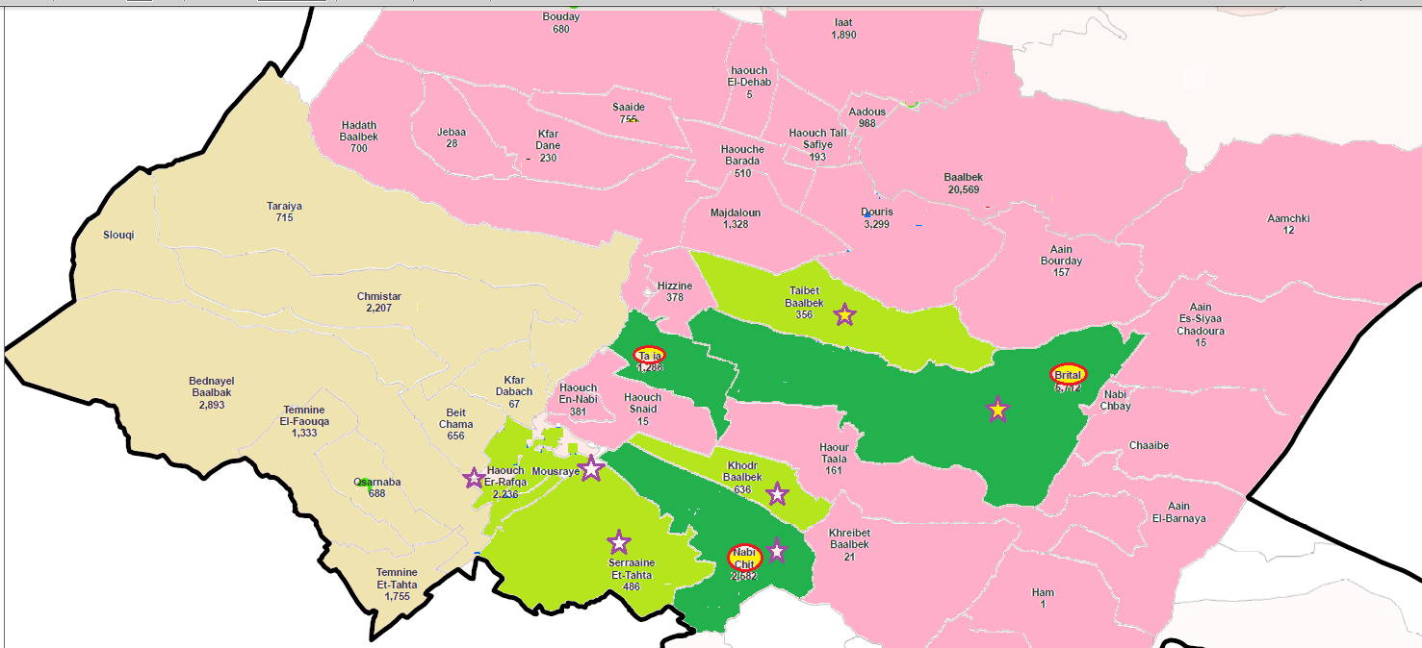
MAP of coverage North Bekaa

Slide 11
Thank you
Health Project Manager, Dr Wael Harb
Healthmanager-leb@medair.org 81728854
Community Midwife, Haneen Harfouch
Community Midwife, Abeer Mekdad
22/06/2016

