Slide 1
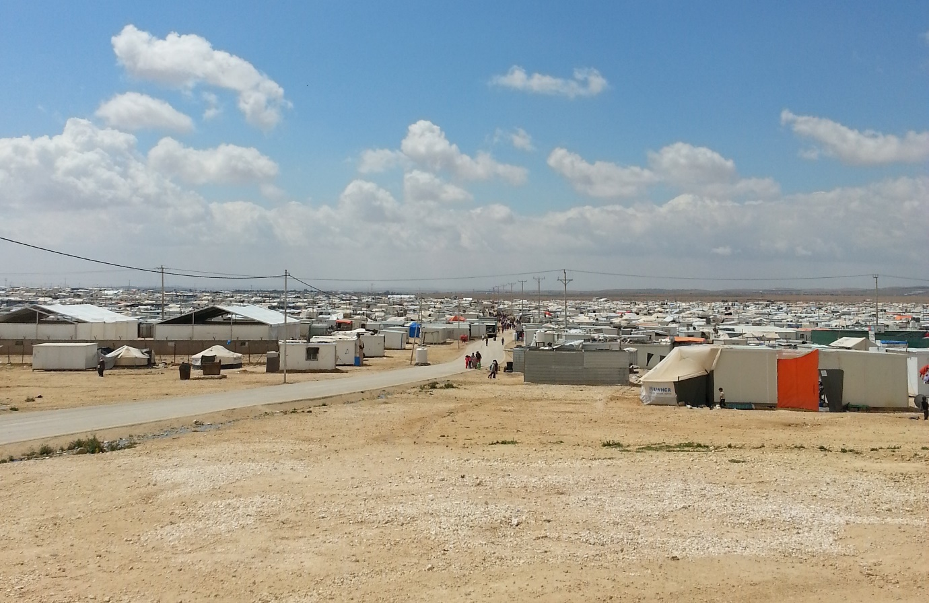


Population Count
Zaatari Camp
Presentation of Key Findings

Slide 2
Introduction / Background
To date, six population counts have been conducted in Zaatari camp, the first of which occurred in May/June 2013 and the most recent in December 2015.
These counts provide a demographic and spatial breakdown of the camp population at the district and block level at a single point in time
Block level data is particularly important, since much of WASH programming is conducted at the block level, including the delivery of water across the camp and planning for the implementation of a waste water network.
REACH, in partnership with UNICEF, conducted a population count from 13-23 December 2015.
To reflect the priority information needs of UNICEF and its partners, the population count also included questions about intentions to leave the camp, attendance of informal and formal education, the condition of private WASH facilities, and the presence of household members with restricted mobility.
Notes:
UNHCR monitors the camp population through regular analysis of the number of individuals registered in the camp.

Slide 3
Methodology
Data collection was completed by a mixed sex team of enumerators and Syrian Cash for Workers who visited every household unit in Zaatari camp.
To ensure that all households were visited, enumerators marked on a map each household assessed.
Location information was logged according to the boundaries outlined by the UNHCR block system and through the collection of GPS coordinates, at a minimum of 6 metre accuracy.
For households that could not be assessed for any reason, a total of three revisits were conducted. If the household could still not be assessed by the third revisit, the household’s location was recorded using ODK.
Upon finalising the assessment and conducting the initial analysis of the population figures, interviews were conducted to contextualise the findings in each of the 12 districts in the camp, with two interviews in districts that experienced the largest reductions in population during 2015 (Districts 1, 2, 3, 7, and 11).
Notes:
All data was entered into Open Data Kit (ODK) collect, a data collection application for android smartphones.

Slide 4
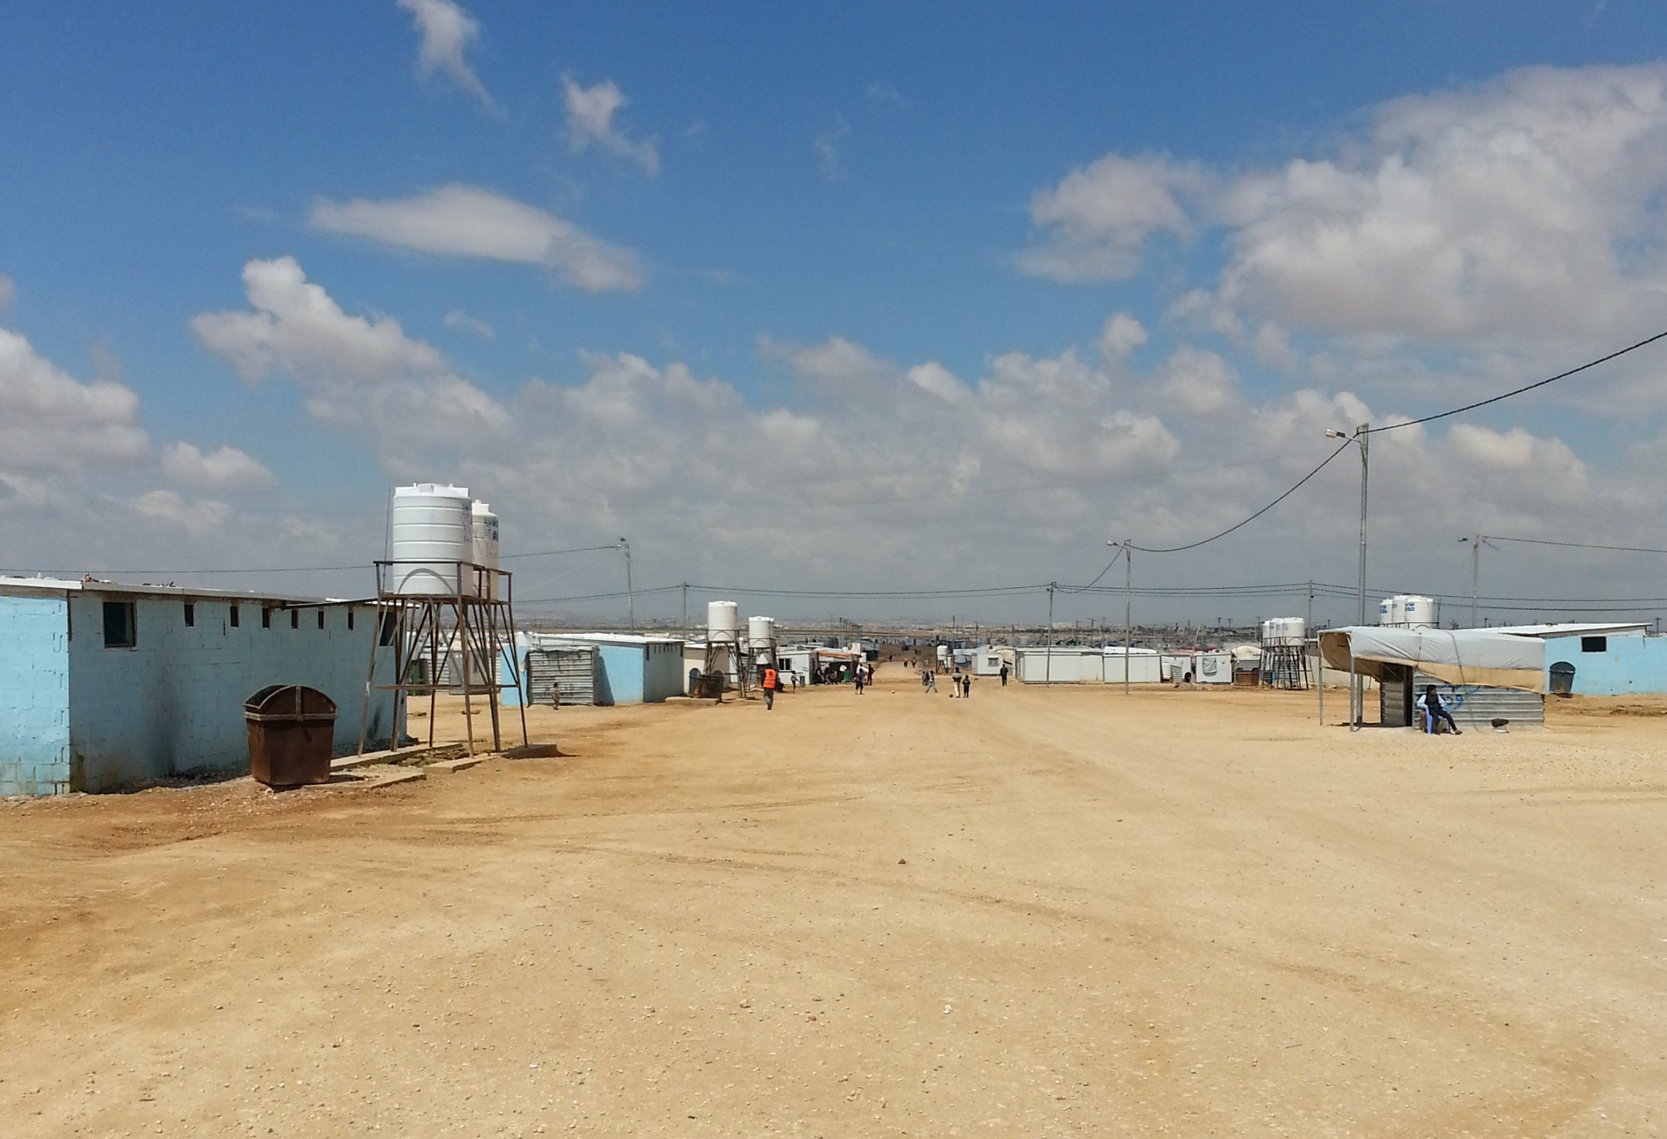
POPULATION AND DEMOGRAPHICS

Slide 5
Overall population
71,227 individuals were recorded as present in the camp at the time of the assessment (13-23 December 2015)
Zaatari Camp population since May/June 2013
Notes:
The decrease in the recorded population is partly reflected in the decrease in the number of individuals registered in the camp from 84,729 to 79,230 between January and December 2015. According to UNHCR, the decrease in Zaatari camp registration figures during 2015 is largely due to voluntary returns to Syria, departures to a third country, and transfer to another camp within Jordan

Slide 6
District level population
On average districts have experienced a 9% decrease in population since January 2015
Population per district
The districts that were found to have the largest populations in Zaatari camp, were Districts 8 and 11, with 7,978 people and 7,582 people respectively
District 4 and 3 are the least populated with 4,162 people and 4,467 people, respectively.
Notes:
The districts with both the largest and smallest populations have remained the same since the January 2015 population count, indicating that the population changes have largely been uniform across districts, rather than affecting some parts of the camp more than others.
Districts 7, 11, and 2 have experienced the largest reductions in actual population, with decreases of 1,057, 925, and 863, respectively.

Slide 7
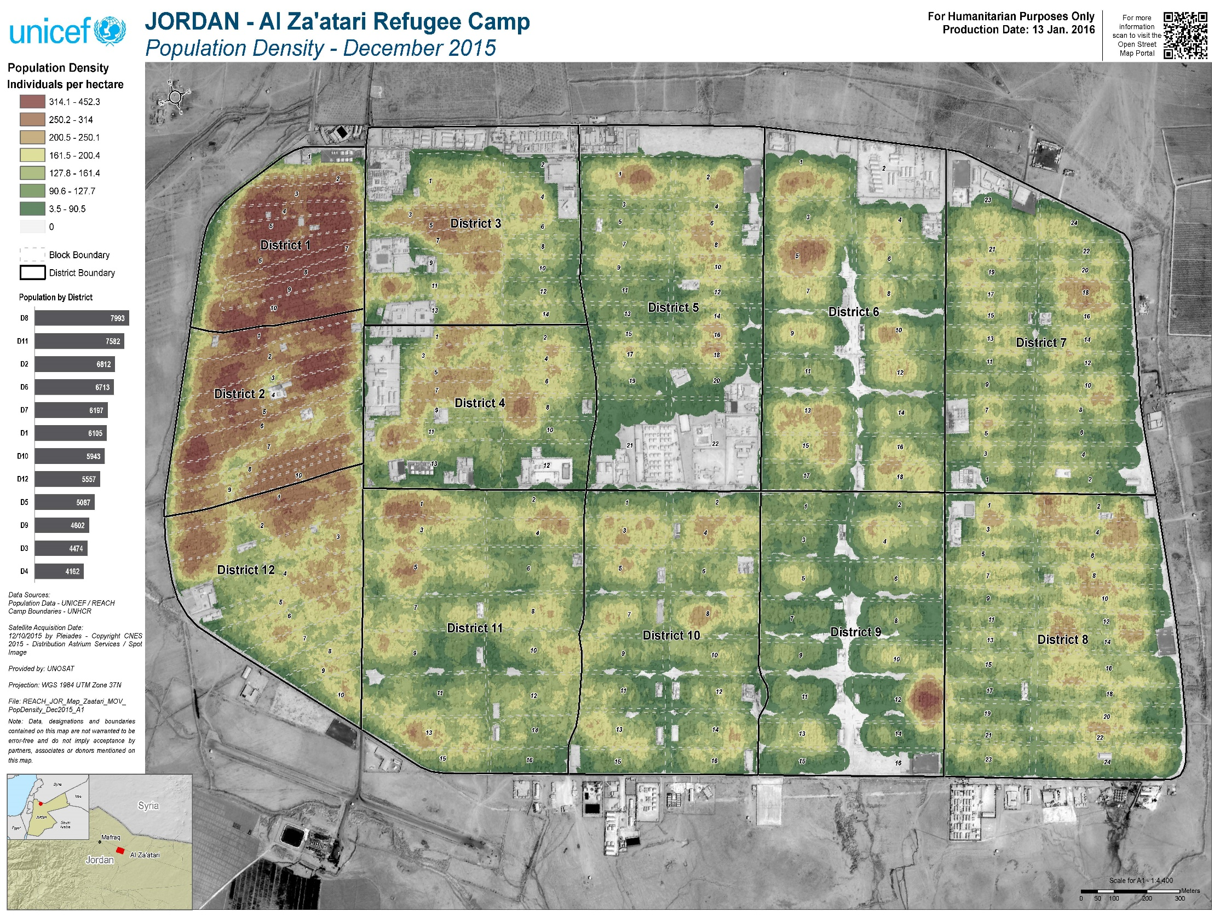

Slide 8
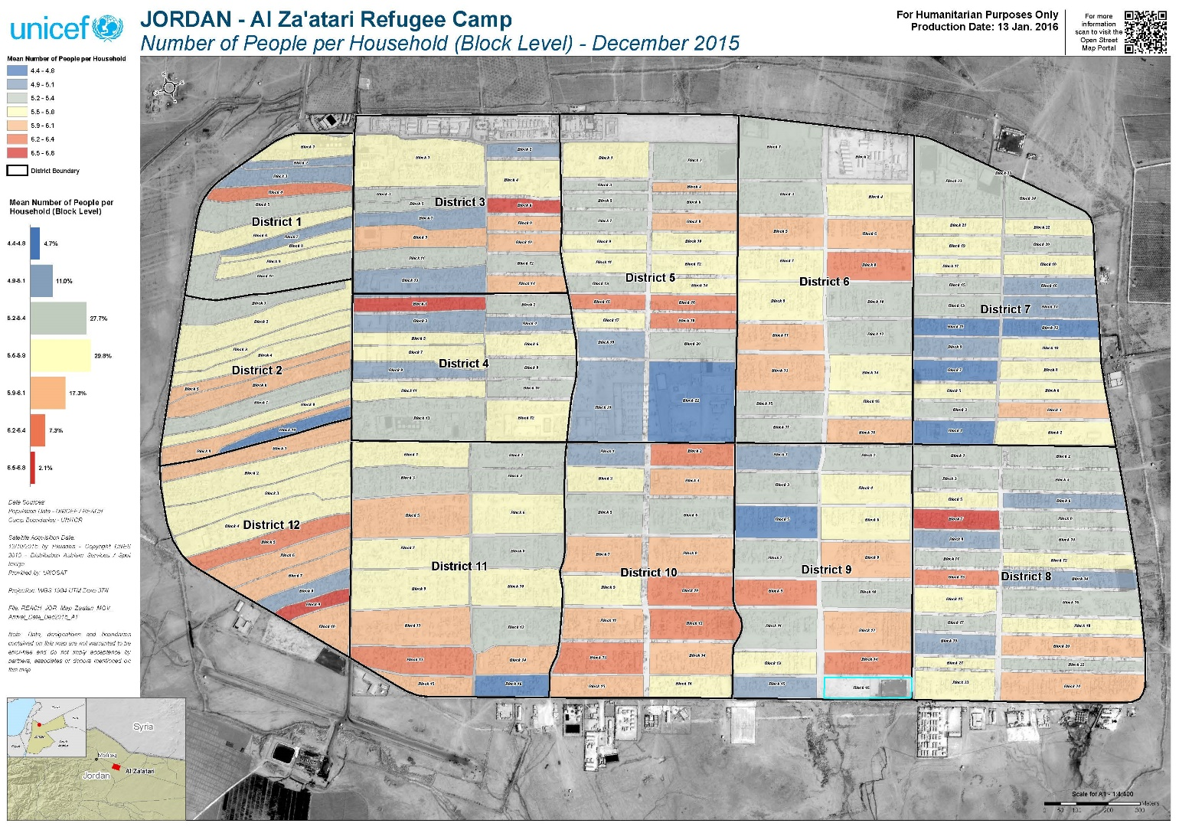

Slide 9
Population Demographics
49.4% (36,051) of the camp population were reported as male, and 50.6% (36,051) as female
Age and sex breakdown of the population
There has been little change in the demographic breakdown of the population since January 2015, with the proportion of children aged 0-5 years increasing from 18% to 23.3%, the proportion of 6-11 year olds decreasing from 23.1% to 18.6%
Notes:
The largest proportion of individuals were reported to be between 18 and 39 years, with 29.9% of individuals falling into this age bracket
23.3% of the population was reported to be 0-5 years, indicating a large population of young children

Slide 10
Month of Arrival in the Camp
The vast majority of households have been in the camp for over a year (99.3%), and 80.7% have been in the camp for more than two years
Reported time since arrival in Zaatari camp
Districts 1 (94.1%), 2 (94.8%), 3 (91.2%) and 12 (90.3%) contain the largest proportion of the population who have been living in the camp for more than 2 years
Notes:
The district level differences in time of arrival to the camp is likely due to some districts being the first to be populated following the inception of the camp and therefore housing many families that arrived upon, or shortly after, the opening of the camp.

Slide 11
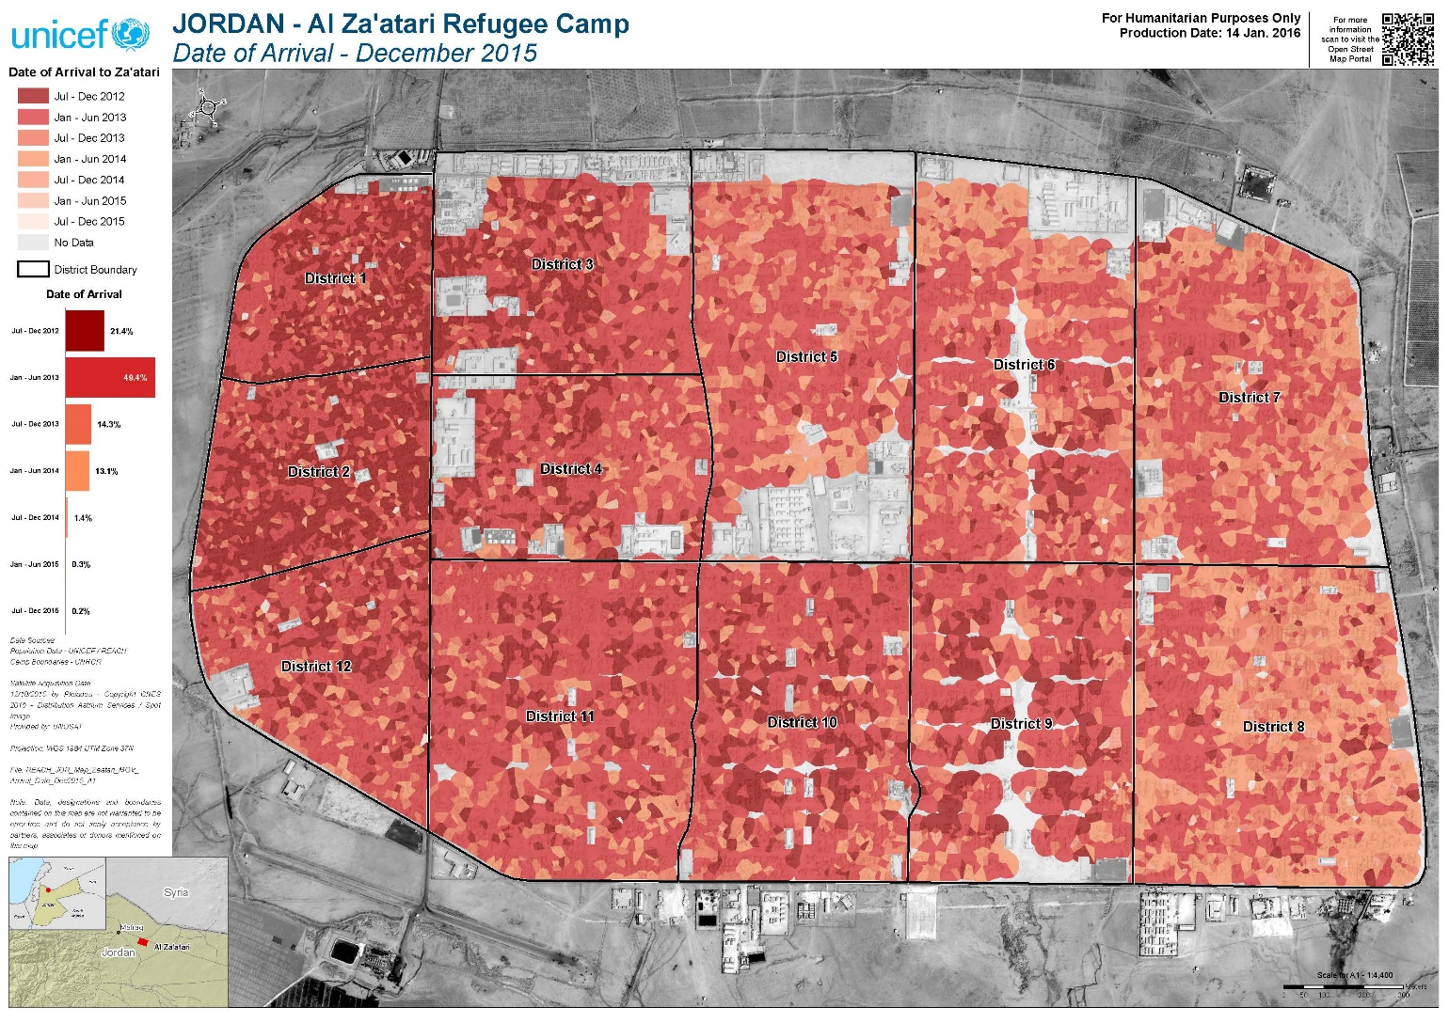

Slide 12
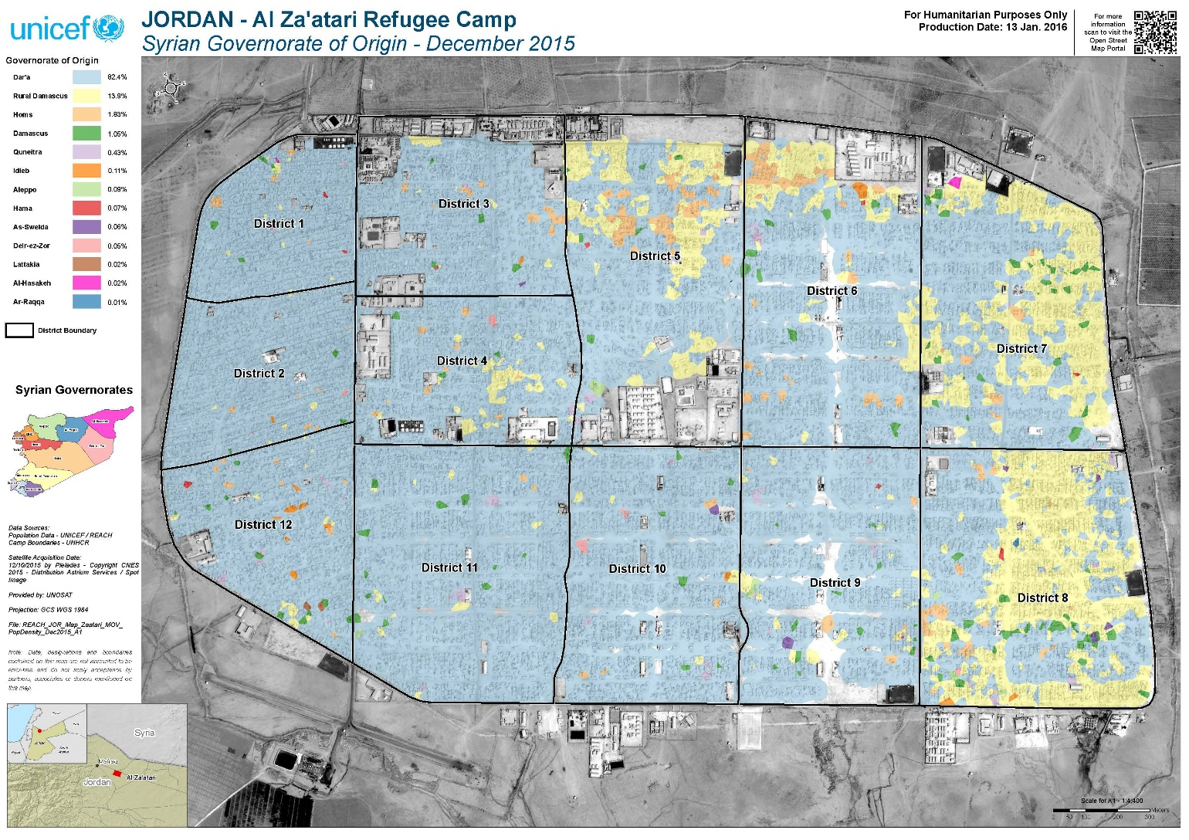

Slide 13
Shelter type
The proportion of households that have caravan(s) as their shelter type has increased by 17% since January 2015: from 80% to 97%
Household shelter type for the January 2015 and December 2015 population counts
There has been a decrease since January 2015 in the proportion of households with tents as their sole form of shelter, from 10% in January 2015 to 1% in December 2015
Notes:
The decrease of 9% in the number of households with tent(s) as their only form of shelter, is largely due to a UNHCR initiative to house all families in a caravan.

Slide 14
Movement Intentions
49.9% of respondents reported that they did not think that families would leave the camp in the four months following the assessment given the opportunity, 25.9% indicated that families would, and 24.2% said they did not know.
Places where respondents perceived families would move to if they had the opportunity
Of the 25.9% of respondents that reported that families would leave Zaatari camp if they had the opportunity to in the four months following the assessment, the most frequently cited location that families would move to was Europe, at 46%, followed by Canada (33.5%) and Syria (11.4%)

Slide 15
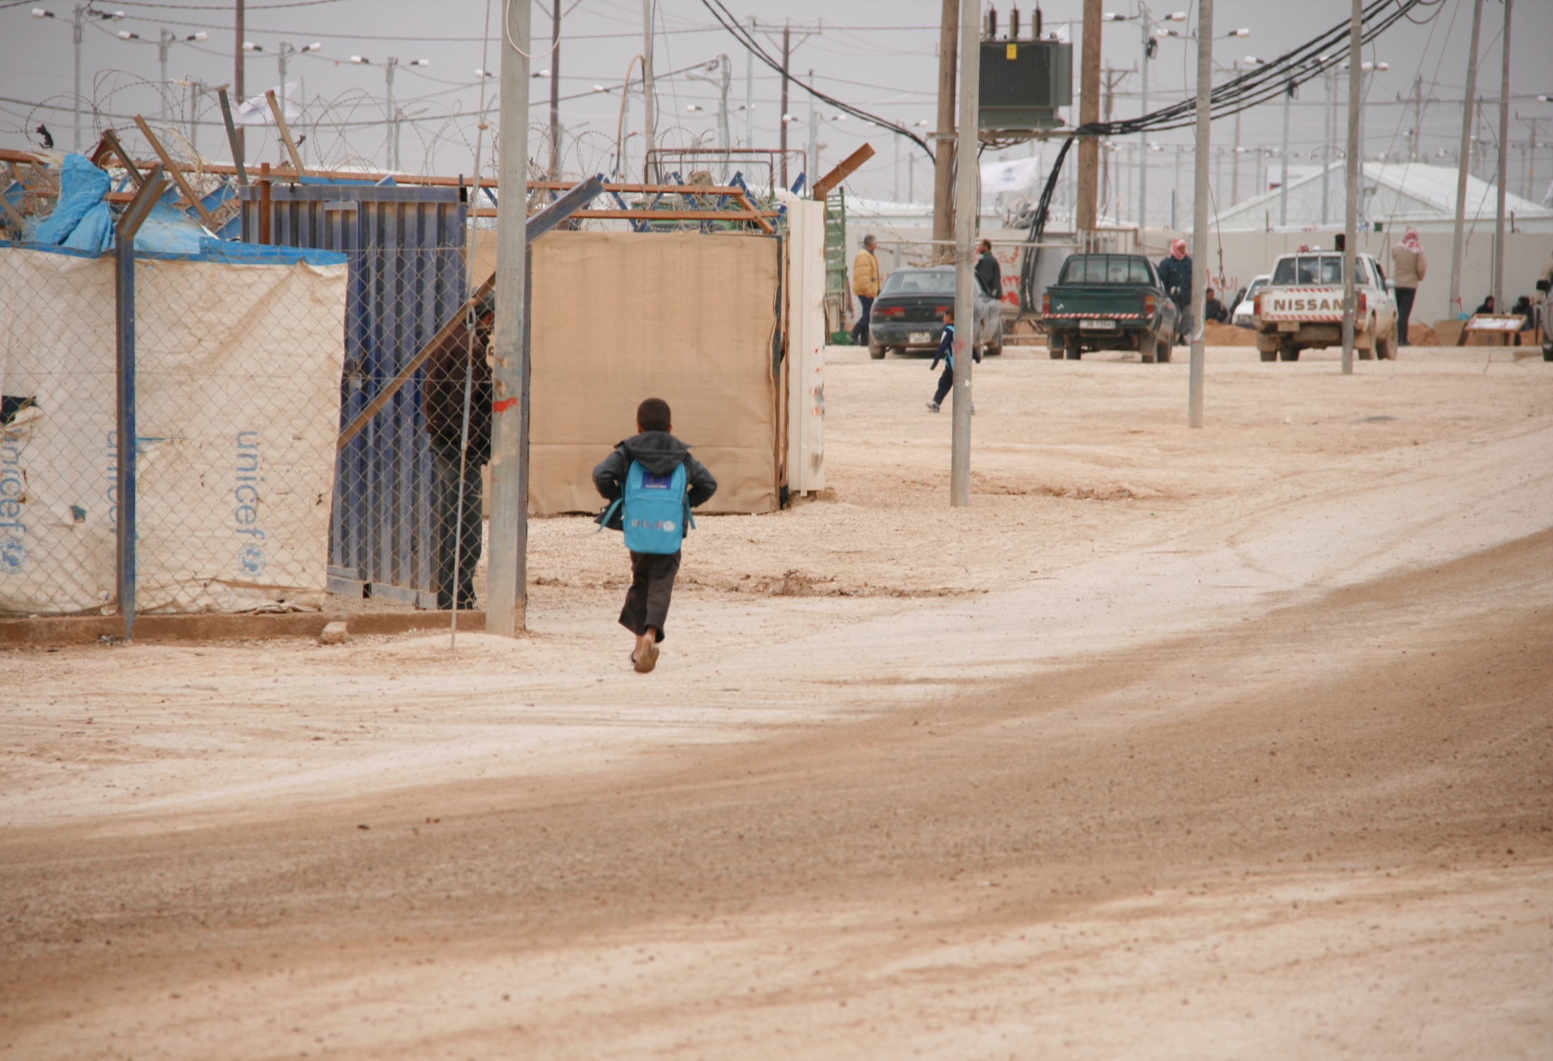
EDUCATION

Slide 16
School-aged children
There were 23,941 school-aged children recorded across the camp at the time of the assessment, representing 34% of the total camp population
  6-11 y/o 18.6%
  12-17 y/o 15%
34% of households without school-aged children were recorded
Notes:
6-11 year olds representing 18.6% of all persons recorded is a decrease from 23% in the January 2015 population count

Slide 17
Formal School Enrolment: 6-11 year olds
Marginally more 6-11 year old boys (10%) were not enrolled in a formal school than 6-11 year old girls (7%).
Proportion of 6-11 year olds enrolled in formal education by sex
Girls
Boys
Not Enrolled / Enrolled

Slide 18
Reasons for 6-11 year olds not enrolling
The most frequently cited reason for 6-11 year old boys not being enrolled in formal education was that they don’t consider education to be important (25%), compared to 17% of households with at least one 6-11 year old girl not enrolled in formal education citing this reason.
Proportion of households with at least one 6-11 year child not enrolled in formal education, by most frequently cited reason for not attending

Slide 19
Formal School Enrolment: 12-17 year olds
The proportion of 12-17 year olds enrolled in formal education was substantially lower than the proportion of 6-11 year olds enrolled in formal education.
93% of 6-11 year old girls were reported as enrolled in formal education compared to 59% of 12-17 year old girls, and 90% of 6-11 year olds boys were enrolled in education compared to 47% of 12-17 year old boys
Proportion of 12-17 year olds enrolled in formal education by sex
Girls
Boys
Not Enrolled / Enrolled

Slide 20
Reasons for 12-17 year olds not enrolling
As with 6-11 year old boys the most frequently cited reason for 12-17 year old boys not being enrolling in formal education was that they do not consider education important (32%)
The most frequently cited reason for 12-17 year old females not being enrolled in education was that they were married or preparing to get married (38%)
Proportion of households with at least one 12-17 year child not enrolled in formal education, by most frequently cited reason for not attending
Notes:
The seconds most frequently cited reason for males 12-17 years being out of school was the need to partake in remunerative activities (21%)
The seconds most frequently cited reason for females 12-17 years being out of school was that they do not consider education as important (19%)

Slide 21
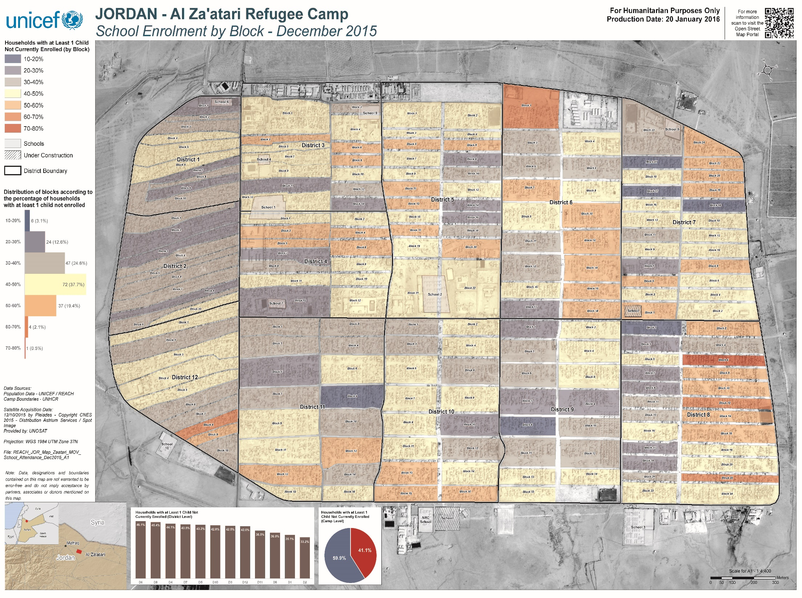

Slide 22
Attendance to informal education
Only 13% of school-aged children were reported to have attended informal education in the two weeks prior the assessment
Proportion of 6-17 year olds who attended informal education in the two weeks prior to the assessment
23% of households with school-aged children have at least one child attending informal education
13% of households with school-aged children do not have any children attending either formal or informal education
Notes:
32% of households with at least one child attending informal education cited Save the Children as an institute that was attended for informal education, 23% cited Relief International, and 13% cited IRD.

Slide 23
Summary
Formal Education
75.4% of school-aged children are enrolled in formal education
  An increase from 51.6% in June 2014 (JENA) and 64.6% in March 2015 (CCFA)
Significant differences exist between the two age groups, with 91% of 6-11 year olds enrolled in formal education versus 56% of 12-17 year olds
Informal Education
Low attendance overall—13% of school-aged children (3,088) attended informal education in the 2-weeks prior to data collection
  ***Age and sex-breakdown not recorded—area for future assessments and understanding
23% of households with school-aged children had at least 1 child attending informal education in the 2-weeks prior to data collection
Most frequent providers were Save the Children, Relief International, IRD, and NRC

Slide 24
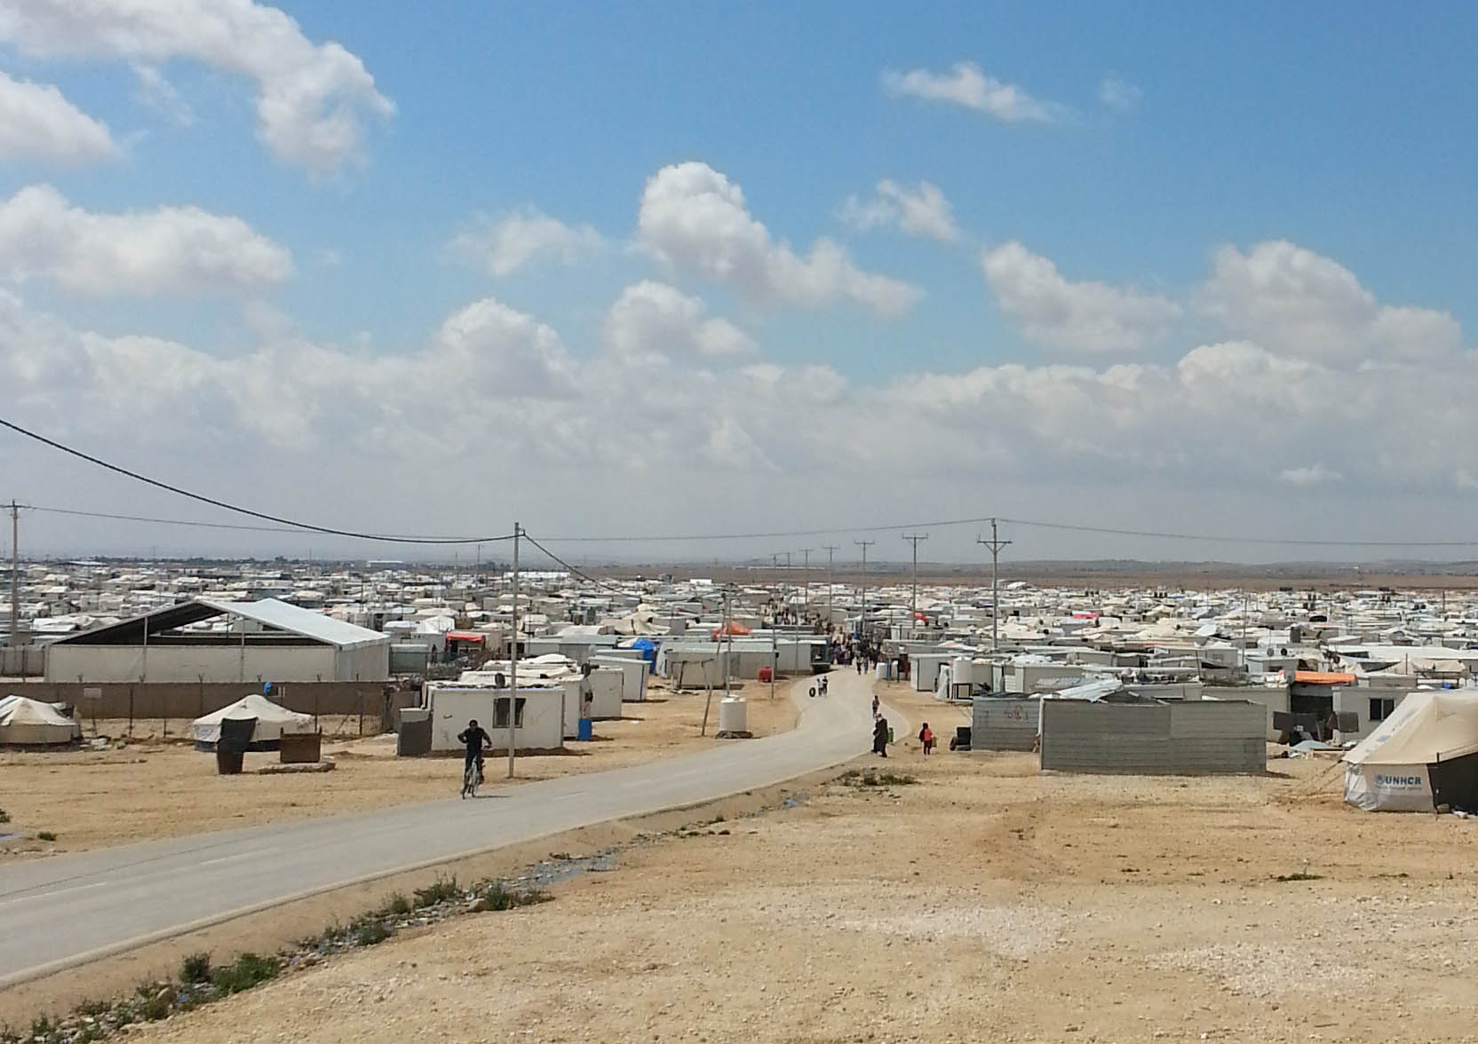
PRIVATE TOILETS

Slide 25
Households with private toilets
91% of households have a private toilet within the household
Districts 6 and 8 had the highest proportion of households without a private toilet (16%) followed by District 5 (15%)
The proportion of households without a private toilet within the household, by district (D)

Slide 26
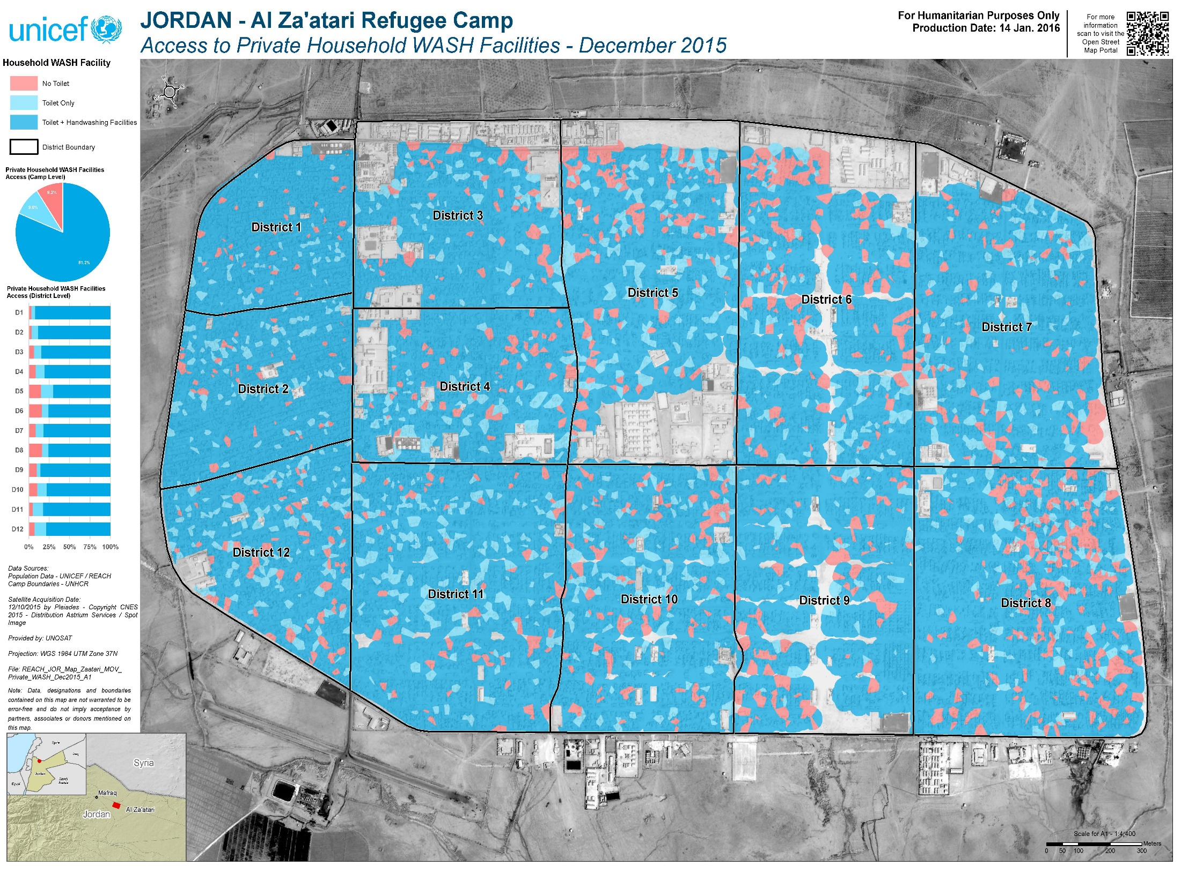

Slide 27
Suitable private toilets
Following inquiries about the structural set-up of their private toilet, 86.5% of households were found not to have a suitable private toilet according to UNICEF standards.
To be suitable a household’s private toilet should have:
Impermeable flooring (concrete or another water resistance material)
A connection to a septic tank or network
Handwashing facilities within the toilet (defined as water source or water container)
Drainage for handwashing waste water
Permanently installed walls or curtains on all four sides of the toilet area

Slide 28
Suitable private toilets - Breakdown
When broken down by suitability indicator the following proportions of household were found to have a private toilet that did not meet the criteria of that indicator:
66% not connected to a septic tank or sewage network
2% with a dirt floor or no flooring
11% with no handwashing facilities
11% with handwashing facilities, did not have drainage facilities
53% did not have permanent walls or curtains
These findings indicate that not being connected to a septic tank or sewage network, and not having permanent walls or curtains, are the main infrastructural barriers faced by households that have a private toilet.
Notes:
These findings indicate that the completion of the waste water network will substantially increase the proportion of households with a suitable private toilet

Slide 29
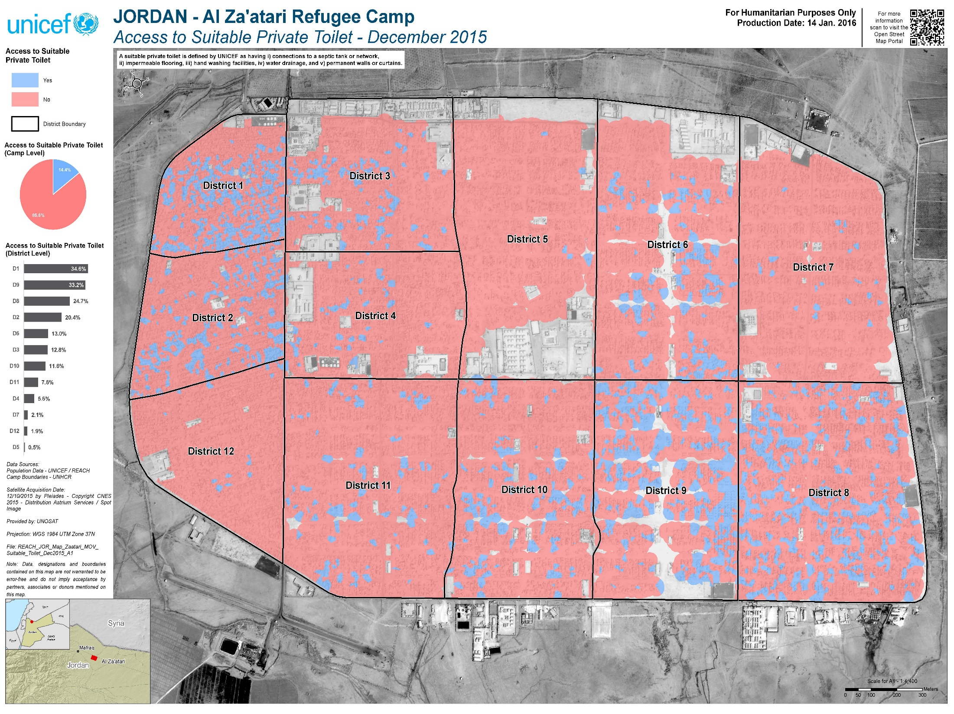

Slide 30
Households with members with restricted mobility and an unsuitable private toilet
5% of households reported that they had at least one member that needed mobility assistance
Of this 5%, 62% reported that they had an unsuitable private toilet.
The proportion of households with at least one member needing assistance with mobility, by suitability of private toilet
Notes:
These findings will be used by UNICEF and camp partners to inform programming that aims to ensure a safe standard of private sanitation facilities across the camp. Households with an unsuitable private toilet and a household member with restricted mobility were considered eligible for follow-up visits to identify their need for additional private WASH infrastructure assistance.

Slide 31
Thank You
For further information regarding the Population Count assessment at Za’atari Camp please contact:
Roxana Mullafiroze – REACH Assessment Officer
roxana.mullafiroze@reach-initiative.org
Andrew McKenna – REACH GIS Officer
andrew.mckenna@reach-initiative.org
Stephen Allen – UNICEF: Field Coordinator
stallen@unicef.org
To access all population count outputs, visit the online interactive dashboard and download any available resources: http://reach-info.org/jor/alzaatari_camp/

