Slide 1
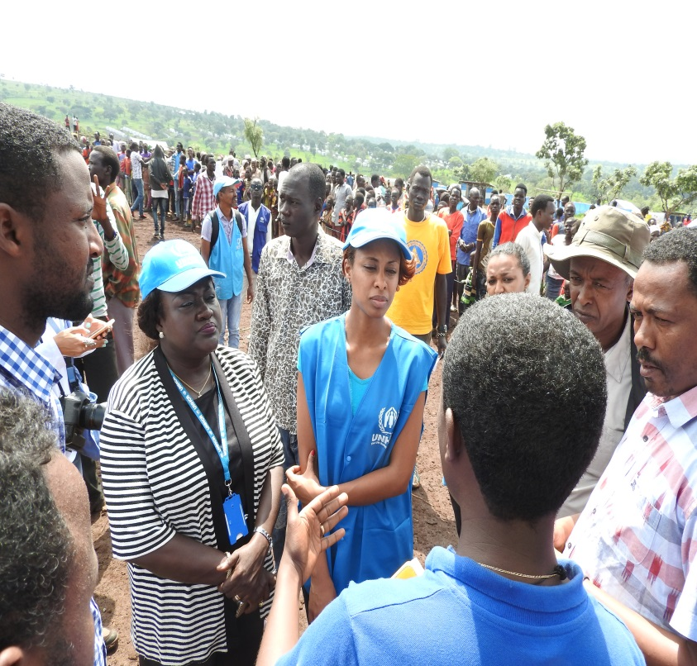
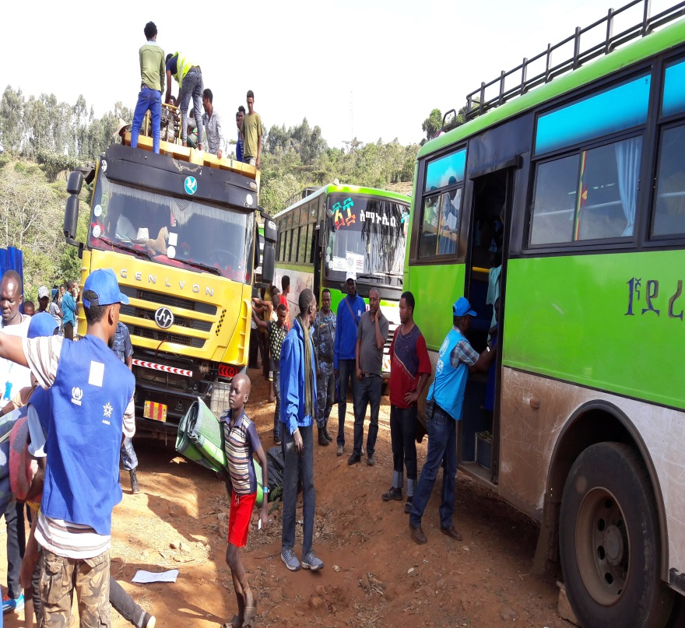


INTER-AGENCY COORDINATION MEETING
Venue: UNHCR Sub office, Assosa
Date: 9, October 2017

Slide 2


Presentation breakdown
Updates from UNHCR HoSO, Assosa and ARRA zonal coordinator
Security updates
Protection updates from ARRA and UNHCR
Sectoral updates
AOB

Slide 3
Security updates
Updates from UNHCR and ARRA Security focal points

Slide 4
PROTECTION
UNHCR
VERA launch
Prison monitoring
Registration of new arrivals happening in Gure-Shombola as 31 October 2017
Surveys (PA, Intention to Return for Sudanese)
Updates on Child labor
Challenges
VERA -Unavailability of ID cards
5 Minors in adult prison , lack CRIs, lack of adequate legal assistance

Slide 5
PROTECTION
ARRA
Registration
518 new arrivals screened, registered and transported to Tsore refugee camp. Medical screening also conducted by medical staff at Tsore refugee camp
42 new arrivals transported to Gure-Shombola from Abrahamo
Vital events (marriage, divorce, birth and death) registration service officially launched in all camps in Assosa
Challenges
Shortage of office and furniture for VER staff
Shortage of vehicles to transport new arrivals from entry points and or reception centers to the camps

Slide 6
PROTECTION
IRC
COMPASS Project
518 new arrivals screened, registered and transported to Tsore refugee camp. Medical screening As part of the sustainability activity the COMPASS program organized a dissemination workshop to highlight on COMPASS programming and learning assessments in Assosa, Participants 35( F-12, M-23)
A meeting was conducted in three camps with ARRA school administration and Good School Committee members on anti-sexual harassment code of conduct and zero-tolerant from corporal punishment code of conduct, strengthening good school committees and to align it with parent teacher association to ensure its sustainability, teacher training and on girls club, mini media club and school libraries
Challenges

Slide 7
PROTECTION
IRC
Child protection Program
Child protection social workers co-facilitated the indoor and outdoor games to provide age specific and appropriate psychosocial support services at CFS
Renovated Sherkole zone A&E fences and Zone E CFS
Equipped Bambasi CFS with slide, Balance, swing, different Toys, volley ball and plastic matt
  Conducted awareness raising activities through different awareness raising strategies to address issues of early marriage, child labor, teen age pregnancy, importance of positive parenting
  One day quarterly parenting night was conducted at Tsore refugee camp on the issue of positive child disciplining, the impact of corporal punishment on the overall physical and emotional wellbeing of children. Around 27 (17F, 10M) care givers and parents from different zone take part on this session

Slide 8
PROTECTION
IRC
Child protection Program cont.
Two days Quarterly mini campaign was conducted at Tsore refugee camp during food distribution on the issue of child labor. Around 110 Brochures and leaflets with child labor message was distributed during the campaign
CP and SGBV coordination meeting was held and child protection officers were actively take part on the meeting
Conducted family makes the difference session at the four camps. In Sherkole the third batch, Tsore 2nd batch, Bambasi 2nd batch and Tongo 4th batch, totally 128 caregivers are attending curriculum based positive parenting session at the four camps
Supported 350 (125F, 225M) at risk children residing at Sherkole refugee camp. They are supported with shoulder bags, laundry soaps, detergents and others
Provided capacity building training for 30 (20M, 10F) community based structures on the forms of child abuse and roles and responsibilities of community based structures at Tongo camp

Slide 9
PROTECTION
Plan International
Child protection Program
Took part in the participatory assessment
Intra Camp Sport Competition-World Mental Health Day (October 10, 2017) were more than 1500 people from both Host Community and refugees attended.
Construction-Youth permanent structure with sex segregated latrine in Zone A and Permanent CFS center in Zone B is in the final stage.
Case Management- A total of 40 (20 Male and 20 Female) incentive workers took part in the meeting.
Meeting with Child right and adolescent boys & girls club members and Participation in Global Hand Washing Day- All 60 members (30 male and 30 female) participated in the weekly meetings.
Weekly meetings to strengthening of Community Based Child Protection Mechanism-CPC members conducted meeting in coffee corner. A total of 12 (8 male and 4 Female) CPC members were part of the meeting and awareness raising activity.

Slide 10
PROTECTION
Plan International
Child protection Program cont.
Weekly meeting to strengthen Feedback and Compliance management Self-relocated New Arrivals-15 UASC (9 separated children and 6 Unaccompanied minor) identified in the Protection Help desk during reception of self-relocated new arrivals
Full Registration for 22 UASC (13 separated children and 9 Unaccompanied minor) and entered in to CPIMS.
Conducted Best Interest Assessments for 26(16 male and 10 female) children.
Home to Home Visit/Follow up for 45 unaccompanied, separated children and Other Vulnerable Children and among these 23 are male and 22 are female.
Case referral and Tracing Request- referred 2 Tracing request (Missing Request) through UNHCR for the case of children living in Kenya Kakuma III refugee camp and 4 (3 male and 1 female) children in Kenya Kakuma II refugee camp and their relatives seeking them in Gure-Shombola refugee camp.
Foster Care arrangement identified for 1 unaccompanied female child.
Child Friendly Space Activities-Indoor/outdoor games and psychosocial support

Slide 11
PROTECTION
Plan International
Youth Program
Peaceful co-existence club discussion- A total of 20 (10 Female and 10 Male) youth attended the Peaceful co-existence club members discussions.
Weekly Drama and Music Club and their participation in Global Hand Washing Day
SRH Club discussion- Through the club it was established that the youth need different SRH services such as prevention of HIV/AIDS and STIDs, how to use contraceptives and safe use and disposal of condom. A total of 20 (10 male and 10 female) members took part in raised awareness to the community on SRH and HIV/AIDS Prevention and response.
Football and Volley ball Outdoor games-A total of 945 (530 male and 415 Female) have attended the youth program activities.

Slide 12
PROTECTION
Plan International
Youth Program cont.
Focus Group Discussion: a total of 15(8 male and 7 female) adolescent minors participated.
Three capacity building training conducted
Challenges
The market adjacent to the CFS in Zone A is creating protection concerns to the children and therefore needs the attention of ARRA and UNHCR

Slide 13
PROTECTION
PRS Psychosocial support program in Tongo
Weekly case review continued with trained psychosocial helpers.
All three psychosocial centers were fully functional in providing indoor games, TV session & community based counseling services whereby 1427 (M680,F747) adult refugee beneficiaries have registered in the centers.
Provision of community based counseling services has delivered for 389 persons (M171, F218) on different psychosocial concerns by trained psychosocial helpers.
DSTV sport showing room has launched and has giving service fully.
Music and drama clubs 100 (M = 45, F=55) Training has continued.
Our music and dance club has participated in HAND WASH day which organized by IRC.
World Mental health day was celebrated in Tongo refugee camp in presence of ARRA, UNHCR Partners and refugees with the motto mental health in the work place. During the celebration different programs were presented, some of the activities were football solidarity competition among Tongo and Gure-Shombola refugee foot ball teams, symposium, musical, drama and traditional dance shows. During the celebration 1689 (724 m, 965f) has participated and watched.

Slide 14
PROTECTION
Action Against Hunger
a) Mental Health Program in Gure-Shombola camp
Routine psychosocial and care-practice supports were being given to all PLWs and caregivers of U2 throughout the reporting month, both at center and community level;
40 new beneficiaries (30 pregnant and 10 lactating women) were admitted in the MHCP program in the month.
466 PLW (137 PW and 309 LWs with their U2 children) have received various psychosocial services (counseling, stress management, psychodrama) within the Baby Friendly Space in the nutrition center.
Care practices including IYCF was promoted and reinforced among 301 PLW and other caregivers of under two children.
Seven (7) mother to mother support groups were formed within blocks in the refugee community.
10 PLW (3 PW, 6 LW & 1 other caregiver) have received follow up home visits in the month.

Slide 15
PROTECTION
RaDO Physical and psychosocial program
One day training for IP staff on Mainstreaming disability and accessibility- The training was organized in collaboration with UNHCR Assosa sub office protection team at Assosa level for 28(3F) IP staffs from all camps. All expected participants (50%) were not attended the training due to unknown reason.
Awareness raising Sessions-45 community discussion sessions were conducted on the issues of disability such as causes, consequences and prevention of disability, stigma and discrimination against PWDs, inclusion of PWDs participation in the community in all camps. The community discussions were attended by 766 (449F) refugees.
Schoolbags distributed to students with disability-108 beneficiaries including; 40 from Sherkole, 30 from Tsore and 38 from Bambasi refugee camps respectively. The beneficiaries were students for ARRA primary school and DICAC secondary school.
Repairing of old and used mobility aids- 2 wheelchairs were repaired/ maintained and 3M crutches were modified in Sherkole.

Slide 16
PROTECTION
RaDO Physical and psychosocial program cont.
One day disability awareness training was conducted for 28(7F) community representatives in Gure-Shombola camp. Participants included RCC, women association, youth association, PWDs association, religious leaders, Community police/shurta/, zonal leaders, etc.
Provision of physiotherapeutic Treatment for Persons with Physical Impairment- 134 (71F) refugees and local PWDs received different physiotherapeutic treatment and physical exercise in the rehabilitation centers and their homes in all camps.
Counseling and Psychosocial Support- Home to home follow up and counseling was conducted in all camps for 91 elderly persons and 77 persons with disabilities.
Referral linkage and mainstreaming-11(F=4) PWDS and older persons were referred to Bambasi ARRA health nutrition center. 4(2F) with visual impaired were referred to Gure-Shombola ARRA health for medication. 1(female) teenager with severe epilepsy was also referred to Action Against Hunger.
Capacity Building for 25 Mothers of Children with disabilities conducted in Gure-Shombola.
Meeting with PWDs Association leaders in all camps conducted.

Slide 17
PROTECTION
RaDO Physical and psychosocial program cont..
Challenges and gaps
Shortage of staff continued as the main problem of Assosa refugee operation.
Lack of Vehicle for Sherkole, Tsore and Gure-Shombola
Lowest salary of professional staffs
huge unmet needs of PWDs and Older persons

Slide 18
PROTECTION
LWF in Bambasi camp
Community Based Psychosocial Support (CBSP) Program
122 sport shirts with shorts, football an volley balls provided to 7 LWF male and female sport clubs
Basic computer an Music training provided to refugee youths
Two additional shelters constructed for youth center expansion for youth’s music and drama club office, indoor games.
Volleyball an football field is under construction for youths
24 Community Conversations with women and elderly groups held
100 home to home visits conducted to identify any psychological complaint/s
Youths an children accessed for TV shows in the youth center and played different indoor and outdoor games
1st round of ‘Bambasi got Talent’ show finalized

Slide 19
PROTECTION
Save the Children International
Child Protection program
15332 (7210 female) children were provided psychosocial supports using the attended different play and recreational programs in the existing CFS in the four camps.
Best interest assessments (BIA) was conducted for 49 (23 female) UASC and other vulnerable children.
Best Interest Determination (BID) was done for one boy child and waiting for inter camp family reunification.
Home to home visit conducted for 842 (338 female) UASC and other 29(16 female) vulnerable children.
In the reporting month, 931(203) children were registered in the CPIMS database.
Monthly child protection coordination meetings taken place in Bambasi, Sherkole, Tsore and Tongo Refugee Camps.
The child protection committee (CPC) reached 254(142 female) community members by their awareness creation efforts.
63 sport uniforms were provided for child led sport clubs to support their regular exercise and sport competition.

Slide 20
PROTECTION
Save the Children International
Child Protection program cont.
One day refresher training was organized for in and out of school child led clubs and 10 newly recruited incentive workers in Sherkole and Tsore refugee camps. A total of 65(45 boys and 20 girls) participants have attended the refresher training for one day.
One day training was organized for beneficiary reference groups, child led club members and child safeguarding focal points on child safeguarding and complaint, feedback and response mechanism. 90(32 female) participants attended the one day training.
30 (12 female) members of community based structures were provided with training on different child protection topics in Tongo Refugee Camp.
A refresher training was organized for 100 (62 female) parents on positive disciplining in everyday parenting skill.
Different items were procured for the support of children based on assessed need. The items include complete wear for 557 boys, complete wear for 339 female children and shoes 557 for boys and 339 for girls. In addition, blanket, matt and tob supports were provided for 442 (213 female) children.
Construction tender documents are opened and winner contractors will awarded in short time to start the construction of CFSs in Bambasi and Sherkole Refugee Camp.

Slide 21
EDUCATION
Save the Children International
782 carton high energy biscuit was supplied to the preschool children in the four camps.
1592 exercise book, 1592 pen 1592 pencil, 1592 eraser, 36 bags for teachers and 21 gumboots for PTC members were provided in Bambasi Refugee Camp.
7440(3147 female) preschool children have attended the preschool education program in the five camps.
Out of the 174 (91 female) children enrolled in ASR program in Tsore for 8 weeks, 155(81 female) children completed the 8th week ARS program. The children are referred to ARRA and UNHCR for primary school enrolment in grade one. Similarly 158(61 female) children completed the 8th round ASR program in Gure-Shombola Refugee Camp.
970(356 female) children have attended the primary school education program from grade 1-4 in Gure-Shombola.
Primary school construction tender announcement was opened and the winner contractor will be awarded in short time and the construction work to be started in Gure-Shombola Refugee Camp.

Slide 22
EDUCATION
Save the Children International cont..
  Challenges
Lack of preschool blocks in Bambasi, Sherkole, Tsore and Tongo Refugee Camps and resulted in high student to classroom ratio.
  Event Celebration: Universal Children’s day on 20 November 2017, will be colorfully celebrated in close coordination with ARRA, UNHCR, IRC and other implementing partners in the four refugee camps where Save the Children operates.

Slide 23
EDUCATION
ARRA Primary Education
Tongo 4193 (1947 F), Bambasi 5820 (2440 F), Sherkole 3632 (1628) and Tsore 3839 (1229) totally 17484 (7244 refugee students attended the school.
Regular teaching learning process conducted in all school days this month.
School supplies ( ex. Books, pen, pencil etc..) distributed for all students
50 library book shelves procured and distributed to 4 refugee primary schools
8 blocks of temporary classrooms constructed. Construction of 6 blocks of student latrines is ongoing and 60% of the work completed
School feeding service provided for primary school students in all school days
Challenges
Shortage of classrooms
Shortage of school uniforms for grade 1 students
Shortage of text books
Lack of qualified incentive teachers
Low incentive payment for refugee teachers
Shortage of budget for floor cementing of the newly constructed temporary classrooms
Lack of permanent school feeding halls and obsolete school feeding materials.

Slide 24
EDUCATION
UNICEF Education program
Through summer ASR initiative that was implemented in 60 schools in the three refugee hosting woredas ( Homosha, Bambasi and Mao-komo) and three pre-school centers in two refugee camps ( Tsore and Gure Shembola), a total of 1713 children(879 girls) from host communities and 319 refugee children benefited.
22 pre-school teachers (18 refugee teachers (3F) and 4 teachers from surrounding host community schools) trained on use of ECD Kits. The trained pre school teachers are expected to cascade the same to other teachers in their respective pre-school centers.
A total of 360 teachers (102 from refugee camps and 258 from host community schools) trained on formative classroom assessment ( Assessment for Learning techniques) which helped them increase their capacity to regularly assess student to get real time information to improve the teaching learning process. Currently, the second round training is being provided for 90 primary school teachers [45 teachers (3F) from refugee camps and 45 teachers from host community schools) at the regional management institute.

Slide 25
EDUCATION
UNICEF Education program through IPs
REB conducted school standard assessment in five primary schools in refugee camps. The findings of the assessment are communicated to all relevant bodies.
UNICEF is closely working with ARRA and UNHCR and other relevant partners to integrate refugee education with the host government education system.

Slide 26
EDUCATION
DICAC Secondary and preparatory
Registration of students from grade 9 to 11 completed.
Educational materials (exercises books and pen) distributed for all students at all camps (Tongo, Bambasi and Sherkole) including Assosa students.
Text books distributed for DICAC-RRAD Sherkole secondary & preparatory school students.
Subsistence allowance paid to Assosa and Bambasi refugee students (September month).
Teaching learning process is going on in Sherkole for grade 9, 10 and 11.
Staff meeting held and different clubs and department established.
Meeting with teachers and other supportive staffs
Cleaning the school compound
Cleaning the classroom per week once

Slide 27
EDUCATION
DICAC Secondary and preparatory cont.
Statistical data of Students supported by DICAC-RRAD at different Camps in 2010EC
 | Refugee |  |  |  |  | Local
Site | Grade | Male | Female |  | Total | Male | Female | Total
Tongo | 9 | 61 | 14 |  | 75
 | 10 | 37 | 8 |  | 45
 | 11N | 12 | 0 |  | 12
 | 11S
 | 12N | - | - |  | -
 | 12S | 2 | 0 |  | 2
 | Sub.T | 112 | 22 |  | 134
Bambasi | 9 | 9 | 1 |  | 10
 | 10 | 20 | 1 |  | 21
 | 11
 | 11S | 5 | 1 |  | 6
 | Sub.T | 34 | 3 |  | 37
Sherkole | 9 | 97 | 23 |  | 120 | 65 | 43 | 108
 | 10 | 83 | 9 |  | 92 | 20 | 11 | 31
 | 11N | 17 | 0 |  | 17 | 3 | 0 | 3
 | 11S | 21 | 2 |  | 24
 | 12N
 | Sub.T | 218 | 34 |  | 252 | 88 | 54 | 142
Assosa | 12S | 9 | 1 |  | 10
 | Sub.T | 9 | 1 |  | 10
Grand Total |  | 374 | 60 |  | 434 | 88 | 53 | 141
Total students’ statistics (both Refugee and local) in Assosa operation by 2010EC
 |  | M | F | T
 |  | 461 | 113 | 574

Slide 28
EDUCATION
DICAC Secondary and preparatory cont..
Challenges
Student uniform at Sherkole.
Staff turnover.
Absence of electric power to our school.
The absence of staff canteen.

Slide 29
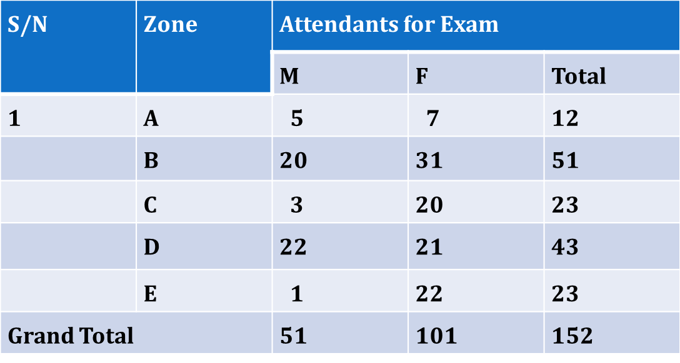
EDUCATION
PRS adult education and learning program
The Adult education learning has continuing after a week vacation. Examination out of 40% was given and out of 200 adult education learners 152 were sat for examination.

Slide 30
EDUCATION
NRC
Assessments being finalized to assess ALP needs in the old camps: to drive 2018 planning. ARRA, UNHCR and NRC- to finalize and verify the needs at camp level
ALP started in Tsore and Gure-Shombola

Slide 31
SHELTER
NRC
Tsore: 56 shelters are handed over to targeted POC. 15 additional shelters fully completed.
Out of the 44 POC lists shared, only 10 are physically present. New beneficiary lists shared by Zonal leaders are shared with the ARRA and UNHCR for verification purposes.
Sherkole: structures 100% completed. Grass thatching of 38 shelters is going on while the rest are completed and handed over to the POC.
Tongo: structures 100% completed. Grass thatching of 125 houses is ongoing. The rest are completed.
Gure-Shombola:170 skeleton completed; 90 ready for CIS roofing.
Devaluation of ETB affecting timely supply and in some cases the quality- NRC has rejected 4164 pcs of CIS due to poor quality

Slide 32
SHELTER
ANE
Transitional shelter Construction- one of the other activities, which ANE implementing at is refugee camp, is construction of transitional shelter. On month of October the following shelter activities are accomplished and the over all shelter construction progress is at 65% accomplishment
Item | Description of Work | Total number of T-shelter planned | Framing work Completed up | Roofing work Completed with CIS | Walling work Completed with split Eucalyptus
1 | Large size Shelter | 250 | 174 | 106 | 39
2 | Mid-size Shelter | 200 | 140 | 75 | 28
3 | Small size Shelter | 20 | 14 | 8 | 5
 | Total | 470 | 328 | 189 | 72

Slide 33
CONSTRUCTION
ANE cont.
Parking area improvement and military base road construction- this activities which was started at month of August, is completed on this reporting month by implementing the following major activities
Construction work for the walk way to ARRA and Refugees screening center completed
One Ford constructed on the way to the Military Base
Formation of green area around the parking area where completed and following this, different green planet where purchased and planted at this green area.

Slide 34
CONSTRUCTION
ANE cont…
Following the end of rain season ANE started slab bridge construction at Bambasi refugee camp on month of September. This project is also continue on month of October by implementing the following major activities
One store where constructed near to the where the new bridge will be construct and construction material like Cement, reinforced bar, sand …. Are purchased and stocked at the new store
By renting and deploying one excavator machinery the existing bridge has Demolished
Site clearing and setting out new foundation for the new bridge are accomplished by using the excavator
by making agreement with different skilled lobar are which are found around this refugee camp all construction work are started on month of October
one detour foot bridge are constructed near to the new bridge construction area, which will be used as woke way during the construction
by renting and deploying one mixer lean concrete work for foundation of the new bridge is started
Considering the above major accomplishment on the month of October, the slab bridge project is estimate at 30% progress.

Slide 35
CONSTRUCTION
ANE cont….
Challenges
Constant rain around the camp consternated the progress of the construction
Hared foundation rock found during excavation of new foundation for the Bambasi bridge construction take time of excavation work

Slide 36
LIVELIHOOD
PRS livelihood and self-reliance program
a) Agricultural intervention livelihood
Follow up has continued on the purchasing process of poultry that will support the poultry multiplication center.
Charcoal briquettes producer incentives have engaged and so far 580 kilo gram charcoal briquettes have produced.
Promotion of charcoal briquettes production has continued in coffee ceremony program in collaboration with ARRA.
Construction of charcoal briquette production shade has completed.
Identification of the problem of solar incubator has done with technician came from A.A.
105 shovels and 100 hoes have distributed for back yard gardening materials beneficiaries.
Materials (buckets = 240) that used for MSG purpose has distributed for 120 Back yard beneficiaries.
Protective shoe has distributed for charcoal briquettes producer incentives.
Vegetable group has preparing land at ARRA compound.

Slide 37
LIVELIHOOD
PRS livelihood and self-reliance program
b) Business Development Intervention livelihood
From 350 targeted beneficiaries 222 Loan taker beneficiary has selected in collaboration with zone leaders and concerned bodies from zone B, D, and E but remained 128 beneficiaries selection from zone A and C and is under process to conclude and organize them in teams and give them loan money.
Follow up of small loan beneficiaries has continued. Until now from the total loan money given to business teams birr 1,191,800.00 birr 819,527.00 birr (69%) was returned. From the 2016 given loan money 682,500 birr 426,310 (62%) is returned and In this month 19,630.00 birr (3%) has re paid from 2016 loan money given.
Challenges
Delay in the Replacement of damaged vehicle.
Absence and shortage of office rooms for staffs.
Delay of business loan takers to repay their loan money.
No respond our budget request from UNHCR Gambella sub office regarding the administration costs incurs starting September,2017

Slide 38
LIVELIHOOD
NRC Livelihood program
BYG: refugees and host communities have harvested. Preparations completed to do small irrigations in Bambasi and Tsore.
Poultry: chickens have started laying eggs. Targeted POC are benefiting from the eggs through household consumption as well as selling in the host community market. (Using the money to meet household needs, purchase chicken feeds, purchase local chickens etc)
Vaccinations provided to the chickens by the agriculture bureau animal health subsector of the Bambasi Woreda
Small business: program is running smooth, however repeated requests from beneficiaries for additional start up cash to strengthen their business and make it sustainable.
Ration cut has affected the purchasing power of the refugees
Pottery: pilot project has started. NFI kits will be produced. Pottery making wheels are produced by YEP furniture students in Tsore

Slide 39
LIVELIHOOD
NRC Livelihood program cont.
NRC is finalizing the preparation to conduct end line assessment on livelihood beneficiaries.
YEP: project works are almost completed. Graduation ceremony to be held in the first week of December- tentatively.
Tailoring students from 2016 YEP program are preparing graduation gowns- enhancing their income generation.
ECHO grant: YEP, poultry and bee keeping trainings are started.
Spending:
As of October overall spending rate was at 65% for both Sudanese and South Sudanese situations.
Challenges/ issues
Lack of standardized actual beneficiary selection means/ method
Devaluation of ETB – has affected delivery of items especially building materials as suppliers terminate their contract agreements
Shortage of vehicles to do proper monitoring of project activities/ One vehicle is old aged
Not a challenge but a kind request for the UNHCR and ARRA- to share information at the sub office level too, should there are any delegations visiting the partner’s projects.

Slide 40
HEALTH
ARRA Health Program
Outpatient consultation services provided for 10302 refugees
Inpatient services provided for 68 refugees in all camps except Gure-Shombola
39 refugees were referred to Assosa and Addis Ababa for further medical treatment.
Delivery services provided for 187 refugee mothers.
PMTCT services provided for 278 POC
Construction of MCH, OPD rooms, drug store, Sc and laboratory room is ongoing and 40% of the constructions completed
95% of public team office construction completed in Bambasi
Model family training started in Gure-Shombola refugee camp.
Camp cleaning campaign conducted in all camps.
11700 ITN distributed nets distributed in Bambasi and Tsore Refugee camps.
Challenges
Drug supply interruption (frequent stock rupture)
shortage of medical equipment like autoclave and lack of CBC and chemistry machine and
Lack of intra-camp transport for public health activities
Shortage of ambulance
Shortage laboratory technologist
Shortage of laboratory test kits

Slide 41
HEALTH
UNHCR
Accordingly, the SENS has enrolled hundreds of sampled households, under five children, pregnant and non-pregnant women for major life saving sectors like Health (prenatal services/mosquito net coverage), nutrition (malnutrition rate/anemia), WASH (water per capita) and food security/coping mechanisms.
The preliminary findings of the SENS indicated that the global acute malnutrition rate (GAM) has slightly increased in Tongo and remains almost similar in other locations, 6.2%, 7.8%, 11.4%, 6.5% and 9.7% in Sherkole, Tsore, Tongo, Bambasi and Gure-Shombola camps respectively. Likewise, the prevalence of severe acute malnutrition (SAM) was found to be slightly higher than that of 2015 finding in Tongo and remains nearly the same, below one percent, in other locations, being 0.7%, 0.8%, 2.8%, 0.8% and 0.8% in Sherkole, Tsore, Tongo, Bambasi and Gure-Shombola camps respectively.

Slide 42
NUTRITION
UNICEF Health & Nutrition program through IPs
A total of 15 health workers from the five refugee caps have been trained on fridge maintenance and effective vaccine management for five days. Smart phones have been provided to the refugee camps to enable them report on the vaccine supply system
All the five camps are receiving the required vaccine with out an interruption through the regional health bureau& PFSA. Access to vaccination service to all under one children of refugees and hosting community has been created.
ARRA at Addis level has received a total of 24,000 ITNs from UNICEF and has been distributing it in the camps.
A continuous technical support on nutrition program through Consultants recruited for the regional health bureau has been provided

Slide 43
NUTRITION
ARRA Nutrition program
Nutrition survey conducted jointly with UNHCR and WFP and the major findings are:
Measles coverage is except Tsore and Gure-Shombola camps others they achieved the UNHCR standard (>=95%).
Vitamin A supplementation in the past 6 months is four the camps are achieved the UNHCR standard (>=90%) except Gure-Shombola.
GAM rate <10% (except slight increments in Tongo)
SAM rate < 2% in all camps (except Tongo 2.8%) and malnutrition situation stable
High Diarrhea rate in Gure-Shombola (18.3%) and Tongo (16.3%)
<40 % Anemia among children in all camps
<20% Anemia for reproductive age women
>80 % timely initiation of breastfeeding, except for Gure-Shombola (78.5%)
Amount of Water LPPD below the UNHCR standard (20% LPPD) at Bambasi (19.9), Tongo (17.8%) and Gure-Shombola (17.8%)
Diarrhea cause higher in Tongo and Gure-Shombola camps needs attentions.
Supplementary feeding program or services provided for 9401 refugee beneficiaries in all camps except Gure-Shombola
124 refugees benefited from OTP

Slide 44
NUTRITION
ACTION AGAINST HUNGER Nutrition program
24 (14 male and 10 females) under five years severely Acute Malnourished children are admitted and treated in Outpatient Therapeutic program in the nutrition center
3 ( 1 pregnant and 2 Lactating women) are admitted and treated in in Outpatient Therapeutic program
31 (10 male & 21 female) under five years Moderate Acute Malnourished (MAM) children are admitted and treated in targeted Supplementary feeding program
82 PLWs (59 pregnant & 23 lactating) are admitted and treated in targeted Supplementary feeding program.
400 (213 males & 187 Females) under two years of age children and 218 P LWs (129 Pregnant & 89 Lactating women) are admitted in BSFP (Blanket Supplementary feeding program)

Slide 45
NUTRITION
ACTION AGAINST HUNGER Nutrition program cont.
Monthly mass MUAC screening conducted for a total of 925 children age from 6-59 months and 430 Pregnant and Lactating Women for nutritional status at the community and Nutrition centre.
Actively participated in Standard Emergency Nutrition Survey which was conducted in Tongo, Gure-Shombola and Bambasi Refugee camps.
Nutrition Triage/screening for 35 new arrivals was done with ARRA and UNHCR colleagues in Gure-Shombola Reception/Hunger center. During the screening ( 2 children and 1 Lactating Woman were found as moderate acute malnourished & 2 children are found as Normal and admitted to Targeted Supplementary Feeding program and admitted to blanket supplementary feeding program respectively)

Slide 46
NUTRITION
ACTION AGAINST HUNGER cont..
Host community Activities
To launch host community Nutrition and IYCF activities in Mao-Komo woredas, Gap assessment was conducted on some selected health facilities (2 HCs & 5 HPs) together with two health bureau staffs from the woredas
Staff recruitment has been finalized for Host Community Mental Health & Care Practice and Nutrition programs, (1 Therapeutic Feeding Program Nurse, 1 Head of Project and 2 Senior Psychosocial workers).

Slide 47
FOOD SECURITY
WFP refugee food program
Food commodities allocated for the month for General distribution, Supplementary Feeding and School feeding were delivered on time and distributions were also carried out in All refugee camp for October
Buffer stock for 1000 beneficiaries were prepositioned in Tsore refuge camp.
General ration cereal size was retuned to 13.5kg per person per month of October 2017
Biometrics assisted food distribution System is implemented smoothly with minor challenges in four refugee camps
WFP participated in Nutrition survey
Program staffs monitored the monthly food distribution and conducted FBM(Food basket monitoring )
We have collected monthly market information in refugee camps where cash is implemented
All biometrics food distribution centers are wired.

Slide 48
FOOD SECURITY
WFP refugee food program cont.
Challenges
Discrepancy between system generated reports and partners’ distribution reports (CPDR)
Delay in recruitment of IT assistants for Bambasi, Sherkole and Tongo refugee camps.
continues finger print capturing is not done for Sherkole refugee camp .
Deactivation of refugees who did not receive their entitlement for three consecutive months is not done as per the SOP.

Slide 49
FOOD SECURITY
ARRA food Program
General food distribution conducted on time ( First week on the month)
494 metric tonnes of food items and ETB 3,887,660 cash distributed.
Challenges
Delay of relocation of rub hall in Tsore incurred addition cost for loading and unloading of food items

Slide 50
WASH
UNICEF WASH program through IPs
For Gure-Shombola refugee camp and host community WASH facility design and construction:
Topographical survey, Environmental impact assessment and data collection for the design are completed,
Geophysical investigation for wellfield identification are underway.
Bid document preparation for drilling of boreholes and construction of water supply and sanitation and hygiene facilities are underway (waiting for the completion of welfield identification).
Challenges:
Accessibility problem for Geophysical investigation for wellfield; as the area is covered with toll savanna grasses and bushes, accessibility was the main challenge during the rainy season to identify the wellfield locations. Starting from November 04, 2017, the RWB has redeployed the team for the second time to complete the geophysical investigation. We hope they will complete in this week.

Slide 51
WASH
IRC WASH Program
Rehabilitation of water source in Tongo (GX898)- Spring and borehole rehabilitation in Tongo, pressure pipe line upgrading and Capacity development for WSG, TA and O&M incentive workers
Water Supply System Improvement in Gure-Shombola (Top Up)-Installation of 110 cubic meter capacity Pioneer water tank installed in Zone-C, procured and supplied of HDPE pipe (110mm, 90mm and 75mm) – partial, procurement of 4,536 meter HDPE pipe is on process (different size), procurement of construction materials on process for the construction of 8 water points (6 Refugee and 2 for host communities)
Construction of Family Latrines (GX898)- 400 in Tsore, 200 in Sherkole and 154 in Tongo camps respectively.
Hygiene & Sanitation Promotion-Celebrated Global hand washing day in Tongo, Sherkole, Tsore and Gure-Shombola camps, hygiene and sanitation promotion activities conducted in all camps as well as the weekly sanitation campaign, coffee ceremony, school WASH club, house to house visit, water container cleaning campaigns.

Slide 52
IRC HEALTH
IRC HEALTH Program
Health education conducted in all the camps.
Preventive Reproductive services provided to women of reproductive age in all the five camps.
Capacity building conducted in all camps on HIV/AIDS prevention
Comprehensive Integrated HIV prevention activities were conducted across the five camps through house to house visits and peer education. Additionally, clothes and hygiene promotion materials including laundry soap were distributed in all camps in collaboration with the child protection program.
Finalized recruitment of three Health officers and about to sign contract agreement

Slide 53
WASH
LWF WASH Program in Bambasi
a) Water supply
19.1 lpppd is supplied to the refugees and 12lpppdn for Womba host community
Proper regular water quality test conducted
Refreshment training given to School WASH club
350 meters Small scale irrigation canal clearing and other protection work using sack filled with sand done near one of the boreholes to reduce the risk of borehole damage due to flooding
b) Sanitation and hygiene
4 solid waste disposal pits Excavated and fenced
A total of 208 filled household latrines decommissioned and reconstructed from LWF’s internal fund- 18 in October
250 home to home visits conducted and health education provided to refugees
Jerry cans disinfected at water points
Reservoirs cleaning has been done (refugee an host community)

Slide 54
WASH
LWF Cont..
WASH Program in Gure-Shombola
LWF has secured additional fund from Church of Sweden and Canadian Lutheran World Federation to construct 240 household latrines and 80 household showers in addition to UNHCR’s fund
4 Pour flush latrines construction on progress
64 household latrines and showers construction on progress (85%)
8 solid waste pits excavated
IEC materials installed
Home to home visits conducted to provide education on sanitation and hygiene issues
LWF/NCA planned to start to provide hygiene NFIs through Cash Based Intervention through E-Voucher
Challenges
Still there are household latrines which needs decommissioning an reconstruction
Fuel for generators
Environmental degradation around the camp and flooding
Increment the cost of construction materials

Slide 55
ENERGY
GAIA ASSOCIATION
Energy program
Distributed 49 clean cook ethanol stoves for newly s beneficiaries who are based on vulnerable criteria.
Distributed 49, 10 House to house visit was conducted and checked identified fuel beneficiary absentees and their reasons, and visited the status of fuel of fuel storage and stove use.
liter capacity fuel storage Jerry cans and pitchers for safe ethanol fuel storage to the newly selected beneficiaries in Tsore.
Distributed 49 Safe Stove Use and Safety Instruction Manual for new ethanol stove recipients
Assessment on availability of feedstock for briquette production is started and in progress.

Slide 56
ENERGY
GAIA ASSOCIATION cont.
Energy program
Ethanol fuel distribution was conducted in Tsore refugee camp for the selected households including new 49 ethanol beneficiaries based on the distribution norm and schedule. Thus, 740 liters of ethanol was distributed at Tsore. 3825 liters of ethanol was distributed at Sherkole.
House to house visit was conducted and checked identified fuel beneficiary absentees and their reasons, and visited the status of fuel of fuel storage and stove use.
One two burner ethanol stove was provided for inpatient feeding program and demonstration is conducted. As two kerosene institutional stoves are provided to school, these stoves are planted and demonstrated. In addition, Gaia and ARRA agreed that ARRA will provide kerosene fuel for school feeding program.

Slide 57
ENERGY
GAIA ASSOCIATION cont..
Energy program
One refresher training on safe use of ethanol stoves and fuel for the new ethanol beneficiaries was conducted in Tsore camp.
Cooperatives to participate on clay production and assembly of stoves from host community were identified in Tsore.
Wood saving multiflex stoves distribution is conducted at Tsore. Thus 11 multi flex stoves are distributed.844 charcoal fuel briquettes at Tsore and 1813 at Sherkole are distributed based on the norm agreed with ARRA and UNHCR. There was also house to house visit to see those beneficiaries using briquette fuel.
Gaia procured 32.94 m3 firewood and distributed 80,977.5 kg to refugees in Gure-Shombola camp.
Ethanol fuel storage facilities (barrels and diesel fuel pump) were transported to Tsore camp. Construction of storage shade construction in progress.

Slide 58
ENERGY
GAIA ASSOCIATION cont..
Challenges
Beneficiary absentee during distribution of items.
Lack of motor bicycle to follow up the house to house visit
High energy demand of refugees and delay to address it
Pick up Vehicle problem to transport ethanol fuel from Sherkole to Tsore.
Traditional cooking practices of Refugees
Lack of alternative energy for lighting due to this refugees use the firewood for cooking and lighting
Selling out of the distributed stoves by refugees.
The beneficiary did not come on the schedule day.
Absence of office for Gaia in the camp:
Seasonality of the feedstock is the main challenge right-now.

Slide 59
ENERGY
LWF Energy Project in Bambasi camp
Carbonization and Milling of carbonized feedstock done
800 Briquettes charcoals produced
Additional feedstock procured
19 biogas plants (4 in the host community) construction completed
Awareness raising on biogas energy usage and operation provided

Slide 60
ENVIRONMENT PROTECTION
NRDP Environment protection program
Regular protection activities of the natural existing resources within & around all camps including planted forests against illegal cutting & animal browsing, man case fire, illegal expansion to the protected forest area were conducted through closed supervision & coordination of guarding system 1,012 hectares’ protected from illegal acts /604.9 ha. Sherkole, 92ha.,Tongo, 100.1ha.Bambasi, 105ha. Tsore& 110ha.Gure-shombola.
Weeding of new plantation sites was conducted as following; 15 ha.in Tongo, 5ha. Sherkole, 19.5 Tsore, 17.5ha. Bambasi, 5ha. Gure-Shombola.
Nursery site clearing completed for 1.5ha Sherkole, 1ha. Bambasi, 0.3ha
Gure-Shombola.
Slashing/clearing of old plantation sites completed as follows; 168.75 hectares in Sherkole, 50 hectares in Bambasi & 20 hectares in Tongo
Fencing of new plantation sites -2ha. Tongo & 2ha. Tsore respectively completed
Nursery site selection -1ha. Tsore & 0.5ha. Gure-Shombola
Infant seedling basket construction-Completed 300 in Sherkole & 60 Gure-Shombola refugee camps
Constructed 10 k.ms of plantation site subsidiary road in Sherkole camp

Slide 61
AOB

Slide 62
Thank you !
Amesginalehu!!!!

