Slide 1
UNHCR Representation in Ethiopia
Safe Access to Sustainable Energy for Domestic Cooking, Baking, Heating and Lighting for Refugees and Host Community services
Briefing Note to the Energy and Environment Task-Force
Addis Ababa
2nd November 2017

Slide 2
The SAFE 2015-2018 Country Strategy at a Glance
UNHCR-Ethiopia operation developed SAFE and Natural Resources Management Country Strategy 2015-2018, with the following strategic objectives:
Expanding Energy Access: Scale-up access to safe and sustainable energy services for domestic cooking, heating, lighting and community services such as water supply, health-care, education, and street lighting; office management and productive use.
Increase use of Renewable Energy: Replacing the use of non-sustainable biomass and fossil fuels, expanding access through renewable energy systems and increasing the contribution of renewables in the total energy mix for domestic use, community services and productive use
Improve Energy Efficiency: Improve energy conversion and end-use efficiency
Sustainable Environment and Natural Resource Management: Ensuring sustainable management of forest resources, degraded land management and biodiversity conservation
Unlock Business Potential for Energy Delivery: Building a vibrant energy market by catalysing private sector investment through targeted business development services and encouraging the development and replication of innovative business models
Capacity Building: Strengthen the capacity of the UNHCR and partners to effectively manage this Strategy through improved staffing, staff training and implementation of an effective M&E system

Slide 3
The two way Approaches and the main pillars in the Strategy
I. ENERGY: Scale up safe access to Energy and Domestic fuels for cooking and fuel efficient cook stoves and cooking utensils
II. ENVIRONMENT: Shared rehabilitation of refugee impacted areas and management of the natural resources and bio-diversity conservation
Why Energy at the center? b/c Energy is a cross-cutting issue touching the areas of:
Relief/Assistances
Protection
Health
Education
Nutrition
Shelter
Environment
WASH
Livelihood, etc.
While Environment is the basis for favorable habitation and sustained supply of energy and alternative energy sources, water, shelter, livelihood etc. Their criticality begins at emergency level stretching to transition to mixed solutions. Direly needed services but often marginalized because of competing priorities and limited budgets.

Slide 4
SAFE 2015-2018 Strategic Goal by 2018
70% of refugee households have access to energy/renewable energy sources for cooking ,baking, heating, lighting and productive use displacing the non-sustainable fuel-wood;
70% of the refugee households have access to fuel saving stoves;
70% of the refugee households have access to modern energy (solar PV) for domestic lighting;
50% of water supply schemes use renewable energy (solar, wind or hybrid systems);
50% of health facilities, schools and office services have access to reliable electricity;
70% of the refugee population has access to street light
50% of the refugee impacted degraded lands rehabilitated

Slide 5
SAFE 2015/2017 Baselines, Performance Indicators/progress and 2018 Targets for the supply of Fuel Saving stoves (FSS), SL, SSL, and Electrification:2015/2017

Slide 6
Iinstitutions involved in the supply of FSS, SL, SSL, and Electrification, Gaps and Actions Required :2015/2017
Strategic goal: Access to energy……. | Baseline (%) | Performance indicator (%) | Target (%) | Responsible Institution | Gaps (%) | Action | Remark*
Access to fuel saving stoves (FSS) | 13 | 30.8 | 70 | UNHCR, ZOA, GAIA | 56 | Institutions must continue providing FSS. Provide training and promote local production of stove | Accounts the damaged and the sold: The fig. does not reflect the current reality
PV-Domestic home lighting | 12 | 56 | 70 | UNHCR | 20 | UNHCR and its partners should continue providing home light with raining and enforcing the implementation of the SOP circulated | Current gaps are more than that indicated in this table The info. Accounts the damaged and the sold.
Solar water pumping | 0 | 12 | 50 | UNHCR, IRC | 76 | UNHCR and WASH partners shall continue replacing diesel run water pumping systems, irrigation systems and , office service etc. by PV-solar powers | Training of staff, & maintenance kits must be availed all time
Electrification of School and health centers | 0 | 9 | 50 | UNHCR, ARRA, i.t.d-UPM | 82 | UNHCR & its partners should continue providing the PV powered electrical services to all schools and health centers | 3 communal kitchen (Miao-Aini, Adi-Harush & Sherekole) are connected to the National grid 1 health center in SOMEL on process with PV.
Access to solar street lights(SSL) | 21 | 31.4 | 70 | UNHCR | 55.2 | UNHCR and its partners should continue providing the street lights, training on the management of SSl with the SOP enforced | Pertains to SSL-distributed in Jijigiga, Shire, Gambella and SOMEL camps. It accounts the damaged and the vandalized etc.

Slide 7
SAFE 2015-2018 Baselines, Performance Indicators/progress and 2018 Targets for the supply of Ethanol, Kerosene, Briquette and Electricity
Type of fuel | Baseline:2015 | Achievement: 2017 | Target :2018
Ethanol | 4,276 hhs | 9,377 hhs | 17,033 hhs
Kerosene | 19,466 hhs | 13,914 hhs | 9,850 hhs
Briquette | 0 hhs | 2,120 hhs | 57,614 hhs
Electricity | 7,588 hhs | 12,435 hhs | 22,573 hhs

Slide 8
Institution involved in the supply of Ethanol, Kerosene, Briquette, Electricity, Gaps and Actions Required
Strategic goal: Access to … | Baseline (HHs) | Performance indicator (HHs) | Target (HHs) | Responsible Institution(s) | Gaps (HHs) | Action | Remark*
Ethanol | 4,276 | 9,377 | 17,033 | UNHCR, GAIA | 7656 | Institutions must continue providing Ethanol fuel and ethanol stoves and promote local maintenance and assembly of the stoves on site | Expansion of Ethanol cook fuel to other camps such as SOMEL,Semara, Shire and Assossa camps is recommended
Kerosene | 19,466 | 13,914 | 9,850 | UNHCR | 4064 | UNHCR and its partners should continue replacing Kerosene by clean fuels (ethanol) | Currently Kerosene is being supplied following the traditional fuel distribution system which would have been otherwise
Briquette | 0 | 2120 | 57,614 | ZOA, Gaia | 55,494 | Feasibility study on acceptability, resource availability, sustainability and affordability study must be undertaken prior to the engagement. | The plan was too ambitious and over emphasizes briquette supply as sole solution to the problem rather consider “mixed solutions” particularly for Gamebella and Assosa camps.
Electricity | 7,588 | 12,465 | 22,573 | UNHCR, ARRA, i.t.d-UPM | 10,108 | UNHCR & its partners shall continue providing the service to cover all camps in Shire and Assosa | Grid connection action shall extend its service to Camps closer to the national grid: such as in Gambella Samara , Jigjiga etc.

Slide 9
What worked and what didn’t?
Provision | Worked | Didn’t | Reason | Action required | Remark
Access to fuel saving stoves (FSS) | Partially | - | Being sold or damaged | Fulfill unmet needs. Institute repair and maintenance scheme on site with spare parts. Enforce the SOP | Most items are sold to purchase unmet needs fuel in particular Repair and maintenance shops contribute to livelihood engagement
PV-Domestic home lighting | Partially | - | Being sold or damaged | Fulfill unmet needs. Institute repair and maintenance scheme on site with spare parts and trained staff. Enforce the SOP | Most items are sold to purchase unmet needs. Repair and maintenance shops contribute to livelihood engagement
Solar water pumping | Worked | n/a | n/a | Scale up, ensure the availability of spare parts and trained staff | Repair and maintenance shops contribute to livelihood engagement
Electrification of School and health centers | Worked (only available in Dolo) | n/a | n/a | Scale-up, ensure the availability of spare parts , repair and maintenance schemes and trained staff | Repair and maintenance shops contribute to livelihood engagement
Access to solar street lights(SSL) | Partially | - | Vandalized or damaged | train staff, Institute repair and maintenance scheme on site with spare parts. Enforce the SOP | SSL are vandalized; B/C poles are used as post for shelters and batteries to recharge mobile phones. Repair and maintenance shops contribute to livelihood engagement

Slide 10
What worked and what didn’t? …cont’d
Provision | Worked | Didn’t | Reasons | Action required | Remark
Ethanol | Worked | n/a | n/a | Train staff, establish repair and maintenance or assembling work-shops for the stoves on site Provide spare parts . Make an arrangement with the Ethiopian SC to produce ethanol on site as appropriate . | Repair and maintenance shops contribute to livelihood engagement. Producing ethanol on site reduces costs related to logistics making it even cheaper etc. but needs thorough cost and benefit analysis.
Kerosene | Worked but to phase out | n/a | n/a | Reduce and substitute the supply of kerosene | It is unsafe, unclean more hazardous and expensive than ethanol which is a clean cooking fuel as well
Briquette | Partially (pilot) | n/a | Sustainability is under risk due to lack of thorough cost/benefit analysis, study on the availability of raw materials/feedstock/ less consultation and low coordination . | Thorough study on the cost and benefit of the product, availability of raw materials/feedstock/and supply value chain be initiated before new engagement and to also improve the active programs . | UNHCR should play the leading role in coordinating energy and environmental programs
Electricity | Worked | n/a | n/a | UNHCR and Partners should continue expanding the provision of electricity from mini-grids, grids and PV-power sources | Provide training on electrical safety procedure and maintenance and handling of electrical equipment
Bio-gas | Pilot stage | Didn’t | Continuity is under risk due to lack of thorough cost and benefit analysis, on the availability of raw materials/feedstock/ including less consultation and low coordination . | Thorough study on the cost and benefit of the product, availability of raw materials/feedstock/ and value chain be initiated before new engagement and to also improve the active programs . | UNHCR should play the leading role in coordinating energy and environmental programs
Solar cooker | Didn't | n/a | Technologies do not support current needs | n/a | n/a

Slide 11
Where we stand now (SAFE): Ethanol, Briquette, FSS and Kerosene supply: 2015-2017
Refugee camp | Number of HHS | HHs supply indicator | Ethanol fuel supply (HHs) | Briquette supply (HHs) | Access to fuel saving stoves (FSS) (HHs) | Kerosene fuel supply (HHs)
Afar | 5,903 | Target | 30% | 30% | 70% | No
 |  | Achievement | 870 | 0 | 0 | -
 |  | Gap | 900 | 1,650 | 4,132 | -
Assosa | 16,075 | Target | 22% | 35% | 70% | 7004
 |  | Achievement | 420 | 820 | 1200 | 6946
 |  | Gap | 3,051 | 4,676 | 10,052 | 0
Melkadida | 38,711 | Target | No | 40% | 55% | 25%
 |  | Achievement | - | 0 | 0 | 1038
 |  | Gap | - | 15,484 | 21,291 | 7,600
Gambella | 82,507 | Target | No | 50% | 100% | No
 |  | Achievement | - | 0 | 23,861 | -
 |  | Gap | - | 41,254 | 29,507 | -
Jijiga | 6,093 | Target | 100% | No | No | No
 |  | Achievement | 6,093 | - | - | -
 |  | Gap | 0 | - | - | -
Shire | 22,740 | Target | 40% | 70% | 70% | No
 |  | Achievement | 1994 | 1300 | 0 | -
 |  | Gap | 6,841 | 14,618 | 15,920 | -

Slide 12
Where we stand now (SAFE):Lighting ,Electricity, SL,SSL supply:2015-2017
Refugee camp | Number of households | HH supply-indicator | Electricity for cooking (communal kitchen) | Solar lantern provision | Solar street lighting
Afar | 5,903 | Target | No | 100% | 100%
 |  | Achievement | - | 90% | 0
 |  | Gap | - | 10% | 100% (370 SSLs)
Assosa | 16,075 | Target | 60% | 100% | 50%
 |  | Achievement | 20% | 3% | 0
 |  | Gap | 40% | 97% | 50% (502 SSLs)
Melkadida | 38,711 | Target | No | 50% | 50%
 |  | Achievement | - | 100% | 70% (1700 SSLs)
 |  | Gap | - | 0 | 0
Gambella | 82,507 | Terget | No | 50% | 50%
 |  | Achievement | - | 75% | 21% (1100 SSLs)
 |  | Gap | - | 0 | 29% (1500 SSLs)
Jijiga | 6,093 | Target | No | 70% | 50%
 |  | Achievement | - | 70% | 75% (288 SSLs)
 |  | Gap | - | 0 | 0
Shire | 22,740 | Target | 100% | 80% | 50%
 |  | Achievement | 50% | 23% | 16% (226 SLs)
 |  | Gap | 50% | 57% | 34% (485 SLs)

Slide 13
Current Domestic Fuel Consumption

Slide 14
Proposed Mixed Energy Solution
Notes:
83% of the refugee households use biomass/firewood for domestic fuel consumption

Slide 15
Mixed Energy Budget Requirement

Slide 16
Investment Cost

Slide 17
Planned Budget and Allocation Gap: SAFE 2015-2017

Slide 18


Slide 19
Natural Resource Management and Environmental Rehabilitation
Interventions
Re-forestation of degraded forest lands
Greening camps with various plant species
Gully controls and rehabilitation of risk prone sites with biological and physical structures including gabion wall construction
Awareness raising on environmental consequences
Integration of livelihood projects with environmental programs
Expansion of bio-sphere and protective areas and
Area enclosures are being undertaken in various camps to reduce further impacts and natural disasters such flood, avalanches and land slides

Slide 20
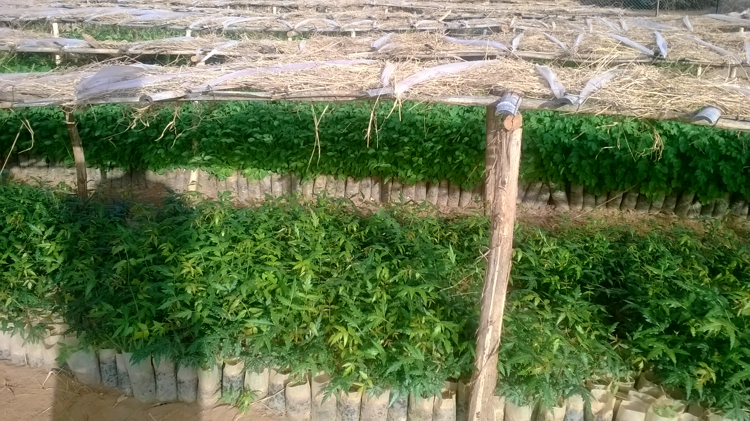
Plantation expansion
Different types of tree species are being raised and planted across the camps
To date more than 795 hectares of land has been afforested mainly in Gambella and Assosa camps
This equates to about 4 Million trees seedlings raised and planted in and around refugees/host community impacted areas

Slide 21
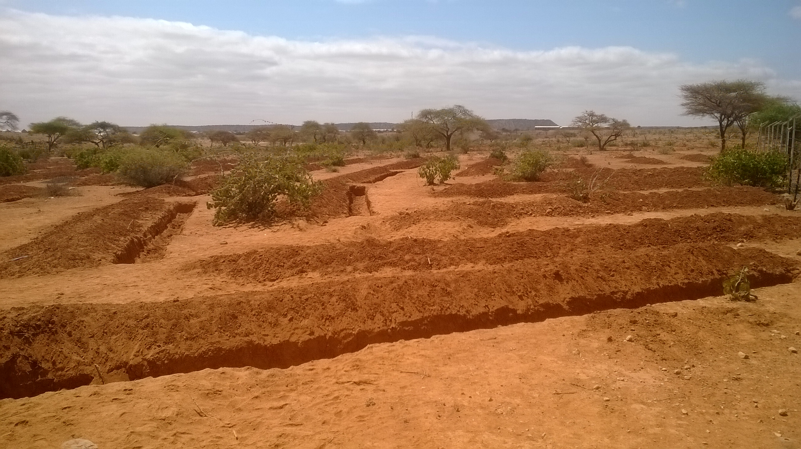
Land development and area enclosure
Soil and water conservation activities are ongoing in and around all camps
Area enclosure and gabion walls have worked well for degraded areas in Shire,
Check dams and gulley control measures have worked better in SOMEL, Jigjiga and Assosa refugee camps
Biological control have effectively controlled lands from denudation and slidding by flood in Gambella and Assosa camps
Survival rate of re-forested areas being better in Gambella and Assosa camps as the rainfall is relatively high
Greening camps with various plant species has resulted well in all camps in institutions and around HHs where protection is ensured

Slide 22
Challenges of NRM and Environmental Rehabilitation program
Low priority
Shortage of alternative solution for fuel wood and construction materials
Scale of intervention limited against the massive natural resource and environmental degradation in and around the camps.
Excessive dependence on exotic tree species
Area enclosure not very well practiced
Weak refugee and host community mobilization in NRM and Environmental activities
Non-integration of fuel wood plantations with re-forestation and woodlots
Weak integration of livelihood activities with natural resource interventions
Climate change

Slide 23
Planned Budget and Allocation Gap: SAFE 2015-2017

Slide 24
Where we stand now in Reforestation and Degraded Land rehabilitation:2015-2017

Slide 26
Mapping of E & E Partners
1. Somali Refugees in Ethiopia (Jijiga and Melkadida)
Implementing partner | Sector | Main activities | Plan for 2018
GAIA | Energy | Provision of ethanol in Jijiga, Installation of solar street lights and solar home systems in Melkadida | -Empower the refugee committees to repair and maintain energy equipment's
SEE | Environment | Distribution of seedlings to the refugee and host communities, physical and biological rehabilitation of degraded lands | Management and training to increase the survival rate of plantations Promotion of gum & resin producing trees, plastic recycling (4Ds) Pilot planting of fuel plants (like Jatropha)
PWO | Environment | Seedling distribution, area enclosure and irrigated woodlot development

Slide 27
Partners Mapping…ctd
1. South Sudanese Refugees in Ethiopia (Gambella)
Implementing partner | Sector | Main activities | Plan for 2018
 |  |  | Briquette production and distribution, biogas production and distribution. Establishment of energy cooperatives for management, maintenance and protection of solar lanterns and street lights Establishment of woodlot for fuel wood consumption
UNHCR, ARRA, AHADA | Energy | Distribution of solar lanterns and installation of solar street lights
NRDEP | Environment | Rehabilitation and reforestation of degraded lands | Community based environmental management and establishment of woodlots Integration of livelihood and environmental management

Slide 28
Partners Mapping…ctd.
1. Sudanese Refugees in Ethiopia (Assosa)
Implementing partner | Sector | Main activities | Plan for 2018
GAIA | Energy | Alternative energy provision (kerosene, ethanol and briquette) | Scale up the pilot projects and apply the energy mix
LWF | Energy | Biogas production from cow dung | Ensure the sustainable supply of feedstock
NRDEP | Environment | Tree plantation, construction of firebreaks, | continue the forest protection and tree planting

Slide 29
Partners Mapping…ctd
1. Eritrean refugees in Ethiopia(Shire and Afar)
Implementing partner | Sector | Main activities | Plan for 2018
OSD | Energy | Alternative energy (ethanol, briquette and solar lanterns) | Briquette production from Prosopis in Barhale and Aysaita and continue the provision of ethanol Expansion of briquette distribution in Afar camps Expansion of grid connected communal kitchen in shire National grid connection for communal kitchen in Aysaita and Barahle
EECMY | Energy | Alternative energy (ethanol and solar lanterns)
ZOA | Energy | Briquette production from sesame husk
UNHCR, ARRA | Energy | Grid Connected Electricity
ARDO, OSD | Environment | Environmental rehabilitation and area enclosure | - Seedling plantation and camp greening - Establishment of woodlots

Slide 30
Partners Mapping
1. Kenya Borena refugees in Ethiopia(Kenya Borena)
Implementing partner | Sector | Main activities | Plan for 2018
ANE | Energy | Provision of alternative energy (fuel saving stoves and solar lanterns) | Proper training and management
ANE | Environment | Replanting and protection of the environment | Awareness creation and environmental trainings

Slide 31
Other Initiatives
Jijiga: Carbon Credit registration for clean Ethanol stoves (GAIA)
Afar: Grid connected electricity for communal kitchen (EECMY), Briquette (OSD)
Shire: Grid connected electricity for communal kitchen, street lights and productive use (Alianza – Shire, i.t.d UPM), Briquette production (ZOA)
Gambella: Assessment of cooking fuel energy demand and alternative energy sources (OSD), Woodlot development in collaboration with FAO
Assosa: Biogas production (LWF), Briquette production (GAIA/PRM), Grid connected communal kitchen (ARRA)
SOMEL: assessment and testing the potential for cooking energy options (Gaia)
National Energy assessment: Integration

Slide 32
What is expected from the E& E WG
Advocacy
Coordination
Fund raising
Pressure group
Monitoring and evaluation
Cross-sectoral link
Represent E & E in all E & E related affairs

