Slide 1
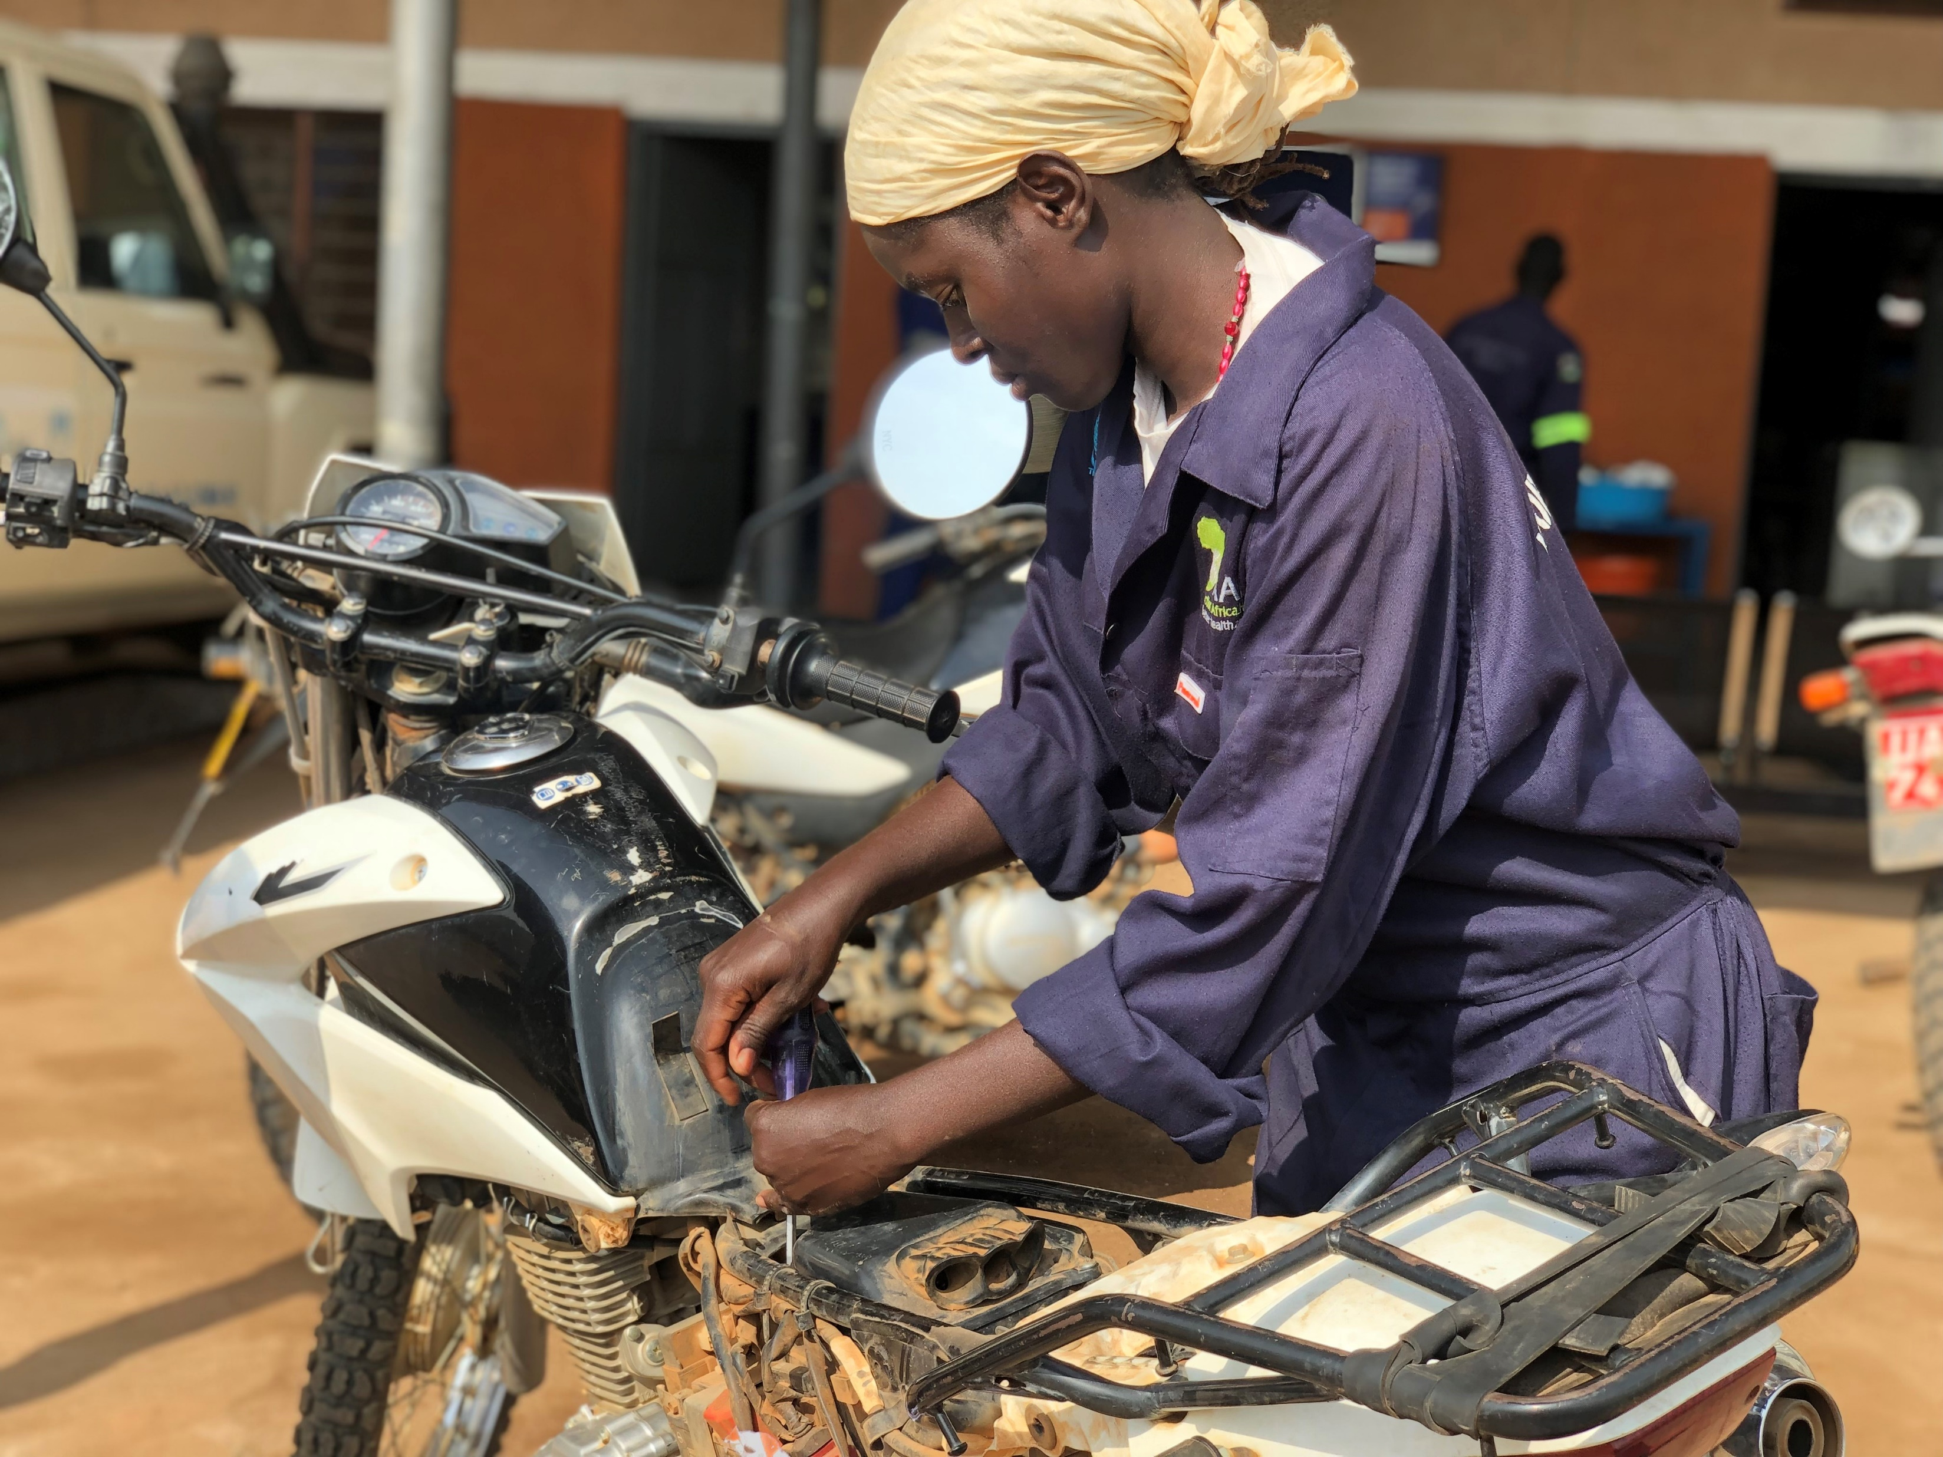
Update on RRRP Revision process
A female graduate in moto mechanics repairing a motorbike in Adjumani

Slide 2

THE REGIONAL REFUGEE RESPONSE PLAN
Requested by the 2 Regional bureau (in Nairobi and Pretoria);
Request made to partners for their inputs regarding their total 2020-2021 budgets; Number of partners who submitted:
Total budget: 359,594,205
Total number of partners: 54
(Bdi:11,020,023; S/S: 161,778,127; DRC: 186,796,055
Narrative was done and shared with the two bureau
Many thanks to all the partners who spent their precious time on the inputs

Slide 3
THE UGANDA COUNTRY REFUGEE RESPONSE PLAN
The document was also requested to be updated and to become the 2020-2021 Uganda Country RRP;
The Representative requested that we maintain the current document we have as it was last updated in May, 2019.
The document may be updated when the need arises possibly in 2020.

Slide 4
A BIG THANK TO ALL OF YOU

