Slide 1

Desk Review – “Internet Challenges Are Leaving People Behind”
Presentation by Joanna Broumana, UNFPA Jordan Youth Team

Slide 2
Purpose of the Desk Review
Guide and inspire youth workers, youth groups and networks and humanitarian actors on innovative solutions to internet connectivity challenges faced by young people in humanitarian settings;
Learn from solutions and recommendations from previous pandemics the world has faced, mainly the Ebola outbreak;
Activate a thinking process around how to adapt programming and projects to be as inclusive as possible due to the COVID-19 pandemic and its long-term affects on face-to-face interactions and physical group gatherings.

Slide 3
Good Practices during COVID-19 Response
Radio and Television
Music videos
YouTube Channels
Free Wi-Fi Hotspots
Phone-based learning
Home Delivery
Distribution of Hygiene Kits
School buses multiple purposes
Chrome books
Books and libraries

Slide 4
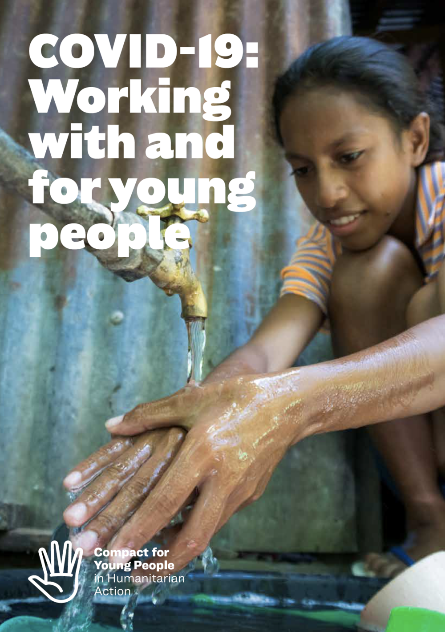

Good Practices during COVID-19 Response

Slide 5
Lessons Learned and Recommendations
Significant barriers to access mobile phones, internet, radio and provision of electricity were listed mainly in poor and rural communities 🡪 strain on already fragile networks;
Singular radio and television provisions which lead to lack of content differentiation 🡪 allow for multiple grade levels and age characteristics;
Investments are required to ensure that young people have access to multiple forms of communication 🡪 donor funding to be flexible to be used for the needs of young people due to COVID-19;
Youth networks and relevant communications and media structures must be in place before a crisis hits 🡪 community networks to help meet connectivity gaps in the population must be an integral part of the response

Slide 6
Lessons Learned and Recommendations
Community networks can play an important role in meeting the needs of refugees for better connectivity 🡪 supporting the communication needs of excluded groups and specific needs population groups, such as women and girls and young people;
Encourage the development of local content 🡪 ensuring applications and mechanisms are available that support communities in producing their own local content.

Slide 7
Conclusion
The internet is a helpful tool to reach as many youth and adolescents as possible, and their ease with technology enables them to enjoy its advantages;
At the same time, internet is a barrier to inclusion as society is becoming increasingly dependent on the internet but internet connectivity challenges remain;
Innovation is not always about inventing something new – what did we do before the digital revolution?
Donors, UN agencies, and Humanitarian actors must invest in equal access of adolescents and young people to good quality internet connection and devices;
Humanitarian actors must be flexible and innovative to reach the most vulnerable and ensure their active engagement in education, learning and self-development and self-care process.

Slide 8

Any Questions? Thank You!

