Slide 1

National Inter-Agency Meeting
12 February 2021

Slide 2
National LCRP Inter-Agency Meeting
Agenda:
Opening
LCRP 2021 – Sector Strategies and Inter-Sector Priorities
LCRP Funding Update
Update on tensions
Presentation: Neighbourhood profiling
AOB

Slide 3
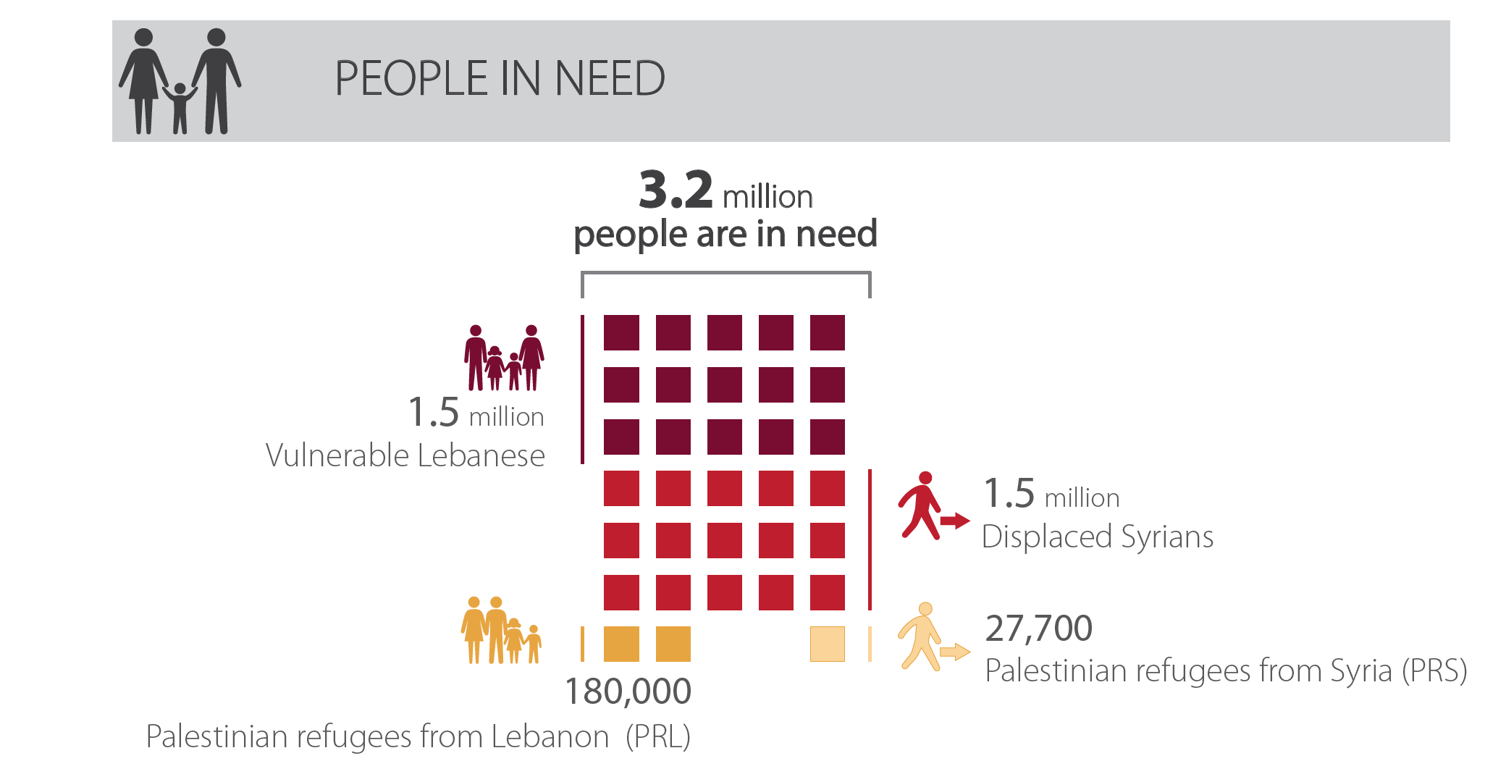
Population in Need 2021
* An additional 50,000 people in need will also be included in the LCRP. These are other UNRWA-eligible people that are not registered refugees, mainly persons married to non-refugees and persons without an identity document.

Slide 4
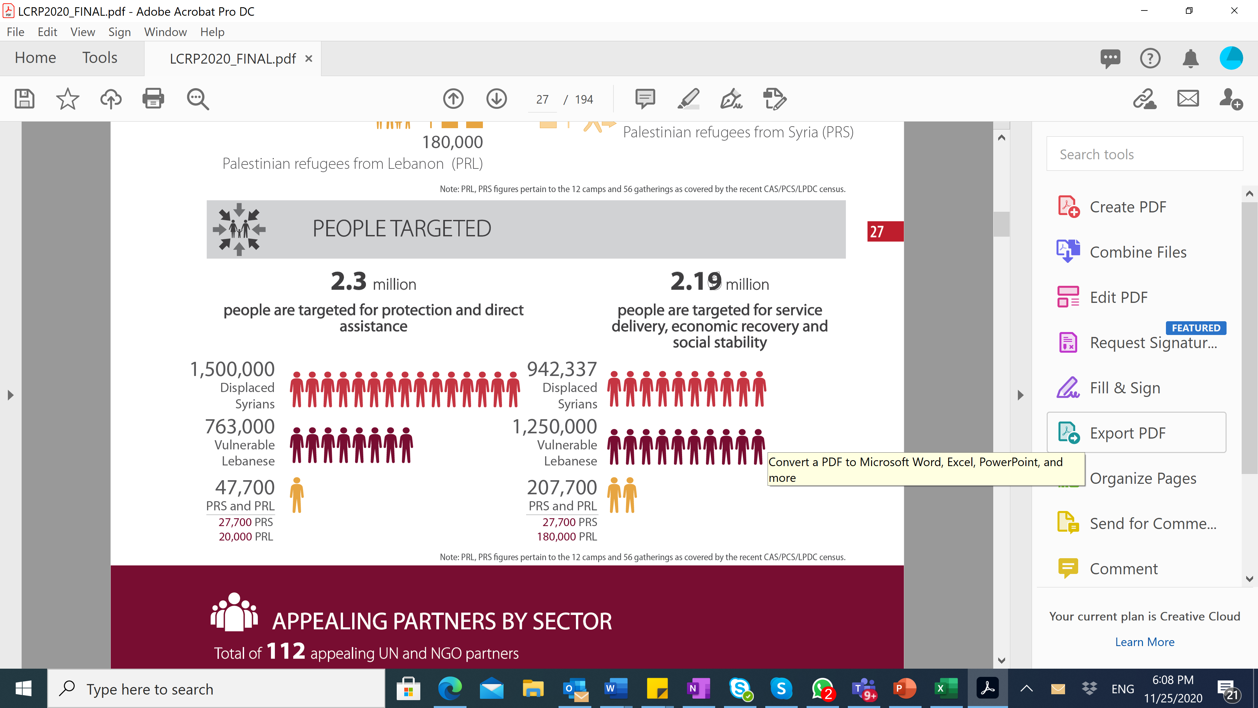
Population Targeted 2021

Slide 5
Basic Assistance
Outcomes, Target and Budget
 | 2021 Target
Outcome 1 – Strengthen the ability of vulnerable HHs, including female-headed, to meet their basic survival needs | 1,608,798 people
Outcome 2 – Strengthen the ability of populations affected by seasonal hazards and emergencies to secure additional basic survival needs
Outcome 3 – Support the National Poverty Targeting Programme (NPTP)
Partner Appeal $414M

Slide 6
Education
Outcomes, Target and Budget
 | 2021 Target
Outcome 1 – Enhance access to- and demand from children, youth and their caregivers for equitable formal or regulated non-formal education | 202,000 Syrian, 315,000 Lebanese, 4,812 PRS and 6,401 PRL children and youth.
Outcome 2 – Enhance quality of education services and learning environment to ensure grade-appropriate learning outcomes for children and youth
Outcome 3 – Enhance governance and managerial capacities of RACE 2 implementing institutions to plan, budget, deliver, monitor and evaluate education services
Partner Appeal
$430M

Slide 7
Energy
Outcomes, Target and Budget
 | 2021 Target
Outcome 1 – Increase in energy production through implementation of renewable energy sources | 678,487 people 29 government hospitals 218 PHC 128 SHC 233 SDCs 343 public schools 4 Water Establishments 251 municipalities MoEW
Outcome 2 – Reduce energy demand due to implementation of energy efficient initiatives
Outcome 3 – Improve access to electricity through rehabilitation and reinforcement works on the transmission and distribution networks
Outcome 4 – Enhance capacity of MoEW to plan, budget and oversee energy sector initiatives
Partner Appeal
$22M

Slide 8
Food Security
Outcomes, Target and Budget
 | 2021 Target
Outcome 1 – Improve food availability through in-kind food assistance and sustainable food value chain | 1,799,475 people 5 institutions
Outcome 2 – Improve food access through cash-based food assistance and agricultural livelihoods
Outcome 3 – Improve food utilization: food safety and nutrition practices are improved through the promotion of consumption of diversified and quality food
Outcome 4 – Promote and stabilize food security through support/capacity building and strengthening of national public institutions and their decentralized services
Partner Appeal $826M

Slide 9
Health
Outcomes, Target and Budget
 | 2021 Target
Outcome 1 – Improve access to comprehensive primary healthcare | 2,475,381 people 40 hospitals 1,300 public schools 250 MoPH-PHCs
Outcome 2 – Improve access to hospital (including ER care) and advanced referral care (advanced diagnostic laboratory and radiology care)
Outcome 3 – Improve outbreak control and infectious diseases control
Outcome 4 – Improve adolescent and youth Health
Partner Appeal
$239M

Slide 10
Livelihoods
Outcomes, Target and Budget
 | 2021 Target
Outcome 1 – Stimulate local economic development and market systems to create income generating opportunities and employment | 92,035 people 3,000 MSMEs 500 municipalities 6 ministries (MOSA, MOET, MOL, MOInd, MOA, MEHE)
Outcome 2 – Improve workforce employability
Outcome 3 – Strengthen policy development and enabling environment for job creation
Partner Appeal $199M

Slide 11
Protection - Protection, SGBV, CP
Outcomes, Target and Budget
 | 2021 Target
Outcome 1 – Women, men, boys and girls have their fundamental rights respected | 1,884,800 people
Outcome 2 – Women, men, boys and girls are protected by a strong and accountable system against all risks of violence, exploitation and abuse, including sexual and gender-based violence (SGBV), violence against children and sexual abuse and exploitation (SEA)
Outcome 3 – Women, girls, men and boys live with dignity and are resilient to shocks
Partner Appeal $213M

Slide 12
Shelter
Outcomes, Target and Budget
 | 2021 Target
Outcome 1 – Reduce immediate protection-related shelter needs of the most vulnerable households | 727,682 people
Outcome 2 – Improve access to adequate shelter as part of a multi-sectoral approach in disadvantaged areas for enhanced stability
Outcome 3 – Enhance contribution of national institutions and organizations to the housing situation in Lebanon
Partner Appeal
$88M

Slide 13
Social Stability
Outcomes, Target and Budget
 | 2021 Target
Outcome 1 – Strengthen the ability of municipalities and national and local institutions to alleviate resource pressure | 2,593,547 people 244 municipalities 46 unions 66 SDCs 6 ministries 7 governor offices 26 districts LAF and ISF
Outcome 2 – Strengthen municipal and local community capacity to foster dialogue and address sources of tensions and conflicts
Outcome 3 – Enhance LCRP capacities on early warning and conflict sensitivity
Partner Appeal $131M

Slide 14
Water
Outcomes, Target and Budget
 | 2021 Target
Outcome 1 – More vulnerable people in Lebanon are using safely managed drinking water and sanitation services while reducing health and environmental risks and improving water quality by increasing the proportion of wastewater that is safely treated | 1,810,843 people Institutions targeted include central ministries, Water Establishments and Litani River Authority, union of municipalities, municipalities, Palestinian camps/gatherings and schools
Partner Appeal
$183M

Slide 15
Estimated 2021 LCRP Appeal
Sectors have developed sector strategies and budgets based on needs, reaching an overall 2021 budget of $3.23 Billion USD.
Partners submitted a prioritized appeal based on their capacities, with an overall partner appeal of $2.75 Billion USD.
Sectors | 2021 Sector Budget | 2021 Prioritized Appeal | # Appealing partners
Basic Assistance | $582 M | $414 M | 46
Education | $395 M | $430 M | 62
Energy | $99 M | $22 M | 10
Food Security | $858 M | $826 M | 56
Health | $286 M | $239 M | 44
Protection, CP, SGBV | $214 M | $213 M | 68
Shelter | $163 M | $88 M | 34
Water | $223 M | $183 M | 32
Social Stability | $140 M | $131 M | 50
Livelihoods | $274 M | $199 M | 73
Total | 3.23 Billion | $2.75 Billion | 112

Slide 16
2021 Inter-Sector Priorities
2021 Focus: Harmonized and streamlined inter-sector response that builds on progress and informs future planning - inclusive engagement
  Field level: increase support and guidance to help design cross-sectoral programming (based on joined-up assessments, context analysis etc)
  National level: aligned planning and reporting across response plans, under a holistic communications plan for partners with increased training on tools. Improved and prioritized reporting
  Inclusive & accountable: enabled co-leadership/co-coordination by NGOs & more regular JTF and SC meetings
  Joint cross-sectoral engagement on time-bound thematic priorities and issues where there is opportunity for impact and change (example: evictions, support to persons with specific needs and removal of subsidies) Focal points for sectors to contribute?
  Stakeholder engagement and advocacy plans developed based on priorities: donors, national authorities, local authorities

Slide 17
2021 Key deliverables under priority areas
Inter-Sector Analysis - Strengthen joint analysis to guide evidence-based planning, programming and advocacy | Quarterly process to identify thematic priorities Update and continue rolling out research questions (and collaboration with academia). Continue producing regular situation analysis and in-focus pieces Sector focal points for advocacy Use and integrating data from NGO into analysis and accelerate data sharing
Emergency preparedness and response - Strengthen and refine emergency preparedness and contingency planning | * Increased focus on feedback from affected population * Quarterly update the Inter-Sector on progress * Regularly review and update on gaps * Ensure communication in case of emergencies and outbreaks
Inter-Agency Referrals - Strengthen the IA referral system aims to increase accountability to affected populations | Communication on the tools, check with the field to make sure it makes sense Continue training on the IA referral system Regular communication at national/field to update Service Mapping
Sustainability (nexus, localization) - Stabilization including localization, strengthening institutions, contribute to resilience | Synergies across frameworks Stakeholder consultation and produce action plan/steps for localization Anticipating future risks/changes Look at capacity building/providing quality programming Inclusive, effective and transparent coordination processes
M&E and Reporting - Ensure timely, harmonized and systematized reporting. | Includes higher-level M&E; Brussels Commitment; and tracking sector progress Communicate on the tools, training and systematic follow up with partners Find better ways of simplifying reporting across responses (for example in Health).
Coordination & Working Modalities - Continuously review modalities for an inclusive and coordinated response. | Regular Steering Committee and Joint Task Force meetings Focal points per sector, joint thematic discussions to inform advocacy Coordinate assessment through LASER Coordination with non-LCRP partners Strengthen NGO co-leadership
2021 Joint Inter-Sector Priorities
Mainstreaming | Protection, Conflict Sensitivity, PSEA, Gender, AAP, Environment: identify task teams to lead on nationwide progress

Slide 18
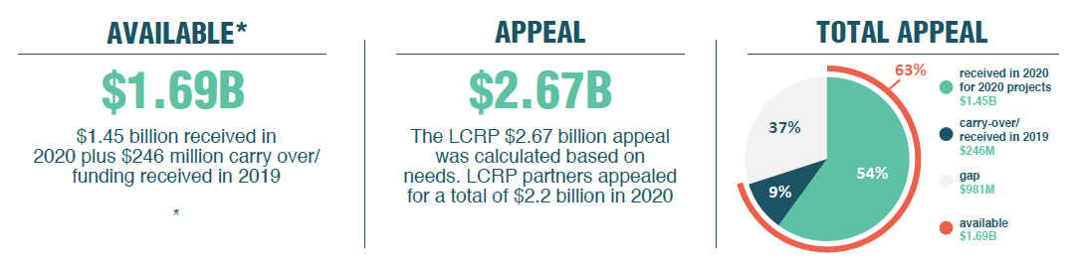
2. Update on LCRP Funding
*Preliminary funding results are based on partner reporting, and are pending verification with donor disbursement reports
79% of the funding went to UN agencies, 18% by INGOs and 3% by NNGOs.
4% ($67 M) was reprogrammed for COViD-19 activities
$2.9M was reprogrammed for Beirut Blast activities.
32% (or $458.6 M) of the funds received between January and Dec 2020 were for multiyear projects (projects longer than 24months). Out of this, $69.1 M are for multi-year projects that will end in 2020

Slide 19
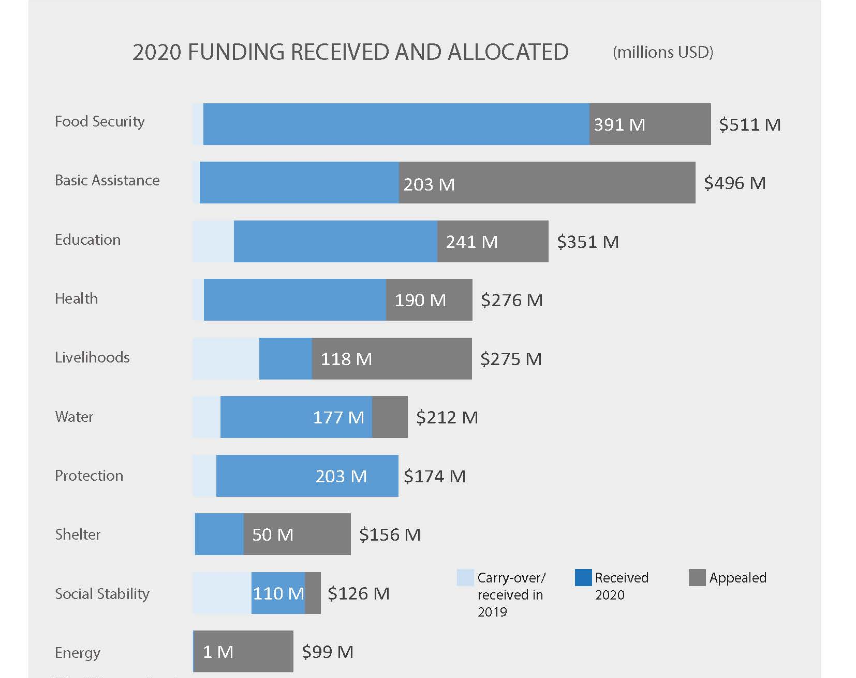
Update on LCRP Funding – breakdown per sector

Slide 20
Tensions Monitoring Update
February 2021

Slide 21

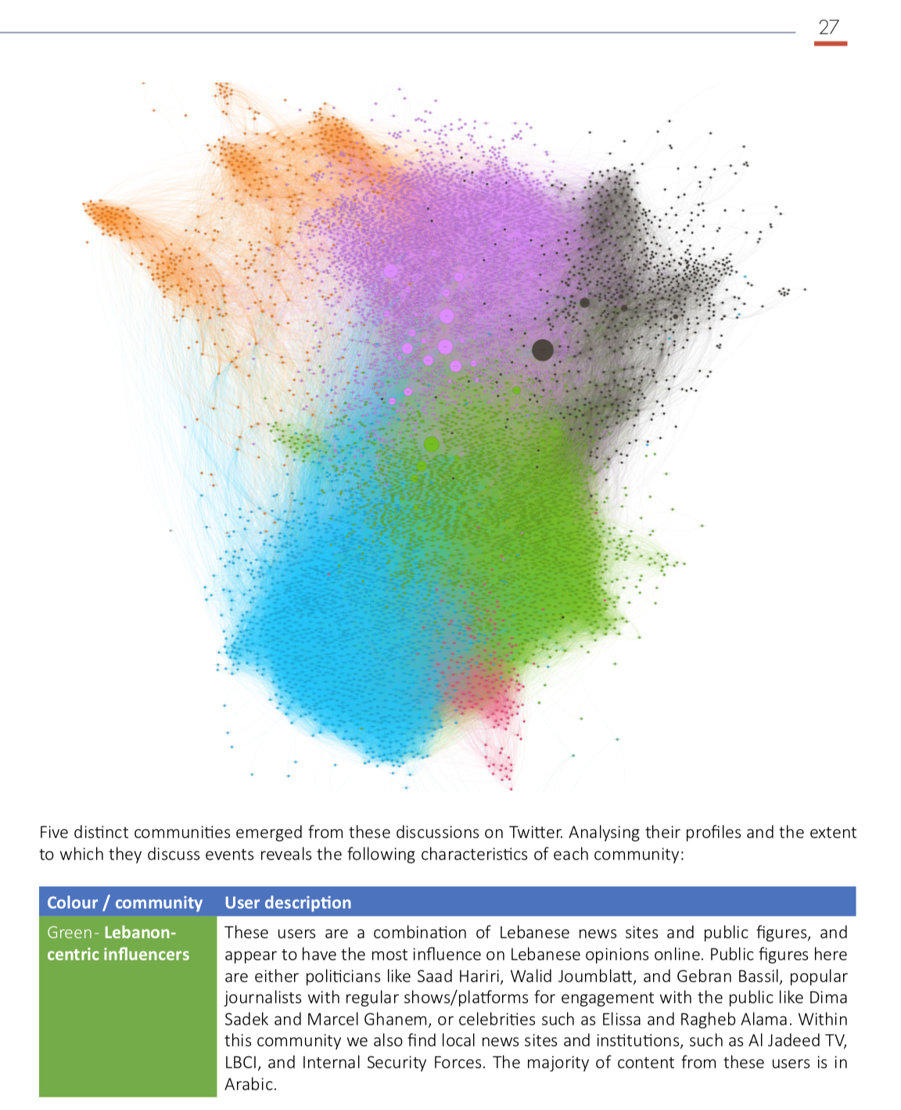
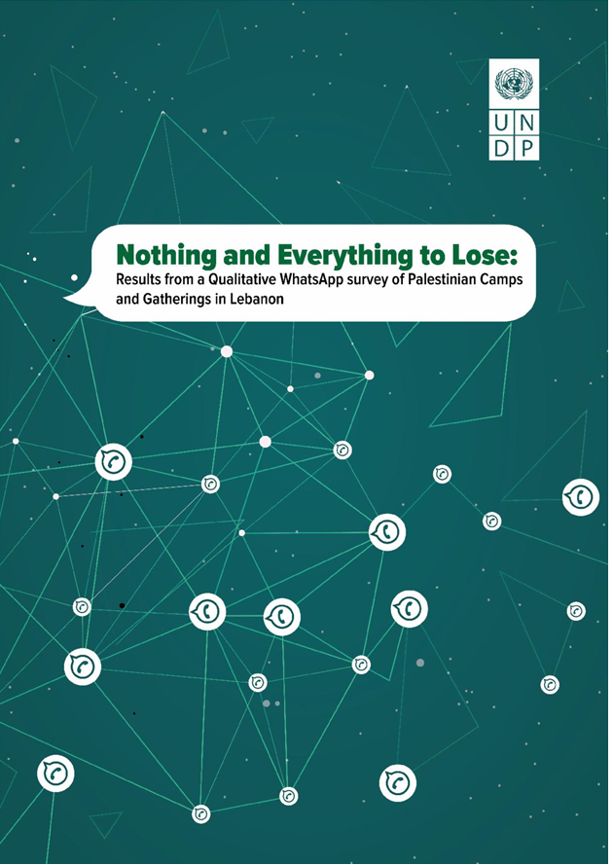
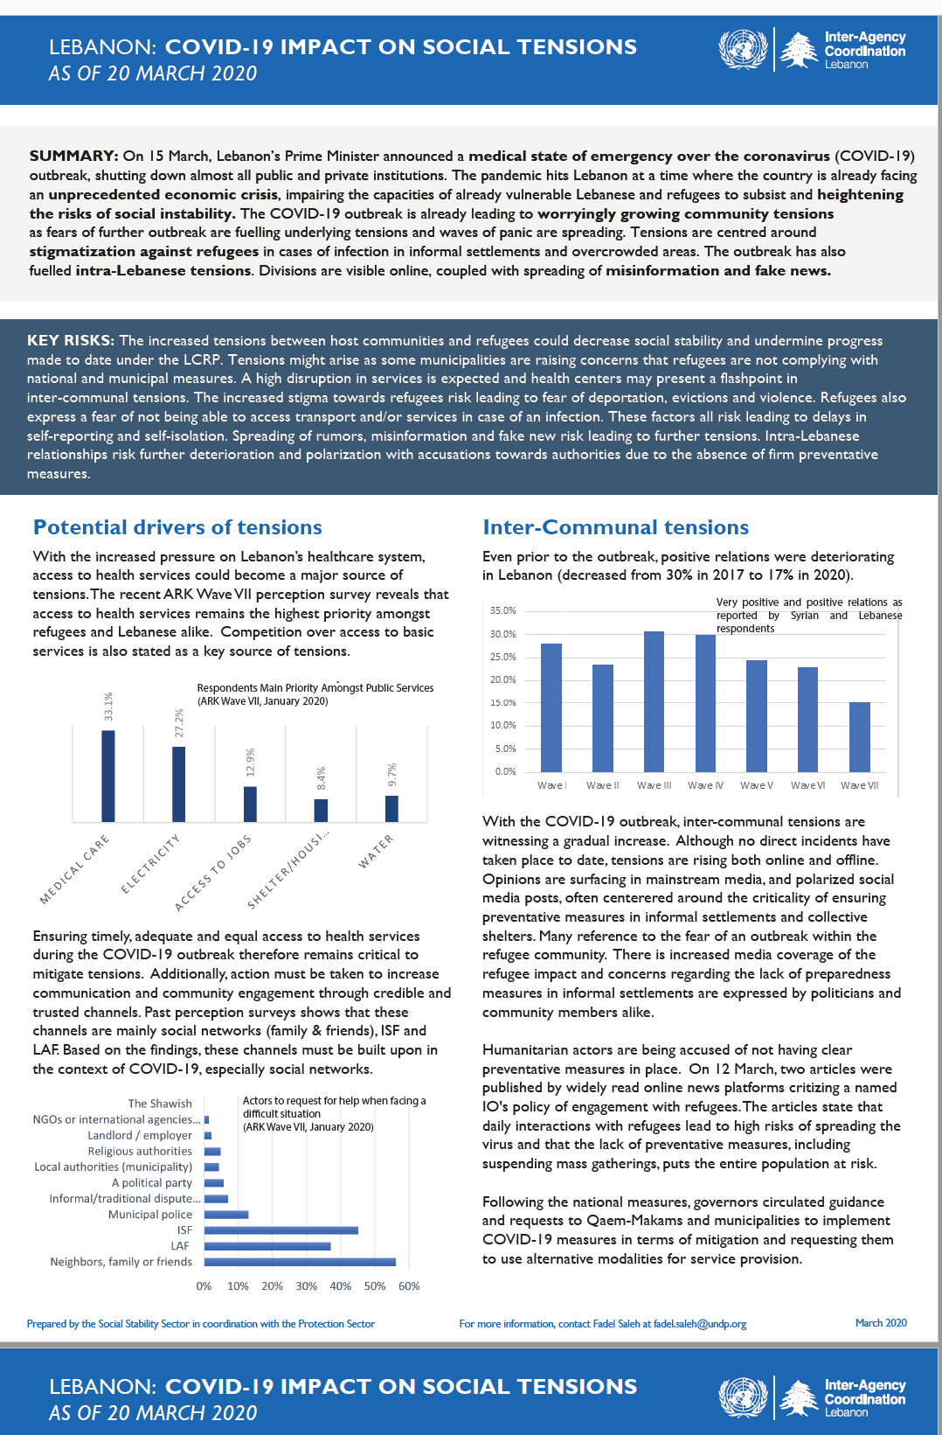
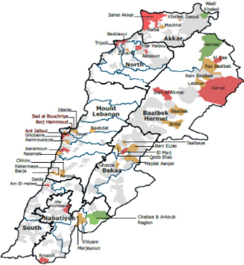

Tensions Monitoring System
1. An ecosystem of sources
3. Targeted at key audiences
2. Resulting in a variety of outputs
1. Monthly Tensions Inputs & Social
Stability WhatsApp groups
Research and situation reports targeted at key stakeholders
Central Level coordination system information, including:
2. Tension Task Forces (regional)
1. Tension Task Force (Central):
Coordination with UNDP, UNHCR, MOIM, MOSA
3. Social Media Monitoring
2. Sector core groups for strategic orientations
4. WhatsApp Surveying of Hotspots
Monthly and quarterly briefs
Perception reports & dashboard
3. Sector working groups for programming information
Social media monitoring
5. Conflict Incident Mapping
4. Inter-Agency at national and regional level
6. Perception Survey
Qualitative research
5. Inter-Sector at national & regional level
7. Academic Research
Thematic Deep-dives
6. UNCT, HCT, NGO and Donor Fora
8. Conflict Sensitivity Mainstreaming Activities
Presentations
Maps of hotspots

Slide 22
Key Findings
January 2021 – Perception Survey

Slide 23
People are in general neutral about Inter-communal relations - suggesting that tensions are driven by other factors than community relations
Answers to the question: How would you describe current relations between Lebanese and Syrians who live in this area? Would you say they are positive or negative?
Trend over the last year
Trend over the last year

Slide 24
Relations are particularly negative in Akkar, Baalbek-Hermel and Beqaa

Slide 25
Access to jobs is the no. 1 reason for tensions, with raising concerns for competition over access to services

Slide 26
People’s main concerns remain socio-economic and basic needs

Slide 27
The overall perception is that the presence of Syrians has resulted in deteriorated safety
- 79% consider that when tensions are high, some restrictions on foreigners' movement or curfews can keep the area safe
Syrian refugees report an increasingly hostile environment

Slide 28
Discriminatory application of restrictive measures
Key finding from UNHCR Protection Monitoring - December 2020 (2,064 HHs consulted):
33% of restrictive measures apply more strictly to refugees (in December, up by 12% from November)
9% apply only to refugees (up by 5% from November)
Refugees in the Bekaa (37%) and South (36%) reported higher rates of stricter targeting by general measures (e.g movement restrictions) than host population
Refugees in the South (24%) and BML (15%) particularly reported being subject to refugee-specific restrictions

Slide 29
The Majority of Return Perceptions Remain Varied in expectations, mostly centered between 1-3 years and 5 years or Above amongst Public.

Slide 30
A more volatile situation and increased propensity to violence
In December 2020, Social tensions manifested mainly in ‘community insecurity’ (59% of all incidents) - theft, armed clashes, and smuggling were predominant.
‘Service-related’ tensions (such as lifting of subsidies, gas shortage, electricity cuts) comprised 13% of the incidents - mainly happening in the Bekaa and Northern Lebanon.
Intra-communal relations are deteriorating – 21% of Lebanese describe relations as negative compared to 4% in 2018.

Slide 31
Municipalities and NGOs are still trusted for their services – but with increasing concerns regarding municipalities capacities

Slide 32
* Physical confrontations in Beirut and the North during distribution of aid
* Intermittent Spikes in Social Media campaigns against assistance schemes.
* Requires CS and DNH mainstreaming and enhanced communications and community engagement
People feel that aid is biased – this requires mainstreaming and enhanced communications
Trend over the last year

Slide 33
AOB

