Slide 1
Inter-Agency Meeting
17 June 2022

Slide 2
Agenda
In-Focus
  Thematic brief on cash assistance under the LCRP
Partner Update – Save the Children
  Child Wellbeing Study
Tensions Monitoring Update
Calendar: upcoming training, needs assessments & briefs
AOB

Slide 3
Cash-based Assistance Under the LCRP: In Focus

Slide 4
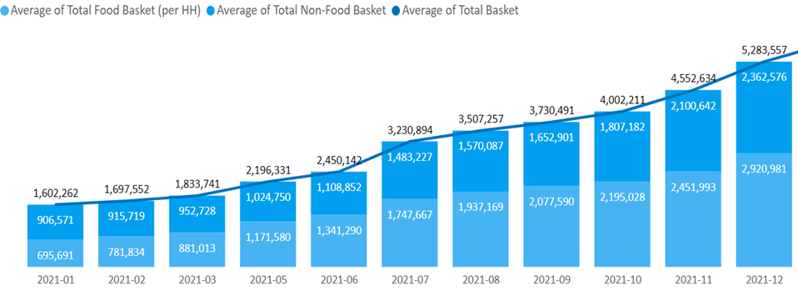
Lebanon is going through one of the deepest economic crises in the world
The real GDP fell by 21% in 2020 and 11% in 2021.
Basic goods and services have become unaffordable for many, hitting the most vulnerable in society the hardest.
Consumer Price Index: average 7% monthly increase in prices March to April 2022; 15% increase in price of food and 7% increase in health-related costs.
1,062% increase in the ‘Survival Minimum Expenditure Basket’ from October 2019 to March 2022: non-food item basket saw 1,315% increase.

Slide 5
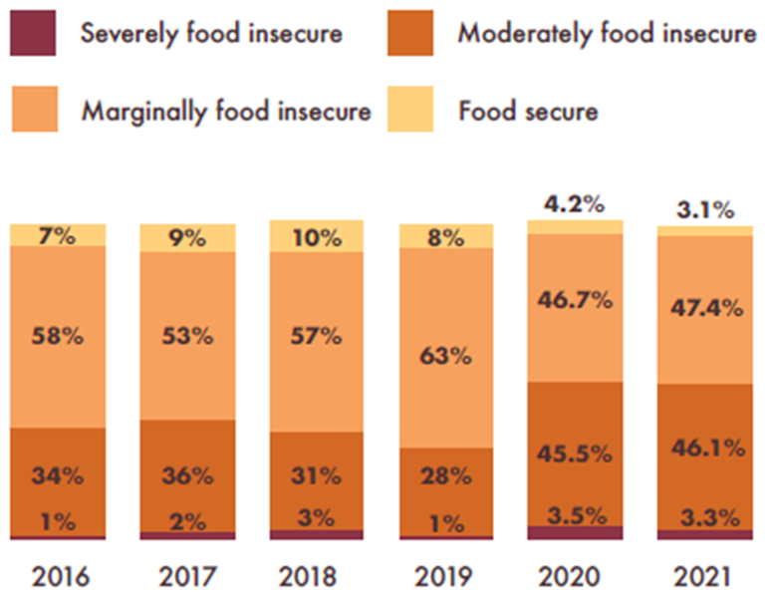
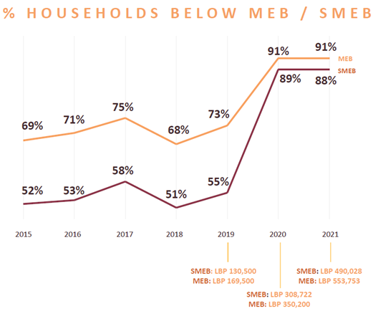
People's ability to meet basic needs is diminishing
Food insecurity is on the rise across populations
92% of refugee households are in debt
Child labour up from 2% in 2019 to 5.5% in 2021
Decent work opportunities have shrunk. 20% Lebanese & Syrian HHs losing a job or pay, 47% reduced hours.
This has an impact across sectors: people cannot afford transport to access services, medication, residency renewal fees, among other costs.

Slide 6
Cash-based assistance is a lifeline in helping families meet specific needs
Amount injected into the Lebanese economy
in cash assistance under the LCRP in 2021:
USD 376 Million
35 % of the funds received in 2021

Slide 7
Evolution of cash-based assistance under the LCRP

Slide 8
Benefits of cash-based assistance
social protection – cash can work within wider safety-nets to provide long-term support for vulnerable groups
choice, dignity and flexibility - enables recipients to prioritize their own spending preferences
cost efficiency - cash can be distributed at a lower cost than goods and services
cost effectiveness - CVA can achieve better outputs and outcomes than in kind assistance
fostering economic support - CVA supports the development of sustainable local markets
financial empowerment - CVA can leverage access to additional finance resources such as seed capital

Slide 9
Cash-based interventions under the LCRP: sectoral outcomes
 | Cash for Food | Seasonal Cash Assistance | Multi-Purpose Cash | Child-focused Cash
Sectors involved | Food Security & Agriculture, Basic Assistance | Basic Assistance | Basic Assistance, Food Security & Agriculture | Basic Assistance
Objective | Prevent food insecurity, provide social assistance | Mitigate winter costs (heating, clothing, blankets) | Cover the expenditure gap of poor households, provide social assistance | Reduce reliance on negative coping strategies harmful to children
Eligibility criteria | Families with vulnerability to food security; economically vulnerable families | Economically vulnerable families | Economically vulnerable families | At risk children
Targeting Approach | Socio-economic vulnerability scoring; proxy means testing; and categorical targeting through assessments for some partners. | Socio-economic vulnerability scoring; proxy means testing; and categorical targeting through assessments for some partners. | Socio-economic vulnerability scoring; proxy means testing; and categorical targeting through assessments for some partners. | Assessment by partners at the household level & through other internal programs.
Assistance cycle | Regular (12-month period) | During winter months (November-March) | Regular (6-12-month period) | 12 months

Slide 10
Cash-based interventions under the LCRP: sectoral outcomes
 | Cash-for-rent | Cash for education | Protection cash (re-occurring assistance) | Emergency cash assistance | Cash for work
Sectors involved | Shelter | Education | Protection | Protection | Livelihoods, Water
Objective | Ensure security of tenure for severely/highly economically vulnerable individuals | Increase school retention and attendance by covering indirect costs of education | To achieve protection outcome: Prevent or respond to a protection threat | To achieve protection outcome: Prevent or respond to an protection threat/emergency shock | Immediate decent employment opportunities (short term), support job retention in MSMEs and cooperatives
Eligibility criteria | Syrians, PRS, Lebanese with risks to security of tenure | Children enrolled in second shift public schools (+1) | Persons with protection needs, at risk of protection threat, where cash can address the harm | Individuals/HH affected by emergency shock which put them at protection risk | Economically vulnerable families
Targeting Approach | Assessment by partners at the household level. | Assessment by partners at school level. | Assessment by partners at the individual/household level. | Assessment by partners at the individual/household level. | Socio-economic vulnerability assessments by partners at the individual/HH.
Assistance cycle | Time-bound, up to 6 months (extendable for another 6) | Every two months for six months period. | Time-bound, between 3-12 months, depending on needs | One-time | A total of 40 days per beneficiary

Slide 11
Key Challenges for LCRP Partners
Gap in people's ability to meet needs reduces the effectiveness of other cash interventions (eg. Winter cash diverted to pay rent).
Transfer values have not kept pace with rising prices amidst price increases and currency deterioration.
Concerns regarding perceptions of aid bias (related to the gap between those receiving assistance and those who are not), as well as funding constraints, have further limited an increase in TVs. (Syrian recipients of MPCA for example currently receive only half of what is required to meet the household SMEB).
Coverage remains insufficient, particularly among Lebanese & PRS households.
Partners have struggled to access a viable exchange rate to change dollars to LBP for distribution, risking losing some of the value of funding provided for assistance. Strides were made to successfully negotiate improved rates with financial service providers, but concerns remain with further fluctuations.
Some programmes (that do not specifically target Syrian refugees) have been shifted from disbursement in LBP to disbursement in dollars in order to overcome exchange rate challenges. 18% of assistance provided under the LCRP in 2021 was 'dollarized'. Partners have reported benefits, including ensuring value for money, avoiding the purchasing power of beneficiaries dropping with the exchange rate and ease in budgeting.
However, dollarization of some assistance has led to concerns regarding a lack of harmonization across partners in the amount and currency that beneficiaries are receiving, potentially further driving perceptions of unfairness.

Slide 12
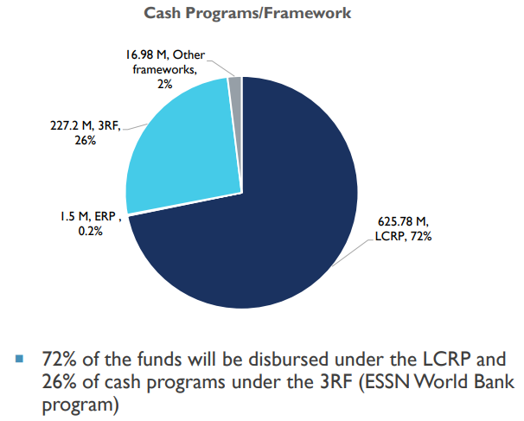
Throughout 2022, LCRP sectors and partners plan to:
Reach more people in need with cash assistance: in the 2022 LCRP, across sectors, partners are seeking to reach 2.2 million people with different forms of cash-based assistance, amounting to almost $1. 5 billion to be programmed (46% of the needs-based appeal).
Re-evaluate transfer values in LBP and USD to ensure strengthened purchasing power for beneficiaries.
Roll out updated operational guidance for partners including on protection cash, cash-for-shelter and conflict sensitive approaches to providing cash assistance [links].
Review dollarization of assistance for programmes still disbursed in LBP, to assess whether value for money and the interests of beneficiaries can be better met.

Slide 13
Partner Update - Save the Children: Child Wellbeing study

Slide 14

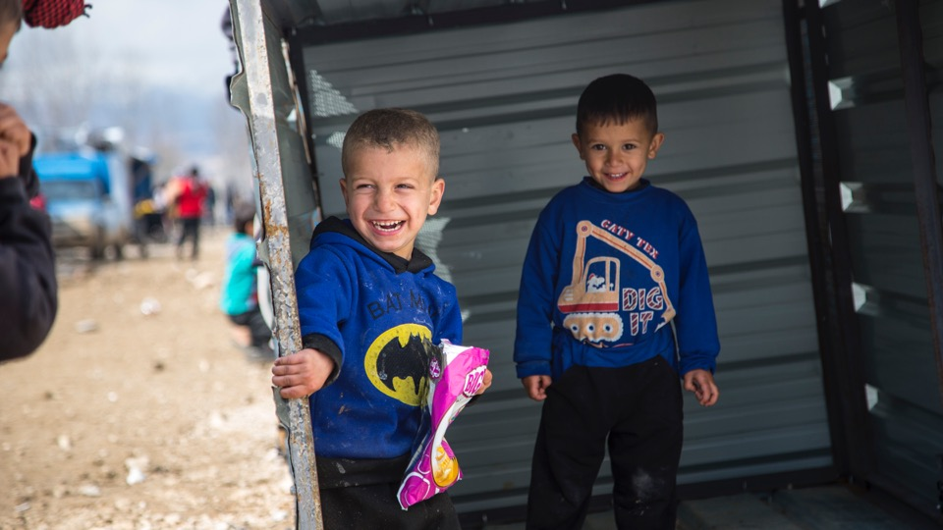

Save the Children Lebanon
Child Wellbeing Assistance
Interagency Meeting
17 June 2022

Slide 15
Background
Chronic economic emergency where the families most in need are rarely fully covered
Childhood is a uniquely vulnerable period, from birth, through 0-5, through schooling, and then later as an adolescent and youth
Families that struggle to adequately meet the healthcare, nutrition, protection, and education needs of children, can result in cumulative deprivations, having long-term, irreversible negative impacts on a child’s life as well as on society as a whole
Protecting children from the impact of poverty is one of the most economically and socially sound investments that Lebanon can make to support the development and economic stability of the country
Notes:
Small MPCA values not meeting SMEB, lack of GOL SP coverage and value, concerns over targeting
This aligns with the Nat SP plan, and similar to UNICEF’s Haddi, contributes to learning on a child-focused social grant for this vulnerable group.
SCI 2020 “Foundation to End Child Poverty” Available in English and Arabic at https://resourcecentre.savethechildren.net/library/foundation-end-child-poverty-how-universal-child-benefits-can-build-fairer-more-inclusive

Slide 16
Approach
12 months of assistance in bimonthly payments, by money transfer agent
Compelling global evidence that combining cash assistance with complementary interventions including linkages to other services can achieve significantly greater impacts on children
Cash “plus” household financial counselling, support for savings, nutrition messaging, and referral follow up
Counselling aims that children’s needs are covered and spending choices are made in the best interest of the child, to support their wellbeing, and to prevent harmful coping strategies like child labor
Counsellors deliver key nutrition messages, and understand when and how to make referrals to specialist support for lactating mothers or assessing possible malnutrition – in the future SCI nutrition counsellors available in house
Comprehensive and regularly updated service mapping of both internal (SCI) and external programs to make referrals to MHPSS, child protection, education, shelter, and health
Notes:
For more information on SCI’s Cash Plus programming: SCI 2017 https://resourcecentre.savethechildren.net/library/cash-plus-programmes-children and on evidence of effectiveness: SCI 2020 https://resourcecentre.savethechildren.net/library/effectiveness-cash-transfer-programming-children

Slide 17
Outreach and targeting
Child Wellbeing Assistance targets children in the family and their caregivers - only families with children are eligible to receive the support
A “child” for the purpose of this program is between the ages 0 through <18. This can include families with pregnant women in their third trimester.
Assistance is equally provided to Lebanese and refugee (Syrian, Palestinian) families, and reported under LCRP BA sector and the ERP FS Sector
Eligibility determined through comprehensive approach to the vulnerability of children in the household, combining risks from many sectors to establish a multidimensional assessment of child vulnerability, and therefore eligibility for Child Wellbeing Assistance
Child Wellbeing Assistance is intended to either stand alone or to be a complimentary cash assistance to any other cash program and is not considered duplication of any other type of cash program

Slide 18
Reach to date
Program design and outreach begin July 2021, first disbursements made in November 2021
Approximately 2,000 families assisted (7,000 children)
Evenly split between Lebanese and Syrian nationality, very few PRS/PRL (~2%)

Slide 19
Cash transfer value
Calculation of the transfer value is based on market monitoring of the SMEB to understand what is needed for a family to ensure their children’s wellbeing
Current MPCA ~40% of non-food SMEB, and cash for food ~50% of food SMEB, so if a family receives multiple types of cash, CWA still fills a gap rather than duplicates
Non-food component/HH – own income + food component*number of children – due to budget restrictions agreed to 70% of this calculation and capped at 3 children
Values are reviewed quarterly, currently in LBP, transitioning to USD based on completion of the Phase 1 evaluation
Notes:
Decided to use SMEB rather than HEA LP threshold given that LP is expenditure based, and SMEB includes more dietary diversity in the food basket and some rights-based approaches.
3+ children: $160
2 children: $120
1 child: $60
(in USD or in LBP at OMT’s rate)

Slide 20
Findings: Access and tensions
49.2% of PDM respondents had to pay transportation to access OMT, however 97.6% say they did not face challenges
  OMT too far or too expensive to reach
  Lack of electricity at the OMT
  No cash available
90% were able to withdraw the full amount in one trip, most of the remainder (9.6%) were able to withdraw the full amount
68.5% of families made spending decisions jointly (two caregivers)
  5% said that the cash caused disagreement in the household, males were more likely to report this
  No respondents said that it caused tension in the community
Notes:
From PDM analysis

Slide 21
Findings: Spending
Food, healthcare, and rent are the main expenses
First need:
Second need:

Slide 22
Findings: Indebtedness
94.7% have debts – total value of new monthly debt is half the SMEB
Food is the main reason for taking on debt
One-third of respondents are either temporarily or permanently unemployed.
Notes:
Total debt value is very high and debt appears to be the main source of income of the households reached at baseline. Increase from our MPCA impact assessment (2021) where 85% had debts
This lack of regular or sufficient income from work explains the high levels of debt taken on by households on a monthly basis – the average amount of monthly debt is LBP 2,735,000 across all nationalities. This is approximately half of the average family’s monthly expenditure, a worrying and potentially critical factor for these families’ resilience to further price shocks. At the time of this assessment, the SMEB averaged 4,760,034 LBP indicating that these families were barely reaching this nationally-accepted poverty threshold for a dignified life.

Slide 23
Findings: Negative coping
CWA recipients in Bekaa appear overall to face more challenges than those in the North/Akkar and BML/South. This is demonstrated by the use of more and more crisis-related, coping strategies and indicates an eroded resilience to the economic crisis.
Women heads of household also rely more on the coping strategies than men heads of household, and Palestinians rely on coping strategies more than Lebanese and Syrian.
Shelter conditions are an overall concern, with just over half of Syrians (50.2%) and Palestinians (51.8%) disagreeing that their shelter is in a suitable condition, including appropriate insulation. Notably, the majority (55%) of Beirut respondents struggled to cover their house rent.
Notes:
Baseline: Almost half of surveyed beneficiaries (49.8) in Bekaa area they ask money from strangers.
26% of Syrians rarely or often accepting high risk work, while 16% Lebanese do so.

Slide 24
Direct impact of CWA
Negative coping strategies | Before receiving cash assistance |  | After receiving cash assistance |  | Difference in the percentages
 | Number of households | % | Number of households | %
Selling households goods or productive assets (sewing machine, furniture, television, jewelry, car etc.) | 466 | 65.3% | 9 | 1.3% | Decreased by 64%
Reduced portion size of meals | 453 | 63.4% | 110 | 15.4% | Decreased by 48%
Reduced the number of meals eater per day | 515 | 72.10% | 227 | 31.8% | Decreased by 40.3%
Reduce essential non-food expenditure (such as healthcare, education, etc.) | 514 | 72% | 241 | 33.7% | Decreased by 38.3%
Bought food on credit and/or borrowed money to purchase food | 611 | 85.6% | 351 | 49.2% | decreased by 36.4%
Spent some or all of the households savings | 373 | 52.2% | 151 | 21.1% | Decreased by 31%
Borrowed food and/or relied on help from friends/relatives | 167 | 23.4% | 58 | 8.1% | Decreased by 15.3%
Spent days without eating | 67 | 9.4% | 9 | 1.3% | Decreased by 8.1%
Relied on less expensive/less preferred food | 709 | 99.3% | 668 | 93.6% | Decreased by 5.7%
Restricted consumption of adults in order for young children to eat | 53 | 7.4% | 17 | 2.4% | Decreased by 5%
Have school aged children (aged 18 years and under) involved in income generation | 88 | 12.3% | 71 | 9.9% | Decreased by 2.4%
90% of families using less and less risky forms of negative coping as a direct result of CWA.
This means that fewer school-aged children are being sent to work, and families are less likely to spend a whole day without eating and more able to invest in essential non-food expenditure.
Notes:
A reduction in these and other negative coping strategies impact children directly, enabling them and their families to be safer, adequately sheltered, and fed.

Slide 25
Direct impact of CWA
46.6% spent entitlement to cover all household general costs (rent, food items, non-food items, etc)
38.2% spent half the amount directly on children
Compare to SCI’s 2021 MPCA impact assessment: 15% spent half directly on children
May indicate that the “plus” activities such as financial counselling and communication on CWA to benefit children’s wellbeing is effective
Notes:
This is an increase from the average numbers SC has seen with previous, non-child-specific cash assistance programs, which may indicate that the counselling and communication on CWA to benefit children’s wellbeing is effective. (MPCA impact assessment: 15% spent half directly on children)

Slide 26
Amelia Charles
Social Protection, Food Security and Livelihoods Technical Advisor
amelia.charles@savethechildren.org

Slide 27
Tensions Monitoring – Q1 2022

Slide 28









Q1 – 2022 Five Key Tension Trends
1.
2.
3.
Inter-Communal Tensions and scapegoating of refugees
Deteriorating community insecurity with increasing incidents
Intra-Communal Tensions with Increased sectarian & political strive
4.
5.
Increased distrust and dissatisfaction with services
Elections Related Tensions
Notes:
1)Risk of sectarian/political strive leading to confrontations in an intermittent manner, especially in Beirut, Bekaa, and Mount Lebanon;
2) Increased politicization of the refugee file, including heightened pressures on NGOs/UN with access constraints and shrinking protection space;
3) Community insecurity (theft, clashes, use of arms) leading to tensons on a micro level tensions triggering distrust around socio-economic drivers.
4) Surge in hate speech on social media (Intra-Lebanese & Inter-Communal), expected to increase amidst the current political discontent.
As proven by the recent Tayouneh incident, civil peace in Lebanon is fragile. The clashes raised fears that sectarian violence could fill the void left by the collapsing state services. State security personnel are struggling to curb mounting violence due to the economic collapse leaving space for vigilantism and social/sectarian barricading

Slide 29
Inter-Communal Tensions and scapegoating of refugees

Slide 30
Rising Inter-Communal Tensions & Scapegoating of refugees
Inter-communal relations are at a low – 34% of Lebanese and Syrian respondents report that they perceive relations as negative, an increase from 24% in January 2021
Shrinking protection space, including a surge in eviction threats and actual evictions and heightened pressures on NGOs/UN
Increase in antagonistic statements by political and religious figures - likely to continue given upcoming municipal elections
Primary reason for inter-communal tensions: Unemployment – competition over jobs
Notes:
This increasingly antagonistic rhetoric is similar to what was observed prior to the elections in 2018 and in the spring of 2019.
The trends witnessed in 2019 are very similar in nature and political color to those resurfacing over the last couple of weeks.
Access restrictions imposed by municipalities on organizations related to unmet needs on the rise (Bekka/Baalbeck/Hermel/BML/Akkar)
Access restrictions linked to procurement processes
Threats of evictions of refugees if needs are unmet by organizations. Lebanese and Syrian women reporting increased sense of insecurity (BML/South)

Slide 31
Negative inter-communal relations continue, driven by socio-economic factors and political drivers secondarily

Slide 32
Access to jobs is the main reason for inter-communal tensions since 2017

Slide 33
Deteriorating community insecurity with increasing incidents

Slide 34

Deteriorating community security
Since January 2021, over 11,600 incidents recorded across Lebanon
Most recurrent
type of incidents
1.
Theft
2.
Roadblocks
Demonstrations
3.
Armed Clashes
Notes:
Mention propensity to violence

Slide 35
Most incidents recorded in 2022 have occurred in the North & Mount Lebanon

Slide 36
Incidents are mainly related to theft

Slide 37
Intra-Communal Tensions with increased sectarian & political strives

Slide 38
Intra-Communal Relations: Relations between Lebanese fluctuate and are highly dependent on political rifts

Slide 39





Intra-Communal Relationships have reached an all-time low
With upcoming municipal elections, high levels of tensions could lead to escalations and political instrumentalization with hate speech
Intra-Lebanese tensions primarily driven by:
66%
Political and Sectarian conflicts
28%
Economic Completion (Jobs and resources)
21%
Competition over subsidized goods or services
34%
Unfair distribution of resources
21%
Cultural and religious differences
Notes:
Much better off Better off About the same Worse Much worse
0.3% 18.1% 36.9% 24.1% 20.6%

Slide 40
Strained citizen-institution relations
Trust in central government institutions have been deteriorating since 2019
Decrease in trust is mainly driven by dissatisfaction with services
Nevertheless, local level institutions are still maintaining community approval
NGOs & UN are highly trusted, but this comes with high levels of expectations

Slide 41
Population is increasingly dissatisfied with the quality of public services across all regions, a two-fold increase across most regions
Notes:
When asked about the removal of government subsidies, 73.8% of Lebanese and 90.% of Syrians said they were impacted ‘a lot’ by the removal of subsidies on food.
For subsidies on fuel, 90% of Lebanese and 80.% of Syrians said they were impacted ‘a lot’ by the removal of these subsidies. And
for subsidies on medicine or medical devices, 82.% of Lebanese and 71% of Syrians said they were impacted ‘a lot’ by the removal of these subsidies.

Slide 42
With the removal of subsidies on basic goods, the public remains highly concerned about their ability to access cash, medicine and other services
Notes:
When asked about the removal of government subsidies, 73.8% of Lebanese and 90.% of Syrians said they were impacted ‘a lot’ by the removal of subsidies on food.
For subsidies on fuel, 90% of Lebanese and 80.% of Syrians said they were impacted ‘a lot’ by the removal of these subsidies. And
for subsidies on medicine or medical devices, 82.% of Lebanese and 71% of Syrians said they were impacted ‘a lot’ by the removal of these subsidies.

Slide 43
Over 60% of respondents are positive towards UN/NGOs and 35% municipalities

Slide 44
Elections & Tensions

Slide 45
Perception survey revealed that 58% of Lebanese were concerned about the threat of electoral violence
Notes:
A majority of 58.1% of Lebanese were concerned about the threat of electoral violence. Respondents were asked, ‘Thinking about the area where you live, how likely do you think it is that competition in the elections will also provoke clashes between the supporters of different parties in the area’.

Slide 46
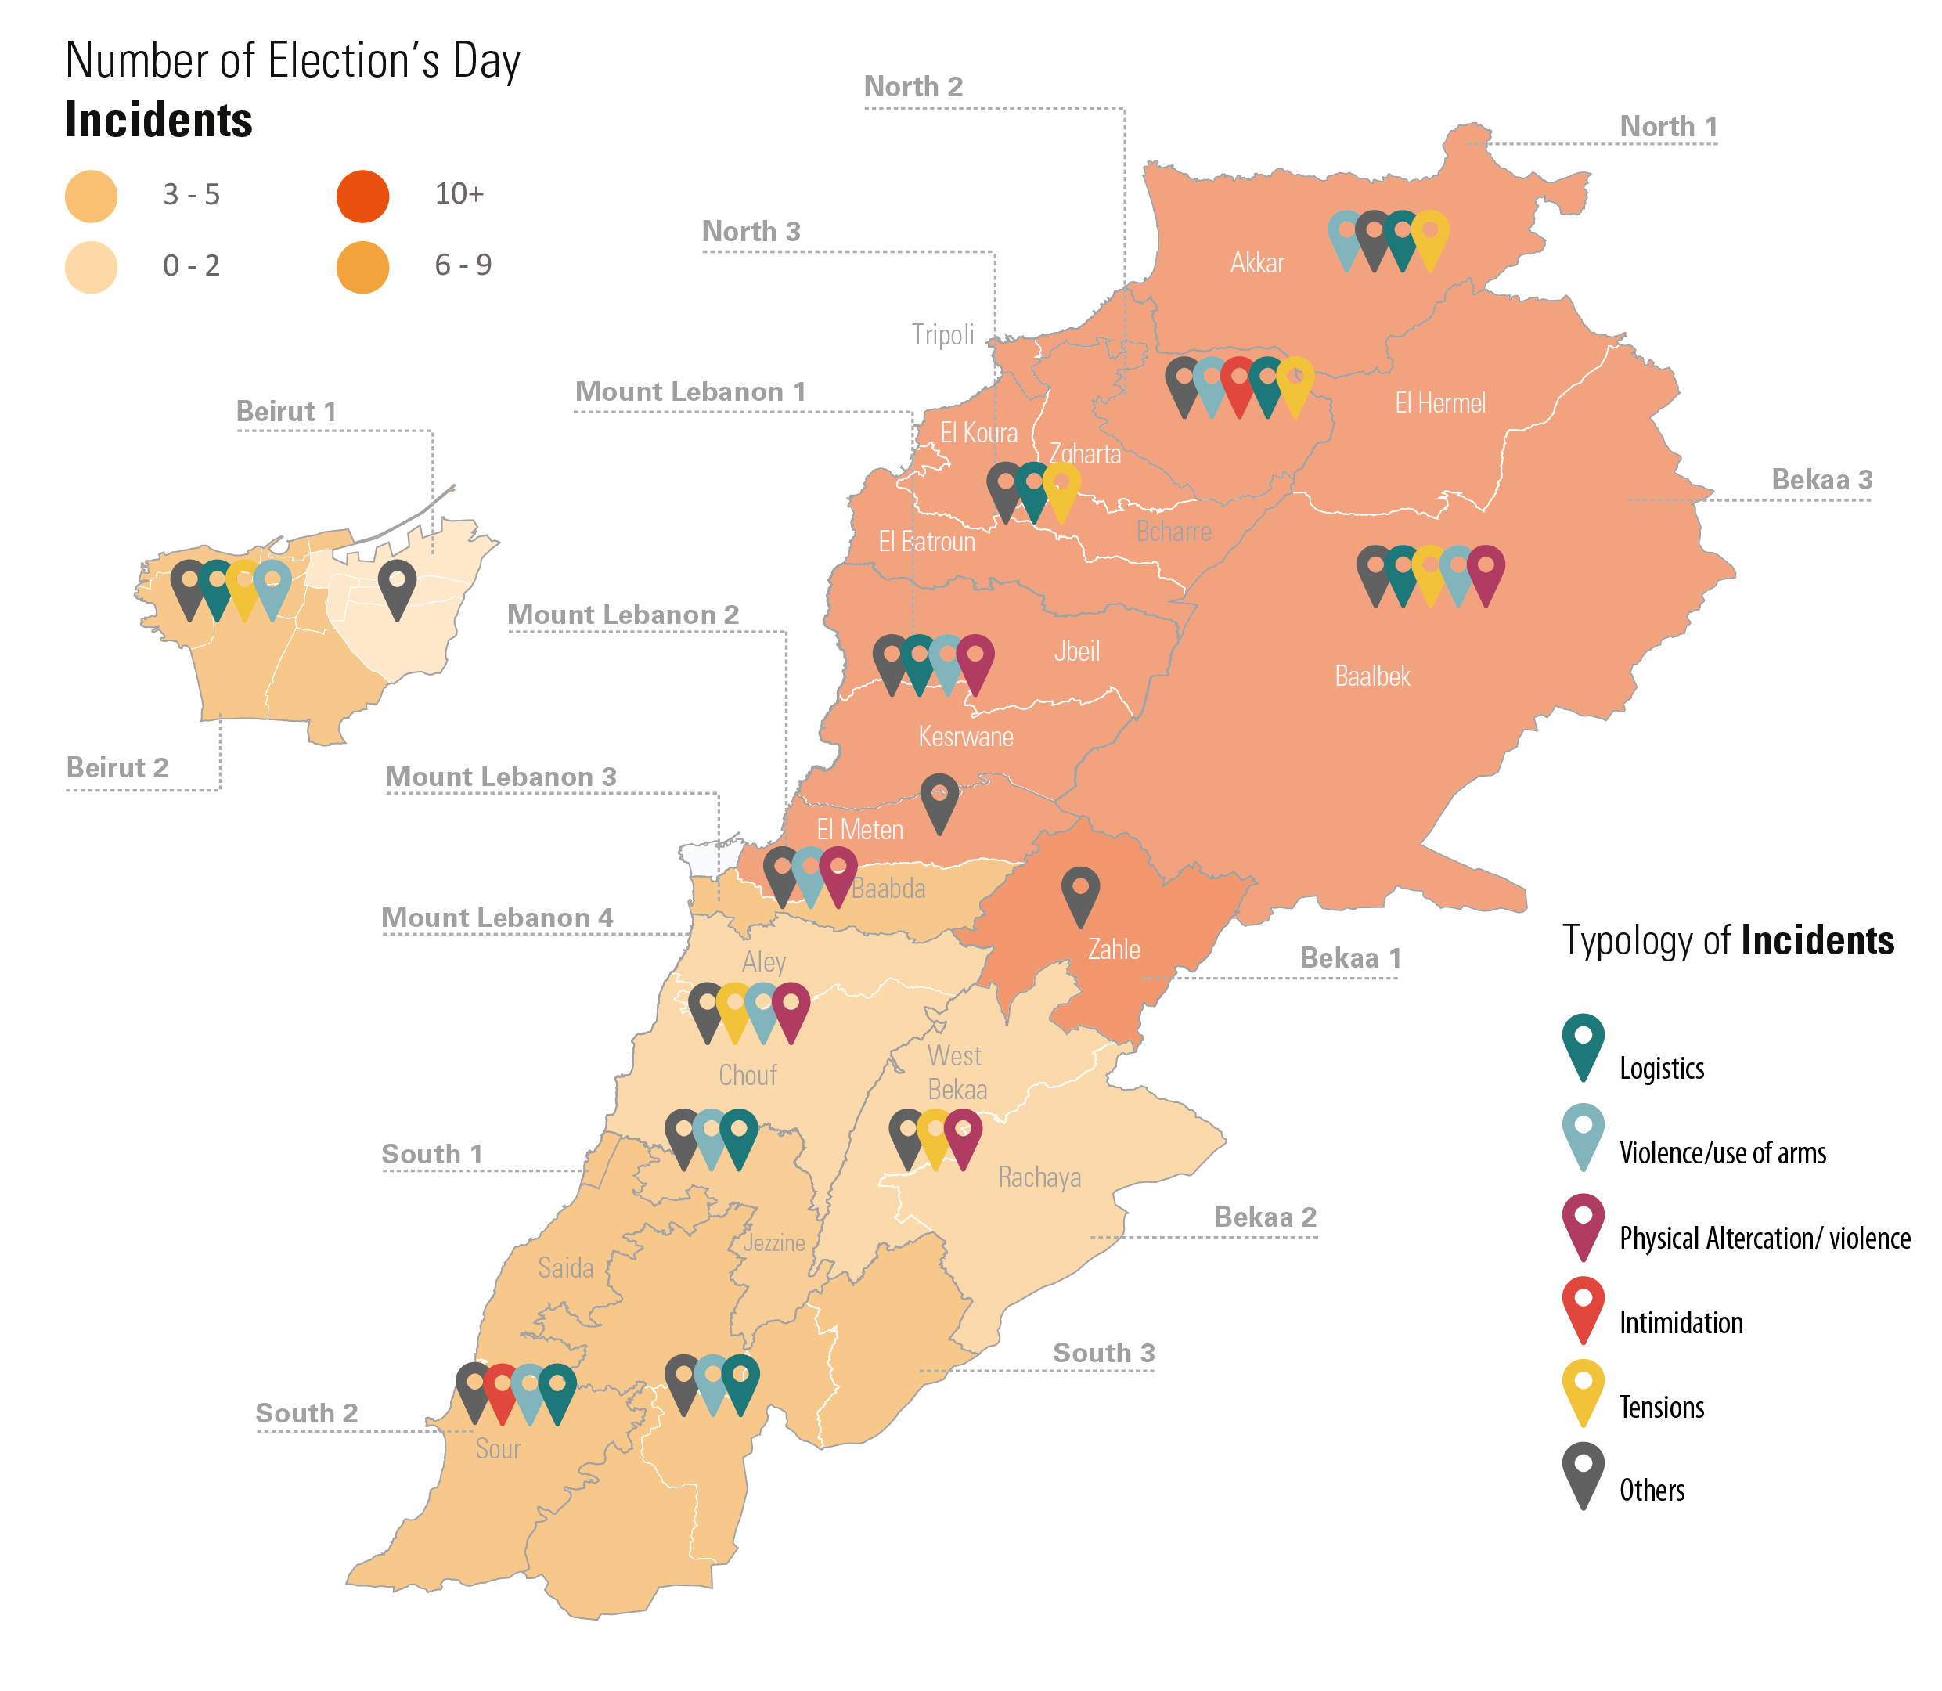
Incident Overview: Elections Day

Slide 47
Analysis of elections-related tensions
Overall: electoral process took place in a generally calm and organized climate. During the second half of the day, atmosphere was marked with a rise in electoral violations, low-scale tensions and intermittent escalations.
No widespread communal violence occurred and the use of arms was minimal.
Tensions and escalations mirrored the existing sectarian and political divides
However, social media landscape was highly antagonistic as well as hate-speech
Main risks moving forward:
    Tensions and violence linked to the municipal elections. Medium to major impact on the operational environment as well as the scapegoating of refugees
    Political instability in the period of Government formation

Slide 48
Impact on LCRP Business Continuity
LCRP BCP looks at seven risks:
  Lack of containment of COVID-19 Outbreak
  Sharp deterioration in protection space and involuntary movements
  Increased social instability
  Supply gaps (including for wheat, fuel and electricity)
  Pressure on partners due to increasing needs
  Access gaps and closing operational space
  Operational risks linked to transfer values and currencies

Slide 49
Post-elections context: update to the BCP
For 2022, dynamics around the parliamentary elections could have an additional detrimental effect on factors under
    Risk 3 - Increased social instability (including intra-communal clashes) and insecurity – key areas of risk include Bekaa, Aley & Chouf, Baalbek-Hermel, and some areas of Beirut/Beirut Southern Suburbs (Ain Remmaneh-Chiyah)​
    Risk 4 - Supply gaps (including fuel, telecommunication, wheat, electricity and water) - linked to removal of subsidies, increase in prices and gaps in institutional capacities.
    Risk 5 - Pressure on partners due to increased needs in particular in the run up to municipal elections
    Risk 6 - Access issues and closing operational space linked to unmet needs

Slide 50
New / Updated Prevention & Preparedness Measures
Readiness to re-deploy remote modalities to overcome movement restrictions (apply lessons learnt)
Expanded monitoring & analysis of social media sentiments, enhancing communication strategies to combat fake news/hate speech and aid bias perception. Training in “working online”
Roll-out of conflict sensitivity guidance notes –project design, targeting and procurement. Strengthen engagement of community leaders + communication of cross-population services
Cross-sectoral approach to eviction prevention & preparedness (referral pathways, guidance & training, housing stock assessments etc.) (Shelter, PRT, SoST)
Prioritized support to municipalities, including running costs (solar, SWM, wastewater).
Prioritize clustering-approach or area-based approaches
Develop contingency plans for large-scale communication system failures and banking collapse
Notes:
Prevention and preparedness measures identified for each risk, reviewed on an ongoing basis (national / regional inter-sector)

Slide 51
Prevention & Preparedness Measures to be maintained
Ensure updated package of critical activities despite the COVID-19 outbreak, supply gaps, system collapse or other risks (including those in-person)
Continue to share the requests received from municipalities with relevant sectors and sub-national inter-sector for follow up.
Continue to share access issues with sub-national inter-sector for follow up.
Continuation of protection and tensions monitoring with regular updates, guidance and recommendations to partners. Conflict Sensitivity & DNH guidance and training to frontline staff
Maintain early warning and risk monitoring systems (ex. Tensions Task Forces at sub-national level)
Advocacy and communication with authorities and communities. Joint communication strategy (underway)
Prepare reports and inputs on operational context for joint advocacy to be shared with HCT, informal donor group and other relevant bodies

Slide 52
Upcoming training and briefs

Slide 53
Upcoming meetings, training and briefs
VASyR: Updates on process & upcoming IMWG on needs assessments (VASyR/MSNA alignment, LVAP, update to the 251 most vulnerable cadastrals)
LCRP 2022 Briefing Sessions (end June) - following LCRP launch event on 20 June
GENDER: Area based training starting on July 18
  Starting field-based trainings with field mentoring at the end of July
  New training formats starting in September – Advanced trainings
  Mentoring and learning sessions
Mid-year situation analysis (based on Q2 reporting)
In-focus and thematic briefs
  Cash Assistance under the LCRP (July)
  Mini in-focus on solid waste situation (July)
  Persons with disability and older persons (July)
  Increased challenges faced by municipalities (August)
  Basic Assistance-led advocacy note on inability to meet basic needs

Slide 54
AOB

Slide 55
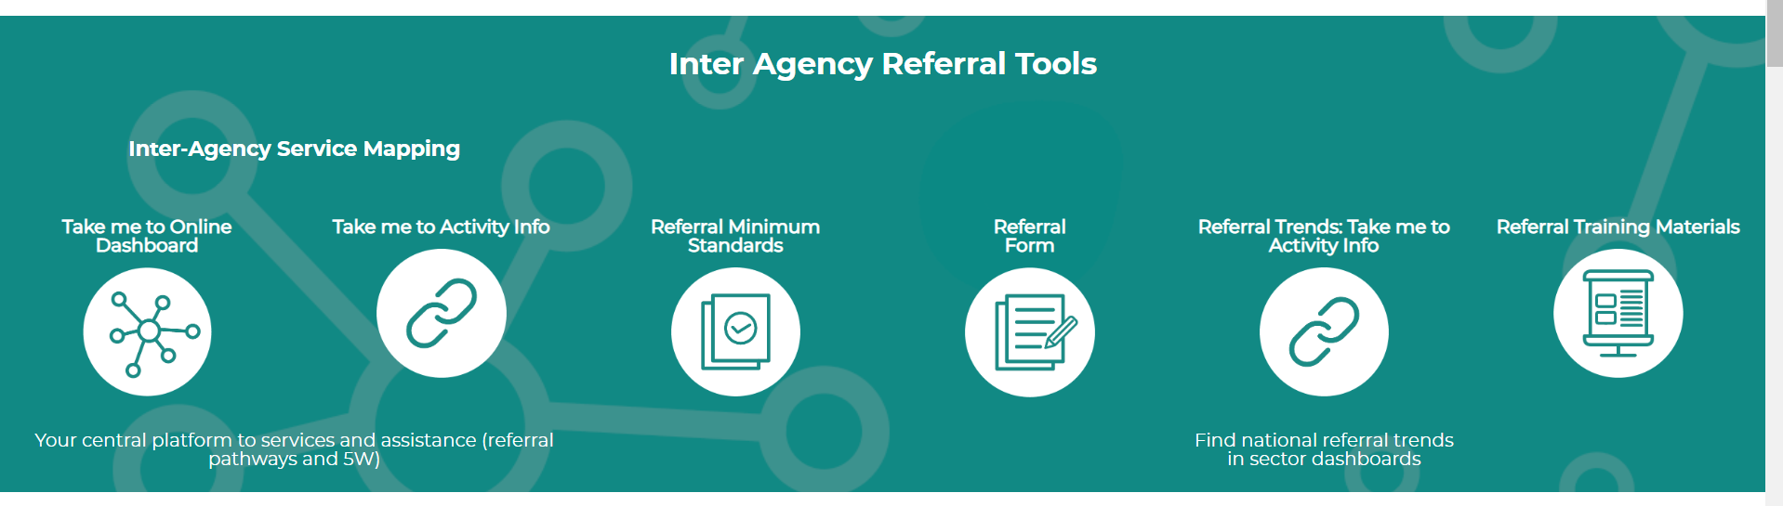
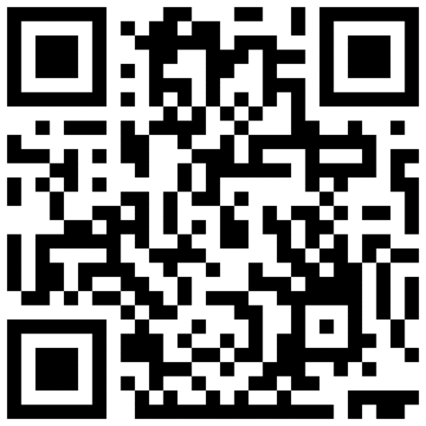
Inter-Agency Referral Tools
Sign up to Referral Orientation Sessions – invite to be shared soon!
4, 5, 11, 12 July 2022 (10-12pm)
https://ialebanon.unhcr.org/

Slide 56
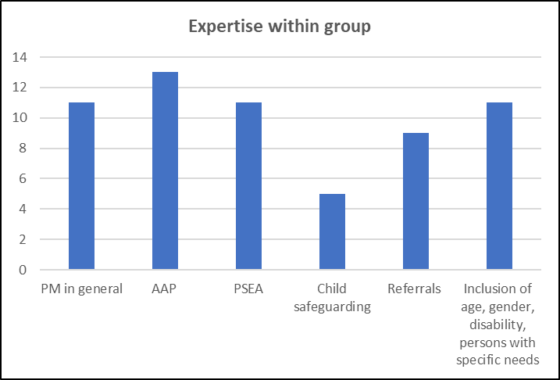
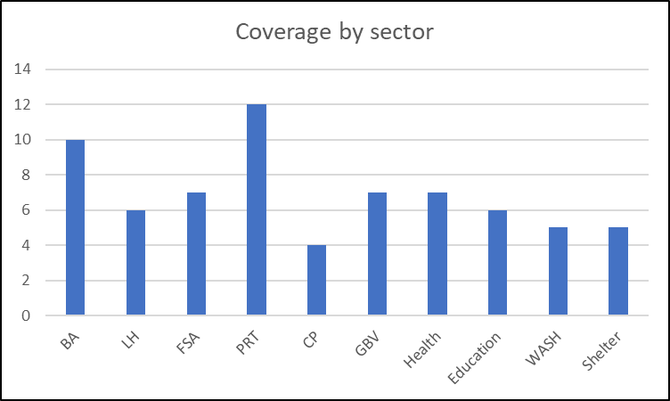
Protection Mainstreaming Community of Practice (including AAP, Inclusion, Referrals etc.)
Membership
23 members (17 Orgs - 8 INGO, 3 NGO, 3 UN)
Objectives
To discuss common challenges and find remedies
To share best practices, lessons learned, technical resources, trainings with/among members
To provide peer-to-peer support and promote learning
To form pool of technical and trained staff
To join reach out to - hoggc@unhcr.org

