Slide 1

UNHCR MENA Accountability to Affected People Toolkit Rollout Series
Session III – Chapter IV: Feedback Complaint and Response Mechanisms
UNHCR MENA REGIONAL BUREAU
Tuesday 29 October 2024
12:30 - 14:00 pm Amman time

Slide 2

Agenda
Welcome and Introductions
UNHCR MENA AAP Toolkit Chapter IV: FCRM
MENA FCRM SOP template
Digitalization of AAP through RAIS (Iraq)
Helpline SOP: (Jordan)
Questions & Answers

Slide 3
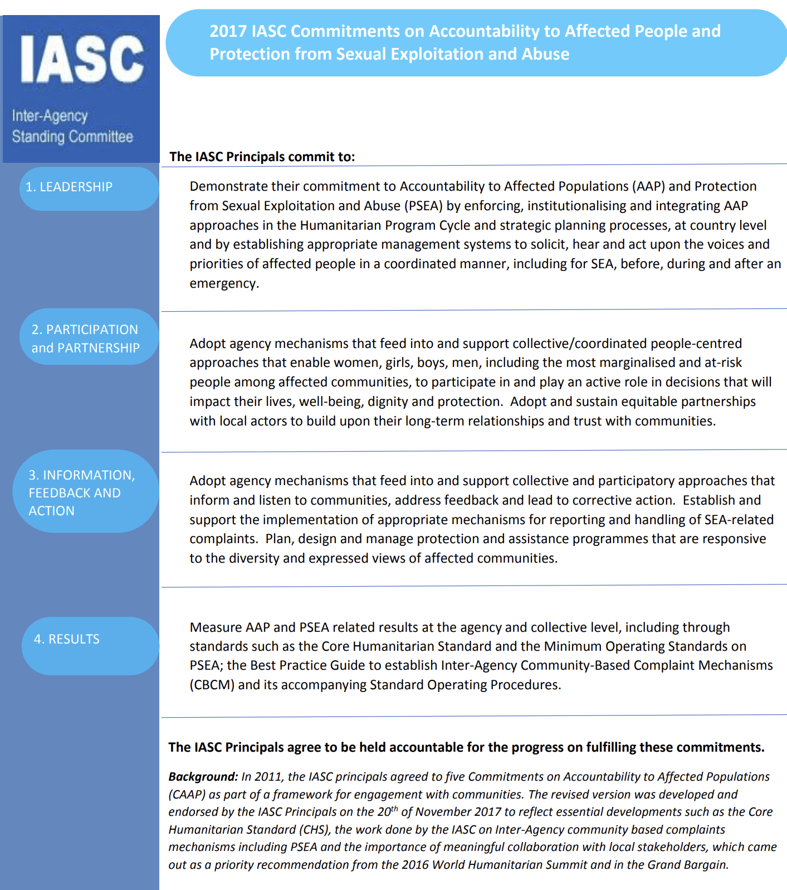


AAP Commitments and Policy Guidance
Notes:
BELEN
A Participatory Assessment is an effective, field-tested methodology for gaining an understanding of the needs and capacities that reside within individuals and groups - considerations that should inform all planning, implementation, monitoring and evaluation.
CBP approach demands that we understand political context, gender roles, community dynamics, protection risks, and concerns. It builds on their resilience, fostering self-steem and empowering them. It recognizes our role as facilitators.
AGD policy 2018- reinforces our commitment towards the community from multisectoral point of view.
Priority 2 of GPC – Ensure voices of crisis affected people and communities are heard, especially forgotten ones..
SDGs, no one behind-
GCR- para 34 encourages consultations with refugees and host communities to design protection, assistance, and solutions.
GHR Plan COVID – specific objective prevent violence, discrimination and stigma through awareness raising on COVID 19 and related matters. (Refugees and other displaced people are considered most vulnerable population)
10 Point plan in Action- Information strategy –communication and transparency –awareness raising

Slide 4
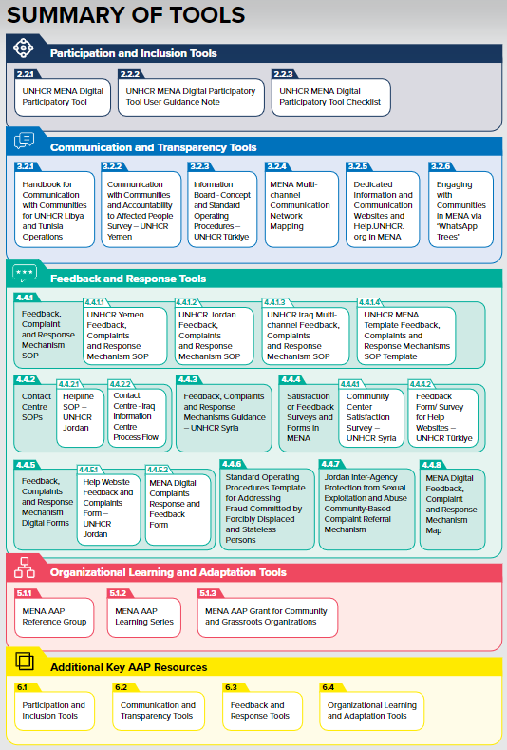

What can you find in the MENA AAP Toolkit?
6 Chapters
Introduction
Participation and Inclusion
Communication and Transparency
Feedback and Response
Organizational Learning and Adaption
Other resources
Notes:
Belen

Slide 5
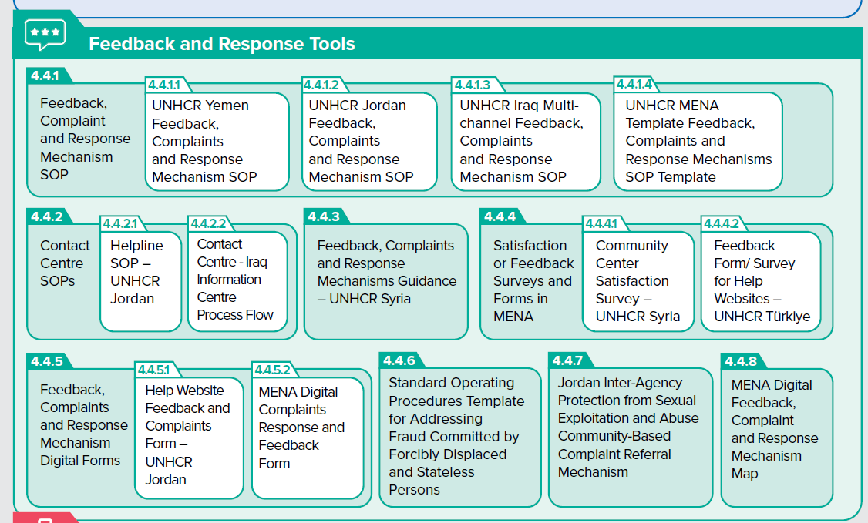





Chapter IV
Notes:
Belen

Slide 6
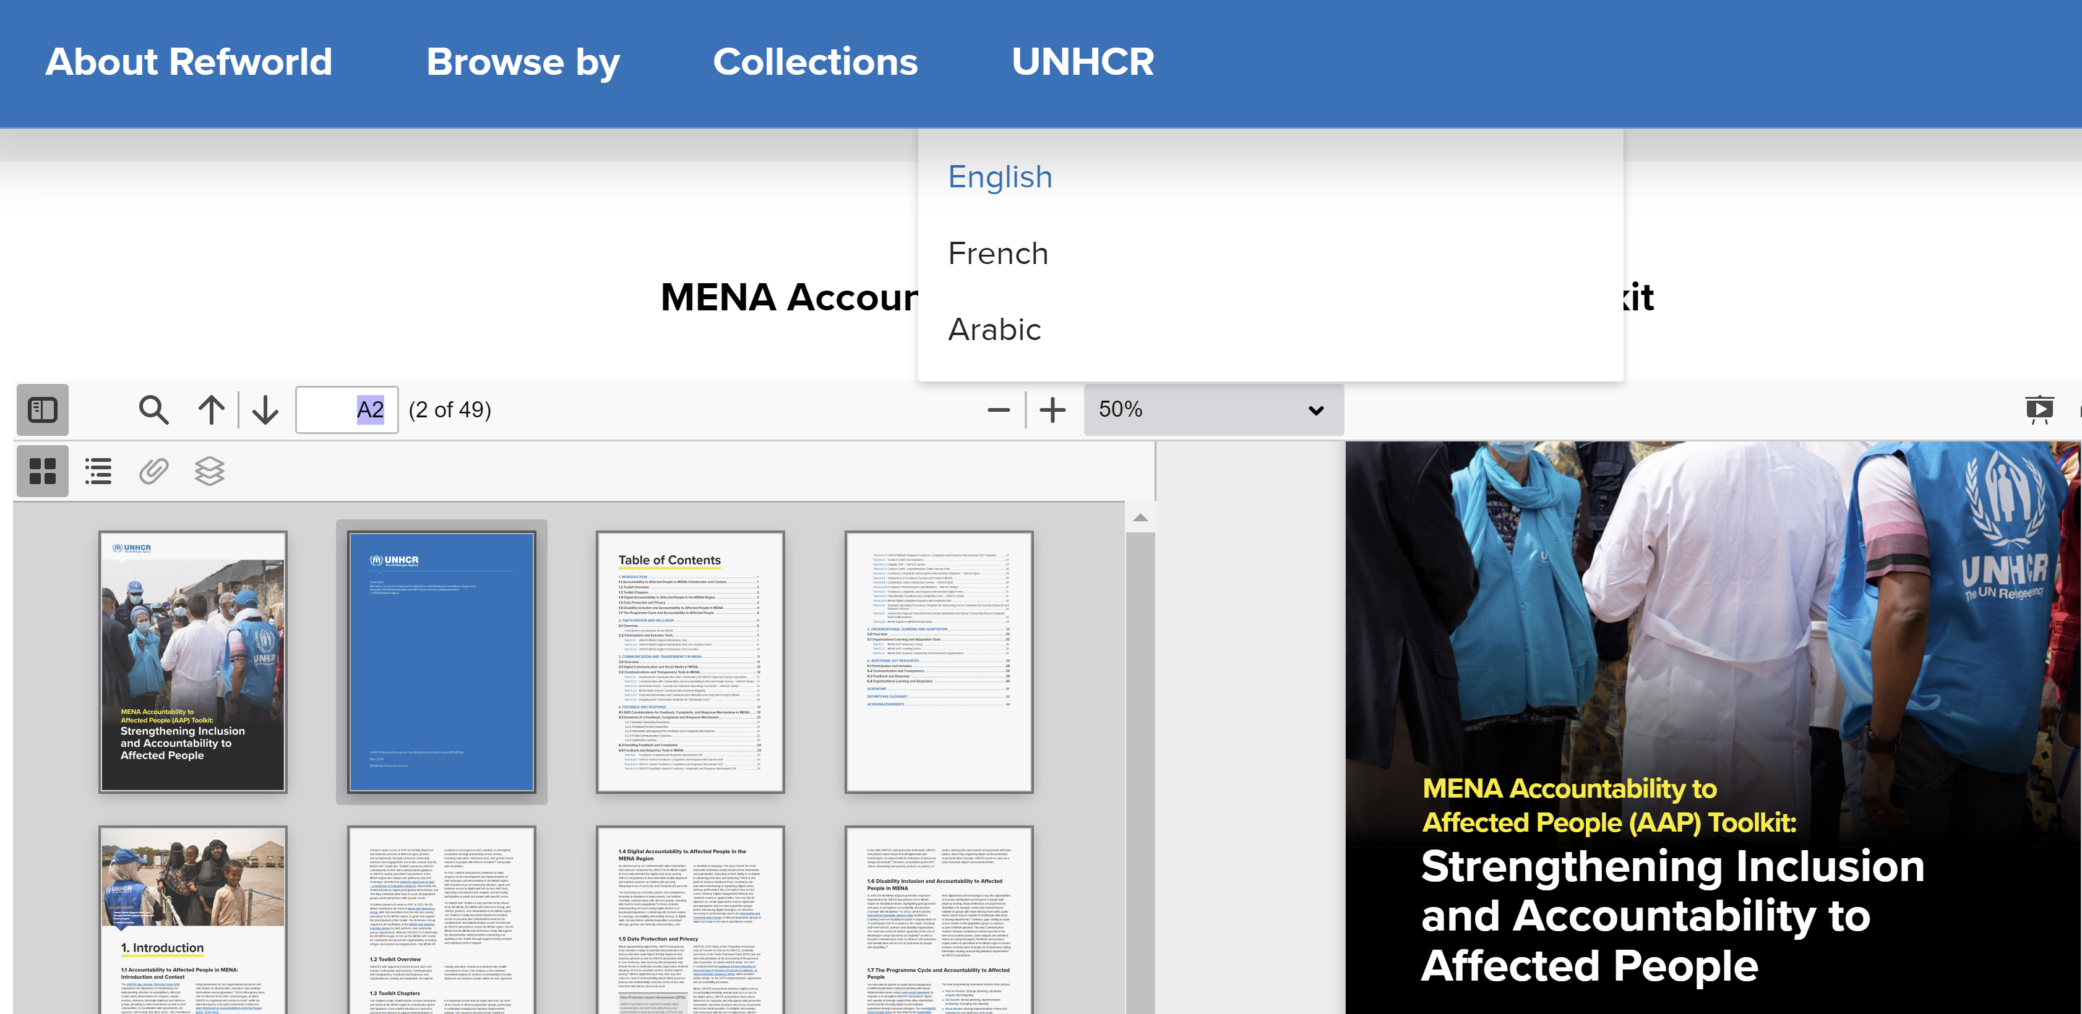
How to access the MENA AAP Toolkit
            https://www.refworld.org/policy/opguidance/unhcr/2024/en/148027
Notes:
Khadija

Slide 7
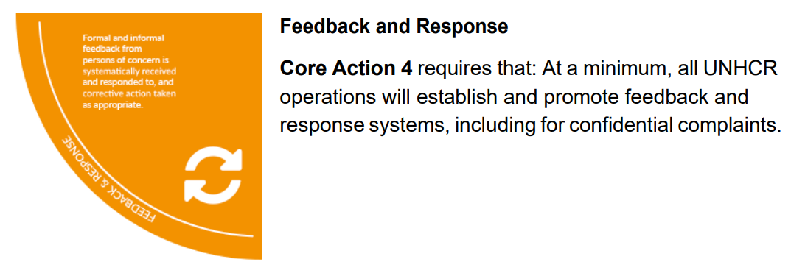
Core action 4: Feedback and Response

Slide 8
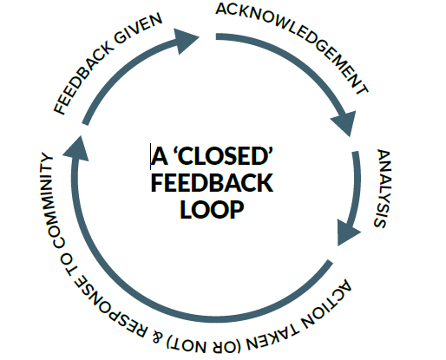
Why is feedback and response so important?
It allows us to hear directly from forcibly displaced and stateless people, to have a real-time understanding of the protection risks they face, and to gauge the effectiveness of our protection, assistance, and solutions programmes.
Notes:
Effective communication between UNHCR and communities also serves to manage expectations about the type and level of assistance that can be provided, to whom and why.

Slide 9



FCRM properties and key elements
Consult Diverse Community Members
Communication channels
Respond to Feedback Promptly
SOP / Process flow
Manage Feedback Effectively
Information Management / Satisfaction surveys
Notes:
FRS Communication channels: Active steps were also taken to reach older persons, children and adolescents, and people with hearing, visual, mobility or learning difficulties
Standard Operating Procedures The establishment of SOP is essential to rolling out a FCRM. SOP describes the channels, the roles and responsibilities, referral pathways, response timelines, and handling of different types of feedback and complaints. Document - Tool 4.4.1.4 - UNHCR MENA Template Feedback, Complaints and Response Mechanisms SOP Template
Information Management for Feedback and Complaints Mechanisms For an effective FRS, the data collected needs to be recorded, stored, and analyzed through an information management system that is in line with UNHCR’s Data Protection Policy. The information should include the personal information of the users, the details of the feedback and complaints, their status over time, the contact details of focal points from different organizations, as well as steps taking for the response.

Slide 10
FRS steps
1
2
3
4
  Consult community members
  Consider multiple communication channels
  Identify tools and design required process
Develop, test and rollout AGD sensitive awareness raising
5
6
7
8
  Equip staff with the necessary resources and knowledge
  Respond to feedback and complaint to close the referral loop
  Ensure disaggregated data
Consider an FCRM exit strategy from the start

Slide 11
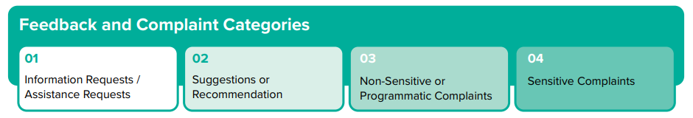
Feedback and Response Standard categories
Notes:
Question:
Which category does this scenario under?
French:
Dans quelle catégorie ce scénario entre-t-il ?
Arabic:
تحت أي فئة يندرج هذا السيناريو؟
Scenario 1:
English:
A family of asylum seekers is asking, “Where can we register our children for school? What documents do we need?”
French:
Une famille de demandeurs d'asile demande : « Où pouvons-nous inscrire nos enfants à l'école ? Quels documents nous faut-il ? »
Arabic:
أسرة من طالبي اللجوء تسأل: "أين يمكننا تسجيل أطفالنا في المدرسة؟ ما هي الوثائق التي نحتاجها؟"
• ☐ Information or assistance request
• ☐ Suggestion or recommendation
• ☐ Non-sensitive programmatic complaint
• ☐ Sensitive complaint
French:
• ☐ Demande d'information ou d'assistance
• ☐ Suggestion ou recommandation
• ☐ Réclamation programmatique non sensible
• ☐ Réclamation sensible
Arabic:
• ☐ طلب معلومات أو مساعدة
• ☐ اقتراح أو توصية
• ☐ شكوى برمجية غير حساسة
• ☐ شكوى حساسة
Scenario 2:
English:
An asylum seeker asks to have an additional time slot in the afternoon for food distribution.
French:
Un demandeur d'asile demande un créneau supplémentaire dans l'après-midi pour la distribution de nourriture.
Arabic:
طالب لجوء يطلب تخصيص فترة إضافية بعد الظهر لتوزيع الطعام.
• ☐ Information or assistance request
• ☐ Suggestion or recommendation
• ☐ Non-sensitive programmatic complaint
• ☐ Sensitive complaint
French:
• ☐ Demande d'information ou d'assistance
• ☐ Suggestion ou recommandation
• ☐ Réclamation programmatique non sensible
• ☐ Réclamation sensible
Arabic:
• ☐ طلب معلومات أو مساعدة
• ☐ اقتراح أو توصية
• ☐ شكوى برمجية غير حساسة
• ☐ شكوى حساسة
Scenario 3:
English:
A group of refugees noticed an unusual color in the water in the camp and asked if this can be checked.
French:
Un groupe de réfugiés a remarqué une couleur inhabituelle dans l'eau du camp et demande si cela peut être vérifié.
Arabic:
لاحظت مجموعة من اللاجئين لونًا غير عادي في مياه المخيم وتسأل عما إذا كان يمكن التحقق من ذلك.
• ☐ Information or assistance request
• ☐ Suggestion or recommendation
• ☐ Non-sensitive programmatic complaint
• ☐ Sensitive complaint
French:
• ☐ Demande d'information ou d'assistance
• ☐ Suggestion ou recommandation
• ☐ Réclamation programmatique non sensible
• ☐ Réclamation sensible
Arabic:
• ☐ طلب معلومات أو مساعدة
• ☐ اقتراح أو توصية
• ☐ شكوى برمجية غير حساسة
• ☐ شكوى حساسة
Scenario 4:
English:
A refugee is saying that he is paying to receive a refugee card.
French:
Un réfugié dit qu'il paie pour recevoir une carte de réfugié.
Arabic:
يقول لاجئ إنه يدفع للحصول على بطاقة لاجئ.
• ☐ Information or assistance request
• ☐ Suggestion or recommendation
• ☐ Non-sensitive programmatic complaint
• ☐ Sensitive complaint
French:
• ☐ Demande d'information ou d'assistance
• ☐ Suggestion ou recommandation
• ☐ Réclamation programmatique non sensible
• ☐ Réclamation sensible
Arabic:
• ☐ طلب معلومات أو مساعدة
• ☐ اقتراح أو توصية
• ☐ شكوى برمجية غير حساسة
• ☐ شكوى حساسة

Slide 12
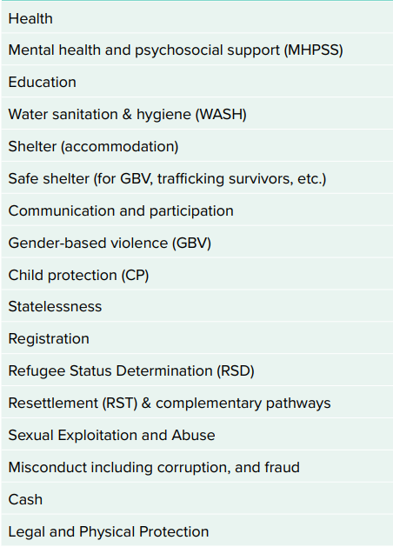
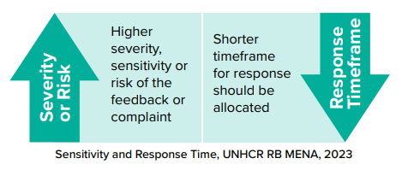
MENA recommended Feedback and Response Topics and Timeframe

Slide 13
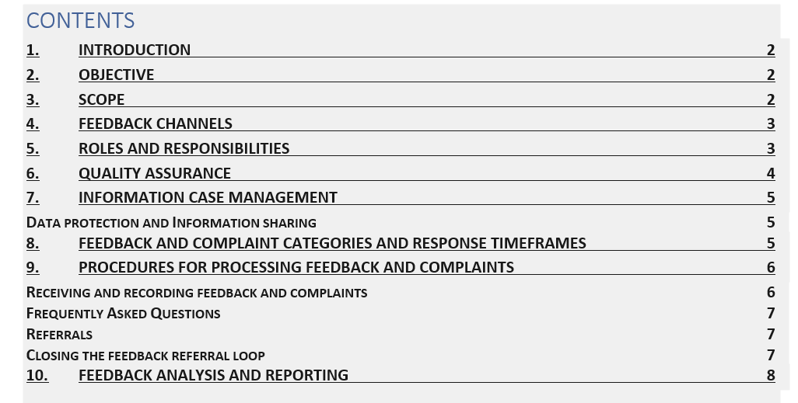
MENA FCRM SOP template
Notes:
https://unhcr365-my.sharepoint.com/:w:/g/personal/aboulnas_unhcr_org/EZvuTeKhNf9MuWPmzxmscLYBTJwNU4lToDUXSssawJ1dvA?email=anguita%40unhcr.org&e=Icqxen

Slide 14
Feedback and Response Tools in MENA
RAIS
MENA RB - Khalil Ibrahim, Business Analyst
Country Operation – IRAQ, Hardi Fateh, Data Mgmt Associate

Slide 15
Refugee Assistance Information System.
It is an online assistance management platform used by UNHCR and its operational partners to ensure effective monitoring of assistance, strengthen accountability, feedback and response and minimize duplication of efforts (inter-agency tool).
RAIS is used in MENA region and Europe (more than 20 countries)
Hosted in Azure

Slide 16
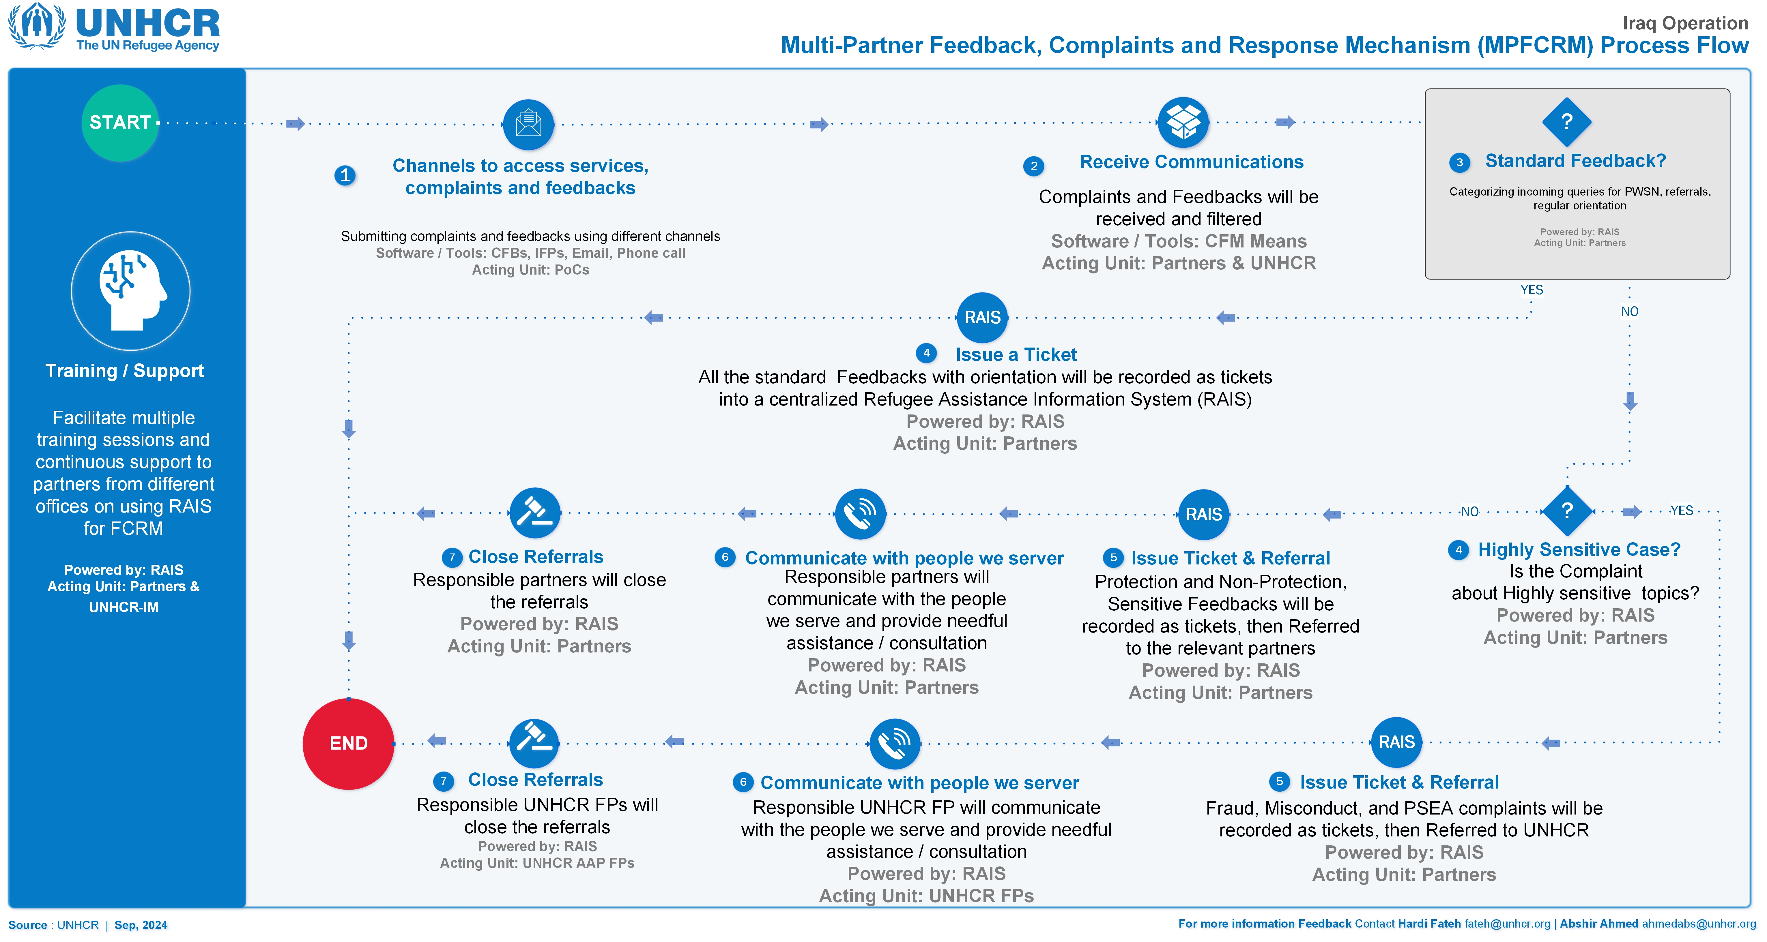

Slide 17
Feedback and Response Tools in MENA
Tool 4.4.2.1. Helpline SOP
Country Operation – Jordan

Slide 18

Identified challenge or problem
Limited Access to Information and Services
Difficulty in Reaching Vulnerable Populations
Large Number of Refugees
Inefficient and Time-Consuming Processes
Lack of consistency in service delivery
Tracking Progress

Slide 19
Objectives
Serve as one of the complaint and feedback mechanisms used by the UNHCR.
Strengthen the relationship between UNHCR and refugees, improve the quality of services provided, and ensure that the needs of refugees are met effectively.
Provide a direct and accessible channel for registered refugees and asylum seekers to communicate their needs, concerns, and experiences to UNHCR.
Objectives

Slide 20
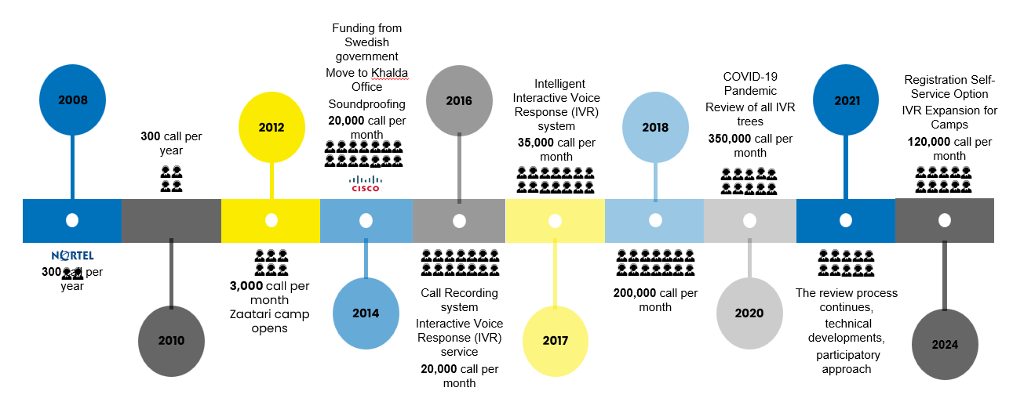
Implementation

Slide 21




Technical Infrastructure
System
Channels
Helpline is using the Cisco Call Centre Express (CUCCX) since 2014 .
Helpline has 120 channels and can receive 120 calls at the same time.
Database
Technical Contractor
IVR retrieves data from RAIS and ProGres V4
A frame agreement is signed with a CISCO gold partner

Slide 22
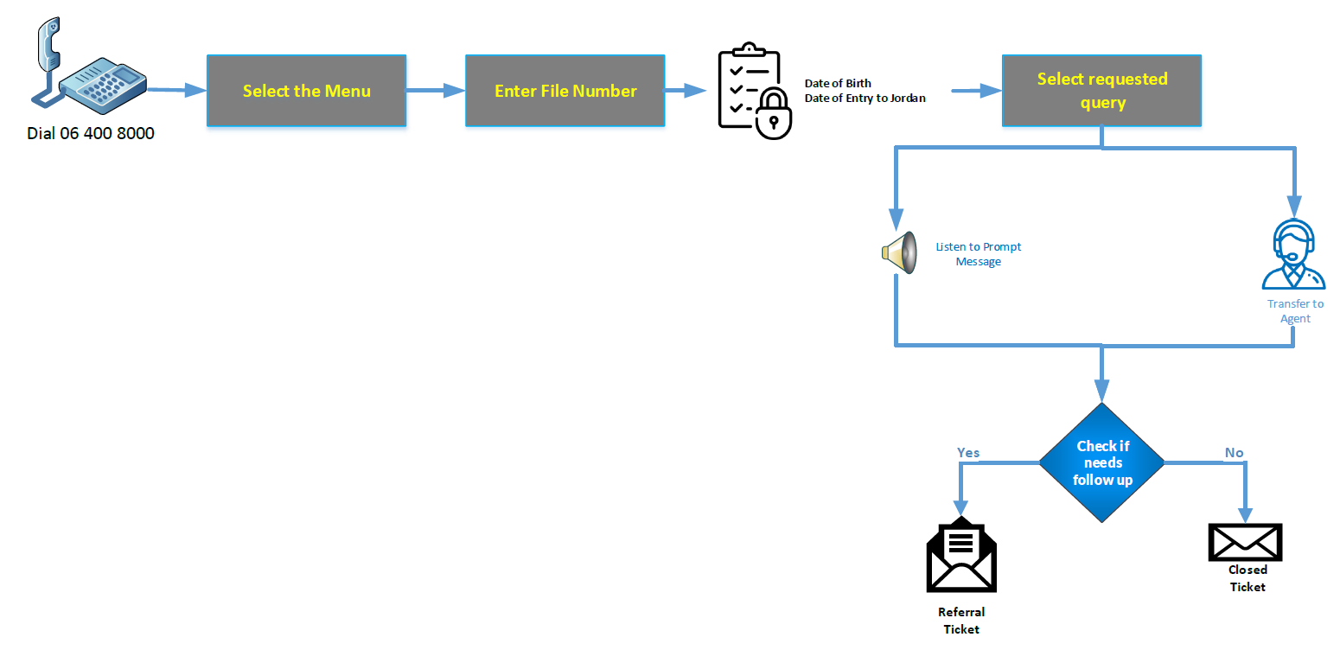
Call Process

Slide 23
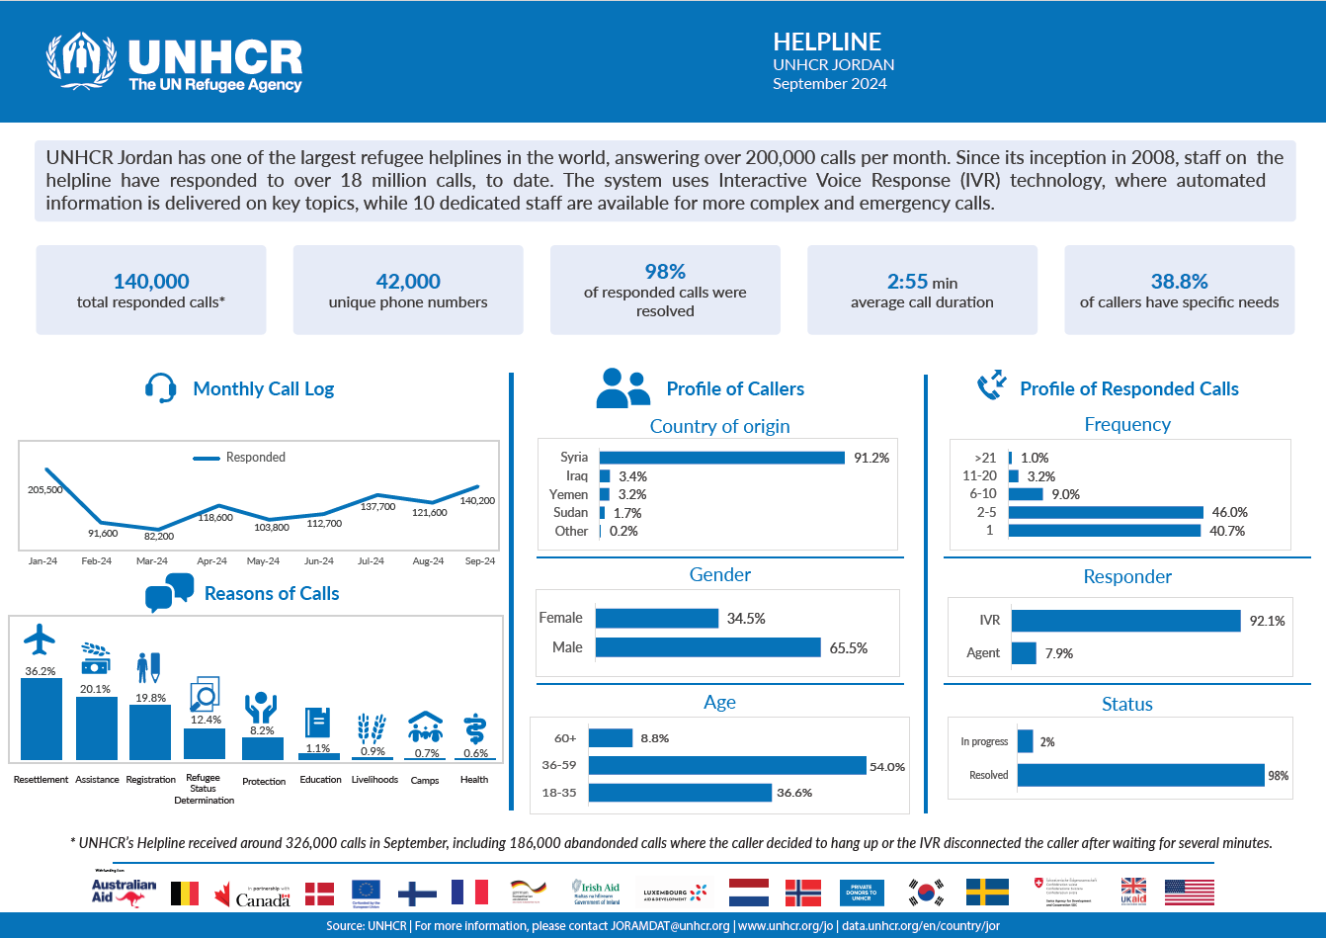
Reporting

Slide 24
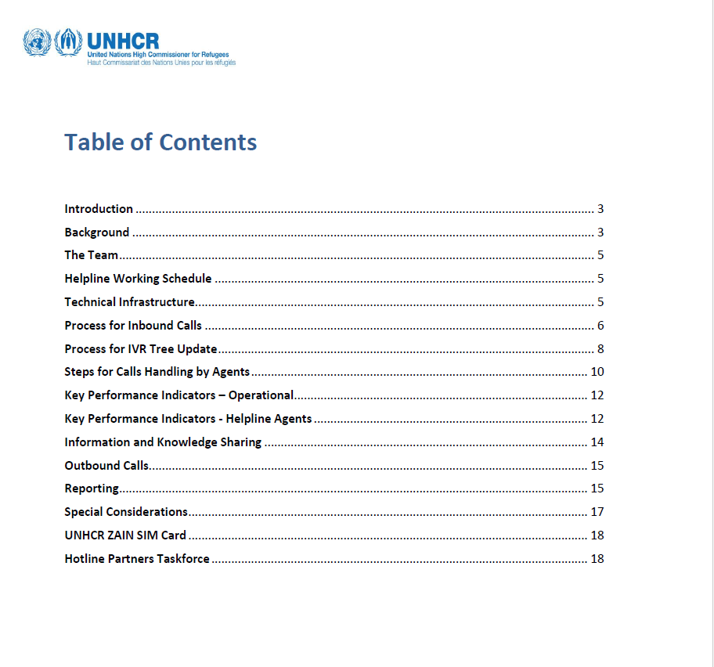
Tool 4.4.2.1 - UNHCR Jordan, Helpline SOP SoPs

Slide 25





Key outcomes and how it solved the problem
Improved Accessibility
Increased Accountability
Enhanced Coordination & Collaboration
Enhanced Feedback Quality
Increased Refugee Empowerment

Slide 26
Next steps
Implement an interagency unified call center in coordination with partners to expand the reach and impact of UNHCR Helpline for refugees and asylum seekers.
This will enhance access to essential services, reduce response times, and improve overall efficiency

Slide 27
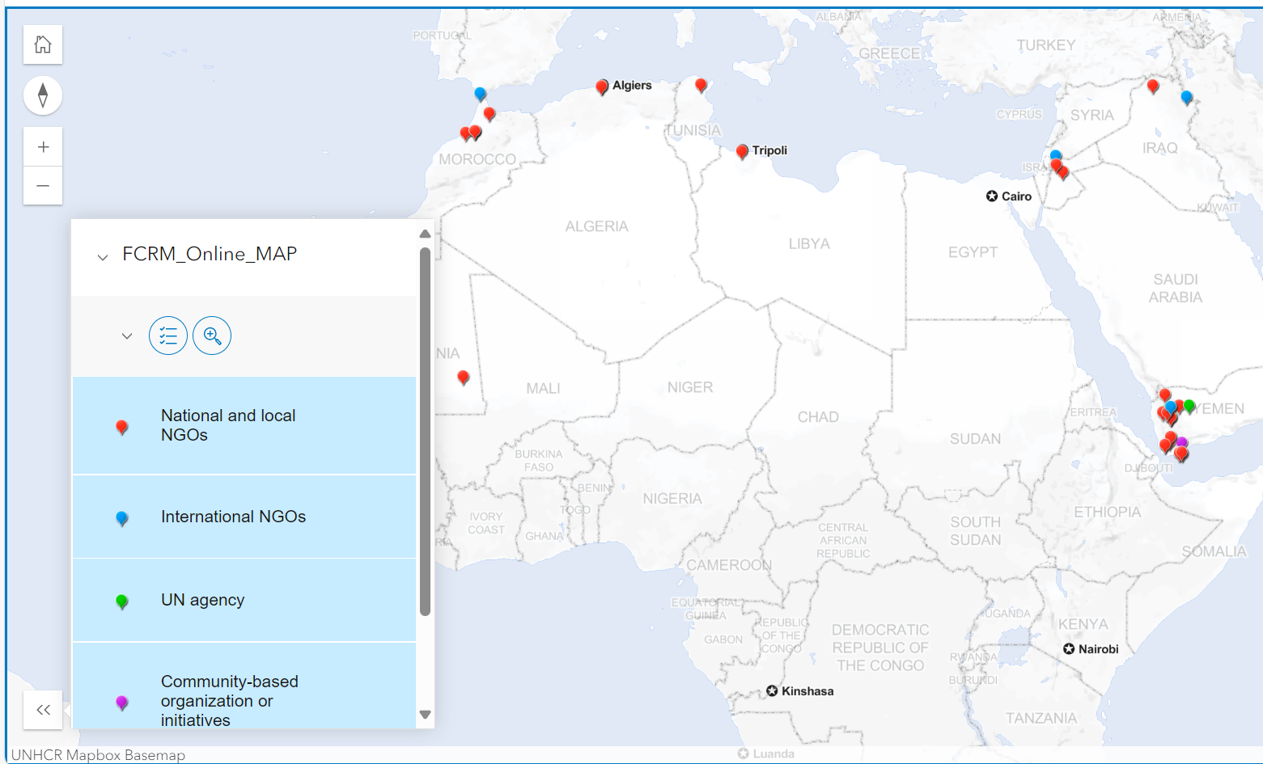
Online Map - Digital FCRM
Notes:
Form: https://enketo.unhcr.org/x/6tWWE95K
Map: https://unhcr.maps.arcgis.com/apps/instant/interactivelegend/index.html?appid=6581f4da07674a478f2c9550a9b05f1b

Slide 28
Online Map - Digital FCRM Form - UNHCR Inter-Agency MENA Regional Bureau
Notes:
Form: https://enketo.unhcr.org/x/6tWWE95K
Map: https://data.unhcr.org/en/documents/details/97414

Slide 29

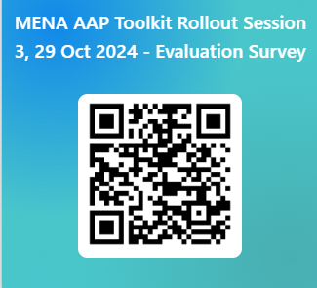
Evaluation survey
Notes:
https://forms.office.com/e/KjLfCP5ewL

Slide 30
For more information:
Ana Belén Anguita Arjona,
UNHCR MENA Regional Bureau
Senior Community-Based Protection Officer
anguita@unhcr.org
Khadija Tarek Aboulnasr,
UNHCR MENA Regional Bureau
Community-Based Protection Officer / AAP
aboulnas@unhcr.org
MENA Regional Bureau Community-Based Protection Unit Mailbox jorammenacbp@unhcr.org

