Slide 1

Integrated Urban sheltering options Athens
Shelter and NFI working group meeting
10th June 2016
Joshua Kyller, Seki Hirano
Joshua.Kyller@crs.org

Slide 2
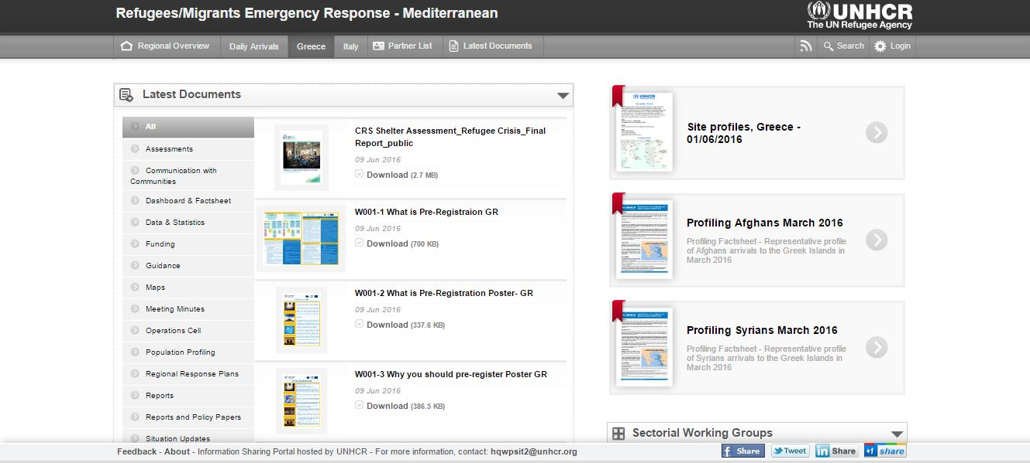
Urban shelter assessment
http://data.unhcr.org/mediterranean/country.php?id=83

Slide 3

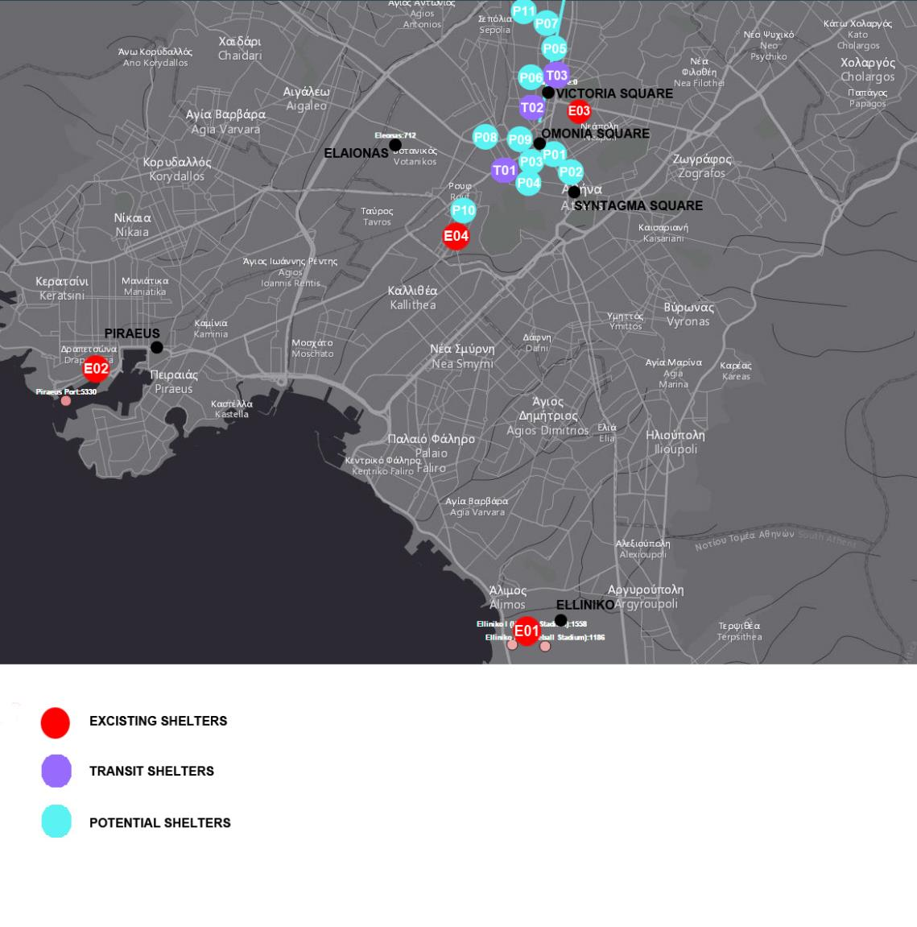

Slide 4
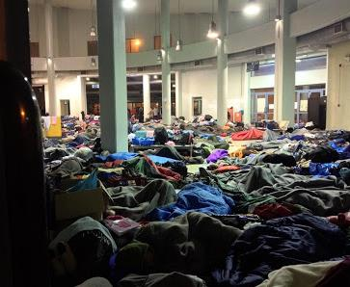
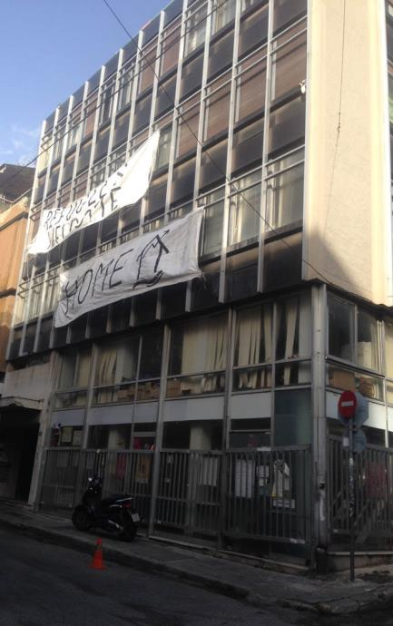
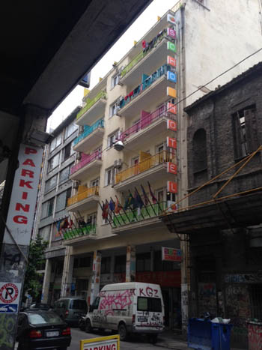
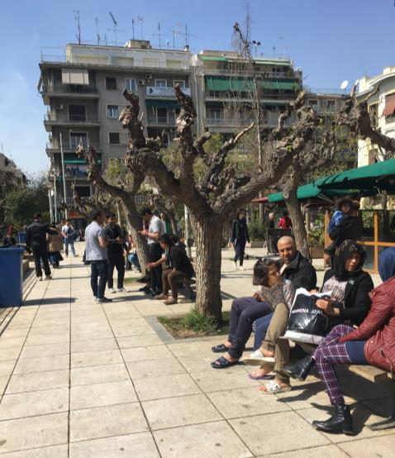
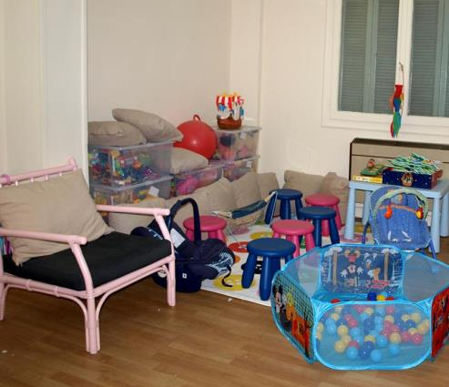
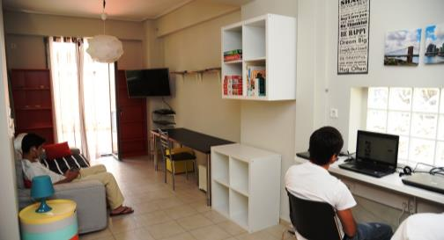
Existing shelters
Existing ShelterS, Official Government Building , Unofficial Collective Centers, Piraeus, Unoffical Occupation Of Public Building Run By Community Based Orgainsations,Private House
Existing Transit ShelterS, Hotel Day Center, Squating On Public Space,

Slide 5
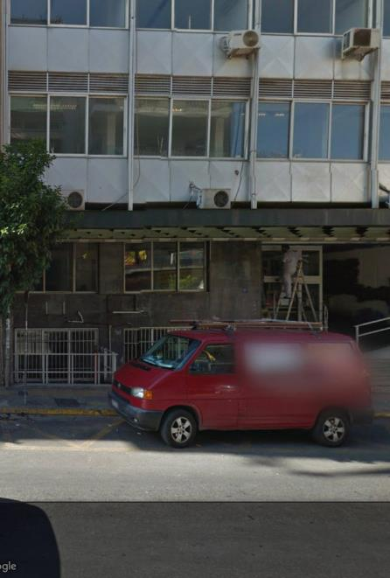
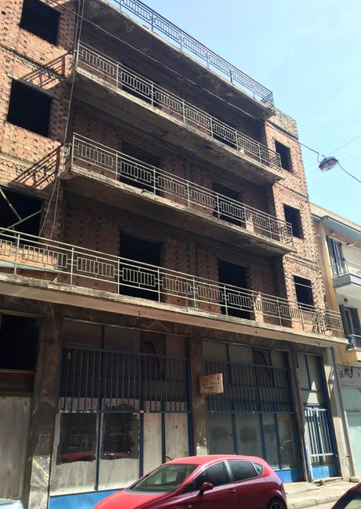
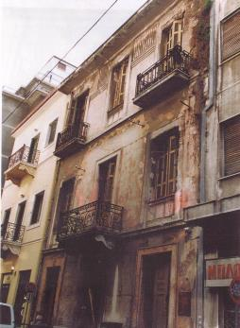
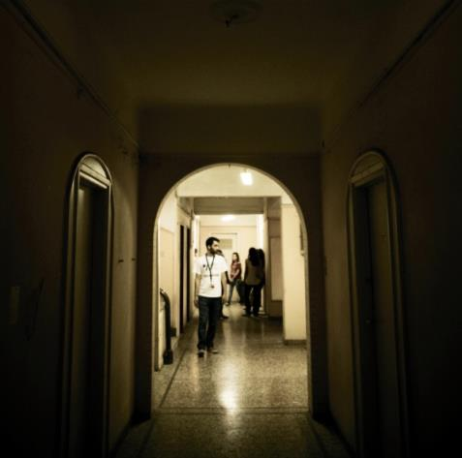
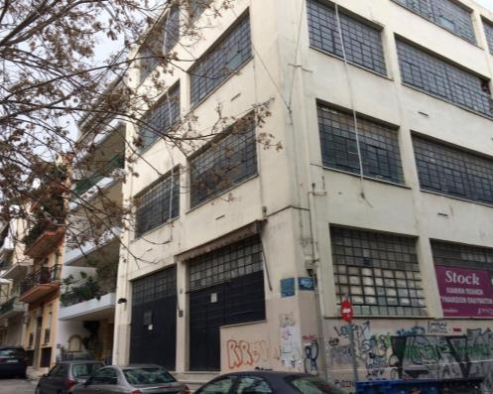
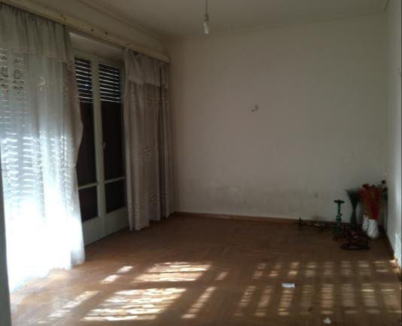
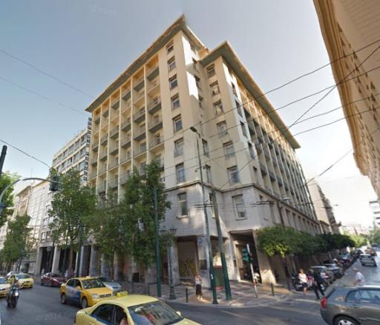
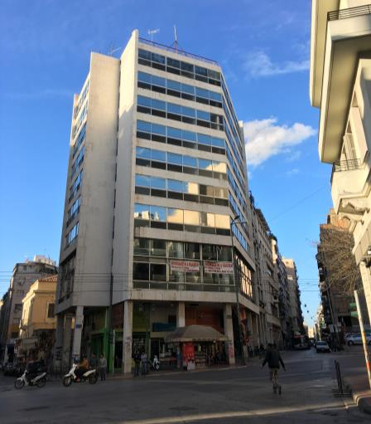
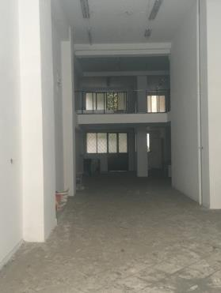
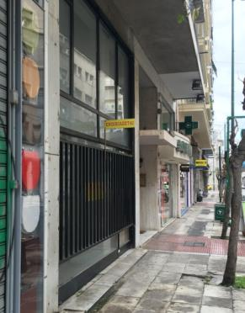
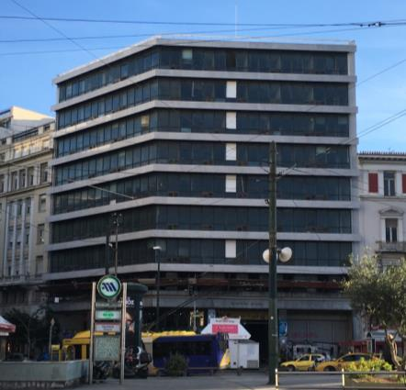
Potential urban sheltering opportunities
Potential Urban Shelter solutions – Public Office Building, Public Vacant Hotel, Listed Residential Building , Private Hotel, Private Storefront, Private Flat, Private House, Private Apartment Block, Private Office Building, Private Industrial Building , Private Hospital 51
5

Slide 7
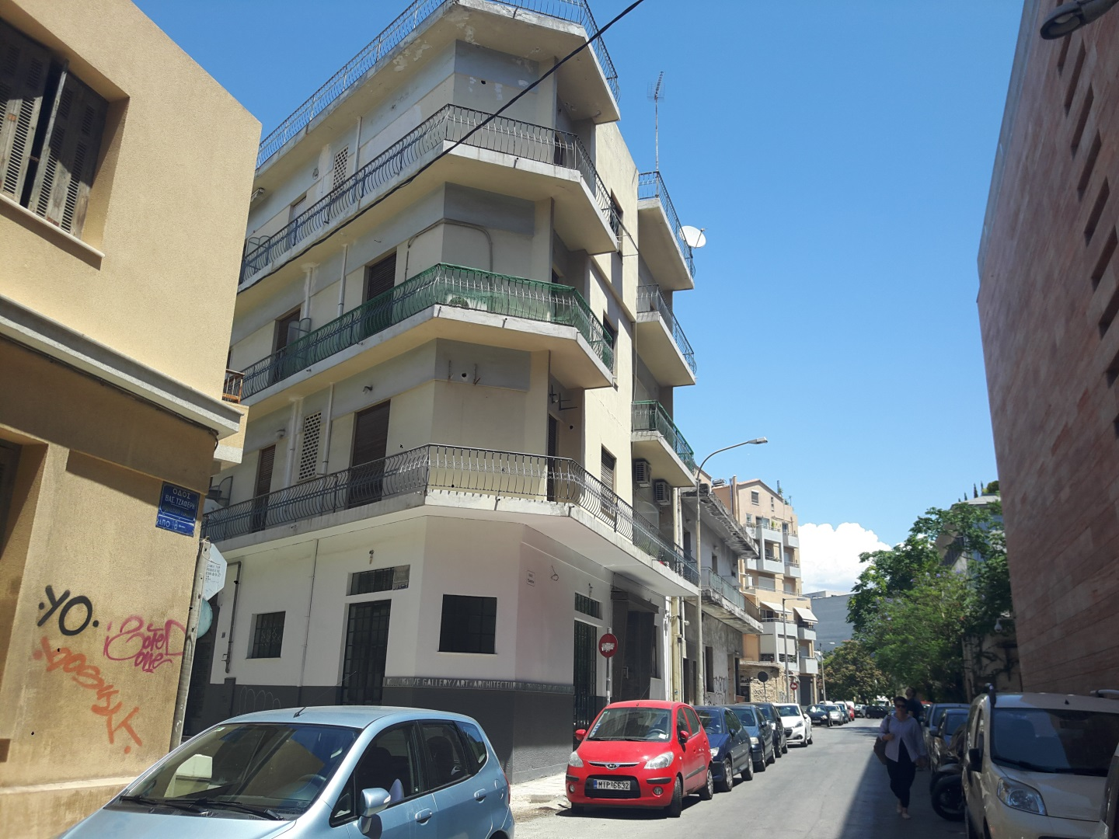
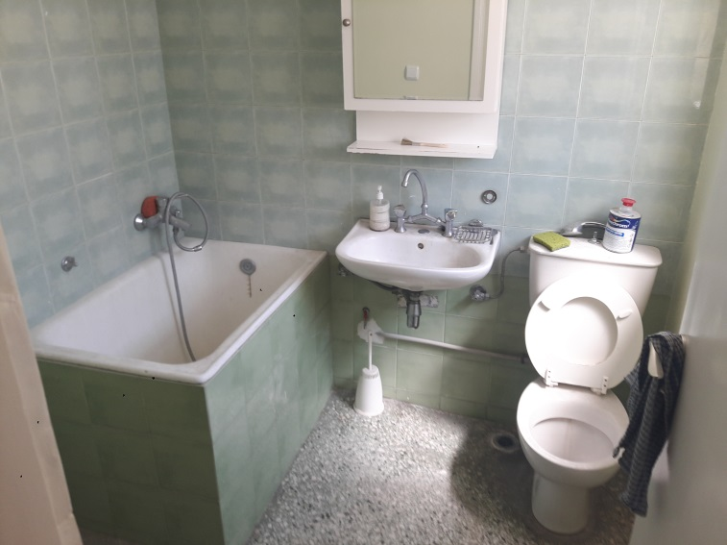
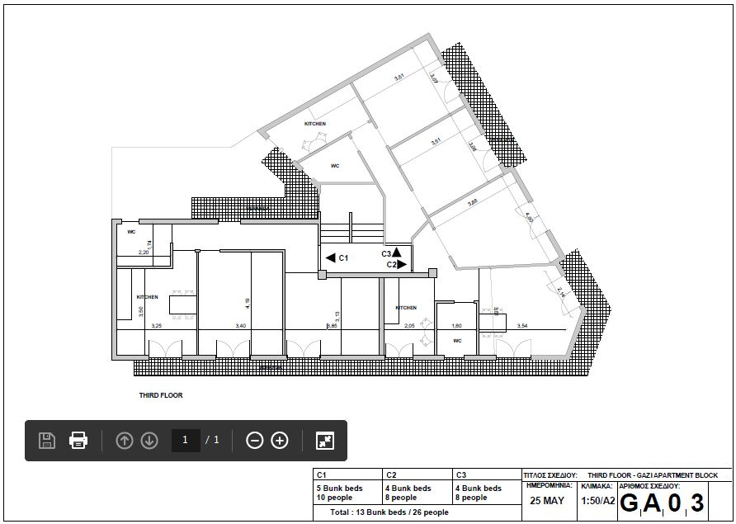
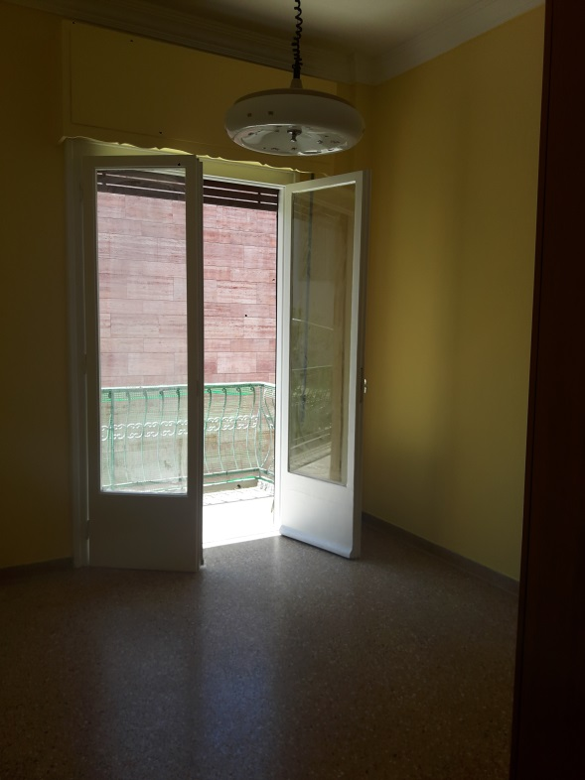
Integrated services
Durable and appropriate space (Water, WC, kitchen)
Cash
Psych-social
Case workers
Referral system
Child friendly spaces
Value for money,
Host community integration
Local economy support

