Slide 1
INCLUSIVE JOBS AND EDUCATION FOR HOST COMMUNITIES, REFUGEES AND OTHER FORCIBLY DISPLACED PERSONS - Kenya, Uganda, Ethiopia, Sudan, Egypt, Jordan, Lebanon, Iraq
The Partners: The Government of the Netherlands, ILO, UNHCR, UNICEF, WB and IFC

Slide 2
REFUGEE CONTEXT IN KENYA
Kenya is the 5th largest asylum country in Africa and 11th in the world;
The population of asylum seekers as at end of October stood at 468, 731;
A high encampment is a characteristic of the refugee situation in Kenya;
The total refugees population in camps is as follows;
Dadaab – 44%
Kakuma – 32%
Kalobeyei settlement – 8%
Humanitarian assistance remains the main source of income and employment for most;

Slide 3
EXPANDING LIVELIHOOD OPPORTUNITIES
The partnership aims to enable host community and refugees become self reliant and lessen dependent on humanitarian assistance;
The Kenyan government has made a series of statements in support of greater self-reliance and expanded socio-economic opportunities:
In September 2016, during the UNGA adoption of the New York Declaration for Refugees and Migrants, the GoK committed to enhance refugees self reliance and inclusion;
In March 2017, the Government of Kenya signed the Nairobi Declaration committing to enhance training, skills development for refugees to reduce their dependence on humanitarian assistance
The GoK has also prepared an implementation plan for adoption of the CRRF with a commitment to expand economic opportunities in refugee hosting areas.

Slide 4
THEORY OF CHANGE
GOAL: Increased access to education, skills development and livelihood opportunities for host communities and refugees
Output 1:
Inclusive livelihoods for host community and refugees strengthened
Output 2:
Needs-based education and skills learning architecture strengthened
Output 3:
Protection and policy environment for self-reliance strengthened
Output 1 – ILO
Capacity building of local authorities, contractors, and training institutions to develop EIIP, promote job matching, promotion of access to procurement opportunities
Output 2 – ILO
Models for skills recognition, recognition of PRL, formal and informal skills upgrading, demand driven/on-job training and RPL adapted, SIYB training
Output 3 – ILO
Awareness, sensitization and promotion of workers rights , improved capacities of tripartite partners, empowering women to participate in rural economy

Slide 5
KEY CONSTRAINTS – Output 1
Lack of private sector engagement/investment and access to markets;
Lack of alternative work opportunities;
Inadequate information and related costs/obstacles concerning business permits and licenses;
Weak infrastructure (environmental assets) to support enterprises;
Insufficient awareness of employment-intensive infrastructure investment technologies;
Poor public and community infrastructure coupled with public under-investment;
Weak intermediation services and associated institutions (public employment services and private employment agencies).

Slide 6
KEY CONSTRAINTS– Output 2
Limited post-primary education opportunities;
High number of out of school youth and adolescents;
Education-skills mismatch to employment market and placement opportunities;
High number of adolescents and youth without education and requisite skills;
Limited access to Technical and Vocational Education and Training (TVET) institutions;
Limited physical infrastructure;
Lack of relevant curricula;
High number of youths and adolescents at risk.

Slide 7
KEY CONSTRAINTS– Output 3
Constraints in legal framework and policy environment (particularly restricted movement from camps, requirement for issuance of work permits, business registration and KRA PIN, inaccessibility to financial services, etc);
Lack of documentation or delays in issuance of refugee ID cards;
Weak public employment/information systems;
Inadequate information and accessibility to work permits, business registration and licenses, KRA PIN;
Integrated Personal Registration System (IPRS) only holds rdata for whom refugee ID cards were issued.

Slide 8
EIIP TESTIMONIES
“We are grateful to ILO because providing opportunities to receive income with dignity and not based on handouts”. – Contractor Irbid;
“I wish that there was another program because I just got of the financial stress for three months and now I have to pay rent again and its stressful again”. – Beneficiary Mafraq;
“The program has created the spirit of one team of bonding between the two cultures: Syrian and Jordanian”. – Male Labourer Irbid;
“At the beginning women were not so willing to work but at the end they had lines of female workers looking for work”. – Beneficiary, Hosha Municipality Mafraq.

Slide 9
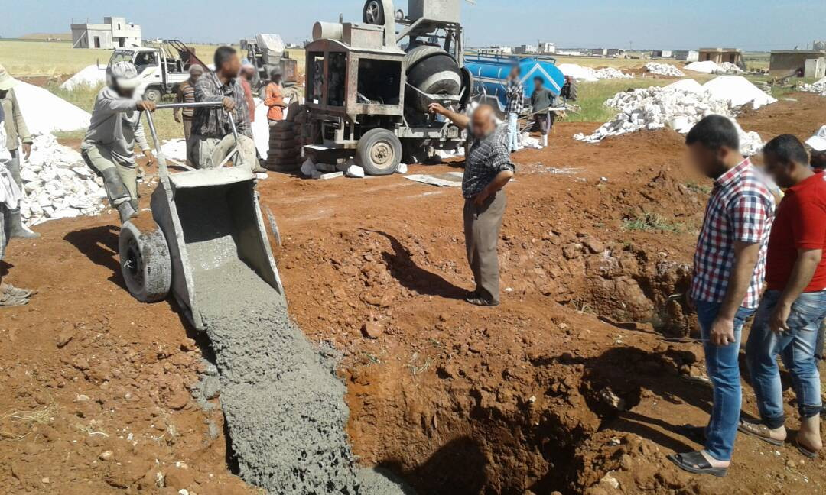
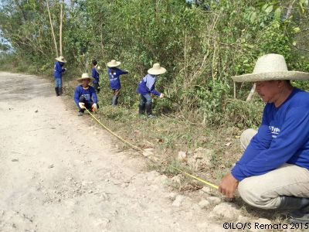

Slide 10
GEOGRAPHICAL SCOPE
All partners will work in Turkana and Garissa counties where the two refugee camps/settlement are located
Questions and Answers
Thank you.

