Slide 1
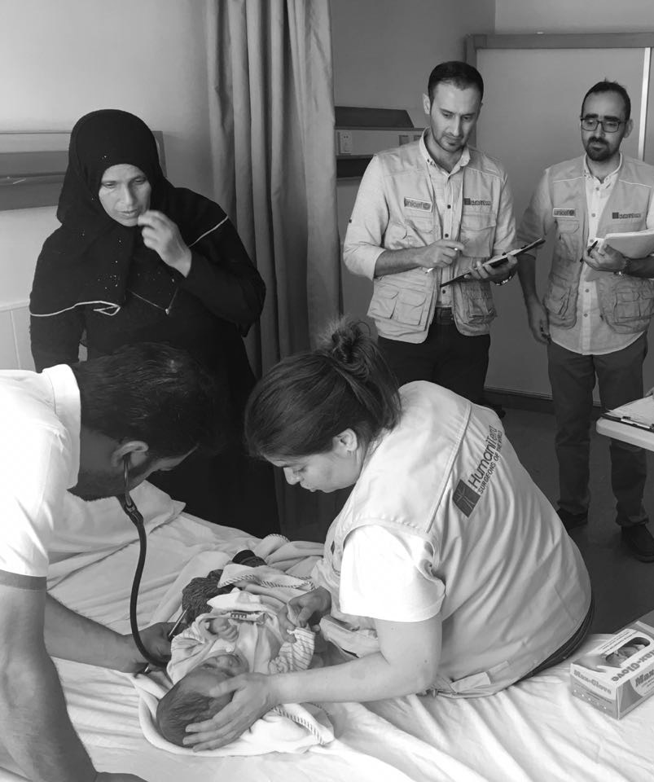

Improving Access to
Overall Surgical Care
for Vulnerable Children

Slide 2






Overal Surgical Care Programs worldwide
*2018/19 MISSIONS
Afghanistan
Jordan
Jordan
Bangladesh
Bangladesh
Burkina Faso
Cambodge
Central Africa
Équator
Cameroun
Notes:
9 countries. Cox Bazaar refugee camp – Woman health in Burkina Faso - Jordan

Slide 3
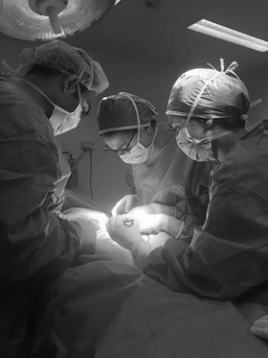
WHAT DO WE DO Consultations, Operations & post-op care
Life Changing Program Improving access to qualitative surgical procedures for the most vulnerable children
SURGICAL SPECIALITIES
Reconstructive Plastic Surgery
Pediatric-Urology Surgery
General & Visceral Surgery
Orthopedic & Trauma Surgery
Otorhinolaryngology (ENT) Surgery
Appropriate Follow-up & Postoperative care are mandatory to reduce the risks of complications after surgery and to
support the recovery process
OVERALL SURGICAL CARE
Post-Operative Care
Training in post- Operative care
Physiotherapy 145 sessions for 90 patients were conducted.

Slide 4
DETAILS OF THE SURGERY
Reconstructive plastic surgery
Orthopedic surgery
Pediatric and urologic surgery
ENT
Burns
Congenital malformation
Benign skin tumor
Cysts/Lipoma/ Abscess/Hematoma/Hemangiomas
Keloid scars
Polydactyly/Syndactyly
Tendon Dysfunction
Limp Length Discrepancies
DDH
Deformity Of The Lower & Upper Limps
Rotation Of The Hip& Tibia
Bone Cyst / Mass
Club Foot
Knee Flexion
Epiphysiolysis Of The Hip
Hernias
Hydrocele
Ectopic testicles/ not descended/ retractile
Congenital malformations
(Hypospadias)
Testicular torsion
Benign Skin Tumor
Tongue Tie
Cleft lip and cleft palate
Tonsillectomy &
Adenoidectomy
Antrostomy
Septoplasty
Nasal Polypectomy
Mastoidectomy

Slide 5
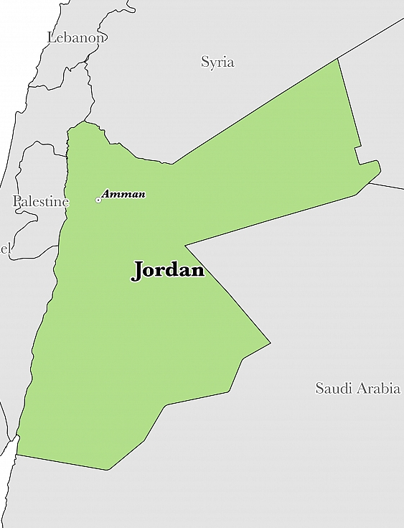
WHERE DO WE WORK
We operate in Amman in
Al Hanan hospital (offices) and
in Al Basheer public hospital
We receive patients from
all over Jordan

Slide 6
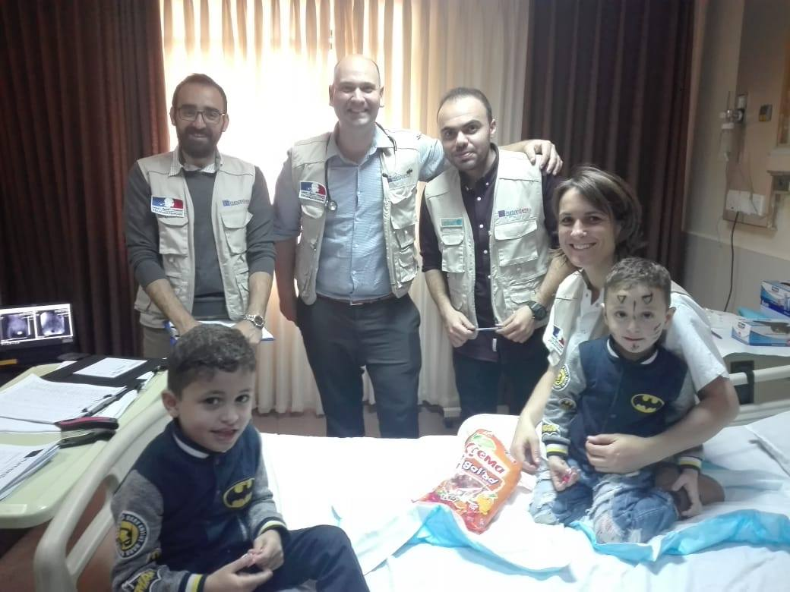
ACHIEVEMENTS
FROM DECEMBER 2017 TO JANAURY 2019:
1282 consultations
578 surgical interventions
During a consultation day

Slide 7
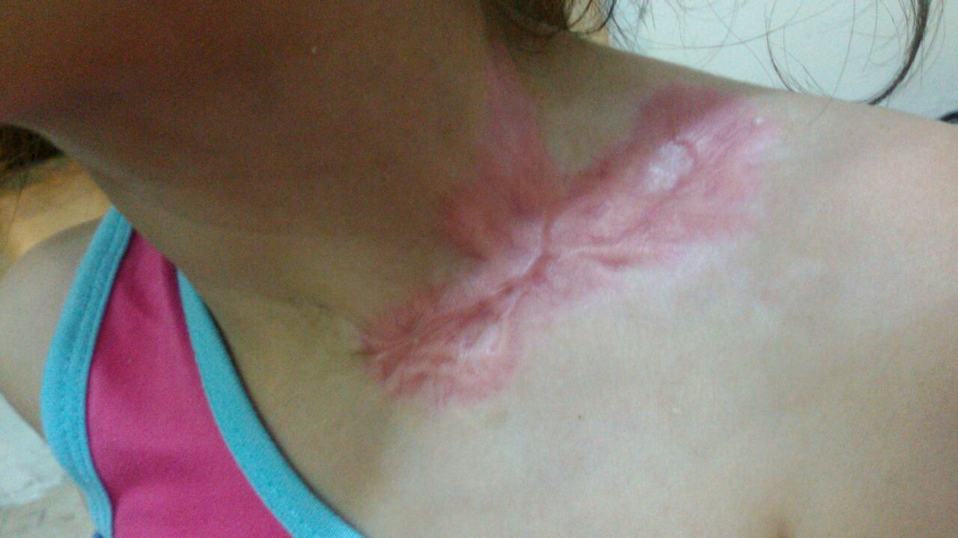
STATISTICS
Surgery provided
1 or 2 missions per month
Upon the needs of beneficiaries.
Gender breakdown
Pediatric surgery: mainly boys (congenital and acquired deformities of the urogenital tract and abdominal wall)
Reconstructive plastic surgery: mainly girls (burns, scars, contractures)

Slide 8
STATISTICS
Region
Age Groups
HTI provides surgical services for Refugee and vulnerable Jordanian children under the age of 18 years.

Slide 9
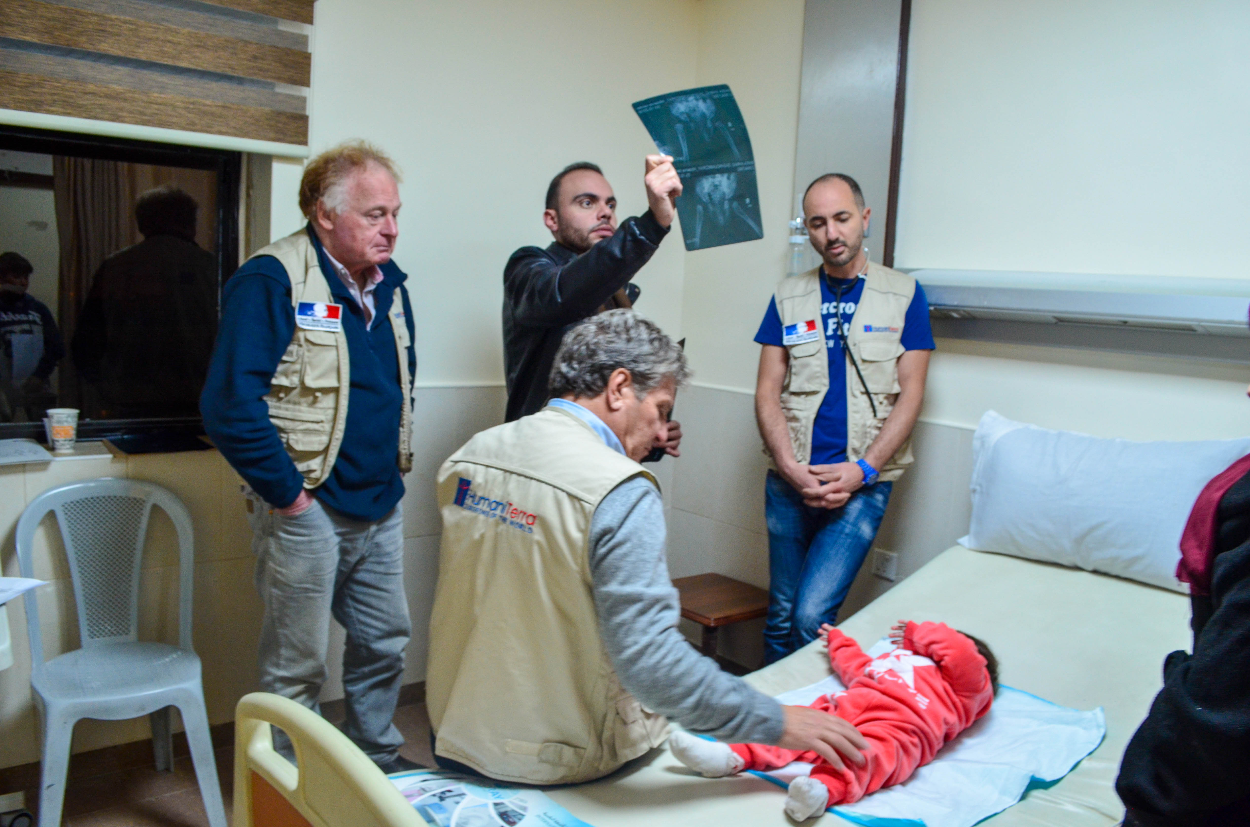
STATISTICS
Patients collection
Through Hotline, Social media and Referrals from partners:
Hotline patients: 1029 Patients (88%)
Referred Patients: 145 Patients (12%)
On consultation day surgeon decides about surgery
If a patient does not fit the criteria is referred
During a consultation day

Slide 10
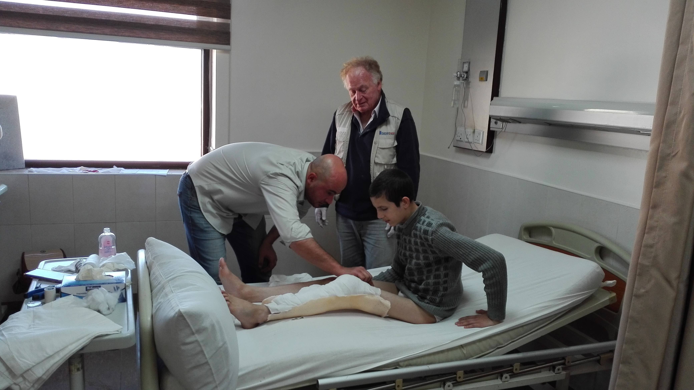
BEST PRACTICES Pre & post operation care
Between 35 – 40% of the patients seen during the consultation day, require only conservative treatment/medicaments (provided)
Pre-op physical therapy – mainly for orthopedic and plastic reconstructive surgery patients – is provided;
Post-op physical therapy- for plastic reconstructive (scars and contractures) and orthopeadic – is provided and includes:
- Exercises to strengthen muscles
- Posture/balance/coordination training
- Gait analysis and training
- Manual therapy techniques
- Self-care training
- Home exercise instruction
Post-op care - dressing and follow- up checks - is provided.
Pre-op physical therapy

Slide 11
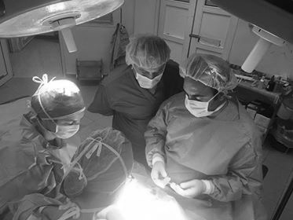
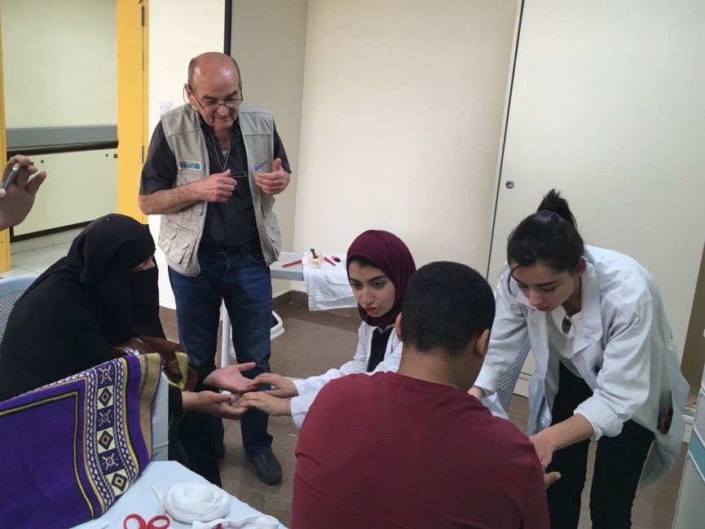
BEST PRACTICES Practice sharing & Medical training in advanced surgical techniques
Experienced professionals share their medical knowledge and skills with Resident doctors & Students
Operating in
Al-Basher Public Hospital
Sharing practice with the surgeons & scrub nurses
Training surgery-interns by observation and discussion
Collaborating with
The Jordan University
Students invitation to
Assist Physiotherapist during consultation
Sharing practice on Splints technics and Rehabilitations exercises

Slide 12
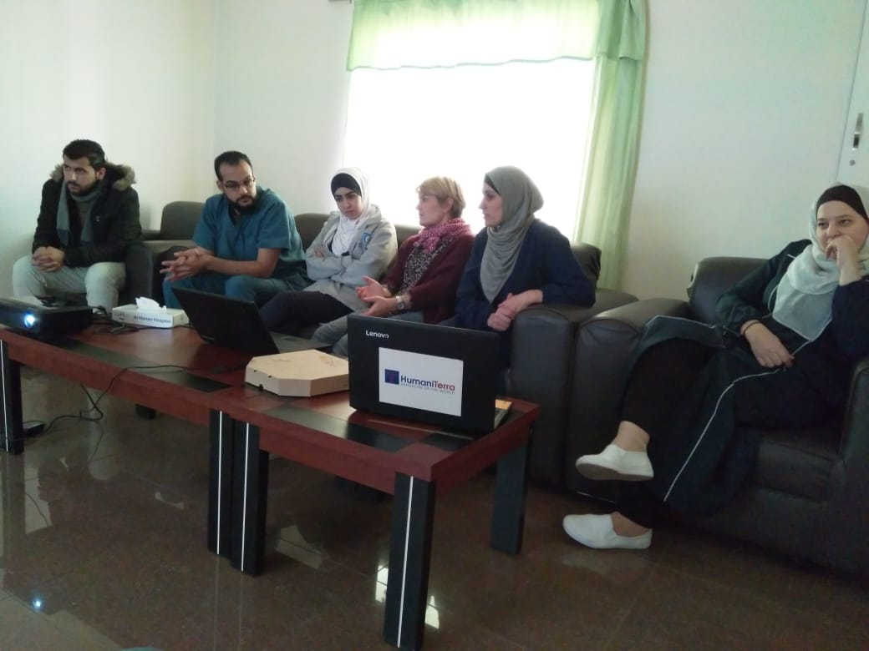
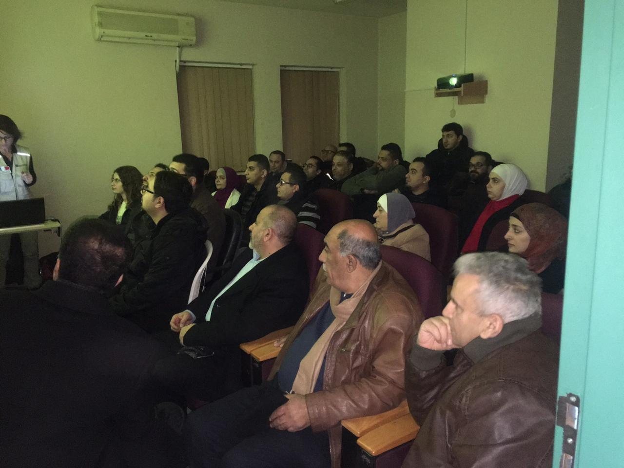
BEST PRACTICES Practice sharing & nursing training
Nurse training in
Al- Hanan Hospital
Sharing practices with scrub nurses
Pre-op, post-op and hygiene protocols
Anesthesiologist training in
Al Basheer public hospital
Sharing practice with the surgeons
Training surgery-interns by observation and discussion

Slide 13
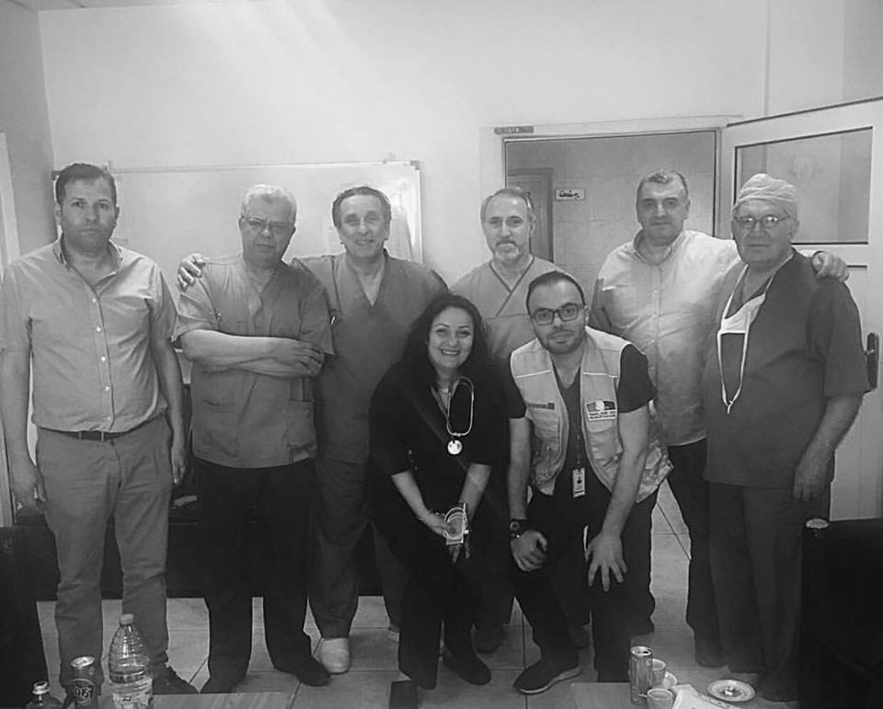
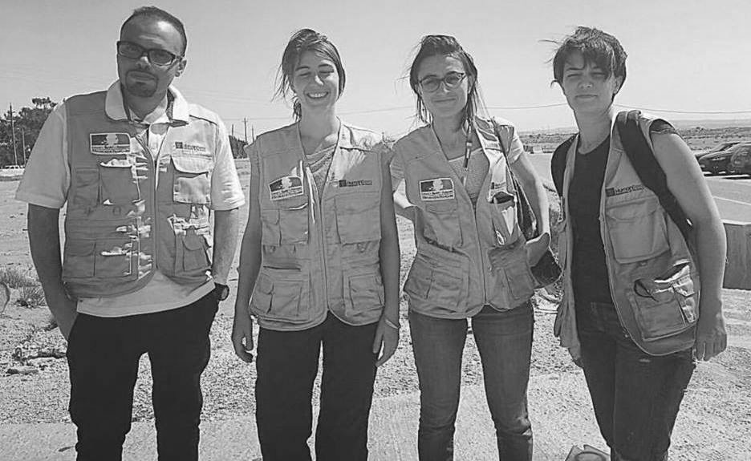
BEST PRACTICES Collaboration with local services to strengthen the assistance to refugees and vulnerable people
In order to ensure self-sufficiency, local medical services must have adequate hospital structures. HumaniTerra provides expertise in hospital infrastructure building, rehabilitates existing buildings and equipment (operating rooms, anesthesia, radiology…), adapting to the local environment
Consultations in refugee camps
Donation of surgical material

Slide 14
MAIN CHALLANGES
Administrative approval at government level
High number of patients compared to funding
Size of our organization

Slide 15
COORDINATION EXCHANGE OF INFORMATION SECTOR SUPPORT
LESSONS LEARNT

Slide 16
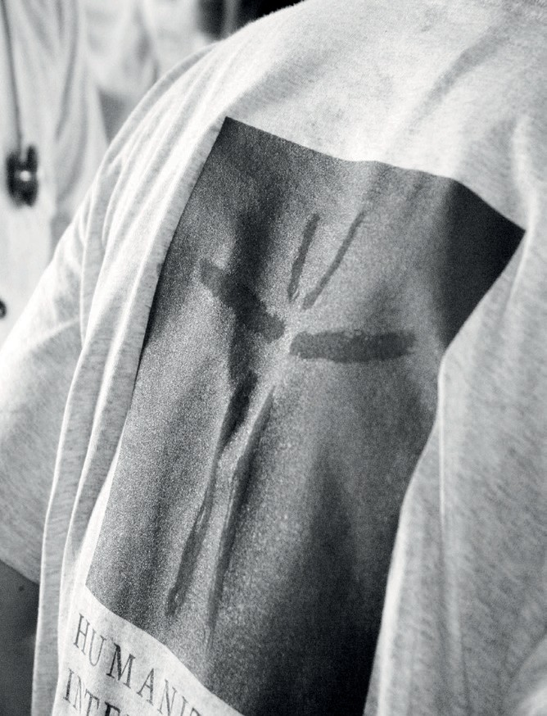




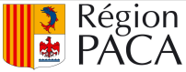
TIMELY ACCESS TO SURGICAL CARE SAVES LIVES AND PREVENT DISABILITY
Contact in Jordan: Chiara Lorenzini – HoM
0798794301
HUMANITERRA INTERNATIONAL
14, rue Raphael 13008 Marseille, France

