Slide 1

Data Management Working Group
Friday 17 May 2019

Slide 2
Agenda
Revised WG ToR (attached)
Update on the roll-out of ActivityInfo
Briefing from the Assessment Technical Working Group
AOB

Slide 3
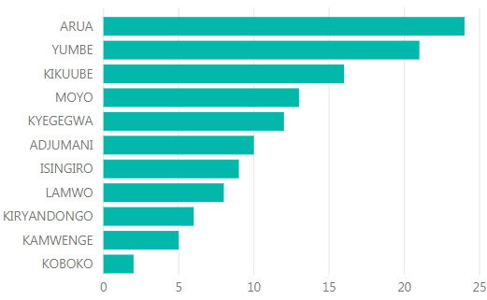
ActivityInfo RRP response monitoring – status and next steps
Q1 timeline:
Partner reporting: 3 – 18 April (12 working days, normally 1 week)
Sector-lead clearance: 24 April – 2 May (6 working days)
Product development: 24 April – 10 May (12 working days, normally 1 week)
Product clearance: 14-16 May (3 working days)
Dissemination: 20 May
Number of partners reporting broken down by sector and district

Slide 4
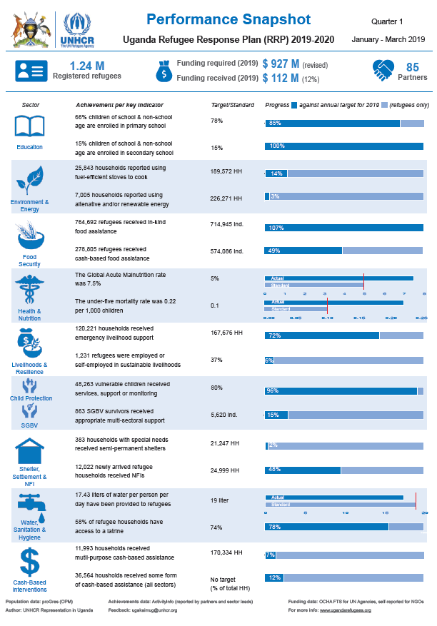
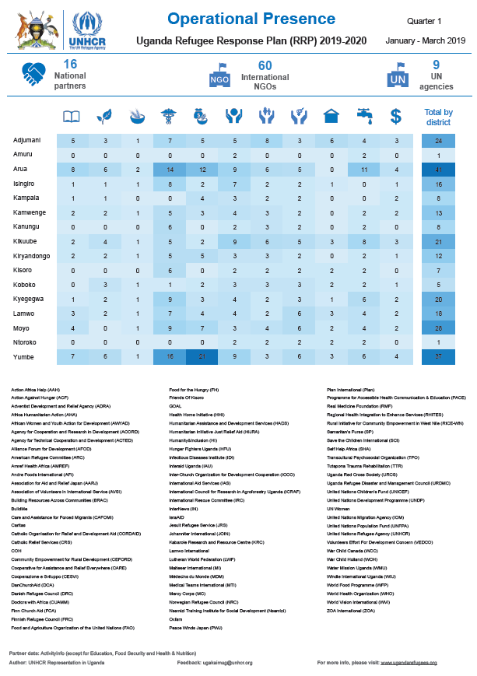
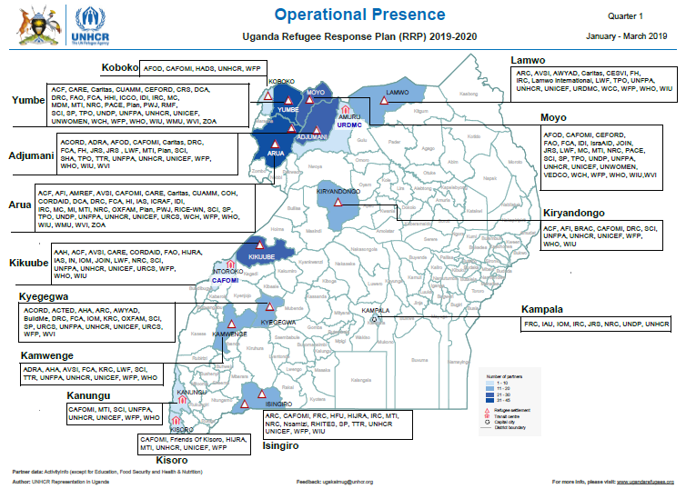
ActivityInfo RRP response monitoring – status and next steps
Products:
  3-page “Performance Snapshot” with key figures for the response, achievements against key indicators and operational presence for all sectors.

Slide 5
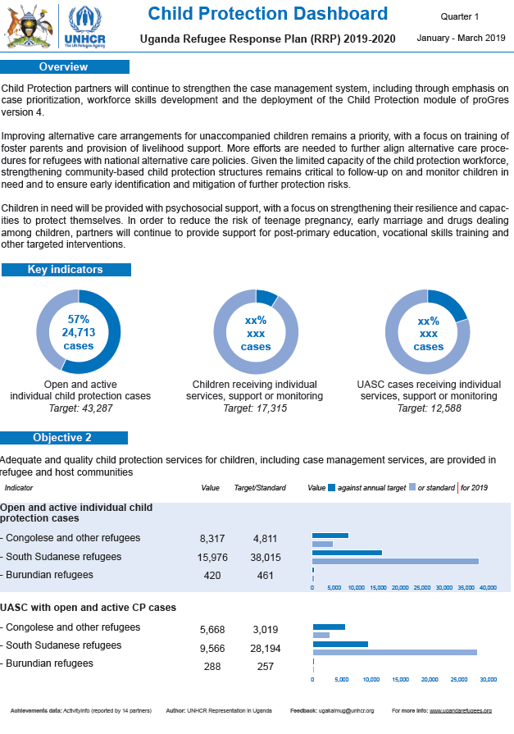
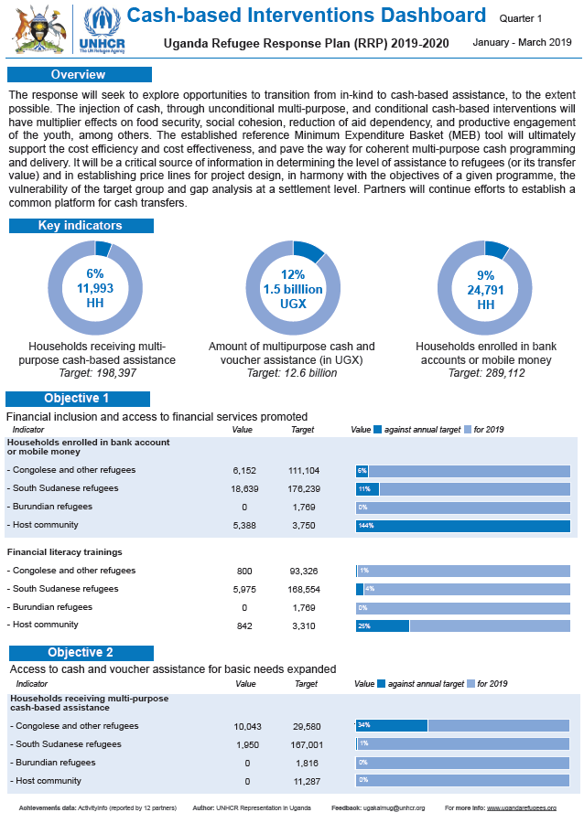
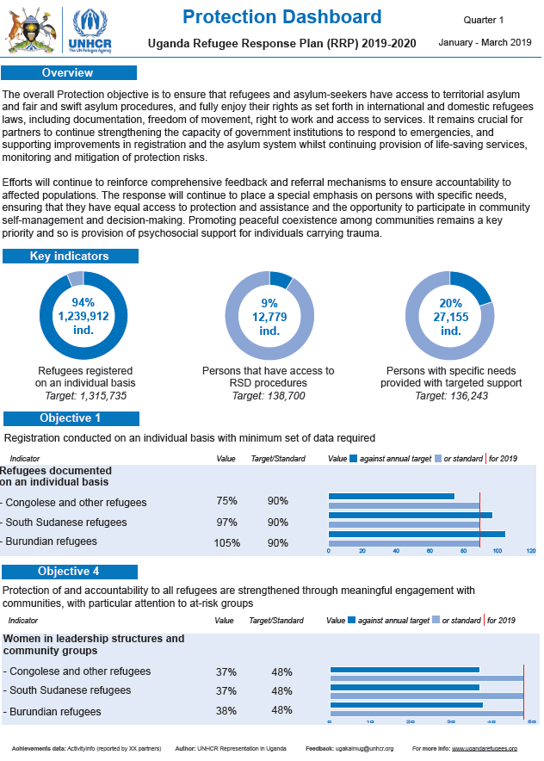
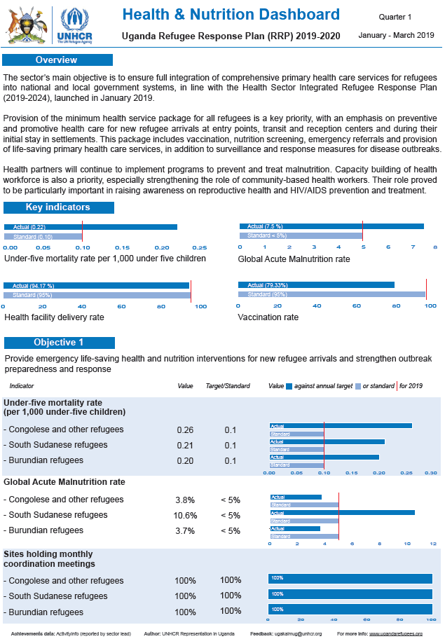
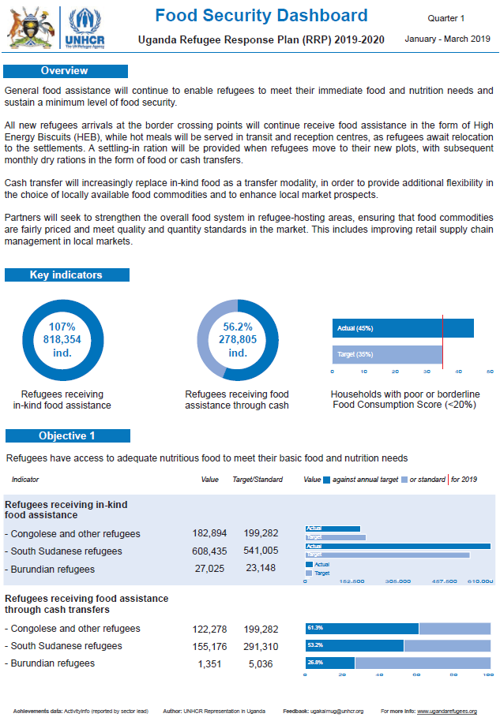
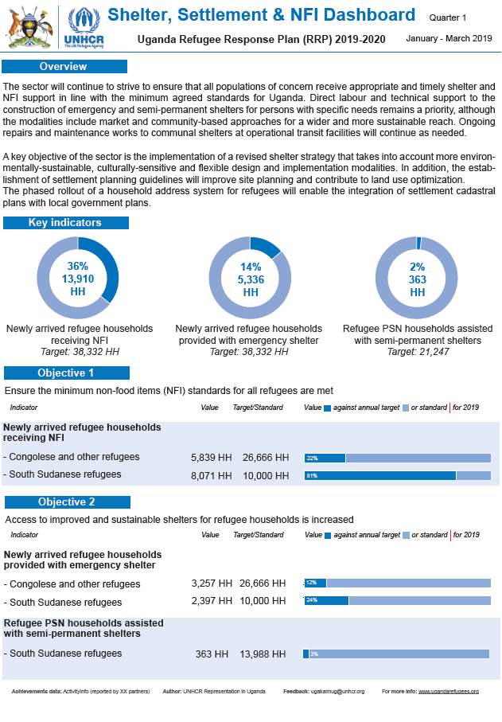
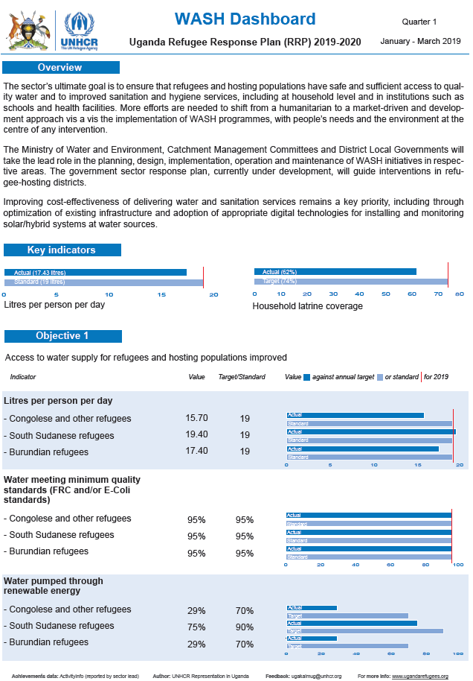
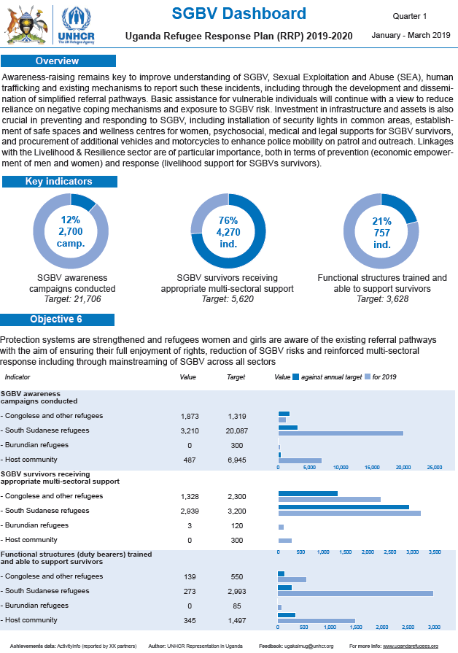
ActivityInfo RRP response monitoring – status and next steps
Products:
  2-3-page “Sector Dashboard” with short narrative, all indicators as well as sector-specific operational presence.

Slide 6

ActivityInfo RRP response monitoring – status and next steps
Upcoming deadlines
  May reporting: 7 June (CBI, CP, E&E, PROT, SGBV, SSNFI, WASH)
  June / Q2 reporting: 5 July (All sectors – feeds into RRP Mid-Year Report)
Next steps:
  Feedback session for partners and sector leads in June
  Explore alignment with government systems
  More training (DLGs, HCR staff for direct implementation etc.)
  Simplify reporting for cash-for-work activities
  Harmonise reporting frequencies

Slide 7
ActivityInfo RRP response monitoring – status and next steps
Cash-for-work
  Current guidance: report output under relevant sector, employment generated under Livelihoods & Resilience
  Some sectors are tracking employment as well (ex. SSNFI)
  Partners are required to report across multiple sectors for one intervention
Environment & Energy
  # of trees planted
Livelihoods & Resilience
  # of people engaged in short-term employment opportunities
Shelter, Settlements and NFI
  # of refugees employed in sustainable construction projects
  # of host community members employed in sustainable construction projects
  # of kms of roads rehabilitated

Slide 8
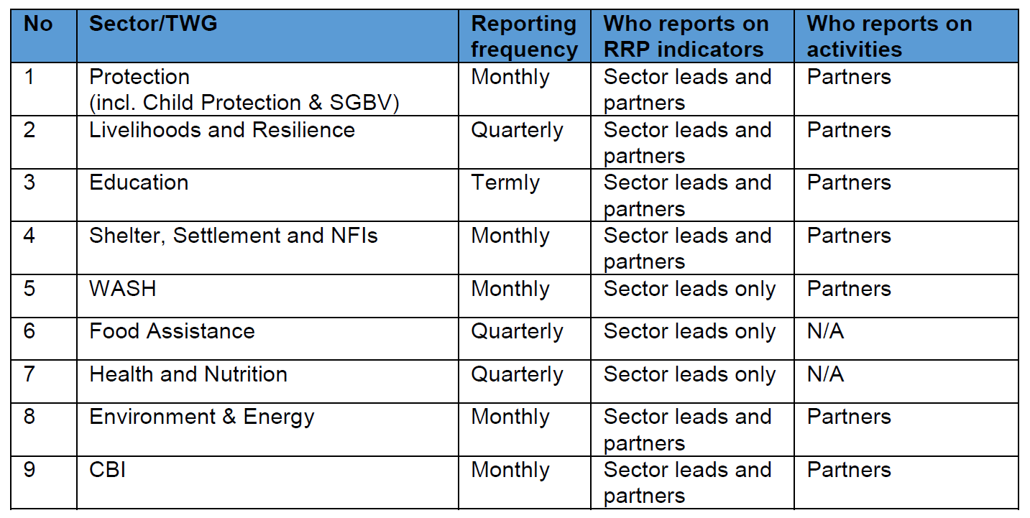
ActivityInfo RRP response monitoring – status and next steps
Reporting frequencies

