Slide 1


InTER- Sector plus
Working group

Slide 2
Agenda
Hard Structures overview analysis in the North
Principles for issuance of emergency cash in emergency situations (North Emergency Cash Coordination Group)
Update on RNA in mass eviction situations (UNHCR)
Updates on other recent GOL decisions relating to Syrians in Lebanon (UNHCR)

Slide 3
Hard Structures
overview

Slide 4
Content
IA Hard Structure SOPs: topology, messages, assistance package, response mechanism, monitoring and assessment tools
Update: notifications, dismantling and assistance provided
Analysis: mapping of hard structures in T5 and Akkar

Slide 5
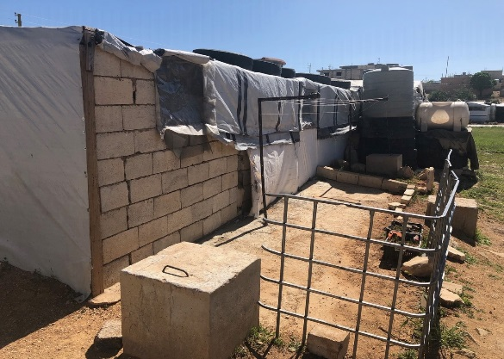
SOPs: Type 1 | Partially Built Structure
Notes:
Partially Built Structures:
Structure: Timber columns and studs
Walls/partitioning: Varying combination of plastic sheeting and stacked concrete blocks with minimal mortar
Roof: Plastic sheeting with timber structure
Wash facilities:
communal wash facilities (either built or prefabs)
individual latrines integrated within shelters and built from concrete blocks
emergency latrines

Slide 6
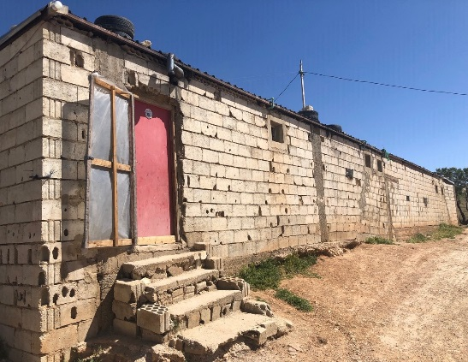
SOPs: Type 2 | Fully built with Zinc roof
Notes:
Fully Built Structures – Zinc Roof
Structure: Concrete columns or absence of formal structure
Walls/partitioning : Concrete blocks
Roof: Zinc roofs with metal structure
Wash facilities: Integrated within shelters and built from concrete blocks.

Slide 7
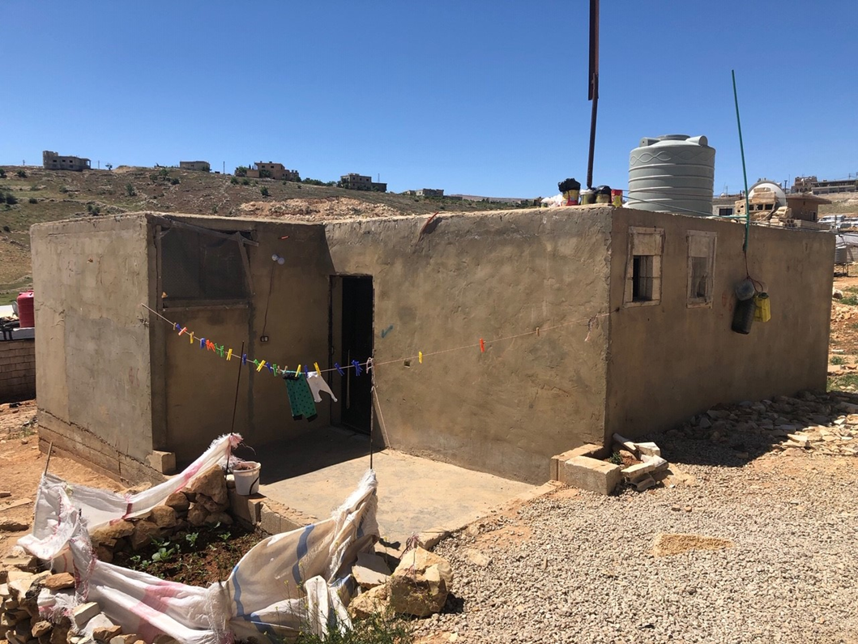
SOPs: Type 3 | Fully Built Structure – Cast Concrete Roof
Notes:
Fully Built Structure – Cast Concrete Roof
Structure: Concrete columns or absence of formal structure
Walls/partitioning: Concrete blocks
Roof: Reinforced concrete slab
Wash facilities: Integrated within shelters and built from concrete blocks

Slide 8
SOPs: Messages (Frontline Staff)
Inform refugees that the humanitarian community is aware of LAF’s demolition order.
Reiterate that refugees should take the instructions by authorities seriously.
Remind refugees that the primary responsibility remains with those who have erected the structures, and landlords and refugees are to dismantle them.
Encourage refugees to engage with landlords to find solutions that are in line with national regulations.

Slide 9
SOPs: Messages (Frontline Staff)
Recommend that that refugees safeguard all personal and household belongings. (i.e. ID, Documentation)
Let refugees know that humanitarian actors need to respect the Lebanese Government’s laws, while advocating to mitigate negative impact.
Inform refugees about with authorities on how the instruction can be implemented in as humane and dignified, and with respect for due process. (sufficient notice period, consultation, & alternative relocation sites)
Tell refugees to report any raids, arrests, or detentions or any violence to help lines or staff immediately.

Slide 10
SOPs: Assistance
Provide guidance note on safe dismantlement.
Identify vulnerable individuals through protection case management requiring temporary relocation assistance (i.e. empty tents, rehabilitated shelters, community center, mosque or school). WASH facilities in temporary relocation sites
Disseminate messaging on available in-kind assistance, resources (municipal machinery) and available temporary shelters for relocation.
Rehabilitation or construction of the emergency toilet and water point (if needed)
Identify actor to assist with safe rubble removal (LAF, municipality/MoE).
ECA for extremely vulnerable cases, in exceptional circumstances and in accordance with ECA guidelines.
Type 1: partially built structure | Type 2: Fully built structure with Zinc roof | Type 3: Fully built structure with concrete roof
MRK | MRK + NAK | MRK + NAK

Slide 11
SOPs: Reponses, Monitoring, Needs and Eligibility
The response to be coordinated through Emergency Coordination Mechanism (RNA)
Monitoring and determining eligibility for assistance through Eye On the Situation (EOS)/Unified weatherproofing shelter assessment.

Slide 12
Current Situation
During May and June, 13 sites were visited by LAFI and ISF to identify hard structures, including 12 in Akkar and one site in T5.
Four sites notified to dismantle (Mhammaret 010, 046, Bebnine 001 and Merkebta 112).
Ongoing dismantling in Mhammaret 010 and 046. Around 10 hard structures still be dismantled in Mhammaret 010.
Landlord mediating to resolve the issue with ISF in Merkabta. No follow up visit by ISF report.
Bebnine 001 challenged LAFI asking for a court order to enforce the dismantlement. Deadline passed and no follow up visit by LAFI.

Slide 13
Analysis: Visibility and Prominence (44 Sites)
Total # of Sites |  | Total # of Hard Structures |  | Total # of Households |  | Total # of Individuals
264 |  | 553 |  | 625 |  | 3359

Slide 14
Analysis: Typology and Specific Needs

Slide 15
Analysis: WASH Facilities and Coping Mechanisms

Slide 16
Emergency Cash

Slide 17
Emergency cash coordination in North Lebanon
Current goal: ensure more harmonized and coordinated approach in emergency situations (extreme weather, fires and evictions)
14 ECA partners in the North, five of which have funding for emergency situations
Aim to agree on common principles, harmonized amounts, common assessment tool and geo split for emergency situations

Slide 18
Draft principles for emergency cash assistance in emergency situations (1)
ECA payments to be issued as targeted assistance of last resort.
Duplication of ECA with other assistance packages only justified where family lost most of their belongings as a result of the emergency (e.g. devastating fire)
Duplication with other types of cash intervention to be generally avoided.

Slide 19
Draft principles for emergency cash assistance in emergency situations (2)
Two types of criteria should be taken into consideration for grant of ECA in emergency situations: pre-existing vulnerabilities AND the impact of the emergency situation
Criteria and amounts for granting ECA to be harmonized to avoid gaps/overlaps/harm
ECA to be distributed only after it has been agreed with the coordinating agency and based on agreed geo split

Slide 20
Emergency response to evictions
Development of harmonized pre-eviction and post-eviction assessment tools
Revision of RNA to better reflect roles and responsibilities relating to evictions
Call for interest among partners to carry out pre- and post-eviction assessments

Slide 21
THANK YOU.

