Slide 1
COVID-19: Guidance Working with and for young people
Compact For Young People in Humanitarian Action, June 2020
Presentation Prepared by: Bothaina Qamar, UNFPA for the LWG Meeting

Slide 2
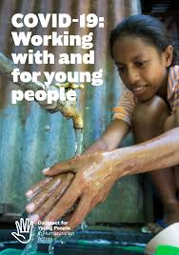
This guidance note is meant to assist humanitarian actors, youth-led organizations, and young people themselves across sectors, working at local, country, regional, and global levels in their response to the novel coronavirus pandemic.
Exploring the impacts of (COVID-19) on young people.
Proposes a series of actions to ensure that COVID-19 preparedness, response plans and actions, are youth-inclusive and youth-focused – with and for young people.
Recommendations are structured around the five key actions of the Compact for Young People in Humanitarian Action:
**This is a Green Document
Notes:
https://www.youthcompact.org/the-compact-response

Slide 3
Part One - Young People are Seriously Affected by COVID-19, are Part of the Global Response
Specific Vulnerabilities
Refugees, asylum seekers, and internally displaced persons, young people living in poverty and high density areas, young people experiencing homelessness, young migrants, young people seperated from parents, young people with disabilitues, LGBTQI, adolesents girls and young women, young people with
Vulnerabilities related to:
Health Impact
Safety and protection issues
Educational Impacts
Economic Impacts
Impact on civic space and participation

Slide 4
Zoom into Economic Impact
Some examples
Young people tend to be economically fragile, live closer to the poverty line than other age groups, have few savings, and work in the informal sector.
Dependence on daily wages is forcing some to remain economically active, both exposing themselves to COVID-19 and risking spreading the virus to others.
A global recession is a likely consequence of the COVID-19 pandemic, and young people’s livelihoods will be disproportionately affected.
Young people, who disproportionately work in the informal sector, are also more likely to be excluded from public policies and stimulus packages addressing the economic impacts of the pandemic.
Before the pandemic began, the World Bank estimated that 1 billion young people would enter the labor market in the next decade, out of whom only 400 million would find a job. The coming recession will only increase the uncertainty around the prospects of the remaining 600 million.

Slide 5
Young People Mobilize
Notes:
In spite of the multiple impacts of COVID-19 on young people’s lives, many adolescents and youth have mobilized immediately to respond to the crisis.

Slide 6
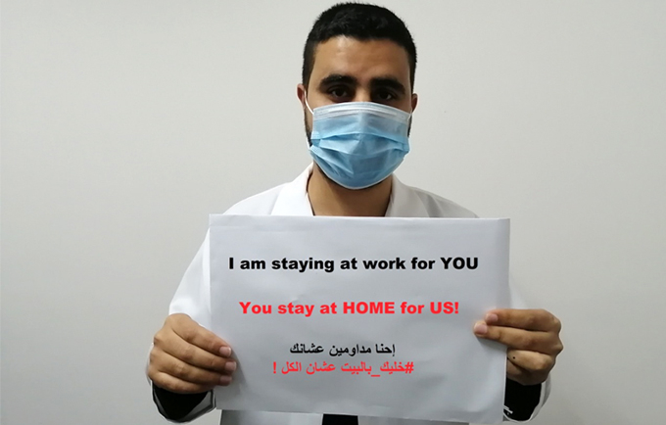
Notes:
Check out the story:
https://jordan.unfpa.org/en/news/jordanian-youth-voices-and-action-covid-19-response

Slide 7
Key Actions
Notes:
In spite of the multiple impacts of COVID-19 on young people’s lives, many adolescents and youth have mobilized immediately to respond to the crisis.

Slide 8
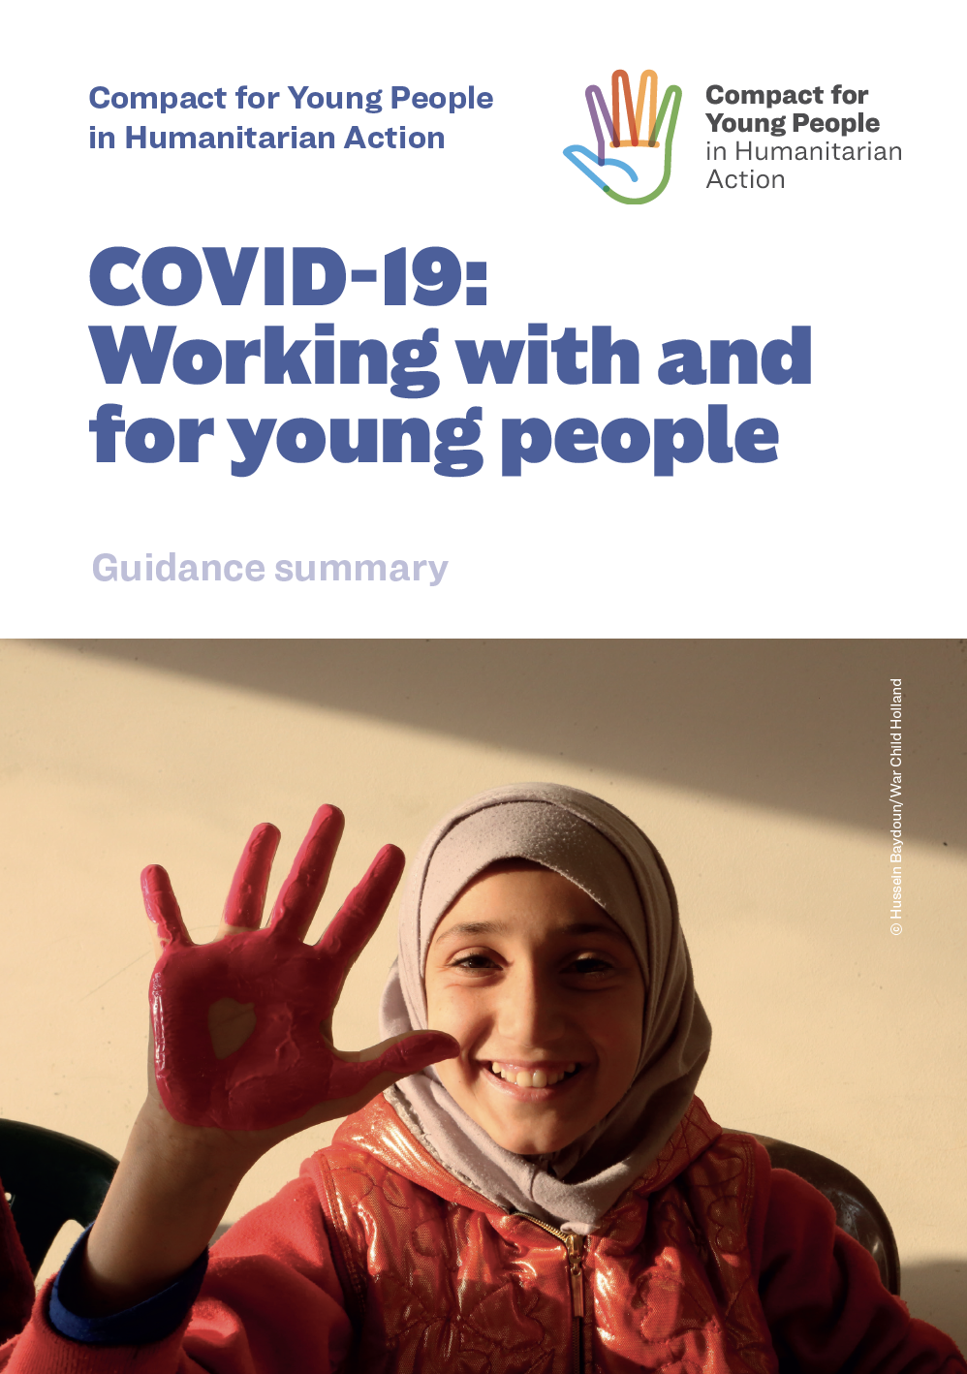
Key Actions
Action 1: Services
Action 2: Participation
Action 3: Capacity
Action 4: Resource
Action 5: Data
Check out the Summary

Slide 9
Action 1: Services
Health
WASH
Education
Protection
Livelihood, Cash and Markets

Slide 10
Zoom into Livelihoods, Cash and Market Recommendations
Ensure that young people whose incomes may be affected by the COVID-19 crisis are supported.
Advocate for loan and rent forgiveness and the establishment of national safety nets that consider young people.
Train young people to cope with the financial impact they are likely to experience as a result of the pandemic, and mentor them.
Consider cash and voucher assistance to support and maintain local market functionality during the crisis (trade services and goods where the cash economy is dysfunctional).
Advocate for increased access to targeted credit, loans, and insurance for young entrepreneurs, especially for young people in the informal economy
Ensure that young people and young entrepreneurs are aware of and counselled on any assistance schemes run by their governments.

Slide 11
Next steps
National Level/ UNFPA office
High Level Event to officially launch the Compact and the COVID-19 guidance / MOY, UNFPA, UNICEF, UNHCR, and NRC - 29 June 2020
Humanitarian Response/ Coordination
Presentation at ISWG and other relevant WG’s - Today with LWG
Zaatari Camp/ YTF level + Azraq Camp/ PWG
YTF Presentation + Presentation and advocacy with relevant WG’s including CMC, Health, Protection, BNLWG, and Education

Slide 12
Questions?
Suggestions?

