Slide 1
BURUNDI INFLUX EMERGENCY
MEETING
JOINT FIELD ASSESMENT
REPORT
JOHN ALINAITWE
SENIOR SETTLEMENT OFFICER OPM KAMPALA

Slide 2
BURUNDIAN INFLUX TREND
PERIOD | NUMBER RECIEVED | STATUS
November 2014 to 10th April 2015 | 476/1352 | All granted Status and Settled
13th April 2015 – 22nd May 2015 | 1268/3215 | All granted Status and being Settled
25th May 2015 | 250/564 | Profiled but not yet granted status
26th May 2015 | 515 | Profiled but not yet granted status
27th May 2015 | 306 | Profiled but not yet granted status
28th May 2015 | 302 | Profiled but not yet granted status
29th May 2015 | 179 | Profiled but not yet granted status
01st June 2015 | 121/288 | Profiled but not yet granted status
2nd June 2015 | 89/197 | Profiled but not yet granted status
3rd June 2015 | 59/133 | Profiled but not yet granted status
Total | 7051 | Total Burundians received since November 2014 to date

Slide 3
BURUNDI CONFLICT SITUATION UPDATE
Over 30 people have died since the Conflict started and several people arrested.
Electoral body has delayed the planned local and Parliamentary elections which were supposed to take place today 5th June 2015 to unknown date.

Slide 4
Conflict situation update cont..
European Union has pulled out the election observers and the Catholic Church in Burundi says they wont be involved.
Streets in Bujumbura relatively calm but some protests are being reported up country towns
Opposition continue to urge people to protest until Nkurunziza abandon participating in elections

Slide 5
Conflict situation Update cont..
17 Political Groups that had broken from UN and African Union led talks have promised to resume talks but Nkurunziza side appear reluctant
Parties insist they cant participate in un constitutional elections.
President Nkurunziza insists that Burundi is a sovereign state and will continue with elections

Slide 6
JOINT ASSESMENT REPORT
The assessment followed a recommendation of the Burundian emergency interagency meeting that took place on the 26th May 2015 at OPM
The Assessment took place on the 28th and 29th May 2015 in both Nakivale and Orucinga Refugee Settlement as well as Mutukura border

Slide 7
ASSESMENT METHODOLOGY
Inception Meeting
Reviewing the Secondary data that was provided
Field observation

Slide 8
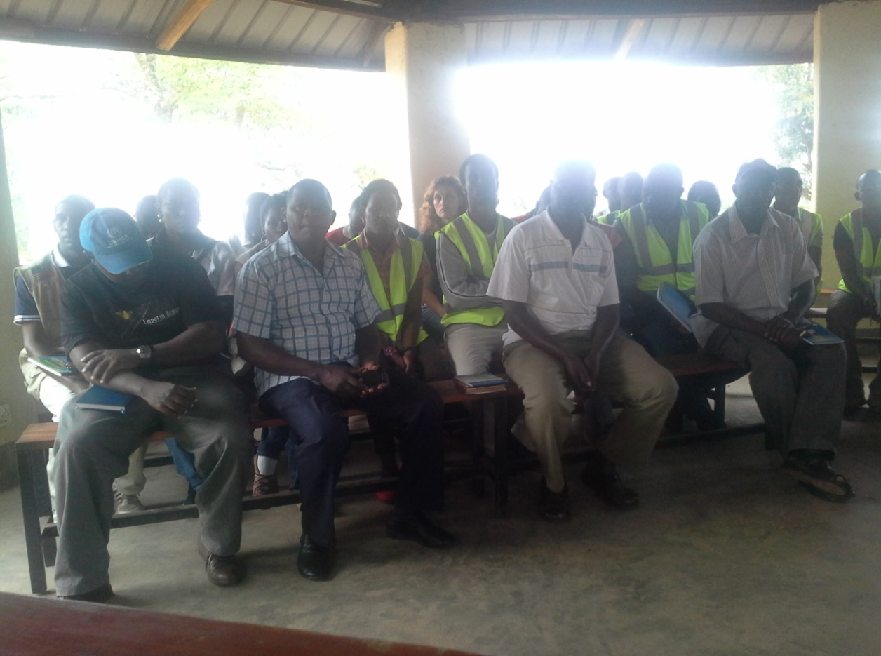
Inception planning meeting at Nakivale settlement

Slide 9
Methodology cont..
Key informant interviews
Focal group discussion
Sampling

Slide 10
INSTITUTIONS THAT PARTICIPATED
OPM
UNHCR
WFP
UNFPA
UNICEF
IOM
ARC (American Refugee Council)

Slide 11
Institutions involved cont..
DRC (Danish Refugee Council
ADRA Uganda
AIRD
ICRC
URCS
Save the Children
HIJRA

Slide 12
Institutions involved cont..
MTI
Samaritan Purse
Windle Trust
Nsamizi Project
Refugee law Project
Uganda Police Force
UBC

Slide 13
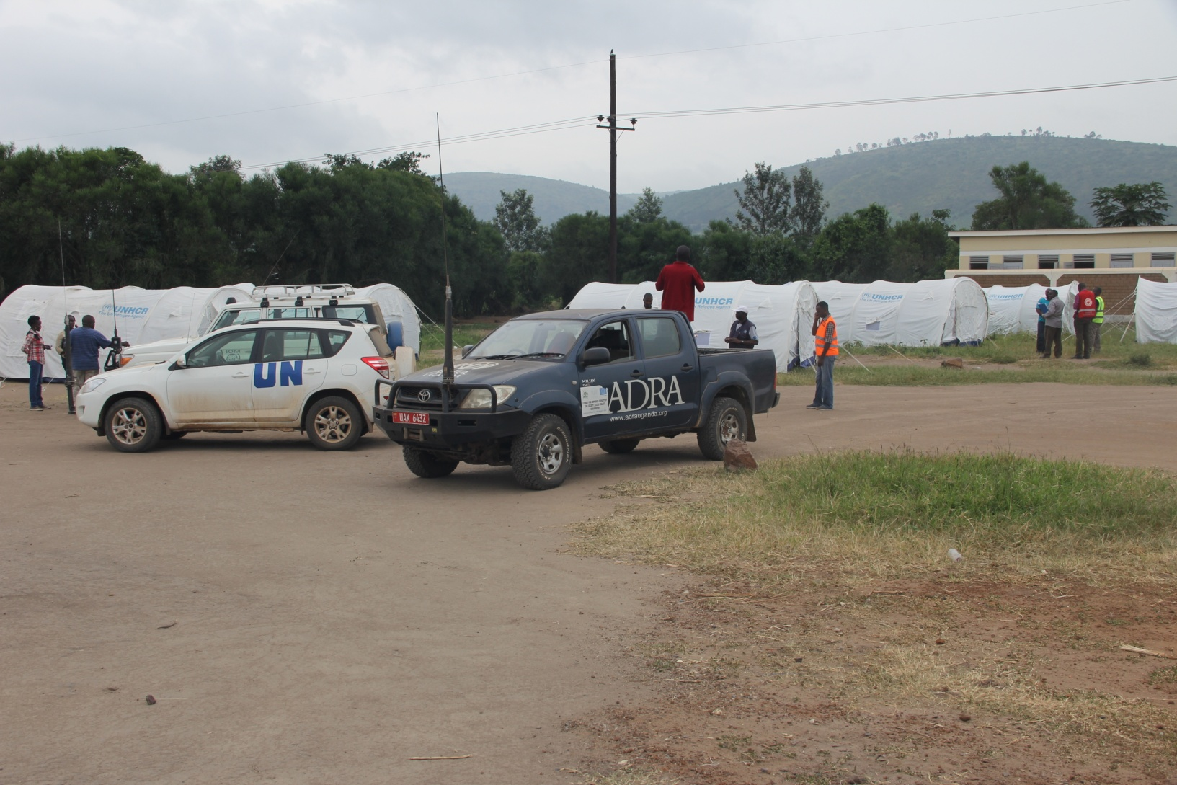
Assessment team assemble logistics

Slide 14
ASSESMENT TEAMS
Registration, reception and security led by OPM.
2. WASH, shelter and infrastructure led by UNICEF
livelihood/Environment, food and NFIs led by WFP
4. Health led by UNFPA

Slide 15
Assessment teams cont..
5. Education led by Windle Trust
6. Protection and Community Services led by UNHCR
7. Settlement management and coordination and Border monitoring led by OPM

Slide 16
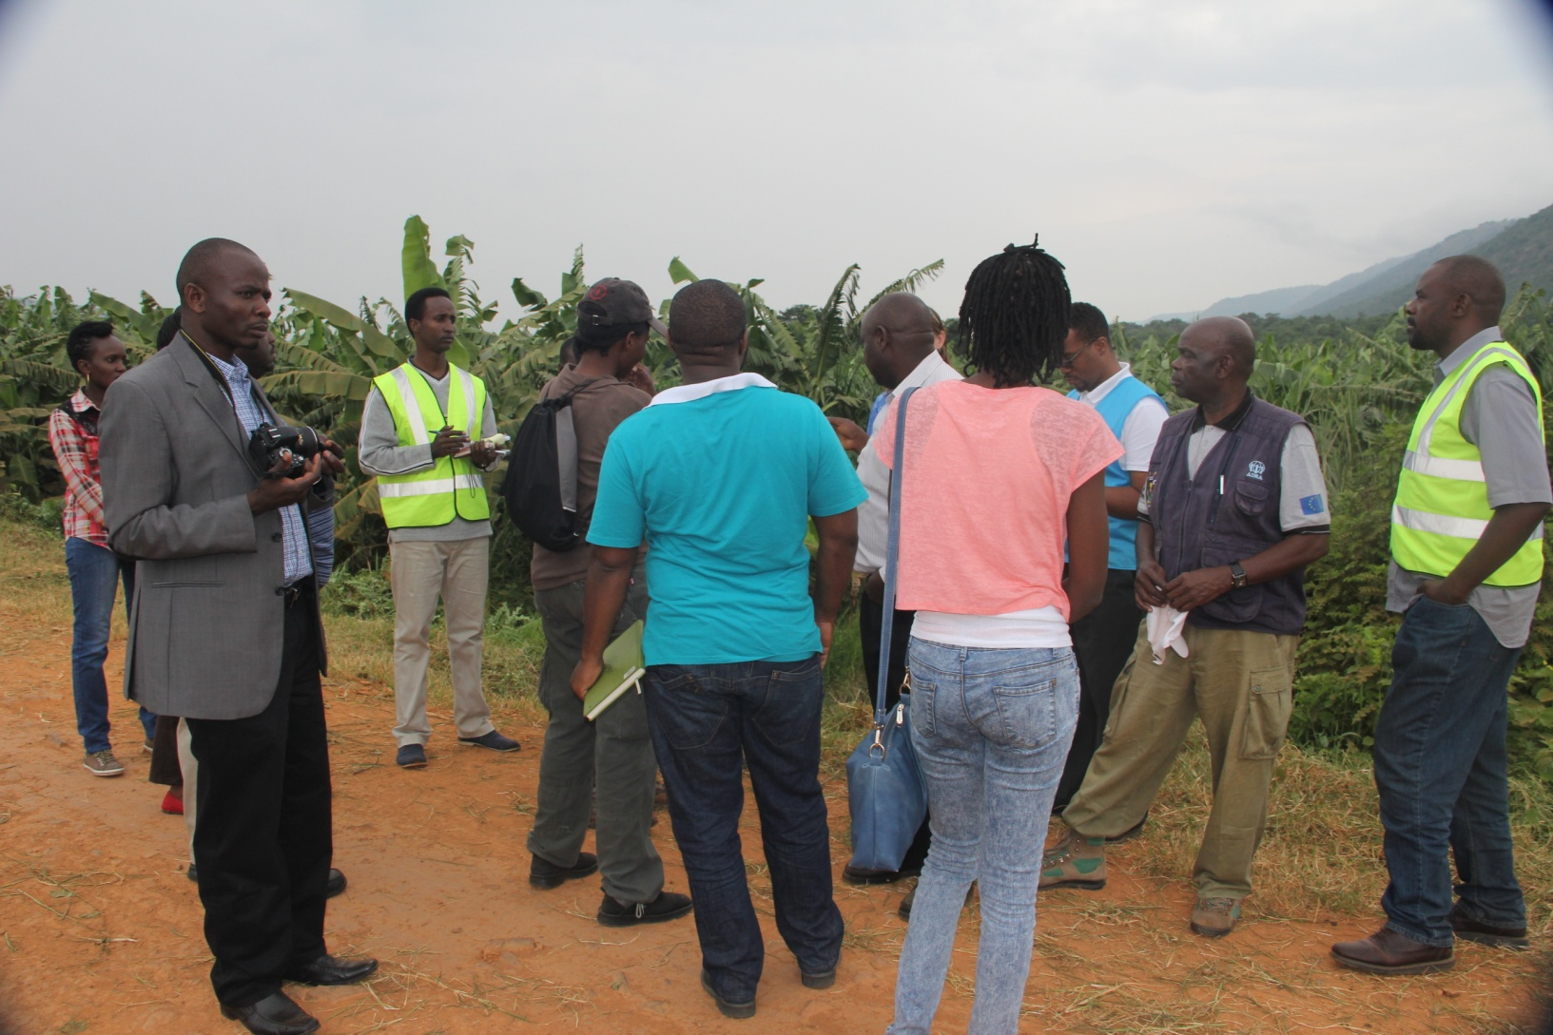
Assesment team in the field

Slide 17
FINDINGS AND RECOMMENDATIONS
1. Registration/reception/security coordination assessment team:
The team assessed the OPM RSD center, Juru and Kabazana reception centers in Nakivale and Kashozwa near the base camp.
The team noted that the current OPM structures are adequate for RSD procedures, a waiting shed, drinking water and latrines need to be made available urgently.

Slide 18
Registration/Reception cont..
The team noted that the current number of six registration staff is low and the number needed to be doubled.
The Registration was also being slowed by the intermittent net work. It would also be important to increase the current band width to increase the speed of the registration system. Creating an off line link was also proposed.
The team recommended the training of border officials to increase their knowledge of refugee matters as most of the border officials lacked knowledge on the Asylum procedures

Slide 19
Registration/Reception cont..
For Kabazana reception center, it was recommended to install solar lights, decongest rooms as they are overcrowded, as well as ensure continuous Police presence.
For Juru reception centre, it was noted that health Partner presence and nutrition screening should increase, water points need to be fenced, and Police presence must be ensured.

Slide 20
Registration/Reception cont..
At Kashozwa Police post, it was noted that the number of police officers needed to be increased.
They were lacking the basic necessities to undertake their duties.
OPM also noted the need for increased staffing to respond to the current emergency.

Slide 21
Key recommendations on Registration and reception
The number of OPM registration staff should be increased to respond to the current influx
The reception centers need to be decongested

Slide 22
Key recommendations on Registration/reception:
The number of Police officers must be increased in the reception centers and settlement areas.
New ways of shelter construction, i.e. using mud bricks, need to be urgently explored

Slide 23
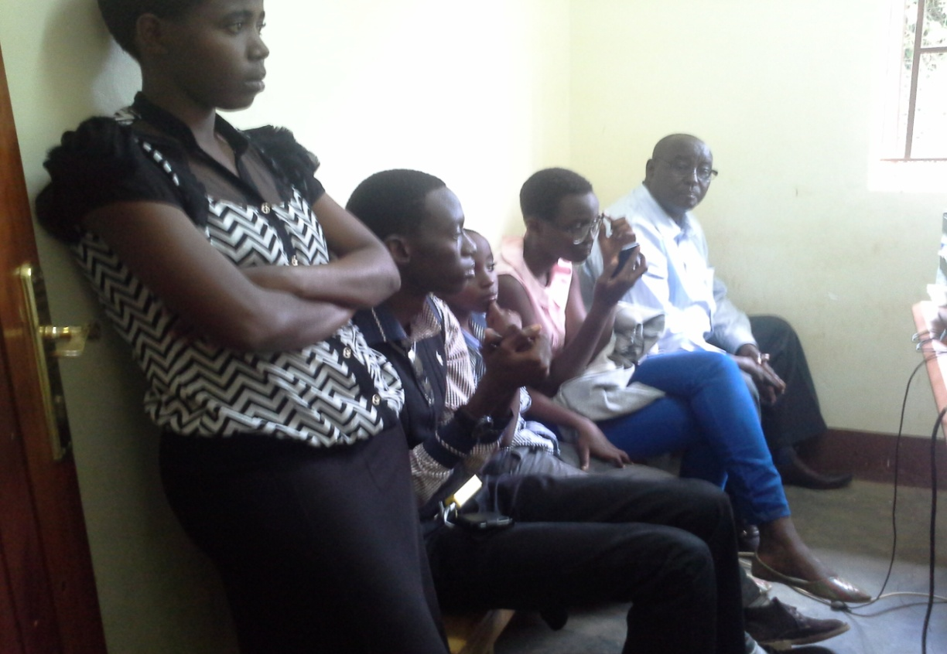
Burundian Family awaiting Registration

Slide 24
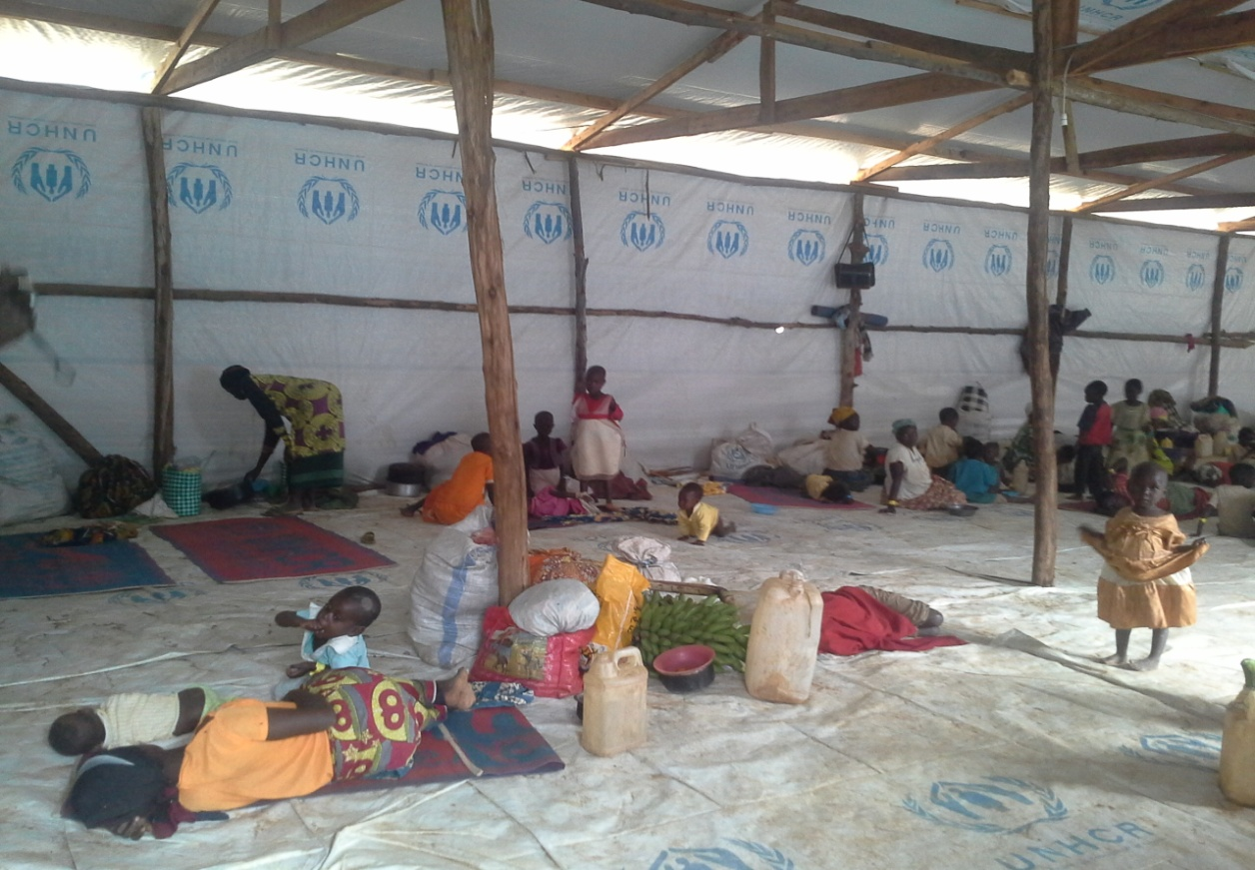
Sleeping conditions for some of the new arrivals

Slide 25
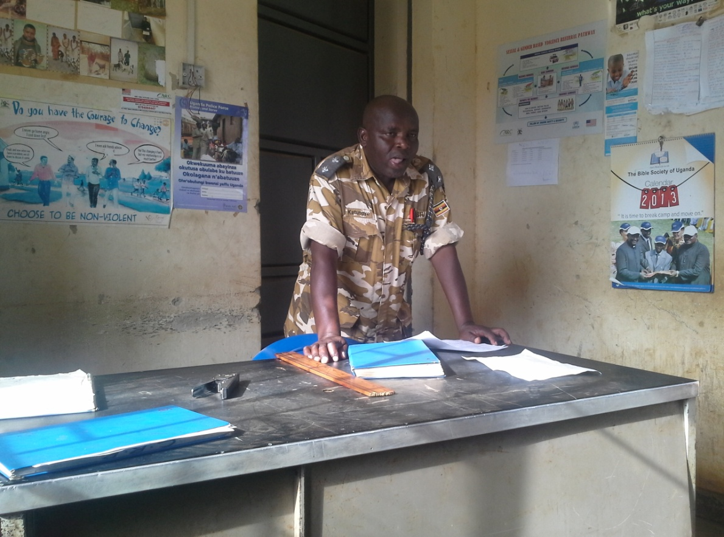
The OC Police addresses the assessment team

Slide 26
2. Presentation by WASH/Infrastructure team:
The most urgent issues in their sector:
They clearly stated that there is a gap in water supply and that the current system is not durable. Current supply is 12 lpd and it reflects a gap as recommended is at least 15 lpd during emergencies.
Furthermore, it was clear that increased preparedness is needed to respond to cases of acute water born diarrhea. A hygiene specialist was urgently needed.

Slide 27
Wash/infrustructure team cont..
UNHCR was also asked to share the assessment that has been undertaken and the proposal for additional funding that the agency has developed.
The team also noted that infrastructure was currently inadequate in the areas where the new arrivals are being settled.

Slide 28
Key recommendations in Wash/Infrustructure:
Water trucking necessary for area where there are currently no WASH services.
Hygiene specialist needed
At least 60 km of roads rehabilitation needed
Site planning needed for all new settlement areas

Slide 29
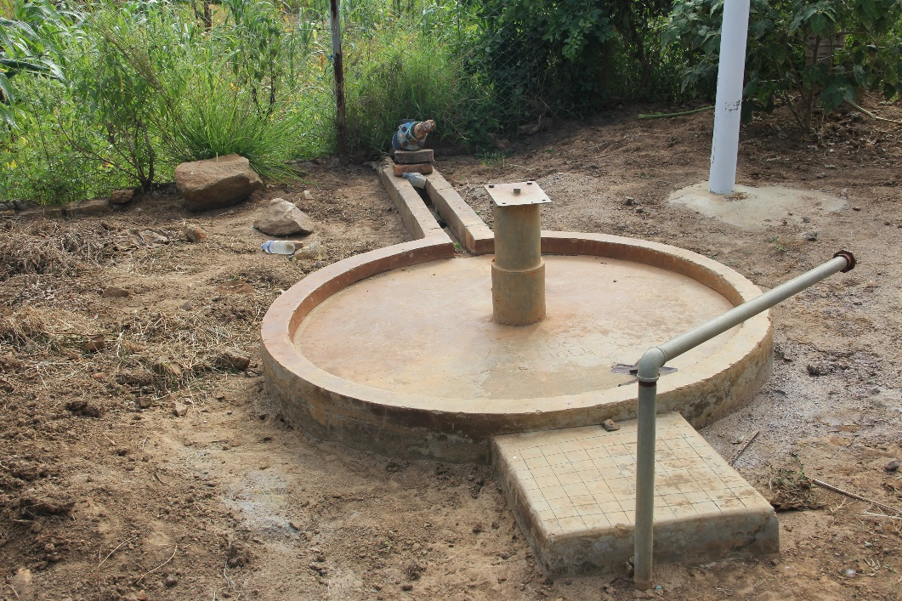
ESVI.NSAMIZI One of the distribution mechanisms that broke down.

Slide 30
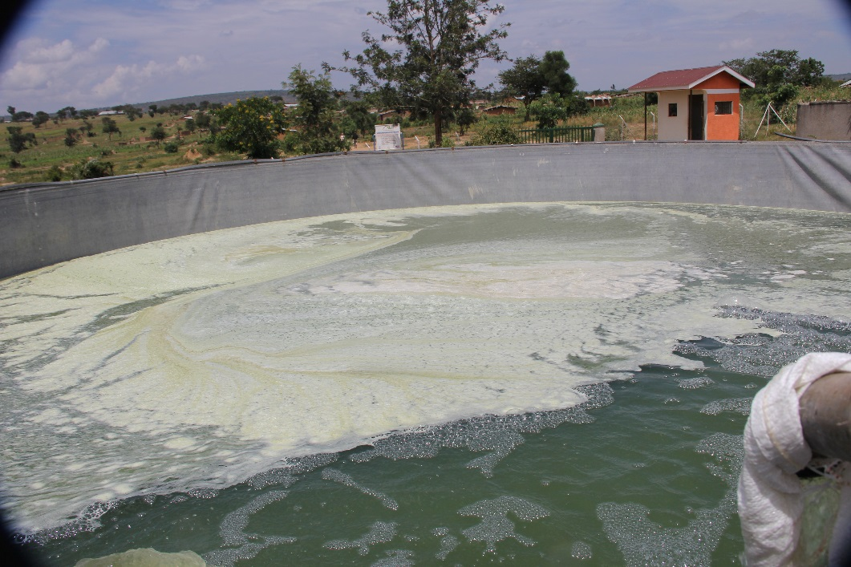
High Turbidity - Treatment tank

Slide 31
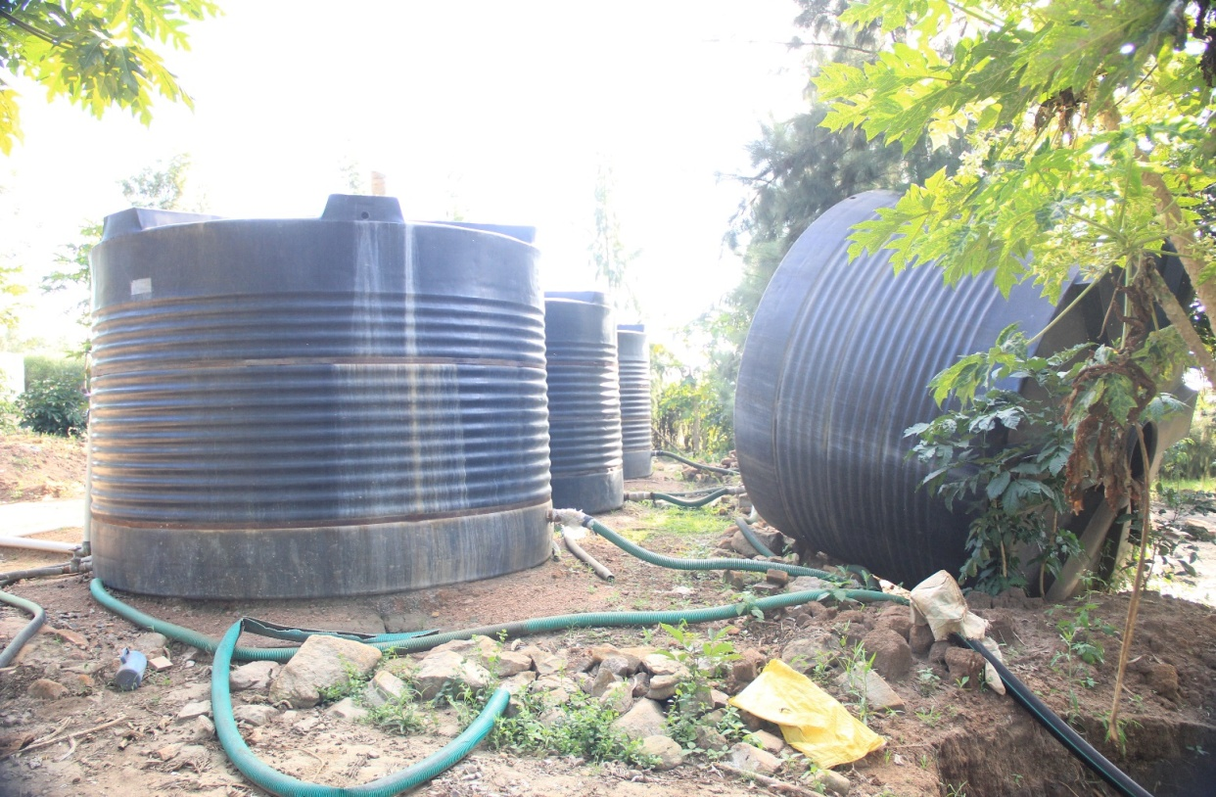
Low durability of large capacity Plastic tanks

Slide 32
Presentation by Health assessment team:
The team had visited the two reception centers and four health centers. They reported of one death of a child in the reception center, the reasons for the death are currently being established.
The team noted that the new outposts that have been put in place have drained staff from other facilities, and that staff is needed in all areas.
In the health facilities, the privacy of patients is not respected, but that the issue is currently being attended to.

Slide 33
Health cont..
They also noted that vaccines are out of stock. Although they have been ordered, more needs to be done to ensure they arrive quickly. Observation showed that therapeutic feeding is immediately needed for malnourished children.
Furthermore, the in-patient capacity is not adequate for a larger influx. So far HIV patients have not been actively identified. The team noted that medical attention to HIV patients and family planning are part of the minimum standards in emergency response.

Slide 34
Health cont..
The team also mentioned that two settlement health centers are not part of MoH credit lines for medication, and this will need to be attended to in order to respond to the influx.

Slide 35
Key recommendations in Health:
More staff needed to maintain services in the existing health centers and new outposts.
Therapeutic feeding needed for malnourished children.
Out of stock vaccines and medicines must be urgently replenished

Slide 36
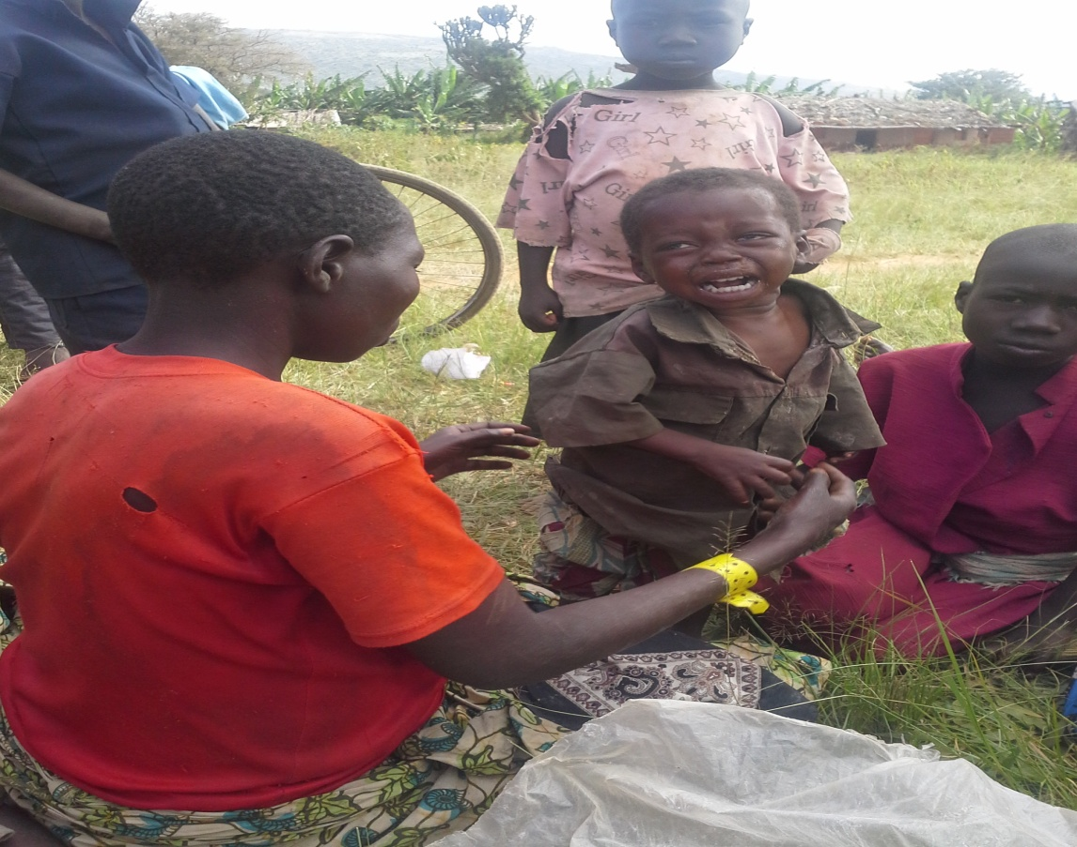
A malnourished child at the Reception centre(Juru)

Slide 37
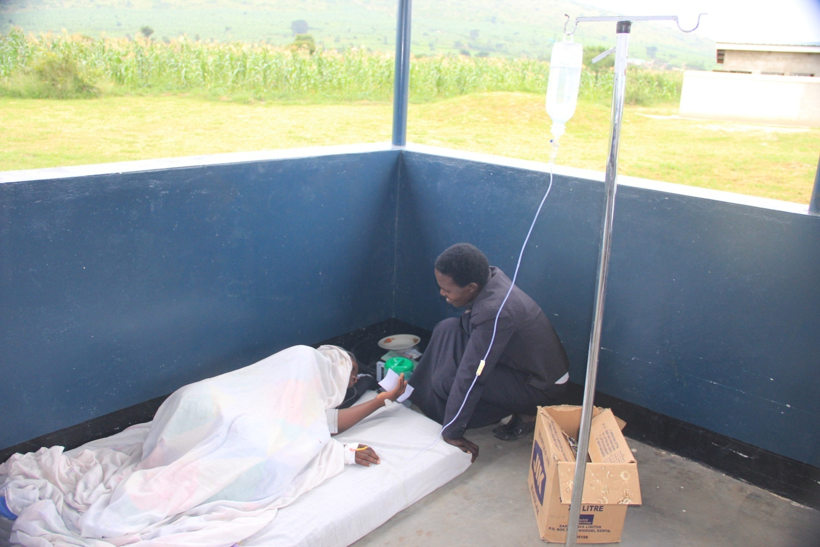
Admitted patient on the floor

Slide 38
iv). Presentation by Education team:
The education assessment team highlighted that language as a challenge for children to access education. The new arrivals have enrolled in the schools, but are not able to follow the lectures because they do not speak any of the languages used.
There is also a challenge related to the low number of teachers and the classroom congestion in the schools where the newcomers enroll, for P1 and P2 at 1:213, on average 1:93, as opposed to the 1:53 standard.

Slide 39
Education cont..
The team found that there was a need to provide orientation about the curriculum.
In order to overcome the identified challenges, it was suggested to try to recruit teachers among the group of new arrivals.

Slide 40
Key recommendations in Education Sector
Classrooms must be decongested
New teachers have to be recruited.
New approaches need to be designed to overcome language barriers

Slide 41
Presentation by Food/livelihoods/roads/infrastructure team:
The group noted that there were still challenges in how food is prepared and served at the reception centers and that screening for malnutrition is urgently needed.
Large gaps in infrastructure were noted, and it was recommended that crowd control mechanisms be put in place, especially in relation to food distribution.

Slide 42
Food/Livelihood cont..
It was furthermore noted that for those refugees settled in Nakivale, allocation of agricultural plots and implements are urgently needed.
Measures to save the environment and increased tree planting was recommended because a few available trees were being cut for firewood/construction.

Slide 43
Food/Livelihood cont..
They also noted that road infrastructure needs rapid improvement.
In the identified area for settlement in Oruchinga, the team noted that the land was currently used for agriculture, and that there were serious signs of soil exhaustion and limited land

Slide 44
Key recommendations in Food/Livelihood and Shelter:
Additional cooking utensils must be provided to the reception centers.
Review the number of poles given to each family for shelter construction as it is not adequate

Slide 45
Recommendations in Food/Livelihood cont..
Land for agriculture must be provided to newly settled families.
Energy saving stoves should be distributed

Slide 46
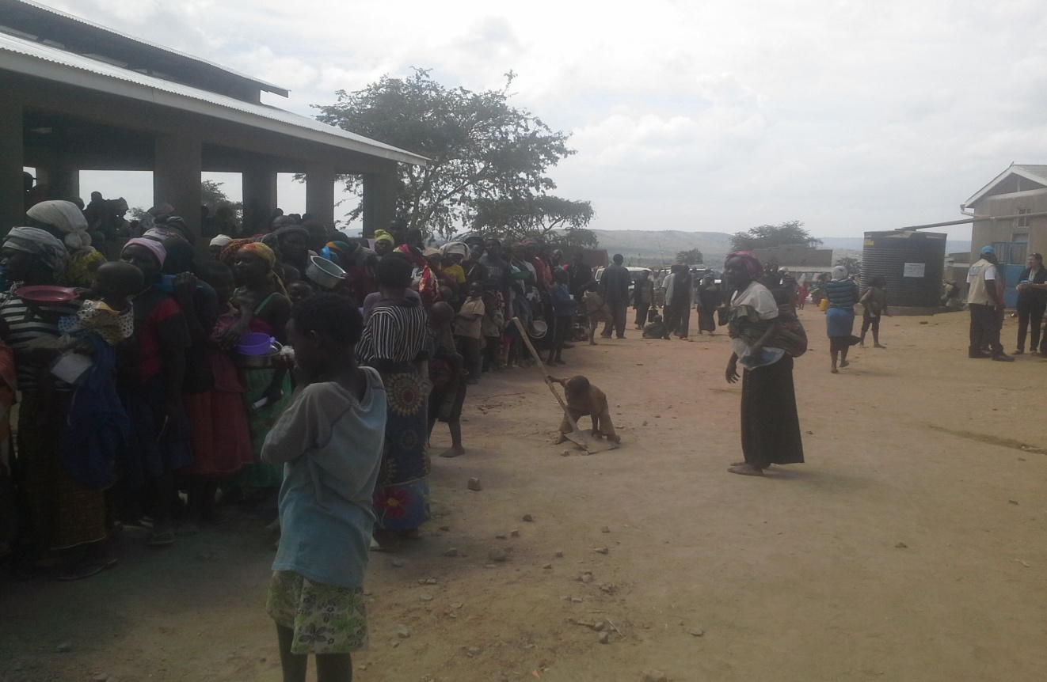
Burundian Refugees line up for food at Kabazana reception centre

Slide 47
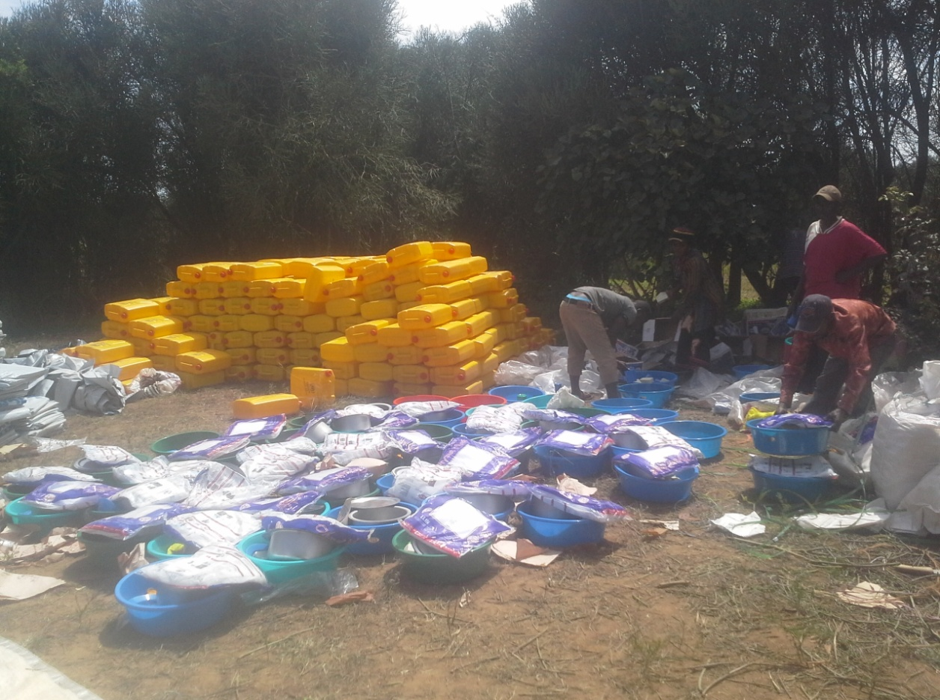
Some of the NFIs being given to families after plot allocation

Slide 48
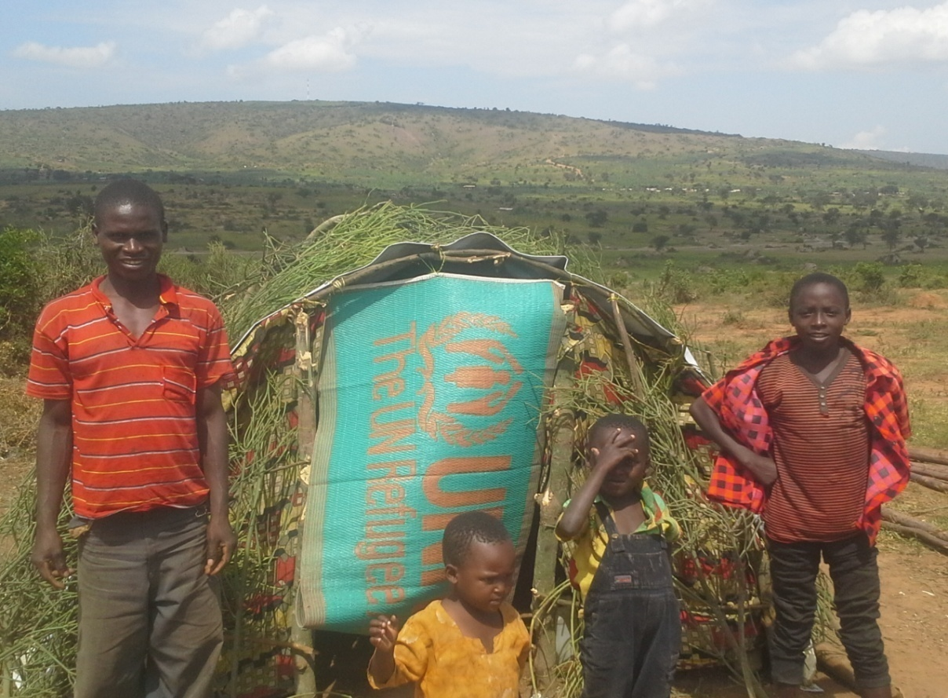
A Burundian family pose for a photo after construction of the tukul in the newly allocated plot

Slide 49
vi). Presentation Protection team:
The protection team had the same observations about food and WASH as the other teams.
Furthermore, the team clarified that more should be done to identify and give priority to persons with specific needs in the RSD procedures.
It was also noted that there needs to be more systematic information sharing, and it was suggested that every morning an information session should be held at reception centers and at the RSD center.

Slide 50
Protection cont..
It was further noted that child friendly spaces need to be established in the reception centers.
The team also highlighted that some returning refugee families from DRC have been sent to different settlements, and that tracing and verification needs to happen immediately so that families can be reunited.

Slide 51
Protection cont..
It was noted that more human resources are needed to screen new arrivals for specific needs and provide the necessary immediate follow up to the identified cases.
In order to ensure safety for the refugees when they are settled, handheld solar lanterns should be urgently distributed..

Slide 52
Protection Cont..
NFI distribution should also happen early in the morning to allow refugees to construct a shelter before nightfall.
Attention also has to be given to engaging the populations surrounding the new areas of settlement, so that there will not be any conflict regarding land or access to resources

Slide 53
Key recommendations in Protection:
Family tracing and family reunification for separated children and families need to happen urgently
More staff needs to be allocated to respond to emergency and regular protection programming
Settled families need to be provided with one hand held solar lantern per family

Slide 54
vii). Presentation border point team:
The team noted that Burundians have entered Uganda for three years. During this period they have been treated as irregular migrants as they were not providing good reasons why they needed asylum.
In the current situation, border authorities have been informed that they should not turn back the Burundians. The team had been able to note that the lack of documents and fear make the arriving Burundians use their networks to move into the local communities where they survive by offering their labour for food.

Slide 55
Border team cont..
The team emphasized the need for training and sensitization of local authorities. It was also thought that there is a need to establish holding points for those who are crossing the border as they are exhausted from their journey when they arrive.
In the discussion it was agreed that sensitization should be an immediate priority. HIJRA expressed that they are ready to support on the border where needed.

Slide 56
Key recommendations on border visit:
Holding points for new arrivals needed on the border .
Border officials need to be trained to ensure that asylum-seekers are given proper attention.
Local authorities need to be sensitized so that they can identify the Burundians in need of international protection that are currently in their communities

Slide 57
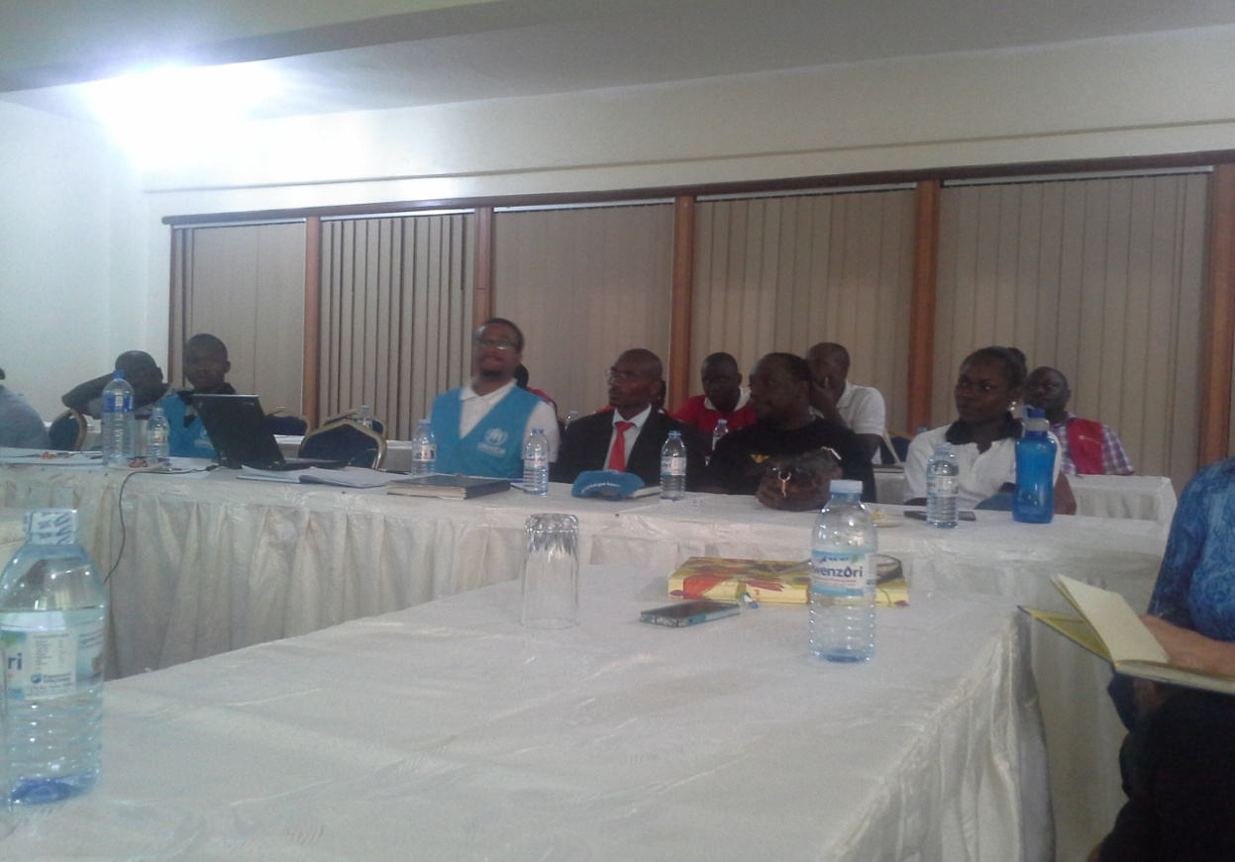
Wrap Up meeting at Lake View Hotel

Slide 58
KEY ISSUES TO NOTE
The Team on the Ground was doing a commendable job but a little bit of improved coordination and information sharing would help greatly
There is still land in Nakivale to settle the new arrivals but the land in Oruchinga needs further mapping. As such we can continue settlling Burundians in Nakivale and only go to Oruchinga when Nakivale is Exhausted

Slide 59
Issues to note cont..
The Response in Nakivale and Oruchinga settlements should not ignore other Natio nalities like Congolese over (779 as of 22nd may)and Somalis whose population is also increasing.
The Host community figures must be factored in the over all planning

Slide 60
Issues to note cont..
Some of the gaps/conditions could have improved by now because the mission was also meant to awaken our field colleagues and actually some of the recommendations/action were made there and then
Security should not be taken for granted. A total of 35 ill faccilitated Police men cannot support the Nakivale operation with a population of about 100.000.

Slide 61
Issues to note cont..
The Assessment was not an in-depth one. There is need for an in-depth study and analysis of the gaps and the implications on the population and surrounding areas(water quality, Malnutrition levels etc)
The Operation urgently requires emergency funds as well as support from other agencies as the numbers keep increasing.

Slide 62
CONCLUSION
On behalf of the Commissioner I wish to thank the team for the support and commitment during the two days mission.
JOHN ALINAITWE
JOINT ASSESMENT TEAM LEADER
OPM KAMPALA
5TH JUNE 2015

