Slide 1

Rapid Assessment: Child Labour
Agricultural Sector In Jordan
Mafraq & Jordan Valley (Ghor)
Jordanians And Syrians

Slide 2
Jordan Indicators
More than 70% of Jordanians are under 30 years of age.
70% of its GDP is attributed to services which also account for more than 75 percent of jobs.
Unemployment rate 14 percent in the third quarter of 2013 from 12.60 percent in the second quarter of 2013.
Ratified UN convention on the rights of the child, CRC in 1991
Ratified 24 of the ILO’s conventions, including seven that represent the basic standards for human rights.
ILO convention no. 138 on the minimum age for admission to employment, in 1997.
Convention no. 182 on the worst forms of child labour, in the year 2000.

Slide 3
Objective of the Assessment
Determine the nature, magnitude, pattern, distribution, dynamics and causes of child labour in agriculture for both Jordanian and Syrian refugees in relation to the study areas;
Establish the socio-economic characteristics of the working children and their families;
Investigate the effects of child labour on the health, safety, education and rights of the working children;

Slide 4
Methodology
Scope of work / Area
The Assessment covered Jordan Valley and Mafraq that include agriculture as one of the main sources of income for the people.
Quantitative
Qualitative
Household RA: All the sample included households with working children.
RA of 215 households in the identified geographical areas, divided between Jordanian and Syrian households.
Desk Review: identification & analysis of available studies, including legal economic and statistical studies, as well as social research, surveys and reports.

Slide 5
Key findings
Working children chances for going to school are less than that for other children, and if they attend school, it’s mostly basic education.
Working children are more likely to have less educated parents
Strong relationship between working children and being poor.
If you are a working child, you are more likely to feel exhausted, tired and be exposed to more health risks and injuries.
Notes:
more than a third of parents are illiterate; with Syrian percentage double that of Jordanians. Parents with “basic education and less” constitute the majority of parents with 77.3% (Jordanians 66% versus 88% for Syrians).
Most of the Jordanian working children 72% (122 out of 170) reported that they have basic education, and only 22% (38 out of 170) reached grades 11 and 12, compared to 64% of Syrian working children (126 out of 198) who have basic education and only 9% (17 out of 198) who have high school.

Slide 6
Key findings
Children
Parents
The percent of working children under 12 is high at almost one fifth at 17.9%
82% of the working children were between the ages 12-17 years old
Girls and boys had almost equal percentages for age for starting work 7-12 years, with 18% for girls (20 girls from a total number of girls 110) and 18% for boys (46 from 258).
Only a third of total working children go to school.
Percentages for Syrian children working were more than double of Jordanians.
Notes:
The percent of working children under 12 is high at almost one fifth at 17.9%; with Syrians almost double the percentage of Jordanians at 11.1% compared to 6.8% Syrians. Mafraq was higher at 10.3% vs. 7.6% in Ghor.
When investigating the reason for having less working girls, respondents in both Mafraq and Ghor stated that parents would send the boys out to work first and then if needed they would send out their daughter to work. Respondents from FGDs participants as well as parents of working children

Slide 7
Key findings
Children
Parents
More than a third of parents were illiterate; with Syrian percentage double that of Jordanians.
Almost 69% of the parents were working, 26.4% unemployed, 3.5% retired or cannot work and 1% had seasonal work.
Close to half of the families reported that they have one working child, and about 40% of them has two working children, while only 1% and 2% reported that they has 3 and 4 working children respectively.

Slide 8
Key findings
Families
Education
Income
Child Labour
Safety
Health Services
Over half of the households surveyed (52.6%) had 6 members in the household which is above the average size of the family estimated at 5.4
23.3% of the families had 7 members in the household, only one Jordanian family had 12 members and one Syrian family had 13 members
89.8% of households had 8 members or less.

Slide 9
Key findings
Families
Education
Income
Child Labour
Safety
Health Services
RA shows that 89% of Syrians or 45.3% of all surveyed families, live in tents compared to15 Jordanian families, or 7 percent.
Jordanian families living status
Syrian families’ living status
Tent, 89%
Farm House, 3%
House, 8%

Slide 10
Key findings
Families
Education
Income
Child Labour
Safety
Health Services
Comparing the level of education of the parents with their working children, results show that the percentage of the illiterate parents is higher than the illiterate children (32.1 % compared to 10.1% respectively).
Level of Education for Parents vs. Children for Level of Education

Slide 11
Key findings
Families
Education
Income
Child Labour
Safety
Health Services
1/3 or 30.4%, of working children go to school - 112 children, vs 256 children or 69.6% who do not attend school.
Age of WC who attend school ranges from 8 -17 years; Almost a quarter or 22 % were between the ages of 14 & 17
Only 2.4 % of Syrians, Working children attend school
Most of WC who go to school are Jordanians at 28 %
Percent of Children's School Attendance by Age
School Attendance by Nationality and Gender

Slide 12
Key findings
Families
Education
Income
Child Labour
Safety
Health Services
More Syrians at 19% than Jordanians at 1% reported they were not accepted in near by schools.
Almost all reasons for not attending school were related to economic reasons.
Working children in Ghor attended school more than working children in Mafraq at 62.5% and 37.5% respectively.
Reasons for not attending school
Reasons for not attending School -Nationality & Area

Slide 13
Key findings
Families
Education
Income
Child Labour
Safety
Health Services
The minimum monthly income earned by families surveyed was JD 30 for Syrian families and JD 90 for Jordanian families for families living in Mafraq.
The maximum earned by Syrian families was JD 600 and JD 900 by Jordanian families for families living in the Jordan Valley.
Families Cash Income Compared with Absolute &Abject Poverty Line
All households live above the abject poverty line, except one household who lives on the boundaries of the abject poverty line.
Moreover, 142 households out of 206 households who reported their income, live under the absolute poverty line

Slide 14
Key findings
Families
Education
Income
Child Labour
Safety
Health Services
According to the working children’s responses, individual cash income, including working children income, ranged from JD 5 to JD 200.
The family cash income, as reported by parents, ranged from JD 30 to JD 900 monthly.
Income for Household including Working Children by Gender

Slide 15
Key findings
Families
Education
Income
Child Labour
Safety
Health Services
91% of the children reported their family needed income; followed by 8.3% who could not afford school.
4% mentioned that they reached age for work.
Almost 70 percent of parents reported they were currently working, while 26.4% were unemployed.
1.9% of Jordanian parents reported they were unable to work or were retired.
Children Responses for Reasons for Work

Slide 16
Key findings
Families
Education
Income
Child Labour
Safety
Health Services
There were two Syrian boys and one girl who stated they worked herding livestock.
Mafraq had a higher percentage and number of working children in agriculture than the Jordan Valley, with 52% compared to 42%.
There were more Syrian children working in agriculture than Jordanians.
Type of Work the Working Children
Area | Jordanians |  | Total
 | C | % | C | %
Agriculture | 152 | 43% | 330 | 94%
Herdsman | 0 | 0% | 3 | 0.9%
General/Mechanic Assistant | 7 | 2.3% | 18 | 5.1%
Total | 159 | 45% | 351 | 100%

Slide 17
Focus Groups discussions (FGDs)
FGDs with Syrian Families
FGDs with labour inspectors and trade representatives in the Jordan Valley
Families are hesitant (unless they do not have in the family boys that are old enough to work) to send their younger girls to work outside the house at a very young age, and wait until they are a bit older to work outside the house.
Syrians working in the agriculture sector in Mafraq constitutes a sizeable portion of agricultural labourers, a trend which dates back to even before the current conflict in Syria.
Some Syrian families had mixed marriages with the local community and have settled in Mafraq, yet some of them actually registered as refugees with UNHCR to receive benefits and because they cannot go back to Syria as they usually do at the end of the working season.
Agricultural sector was the main sector for female child labour, there were risks involved especially with foreign labour present.
child labour starts between the ages of 8 and 14,
There was no difference in terms of the difficulty of working hours in the harvest season between boys and girls.
Some children work in hard conditions and are exposed to high temperatures in summer and cold weather in winter. There were also risks associated with their work such as being forced to use modes of transport that were not suitable for passengers such as the back of pickup trucks.
Children worked hard and are exposed to diseases especially working with farms that have animals.

Slide 18
Key findings
Families
Education
Income
Child Labour
Safety
Health Services
Who Receives Child's Pay
Over a third of Syrian working children 32.3% said their fathers received their wage, compared to only 16.6% for Jordanian working children.
Both nationalities had close percentages for pay received by the mother.
More Jordanian children received the pay directly 21.5% compared to only 11.3% of Syrian children.

Slide 19
Key findings
Families
Education
Income
Child Labour
Safety
Health Services
Percent of Children Working Particular Hours per Week, by Nationality
Percent of Children Working Particular Hours per Week, by Gender

Slide 20
Key findings
Families
Education
Income
Child Labour
Safety
Health Services
Reasons that May Stop Children from Working
Almost half of the families indicated that Enough Income for family including children’s education was the main reason for children working.
For refugees going back to Syria was a significant reason.

Slide 21
Key findings
Families
Education
Income
Child Labour
Safety
Health Services
Close to half 46 % of children stated that health risks were ordinary, 31 % stated that they were high.
Syrian children thought that health risks were higher than the Jordanian children.
These perceptions were higher in Ghor than Mafraq (18.3% compared to 12.8% respectively).
Health Risks as Stated by Working Children
Health Risks by Nationality and Gender , as Stated by Children

Slide 22
Key findings
Families
Education
Income
Child Labour
Safety
Health Services
Percent of Children Working Hours per Week, by Level of Exhaustion
Close to a quarter 24.2% of the children who reported they were highly exhausted, work between 20 to 30 hours a week.
Extent Work Exhausts the Child

Slide 23
Key findings
Families
Education
Income
Child Labour
Safety
Health Services
Injuries reported by the children include eye, ear injuries, skin infection, breathing problems, tiredness & other injuries.
Almost half 49.4% of the dangers mentioned by children were a combination of the dangers including dust & pesticides.
Dangers fall under the pesticides category at 23%.
Only three Jordanian girls reported they were exposed to the dangers related to working at night.
Percent of children Injured During their Work

Slide 24
Key findings
Families
Education
Income
Child Labour
Safety
Health Services
When parents were asked whether they receive health services or not, about two third reported that they receive 67.1%.
Of these respondents only 21.7% are Syrians, and it’s almost an equal percentage between Mafraq and Ghor 32.4% and 34.8% respectively.
Services were received from different agencies such as government centres & hospitals, private centres & hospitals, NGOs, & international organizations (UNHCR & others).
Benefits from Health Services
 | Jordanian | Syrian | Total Count | Total Percent
Yes | 45.4% | 21.7% | 139 | 67.1%
No | 4.8% | 28% | 68 | 32.9%
Total | 50.2% | 49.7% | 207 | 100%

Slide 25
Child Labor In The Urban Informal Sector In Three Governorates Of Jordan
(Amman, Mafraq And Irbid)

Slide 26
Main objective of the study
To provide up to date and detailed information on the dynamics and characteristics of child laborers who work in the informal sector in urban environments in Jordan
Target group: Children aged between 5 and 17 years old, of all nationalities
The nationalities that were the main focus in this report are Syrian and Jordanian

Slide 27
Methodology
The study followed the rapid assessment methodology on child labor established by the ILO and UNICEF
Surveys for the three specified target groups implemented in Amman, Mafraq, Irbid included:
45 child workers, not linked to the employers
45 Employers of child laborers, indirectly including data on 55 child workers
200 families, focusing on 506 children between the ages of 5 and 17 (not all of them workers) in the three areas of research
Key informant interviews with a group of stakeholders from Jordanian government ministries, international organizations and non-governmental organizations.
Held three focus groups with representatives from civil society, the local community, opinion leaders and representatives of institutions and organizations operating in the three provinces

Slide 28
Results of the study
National challenges
Causes of child labor
The effects of child labor
Characteristics of child labor
Recommendations

Slide 29
1.National Challenges
1.2 Targeting Child Labour Amongst Syrians
In Jordan
National challenges
Causes of child labor
The effects of child labor
Characteristics of child labor
As of January 2014, UNHCR estimates that there are a total of 576,354 Syrians as ‘people of concern’ in Jordan, the majority of whom are living in urban areas. Of these, the majority (60.1%) are under 18 years old
A 2013 UNICEF report states that one out of ten Syrian refugee children are working in their host countries

Slide 30
2. Characteristics Of Child Labor
National challenges
Causes of child labor
The effects of child labor
Characteristics of child labor
Children ages: No children below the age of 5 were identified as working. Half the child labourer respondents interviewed in Irbid and Mafraq were between the ages of 5 and 11.
Gender: In Jordan child labour is considered to be primarily a phenomenon among male children.
Geographic locations: Child labourers in urban environments are mainly found working on the street, in shops and in restaurants.
Employer : A majority of employers reported that they had only been employing children for the last 1-2 years, (83%) reported that the child working for them was not related to them. No employers reported employing children on a seasonal basis.

Slide 31
2. Characteristics:
2.1 Employment Sectors And
Occupations
National challenges
Causes of child labor
The effects of child labor
Characteristics of child labor
In their efforts to find paid work in urban environments, Syrian children are travelling farther from home than Jordanians

Slide 32
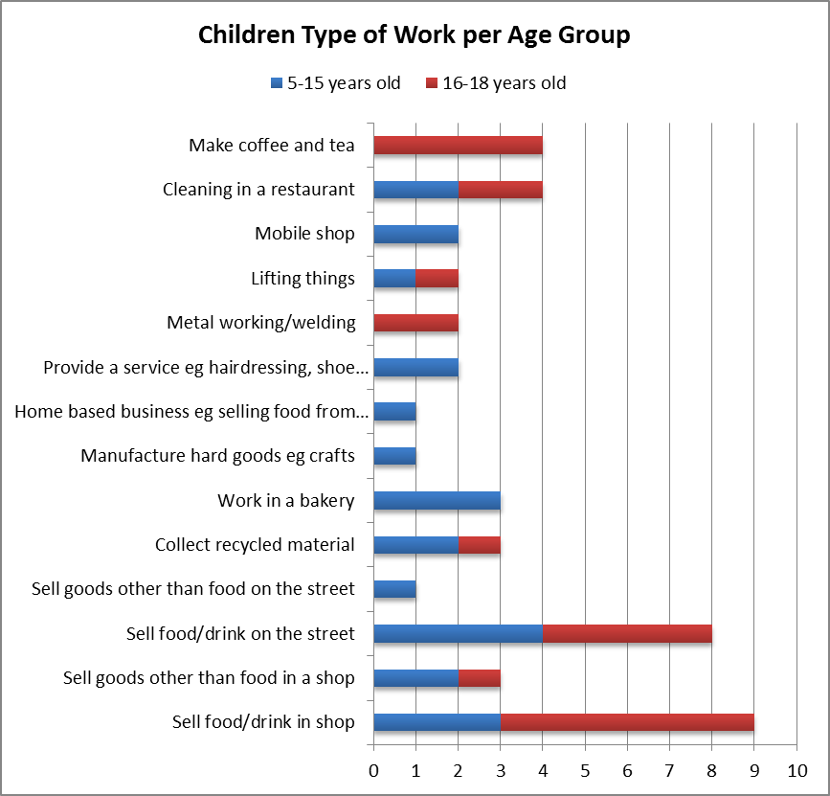
2 Characteristics:
2.1 Employment Sectors
And Occupations
National challenges
Causes of child labor
The effects of child labor
Characteristics of child labor

Slide 33
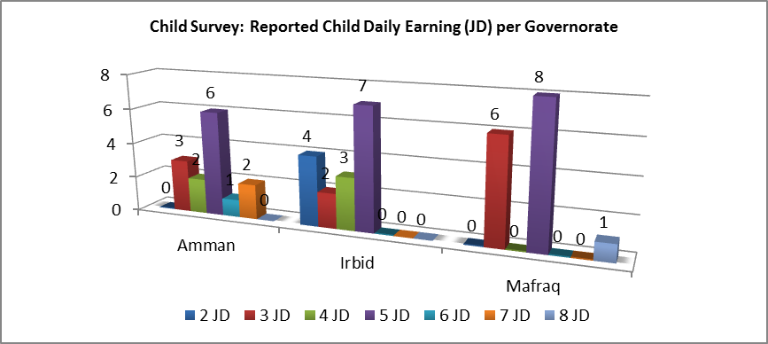
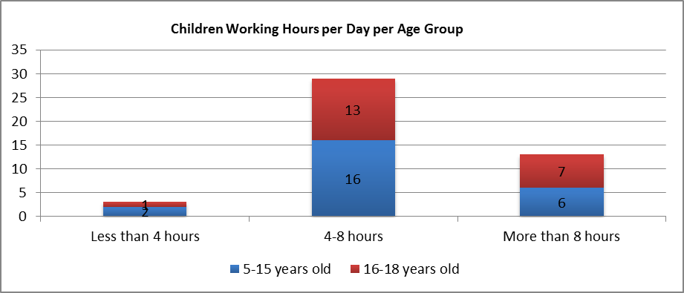
2 Characteristics
2.3 Working hours and Remuneration
National challenges
Causes of child labor
The effects of child labor
Characteristics of child labor
The majority of child laborers working in urban environments worked 6-7 days a week and between 4-8 hours a day

Slide 34
2. Characteristics
2.4 Children’s Health
National challenges
Causes of child labor
The effects of child labor
Characteristics of child labor
Although the health status of children in urban environments appeared generally good, there are worrying indications of physical pains and other conditions caused by work.

Slide 35
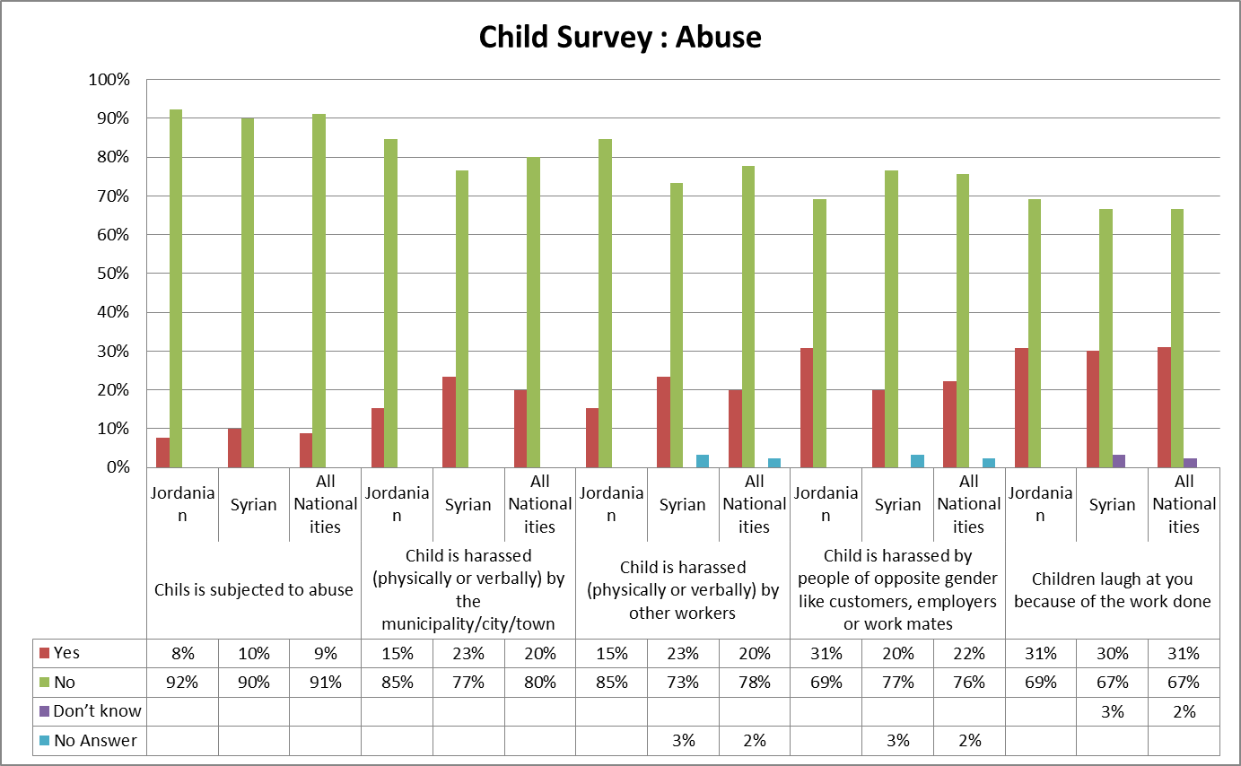
2 Characteristics:
2.6 Safety In The Workplace
National challenges
Causes of child labor
The effects of child labor
Characteristics of child labor
A small number of serious injuries were reported by children labourers, and researchers heard reports of serious risks faced by children in certain locations such as ‘hissbeh markazieh’.

Slide 36
3. Causes Of Child Labour
3.1 Economic need
National challenges
Causes of child labor
The effects of child labor
Characteristics of child labor
Wages of working children constitute a large part of the household income, where 45% of children under eighteen were identified as the main breadwinner, or joint-breadwinner(s)
There are indications that not all children who work in the informal sector are paid fully for their work.
Notes:
When asked to identify the main, or of the family, respondents to the household survey gave ‘father’ (56%), ‘child under 18’ (45%) and mother (10%) as their main answers. That 45% of respondents identified a child under 18 as the main or joint-main breadwinner of the family indicates that child labourer’s wages should be considered as a significant component of family incomes, therefore making a considerable impact in terms of maintaining quality of life for the family, even if this quality of life is comparatively low.
This was a ‘multiple response’ question where respondents were allowed to check more than one answer, such as in the case of a household having ‘joint-main’ breadwinners. Hence the combined percentages for this particular response totalling more than 100%.

Slide 37
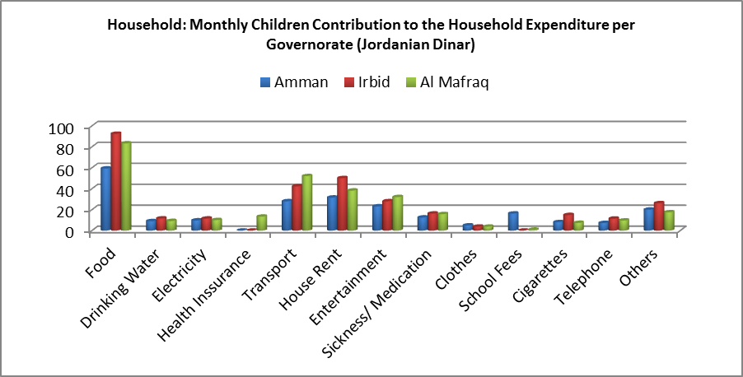
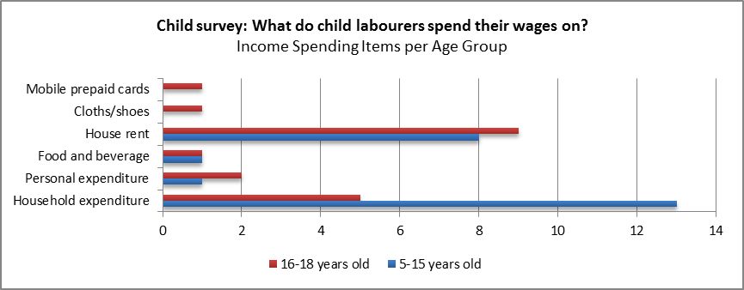
3. Causes Of Child Labour
3.1 Economic Need
National challenges
Causes of child labor
The effects of child labor
Characteristics of child labor
The living conditions of families where children laboured are very poor and were a source of psychological stress for many respondents.
Comments made to researchers during interviews often focused on the lack of basic items for the home, the state of disrepair of the housing, high rents costs for low quality houses and the lack of income to buy, a heater for the home or to pay for electricity costs.

Slide 38
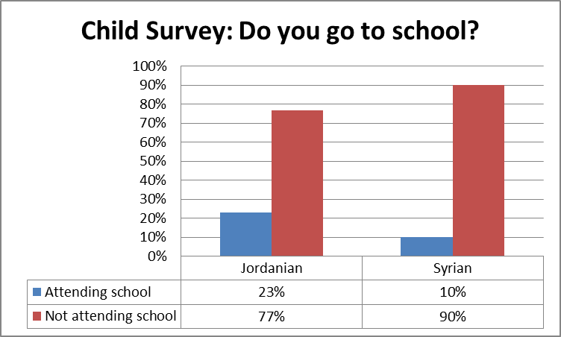
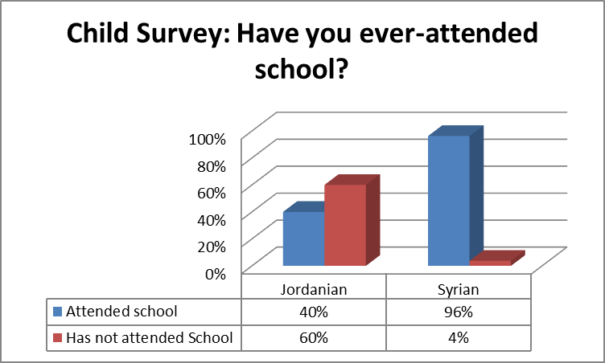
3. Causes Of Child Labour
3.2 Attitudes Towards Education
National challenges
Causes of child labor
The effects of child labor
Characteristics of child labor
By nationality, nearly all Syrian child labourers (96%) mentioned that they used to attend school, compared to only 40% of the Jordanian respondents. From those who had previously attended school, nearly three-quarters (71%) had reached the intermediary level, with the majority of these being Syrians. Around 65% of the Syrians left school a year ago, 19% left two years ago and 12% 3 years ago, while all of the Jordanian respondents had left school at least 4 years ago.

Slide 39
3. Causes Of Child Labour:
3.2 Attitudes Towards Education
National challenges
Causes of child labor
The effects of child labor
Characteristics of child labor
The reason for non-attendance at school for Syrians was that war had forced them to leave school
A small portion of Syrian children reported that “school harassment” was the reason they no longer attended.
For Jordanian child labourers, reported reasons for leaving school were given as “I don’t want to study anymore”, which was not heard from any Syrian respondents.
Additionally a small portion of Jordanians reported that they had left school due to economic reasons - lacking school fees – or health reasons, i.e., that they had become sick.

Slide 40
4. Effects of Child Labour
National challenges
Causes of child labor
The effects of child labor
Characteristics of child labor
On the family
On the child’s rights
On the child’s health and safety
On the child’s future

Slide 41
4.1 The Effects Of Child Labor:
On The Family
National challenges
Causes of child labor
The effects of child labor
Characteristics of child labor
Syrians in Jordan depend on international support from the United Nations agencies, but the wages of working children constitute a significant contribution to the family income. –Household survey.

Slide 42
4.1 The Effects Of Child Labor:
On The Family
National challenges
Causes of child labor
The effects of child labor
Characteristics of child labor

Slide 43
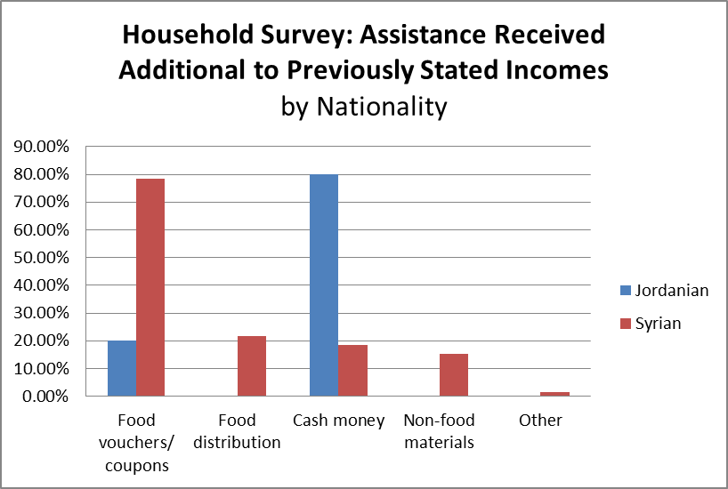
4.1 The Effects Of Child Labor:
On The Family
National challenges
Causes of child labor
The effects of child labor
Characteristics of child labor

Slide 44
4.2 The Effects Of Child Labor:
On The Childs Rights
National challenges
Causes of child labor
The effects of child labor
Characteristics of child labor
Long working hours and working weeks often between 6 or 7 days long mean that the child’s right to education is infringed and their right to play curtailed.
They may be unable to socialise with others their own age, and they may feel cut off from friends or acquaintances due to the burden created by the financial responsibility on their shoulders.

Slide 45
4.3 The Effects Of Child Labor:
On Health and Safety
National challenges
Causes of child labor
The effects of child labor
Characteristics of child labor
Children aged 16-18 in Amman, Mafraq and Irbid are working in environments that are, by ILO definition, classified as hazardous, such as metal works, where the potential of physical harm to the child is high.
A child was more likely to be surrounded by non-related adults and therefore potentially more likely to be exposed to negative behaviours, such as smoking, drinking, drugs or violence, bad language and/or attitudes that are inappropriate for their age.

Slide 46
4.3 The Effects Of Child Labor:
On Health and Safety
National challenges
Causes of child labor
The effects of child labor
Characteristics of child labor
The mental health of children who labour: There are indications from focus group discussions and from primary data, that this is negatively impacted both as a direct result of work itself, but also as a result of the associated pressures that come from the responsibility of being a wage-earner in a household.

Slide 47
4.4 The Effects Of Child Labor: On
The Child’s Future
National challenges
Causes of child labor
The effects of child labor
Characteristics of child labor
Loss of education particularly may negatively impact
  The opportunities available to a child
  Their chance to develop new skills.
  Acquisition of basic literacy and numeracy skills, and access to the opportunities that formal education can offer.
  The child will not necessarily gain additional skills or experience through this work

Slide 48
5. Recommendations
National challenges
Causes of child labor
The effects of child labor
Characteristics of child labor
Recommendations
Education
Need to a clearer national definition of ‘school drop-out’;
The design and development of innovative and creative education programmes for Syrian refugees should continue, with the intention of encouraging their return to school and to ensure that they remain there
Extra-curricular activities for children in schools and in communities should be encouraged by all national and international actors, to try and improve school environments and to enhance the range of activities that are available outside school hours, with the intention of occupying children in useful learning situations and allowing them a chance to socialise in a safe environment.
Financial assistance
Provision of cash assistance to child labourer families must be maintained, expanded and increased to the extent possible.

Slide 49
5.1 Recommendations
National challenges
Causes of child labor
The effects of child labor
Characteristics of child labor
Recommendations
Awareness Raising and Alternative Support
National awareness campaigns on child labour should be designed and implemented as quickly and comprehensively as possible.
Information for Syrians specifically regarding child labour and Jordanian labour laws in respect of minimum age of employment and hazardous work should be distributed in UNHCR registration centres, as well as via media outlets such as the ‘Syrian Hour’ radio show.
Particular focus should be on the impact of child labour on children’s health, well-being and future by being deprived of an education;
For children who labour, and their families, there needs to be more than just cash assistance that targets economic issues. There needs to be improved labour market access, vocational education that is especially focused on youth (although not to the exclusion of others) and income generating activities;
Policy dialogue between national and international stakeholders to discuss the sensitive issues of labour market access, employment opportunities and access to vocational education for Syrian refugees which, at present, have not been comprehensively addressed;
Improving awareness levels and training for labour inspectors tasked with identifying child labour cases, as well as offering practical support on how to deal with children and their families in these cases.

Slide 50
5.2 Recommendations
National challenges
Causes of child labor
The effects of child labor
Characteristics of child labor
Recommendations
Frameworks and Coordination
The National Framework for Combating Child Labour should, in its next phase, work to formally engage civil society and employers in order to enhance identification and follow-up of child labour cases, and to improve the coordination of services for child labourers and their families. This should include addressing the situation of child labour among the Syrian refugee population.
A coherent and monitored follow-up system for the child after an intervention is implemented should be formalised in the NFCCL;
Improve the coordination between the Ministries and the service providers that are not currently named in the NFCCL but who are providing services to child labourers and their families;
Improve the cooperation between the three Ministries named in the NFCCL with child labour cases - the MoL, the MoE and the MoSD – thereby facilitating them in carrying out their assigned tasks relating to child labour cases;
Coordination efforts among all child protection actors – developmental and humanitarian - must continue to strive for improvements to the provision of services for child labourers and their families.

Slide 51
5.3 Recommendations
National challenges
Causes of child labor
The effects of child labor
Characteristics of child labor
Recommendations
Capacity Building
The capacity of relevant government actors, especially those responsible for the implementation of the NFCCL, needs to be improved starting immediately and looking at the medium-term future, with the support of government and international actors, particularly the ILO.
Early consideration should be given by the MoL to hire and train additional labour inspectors to improve national coverage of labour inspection and to strengthen identification, reporting and monitoring of child labour cases.
Development of the National Database on Child Labour should continue and greater efforts made with relevant government staff to ensure broad uptake and use of the database once completed. The database should ultimately cover all nationalities of child labourers in Jordan.
National Statistics
In view of the fact that the incidence of child labour appears to be increasing, not only among Syrian refugees, and in order to keep abreast of trends in this phenomenon, the government should include a specific focus on child labour in existing national surveys through appropriately designed questions as soon as possible.
The Department of Statistics is ideally placed to coordinate this process based on its previous experience in this field.

Slide 52
Full reports on ILO Website
http://www.ilo.org/beirut/events/WCMS_244603/lang--en/index.htm?shared_from=shr-tls

Slide 53
Thank you

