Slide 1

Accountability to Affected Populations in Lebanon
Complaints and Response Mechanisms
Participation

Slide 2
Handling complaints and feedbacks
To provide pathway for target population’s concerns to be heard
To have more transparency between organization and target population
To address problems and improve programming
Specificity: joint pathways for complaints, feedback, and referrals
Entry points:
  Hotline (Complaints and Referrals Officer)
  Collective Site Management and Coordination (CSMC) Committees
  Field staff

Slide 3
Types of feedback and complaints received
Feedbacks: Minor comments, or comments not necessarily related to SI’s work and objectives
Non-sensitive complaints: Issues related to SI’s program implementation, generally received by hotline and routed according to seriousness.
Sensitive complaints: Issues related to fraud/corruption, sexual exploitation and abuse or misconduct
Separate logbook and pathway that ensures discretion and complete privacy/confidentiality of those involved
+ Referrals: Internal, incoming and external

Slide 4

CRM and Whistleblowing Flowchart
Complaint received or adequate suspicion of abusive situation
Yes
Is it a minor issue that can be addressed on the spot?
Is it a sensitive complaint?
Is it a serious sensitive complaint involving SI?
Can I alert my hierarchical manager?
No
Yes
Yes
Yes
No
No
Yes
No
FEEDBACK
Referral and Complaint Officer
Administrative Manager
Hierarchical manager
Form sent to stop@solidarites.org
Program Manager
Investigation committee
RESPONSE
RESPONSE
Managing Director
Ethics committee
DISCIPLINARY PROCEDURES
JUDICIAL PROCEEDINGS
Notes:
Explain the different between feedbacks, sensitive and non-sensitive complaints
Each type is dealt with separately and differently
Privacy and confidentiality always ensured

Slide 5
Types of follow up
Feedback | Non-sensitive complaints | Sensitive complaints
Responses usually given immediately (over phone or in person, depending on context) | Sent to relevant program manager, dealt with confidentially | Referred to Administrative Manager (staff issue) or to Field Coordinator (field issue) – option to reach for higher level of authority if necessary (potential link with internal whistle blowing policy)

Slide 6
Analysis of the mechanism
Average number of entries per day: 19
Good appropriation of entry point (97% satisfied in CSMC KAP survey March 2016)
Challenges:
Current systems do not allow for systematic response tracking (mainly because of the diversity and number of people involved)
Impact of different site committees is difficult to assess
Lessons learnt (data from CSMC KAP survey March 2016):
Design and operationalization of both CRM and referral system were carried out by SI MEAL department (cross-cutting) => Led to better mainstreaming of related principles and appropriate construction of data flows and tools
  However, all services and top management get involved to enforce responsibilities
Hotline good entry point for Syrian refugees (80% have the hotline number and it remains most used pathway)
Efforts in communicating mandate (through CSMC and other front liners) seems to have improved the use of the mechanisms

Slide 7
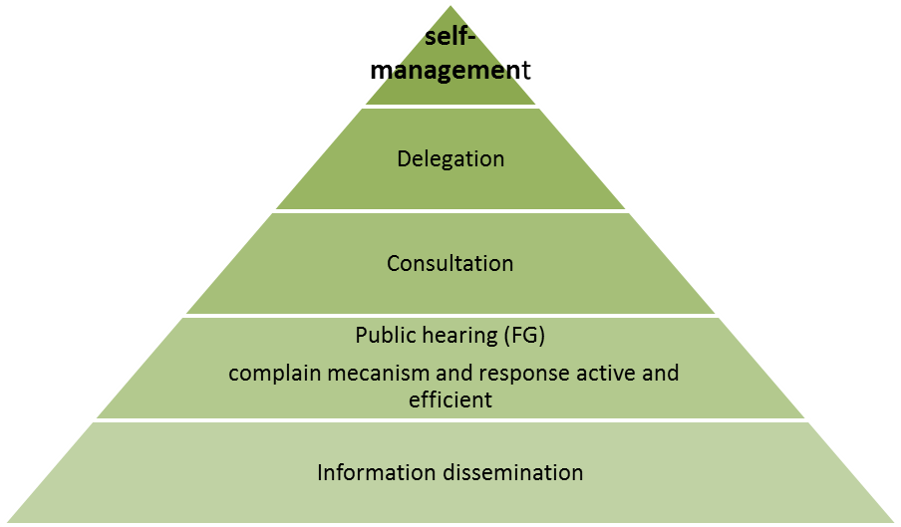
Enhancing participations of affected populations through CSMC
Creation of 50 CSMC committees in 2015 in the North
Activity: Information dissemination and capacity building on humanitarian principles and law, protection, conflict mitigation, participatory mapping etc.
Notes:
Collective Site Management & Coordination is a cross-sectorial theme that aims to empower ‘back’ refugee population to be efficient and self-sustainable in managing their own lives at the collective sites. It also pays attention to strengthening the refugee community structures in order to:
Promote partnership and collaboration with national authority, the host community, the humanitarian community, the affected population, and other stakeholders;
Build awareness on the humanitarian principles;
Ensure standards and coordination of activities within the sites;
Set up CRM mechanism and seek to improve accountability.

Slide 8
Enhancing participation of affected populations through CSMC
CSMC has generated key progress in
  Information sharing and empowerment (transparency)
  Active engagement of populations in decision-making (participation)
  SI’s understanding of governance mechanism and its capacity to engage with all groups (participation)
  Capacity to handle complaints and feedback – ~50% rely CSMC committee (complaints and feedback)
Other effects:
Women’s empowerment: “It strengthened us. Before [CSMC] we felt like we could not do anything. Now, this has empowered us.” – Female Daraya participant
Autonomy: “We are able to solve our own internal problems now. If someone [from our site] is unable to pay for healthcare and does not receive assistance from agencies, then we can help them pay for healthcare [by pooling money] – up to 400,000 LBP, we can handle it.” – Mqeatea 026 participant
Notes:
The words in brackets are among the five AAP commitments from the IASC:
- Leadership/governance
Transparency
Complaints and feedbacks
Participation
M&E

Slide 9
Thank you

