Slide 1



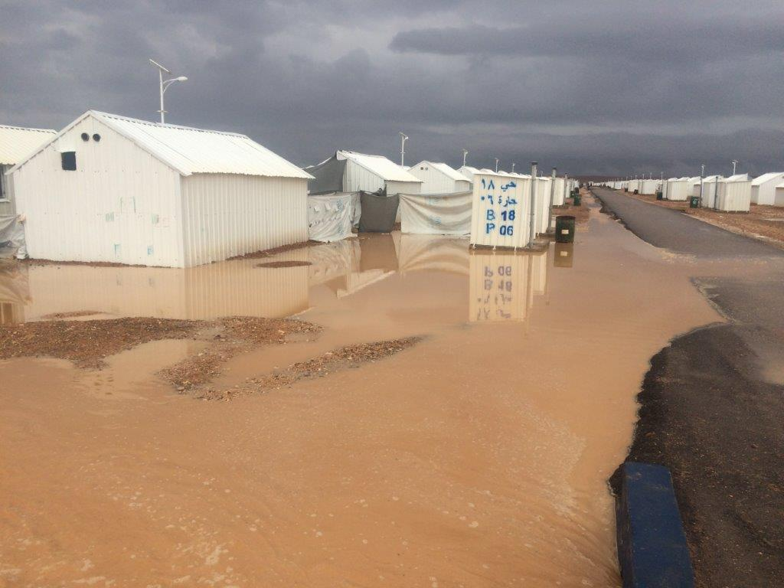
WASH AND SHELTER INTER-SECTORAL LINKAGES
2nd DECEMBER 2015

Slide 2
Presentation Background
  WASH and Shelter interventions have a blurred line particularly in Host Communities where the scope of work coincide and can even overlap.
  The following actions were taken by both sectors with the intention of harmonising approaches and encouraging integration of their activities.

Slide 3
ACTUAL LINKAGES
WASH-SHELTER
.
The Shelter WG requested a presentation from the WASH WG on WASH guidelines in HC (urban context)
A subgroup/TF was called for decision making in Azraq camp with regards to provision of Shelters including WASH facilities
In camps the design of WASH systems (water supply, waste water, etc) is closely coordinated with shelter/site planning

Slide 4
ACTION PLAN
Assigned focal points for WASH/Shelter WGs
ICLA presentation on legal procedures and advice on HC/urban context WASH/Shelter interventions
WASH/Shelter technical guidelines Task Force for HC.
WASH WG to finalise HC WASH Minimum standards and share them with Shelter WG
Establish partnerships between WASH and Shelter members to write proposals together and answer calls for interventions at HC level

Slide 5
POTENTIAL INTER-SECTOR LINKAGES
WASH-SHELTER
Develop solid referral system working both ways (WASH-Shelter) when there is no tandem intervention
Ensure follow up on any referrals
Shelter members to include in their proposal some of the following interventions :
  Household Water Treatment & Safe storage (distribution and appropriate training)
  Consider toilet retrofits
  Low flow shower heads and taps or tap aerators
  Early detection and repair of leaks in fittings, pipes, tanks etc.
  Reuse of greywater

Slide 6
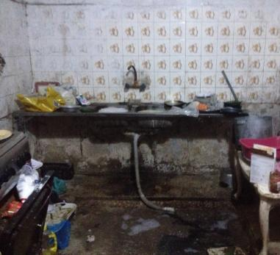
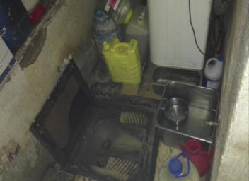
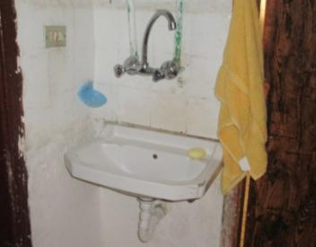
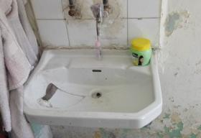

Slide 7
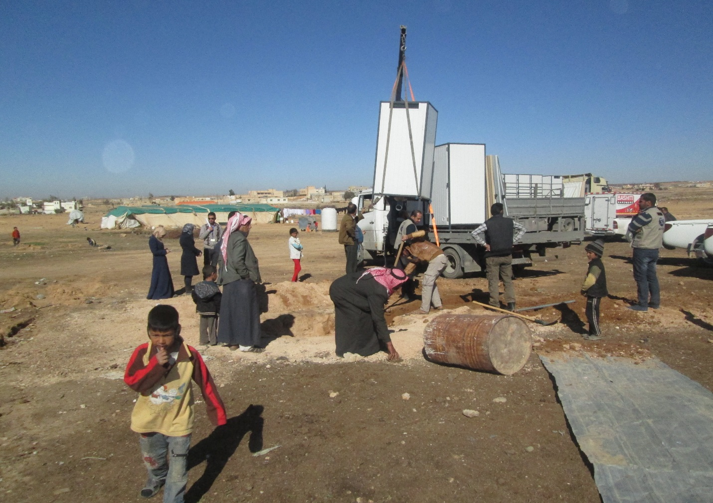
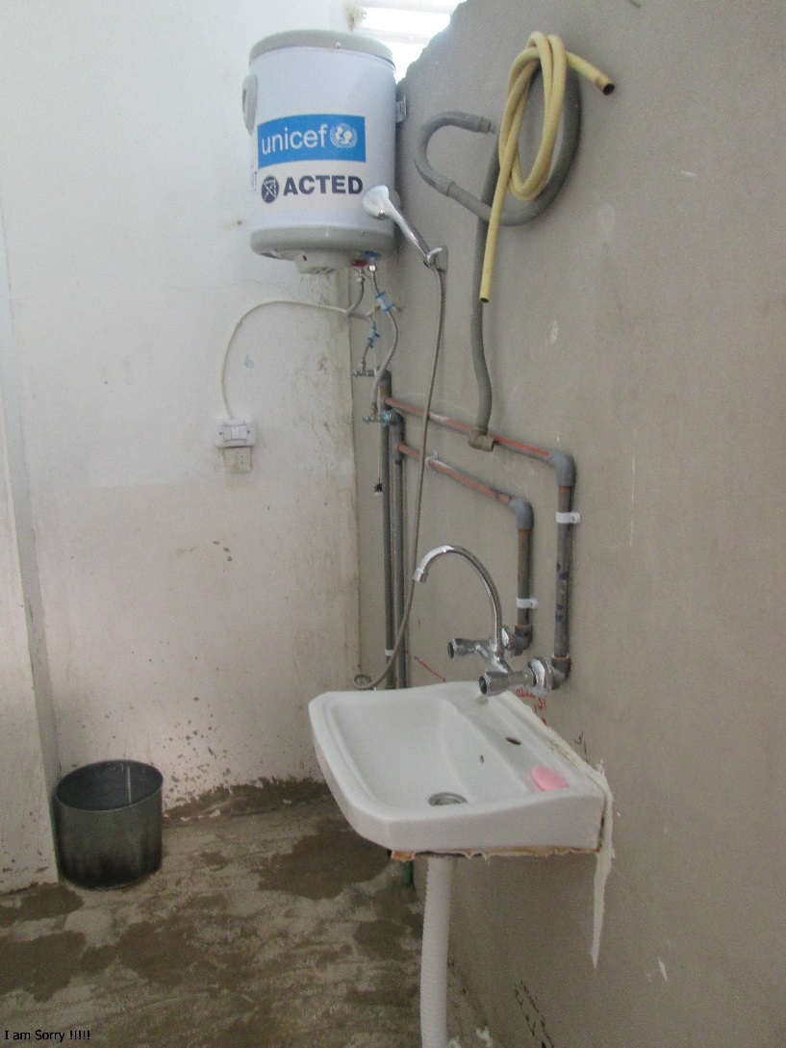
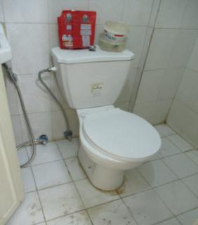

Slide 8
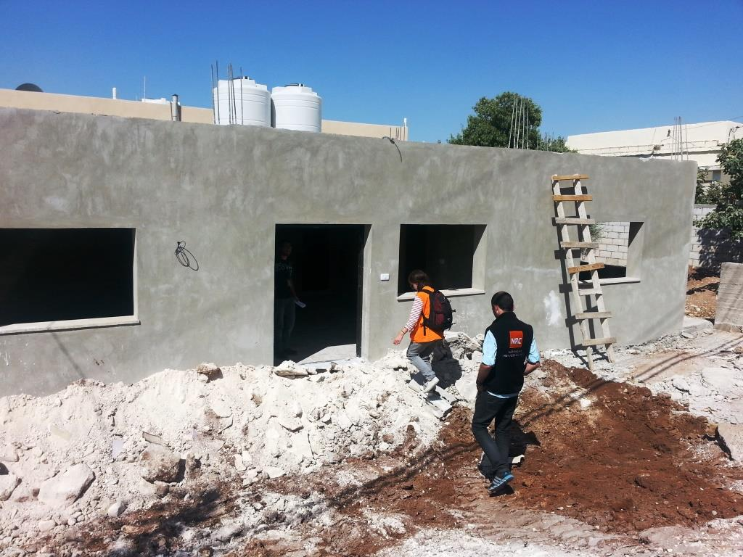
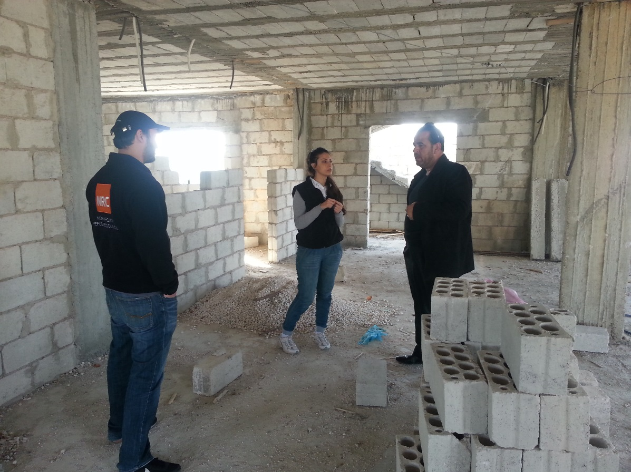
Shelter – Under Construction

Slide 9
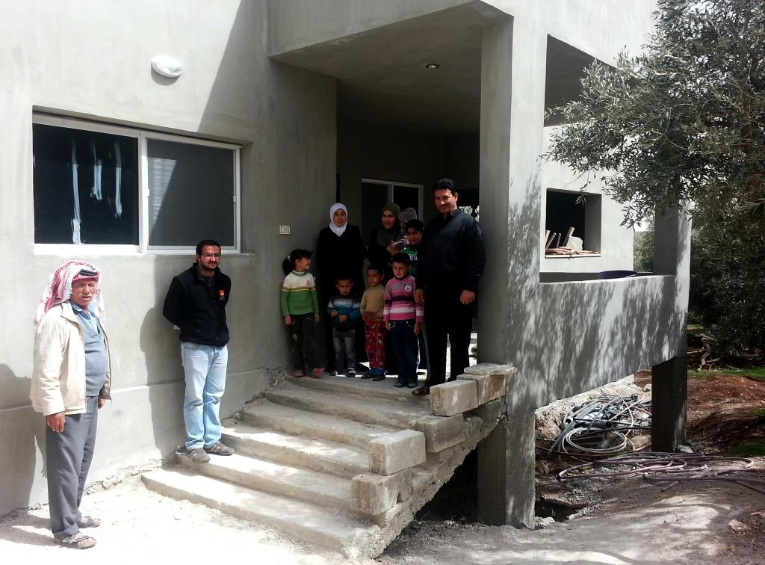
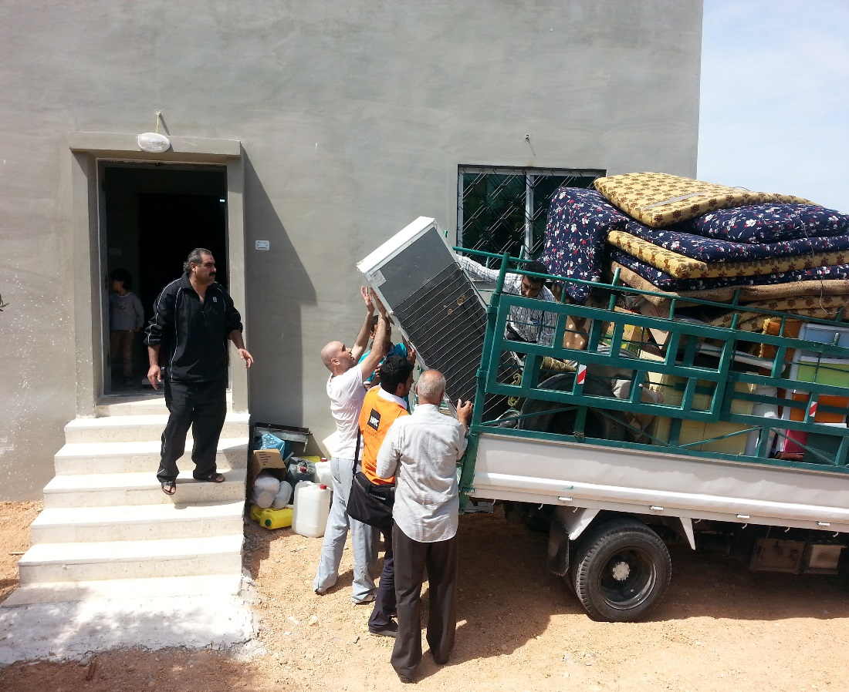
Shelter – Relocating to New Shelter

Slide 10
CHALLENGES
Defining WASH/Shelter activities within a HH
Number of beneficiaries (as many families seem to be equipped in particular in WASH)
Repairs of septic tanks (technically difficult and expensive)
O&M and women involvement
Identification of ar eas of intervention
Behaviour change

Slide 11
Recommendations
Follow up on action plan
Carry out joint needs assessments
Define role responsibilities at camp level
Focus on behaviour change campaigns

Slide 12

Shukran

