Slide 1
Winterization Task Force
17 September 2015

Slide 2
Winterization Task Force - Agenda
17 September 2015
1.) Welcome
2.) Winterization Standards
3.) ToR and Scope of Winterization TF
4.) Discussion and finalization of targeting approach
5.) Operational Update by Organization
6.) Winterization Module
7.) Harsh Weather Emergency Response
8.) Timeline, action plan and next meeting
9.) AOB

Slide 3
Winterization Standards

Slide 4
Winterization Standards (1)
Lessons Learnt from last winterization in March/April 2015 (cf. packages)
Formulation of standards (May 2015 – cf. composition)
Costing the standard (June 2015 – cf. per capita calculation / tiers / heater rapid assessment)

Slide 5
Winterization Standards (2)
Results are as follows:
Draft Final Standard:
Per capita cost (Tier 1 – “Full”): 16 + 57 JOD = 73 JOD
Per capita cost (Tier 2 – “Partial”): 16 + 32 JOD = 48 JOD

Slide 6
Winterization Standards (3) - Zaatari
Zaatari winterisation standard package for Zaatari 2015
Sector | Description of items for distribution during winter | Target Households | Persons | Cost per Household | Cost per unit/per person (USD) | Frequency: # of times distributed during winter | Total requirement (USD) | Available in-Kind stock in Zaatari | Gap required-for in-kind distribution | Time frame/ comment
CRI | Gas Refill | 19879 | 80146 | 14 | $3.5 | 2 | 556,612.00 |  |  | Oct-Nov
 | Winter clothes | 19879 | 80146 | 48 | 12 | 1 | 954,192.00 | 5740 | -74406 | Oct-Nov
 | Warm Jackets | 19879 | 80146 | - | 0 | 1 | 0.00 | 12,198 | -67948 | Oct-Nov
 | Assorted winter kits (0-14 yrs) | 19879 | 30,000 | 10 | 7 | 1 | 198,790.00 | 241 | -29759 | Oct-Nov
 | Heaters(Vulnerable HH), New Arrivals | 1000 | 5000 | 50 | $10.0 | 1 | 50,000.00 | 0 | -5000 | Oct-Nov
 | High Thermal Blankets | 19879 | 80146 | - | 0 | 1 | 0.00 | 12552 | -67594 | Oct-Nov
Shelter | Plastic sheets | 1000 | 0 | - | #DIV/0! | 1 | 0.00 | 1000 | 0 | Oct-Nov
 | Shelter maintenance | 19879 | 80146 | 20 | 5.0 | 1 | 397,580.00 | 0 | -80146 | Oct-Nov
WASH | Rain Coat | 19879 | 80146 | 7 | $1.7 | 1 | 139,153.00 | 0 | -80146 | Oct-Nov
 | Wellington boot | 19879 | 80146 | 7 | $1.7 | 1 | 139,153.00 | 0 | -80146 | Oct-Nov
 |  |  |  |  |  |  | 2,435,480.00
Note: Population Planning figure is as of 16 June 2015

Slide 7
Winterization Standards (4) - Azraq
Azraq Camp Estimated Population by March 2015 | Households | Persons | Average Family size
 | 5,500 | 22,000 | 4
Sector | Household | Unit/item description | Households | Persons | Cost per Household | Cost per unit/per person | Frequency: # of times distributed during winter monthly | Total requirement | Available stock in Azraq | Time frame/ comment
NFI | 5,500 | Winter gas distribution - Azraq | 5,500 | 22,000 | 14 | $3.50 | 4 | $308,000.00 | 3900 cyclinders | October
 |  | Heaters and gas cyclinders- for new arrivals in 2015 and movement from urban to Azraq camp | 3,500 | 14,000 | 106 | $26.50 | 1 | $371,000.00 | 1421 (some of them are damaged and requires fixing) | October
 |  | HT Blankets (2 blankets per person) for all camp population, the new arrivals and referrals from urban | 5,500 | 22,000 | 39 | $9.80 | 1 | $215,600.00 | 0 | October
 |  | Winter clothes and shoes | 5,500 | 22,000 | 100 | $25.00 | 1 | $550,000.00 | 3000 winter jackets | October-November
TOTAL |  |  |  |  |  |  |  | $1,444,600
Shelter
 | 100 | Shelter Quick Fix | 100 | 400 | 50 | 12.5 | 1 | 5000 | N/A | October-February
TOTAL |  |  |  |  |  |  |  | $5,000
Cash Assistance | 5,500 | One-time cash assistance | 5500 ( 2100 F/s 1 amd 3400 F/s >1) | 22000 | 50 for Fs>1 , 20 for F/s 1) | 12.5 | 1 | 212000 | N/A
TOTAL |  |  |  |  |  |  |  | $212,000
 |  |  |  |  |  |  | GRAND TOTAL | $1,661,600

Slide 8
ToR and Scope
WINTERIZATION (OUTSIDE OF CAMPS) IN JORDAN 2014-2015
STANDARD OPERATING PROCEDURES (SOPs)
Background and Scope
In August 2014, humanitarian partners of the NFI and Cash Working Groups (WGs) in Jordan came together in order to better frame the winterization assistance provided to Syrian refugees and vulnerable Jordanians. This document aims to support the coordination of winterization interventions in of-camp settings and covers the winter months of November to March (2014-15). Reference documents can be found here:
Outline of Inter-agency winterization efforts in Jordan (2014-15). http://data.unhcr.org/syrianrefugees/download.php?id=7048
Moreover, and in line with the submissions under the Regional Response Plan 6 (RRP6) and the Regional Response Plan 6 Review process, partners have updated their activities on Activity Info Coordination database http://syrianrefugeeresponse.org.
Coordination of Winterization Activities
In the cross-sectoral coordination meeting on the 13th of October, agencies reaffirmed their commitment to the following coordination principles:
Regular update by all partners of planned activities including district of intervention, targeted population and type of assistance.
Real-time entry and verification of beneficiaries on RAIS module by all partners (with the objective to avoid duplication as much as possible).
Delivery of assistance to beneficiaries within the agreed timeframe (within two weeks upon identification of cases).
Inter-agency referral process with the purpose of covering specific needs of extremely vulnerable cases will be in place.
Monthly update of the Winterization dashboard to capture progress against initial targets.
Winterization assistance will be prioritised for cases not having received assistance before.
A Winterization TF will meet to better coordinate winterization interventions and make sure a harmonised approach is in place.

Slide 9
Discussion and finalization of targeting approach
Eligibility for winterization assistance:
It is recommended that eligibility criteria for winterization assistance should be based on the VAF Basic Needs Vulnerability tree and that both the extremely and the highly vulnerable should be considered for assistance (score of 3 or 4 overall, not enough to have a score of 3 or 4 in one or two areas only). This scoring should apply for all nationalities.
NFI/Cash - Basic Needs
Reliance on Negative Coping Strategies
(food specific)
1 = HH not adopting strategies
2 = Existence of stress strategies
3 = Existence of crisis strategies
4 = Existence of emergency strategies
Dependency Ratio
(disability adjusted)
1 = 1:0 (no dependents)
2 =
3 = 1:1 (one dependent)
4 = 1:2 (two dependents)
Economic
Debt per capita
Expenditure per capita
1 = No debt
2 = 0 < debt < 40
3 = 40 <= debt < 100
4 = debt >= 100
1 = expenditure >= 100
2 = 100 > exp >= 68
3 = 28 <= exp < 68
4 = expenditure < 28

Slide 10
Discussion and finalization of targeting approach
Coping strategies:
Stress: Spent savings, sold HH goods, bought food on credit
Crisis: Sold productive assets, reduce essential non-food expenditure,
Emergency: Sent adults or children HH members to beg, high risk/illegal/socially degrading jobs
Extra tool for targeting:
For organisations that wish to fine-tune their targeting, the table below has been designed to better analyse levels of vulnerability. The scoring can be easily applied to assessed households and should allow organisations to select beneficiaries with their desired threshold.

Slide 11
Discussion and finalization of targeting approach
Vulnerability | Criteria | Scores
Reliance on Negative Coping Strategies (food specific) | Emergency: Sent adults or children HH members to beg, high risk/illegal/socially degrading jobs | 30.0
 | Crisis: Sold productive assets, reduce essential non-food expenditure, | 22.5
 | Stress: Spent savings, sold HH goods, bought food on credit | 15.0
 | HH not adopting strategies | 7.5
Dependency ratio = # children + # of with chronic disease0 + # with disabilities ÷ # adults without disease or disability | Dependency ratio = .5< R | 30
 | Dependency ratio = 0< R <= .5 | 22.5
 | Dependency ratio = 0 | 7.5
Debt | Debt/ capita= > 100 JD | 20
 | = > 100 JD Debt/ capita =>40 JD | 15
 | = > 100 JD Debt/ capita =>40 JD | 10
 | > 0 JD Debt/ capita | 5
expenditure | total expenditure/ HH members= < 28 JD | 20
 | 68 JD= >total expenditure/ HH members= > 28 JD | 15
 | 100JD= >total expenditure/ HH members= > 68 JD | 10
 | 100JD= < total expenditure/ HH members | 5
Total Score |  | 100

Slide 12
Discussion and finalization of targeting approach
Extreme Vulnerability | Score > 75 | 4
High Vulnerability | 75= >Score >50 | 3
Moderate Vulnerability | 50= >Score >25 | 2
Low Vulnerability | 25 =>Score | 1
Winterization Assistance Recommended
Tier 1 = “Full”: 73 JOD/ capita or NFI worth the same
Tier 2 = “Partial”: 48 JOD/ capita or NFI worth the same
Criteria for selecting Tier 1 and Tier 2:
Jordanian:
Eligible Jordanians should receive Tier 2 under these conditions:
If the Jordanian beneficiaries will be taken from MoSD, then they will be blocked from other assistance, so all of them must receive the same amount of assistance.
It is not always possible to check if Jordanian beneficiaries received assistance in 2014/2015 or not.
If any organization has not been requested to take the names from MoSD, then the Jordanian beneficiaries can take tier 1, unless they received any of the assistance mention below.

Slide 13
Operational Update by Organization
What? (Tier 1 [cash] / Tier 2 [cash] / Tier 1 [in-kind] / Tier 2 [in-kind] Other)
Where? (Camp / Urban [Governorate]
Template will be sent out after the meeting to all partners having planned, fundraised or started winterization activities.

Slide 14
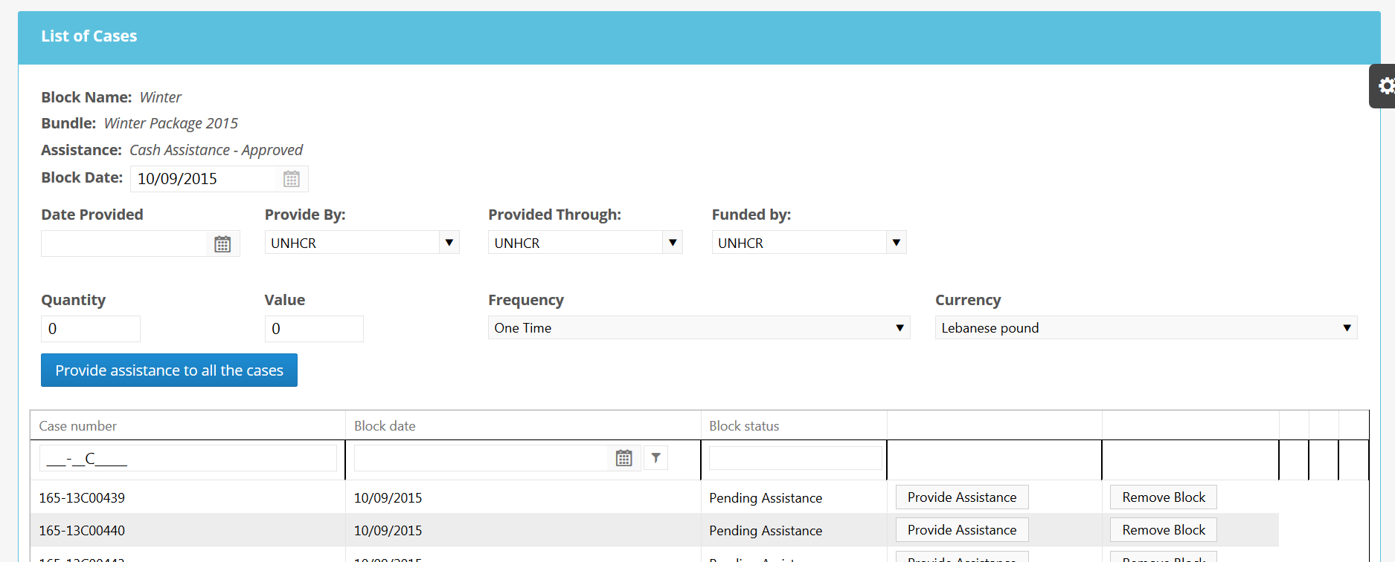
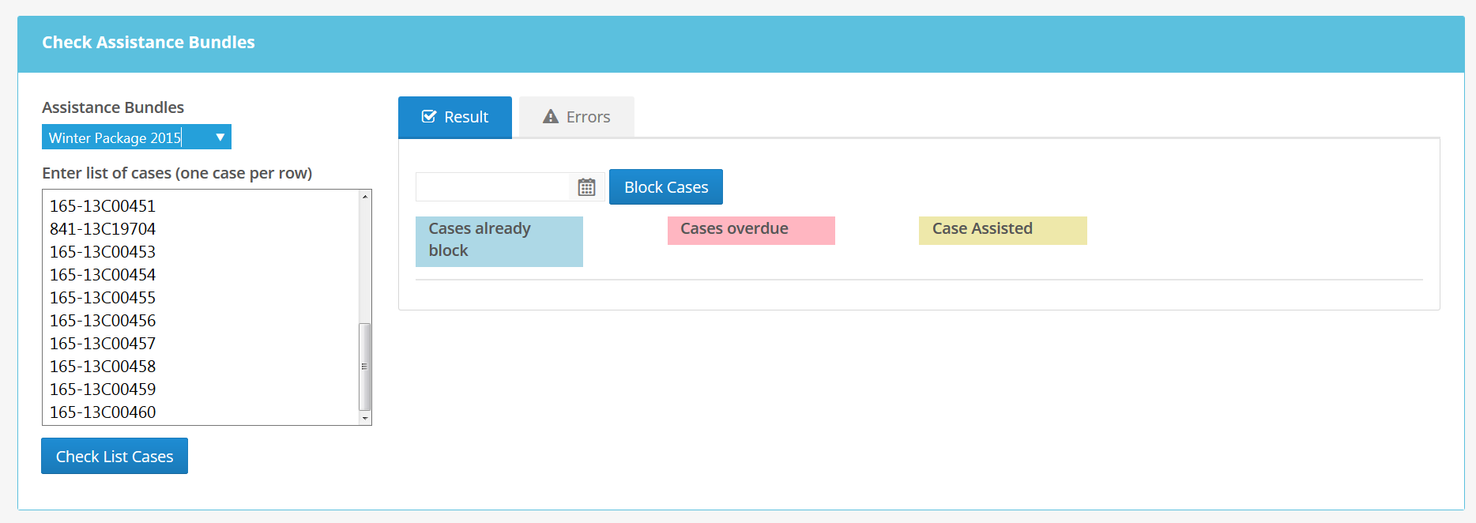
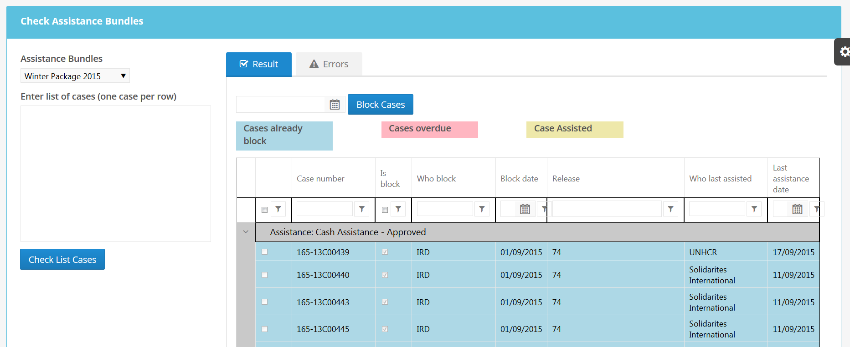
Winterization Module

Slide 15
Harsh Weather Emergency Response Plan?

Slide 16
Timeline, next meeting, AOB

