Slide 1
2016 Lebanon Response Crisis Plan (LCRP)
Health Chapter

Slide 2
2016 LCRP- Timeline
Inception Workshop
Sept, 15th
Submission to JTF
Nov, 18th
Official Launch
Dec,17th
Field Consultations
Submission to CPT
Oct, 18th
Endorsement by Steering Committee
Health Core Group -MoPH, UNHCR, WHO, PU-AMI, Amel -
Health Narrative, Results Framework & Budget
Setting Targets
Nov, 12th
Expression of Interest
Oct, 16th
Health Steering Committee
Nov, 1st
Mainstreaming Workshop
Oct, 20th

Slide 3
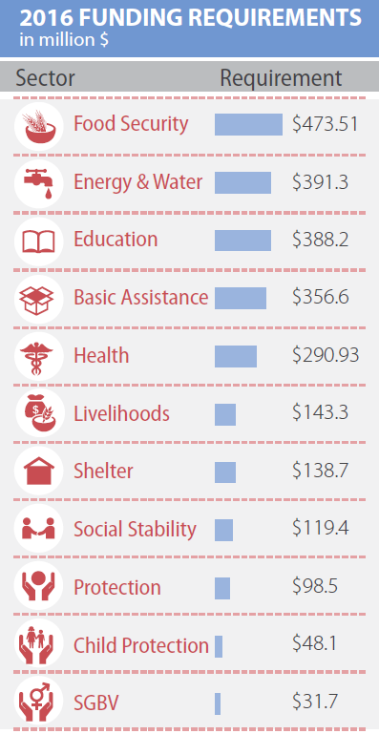
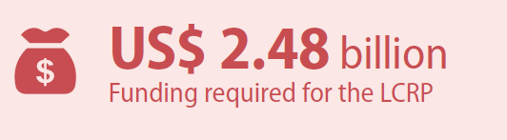
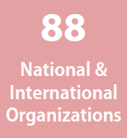
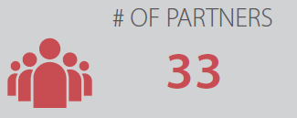
Funding Requirements

Slide 4
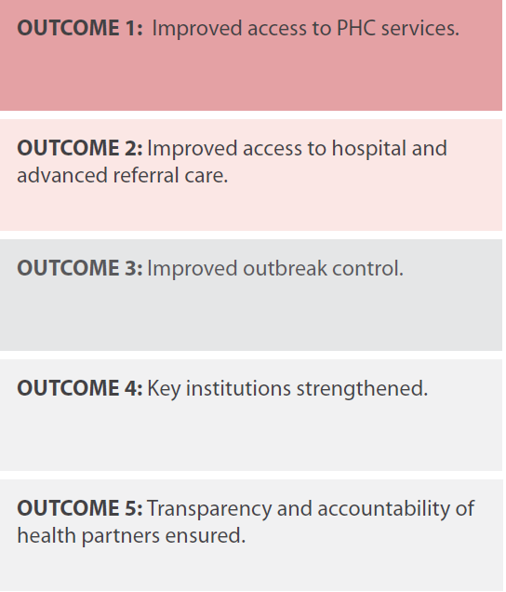
Outcomes

Slide 5
Outcome 1: Improved Access to PHC services
Outputs | Partners
Output-1.1: PHC services received by population in need | AMEL, AVSI, CCP Japan, CLMC, HI, Humedica, ICU, IMC, IOCC, IOM, IR Lebanon, MDM, Makassed, Makhzoumi, MAP-UK, Medair, Medical Teams International, PCPM, Qatar Red Crescent, RI, Seraphim Global, UNFPA, UNHCR, UNICEF, UNRWA, URDA, WHO
Output-1.2: Sufficient chronic diseases medication available | AMEL, ANERA, CLMC, FPSC, IOM, IR Lebanon, MDM, Makassed, Makhzoumi, Medical Teams International, MoPH, PCPM, PU-AMI, Qatar Red Crescent, RI, UNRWA, WHO
Output-1.3: Sufficient acute diseases medication available | AMEL, ANERA, CLMC, Humedica, IMC, IOM, IR Lebanon, MDM, Medair, Makassed, Makhzoumi, PCPM, PU-AMI, Qatar Red Crescent, RI, UNFPA, UNICEF, UNRWA, URDA

Slide 6
Outcome 1: Improved Access to PHC services (continued)
Outputs | Partners
Output-1.4: Routine vaccination coverage increased for all children U5 | AMEL, CLMC, ICU, IMC, IR Lebanon, MDM, Medair, Makassed, Makhzoumi, PCPM, PU-AMI, RI, UNICEF, UNRWA
Output-1.5: Implementation of National Mental Health Strategy | MoPH, WHO
Output-1.6: Expansion of the PHC-MoPH network | MoPH, WHO

Slide 7
Outcome 2:Improved access to hospital and advanced referral* care
Outputs | Partners
Output-2.1: Population in need receives hospital and diagnostic services | CLMC, IMC, IOCC, IOM, Makhzoumi, MAP-UK, Qatar Red Crescent, UNHCR, URDA, UNRWA
Output-2.2: Financial gap for public hospital bill reimbursement decreased | IMC, MoPH
Output-2.3: Public hospitals compensated for the financial losses which they incurred due to the Syrian crisis | MoPH

Slide 8
Outcome 3:Improved outbreak control
Outputs | Partners
Output-3.1: Expand EWARS | MoPH, WHO
Output-3.2: Selected contingency vaccines and reagents are procured | MoPH, WHO
Output-3.3: Support vaccination campaigns | MoPH, WHO, UNICEF

Slide 9
Outcome 4:Key Institutions Strengthened
Outputs | Partners
Output-4.1: Strengthen caza public health office for enhanced decentralization | MoPH, PU-AMI, UNDP, URDA
Output-4.2: Public Hospitals service delivery strengthened | IOCC, MoPH, UNFPA, URDA, WHO, WVI
Output-4.3: School health program expanded (youth health) | MoPH, WHO
Output-4.4: Ensure Capacity Building at central level, peripheral level and PHCs | FPSC, IOCC, IOM, MDM, MoPH, UNDP, UNFPA, UNHCR, UNICEF, WHO
Output-4.5: Budget support provided to fund MoPH financial dues to hospitals in relation to the Syrian Crisis | MoPH

Slide 10
Outcome 5:Transparency and Accountability of Health Partners Ensured
Outputs | Partners
Output-5.1: Accurate Expenditures on Health by all health partners are available to MoPH | MoPH, WHO
Output-5.2: The bulk of received donations for the health sector is disbursed on direct health services | MoPH, WHO

