Slide 1
Primary Health Care Department Programs
26/02/2016

Slide 2
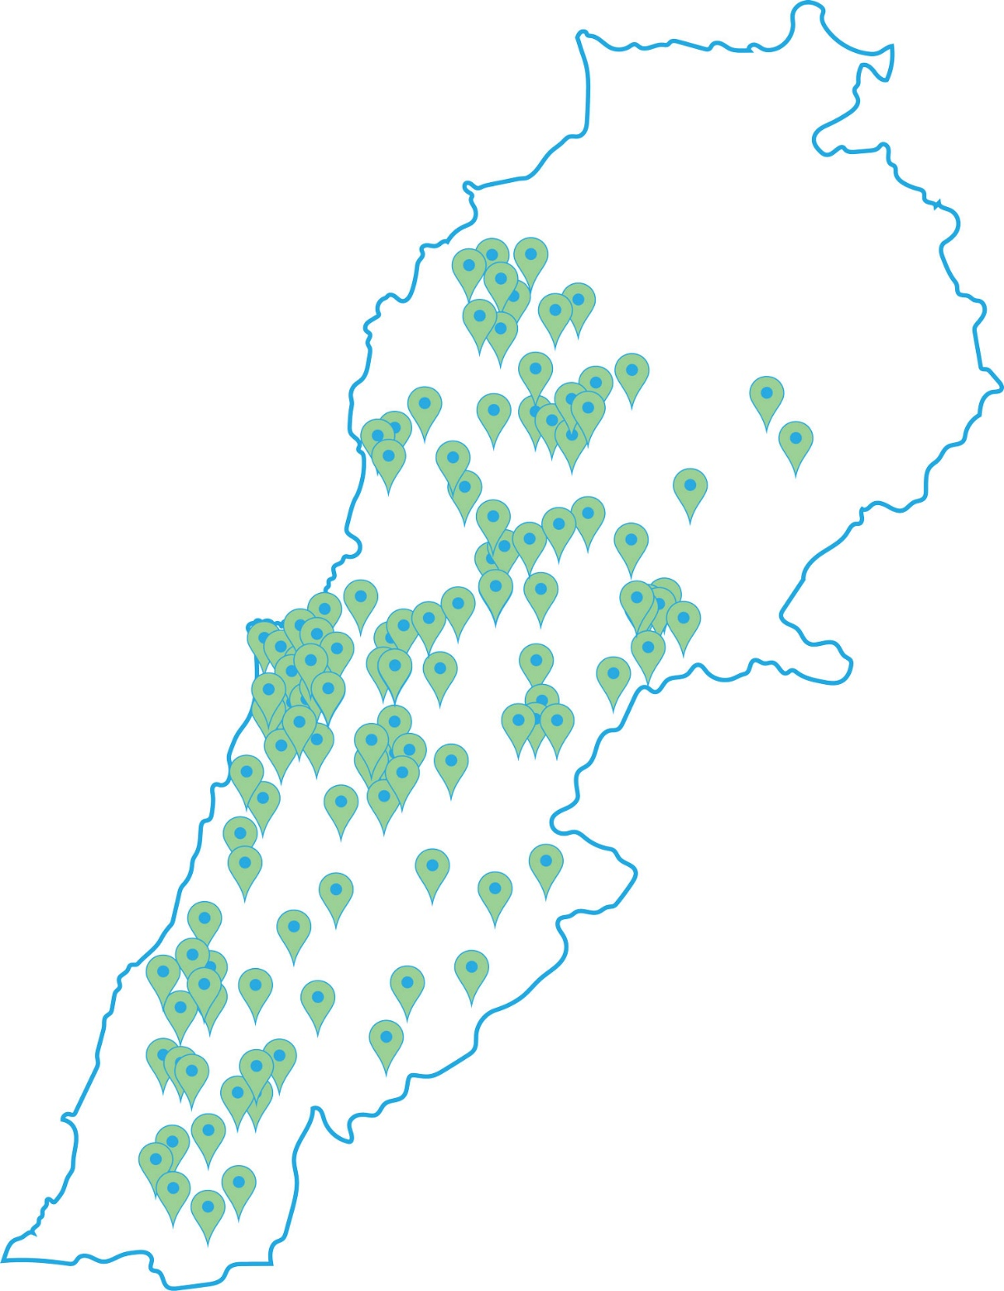
Acute Malnutrition

Slide 3
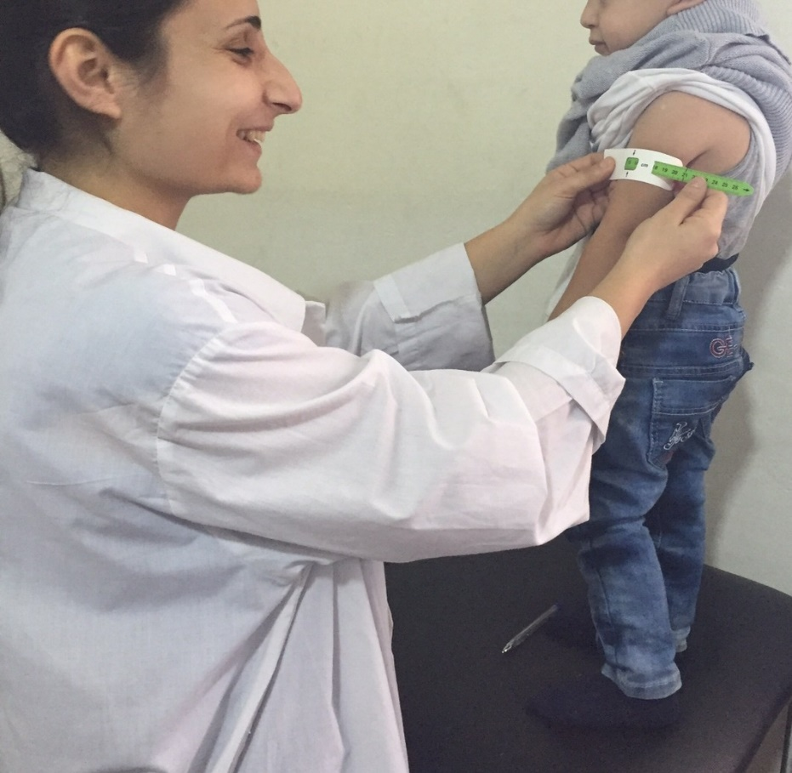
Definition
Acute Malnutrition is a drastic deterioration of weight over a short period of time due to a series of factors that include inadequate dietary access and disease in addition to several underlying causes.
The result is a serious health condition that requires proper treatment and follow up to increase the chances of survival among the most vulnerable.
Children under five and women of reproductive age are most vulnerable.

Slide 4
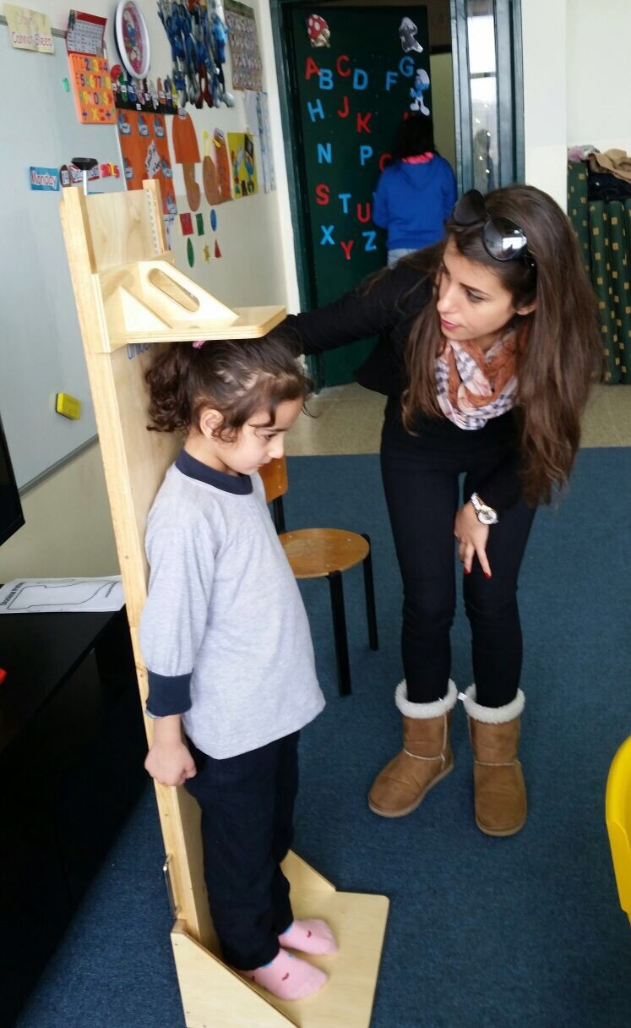
Rationale
Malnutrition rates in Lebanon are within acceptable
levels, but since there are several aggravating factors,
preparedness for a deterioration in the nutritional
situation must be taken into consideration.
Also, early detection and treatment of acute malnutrition
is essential to prevent the increase in
morbidity and mortality among the vulnerable populations,
especially children under 5.
MoPH with the support of UNICEF , included
screening and treatment of Acute Malnutrition in the services
provided by the 214 MoPH network PHC centers.

Slide 5
Measurements
Weight
Height
MUAC ( for infants older than 6 month)
Edema (Bilateral)

Slide 6
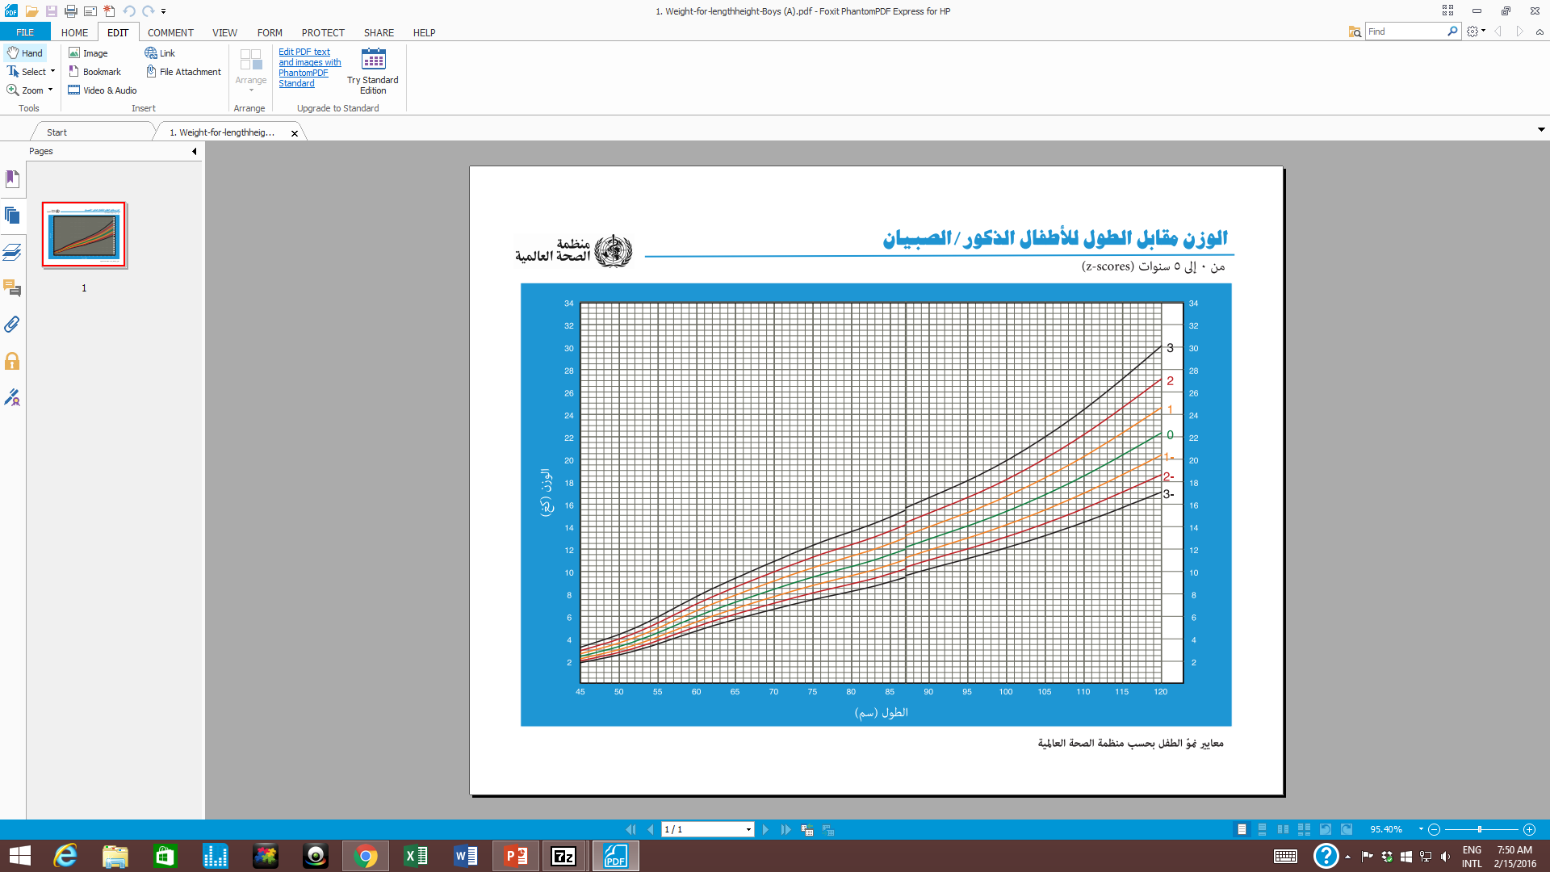

Slide 7
WHO growth charts are used to diagnose
Both W/H z-score and MUAC are used as diagnosis criteria

Slide 8
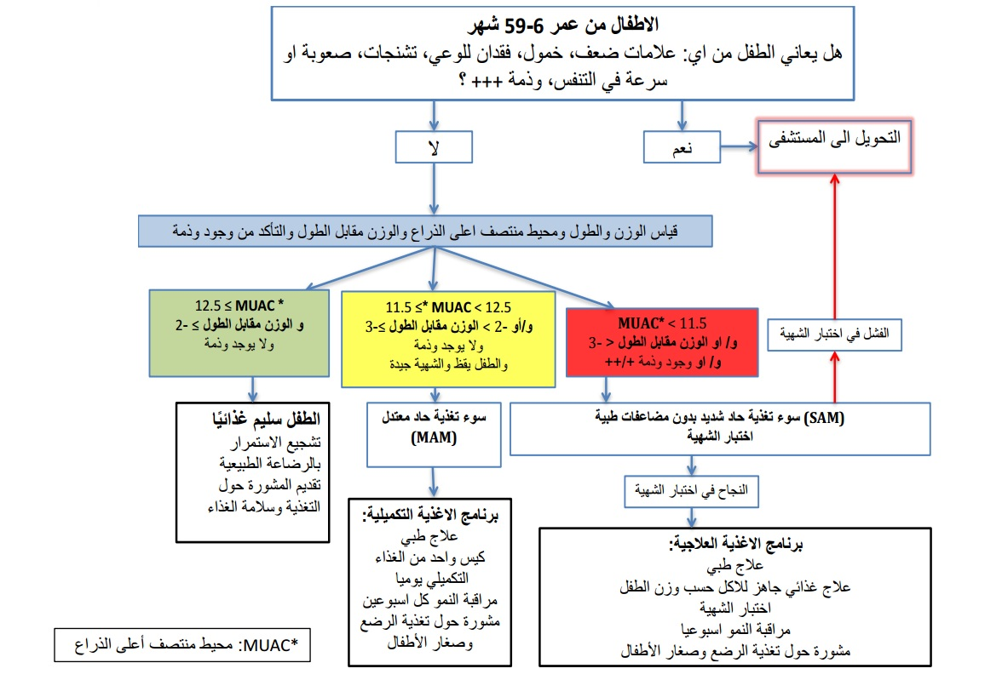
Decision Making Tree

Slide 9
Initiative in PHC Centers

Slide 10
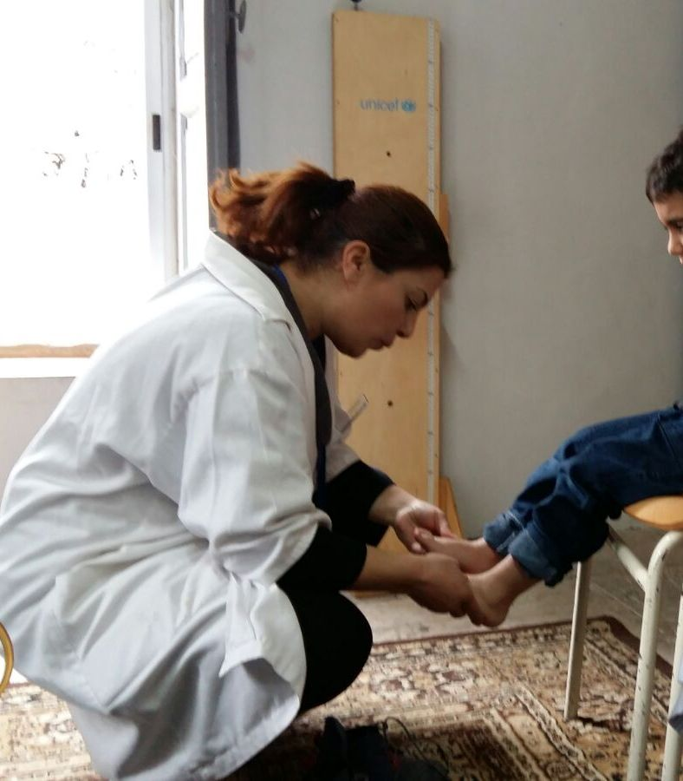
Implementation
214 PHC centers are trained on :
Screening for Acute Malnutrition in children under 5 based on:
Weight
Height
MUAC (mid upper arm circumference)
Edema
Identification of Types of
Acute Malnutrition (SAM and MAM)
Referral of Acute Malnutrition cases for
treatment to designated PHC centers.

Slide 11
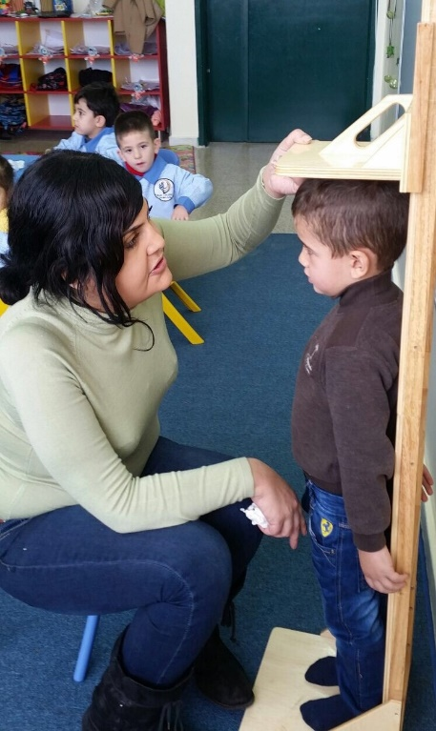
Implementation
60 PHC centers are trained on :
Screening for Acute Malnutrition in children under 5 based on:
Weight
Height
MUAC (mid upper arm circumference)
Edema
Identification of Types of Acute Malnutrition
(SAM and MAM)
Treatment of cases of uncomplicated Acute Malnutrition (SAM and MAM)
Referral of Acute Malnutrition cases with complications for treatment to designated Hospitals

Slide 12
Implementation
16 PHC treatment centers in Bekaa and Baalbak/Hermel :
البريد الإلكتروني | الهاتف | المسؤول | Mal Treatment | القضاء | المحافظة | إسم المركز
 |  |  | Treat
fmcs1998@gmail.com | 08-505322 | حسين صوان | + | زحلة | البقاع | الفاروق الصحي - سعدنايل
iws.phcc@hotmail.com | 08-500688 | د. درويش خان | + | زحلة | البقاع | مركز قب الياس
husseinhamad71@hotmail.com | 08-510018 | د. حسين حمد | + | زحلة | البقاع | بر الياس الصحي الحكومي
dr.walidd@hotmail.com | 08-513321 | د. وليد دله | + | زحلة | البقاع | مديرية الصحة - تعنايل - مؤسسة رفيق الحريري
iman.bahmad@outlook.com | 08-561159 | شوقي بحمد | + | راشيا | البقاع | رعاية الطفل - ضهر الأحمر
alabrar.center@hotmail.com | 08-563207 | الشيخ محمد فرج | + | راشيا | البقاع | الابرار الطبي
fatima.rachini@hotmail.com | 08-200089 | فاطمة الرشعيني | + | الهرمل | البقاع | الصليب الأحمر اللبناني - الهرمل
nadar123@hotmail.com | 08-373513 | جمال طليس | + | بعلبك | البقاع | الشهيد فرج بلوق
nadar123@hotmail.com | 08-335720 | ايمن جمعة | + | بعلبك | البقاع | النبي شيت الصحي
robakronbi@hotmail.com | 08-241231 | د. مسعود الحجيرى | + | بعلبك | البقاع | مديرية الصحة - عرسال - مؤسسة رفيق الحريري
nadar123@hotmail.com | 08-330024 | علي غصن | + | بعلبك | البقاع | شمسطار الصحي
nadar123@hotmail.com | 08-300885 | عبد الله السبلاني | + | بعلبك | البقاع | بوداي الصحي الحكومي
dimarabah@hotmail.com | 08-233655 | ديما رباح | + | بعلبك | البقاع | مركز بلدية اللبوة
naji.melhem@haririmed.org | 08-371010 | ناجي ملحم | + | بعلبك | البقاع | مديرية الصحة - بعلبك - مؤسسة رفيق الحريري
machgaracenter@hotmail.com | 08-651125 | وائل المقداد | + | البقاع الغربي | البقاع | مركز مشغرة للرعاية الصحية الأولية
gazzamedicalcenter@gmail.com | 08-640638 | منصور منصور | + | البقاع الغربي | البقاع | مركز غزة الصحي

Slide 13
The RUSF and RUTF are provided free of charge to all patients
The MAM or SAM patient has to attend to the pediatrician only
upon entry to the program and up on discharge

Slide 14
Early detection in ISs
Medical teams in Beyond Association are trained on:
Screening for Acute Malnutrition in children under 5 based on:
MUAC ( for infants older than 6 month)
Edema (Bilateral)
Identification of Types of
Acute Malnutrition (SAM and MAM)
Referral of Acute Malnutrition cases for
treatment to designated PHC centers.

Slide 15
Early detection in ISs
In case of Referral of any MAM or SAM baby,
Based on an agreement between Beyond and the treatment centers, Beyond will cover:
The first pediatrician consultation fees (8000 LP)
Visit fees X 5 (3000 LP)
Transportation fees for parents X 6 (15000 LP regardless the distance)
(if the centers is not contracted with any NGO covering the refugees consultations)

