Slide 1

Food Security Sector Working Group
LCRP preparation Workshop 2
22/09/2016
Venue: WFP

Slide 2
AGENDA
  Define the sector LCRP strategy 2017-2020
  Outcomes and activities (focus on 2017)
  FS priority interventions
  Approach for the definition of the 2017 People in need and sector targets

Slide 3
STRATEGY
  Necessity to continue provide food assistance to the most vulnerable ones based on the identified needs ( 93% HHs as per the Vasyr present some level of food insecurity) , but AT THE SAME TIME there is a needs to identify activities contributing to stabilization
  As a result the sector strategy should follow a dual-track approach to respond within the current context designed to:
  Continue the provision of life-saving food assistance
  Enhance efforts to develop durable solutions through human capital/ livelihood support to vulnerable refugees and host community members and other vulnerable groups.
  Through this approach the sector partners will better address root causes of vulnerability, increase self-reliance, and help reduce the need for international assistance over time

Slide 4
STABILIZATION
  “To be food secure, a population, a household or an individual must have access to adequate food at all times. They should not risk losing access to food as a consequence of sudden shocks (e.g. an economic or climatic crisis) or cyclical events (e.g. seasonal food insecurity). The concept of stabilization can therefore refer to the other 3 pillars of Food Security: the availability, access and utilization dimensions of food security. “
  at both HH and MACRO level.

Slide 5
Four Pillars of Food Security:
Outcome 1 - Food Availability:
  Food availability improved through in-kind food assistance and the development of sustainable food value chains.
Outcome 2 - Food Access:
  Improved food accessibility through food assistance and agricultural livelihoods.
Outcome 3 - Food Utilization:
  Improved food safety and nutrition practices through the promotion of consumption of diversified and quality food.
Outcome 4 - Stabilization:
  Stabilization promoted through enhanced information on food security, coordination of agriculture activities and support of national institutions.

Slide 6
Working group exercise: Review of the current LF and identification of stabilization and humanitarian actions - inclusion of new activities – identifications of activities to be conducted in 2017 and 2018-2020
1. CHECK OUTPUTS AND ACTIVITIES AND ADD NEW ONES IF NEEDED
2. IDENTIFY WHICH ONES ARE HUMANITARIAN OR STABILIZATION or BOTH
3. WHICH ONES ARE FOR 2017 or 2018-2020
4. OUTCOME INDICATORS: HOW DOES IT CONTRIBUTE TO HUMANITARIAN OR STABILIZATION

Slide 7
PRIORITY INTERVENTIONS 2016
Provide direct and critical food assistance to ensure improved food availability through in-kind food assistance (e.g. food parcels, community kitchens) and improved food access through cash-based transfers for food (e.g. e-cards, food vouchers) for vulnerable individuals.
Improve agriculture livelihood by increasing capacity of production of vulnerable small-scale farmers and by increasing employability in the food and agriculture sector.
Improve nutritional practices and household dietary diversity
Strengthen food security information systems and coordination mechanisms.

Slide 8
Sector People in Need
Food Assistance:
Displaced Syrians: those presenting some level of food insecurity based on the VaSyr 2016 results
PRS: UNRWA-AUB socio-economic survey plus the new head counting figures
Vulnerable Lebanese : NPTP classification
Agriculture livelihoods:
MoA census, FSLA 2015 (FAO/MoA/REACH, Agriculture Labour study (FAO), Agriculture Production assessment (MoA), Poverty Assessment (UNDP/WFP)

Slide 9
Date | Event | Expected inputs from sector | Preparation needed (include deadline) | Required Follow-up after workshop (include deadline)
7 Oct. | 3rd Multi Stakeholder Workshop "Inter-sector / sector Needs Analysis and Delivering the LCRP" Sector presentation on their needs overview, defined population in need Findings and preliminary results of VASyR and UNDP Rapid Poverty Assessment, as well as other assessments/studies by relevant actors such as UNICEF, UNRWA, ILO, WB Review/Adjust the chapeau | Sector review/update of Needs analysis for 2017-2020 Desk review and analysis of data using existing assessments and, if needed, carry out in-depth needs assessments Definition of priorities by sector based on data analysis | Preparatory meeting held on 22nd September to discuss with partners and core group on : Define the sector LCRP strategy 2017-2020 FS priority interventions Outcomes and activities (focus on 2017) Approach for the definition of the 2017 People in need and sector targets | Meeting with SC to for strategy /PIN and endorsement Week 26-30 September Drafting of strategy and revision of the current LF to adopt it to the new timeline
Week 17 October | 4th Multi Stakeholder Workshop "Sector Response Plan" Sector presentation on their sector strategy/ framework /target/budget for 2017-2020 | Development of Sector Response plans Include: -Sector strategy that reflect national strategies, policies and guidelines -Target population/institutions - Results Framework - Budget - Monitoring indicator - Definition of milestones in line with M&E framework for better monitoring of progress | • Strategy fine tune for 2017-2020 • Identification of sector priority and targets for 2017 • Finalization of Results framework • Budget • M&E Meeting with partners will be organized based on the needs
31st October | Sector chapter draft submitted to the Inter-sector for initial review and editing to ensure overall coherence | Sector chapter draft finalized and includes final targets and budgets
7 Nov. | Sector Chapter endorsed by Sector Steering Committees
14 November | Lebanon Chapter submitted to the 3RP for incorporation in the Global Humanitarian Overview (includes final targets and budgets)

Slide 10
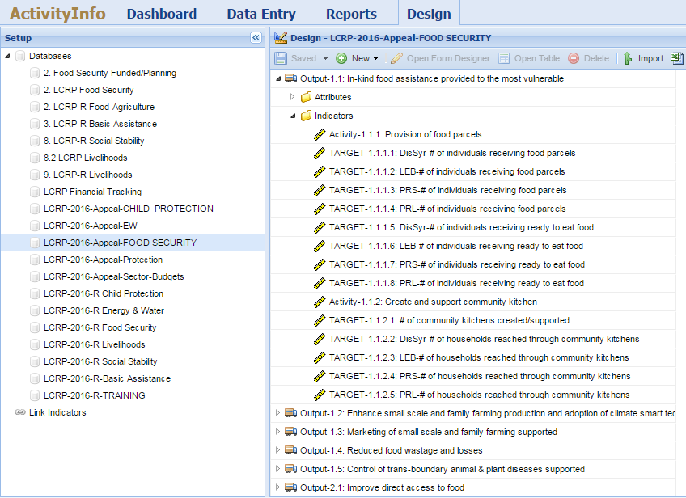
2016 APPEAL PROCESS - Step 1 – FS IMO
Design of logframe on AI per Outcome/Output/ Activity/Segregated Indicators

Slide 11
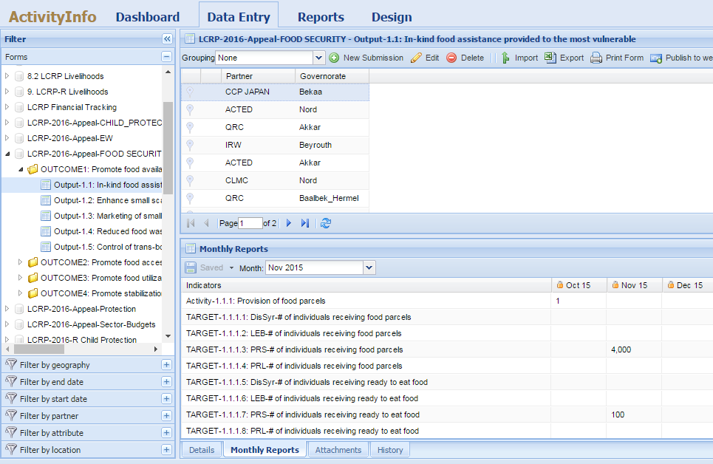
Step 2 – FS partners
Appeal by partners at activity level per governorate for each output (by entering 1)
Adding target per segregated indicator

Slide 12
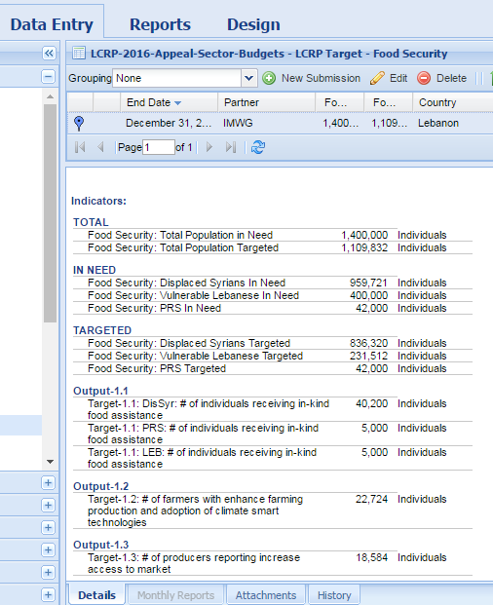
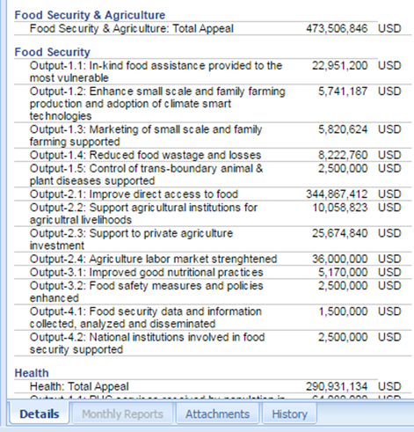
Step 3 – FS sector
Submission of sector Targets & Budget requirements

Slide 13
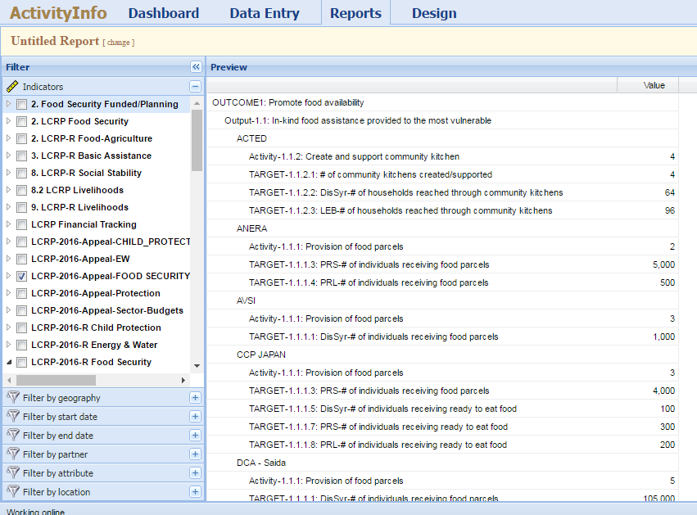
Step 3 – FS coordination
Extract partners’ appeal per output and report on it in the LCRP document

