Slide 1
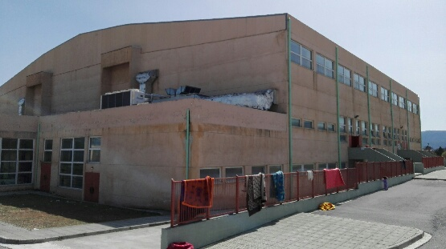
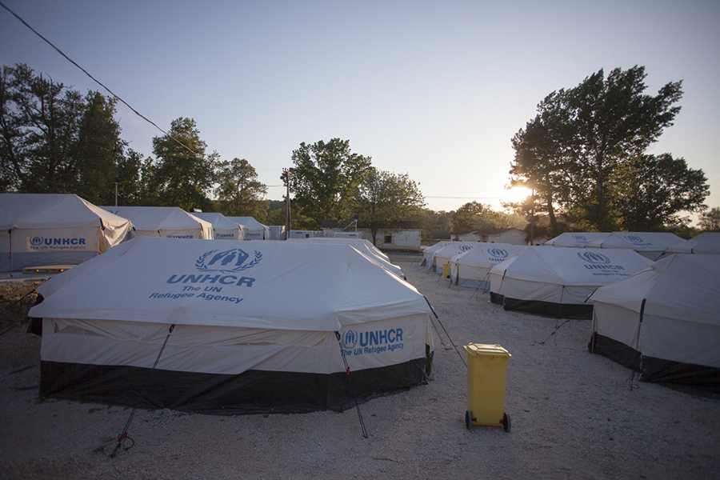
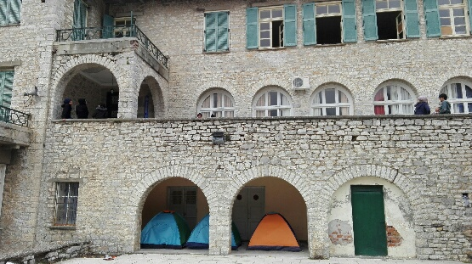
Situation in Greece
1 million refugees/migrants since 2015
First 3 months of 2016, 150,000 refugee/migrants Greek islands.
EU-Turkey deal (20 March), sites on mainland Greece

Slide 2
Site Monitoring Rational
Lack of information on mainland sites (Locations, Capacity, Sectorial info)
Mainly refugee context, establish UNHCR’s coordination role
Rapid assessment of new sites
Track movement between sites (Eidomeni, Piraeus Port)
Verify population figures

Slide 3
Site Monitoring - Greece
Create Site Master List (Names, Locations, Populations)
Develop questionnaire (sectorial input)
Kobo and GeoODK, train teams (Protection)
Collate, Clean, Verify
Import into Site Monitoring Tool (Excel)
Create Site Profiles and Sectorial Dashboards (Excel)
Disseminate - ArcGIS Online, print, email etc

Slide 4
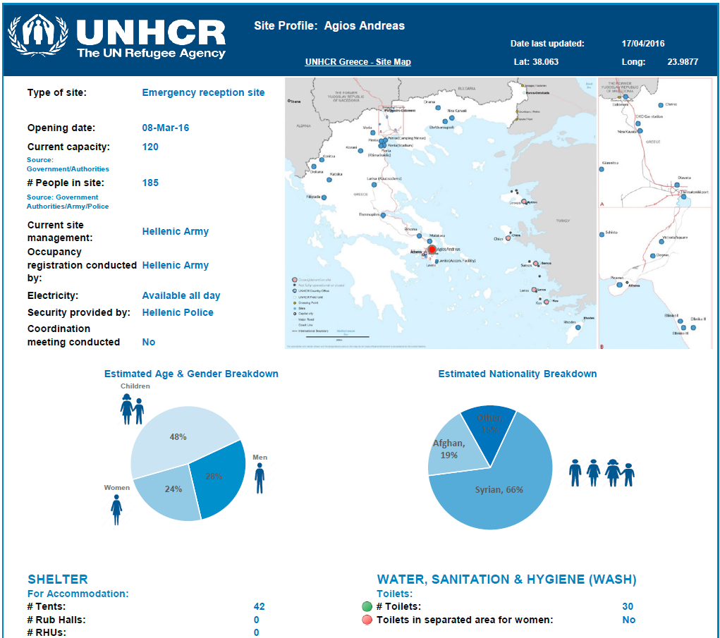
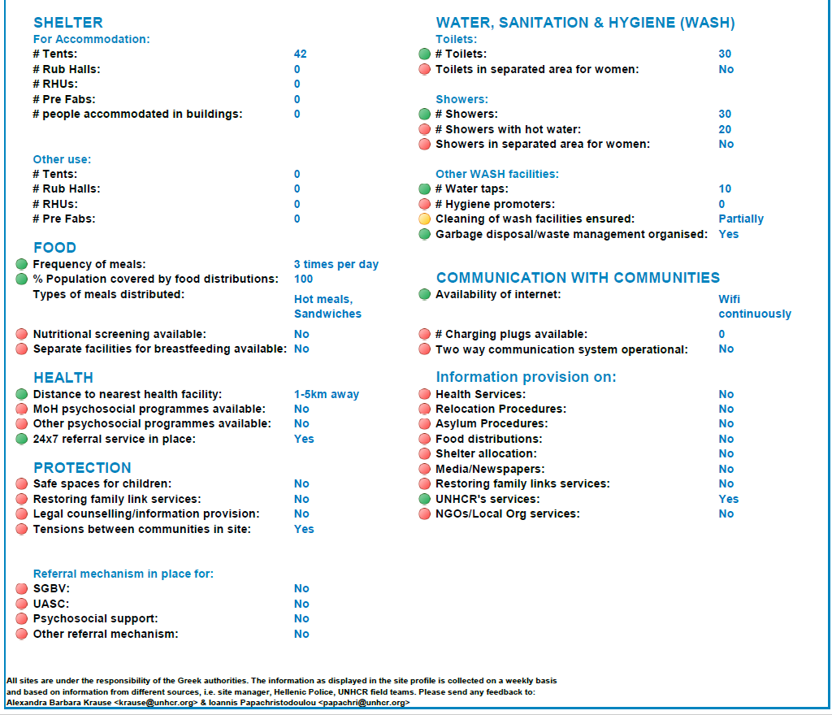
Site Monitoring – Site Profiles

Slide 5
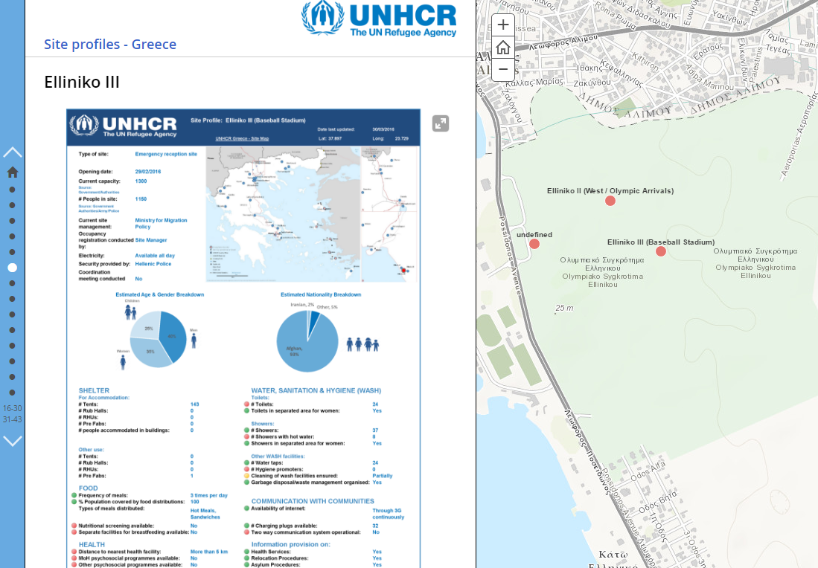
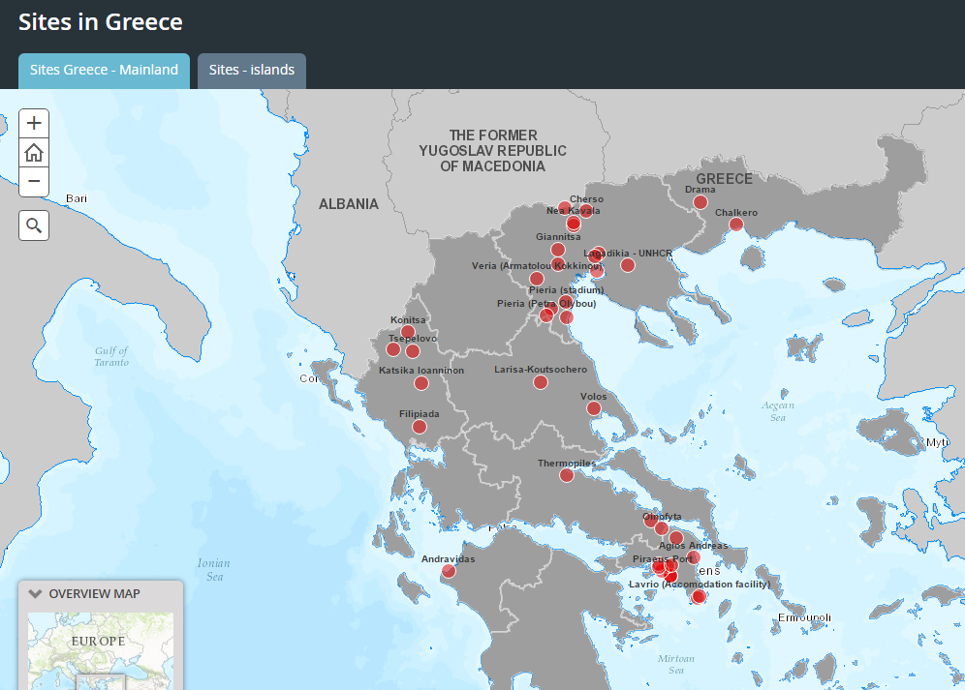
Site Monitoring – ArcGIS Online
www.unhcr.gr/sites/profile
www.unhcr.gr/sites

Slide 6
Pros and Cons
Pros:
Easy and rapid deployment
Easy to create site profiles, dashboards, ArcGIS online maps, products
Facilitated overall coordination and at sectorial level
Cons:
Difficult to maintain field teams
Obtain input from sectorial units
Staff unfamiliar with data collection on mobiles

Slide 7
Way Forward
Refugees - site pop data 70% registration, is site information collected accurate & standardized?
Refugees - site information and population estimates, which system is used?
IDP implementation? How to standardize?

