Slide 1
Refugees’* Livelihoods and Economic Inclusion Xchange
5 March 2019
UNHCR Regional Support Centre, Nairobi

Slide 2
Welcome to the Regional Support Centre
Regional Support Centre
Regional Refugee Coordinators (2)
Special Envoy for East Africa
Geo coverage: Tanzania, Rwanda, Burundi, Kenya, Ethiopia, Djibouti, Uganda, Somalia, Eritrea, Sudan, South Sudan
Forthcoming regionalization

Slide 3
Agenda for today
1. UNHCR Introduction: what the “exchange” is not, what it can be - definitions
UNHCR Global programme to alleviate poverty
IGAD conference on Jobs, Livelihoods and Economic inclusion, Kampala 25-28 March
2. FAO/UNHCR partnership
3. Alexander Betts (Refugee Study Centre, Oxford) presenting results of research in Uganda/Kenya
4. ILO The “Dutch partnership” on Inclusive Jobs and Education for forcibly displaced persons and host communities - Government of the Netherlands, IFC, ILO, UNHCR, UNICEF and the WB
5. AOB

Slide 4
“Economic Inclusion means enabling refugees to provide for themselves and be net contributors to economic development as consumers, workers and entrepreneurs. It is one of the most important keys to enhancing protection and unlocking solutions for refugees” Filippo Grandi, UN High Commissioner for Refugeeswha
WHAT
Notes:
WHAT

Slide 5
Why economic inclusion of refugees?
Why strengthening livelihoods?
WHY
Reduce depending on assistance and negative coping
Contribute to economies
Prepare for the future (return, integration, resettlement)
Protection and solutions
Self-reliance and resilience
Dignity, normal life, social cohesion
earn&spend

Slide 6
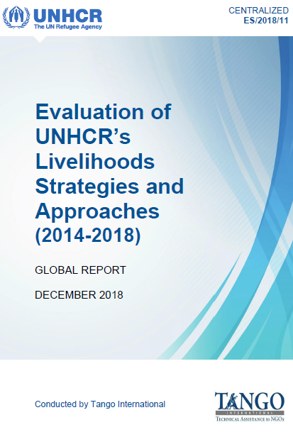
2014-2018 Livelihoods Centralised Evaluation Findings
HOW
“positive shift”
Increased partnerships with development actors
Learning and adapting new ways of working with
private sector, financial service providers, government
Market-based approach
Going forward:
UNHCR to work on livelihoods, but in a strategic role,
facilitating access to economic and financial inclusion through partnerships
Continue to ensure protection
Build on access to basic services and systems to further economic and development activities
https://reliefweb.int/report/world/evaluation-unhcrs-livelihoods-strategies-and-approaches-2014-2018-global-report

Slide 7
Global Programme to Alleviate Poverty for Refugees & Host Communities Geneva 27-28 FEBRUARY
WORKING IN PARTNERSHIP – ONE OF THE LATEST INITIATIVES

Slide 8
The coalition

Slide 9
Programme features: The Graduation Approach
Consumption
Mentoring
Training
Asset transfer
18-36 months

Slide 10
Targets (2020-2025)
27 countries
500,000
500 million
5 years

Slide 11
Coalition activities 2019-2020
March-May: Finalizing programme document
April-June: Finalize donor mapping
June-December: Fund raising and donor events
December: Pledge for “Global Refugee Forum 2019”
February 2020 Expected start date

Slide 12
25-28 March in Kampala
(1) an enabling environment for self-reliance (2) opportunities for engagement with private sector, non-state actors engagement and coordination (3) the return and especially reintegration dimensions of livelihoods development (4) regional coordination and resource mobilization, and (5) land and natural resources in livelihoods development.
Notes:
1. Review opportunities and challenges which States have faced in advancing the economic inclusion of refugees;
2. In line with the content of the background paper, discuss issues related to creating (1) an enabling environment for self-reliance (2) opportunities for engagement with private sector, non-state actors engagement and coordination (3) the return and especially reintegration dimensions of livelihoods development (4) regional coordination and resource mobilization, and (5) land and natural resources in livelihoods development;
3. Explore how the legal aspects of the refugee right to work, and rights at work, can be advanced. Included will be a discussion of the concept of the right to work for refugees embedded in Articles 17, 18 and 19 of the 1951 Refugee Convention;
4. Determine how States, and other relevant stakeholders, can further contribute resources, revise regulations and promote economic opportunities, to enable decent work, job creation, and entrepreneurship programmes for host community members and refugees;
5. Encourage Governments to strengthen infrastructure and incentives for private sector investment into refugee hosting areas;
6. Explore how affordable financial services for women and men in host and refugee communities can be supported, including by reducing associated risks and enabling access where appropriate;
7. Summarize commitments made into a Joint Declaration which will be released at the conclusion of the conference;
8. Report back on implementation at subsequent Nairobi Declaration events.

Slide 13
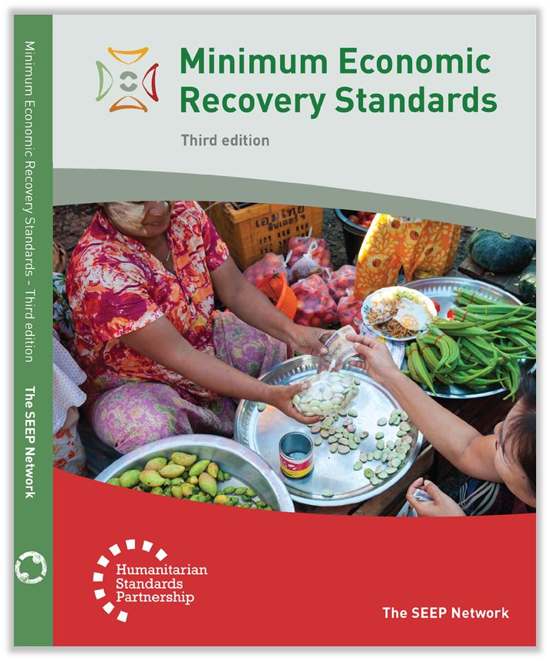
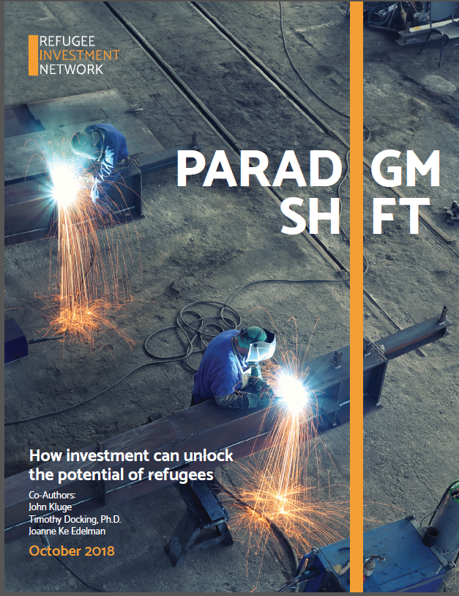
2014-2018 Livelihoods Centralised Evaluation Findings
FORTHCOMING
The Impact of Forced Displacement on Host Communities: A Review of the Empirical Literature in Economics, Paolo Verme and Kirsten Schuettler
No 8727, Policy Research Working Paper Series from The World Bank
RIN – Refugee Investment Network
GCR progress
MERS training first week of April
Country focus? Uploads?

