Slide 1
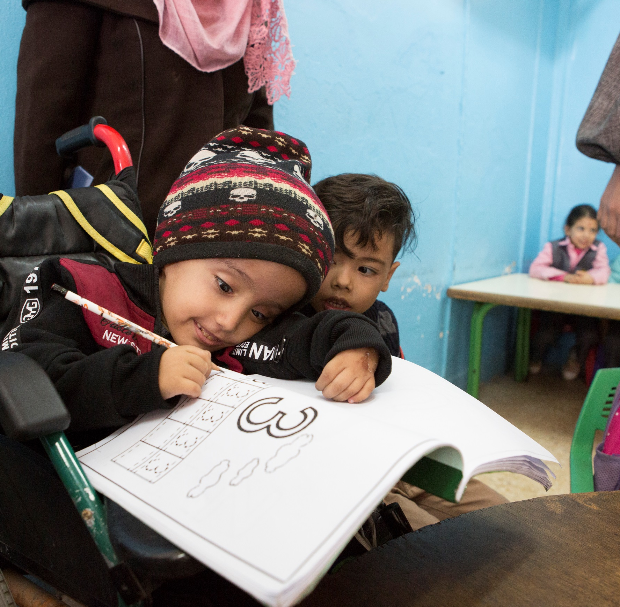
HI Jordan Mission
Rehabilitation and ED/EI Services
Feb.2019

Slide 2
Project objectives:
Syrian crisis affected most vulnerable population, with an enhance focus on children 0-6, have access to quality comprehensive rehabilitation services and other essential services through strengthened Jordanian service providers and a more inclusive humanitarian response
Reduce vulnerability and promote the dignity for most vulnerable population with functional limitations.
  Facilitate access to sustainable comprehensive rehabilitation services (equity fund) and external complementary services (referral network)
Technical capacity building and support to service provider rehab teams
To establish and help lead a coordination platform for rehabilitation in Jordan with aim to set-up an initial framework for coordinated quality comprehensive rehabilitation service provision.
Children aged 0 to 6 with impairments are identified and receive timely intervention to reach their full potential
Notes:
Equity fund

Slide 3
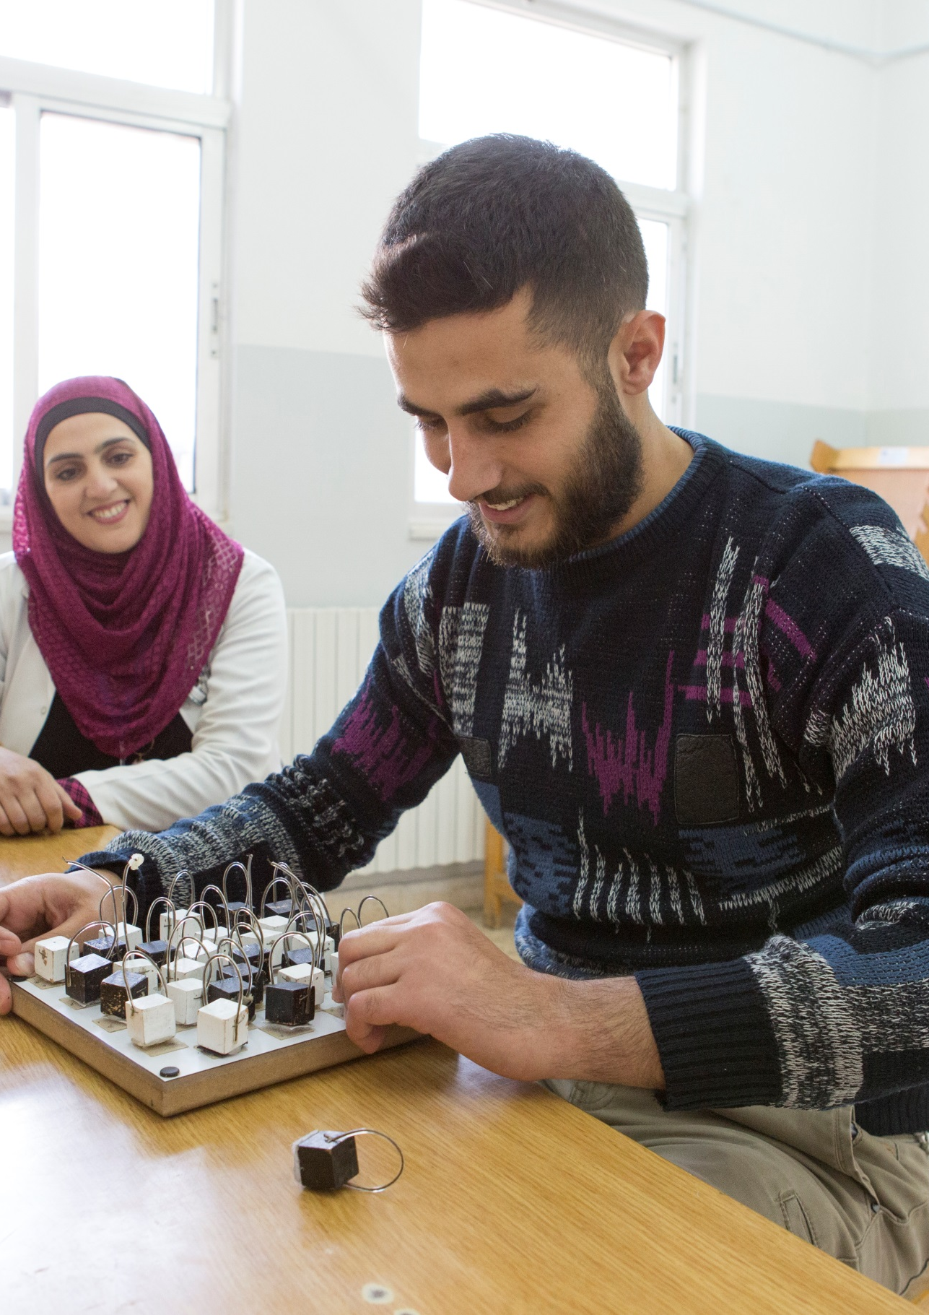
The project works on 3 levels
National level  National Rehabilitation Platform/ EDEI guideline and protocols
Service provider (Centre) level  Partners (public, charities, local NGOs)
Community Level  community based rehabilitation (CBR)

Slide 4
Work/expect to work with:
Governmental institutions
Ministry of social development (MoSD)
Higher council for rights of persons with disabilities (HCRD)
Ministry of health (MoH)
Primary health centers PHCs
Intervention centers

Slide 5
Methodology of implementation
Empower local service providers and build their capacity to provide comprehensive functional rehab services to persons with disabilities, for children with development delay and person with injuries.
Towards sustainability and resilience of local actors:
Apply equity fund coverage for rehabilitation/ interention scheme, thereby allowing the most vulnerable to access the needed services.
Coordinate with involved stakeholders to create the rehabilitation platform.
Empower the community to be involved through CBR component.

Slide 6
Community component – Activities
Home based intervention program – (Portage)
Awareness sessions
Self help Support group
CBR Volunteers

Slide 7
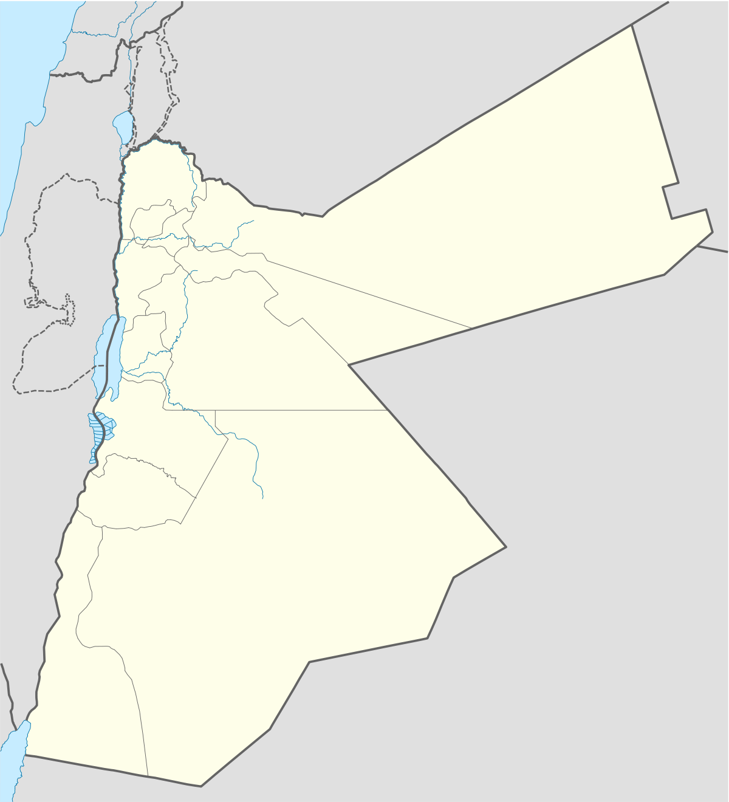
Where we work
Host communities in Amman, Irbid, Mafraq and Zarqa governorates
Azraq and Zaatari refugee camps (via implementing partner)
SYRIA
Irbid
WEST
BANK
Mafraq
© E. Fourt / HI
Zarqa
Za’atari camp
Amman
Azraq camp
ISRAEL
JORDAN
HI areas of intervention
Cities
Refugee camps

Slide 8
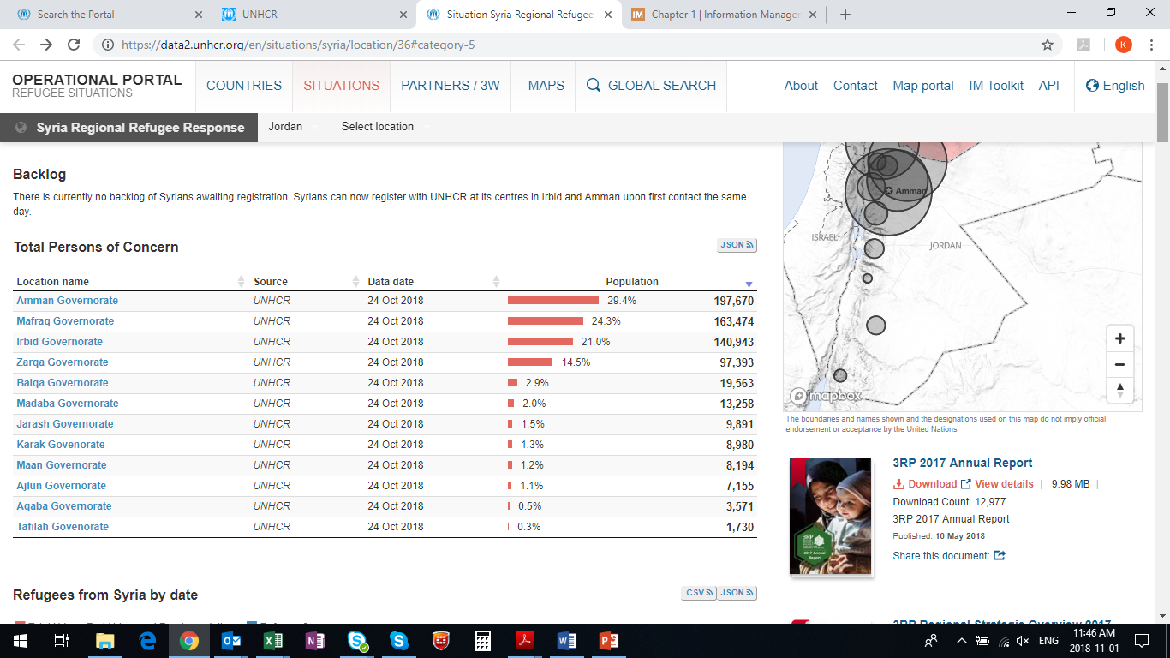
Why do we work in these locations?
Highest concentration of Syrian refugees
Access to medical services is a challenge (especially in Irbid)
  The cost of medical services is a major barrier.
        Rural populations require transport to reach appointments and therefore experience greater financial hardship in accessing rehabilitation services.
Notes:
- Access to services: 17.0% of households with disabilities could not access medical services when needed, compared to 11.2% of households without disabilities.
- Cost: especially true for households with member(s) with disabilities (92.9%) compared to 72.7% households without disabilities.

Slide 9
Why do we work in these locations?
Higher prevalence of disability in Northern governorates
Government funding for assistive devices (including P&O) is limited and fragmented, it is not meeting the wide range of needs among the population (especially outside of Amman)
In Jordan there are main 3 diagnosis centers (Irbid, Amman and Zarqa) where the children with disability are diagnosed.
In Jordan the only center which provides diagnostic and intervention services for children with disability exists in Zarqa
Notes:
P&O: services outside Amman very limited. As such, HI is supporting the re-activation and working of the P&O department in Basma Hospital.

Slide 10
Who do we work with?
4 types of institutions – 11 partners :
Ministry of Health hospitals (5) → supported service provider (Mafraq, Ramtha, Princess Bassma, Princes Faisal and Totangi hospitals) for rehabilitation. Primary health centers PHCs
Charitable organizations (5) → supported service provider (CDC Zarqa, CDC Wehdat, CDC Irbid, CDC Baq’a, CPF)
Local NGOs (1) → implementing partner (NHF)
MOSD Intervention centers ICs
Notes:
If further details needed on the individual partners:
MoH: 5 hospitals in 4 governorates
Totangi Hospital (Amman)
Princess Basma & Ramtha (Irbid)
Mafraq Hospital (Mafraq)
Prince Faisal (Zarqa)
Charitable orgs & local NGO:
CDC Wehdat & CP Foundation (Amman)
CDC Zarqa (Zarqa)
NHF (camps) –implementing partner

Slide 11
Key achievement →HI
STAR assessment: with the collaboration of MoH and WHO, HI was able to conduct the Systematic Assessment of Rehabilitation Situation in Jordan during May-August 2018.
conduct an assessment to evaluate the situation of early detection and early intervention in Jordan during 2017

Slide 12
Challenges
Lack of ownership and strategy in rehabilitation services/ Lack of EI protocols and services.
Gaps in the quality of the services provided (lack of functional approach, lack of adapted assistive devices, lack of caregiver education, etc.)/ Lack of recourses (tools, materials and staff) for providing EDEI services.
No specialised rehabilitation hospital or clinic of excellence that can contribute to the advancement of rehabilitation in Jordan.
Public hospitals have no dedicated beds for acute stages cases or pediatric intervention.
Notes:
The public P&O services are provided only at Al Basheer hospital in Amman or by the Royal Medical City facility, and in a limited fashion in Princess Basma Hospital in Irbid governorate.

Slide 13
Challenges
Services concentrated in Amman
Strong emphasis on immunization, and pre-school education, nevertheless not all components of early childhood development have been addressed so far
Provision of P&O services is a major gap in the public sector in Jordan.

Slide 14
Opportunities
Jordan signed and ratified the CRPD, PWDs’ law 2017
New directorate in MoH “mental health and disability, Existing the higher council for the rights of persons with disability HCRD
HI one of the few actors working in rehabilitation, especially in the northern governorates.
There is a good level of technical capacity in rehabilitation in Jordan through a workforce that is degree-level trained across five universities. Recently, Master programmes is being offered and several faculty members have a PhD degree from abroad. They are also represented by professional societies.
.
Notes:
Info system: This will contribute to improve systems on rehabilitation and case management, and coordination.

Slide 15
Opportunities:
Diagnosis of disability is one of the main priorities for Jordan based on the new law of persons with disability.
Systemized ED system (protocols and services) more over there are multi-disciplinary teams available in several governmental health facilities and good some examples of person centred approach in both government facilities and NGO provided services
There is now a computerized health record system available in the majority of Ministry of Health and Royal Medical Services’ facilities. This system provides an opportunity for information to be collected at facility level and potentially collated at governorate and central level.

Slide 16
Success story → HI services
Ali Hammad is a six year old boy who lives in Az Zarqa’ governorate. He suffers from a moderate spastic quadriplegic cerebral palsy.
Notes:
Ali’s sister found difficulties to move him because he was having poor head control, poor balance at sitting and no control spastic (increase while he is crying). She also found that he has difficulties to grasp a pen for writing.
After 25 rehabilitation sessions by the PT in CDC Zarqa, Ali became able to sit with a good balance without any support.
Ali’s head control was improved and the ability to grasp a pen in his hand.
The inclusion team from CDC assessed Ali one more time after finishing the first rehabilitation course so that he can enter school at the start of next semester. Ali passed the “joining school” standards of the inclusion assessment. Ali entered school in July 2018!

