Slide 1
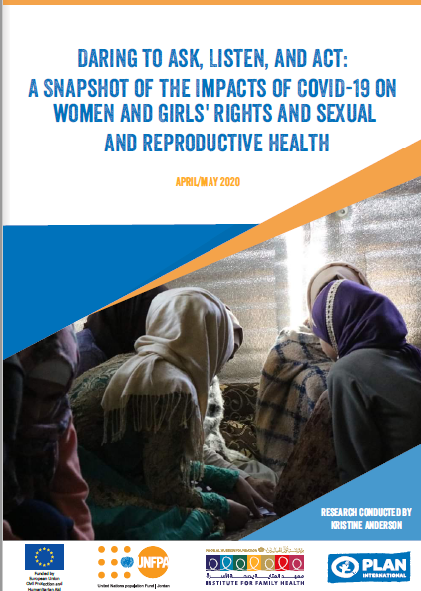
"DARING TO ASK, LISTEN, AND ACT: A SNAPSHOT OF THE IMPACTS OF COVID-19 ON WOMEN AND GIRLS' RIGHTS AND SEXUAL AND REPRODUCTIVE HEALTH"
April/May 2020

Slide 2
Background and Methodology
In April 2020, the UNFPA Jordan in coordination with Plan International and the Institute for Family Health (IFH)/ Noor Al Hussein Foundation commissioned a rapid assessment of the COVID-19 situation in Jordan.
The overall purpose of this rapid assessment is to measure the impact of COVID-19 on gender-based violence and sexual and reproductive health and rights among adolescent girls.
397 participants were involved (60% female, 40 % male ).
The methodology sought a distribution of age and gender groups across five locations for data collection: Irbid, Amman, Karak, Zaatari camp and Azraq camp.
Notes:
76 respondents are from Zaatari camp
(defined as girls ages 10-17) and young women (aged 18-24) in Jordan, including people with disabilities (PwDs).
Assess effects of COVID-19 pandemic on adolescent girls and young women.
Identify main obstacles for young women and girls to seek help and provide a snapshot of available services
Identify areas of potential collaboration on GBV and SRHR interventions.
Draw on lessons learned and experiences from the COVID-19 current response to provide recommendations for decision-making at the programmatic level.
total of 397 participants were involved (60% female, 40 % male ).
A combination of quantitative and qualitative tools were used, including:
360 phone surveys targeting adolescents (10-17) and adult men and women (18-49),
28 key informant interviews with service providers and partners,
2 focus group discussions with women and girls.
The methodology sought a distribution of age and gender groups across five locations for data collection: Irbid, Amman, Karak, Zaatari camp and Azraq camp.
Raw survey results were downloaded from Kobo into an Excel file for quantitative analysis, looking at variables according to gender, age, disability and marital status.
Qualitative data (FGD and KII) was recorded and summarized in written form to identify common themes and codes that help to contextualize and provide more nuance to the findings from the surveys.

Slide 3
MAIN FINDINGS
Notes:
(defined as girls ages 10-17) and young women (aged 18-24) in Jordan, including people with disabilities (PwDs).
Assess effects of COVID-19 pandemic on adolescent girls and young women.
Identify main obstacles for young women and girls to seek help and provide a snapshot of available services
Identify areas of potential collaboration on GBV and SRHR interventions.
Draw on lessons learned and experiences from the COVID-19 current response to provide recommendations for decision-making at the programmatic level.
total of 397 participants were involved (60% female, 40 % male ).
A combination of quantitative and qualitative tools were used, including:
360 phone surveys targeting adolescents (10-17) and adult men and women (18-49),
28 key informant interviews with service providers and partners,
2 focus group discussions with women and girls.
The methodology sought a distribution of age and gender groups across five locations for data collection: Irbid, Amman, Karak, Zaatari camp and Azraq camp.
Raw survey results were downloaded from Kobo into an Excel file for quantitative analysis, looking at variables according to gender, age, disability and marital status.
Qualitative data (FGD and KII) was recorded and summarized in written form to identify common themes and codes that help to contextualize and provide more nuance to the findings from the surveys.

Slide 4
Women and girls well being and experience of lockdown
High level of anxiety and stress about the pandemic and the measures enacted by the government: Highest level - Adult women at 78%
The economic situation has resulted in considerable stress regarding the uncertainty of the future: 86% stated that the pandemic will negatively impact economic insecurity.
Women and girls suffer from inhibited access to economic assistance in comparison to men and boys, rendering them especially vulnerable to dependency on their family, partners, or aid agencies, and thus at risk of exploitation or denial of resources
Notes:
Interestngly, anxiety levels are lower in both Irbid and in Za’atari camp.
Figure 5 Women and girls in Za’atari report the most ability at 70 and 73 per cent respectively,
Zaatari and Azraq women and girls meeting basic needs is better than other governerates
Income generation assistance
Za’atari 0 per cent of girls had access. Young adult women from 18-24, conversely, report the highest level of access in Za’atari camp, while for adult women from 25-49, Amman had the highest percentage at 25 percent, while none of the females in this age group in other locations had accessed assistance.

Slide 5
Zoom on Girls Experience of The Lockdown
Impact of lockdown on adolescent girls: 55% of adolescent girls shared that their cohort is highly impacted by an increase in household tasks including doing chores and looking after younger children in the household, followed by hindered mobility.
Adolescent girls and boys fear their education is compromised by the pandemic: 88% of adolescent girls and boys shared that they are pursuing a form of remote learning; Jordanian boys and girls report higher levels of remote learning than Syrians.
Adolescent girls are affected by closures of non-formal education opportunities such as WGSS and youth programs, depriving them of social engagement with their peers and educators. Only 35 % of adolescent girls reported staying connected with and chatting with friends as a common pastime
Notes:
Camp popula�ons do not appear to have greater access to remote learning than urban popula�ons though camps such as Za’atari are often be�er serviced than urban popula�ons.
Prolonged periods of closures and movement restrictions may lead to anxiety, depression, and other mood disturbances.
Lack of connection, might be linked to adolescent girls being less likely to have their own unique access to a phone. The
The girls who took part in the FGD revealed that this burden is highly gendered, and that they need to take on these tasks “because they are girls, and since men work it is their right to go out and come home to a clean house and food on the table.” 46 per cent of girls also pointed to hindered mobility as a major impact on their well-being.

Slide 6
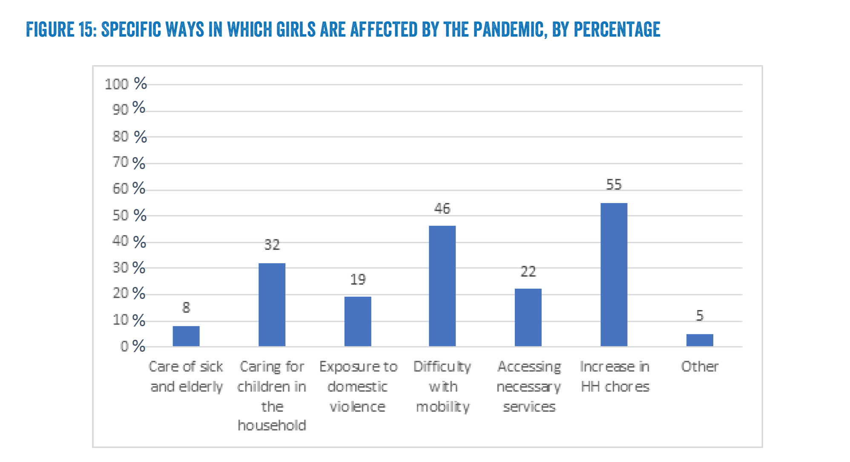

Slide 7
Women and Girls’ Experiences of Gender Based Violence
69% of respondents agreed that GBV against girls and young women has increased since the lockdown .
Physical violence and emotional violence mentioned as the most prevalent types of GBV that are occurring during the lockdown, which are incidentally the types of violence often linked with intimate partners.
Factors may be increasing violence: Economic situation followed by lack of privacy, the inability to go out, and overcrowding at home.
72% of female respondents reported that they knew where to go to obtain help or to refer someone in the case of exposure to domestic violence during the pandemic.

Slide 8
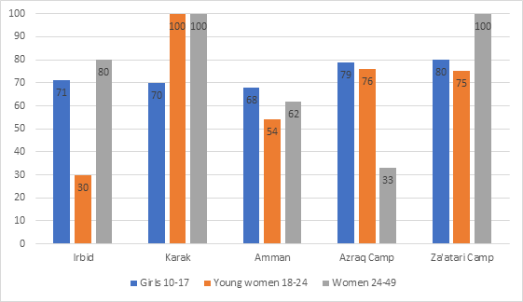
Percentage of women and girls who know where to go for help or to refer someone in the event of violence by location

Slide 9
Women and Girls’ Experiences of GBV-continued
(69%) stated they strongly agree with or somewhat agree with the statement that since the lockdown GBV against girls and young women has increased.
Access to Virtual services: Adolescent girls reported being most active in virtual sessions while older women were less active.
Virtual support activities are being utilized and are generally well-received, even if they are not a replacement per se for social interaction offered by actual WGSS, clinics, or youth-friendly spaces.
Majority of adolescent girls and young women cited the police as a resource to turn to major source of help; however, the majority of adult women over 25 cited NGOs or UN agencies as a source of help to turn to.
Factors preventing seeking help: Fear of reactions of people around them, fear of the consequences being mostly reported. Controlling behavior of perpetrator and restriction of movement
Women and girls did not rate PwDs as more vulnerable during the curfew, and men and boys overall agree in higher numbers that PwD are vulnerable

Slide 10
Sexual and Reproductive health needs and rights
Changes in SRH Seeking Behaviours
70% of adolescent girls turn towards a trusted close person, specifically a parent (usually a mother), or to a sibling for information on the physical and psychological changes that occur with puberty.
MOH clinics were reported to be an important source for information on contraception and STIs by young women (72%)
Women and girl reported having less information on how they can access SRH services during the lockdown than prior by at least 10% across the age groups surveyed. .
Levels of information in Irbid were especially low, particularly for young girls and adult women who all did not know where to go to obtain information following the pandemic
Sexual and reproductive health care is expected to be stymied by broader economic and social hurdles noting that 86% of all gender and age groups stated that the pandemic will negatively impact economic status
Notes:
As seen in Figure 28 below, in three of the research locations of Irbid, Amman, and Za’atari, adult women aged 25 to 49 showed the highest level of knowledge of where they might obtain help, though in Azraq camp there is a notable gap in knowledge among women from 25 to 49.. For adolescent girls, the survey data suggests that around 10 per cent more girls residing in a camp se�ng know where they might obtain support than those in an urban se�ng: for example, in Za’atari camp, 80 per cent of girls know where to go as opposed to 70 per cent of girls in Karak town. As mentioned in the methodology section, it bears mentioning that the sampling method may have a minor bias towards women and girls being aware of services given that they are on the lists of NGOs.

Slide 11
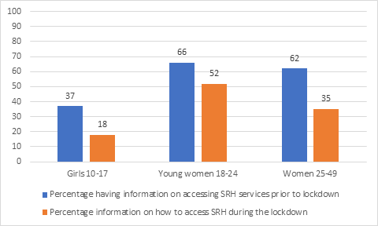
SRH needs and rights-continued

Slide 12
SRH needs and rights-continued
Changes in Access to SRH Supplies and Services
Access to family planning counselling and services has been negatively impacted in the three age categories with an increase of 10-20% in the number of women who are not at all able to access family planning.
For young women who remained able to access FP services during the lockdown, MoH clinics were a preferred source (35%), followed by pharmacies (26%).
Adolescent girls are more likely to seek out family planning from NGOs (25%) where there may be less of a risk of stigmatization.
The majority of women and girls also reported limitations to accessing safe maternity services following the lockdown with more than 50% reported having no access to these services.

Slide 13
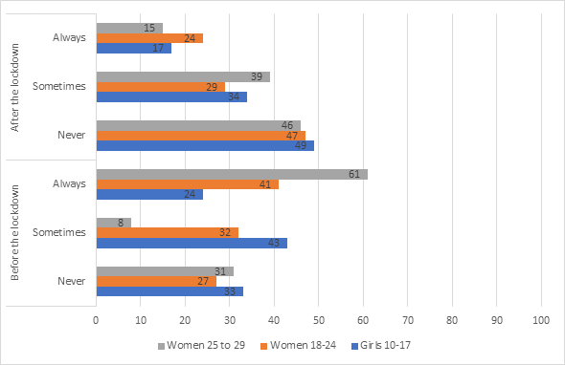
Access to Counselling and Family Planning Pre - and post - lockdown, by percentage
Notes:
Access to Counselling and Family Planning Pre - and post - lockdown, by percentage

Slide 14
SRHR in Azraq and Zaatari refugee camps
76% of adult women and men in Zaatari camp agree on the increased risk of intimate partner violence during the lockdown. In Azraq camp awareness is lower with only 40% of women and 65% of man pointing out an increased risk
Knowledge of GBV services: In Zaatari 100% of adult women (25-49) reported the highest level of knowledge of where they might obtain help, though in Azraq camp is only 33%. Women under 25 show a good knowledge across the two camps ( 78%)
Adult women (25-49) in both camps they have no access to Income Generation Activities
86% of women age (18-24) have better information information on accessing SRH services during pandemic in Azraq camp while this percentage is only 50% in Zaatari Camp.
Same applies to the percentage of women age (25-49) where in Azraq it’s 67% compared to only 17% at Zaatari Camp.
Virtual services shows higher penetration among Azraq (38%) women age (18-24) compared to Zaatari (15%)

Slide 15
Experiences of Service Providers
For several GBV, youth and SRH service providers, virtual sessions should not be considered a true alternative for in-person activities
Staff performance and wellbeing:
Working from home can be physically and mentally demanding (possession of a laptop, stable internet connection, domestic responsibilities and looking after children),
A greater risk of work-life imbalance,
High levels of stress as several jobs were thrown into uncertainty (i.e. projects cancelled or altered due to the unexpected change),
Fear of discrimination among service providers who come into regular contact with people suspected to be infected.
Notes:
The study engaged 28 service providers in SRH, GBV, youth, and other key informants.
1) blurring of boundaries in some cases,
2) loss of the depth of a service, warmth and compassion,
3) increased difficulty for survivors to come forward during the pandemic due to the constant presence of husbands and other potential abusers in the household, or having no private access to their own mobile phone,
4) some services simply cannot be offered remotely (e.g. legal or medical services).

Slide 16
Main Recommendations
GBV and SRH response and prevention must be considered an essential service during pandemics- first tier response -should remain open during times of restriction provided they follow hygiene protocols.
Donors should provide more flexible funding sources to adapt to
Continue virtual psychosocial support services through WGSS and youth spaces and programs.
Diversify outreach activities to ensure marginalized women and girls understand their rights and where they can obtain support
Offer alternatives to phone calls for case management
Take steps to improve access to remote learning
Continue and, where possible, upscale economic and material support to women and girls
Ensure a continued emphasis on the needs and risks faced by persons with disabilities
Invest in self care and Well-being of service providers
Upholding SRH rights, it is recommended for UNFPA, medical, and civil society actors to advocate for emergency contraception to be made available in pharmacies
Capacity building on communication and counselling is needed for SRH remote services to bridge missing elements.

Slide 17
Thank You

